Slide 1
Electronic Field Input System
Team 5
Stacy Carlson, Thomas Flores, and Ralph Parkison

Slide 2

The Problem
Paper forms submitted via mail
  Potential for loss
  Errors during transcription
  Long time to access the data

Slide 3
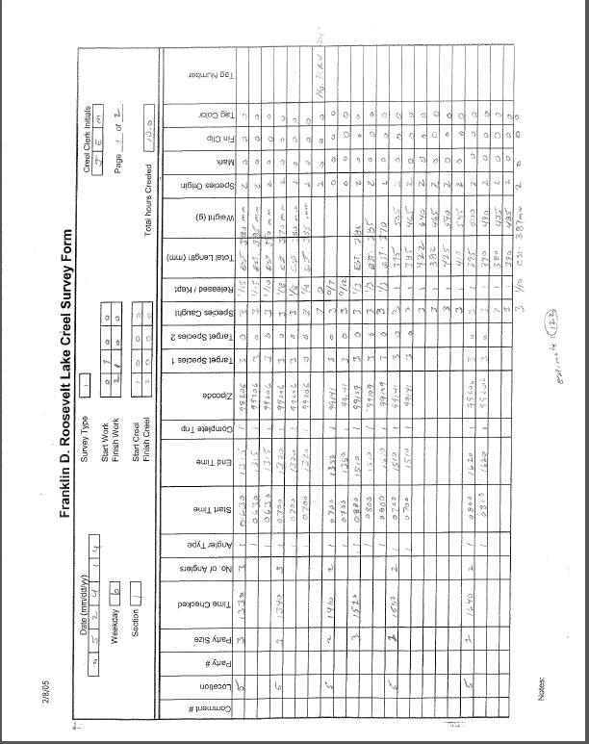

Slide 4
Client Requirements
Electronic Input System
  Creel (Top priority)
  Raw Fish
  FWIN
Easily updatable/maintainable
  Study needs change over time
Fully functional with Database
Solution can’t depend on an Internet connection

Slide 5

End User
Creel Clerk
  Two types
    Stationary
    Bus Route
  Trained how to do Creel survey
  Varying computer skills

Slide 6
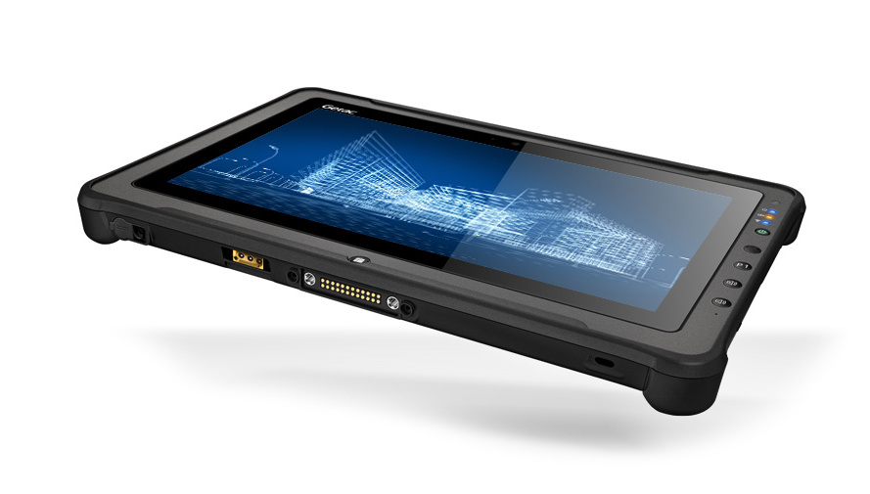
Operating Environment
Getac Tablet
  Windows 7 Professional (64 bit)
  Stylus/On screen keyboard

Slide 7
Specifications
Windows Application written in C#
Store data locally in log files
Interact with Database via JSON

Slide 8
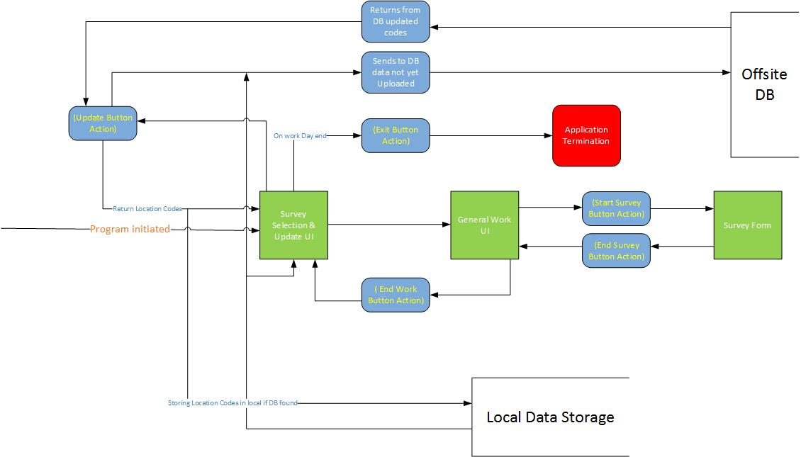
Overview of the System

Slide 9
User Interface Mockups

Slide 10


Slide 11
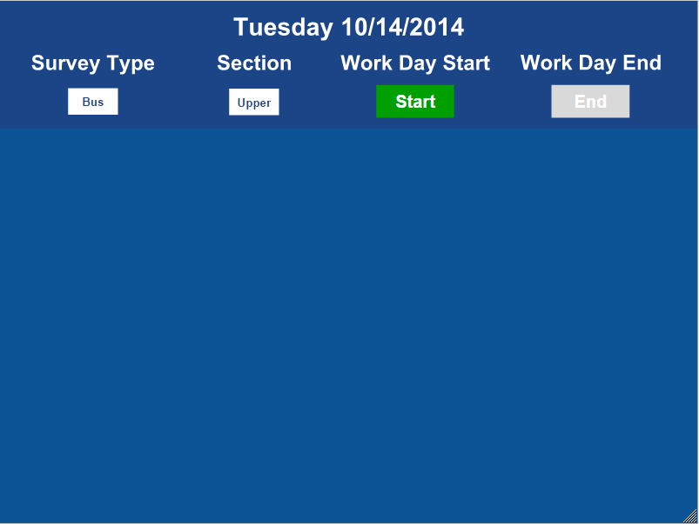

Slide 12
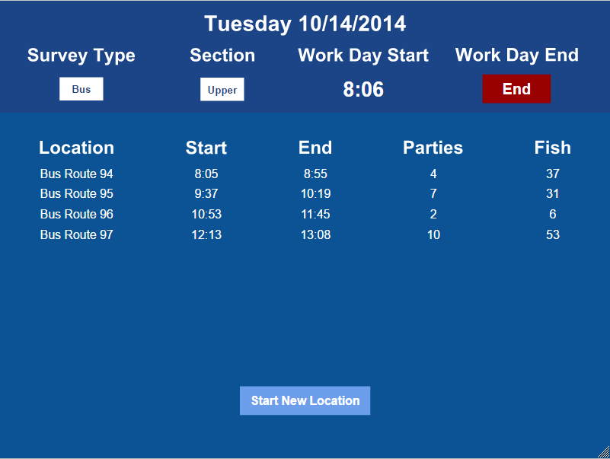

Slide 13
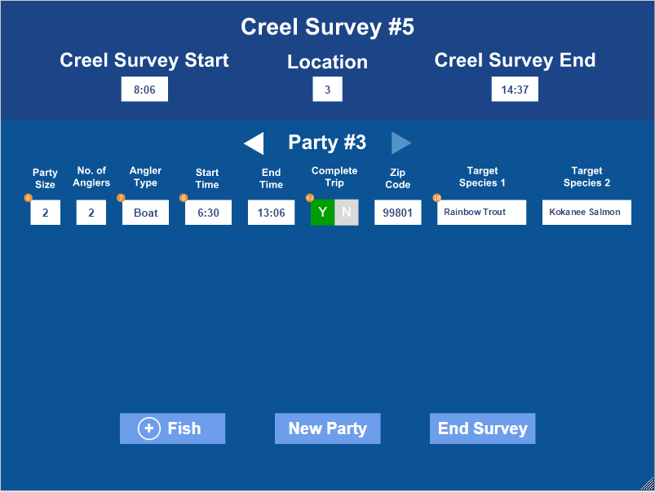

Slide 14
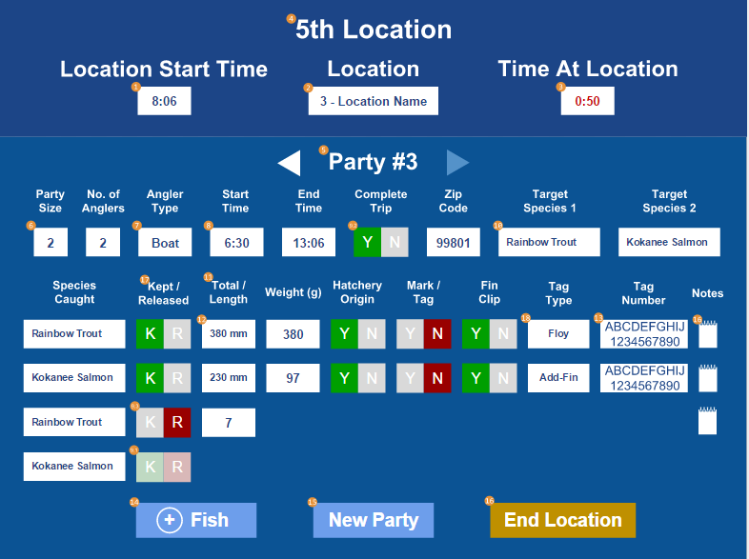

Slide 15

Questions?

