Slide 1
Electronic Field Input System
Team 5
Stacy Carlson, Thomas Flores, and Ralph Parkison

Slide 2

Background
Data is collected on paper forms submitted via mail
Potential for loss
Errors during the collection of the data
Errors during transcription to Excel
Long time to access the data

Slide 3
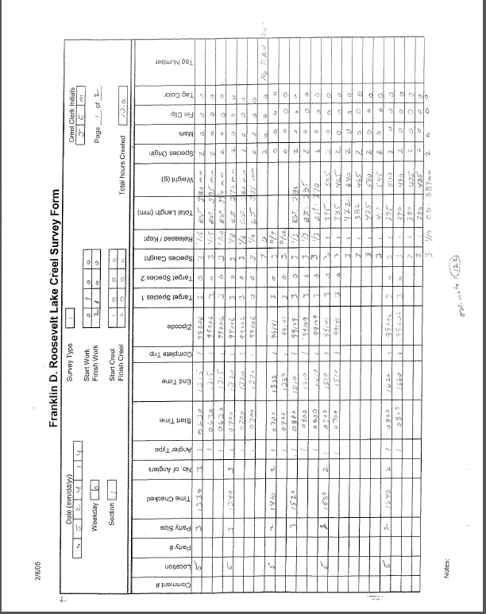

Slide 4
Requirements
Electronic Input System
Creel (Top priority)
Raw Fish
FWIN
Easily updatable/maintainable
Study needs change over time
Fully functional with Team 4’s database
Solution can’t depend on an Internet connection

Slide 5

End User
Creel Clerk
Two Types
Access
Bus Route
Trained how to do a Creel Survey
Varying computer skills

Slide 6
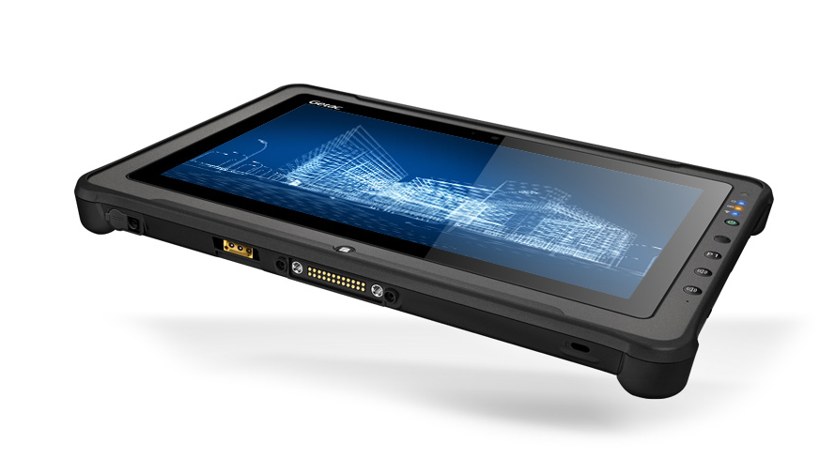
Operating Environment
Getac Tablet
Windows 7 Professional (64 bit)

Slide 7
Our Basic Idea
C# Winforms
Local data storage
Codes
Data collected
Some means of communicating with the database

Slide 8
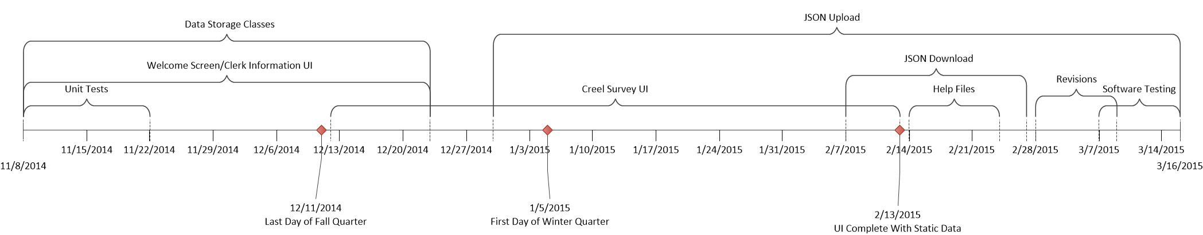
Development Process

Slide 9
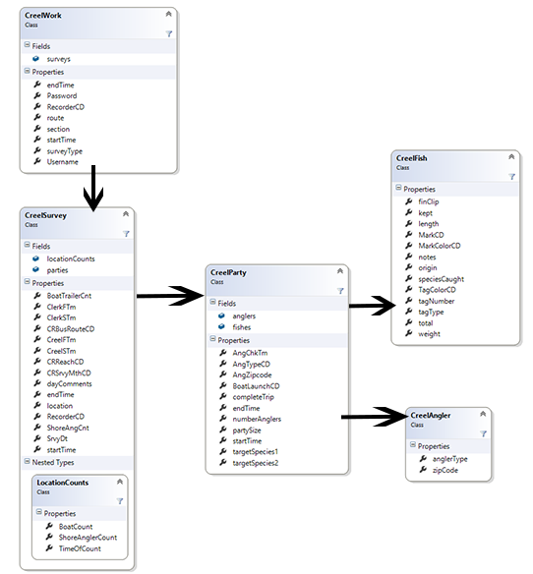
Data Storage Classes

Slide 10
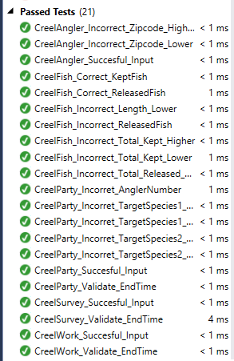
Unit Testing
Used throughout development to ensure proper functionality of data storage objects

Slide 11
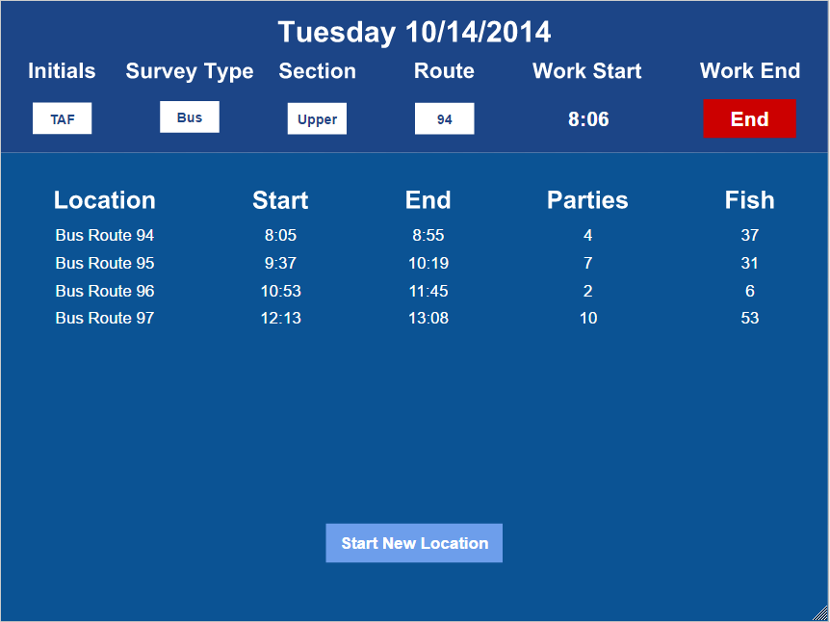
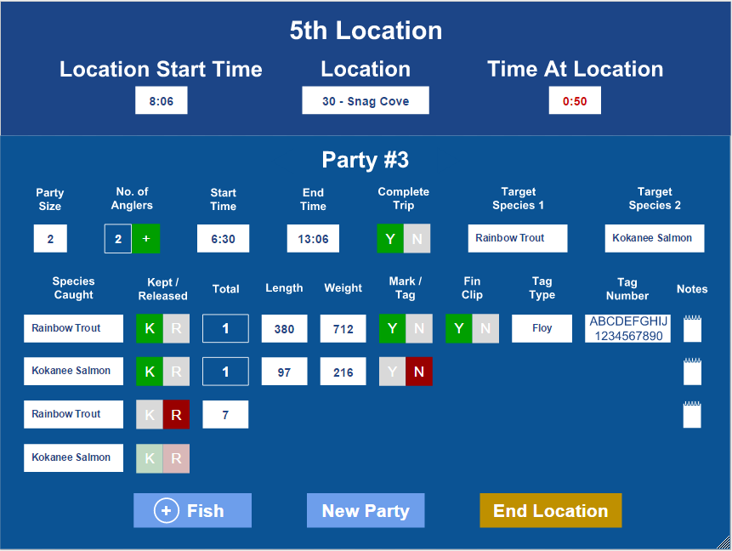
User Interface Mocks
Presented to the client for approval before beginning work
Referred to throughout development

Slide 12
User Interface
Single form
Table layout panels swapped at runtime
Custom controls
Ease of use
Make up for what Winforms was lacking
Custom keypads
Ease of use
Not as much error checking
Aesthetics

Slide 13
JSON Download
We download the look up table from db team using the upload/update button
Data comes in as json which is then deserialized using newtonsoft json package
Placed in objects which are then used for dynamic data
Changes on db side will be reflected on our side(For example adding a new fish species etc…)
Saved on local tablet file system in case Internet connection is not available

Slide 14
JSON Upload
Data is sent to the db via json
Data is serialized using the newtonsoft package
Data is also stored on the tablets local file system in case Internet access is not available at time of upload.
On successful upload to the db json is moved from incomplete folder to complete where it is stored permanently on tablet

Slide 15
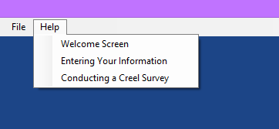
Help Files
Built into the application via a menu bar
Pdf version for in office use

Slide 16

Simulated Field Tests
Testing for
Overall functionality
Performance with large amounts of data

Slide 17

Demonstration

Slide 18
What We Learned
Stacy
C#
Implementing the Software Development Lifecycle
Thomas
Dealing with feature creep
Ralph
C#: Creating User Interface controls
How to work with another team
Read documentation thoroughly

Slide 19

Questions

