Slide 1

Electronic Field Input System
Team 5
Stacy Carlson, Thomas Flores, and Ralph Parkison

Slide 2
General Update
Finished the SRS
Worked on the actual UI
Finalized the code structure
Completed the unit tests

Slide 3
Next Steps
Finish the UI
Find a click testing tool
Begin the code behind

Slide 4

Class Diagram

Slide 5
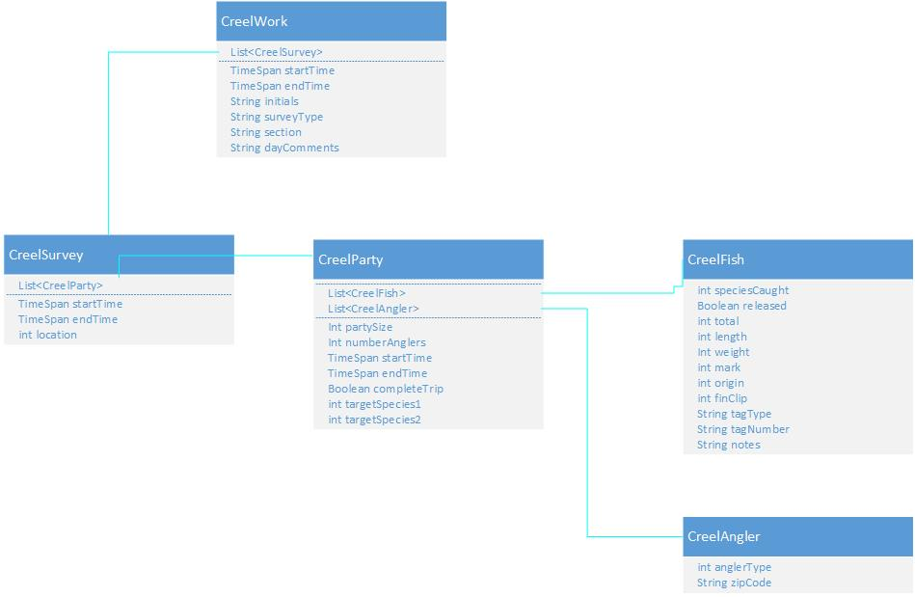

Slide 6

Unit Tests

Slide 7
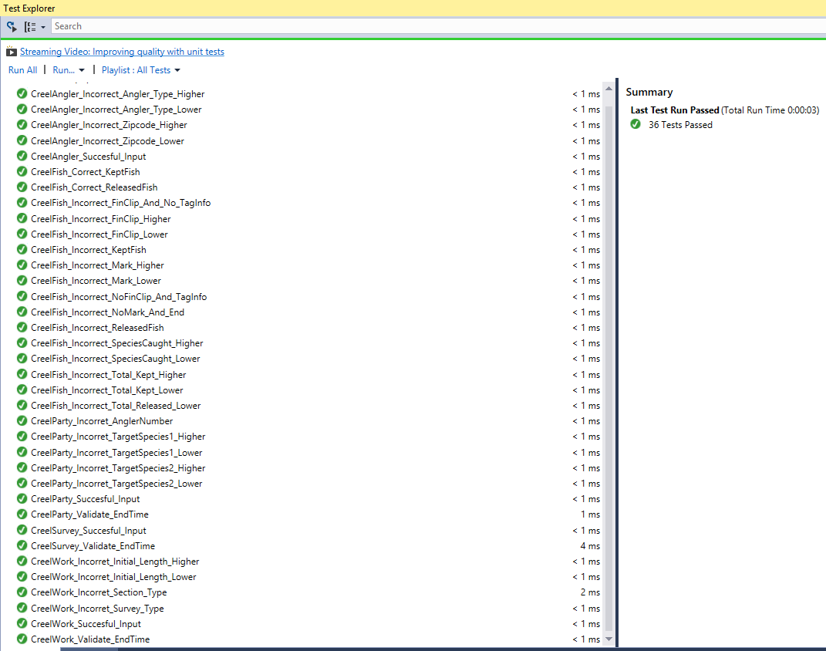

Slide 8

Actual User Interfaces

Slide 9
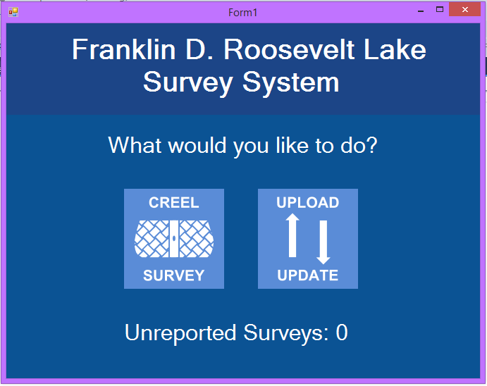

Slide 10
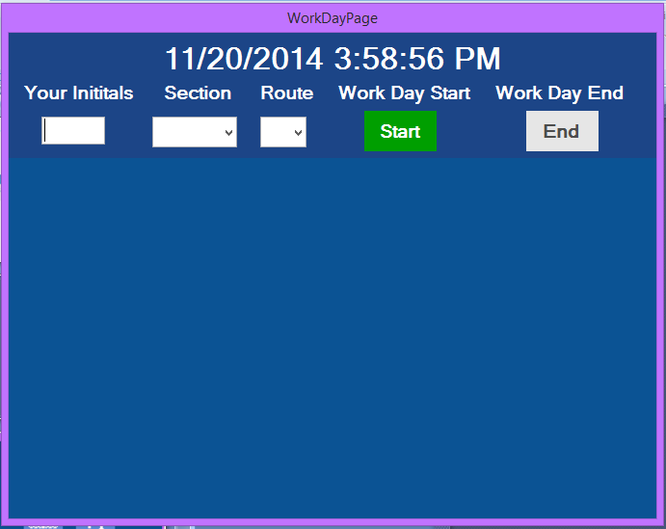

Slide 11
