Slide 1

Electronic Field Input System
Team 5
Stacy Carlson, Thomas Flores, and Ralph Parkison

Slide 2

User Interface

Slide 3
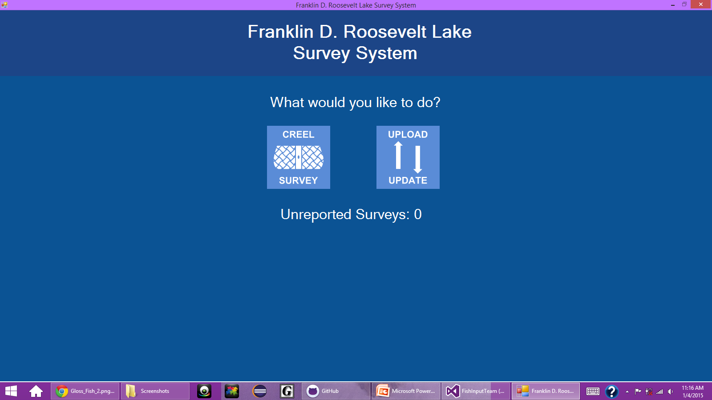
Welcome Screen

Slide 4
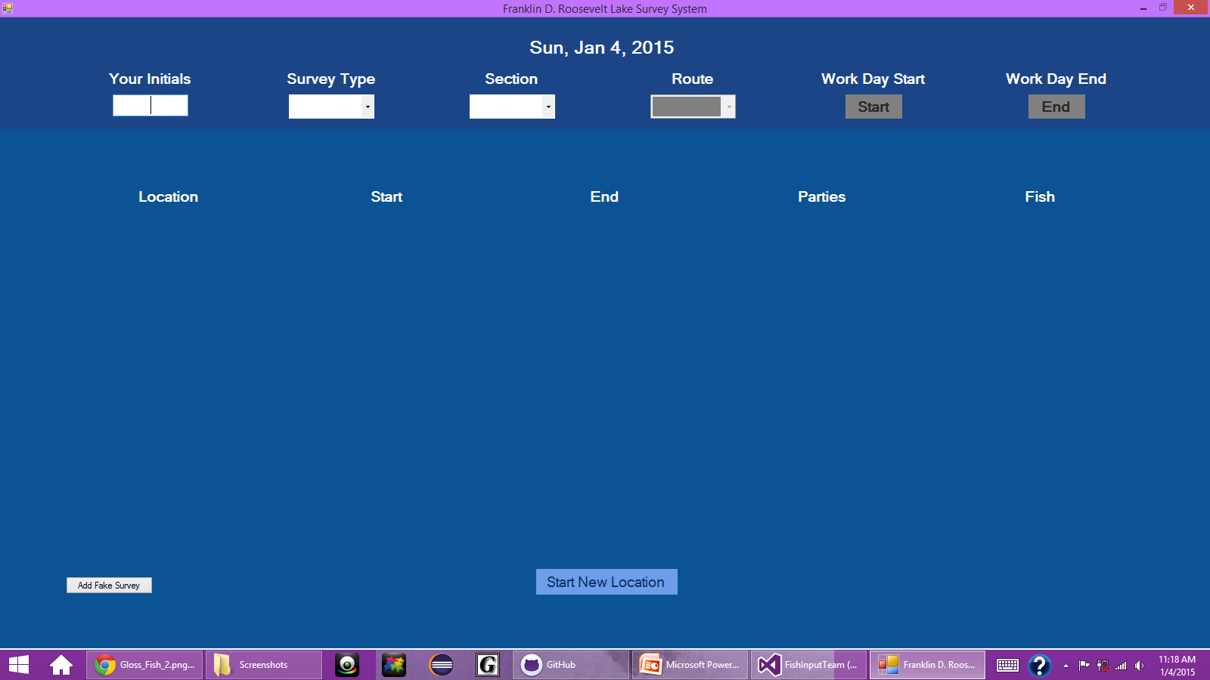
Creel Survey Selected

Slide 5
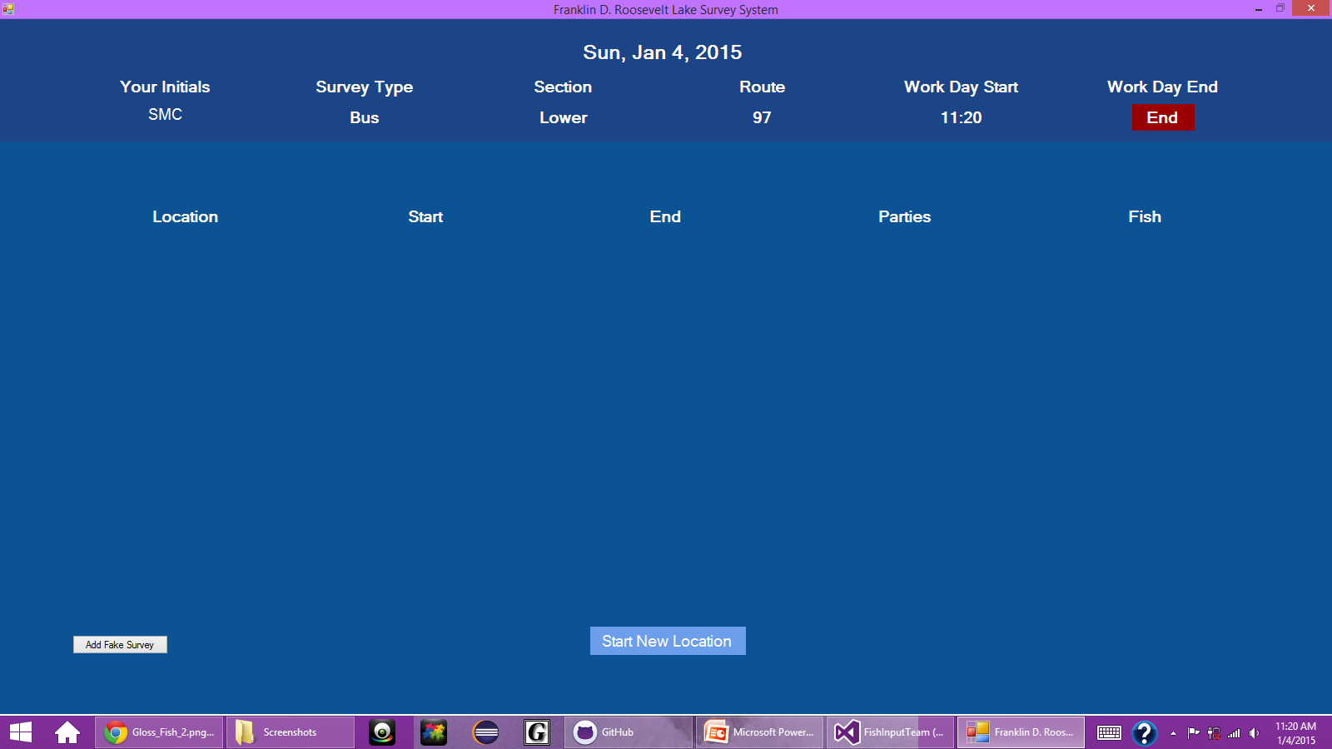
Collect Creel Clerk Information

Slide 6
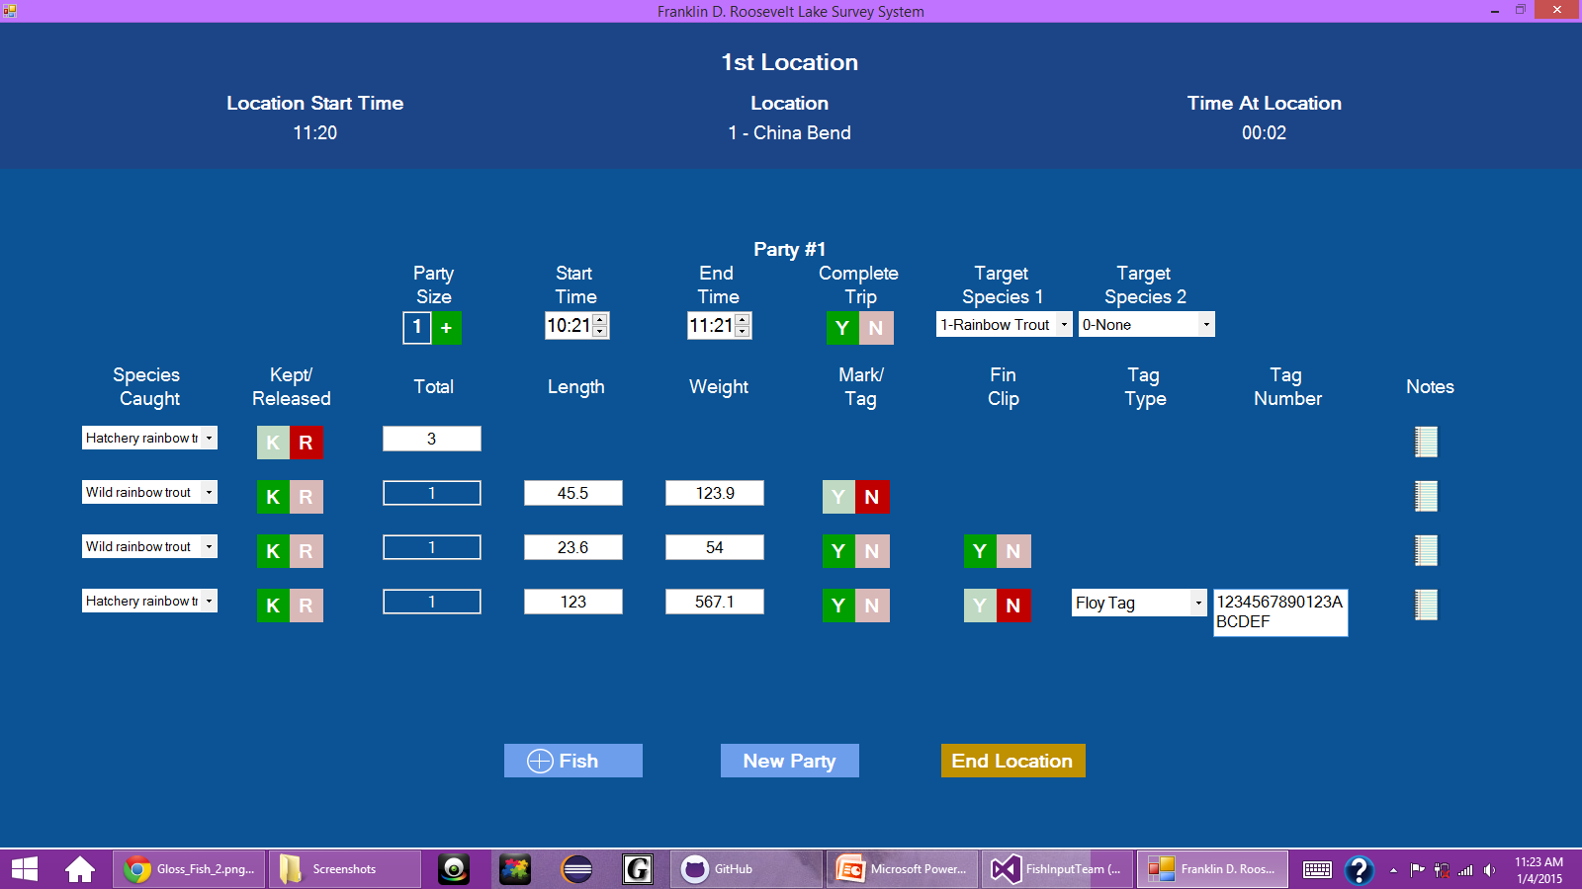
Conduct Creel Survey

Slide 7
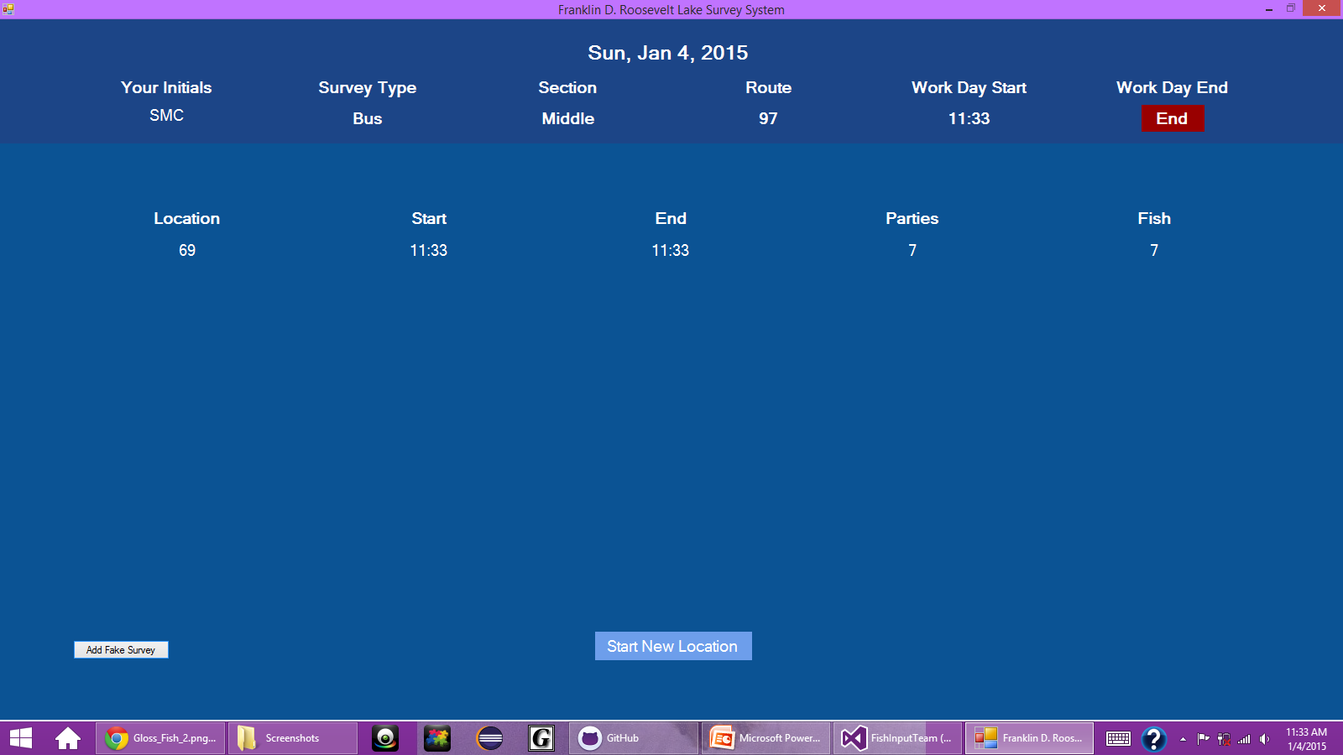

Display Summary Information

Slide 8
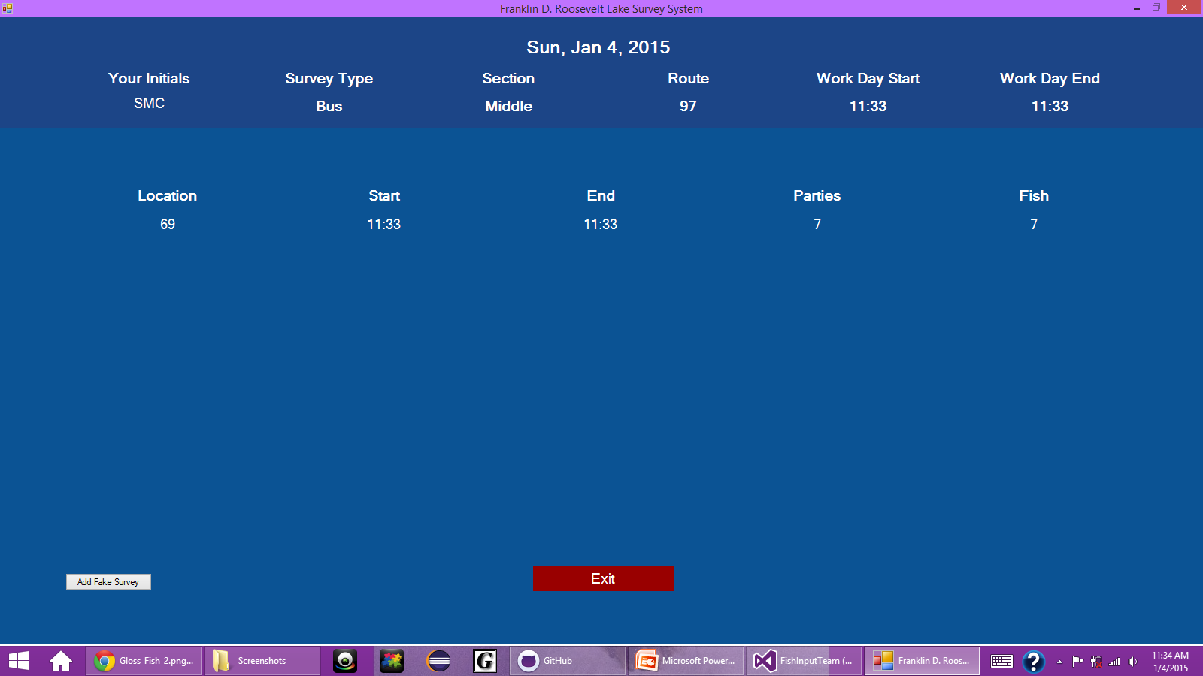
End Day

Slide 9
JSON
Working with Team 4 to refine JSON object
Wrote methods to package up data using Newtonsoft.JSON

Slide 10
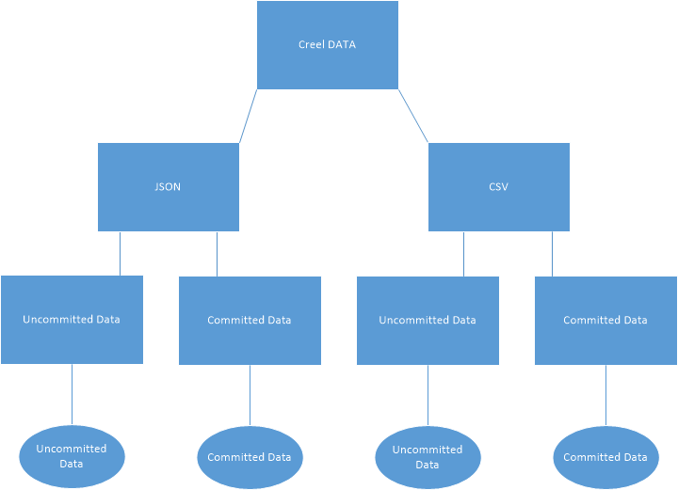
File Structure

Slide 11
Where We’re Going
Meet with client for a live demo and feedback
Continue communicating with Team 4 about JSON
Finish UI and JSON

