Slide 1
ML-Based Surrogate for
Non-Equilibrium Chemistry

Slide 2
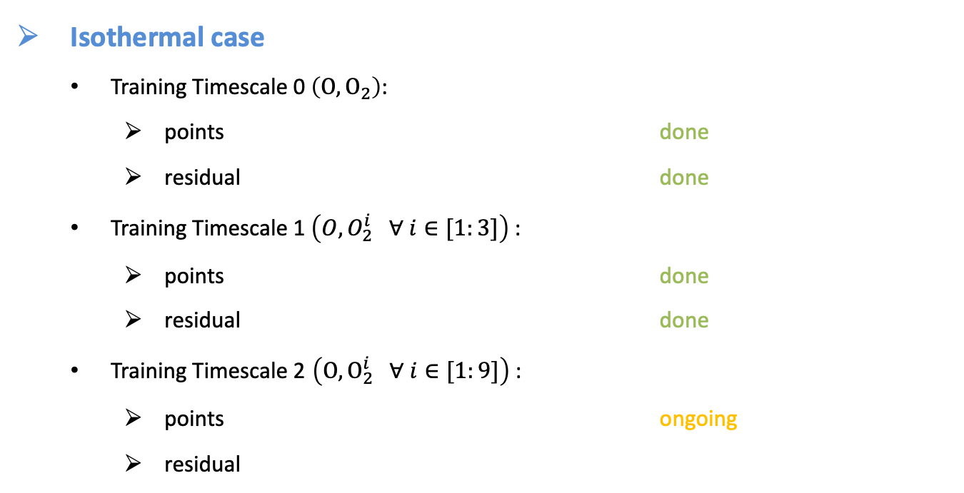
Training updates
Isothermal case
  Training Timescale 0 $\left(O,O_{2}\right)$:
    points done
    residual done
  Training Timescale 1 $\left(O,O_{2}^{i} ∀ i∈[1:3]\right)$:
    points done
    residual done
  Training Timescale 2 $\left(O,O_{2}^{i} ∀ i∈[1:9]\right)$:
    points ongoing
    residual

Slide 3
Adaptive nonequilibrium strategy

Slide 4
Adaptive
Nonequilibrium strategy
Nonequilibrium factor: definition & calibration

Slide 5
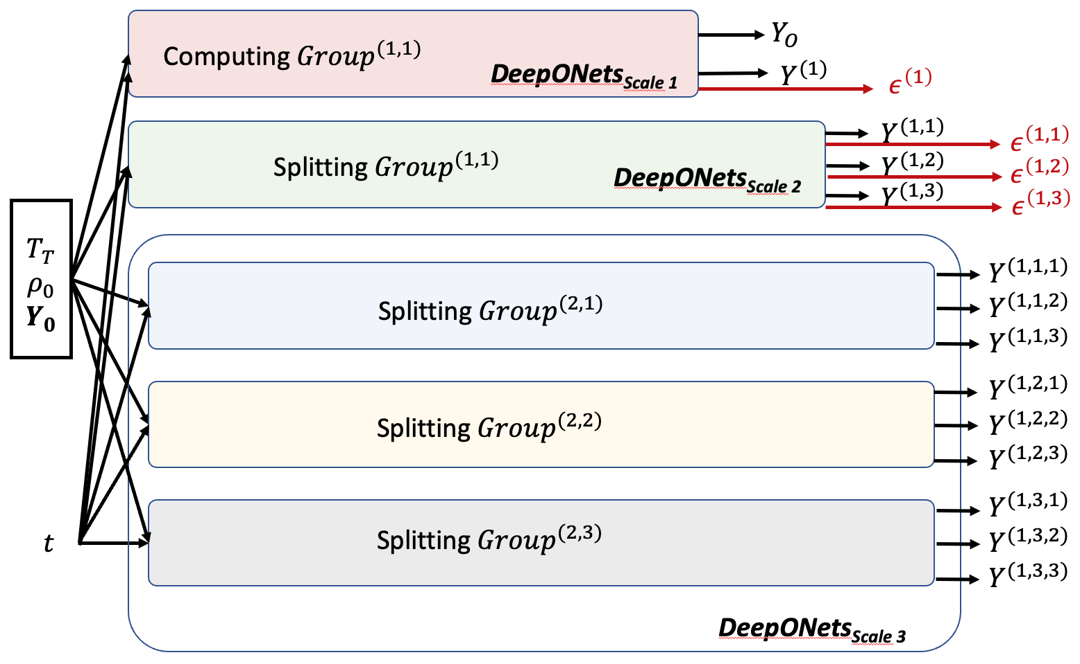

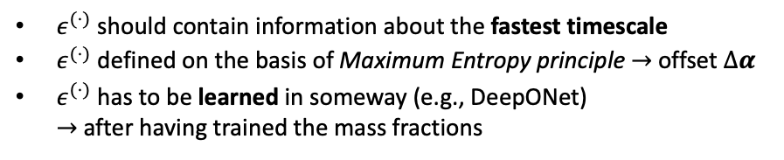
Nonequilibrium factor: definition
$$n_{i}$$
$ε^{(⋅)}$ should contain information about the fastest timescale
$ε^{(⋅)}$ defined on the basis of Maximum Entropy principle $→$ offset $Δα$
$ε^{(⋅)}$ has to be learned in someway (e.g., DeepONet) $→$ after having trained the mass fractions

Slide 6
Nonequilibrium factor: definition
$$n_{i}$$
$ε^{(⋅)}$ should contain information about the fastest timescale
$ε^{(⋅)}$ defined on the basis of Maximum Entropy principle $→$ offset $Δα$
$ε^{(⋅)}$ has to be learned in someway (e.g., DeepONet) $→$ after having trained the mass fractions

Slide 7
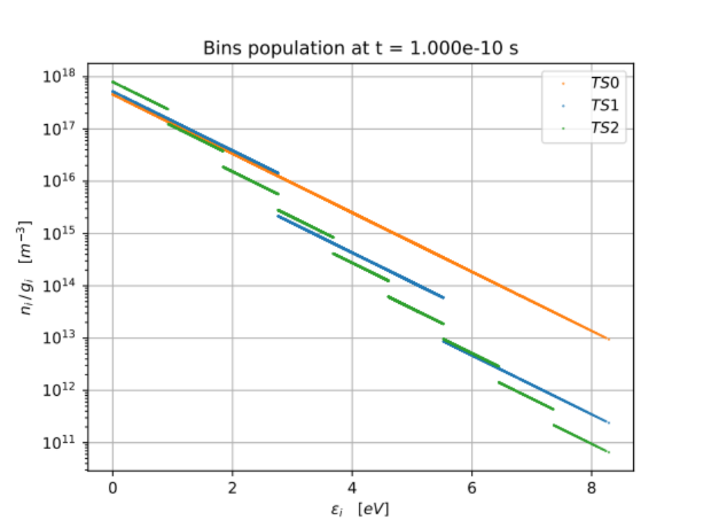
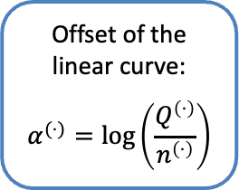

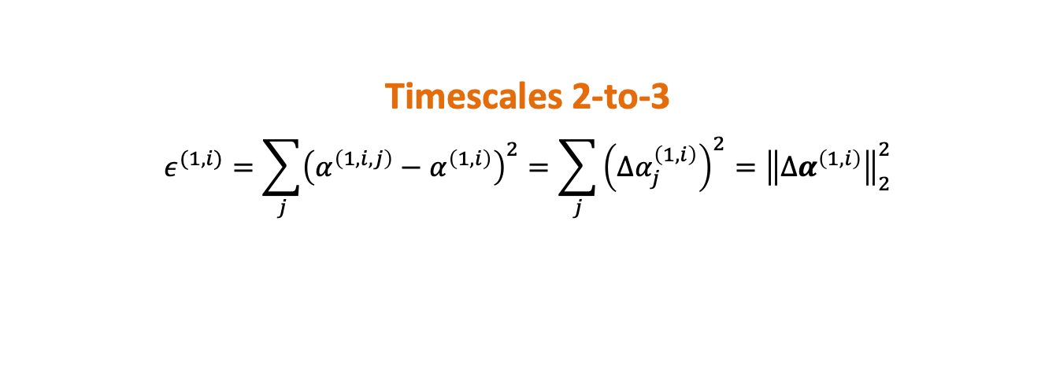
Nonequilibrium factor: definition
Timescales 2-to-3
$$ε^{(1,i)}=\sum_{j}{{\left(α^{\left(1,i,j\right)}−α^{\left(1,i\right)}\right)}^{2}}=\sum_{j}{{\left({Δα}_{j}^{\left(1,i\right)}\right)}^{2}}={\left\|{Δα}^{\left(1,i\right)}\right\|}_{2}^{2}$$
Offset of the linear curve:
$$α^{(⋅)}=\log\left(\frac{Q^{\left(⋅\right)}}{n^{\left(⋅\right)}}\right)$$
$${Δα}_{j}^{\left(1,i\right)}=α^{\left(1,i,j\right)}−α^{\left(1,i\right)}$$

Slide 8
Nonequilibrium factor: definition
$$n_{i}$$
$ε^{(⋅)}$ should contain information about the fastest timescale
$ε^{(⋅)}$ defined on the basis of Maximum Entropy principle $→$ offset $Δα$
$ε^{(⋅)}$ has to be learned in someway (e.g., DeepONet) $→$ after having trained the mass fractions

Slide 9
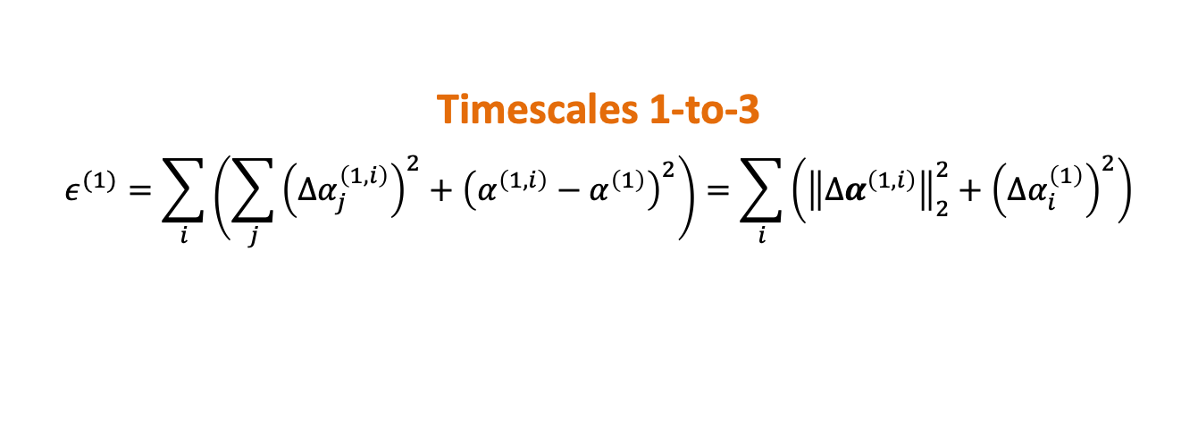

Nonequilibrium factor: definition
Timescales 1-to-3
$$ε^{(1)}=\sum_{i}{\left(\sum_{j}{{\left({Δα}_{j}^{\left(1,i\right)}\right)}^{2}}+{\left(α^{\left(1,i\right)}−α^{\left(1\right)}\right)}^{2}\right)}=\sum_{i}{\left({\left\|{Δα}^{\left(1,i\right)}\right\|}_{2}^{2}+{\left({Δα}_{i}^{\left(1\right)}\right)}^{2}\right)}$$
Offset of the linear curve:
$$α^{(⋅)}=\log\left(\frac{Q^{\left(⋅\right)}}{n^{\left(⋅\right)}}\right)$$
$${Δα}_{i}^{\left(1\right)}=α^{\left(1,i\right)}−α^{\left(1\right)}$$
$${Δα}_{j}^{\left(1,i\right)}=α^{\left(1,i,j\right)}−α^{\left(1,i\right)}$$

Slide 10
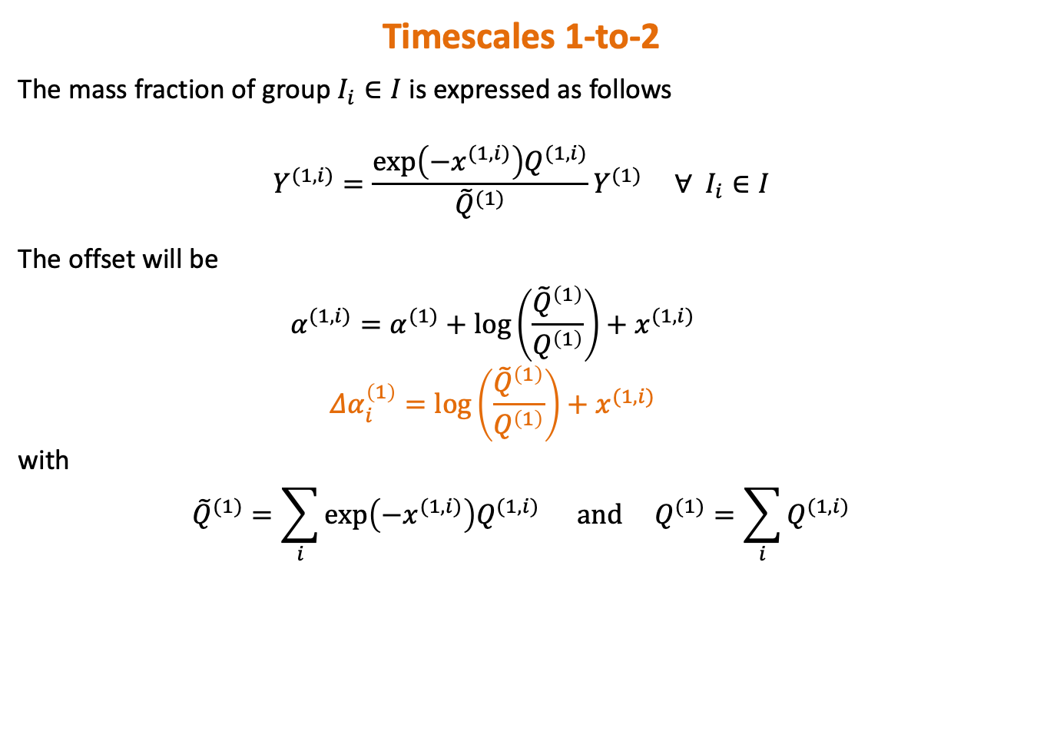
Nonequilibrium factor: definition
Timescales 1-to-2
The mass fraction of group $I_{i}∈I$ is expressed as follows
$$Y^{(1,i)}=\frac{\exp\left(−x^{(1,i)}\right)Q^{(1,i)}}{{\tilde{Q}}^{(1)}}Y^{(1)} ∀ I_{i}∈I$$
The offset will be
  $$α^{(1,i)}=α^{(1)}+\log\left(\frac{{\tilde{Q}}^{\left(1\right)}}{Q^{\left(1\right)}}\right)+x^{(1,i)}$$
  $$Δα_{i}^{\left(1\right)}=\log\left(\frac{{\tilde{Q}}^{\left(1\right)}}{Q^{\left(1\right)}}\right)+x^{(1,i)}$$
with
$${\tilde{Q}}^{(1)}=\sum_{i}{\exp\left(−x^{(1,i)}\right)Q^{(1,i)} and Q^{(1)}=\sum_{i}{Q^{(1,i)}}}$$

Slide 11
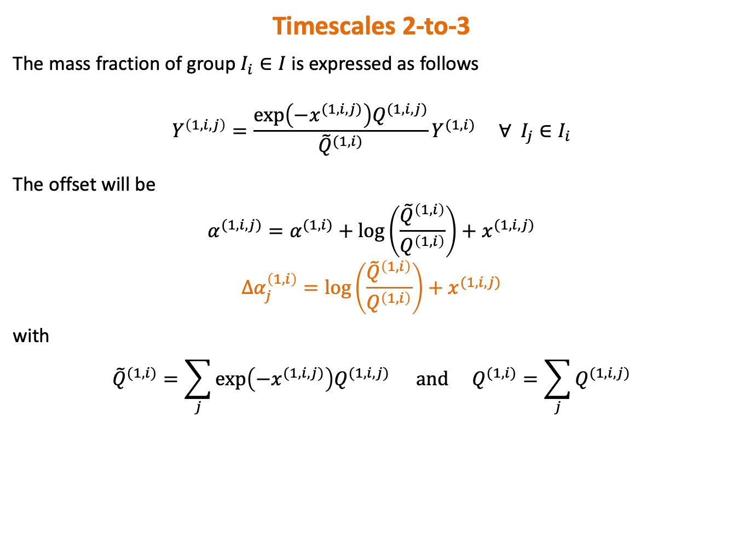
Nonequilibrium factor: definition
Timescales 2-to-3
The mass fraction of group $I_{i}∈I$ is expressed as follows
$$Y^{\left(1,i,j\right)}=\frac{\exp\left(−x^{(1,i,j)}\right)Q^{(1,i,j)}}{{\tilde{Q}}^{(1,i)}}Y^{(1,i)} ∀ I_{j}∈I_{i}$$
The offset will be
$$α^{(1,i,j)}=α^{(1,i)}+\log\left(\frac{{\tilde{Q}}^{\left(1,i\right)}}{Q^{\left(1,i\right)}}\right)+x^{(1,i,j)}$$
$$Δα_{j}^{\left(1,i\right)}=\log\left(\frac{{\tilde{Q}}^{\left(1,i\right)}}{Q^{\left(1,i\right)}}\right)+x^{(1,i,j)}$$
with
$${\tilde{Q}}^{(1,i)}=\sum_{j}{\exp\left({−x}^{(1,i,j)}\right)Q^{(1,i,j)}} and Q^{(1,i)}=\sum_{j}{Q^{(1,i,j)}}$$

Slide 12
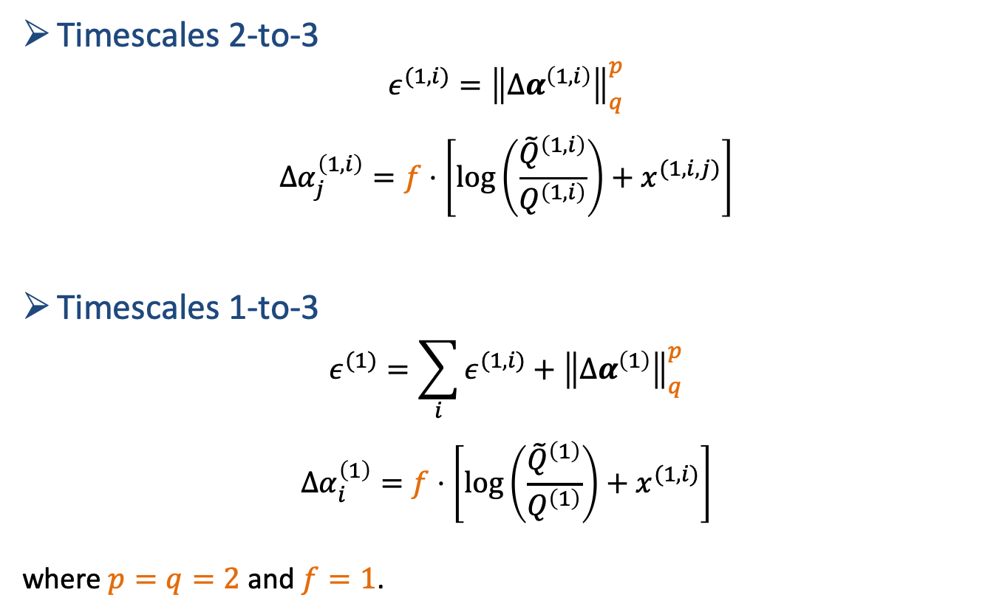
Nonequilibrium factor: definition
Timescales 2-to-3
$$ε^{(1,i)}={\left\|{Δα}^{\left(1,i\right)}\right\|}_{q}^{p}$$
$${Δα}_{j}^{\left(1,i\right)}=f⋅\left[\log\left(\frac{{\tilde{Q}}^{\left(1,i\right)}}{Q^{\left(1,i\right)}}\right)+x^{(1,i,j)}\right]$$
Timescales 1-to-3
$$ε^{(1)}=\sum_{i}{ε^{(1,i)}}+{\left\|{Δα}^{\left(1\right)}\right\|}_{q}^{p}$$
$$Δα_{i}^{\left(1\right)}=f⋅\left[\log\left(\frac{{\tilde{Q}}^{\left(1\right)}}{Q^{\left(1\right)}}\right)+x^{(1,i)}\right]$$
where $p=q=2$ and $f=1$.

Slide 13
Nonequilibrium factor: definition
Timescales 2-to-3
$$ε^{(1,i)}={\left\|{Δα}^{\left(1,i\right)}\right\|}_{q}^{p}$$
$${Δα}_{j}^{\left(1,i\right)}=f⋅\left[\log\left(\frac{{\tilde{Q}}^{\left(1,i\right)}}{Q^{\left(1,i\right)}}\right)+x^{(1,i,j)}\right]$$
Timescales 1-to-3
$$ε^{(1)}=\sum_{i}{ε^{(1,i)}}+{\left\|{Δα}^{\left(1\right)}\right\|}_{q}^{p}$$
$$Δα_{i}^{\left(1\right)}=f⋅\left[\log\left(\frac{{\tilde{Q}}^{\left(1\right)}}{Q^{\left(1\right)}}\right)+x^{(1,i)}\right]$$
where $p=q=2$ and $f=1$.

Slide 14

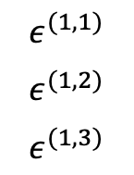


Nonequilibrium factor: definition
Nonequilibrium distance 1-to-3
DeepONet^{(0,1)}
$$ε^{(1)}$$
$$T$$
$$ρ_{0}$$
$$Y_{0}$$
Nonequilibrium distance 2-to-3
DeepONet^{(1,2)}
$$ε^{(1,1)}$$
$$ε^{(1,2)}$$
$$ε^{(1,3)}$$
$$t$$

Slide 15
Adaptive nonequilibrium strategy
Test Case

Slide 16
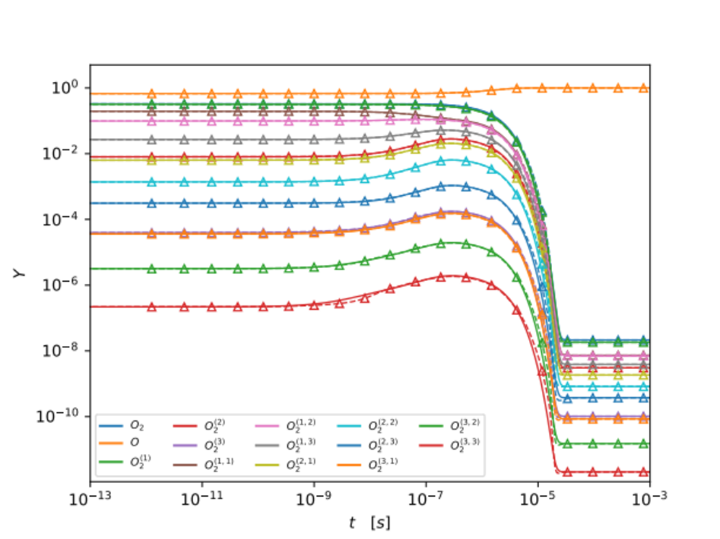
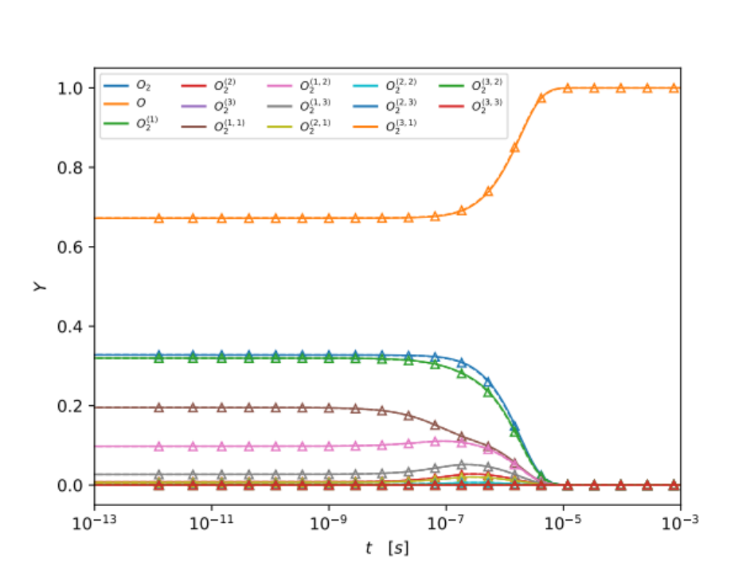
Test Case

Slide 17
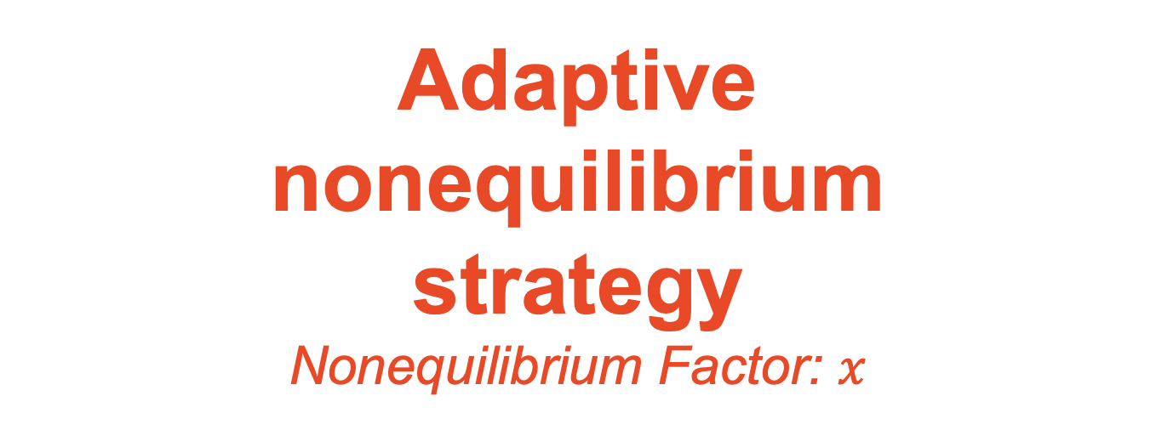
Adaptive nonequilibrium strategy
Nonequilibrium Factor: $x$

Slide 18
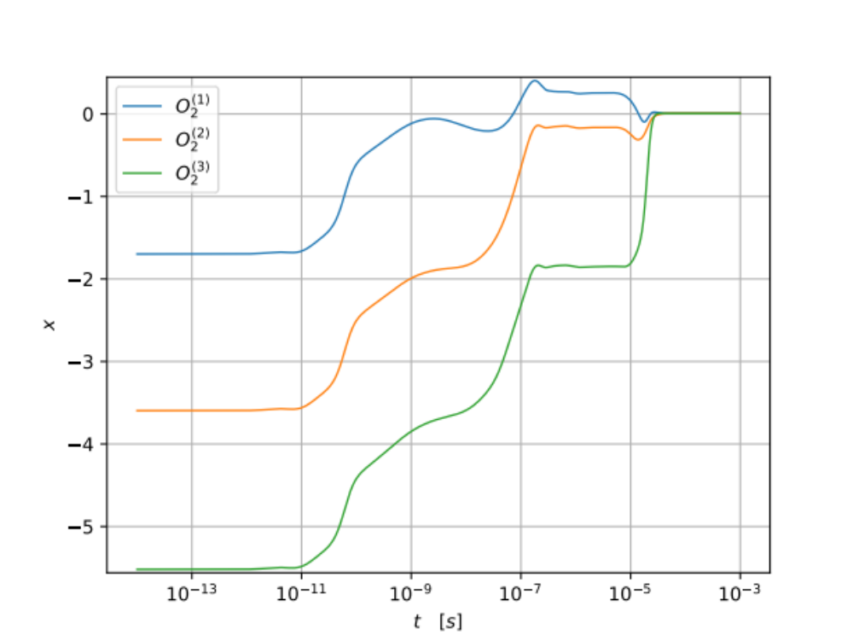
Timescale 2

Slide 19
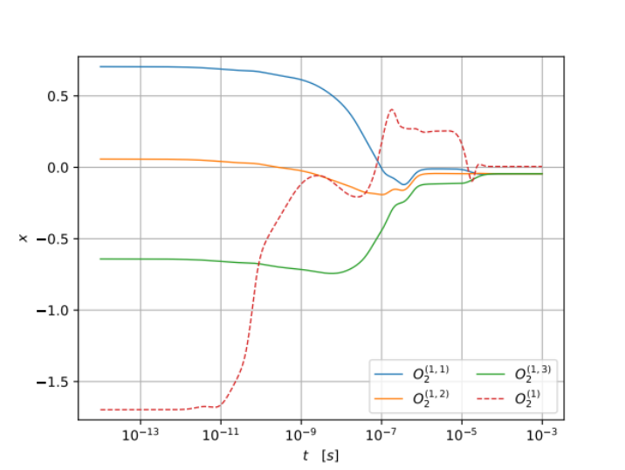
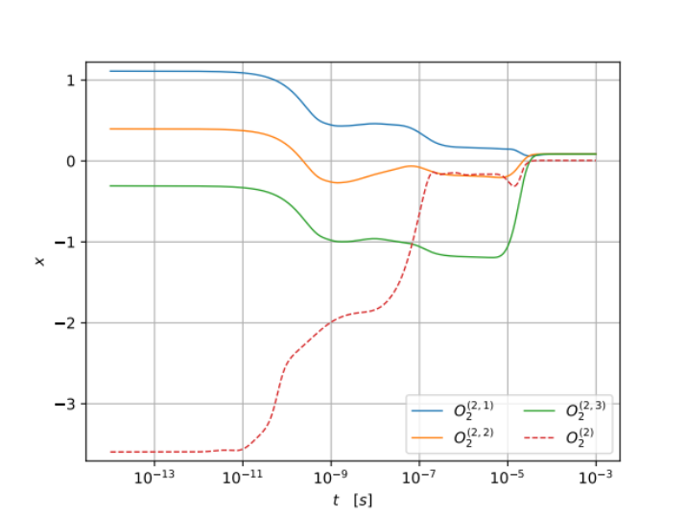
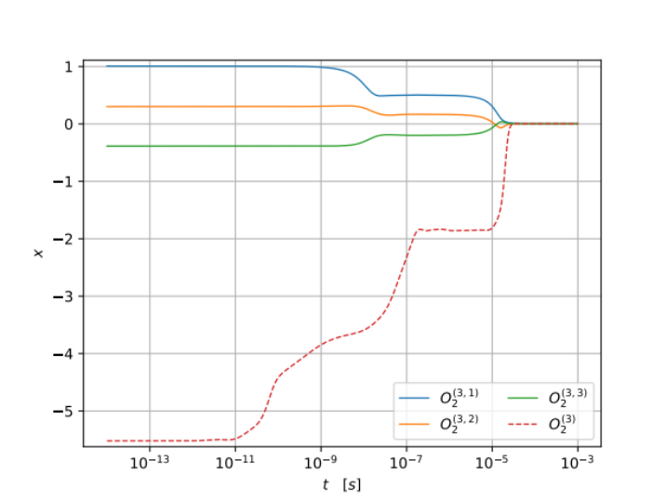
Timescale 3

Slide 20
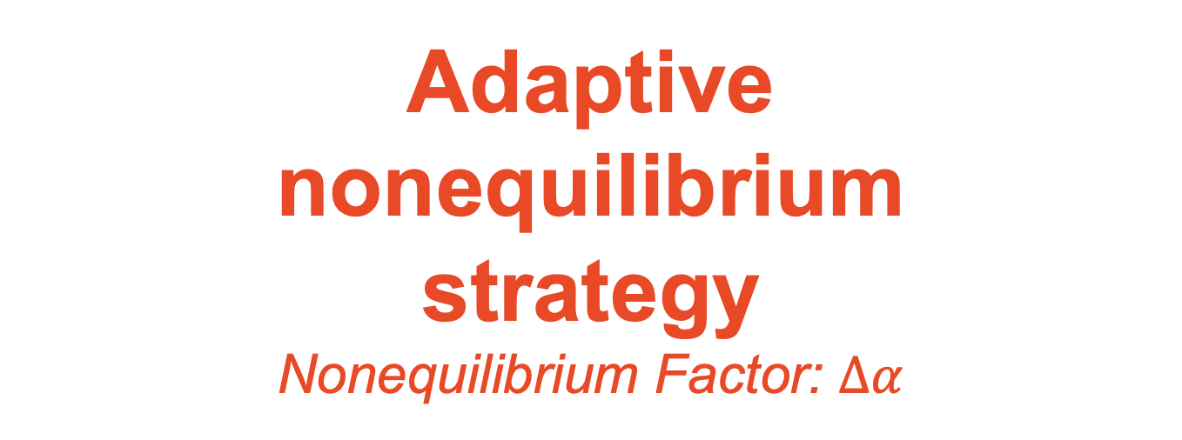
Adaptive nonequilibrium strategy
Nonequilibrium Factor: $Δα$

Slide 21
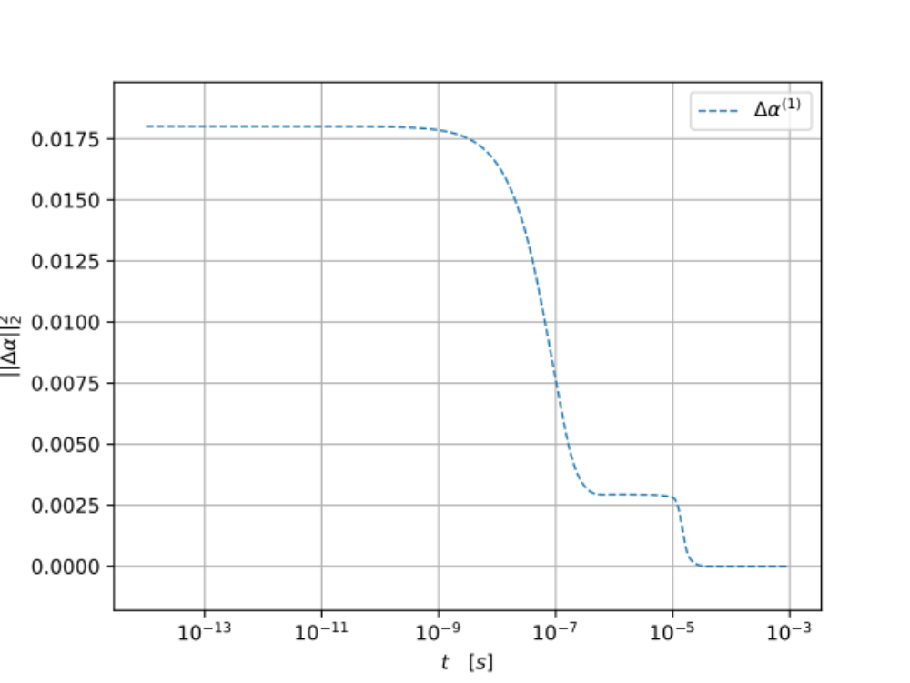
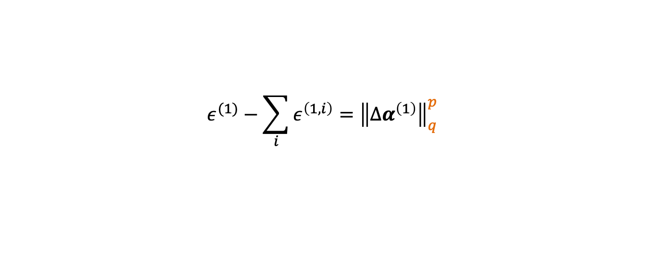
Timescale 1-to-2
$$ε^{(1)}−\sum_{i}{ε^{\left(1,i\right)}}={\left\|{Δα}^{\left(1\right)}\right\|}_{q}^{p}$$

Slide 22
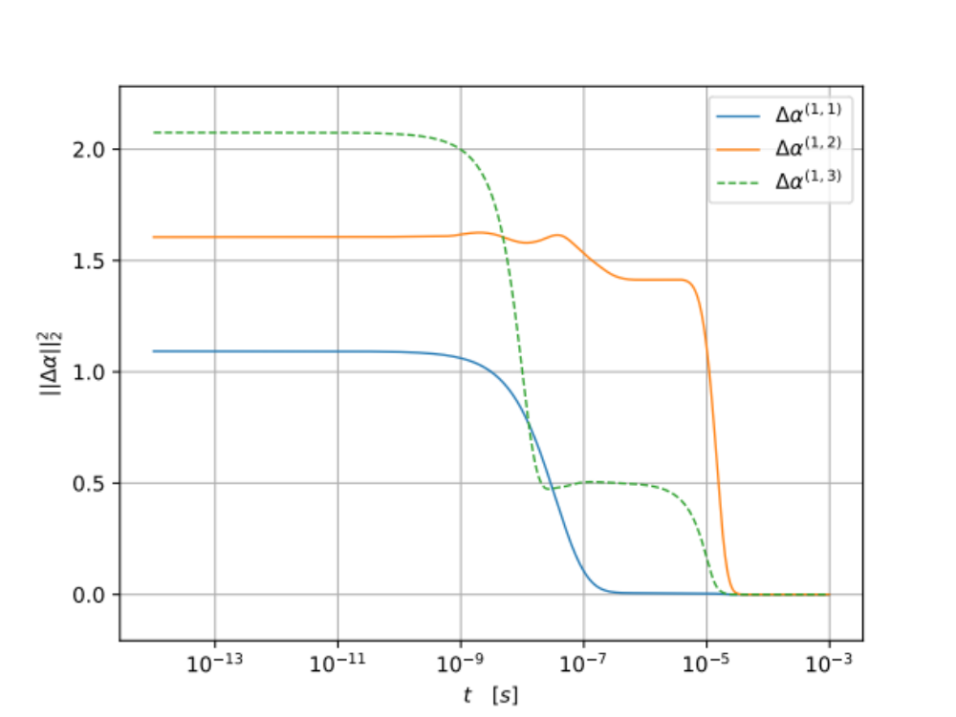
Timescale 2-to-3
$$ε^{(1,i)}={\left\|{Δα}^{\left(1,i\right)}\right\|}_{q}^{p}$$

Slide 23
Adaptive nonequilibrium strategy
Levels distribution

Slide 24
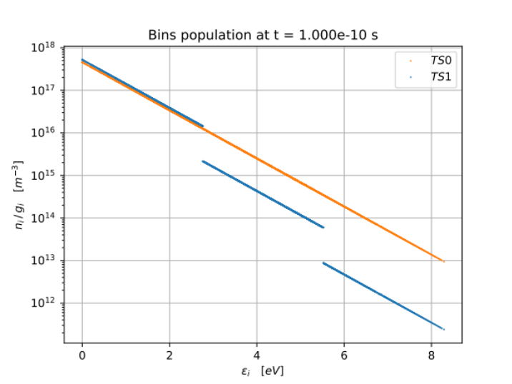
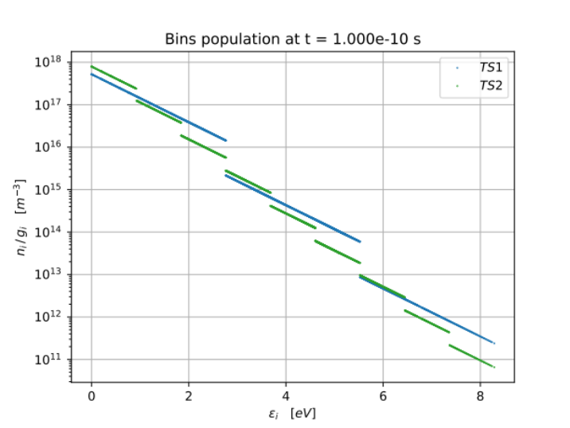
Time = ${10}^{−10}$ s

Slide 25
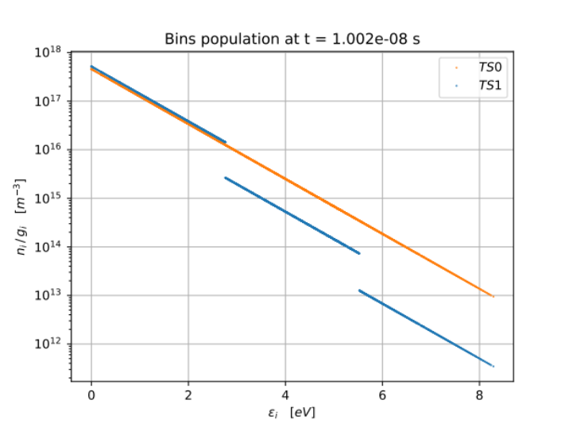
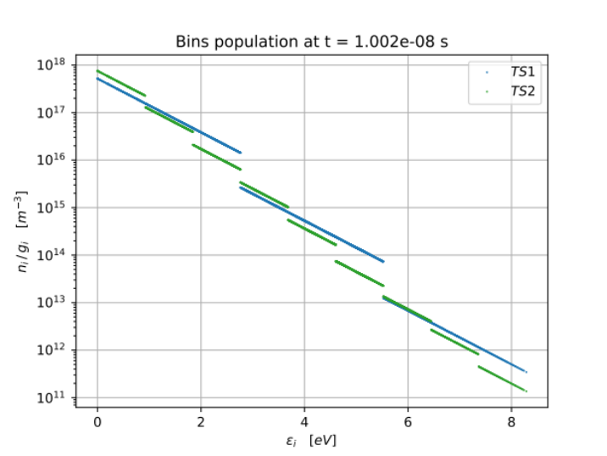
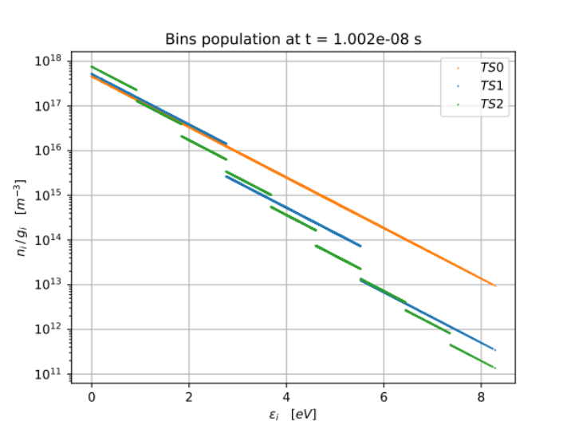
Time = ${10}^{−8}$ s

Slide 26
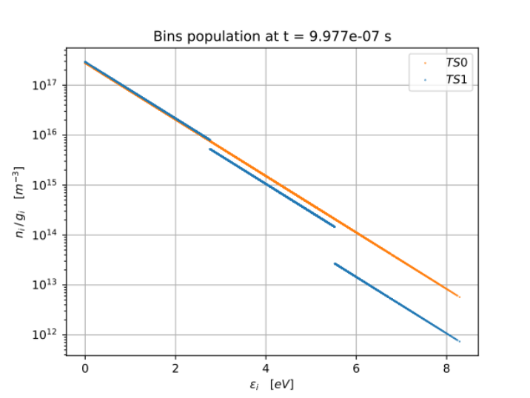
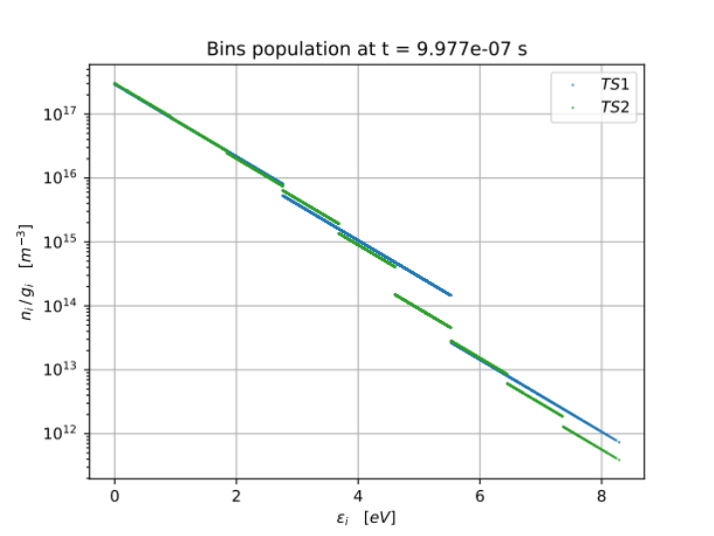
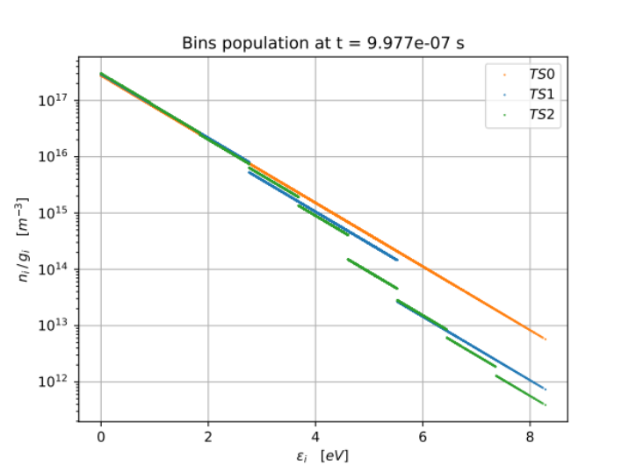
Time = ${10}^{−6}$ s

Slide 27
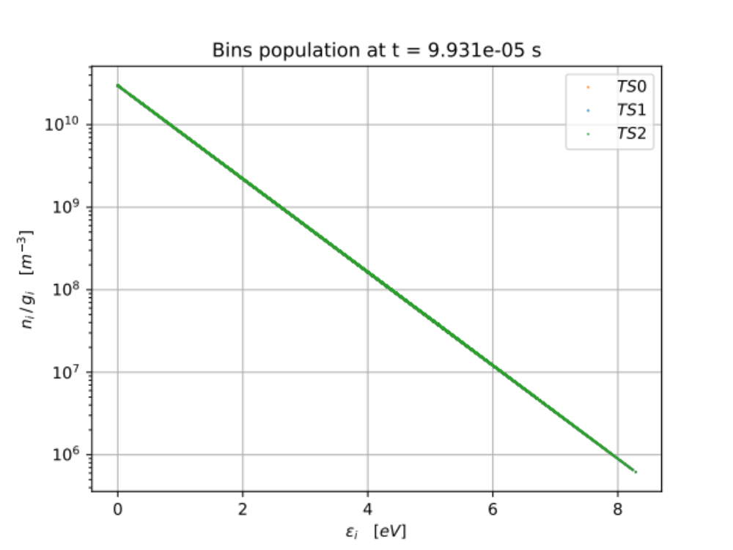
Time = ${10}^{−4}$ s

Slide 28
Self interrogating
DeepONet

Slide 29
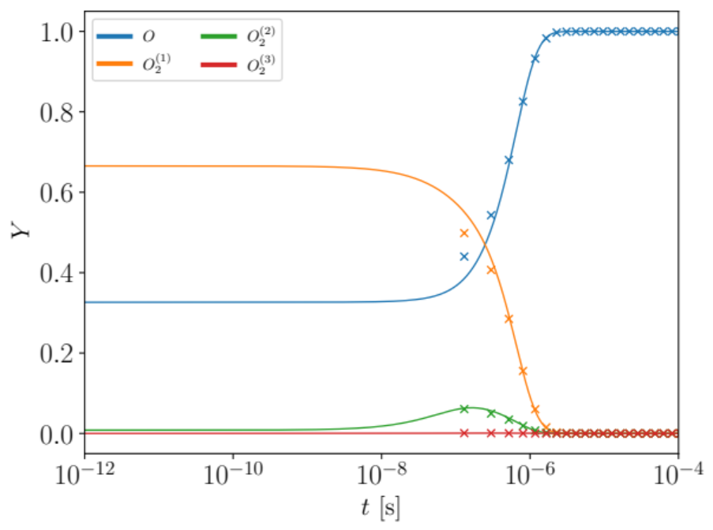
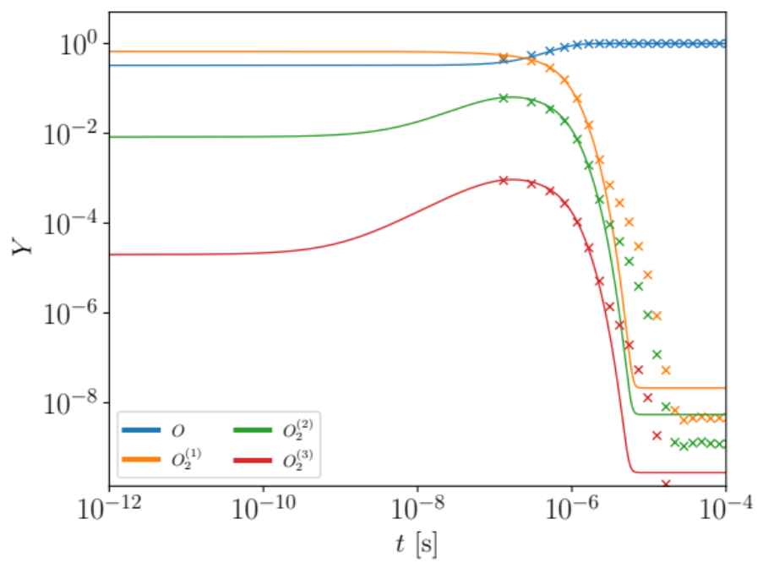
Test Case

Slide 30
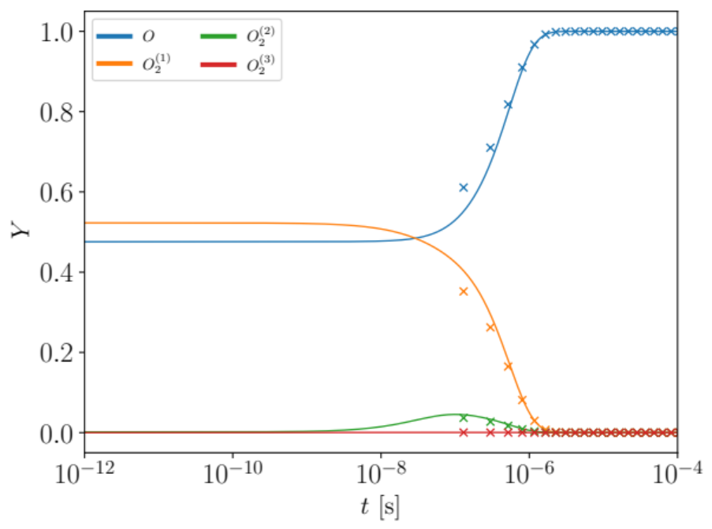
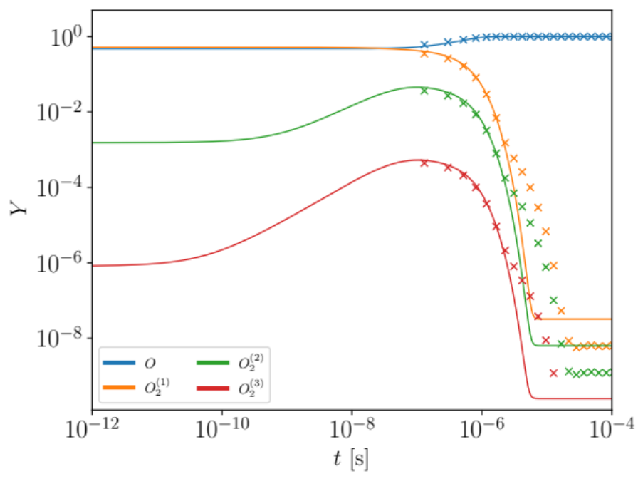
Test Case

Slide 31
Nonequilibrium factor: definition
Wednesday 17:
Written error from equation and understand physical meaning
Plotted error evolution for ~5 cases
Thought about Net structure for the error
Wednesday 24:
Created network
Wednesday 1:
Trained error
Created useful testcases
Wednesday 8:
Tested and Plotted testcases
(AIAA paper 1st draft and title)
(AIAA paper 2nd draft)
(AIAA submission)
(Paper structure)
30

