Slide 1
REMITLY
Money transfers from developed countries to developing countries

Slide 2
REMITLY Founders
Founded in Seattle-WA in 2011 by:
Matt Oppenheimer, current CEO
Josh Hugh, current COO
Shivaas Guati
* From www.geekwire.com
https://www.remitly.com/us/en/home/the_team

Slide 3
REMITLY – main motivation
REMITLY was founded as a solution to simplify international money transfers and payments
Reducing or eliminating fees and really easing the process to get the money overseas
Initially focused on helping people in America transferring money to Philippines
Currently: 16 different developed countries to around 44 developing countries
https://youtu.be/Qk-QjBvQspw

Slide 4
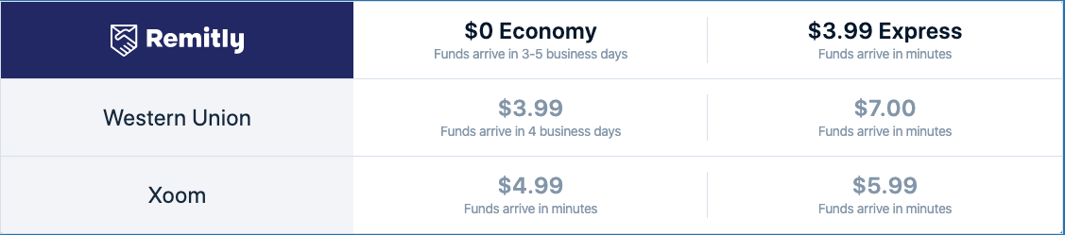
REMITLY – How it Works
* From www.Remitly.com
https://youtu.be/Gs5ReHtlNHc

Slide 5
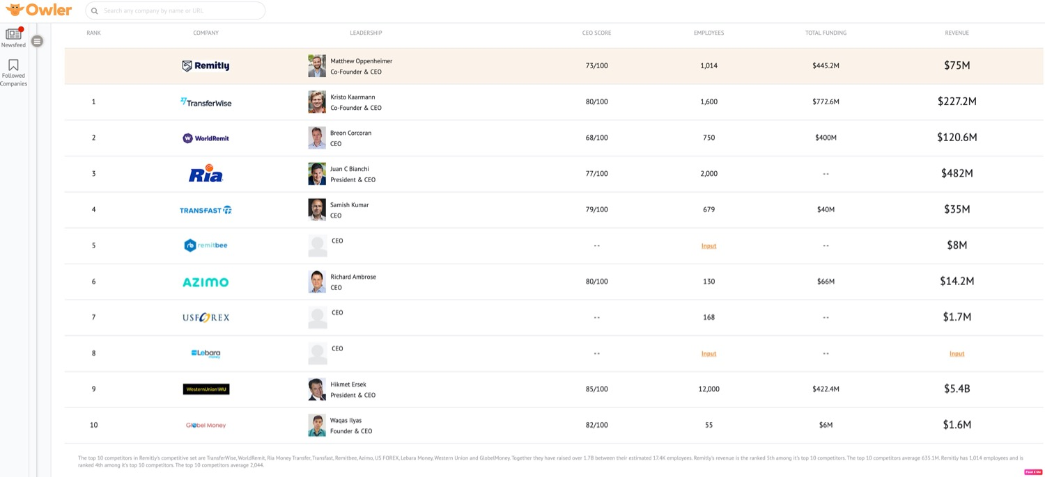
REMITLY – Top 10 competitors
* From www.owler.com

Slide 6
REMITLY – New products
Mini and Micro loans with affordable rates
Helping immigrants to build and maintain credit history
Credit Card
Partnership with major e-commerces to pay with REMITLY directly
On-line investments

Slide 7
REMITLY – Q&A

Slide 8
References
Remitly WebPage. (n.d.). Retrieved December 10, 2019. From https://www.remitly.com/us/en/home/about
GeekWire WebPage - "Remitly raises $135M and inks $85M credit line to grow remittance service, launch new products". Taylor Soper. Retrieved December 12, 2019. From https://www.geekwire.com/2019/remitly-lands-massive-220m-investment-grow-remittance-service-launch-new-fintech-products/
Owler WebPage - "Remitly's Competitors, Revenue, Number of Employees, Funding and Acquisition". (n.d.). Retrieved December 12, 2019. From https://www.owler.com/company/remitly

