Slide 1
Trading FAANG Stocks with Machine Learning
Andres Mejia
Jaime Alvarez
Jean Mathew
Aleida Rodriguez

Slide 2
Objective:
Data - Features - Frequency
Opening price
RSI
LSTM Model
Volatility
Predicted Prices
Sentiment
Volume
Portfolio = FAANG (Facebook, Apple, Amazon, Netflix, Google)

Slide 3
Data Collection
FAANG Stocks History
ALPACA API - Extracted data from all of 2019
Sentiments
SPY - IEX Finance
AAII - QUANDL

Slide 4
Feature
VOLUME
VOLATILITY
STOCKTWITS SENTIMENT
RELATIVE STRENGTH INDEX
PREVIOUS CLOSING PRICE

Slide 5
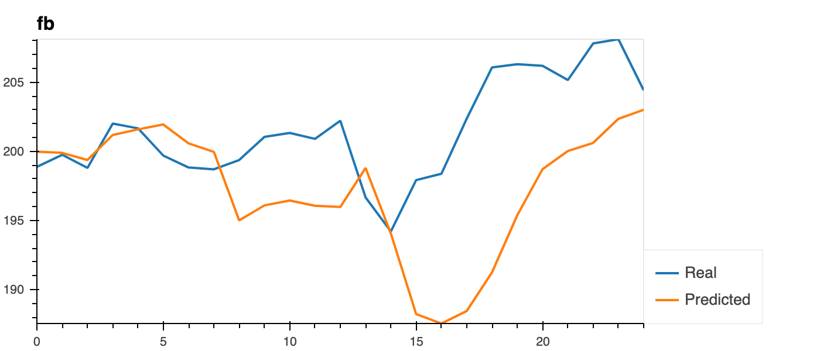
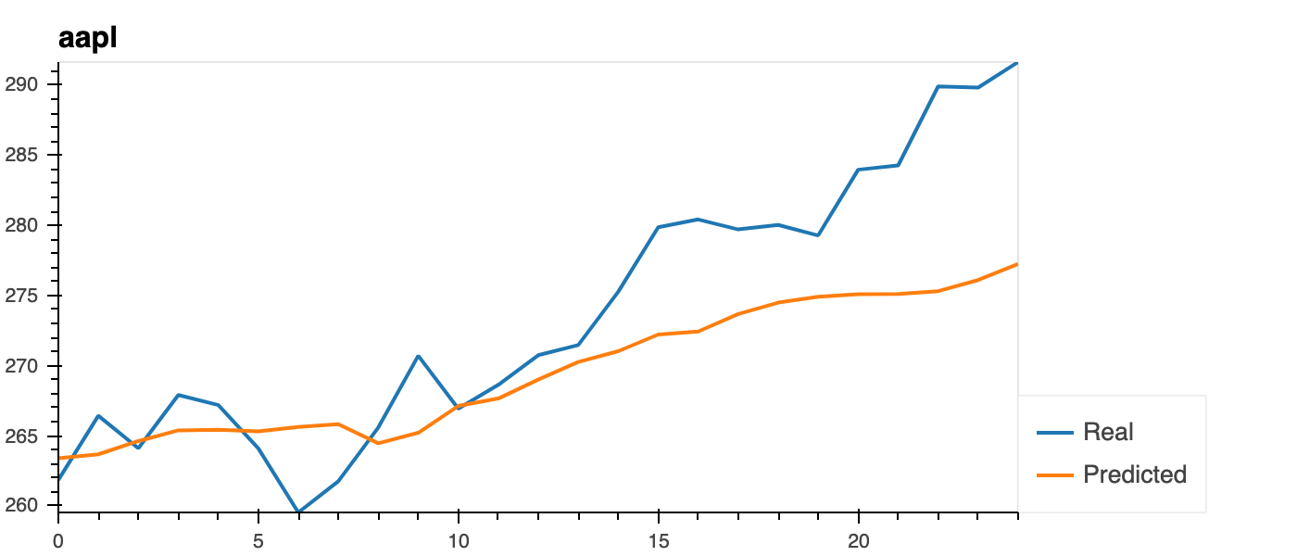
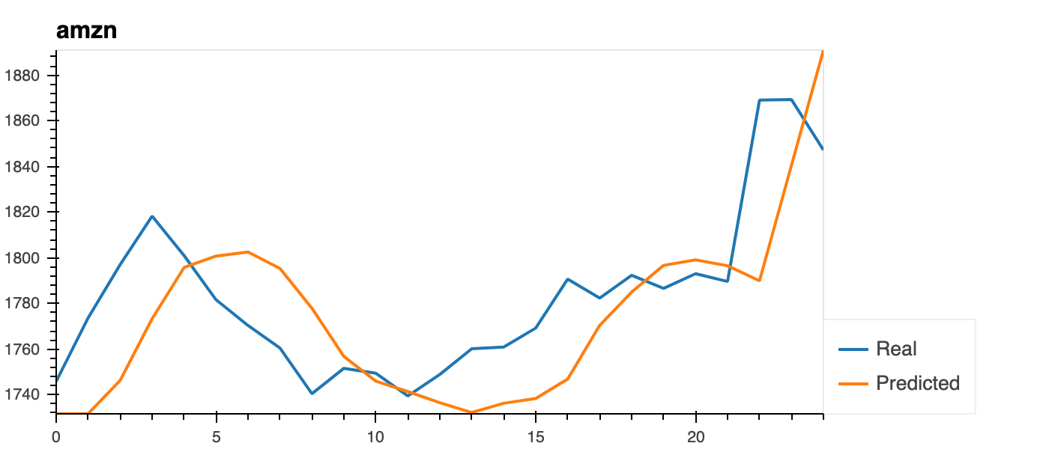
LSTM

Slide 6
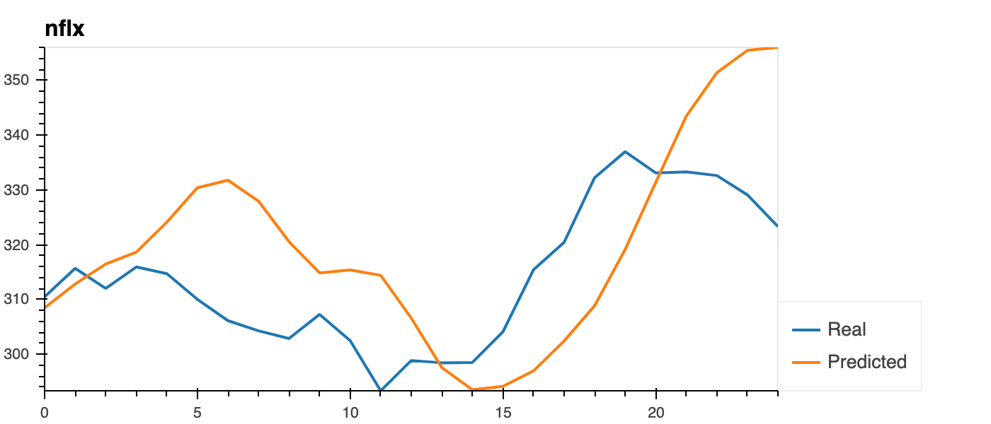
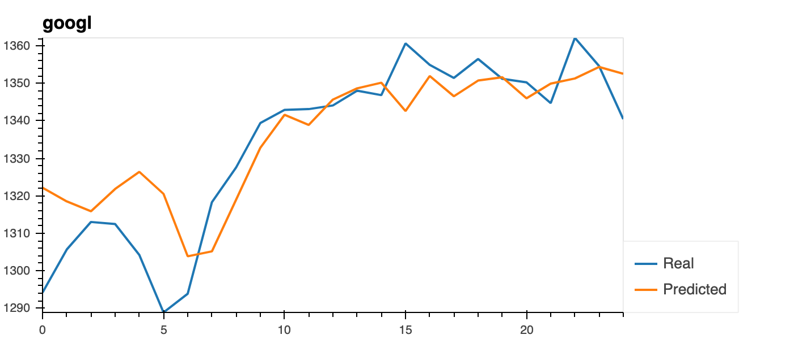
LSTM

Slide 7
Support and Resistance
Used k-means classification with last 7-day prices
Through k-means found optimum number of clusters using inertia and elbow method
Support and resistance levels through cluster centers of the “High” and “Low” daily stock prices

Slide 8
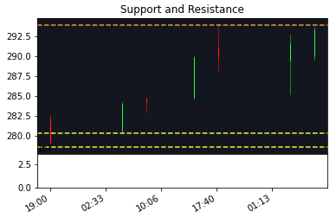
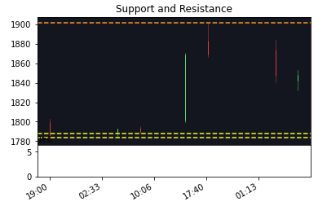
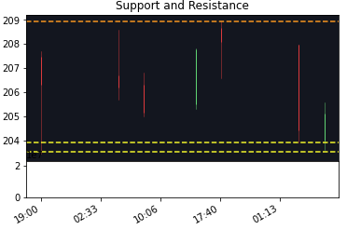
Support and Resistance
Apple
Amazon
Facebook

Slide 9
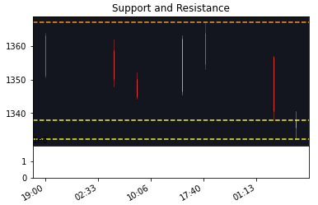
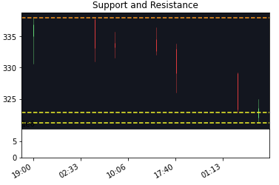
Support and Resistance
Google
Netflix

Slide 10
Strategy
If predicted price >= Low Bollinger and >= Support and Sentiment is > Mid-Strong Positive then Buy Signal with Selling at Min(Up Bollinger, Resistance) or when RSI is > 70.
If predicted price <= Up Bollinger and <= Resistance and Sentiment is < Mid-Strong Negative then Sell Signal with Buying at Max(Low Bollinger, Support) or when RSI is < 30.

Slide 11
Strategy Schematic
Bollinger Up
Bollinger Low
Predicted Prices

Slide 12
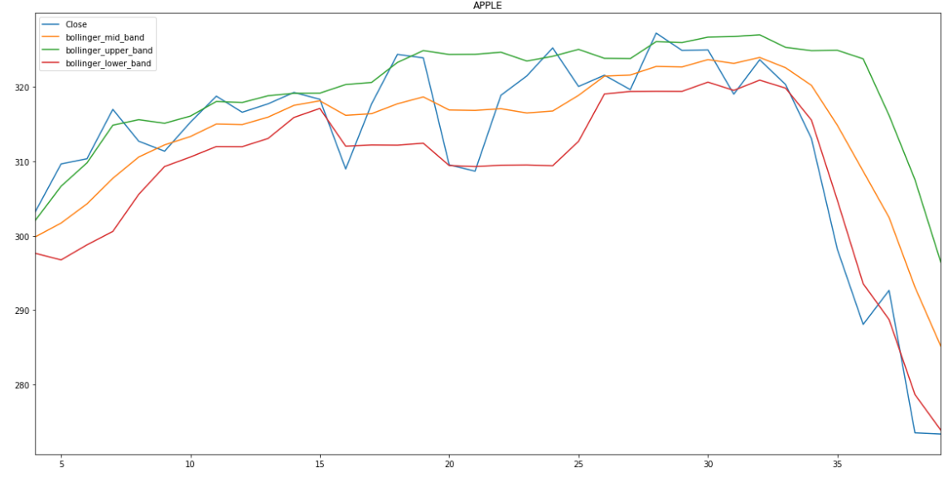
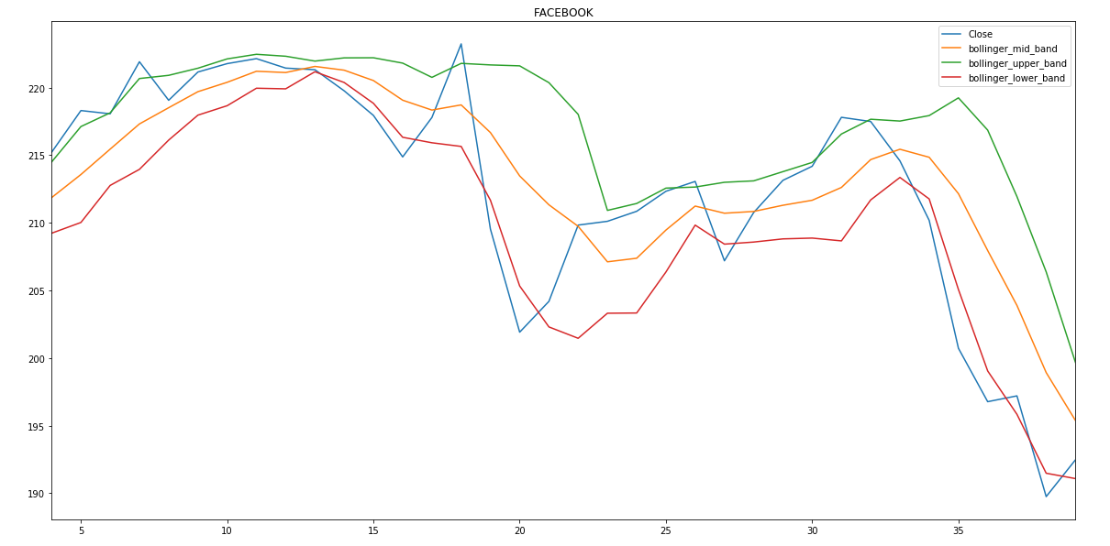
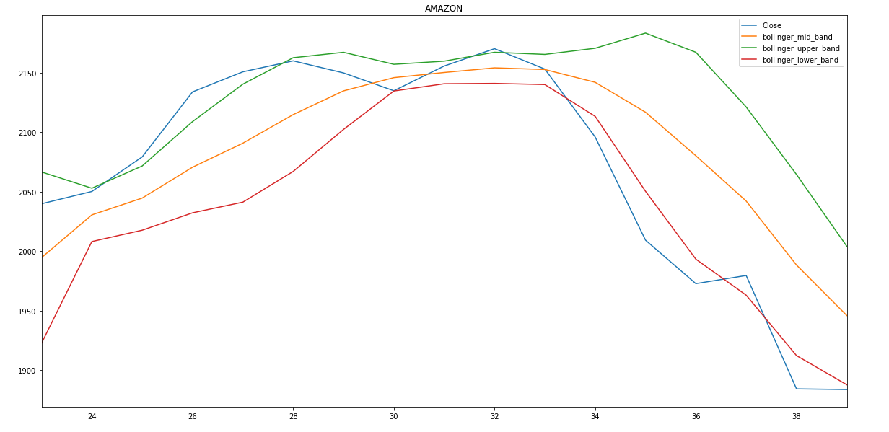
Bollinger Lines

Slide 13
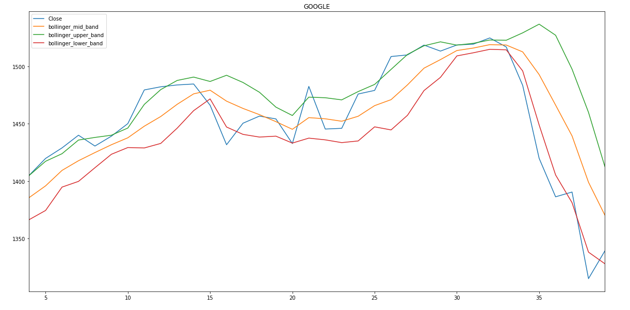
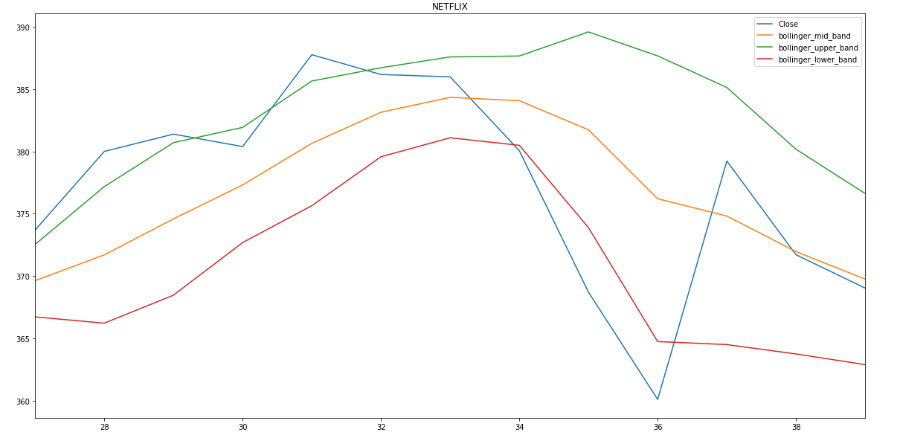
Bollinger Lines

