Slide 1
Java OpenGL
MAR
Master 2 Informatique

Slide 2
Plan
Introduction
Squelette
Primitives
Rendu
Plaquage de textures
GLSL

Slide 3
JOGL Introduction
JOGL
  Java binding of OpenGL – JSR 231
OpenGL
  Bibliothèque Graphique 2D, 3D
    Indépendante du système => Portable
      Windows, Mac, Linux, Unix, etc.
Notes:
In this section, we discuss what the OpenGL API (Application Programming Interface) is, and some of its capabilities.
As OpenGL is platform independent, we need some way to integrate OpenGL into each windowing system. Every windowing system where OpenGL is supported has additional API calls for managing OpenGL windows, colormaps, and other features. These additional APIs are platform dependent.
For the sake of simplicity, we’ll use an additional freeware library for simplifying interacting with windowing systems, GLUT. GLUT, the OpenGL Utility Toolkit is a library to make writing OpenGL programs regardless of windowing systems much easier. It’ll be the base of all of our examples in the class.
We conclude the section with a basic program template for an OpenGL program using GLUT.

Slide 4
JOGL Introduction
JOGL
  Machines à états
    Tout dépend de l’état
  Fonctionnement par callback
  Boucle OpenGL
    On perd la main
  Méthodes
    Dessins primitives
    Gestion de l’état
Notes:
As mentioned, OpenGL is a library for rendering computer graphics. Generally, there are two operations that you do with OpenGL:
draw something
change the state of how OpenGL draws
OpenGL has two types of things that it can render: geometric primitives and image primitives. Geometric primitives are points, lines and polygons. Image primitives are bitmaps and graphics images (i.e. the pixels that you might extract from a JPEG image after you’ve read it into your program.) Additionally, OpenGL links image and geometric primitives together using texture mapping, which is an advanced topic we’ll discuss this afternoon.
The other common operation that you do with OpenGL is setting state. “Setting state” is the process of initializing the internal data that OpenGL uses to render your primitives. It can be as simple as setting up the size of points and color that you want a vertex to be, to initializing multiple mipmap levels for texture mapping.

Slide 5
Squelette

Slide 6
Squelette
Deux classes
  JavaRenderer
    Dessin OpenGL
  JavaDia
    Interface

Slide 7
Squelette
import javax.media.opengl.GL;
import javax.media.opengl.GLEventListener;
import javax.media.opengl.GLAutoDrawable;
import javax.media.opengl.glu.GLU;
import java.awt.event.KeyEvent;
import java.awt.event.KeyListener;
public class JavaRenderer implements GLEventListener, KeyListener {
private float rotateT = 0.0f;
private static final GLU glu = new GLU();

Slide 8
Squelette
// méthode de callback défini par GLEventListener
public void display(GLAutoDrawable gLDrawable) {
// récupération du contexte OpenGL
final GL gl = gLDrawable.getGL();
// init de l’état OpenGL
gl.glClear(GL.GL_COLOR_BUFFER_BIT);
gl.glClear(GL.GL_DEPTH_BUFFER_BIT);
gl.glLoadIdentity();
gl.glTranslatef(0.0f, 0.0f, -5.0f);
// animation
gl.glRotatef(rotateT, 1.0f, 0.0f, 0.0f);
gl.glRotatef(rotateT, 0.0f, 1.0f, 0.0f);
gl.glRotatef(rotateT, 0.0f, 0.0f, 1.0f);
gl.glRotatef(rotateT, 0.0f, 1.0f, 0.0f);

Slide 9
Squelette
// dessin
gl.glBegin(GL.GL_TRIANGLES);
gl.glColor3f(0.0f, 1.0f, 1.0f);
gl.glVertex3f(0.0f, 1.0f, 0.0f);
gl.glColor3f(0.0f, 0.0f, 1.0f);
gl.glVertex3f(-1.0f, -1.0f, 1.0f);
gl.glColor3f(0.0f, 0.0f, 0.0f);
gl.glVertex3f(1.0f, -1.0f, 1.0f);
gl.glEnd();
rotateT += 0.2f;
}

Slide 10
Squelette
// callback
public void displayChanged(GLAutoDrawable gLDrawable, boolean modeChanged, boolean deviceChanged) {
}
// callback
public void init(GLAutoDrawable gLDrawable) {
final GL gl = gLDrawable.getGL();
gl.glShadeModel(GL.GL_SMOOTH);
gl.glClearColor(0.0f, 0.0f, 0.0f, 0.0f);
gl.glClearDepth(1.0f);
gl.glEnable(GL.GL_DEPTH_TEST);
gl.glDepthFunc(GL.GL_LEQUAL);
gl.glHint(GL.GL_PERSPECTIVE_CORRECTION_HINT, GL.GL_NICEST);
gLDrawable.addKeyListener(this);
}

Slide 11
Squelette
// callback
public void reshape(GLAutoDrawable gLDrawable, int x, int y, int width, int height) {
final GL gl = gLDrawable.getGL();
if(height <= 0) {height = 1;}
final float h = (float)width / (float)height;
gl.glMatrixMode(GL.GL_PROJECTION);
gl.glLoadIdentity();
glu.gluPerspective(50.0f, h, 1.0, 1000.0);
gl.glMatrixMode(GL.GL_MODELVIEW);
gl.glLoadIdentity();
}

Slide 12
Squelette
// callback
public void keyPressed(KeyEvent e) {
if(e.getKeyCode() == KeyEvent.VK_ESCAPE) {
JavaDia.bQuit = true;
JavaDia.displayT.stop();
System.exit(0);
}
}
public void keyReleased(KeyEvent e) {}
public void keyTyped(KeyEvent e) {}
}

Slide 13
Squelette
import javax.media.opengl.GLCanvas;
import java.awt.Frame;
import java.awt.event.WindowAdapter;
import java.awt.event.WindowEvent;
public class JavaDia implements Runnable {
// JavaDia est un Thread
static Thread displayT = new Thread(new JavaDia());
static boolean bQuit = false;
public static void main(String[] args) {
displayT.start();
}

Slide 14
Squelette
public void run() {
// window
Frame frame = new Frame("Jogl 3d Shape/Rotation");
GLCanvas canvas = new GLCanvas();
canvas.addGLEventListener(new JavaRenderer());
frame.add(canvas);
frame.setSize(640, 480);
frame.setUndecorated(true);
int size = frame.getExtendedState();
size |= Frame.MAXIMIZED_BOTH;
frame.setExtendedState(size);

Slide 15
Squelette
frame.addWindowListener(new WindowAdapter() {
public void windowClosing(WindowEvent e) {
bQuit = true;
displayT.stop();
System.exit(0);
}
});
frame.setVisible(true);
canvas.requestFocus();
while( !bQuit ) {canvas.display();}
}
}

Slide 16
Squelette – autre version
import java.awt.*; import java.awt.event.*;
import javax.media.opengl.*; import com.sun.opengl.util.*;
public class Squelette implements GLEventListener {
public static void main(String[] args)
{
/* Création d'une fenêtre
* Nous utilisons la classe Frame de AWT
* plutôt que la classe JFrame de Swing pour une question de performance */
Frame frame = new Frame("Squelette");
/* Création du Canvas OpenGL pour pouvoir dessiner dessus */
GLCanvas canvas = new GLCanvas();
/* Nous attachons ensuite le méchanisme de callback */
canvas.addGLEventListener(new Squelette());
/** * Nous attachons maintenant notre surface dessinable à notre fenêtre */
frame.add(canvas);

Slide 17
Squelette – autre version
/* Création de l'Animator */
final Animator animator = new Animator(canvas);
/* Le code qui suit permet de gérer la fermeture
* de la fenêtre par l'utilisateur */
frame.addWindowListener( new WindowAdapter() { void windowClosing(WindowEvent e)
{
/* Nous créons un nouveau thread autre
* que la queue d'évenements AWT
* pour être d'arrêter l'Animator avant
* de quitter complétement */
new Thread( new Runnable() { public void run() {
animator.stop();
System.exit(0); } }).start(); } });

Slide 18
Squelette – autre version
/* Nous donnons une taille à la fenêtre
* et nous l'affichons */
frame.setSize(300, 300); frame.setVisible(true);
/* Nous démarrons l'Animator qui
* va se charger de faire des appels
* à la méthode display(); */
animator.start(); }

Slide 19
Squelette – autre version
/* init() sera appelée une fois au début de l'animation
* C'est dans cette méthode que nous nous chargerons de toute
* les opérations d'initialisation */
public void init(GLAutoDrawable drawable) {
/** * GLEventListener renvoie un contexte (drawable)
* que nous allons utiliser pour instancier un objet
* de type GL, qui nous permettra d'utiliser
* les fonctions OpenGL */
GL gl = drawable.getGL();
/** * Cette fonction permet de désactiver
* la syncronisation verticale, indépendement
* de la plateforme utilisée */
gl.setSwapInterval(1); }

Slide 20
Squelette – autre version
/* reshape() sera appelée si la fenêtre d'affichage est redimensionnée */
public void reshape(GLAutoDrawable drawable, int x, int y, int width, int height) {
GL gl = drawable.getGL(); }
/* display() sera appelée en boucle tout au long de l'application
* par la classe Animator. C'est dans cette fonction qu'on fera
* tout ce qui doit être affiché */
public void display(GLAutoDrawable drawable) {
GL gl = drawable.getGL(); }
/* displayChanged() est appelée si le mode d'affichage par exemple
* est modifié */
public void displayChanged(GLAutoDrawable drawable, boolean modeChanged, boolean deviceChanged) { }
}

Slide 21
Primitives

Slide 22
Primitives
Toutes les primitives sont définies par des sommets
GL_LINES
GL_POINTS
GL_POLYGON
GL_LINE_STRIP
GL_LINE_LOOP
GL_TRIANGLES
GL_TRIANGLE_STRIP
GL_QUADS
GL_QUAD_STRIP
GL_TRIANGLE_FAN
Notes:
Every OpenGL geometric primitive is specified by its vertices, which are homogenous coordinates. Homogenous coordinates are of the form
( x, y, z, w ). Depending on how vertices are organized, OpenGL can render any of the shown primitives.

Slide 23
Primitives
STRIP : Énumération ordonnée des sommets
ObjSTRIP = (P0, P1, P2, P3, P4, P5, P6)
P2
P4
P6
P1
P0
P5
P3

Slide 24
Primitives
FAN : Énumération ordonnée des sommets
ObjFAN = (P0, P1, P2, P3, P4, P5, P6)
P4
P3
P5
P2
P0
P6
P1

Slide 25
Primitives
{
  gl.glBegin( GL_QUADS );
  gl.glColor3fv( color );
  gl.glVertex2f( 0.0, 0.0 );
  gl.glVertex2f( 1.0, 0.0 );
  gl.glVertex2f( 1.5, 1.118 );
  gl.glVertex2f( 0.5, 1.118 );
  gl.glEnd();
}
Notes:
The drawRhombus() routine causes OpenGL to render a single quadrilateral in a single color. The rhombus is planar, since the z value is automatically set to 0.0 by glVertex2f().

Slide 26
Primitives
glVertex3fv( v )
Number of
components
Data Type
Vector
b - byte
ub - unsigned byte
s - short
us - unsigned short
i - int
ui - unsigned int
f - float
d - double
omit “v” for
scalar form
glVertex2f( x, y )
2 - (x,y)
3 - (x,y,z)
4 - (x,y,z,w)
Notes:
The OpenGL API calls are designed to accept almost any basic data type, which is reflected in the calls name. Knowing how the calls are structured makes it easy to determine which call should be used for a particular data format and size.
For instance, vertices from most commercial models are stored as three component floating point vectors. As such, the appropriate OpenGL command to use is glVertex3fv( coords ).
As mentioned before, OpenGL uses homogenous coordinates to specify vertices. For glVertex*() calls which don’t specify all the coordinates
( i.e. glVertex2f()), OpenGL will default z = 0.0, and w = 1.0 .

Slide 27
Primitives
Primitives sont spécifiées par
      glBegin( primType );
      glEnd();
  gl.glBegin( primType );
  for (int i = 0; i < nVerts; ++i )
  {
  gl.glColor3f( red, green, blue );
  gl.glVertex3fv( coords );
  }
  gl.glEnd();
Notes:
OpenGL organizes vertices into primitives based upon which type is passed into glBegin(). The possible types are:
GL_POINTS GL_LINE_STRIP
GL_LINES GL_LINE_LOOP
GL_POLYGON GL_TRIANGLE_STRIP
GL_TRIANGLES GL_TRIANGLE_FAN
GL_QUADS GL_QUAD_STRIP

Slide 28
Transformations

Slide 29
Transformations géométriques
Position de la caméra ultra-simple
  Plan image sur z=0, vision suivant z
Comment passer à un modèle général ?
  Point de vue quelconque, direction quelconque…
Translations, rotations
  On est ramené au cas précédent

Slide 30
Transformations
Se placer dans la scène, modélise
Caméra
  Point de vue
  Orientation de la caméra
  Projection
Animation
Transformation à l’écran
Notes:
Transformations are used both by the applications programmer to move and orient objects (either statically or dynamically) and by OpenGL to implement the viewing pipeline.
Three transformations (model-view, perspective, texture) are part of the state. Their matrices can be set by application programs but the operations are carried out within the viewing pipeline.

Slide 31
Transformations
La transformation s’effectue avant la modélisation
  Position puis géométrie
  On se place là où on crée
Gestion des matrices
  Pile de transformations
Combinaison de transformations
Notes:
Because transformation matrices are part of the state, they must be defined prior to any vertices to which they are to apply.
In modeling, we often have objects specified in their own coordinate systems and must use OpenGL transformations to bring the objects into the scene.
OpenGL provides matrix stacks for each type of supported matrix (model-view, projection, texture) to store matrices.

Slide 32
Transformations
Plusieurs systèmes de coordonnées pour faire des transformations
  Géométrie
    world coordinates
  Caméra
    camera coordinates
  Projection
    window coordinates
  Viewport
    screen coordinates
Notes:
Every transformation can be thought of as changing the representation of a vertex from one coordinate system or frame to another. Thus, initially vertices are specified in world or application coordinates. However, to view them, OpenGL must convert these representations to ones in the reference system of the camera. This change of representations is described by a transformation matrix (the model-view matrix). Similarly, the projection matrix converts from camera coordinates to window coordinates.

Slide 33
Transformations
object
eye
clip
normalized
device
window
v
e
r
t
e
x
Modelview
Matrix
Projection
Matrix
Perspective
Division
Viewport
Transform
Modelview
Projection
Modelview
●
●
●
Notes:
The depth of matrix stacks are implementation-dependent, but the Modelview matrix stack is guaranteed to be at least 32 matrices deep, and the Projection matrix stack is guaranteed to be at least 2 matrices deep.
The material-to-color, flat-shading, and clipping calculations take place after the Modelview matrix calculations, but before the Projection matrix. The polygon culling and rendering mode operations take place after the Viewport operations.
There is also a texture matrix stack, which is outside the scope of this course. It is an advanced texture mapping topic.

Slide 34
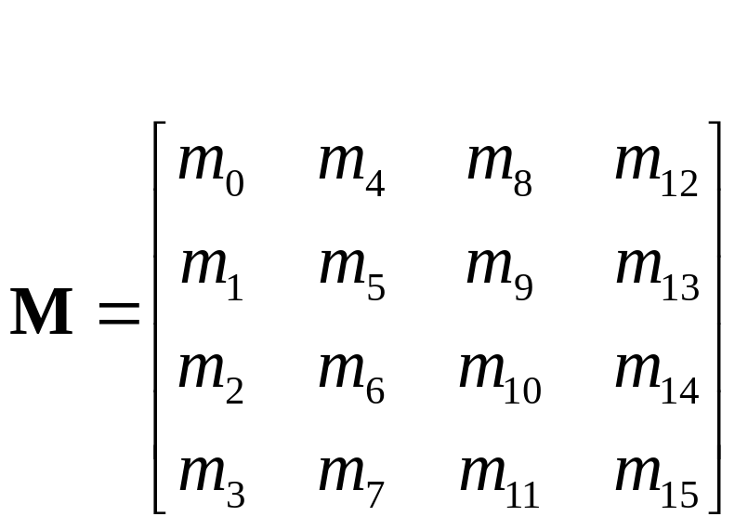
Transformations
Un sommet est transformé par une matrice 4 x 4
  Toutes les applications affines sont des multiplications de matrices
  Les matrices sont stockées comme des colonnes de vecteurs
Notes:
Perspective projection and translation require 4th row and column, or operations would require addition, as well as multiplication.
For operations other than perspective projection, the fourth row is always
(0, 0, 0, 1) which leaves w unchanged..
Because OpenGL only multiplies a matrix on the right, the programmer must remember that the last matrix specified is the first applied.

Slide 35
Transformations
Spécification des transformations
  Matrices
    glLoadMatrix
    glMultMatrix
  Opérations
    Translation
  glTranslate{fd}( x, y, z )
    Rotation
  glRotate{fd}( angle, x, y, z )
      Angle en degrés
      Axe de rotation (x,y,z)
    Mise à l’échelle
  glScale{fd}( x, y, z )
Notes:
Generally, a programmer can obtain the desired matrix by a sequence of simple transformations that can be concatenated together, e.g. glRotate(), glTranslate(), and glScale().
For the basic viewing transformations, OpenGL and the Utility library have supporting functions.

Slide 36
Transformations
État et piles de matrices
  glMatrixMode( GL_MODELVIEW or GL_PROJECTION )
Autres opérations
  glLoadIdentity()
  glPushMatrix()
  glPopMatrix()
Viewport
  Habituellement même taille que la fenêtre
  glViewport( x, y, width, height )
Notes:
glLoadMatrix*() replaces the matrix on the top of the current matrix stack. glMultMatrix*(), post-multiples the matrix on the top of the current matrix stack. The matrix argument is a column-major 4 x 4 double or single precision floating point matrix.
Matrix stacks are used because it is more efficient to save and restore matrices than to calculate and multiply new matrices. Popping a matrix stack can be said to “jump back” to a previous location or orientation.
glViewport() clips the vertex or raster position. For geometric primitives, a new vertex may be created. For raster primitives, the raster position is completely clipped.
There is a per-fragment operation, the scissor test, which works in situations where viewport clipping doesn’t. The scissor operation is particularly good for fine clipping raster (bitmap or image) primitives.

Slide 37
Transformations
Projection Perspective
  gluPerspective( fovy, aspect, zNear, zFar )
  glFrustum( left, right, bottom, top, zNear, zFar )
Projection parallèle
  glOrtho( left, right, bottom, top, zNear, zFar )
  gluOrtho2D( left, right, bottom, top )
Notes:
For perspective projections, the viewing volume is shaped like a truncated pyramid (frustum). There is a distinct camera (eye) position, and vertexes of objects are “projected” to camera. Objects which are further from the camera appear smaller. The default camera position at (0, 0, 0), looks down the z-axis, although the camera can be moved by other transformations.
For gluPerspective(), fovy is the angle of field of view (in degrees) in the y direction. fovy must be between 0.0 and 180.0, exclusive. aspect is x/y and should be same as the viewport to avoid distortion. zNear and zFar define the distance to the near and far clipping planes.
glFrustum() is rarely used.
Warning: for gluPerspective() or glFrustum(), don’t use zero
for zNear!
For glOrtho(), the viewing volume is shaped like a rectangular parallelepiped (a box). Vertexes of an object are “projected” towards infinity. Distance does not change the apparent size of an object. Orthographic projection is used for drafting and design (such as blueprints).

Slide 38

Transformations
d
x
x’
z
Centre de
projection
Plan de
projection

Slide 39
Transformations
Exemple de projection parallèle
  glMatrixMode( GL_PROJECTION );
  glLoadIdentity();
  glOrtho( left, right, bottom, top, zNear, zFar );
Notes:
Many users would follow the demonstrated sequence of commands with a glMatrixMode(GL_MODELVIEW) call to return to modelview stack.
In this example, the red line segment is inside the view volume and is projected (with parallel projectors) to the green line on the view surface. The blue line segment lies outside the volume specified by glOrtho() and is clipped.

Slide 40
Transformations
Positionner de la camera
gluLookAt( eye_{x}, eye_{y}, eye_{z},
aim_{x}, aim_{y}, aim_{z},
up_{x}, up_{y}, up_{z} )
  up = verticale
caméra
Notes:
gluLookAt() multiplies itself onto the current matrix, so it usually comes after glMatrixMode(GL_MODELVIEW) and glLoadIdentity().
Because of degenerate positions, gluLookAt() is not recommended for most animated fly-over applications.
An alternative is to specify a sequence of rotations and translations that are concatenated with an initial identity matrix.
Note: that the name modelview matrix is appropriate since moving objects in the model front of the camera is equivalent to moving the camera to view a set of objects.

Slide 41
Transformations
Exemple modifier le centre de rotation
  On se place au centre de rotation
  On tourne
  On revient
  glTranslatef(x,y,z);
  glRotatef(theta, ax, ay, az);
  glTranslatef(-x,-y,-z);
  object();
Notes:
You’ll adjust to reading a lot of code backwards!
Typical sequence
glTranslatef(x,y,z);
glRotatef(theta, ax, ay, az);
glTranslatef(-x,-y,-z);
object();
Here (x, y, z) is the fixed point. We first (last transformation in code) move it to the origin. Then we rotate about the axis (ax, ay, az) and finally move fixed point back.

Slide 42
Rendu

Slide 43
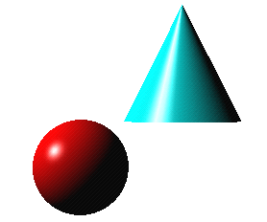
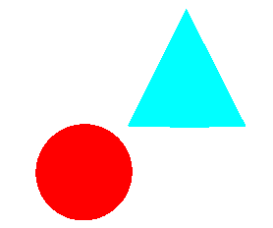
Rendu
Calcul de l’interaction
  Lumière (Lampes)
    Couleur
    Position
  Matériau de l’objet
    Couleur
    Diffusion, spéculaire
Modèle de Phong
  Calcul au sommet et interpolations des couleurs
    Interpolation de Gouraud
Notes:
Lighting is an important technique in computer graphics. Without lighting, objects tend to look like they’re made out of plastic.
OpenGL divides lighting into three parts: material properties, light properties and global lighting parameters.
Lighting is available in both RGBA mode and color index mode. RGBA is more flexible and less restrictive than color index mode lighting.

Slide 44
Rendu
I_{d} = K_{d} . I_{obj} . I_{source} . cos (N, L) / d²
source
lumineuse
observateur
N
R
L
V
P

Slide 45
Rendu
I_{s} = K_{s} . F_{obj} . I_{source} . cos^{n} (R, V) / d²
source
lumineuse
observateur
N
R
L
V
P

Slide 46
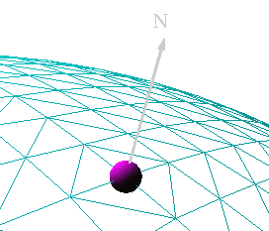
Rendu
Normales par sommet
glNormal3f( x, y, z )
  Normaliser les normales
    Meilleur Rendu
    glEnable( GL_NORMALIZE )
    or
    glEnable( GL_RESCALE_NORMAL )
Notes:
The lighting normal tells OpenGL how the object reflects light around a vertex. If you imagine that there is a small mirror at the vertex, the lighting normal describes how the mirror is oriented, and consequently how light is reflected.
glNormal*() sets the current normal, which is used in the lighting computation for all vertices until a new normal is provided.
Lighting normals should be normalized to unit length for correct lighting results. glScale*() affects normals as well as vertices, which can change the normal’s length, and cause it to no longer be normalized. OpenGL can automatically normalize normals, by enabling glEnable(GL_NORMALIZE). or glEnable(GL_RESCALE_NORMAL). GL_RESCALE_NORMAL is a special mode for when your normals are uniformly scaled. If not, use GL_NORMALIZE which handles all normalization situations, but requires the computation of a square root, which can potentially lower performance
OpenGL evaluators and NURBS can provide lighting normals for generated vertices automatically.

Slide 47
Rendu
Description des matériaux
  Couleurs
    Ambient,Diffuse, Specular, Émission
  Définition des matériaux
glMaterialfv( face, property, value );
GL_DIFFUSE
Base color
GL_SPECULAR
Highlight Color
GL_AMBIENT
Low-light Color
GL_EMISSION
Glow Color
GL_SHININESS
Surface Smoothness
Notes:
OpenGL lighting is based on the Phong lighting model. At each vertex in the primitive, a color is computed using that primitives material properties along with the light settings.
The color for the vertex is computed by adding four computed colors for the final vertex color. The four contributors to the vertex color are:
Ambient is color of the object from all the undirected light in a scene.
Diffuse is the base color of the object under current lighting. There must be a light shining on the object to get a diffuse contribution.
Specular is the contribution of the shiny highlights on the object.
Emission is the contribution added in if the object emits light (i.e. glows)

Slide 48
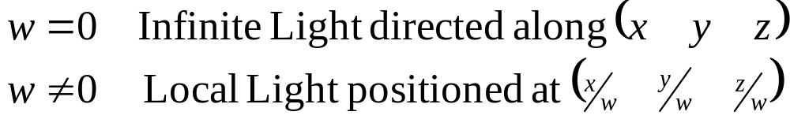
Rendu
OpenGL supporte deux types de lampes
  Locale (Point)
  À l’infinie (Directional)
En fonction de la coordonnée w
Notes:
OpenGL supports two types of lights: infinite (directional) and local (point) light sources. The type of light is determined by the w coordinate of the light’s position.
A light’s position is transformed by the current ModelView matrix when it is specified. As such, you can achieve different effects by when you specify the position.

Slide 49
Rendu
Contrôle des lampes
  individuel
  glEnable( GL_LIGHTn );
  global
  glEnable( GL_LIGHTING );
Notes:
Each OpenGL light is controllable separately, using glEnable() and the respective light constant GL_LIGHTn. Additionally, global control over whether lighting will be used to compute primitive colors is controlled by passing GL_LIGHTING to glEnable(). This provides a handy way to enable and disable lighting without turning on or off all of the separate components.

Slide 50
Rendu
Spécifier les paramètres des Lampes
  glLightfv( light, property, value );
  light définit quelle lampe
    Lampes multiples GL_LIGHT0, GL_LIGHTn
    glGetIntegerv( GL_MAX_LIGHTS, n );
    n du type java.nio.IntBuffer
  properties
    couleur
    position et type
    atténuation
Notes:
The glLight() call is used to set the parameters for a light. OpenGL implementations must support at least eight lights, which are named GL_LIGHT0 through GL_LIGHTn, where n is one less than the maximum number supported by an implementation.
OpenGL lights have a number of characteristics which can be changed from their default values. Color properties allow separate interactions with the different material properties. Position properties control the location and type of the light and attenuation controls the natural tendency of light to decay over distance.

Slide 51
Rendu
Les paramètres des lampes
  GL_AMBIENT
  GL_DIFFUSE
  GL_SPECULAR
  couleurs différentes pour chaque caractéristique des matériaux
Les Spotlights
  Spécification du cône
    GL_SPOT_DIRECTION
    GL_SPOT_CUTOFF
    GL_SPOT_EXPONENT
Notes:
OpenGL lights can emit different colors for each of a materials properties. For example, a light’s GL_AMBIENT color is combined with a material’s GL_AMBIENT color to produce the ambient contribution to the color - Likewise for the diffuse and specular colors.

Slide 52
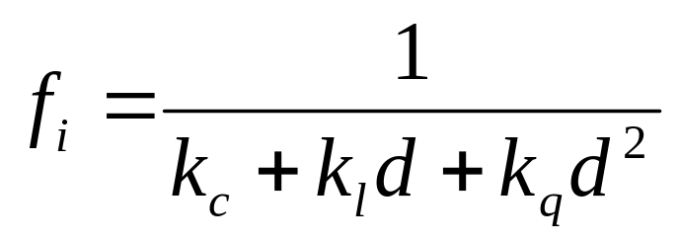
Rendu
Paramètre des Lampes
  Atténuation en fonction de la distance
    GL_CONSTANT_ATTENUATION
    GL_LINEAR_ATTENUATION
    GL_QUADRATIC_ATTENUATION
Notes:
Each OpenGL light source supports attenuation, which describes how light diminishes with distance. The OpenGL model supports quadratic attenuation, and utilizes the following attenuation factor, f_{i}, where d is the distance from the eyepoint to the vertex being lit:
where:
k_{c} is the GL_CONSTANT_ATTENUATION term
k_{l} is the GL_LINEAR_ATTENUATION term
k_{q} is the GL_QUADRATIC_ATTENUATION term

Slide 53
Textures

Slide 54
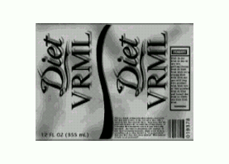
Texture
Plaquage de textures
  Plaquer une image sur une surface
  Une texture est rectangulaire
    elle a son propre système de coordonnées
y
D
v
(0,1)
(1,1)
A
P
C
B
(0,0)
(1,0)
espace
x
espace texture
u

Slide 55
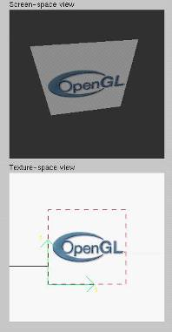
Textures
Application d’images 1D, 2D ou 3D à une primitive géométrique
Utilisation des textures
  « Simulation » des matériaux
  Réduire la complexité géométrique
  Déformation d’images
  « Simulation » réflexions
Notes:
In this section, we’ll discuss texture ( sometimes also called image ) mapping. Texture mapping augments the colors specified for a geometric primitive with the colors stored in an image. An image can be a 1D, 2D, or 3D set of colors called texels. 2D textures will be used throughout the section for demonstrations, however, the processes described are identical for 1D and 3D textures.
Some of the many uses of texture mapping include:
simulating materials like wood, bricks or granite
reducing the complexity ( number of polygons ) of a geometric object
image processing techniques like image warping and rectification,
rotation and scaling
simulating reflective surfaces like mirrors or polished floors

Slide 56
Textures
3 étapes
  Spécifier la texture
    lire ou calculer l’image
    Assigner l’image comme texture
    Autoriser les textures
  Assigner des coordonnées textures aux sommets
  Définir le mode de placage
    wrapping, filtre
Notes:
In the simplest approach, we must perform these three steps.
Textures reside in texture memory. When we assign an image to a texture it is copied from processor memory to texture memory where pixels are formatted differently.
Texture coordinates are actually part of the state as are other vertex attributes such as color and normals. As with colors, OpenGL interpolates texture inside geometric objects.
Because textures are really discrete and of limited extent, texture mapping is subject to aliasing errors that can be controlled through filtering.
Texture memory is a limited resource and having only a single active texture can lead to inefficient code.

Slide 57
Textures
  Spécifier les objets textures
  Définir le mode de filtrage
  Définir la fonction de composition
  Définir le mode de wrapping
  Définir des paramètres de corrections
  Lier l’objet texture
  Autoriser les textures
  Donner les coordonnées de textures aux sommets
    Ou générer les coordonnées de textures
Notes:
The general steps to enable texturing are listed above. Some steps are optional, and due to the number of combinations, complete coverage of the topic is outside the scope of this course.
Here we use the texture object approach. Using texture objects may enable your OpenGL implementation to make some optimizations behind the scenes.
As with any other OpenGL state, texture mapping requires that glEnable() be called. The tokens for texturing are:
GL_TEXTURE_1D - one dimensional texturing
GL_TEXTURE_2D - two dimensional texturing
GL_TEXTURE_3D - three dimensional texturing
2D texturing is the most commonly used. 1D texturing is useful for applying contours to objects ( like altitude contours to mountains ). 3D texturing is useful for volume rendering.

Slide 58
Textures
Liste interne de textures référencées par des indices de textures
Créer les indices de textures
  glGenTextures( n, texIds );
  texIds du type java.nio.IntBuffer
Notes:
The first step in creating texture objects is to have OpenGL reserve some indices for your objects. glGenTextures() will request n texture ids and return those values back to you in texIds.
To begin defining a texture object, you call glBindTexture() with the id of the object you want to create. The target is one of GL_TEXTURE_{123}D(). All texturing calls become part of the object until the next glBindTexture() is called.
To have OpenGL use a particular texture object, call glBindTexture() with the target and id of the object you want to be active.
To delete texture objects, use glDeleteTextures( n, *texIds ), where texIds is an array of texture object identifiers to be deleted.

Slide 59
Textures
Création de l’objet texture
  GL_TEXTURE_1D
  GL_TEXTURE_2D
  GL_TEXTURE_3D
  glBindTexture( target, id );
Rendre actif l’objet texture
  glBindTexture( target, id );

Slide 60
Textures
Définir la texture à partir d’un tableau de pixels (texels)
  glTexImage2D(
  target, level, components, w, h, border, format, type, texels
  );
  texels du type java.nio.Buffer
  Les dimensions sont des puissances de 2
Les texels traversent le pipeline et peuvent être modifiés
Notes:
Specifying the texels for a texture is done using the glTexImage{123}D() call. This will transfer the texels in CPU memory to OpenGL, where they will be processed and converted into an internal format.
The array of texels sent to OpenGL with glTexImage*() must be a power of two in both directions. An optional one texel wide border may be added around the image. This is useful for certain wrapping modes.
The level parameter is used for defining how OpenGL should use this image when mapping texels to pixels. Generally, you’ll set the level to 0, unless you’re using a texturing technique called mipmapping, which we’ll discuss in a few slides.

Slide 61
Textures
Plaquage de la texture sur une face
  A partir des coordonnées paramétriques
  glTexCoord*() pour chaque sommet
Texture Space
Object Space
t
1, 1
(s, t) = (0.2, 0.8)
0, 1
A
a
c
(0.4, 0.2)
b
B
C
0, 0
1, 0
s
(0.8, 0.4)
Notes:
When you want to map a texture onto a geometric primitive, you need to provide texture coordinates. The glTexCoord*() call sets the current texture coordinates. Valid texture coordinates are between 0 and 1, for each texture dimension, and the default texture coordinate is ( 0, 0, 0, 1 ). If you pass fewer texture coordinates than the currently active texture mode ( for example, using glTexCoord1d() while GL_TEXTURE_2D is enabled ), the additionally required texture coordinates take on default values.

Slide 62
Textures
Génération automatique des coordonnées de textures
  glTexGen{ifd}[v]()
Modes de génération
  GL_OBJECT_LINEAR
  GL_EYE_LINEAR
  GL_SPHERE_MAP
Notes:
You can have OpenGL automatically generate texture coordinates for vertices by using the glTexGen() and glEnable(GL_TEXTURE_GEN_{STRQ}). The coordinates are computed by determining the vertex’s distance from each of the enabled generation planes.
As with lighting positions, texture generation planes are transformed by the ModelView matrix, which allows different results based upon when the glTexGen() is issued.
There are three ways in which texture coordinates are generated:
GL_OBJECT_LINEAR - textures are fixed to the object ( like wall paper )
GL_EYE_LINEAR - texture fixed in space, and object move through
texture ( like underwater light shining on a swimming fish)
GL_SPHERE_MAP - object reflects environment, as if it were made of
mirrors (like the shiny guy in Terminator 2)

Slide 63
Textures
Modes de filtrage
  « minification » ou « magnification »
Mode de « Wrap »
  clamping
  repeating
Fonction de composition
  Entre la couleur de l’objet et la textures
    Modulation, remplacement, etc.
Notes:
Textures and the objects being textured are rarely the same size ( in pixels ). Filter modes determine the methods used by how texels should be expanded
( magnification ), or shrunk ( minification ) to match a pixel’s size. An additional technique, called mipmapping is a special instance of a minification filter.
Wrap modes determine how to process texture coordinates outside of the [0,1] range. The available modes are:
GL_CLAMP - clamp any values outside the range to closest valid value,
causing the edges of the texture to be “smeared” across the primitive
GL_REPEAT - use only the fractional part of the texture coordinate, causing
the texture to repeat across an object
Finally, the texture environment describes how a primitives fragment colors and texel colors should be combined to produce the final framebuffer color. Depending upon the type of texture ( i.e. intensity texture vs. RGBA texture ) and the mode, pixels and texels may be simply multiplied, linearly combined, or the texel may replace the fragment’s color altogether.

Slide 64
Textures
Mode de filtrage
glTexParameteri( target, type, mode );
Texture
Polygon
Texture
Polygon
Magnification
Minification
Notes:
Filter modes control how pixels are minified or magnified. Generally a color is computed using the nearest texel or by a linear average of several texels.
The filter type, above is one of GL_TEXTURE_MIN_FILTER or GL_TEXTURE_MAG_FILTER.
The mode is one of GL_NEAREST, GL_LINEAR, or special modes for mipmapping. Mipmapping modes are used for minification only, and have values of:
GL_NEAREST_MIPMAP_NEAREST
GL_NEAREST_MIPMAP_LINEAR
GL_LINEAR_MIPMAP_NEAREST
GL_LINEAR_MIPMAP_LINEAR
Full coverage of mipmap texture filters is outside the scope of this course.

Slide 65
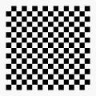
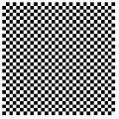

Textures
Wrapping
  glTexParameteri( GL_TEXTURE_2D,
  GL_TEXTURE_WRAP_S, GL_CLAMP )
  glTexParameteri( GL_TEXTURE_2D,
  GL_TEXTURE_WRAP_T, GL_REPEAT )
t
s
GL_REPEAT
wrapping
GL_CLAMP
wrapping
texture
Notes:
Wrap mode determines what should happen if a texture coordinate lies outside of the [0,1] range. If the GL_REPEAT wrap mode is used, for texture coordinate values less than zero or greater than one, the integer is ignored and only the fractional value is used.
If the GL_CLAMP wrap mode is used, the texture value at the extreme (either 0 or 1) is used.

Slide 66
Textures
Contrôle de la composition entre la couleur du texel et la couleur de l’objet
glTexEnv{fi}[v]( GL_TEXTURE_ENV, prop, param )
GL_TEXTURE_ENV_MODE
  GL_MODULATE
  GL_BLEND
  GL_REPLACE
Définir la couleur de fondu GL_TEXTURE_ENV_COLOR
Notes:
The texture mode determines how texels and fragment colors are combined. The most common modes are:
GL_MODULATE - multiply texel and fragment color
GL_BLEND - linearly blend texel, fragment, env color
GL_REPLACE - replace fragment’s color with texel
If prop is GL_TEXTURE_ENV_COLOR, param is an array of four floating point values representing the color to be used with the GL_BLEND texture function.

Slide 67
Textures
Les interpolation des coordonnées de textures
  Linéaire dans l’espace écran
  Prise en compte de la perspective
glHint( GL_PERSPECTIVE_CORRECTION_HINT, hint )
  hint
    GL_DONT_CARE
    GL_NICEST
    GL_FASTEST
Notes:
An OpenGL implementation may chose to ignore hints.

Slide 68
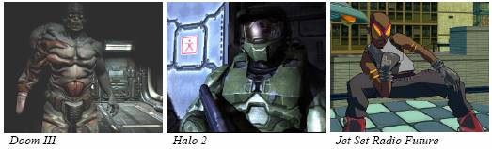
GLSL

Slide 69
GLSL
Cartes graphiques
  Pipeline 3D programmables
Programmes de « shading »
  Changement du comportement par défaut de la carte
Deux types de « shaders »
  Transform and lighting
    vertex shaders / vertex programs
  Fragment processing
    pixel shaders / fragment programs

Slide 70
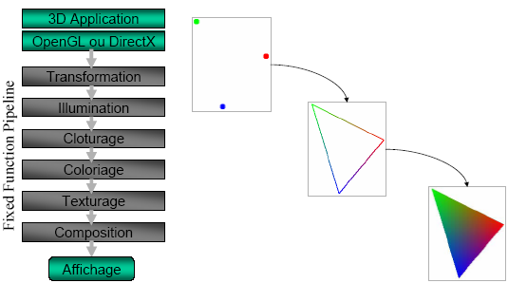
GLSL
Premières cartes « 3d »

Slide 71
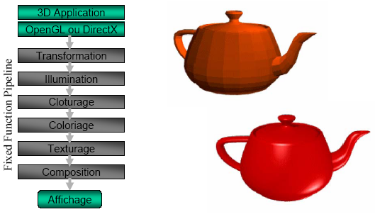
GLSL
Dernières cartes 3d

Slide 72
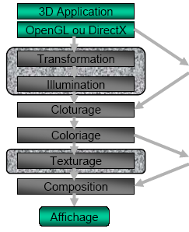
GLSL
Vertex Shader
  Opère sur chaque sommet
    Bruit, vagues
    Réflexion diffuse et spéculaire
Pixel Shader
  Opère sur chaque pixel
    Texturing
    Fog
    Flou

Slide 73
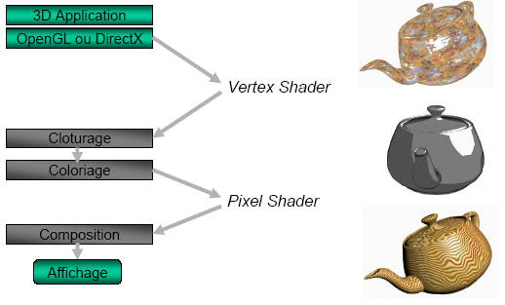
GLSL

Slide 74
GLSL
Spécification les vertex et pixel shaders
  Langages bas-niveau (assembleur)
  Langages « haut-niveau » (comme du C)
Données échangées
  Per-vertex data
    Informations uniformes
      Modelview matrix, etc.
  Per-fragment data
    Informations uniformes
      material parameters, etc.

Slide 75
GLSL
Renderman (Pixar)
  la référence issue du scanline
Cg
  “C for Graphics”
  De NVIDIA
HLSL
  “High-level shading language”
  DirectX 9 (Microsoft)
OpenGL 2.0 Shading Language
  Proposé par 3D Labs

Slide 76
GLSL
Syntaxes proches
  Cg, DirectX HLSL et GLSL
Syntaxe
  Création de type
  Opérateurs, fonctions C/C++
  Présence de conditionnelles

Slide 77
GLSL
Le langage
  Types
  Entrées
  Sorties
  Allure d’un programme
  Exemple: Phong
  Lien avec le programme

Slide 78
GLSL : Types (1/2)
Flottants, entiers, booléens
  float, bool, int
Vecteurs 2,3,4
  [i,b]vec{2,3,4}
    Float : vec2, vec3, vec4
    Int : ivec2, ivec3, ivec4
    Bool : bvec2, bvec3,bvec4
    Accès avec (équivalents, juste pour la lisibilité)
      .x, .y, .z, .w ou .r, .g, .b, .a ou .s, .t, .p, .q

Slide 79
GLSL : Types (2/2)
Matrices de float 2x2, 3x3, 4x4
  mat{2,3,4}
    mat4 m; vec4 v=m[0]; float f=m[0][0];
Accesseurs de textures
  sampler{1,2,3}D, samplerCube
Structures
Tableaux

Slide 80
GLSL : Entrées (1/2)
Built-in : tous les états d’OpenGL, passés par OpenGL
  Position, couleurs, directions des lumières
  Textures
  Matrices
Attribute : passés par le programme OpenGL
  Peuvent varier pour chaque sommet
    comme couleurs, texcoords, normales, …

Slide 81
GLSL : Entrées (2/2)
Uniform
  passés par le programme OpenGL
  Ne varie pas entre glBegin/glEnd
    comme matrices, textures, lumières, …
Varying
  fixés sur les sommets par le vertex shader, interpolés sur les pixels, lus par le pixel shader
Constant

Slide 82
GLSL : Entrées built-in
Vertex shader
  Position
    gl_Vertex
  Couleurs
    gl_Color, gl_SecondaryColor
  Normale
    gl_Normal
  Coordonnées de textures
    gl_MultiTexCoord

Slide 83
GLSL : Entrées built-in
Fragment shader
  gl_FragCoord
    coordonnées du pixel dans la fenêtre
  gl_Color
    couleur du pixel interpolée
  gl_TexCoord[]
    coordonnées de textures interpolées
  gl_FrontFacing
    face ou dos du triangle

Slide 84
GLSL : Sorties
Vertex shader
  gl_Position
    position du sommet en coordonnées homogènes (obligatoire)
  gl_PointSize
    taille d’un point en rendu par point
  gl_FrontColor, gl_BackColor
    couleurs
  gl_TexCoord[]
    coordonnées de textures

Slide 85
GLSL : Sorties
Fragment Shader
  gl_FragColor
    couleur du pixel (obligatoire)
  gl_FragDepth
    profondeur du pixel

Slide 86
GLSL : fonctions built-in
Trigonométrie
  sin, cos, tan, asin, acos, atan, …
Exponentiation
  exp, pow, log, exp2, log2, sqrt, inversesqrt, …
Arithmétiques
  abs, sign, floor, ceil, fract, mod, min, max, clamp, mix, step, smoothstep

Slide 87
GLSL : fonctions built-in
Géométriques
  length, distance, dot, cross, normalize, reflect, refract
Accès aux textures
  texture1D, texture2D, texture3D, textureCube, shadow, …

Slide 88
GLSL : fonctions built-in
Structures de contrôle
  if, if-else
  for, while, do-while
  return, break, discard
Fonctions
  Paramètres qualifiés : in, out, inout, par défaut : in.
    void calcu_coord(in vec3 pos, out coord)
Programme principale
  void main()

Slide 89
GLSL : qualifiers
Attribute : Change typiquement pour chaque sommet
  Uniquement dans Vertex Shader
  Read Only
  Seulement float, vecX et matX (pas d’int ni de bool)
Uniform : Change au plus à chaque primitive
  Communes au Vertex et Fragment Shader
  Read Only
Varying : Communication entre Vertex et Fragment Shader
  Read, Write dans Vertex Shader
  Read Only dans Fragment Shader
Const : Constantes locale à un Shader
  Read Only
Sans qualifieur : Variables locales à un Shader (une seule exécution)
  Read, Write

Slide 90
GLSL : Allure d’un programme
uniform vec4 Bidule; // entrée
vec4 UneFonction( vec4 Entree ) // une fonction
{
return Entree.zxyw;
}
void main() // point d’entrée du shader
{
vec4 pos = gl_ModelViewProjectionMatrix * gl_Vertex;
// sortie
gl_Position = pos + UneFonction( Bidule );
}

Slide 91
GLSL : Blinn-Phong material vertex shader
// Blinn-Phong material vertex shader
uniform vec3 lightPos;
varying vec3 vLightDir;
varying vec3 vViewDir;
varying vec3 vNormal;
varying vec2 vTexCoord0;

Slide 92
GLSL : Blinn-Phong material vertex shader
void main(void)
{
// Compute the vertex position (view space)
vec4 vertexPos = gl_ModelViewMatrix * gl_Vertex;
// Output vertex position (homogeneous space)
gl_Position = gl_ProjectionMatrix * vertexPos;
// Outputs (view space)
vLightDir = normalize(lightPos - vertexPos.xyz);
vViewDir = normalize(-vertexPos.xyz);
vNormal = gl_NormalMatrix * gl_Normal;
// Output texture coordinates
vTexCoord0 = gl_MultiTexCoord0.st;
}

Slide 93
GLSL : Blinn-Phong material fragment shader
// Blinn-Phong material fragment shader
uniform sampler2D baseMap;
uniform vec4 ambient;
uniform vec4 diffuse;
uniform vec4 specular;
uniform float shininess;
varying vec3 vLightDir;
varying vec3 vViewDir;
varying vec3 vNormal;
varying vec2 vTexCoord0;

Slide 94
GLSL : Blinn-Phong material fragment shader
void main(void)
{
// Normalize inputs
vec3 viewDir = normalize(vViewDir);
vec3 lightDir = normalize(vLightDir);
vec3 normal = normalize(vNormal);
// Get the texture base color
vec4 baseColor = texture2D(baseMap, vTexCoord0);
// Compute diffuse color
float NdotL = dot(normal, lightDir);
vec4 totalDiffuse = max(0.0f, NdotL) * diffuse;

Slide 95
GLSL : Blinn-Phong material fragment shader
// Compute specular color
vec3 halfDir = normalize((lightDir+viewDir)/2.0f);
float NdotH = dot(normal, halfDir);
vec4 totalSpecular = pow(max(0.0f, NdotH), shininess) * specular;
// Combine ambient, diffuse, specular and base color
gl_FragColor = (ambient + totalDiffuse) * baseColor + totalSpecular;
}

Slide 96
GLSL : Lien avec le programme
int v = gl.glCreateShader(GL.GL_VERTEX_SHADER);
int f = gl.glCreateShader(GL.GL_FRAGMENT_SHADER);
BufferedReader brv = new BufferedReader(new FileReader("vertexshader.glsl"));
String vsrc = "";
String line;
while ((line=brv.readLine()) != null) {vsrc += line + "\n";}
gl.glShaderSource(v, 1, vsrc, (int[])null); gl.glCompileShader(v);

Slide 97
GLSL : Lien avec le programme
BufferedReader brf = new BufferedReader(new FileReader("fragmentshader.glsl"));
String fsrc = "";
String line;
while ((line=brf.readLine()) != null) { fsrc += line + "\n"; }
gl.glShaderSource(f, 1, fsrc, (int[])null); gl.glCompileShader(f);

Slide 98
GLSL : Lien avec le programme
int shaderprogram = gl.glCreateProgram();
gl.glAttachShader(shaderprogram, v);
gl.glAttachShader(shaderprogram, f);
gl.glLinkProgram(shaderprogram);
gl.glValidateProgram(shaderprogram);
gl.glUseProgram(shaderprogram);

Slide 99

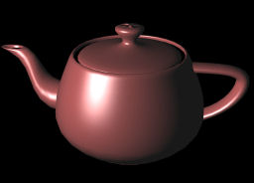
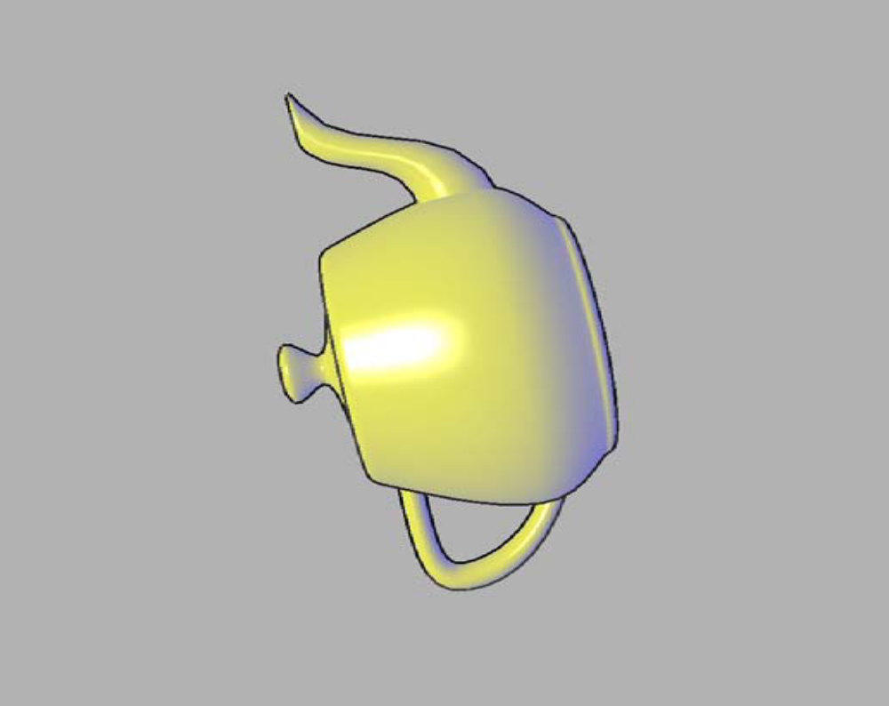


Slide 100
