Slide 1
Module 7-1: MPLS
Performance Measurements of MPLS Traffic Engineering and QoS
Enterprise Networking, Security, and Automation v7.0 (ENSA)
Notes:
Cisco Networking Academy Program
Enterprise Networking, Security, and Automation v7.0 (ENSA)
Module 9: QoS Concepts

Slide 2
Performance Measurements of MPLS Traffic and QoS

Slide 3
Multiprotocol Label Switching
Traditional IP Routing
Disadvantages
Need for MPLS
MPLS basics and terminologies
Experiments

Slide 4
Traditional IP Routing
Choosing the next hop
  Open Shortest Path First (OSPF) to populate the routing table
  Route look up based on the IP address
  Find the next router to which the packet has to be sent
  Replace the layer 2 address
Each router performs these steps

Slide 5



Traditional IP Routing (contd)

Slide 6

Distributing Routing Information
Address
Prefix
Path
Address
Prefix
Path
Address
Prefix
Path
125.50
2
125.50
3
125.50
0
145.40
3
145.40
1
125.50
0
2
3
You can reach 125.50
through me
You can reach 125.50 and
145.40 through me
1
You can reach 145.40
through me
145.40

Slide 7
Distributing Routing Information(contd)
Address
Prefix
Path
Address
Prefix
Path
Address
Prefix
Path
125.50
2
125.50
3
125.50
0
145.40
3
145.40
1
125.50
0
2
3
Data 125.50.33.85
Data 125.50.33.85
1
145.40

Slide 8
Disadvantages
Header analysis performed at each hop
Increased demand on routers
Utilizes the best available path
Some congested links and some underutilized links!
  Degradation of throughput
  Long delays
  More losses
No QoS
  No service differentiation
  Not possible with connectionless protocols
Notes:
How to explain the first point?

Slide 9
Need for MPLS
Rapid growth of Internet
New latency dependent applications
Quality of Service (QoS)
  Less time at the routers
Traffic Engineering
  Flexibility in routing packets
Connection-oriented forwarding techniques with connectionless IP
  Utilizes the IP header information to maintain interoperability with IP based networks
  Decides on the path of a packet before sending it

Slide 10
What is MPLS?
Multi Protocol – supports protocols even other than IP
  Supports IPv4, IPv6, IPX, AppleTalk at the network layer
  Supports Ethernet, Token Ring, FDDI, ATM, Frame Relay, PPP at the link layer
Label – short fixed length identifier to determine a route
  Labels are added to the top of the IP packet
  Labels are assigned when the packet enters the MPLS domain
Switching – forwarding a packet
  Packets are forwarded based on the label value
  NOT on the basis of IP header information

Slide 11
MPLS Background
Integration of layer 2 and layer 3
  Simplified connection-oriented forwarding of layer 2
  Flexibility and scalability of layer 3 routing
MPLS does not replace IP; it supplements IP
Traffic can be marked, classified and explicitly routed
QoS can be achieved through MPLS

Slide 12
IP/MPLS comparison
Routing decisions
  IP routing – based on destination IP address
  Label switching – based on labels
Entire IP header analysis
  IP routing – performed at each hop of the packets path in the network
  Label switching – performed only at the ingress router
Support for unicast and multicast data
  IP routing – requires special multicast routing and forwarding algorithms
  Label switching – requires only one forwarding algorithm

Slide 13
Key Acronyms
MPLS – MultiProtocol Label Switching
FEC – Forward Equivalence Class
LER – Label Edge Router
LSR – Label Switching Router
LIB – Label Information Base
LSP – Label Switched Path
LDP – Label Distribution Protocol

Slide 14
Forwarding Equivalence Class (FEC)
A group of packets that require the same forwarding treatment across the same path
Packets are grouped based on any of the following
  Address prefix
  Host address
  Quality of Service (QoS)
FEC is encoded as the label

Slide 15
FEC example
Assume packets have the destination address as
124.48.45.20
143.67.25.77
143.67.84.22
124.48.66.90
FEC –1 label x FEC – 2 label y
143.67.25.77 124.48.45.20
143.67.84.22 124.48.66.90

Slide 16
FEC example (contd)
- Assume packets have the destination address and QoS requirements as
124.48.45.20 qos = 1
143.67.25.77 qos = 1
143.67.84.22 qos = 3
124.48.66.90 qos = 4
143.67.12.01 qos = 3
FEC –1 label a FEC – 2 label b FEC – 3 label c FEC – 4 label d
143.67.25.77 124.48.45.20 143.67.84.22 124.48.66.90
143.67.12.01

Slide 17
Label Edge Router (LER)
Can be an ATM switch or a router
Ingress LER performs the following:
  Receives the packet
  Adds label
  Forwards the packet into the MPLS domain
Egress LER removes the label and delivers the packet

Slide 18

LER

Slide 19
Label Switching Router (LSR)
A router/switch that supports MPLS
Can be a router
Can be an ATM switch + label switch controller
Label swapping
  Each LSR examines the label on top of the stack
  Uses the Label Information Base (LIB) to decide the outgoing path and the outgoing label
  Removes the old label and attaches the new label
  Forwards the packet on the predetermined path

Slide 20
Label Switching Router (contd)
Upstream Router (Ru) – router that sends packets
Downstream Router(Rd) – router that receives packets
  Need not be an end router
  Rd for one link can be the Ru for the other
  Ru Rd Ru Rd

Slide 21
LSR

Slide 22
Label Switched Path(LSP)
LSP defines the path through LSRs from ingress to egress router
FEC is determined at the LER-ingress
LSPs are unidirectional
LSP might deviate from the IGP shortest path

Slide 23
LSP
LSP

Slide 24
Label
A short, fixed length identifier (32 bits)
Sent with each packet
Local between two routers
Can have different labels if entering from different routers
One label for one FEC
Decided by the downstream router
  LSR binds a label to an FEC
  It then informs the upstream LSR of the binding

Slide 25
Label (contd)
ATM
  VCI/VPI field of ATM header
Frame Relay
  DLCI field of FR header
PPP/LAN
  ‘shim’ header inserted between layer 2 and layer 3

Slide 26
Label (contd)
PPP Header
LAN MAC Header
ATM Cell Header
Layer 3 Header PPP Header
Label
Layer 3 Header MAC Header
Label
DATA HEC CLP PTI VCI VPI GFC
Label

Slide 27
Shim Header
31 23 22 19 0
Label = 20 bits
EXP = Experimental bits, 3 bits
S = Bottom of stack, 1 bit
TTL = Time To Live, 8 bits
Layer 3 Header PPP Header
TTL S EXP Label

Slide 28
Shim Header (contd)
EXP field
  Also known as Class of Service (CoS) bits
  Used for experimentation to indicate packet’s treatment
  Queuing as well as scheduling
  Different packets can receive different treatment depending on the CoS value
S bit
  Supports hierarchical label stack
  1 – if the label is the bottom most label in the label stack
  0 – for all other labels

Slide 29
Time To Live (TTL)
TTL value decremented by 1 when it passes through an LSR
If TTL value = 0 before the destination, discard the packet
Avoids loops may exist because of some misconfigurations
Multicast scoping – limit the scope of a packet
Supporting the traceroute command

Slide 30
TTL (contd)
Shim header
  Has an explicit TTL field
  Initially loaded from the IP header TTL field
  At the egress LER, value of TTL is copied into the TTL field of the IP header
Data link layer header (e.g VPI/VCI)
  No explicit TTL field
  Ingress LER estimates the LSP length
  Decrements the TTL count by the LSP length
  If initial count of TTL less than the LSP length, discard the packet

Slide 31
Label stack
MPLS supports hierarchy
A packet can carry a number of labels
Each LSR processes the topmost label
  Irrespective of the level of hierarchy
If traffic crosses several networks, it can be tunneled across them
Use stacked labels
Advantage – reduces the LIB table of each router drastically
Notes:
3.27 of RFC to continue from here..

Slide 32
Label stack (contd)
Layer 2 Header
Label 3
Label 2
Label 1
IP Packet
MPLS Domain 1
MPLS Domain 2
MPLS Domain 3

Slide 33
Labels – scope and uniqueness
Labels are local between two LSRs
Rd might give label L1 for FEC F and distribute it to Ru1
At the same time, it might give a label L2 to FEC F and distribute it to Ru2
L1 might not necessarily be equal to L2
Can there be a same label for different FECs?
  Generally, NO
  BUT no such specification
  LSR must have different label spaces to accommodate both
  SHIM header specifies that different label spaces used for unicast packets and multicast packets
Notes:
2 labels can be the same if the RD can distinguish from which RU it got the label. It must maintain 2 different label space for the two RUS.

Slide 34
Invalid labels
What should be done if an LSR receives an invalid label?
Should it be forwarded as an unlabeled IP packet?
Should it be discarded?
MUST be discarded!
Forwarding it can cause a loop
Same treatment if there is no valid outgoing label

Slide 35
Route selection
Refers to the method of selecting an LSP for a particular FEC
Done by LDP
  Set of procedures and messages
  Messages exchanged between LSRs to establish an LSP
  LSRs associate an FEC with each LSP created
Two types of LDP
  Hop by hop routing
  Explicit routing

Slide 36
Route selection (contd)
Hop by Hop
  Allows each LSR to individually choose the next hop
  This is the usual mode today in existing IP networks
  No overhead processing as compared to IP
Explicit routing
  A single router, generally the ingress LER,specifies several or all of the LSRs in the LSP
  Provides functionality for traffic engineering and QoS
    Several: loosely explicitly routed
    All: strictly explicitly routed
  E.g. CR-LDP, TE-RSVP

Slide 37
Label Information Base (LIB)
Table maintained by the LSRs
Contents of the table
  Incoming label
  Outgoing label
  Outgoing path
  Address prefix

Slide 38
Label Information Base (LIB)
Incoming label
Address Prefix
Outgoing Path
Outgoing label

Slide 39
MPLS forwarding
Existing routing protocols establish routes
LDP establishes label to route mappings
LDP creates LIB entries for each LSR
Ingress LER receives packet,adds a label
LSRs forward labeled packets using label swapping
Egress LER removes the label and delivers the packet

Slide 40
MPLS forwarding (contd)
Address
Prefix
Out
Path
In Label
Out Label
Address
Prefix
Out
Path
In Label
Out Label
Address
Prefix
Out
Path
In Label
Out Label
125.50
2
9
125.50
3
2
125.50
0
2
9
145.40
3
1
145.40
1
1
8
125.50
0
2
3
Use label 9 for 125.50
Use label 2 for 125.50 and
label 1 for 145.40
1
145.40
Use label 8 for 145.40

Slide 41
MPLS forwarding (contd)
Address
Prefix
Out
Path
In Label
Out Label
Address
Prefix
Out
Path
In Label
Out Label
Address
Prefix
Out
Path
In Label
Out Label
125.50
2
9
125.50
3
2
125.50
0
2
9
145.40
3
1
145.40
1
1
8
125.50
0
2
3
Data 125.50.33.85 9
Data 125.50.33.85 2
1
145.40

Slide 42
Multiprotocol Label Switching
Traditional IP Routing
Disadvantages
Need for MPLS
MPLS basics and terminologies
Experiments

Slide 43
Measurements of MPLS Traffic Engineering and QoS
Series of tests were run to evaluate the performance of TCP and UDP flows.
  Tests include the effects of using different MPLS features on the performance of traffic flows.
Goals:
  Evaluating how well MPLS traffic engineering and QoS can improve the performance of today’s Internet.
  Identify opportunities for improvement and development of new mechanisms to ensure provision of traffic engineering as well as QoS/CoS features in future networks.

Slide 44
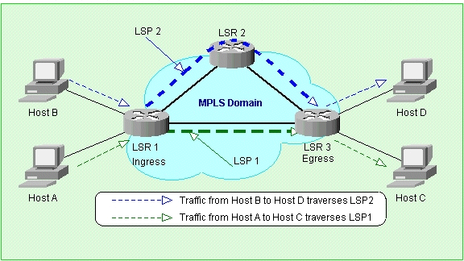
Experimental Network Configuration

Slide 45
Network Description
Host Computers:
  Intel Pentium II, 300MHz processors, 128 MB RAM.
  Equipped with Fast Ethernet NICs and running FreeBSD 4.1.
  Connected to the MPLS domain using 100Base-T connections via Gigabit Ethernet switches.
Label Switched Routers:
  Juniper Networks M40 routers running JUNOS Internet Software supporting Juniper Network’s MPLS implementation.
  Routers connected using OC-12 ATM links.
  Distance between LSR1 and LSR3, LSR2 and LSR3 is about 40Km while LSR1 and LSR2 are 5Km apart.

Slide 46
Experiment Using MPLS Explicit LSPs
Minimize the effects of network congestion by using MPLS traffic engineering capability.
  This is done by applying explicit routing.
Scenario 1:
  Two explicit LSPs are established between LSR1 and LSR3, both following the IGP shortest path.
Scenario 2:
  Two explicit LSPs set up again. However, traffic from host A to host C is made to traverse LSP2 while traffic from host B to host D flows across LSP1.

Slide 47
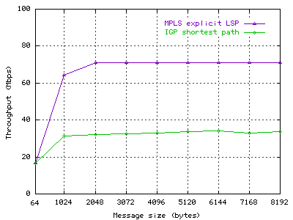
Results
Traffic from host A to host C is diverted to flow on the MPLS explicit path.
Significant improvement of throughput over the IGP shortest path is observed.
Throughput of TCP flow from Host A to Host C

Slide 48
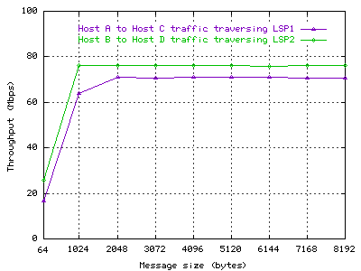
Results (contd)
Throughput of both flows

Slide 49
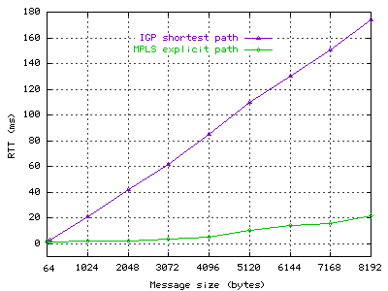
Results(contd)
Average RTT is measured using Netperf request/response method.
RTT dramatically increases for congested IGP path, while it is minimal for packets traversing the MPLS explicit LSPs.
TCP average RTT

Slide 50
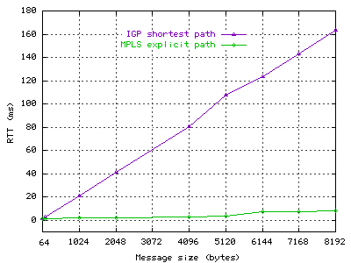
Results(contd)
UDP average RTT

Slide 51
Experiment Using MPLS CoS/QoS
Study how MPLS can be used to provide guaranteed bandwidth and different levels of service for flows.
  This is done by characterizing each LSP with a certain reserved bandwidth across the MPLS network.
  Each LSP is also characterized with different CoS values.
Network configuration is set up in such a way as to apply MPLS service differentiation along the same path.
Reservation of bandwidth is done using the Committed Data Rate (CDR) QoS parameter in CR-LDP.

Slide 52
Assigning CoS Values
EXP header is used. So, we have 8 different classes (0-7) to assign. A class indicates:
  Output transmission queue to use, percent of the queue buffer to use, percent of link bandwidth to serve, packet loss priority to apply in presence of congestion.
  Traffic with higher priority class receives better treatment than a lower priority class.
Ingress router LSR1 is configured so that it can classify and map flows into LSP1 and LSP2 based on their destination address.
The two LSPs are also configured with different CoS values.

Slide 53
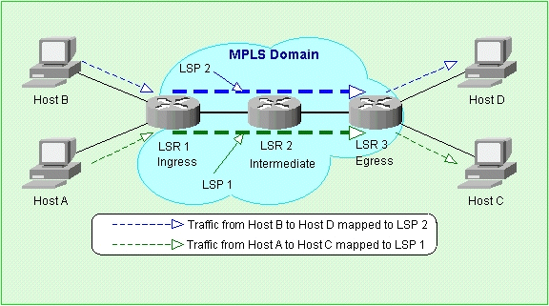
Network Configuration For CoS Test
70 % bandwidth reserved for LSP1
30 % bandwidth reserved for LSP2

Slide 54
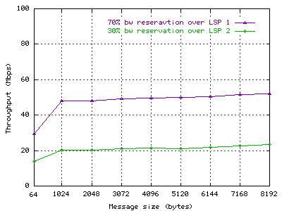
Bandwidth Reservation Over LSPs
This demonstrates how we can reserve resources in advance, as well as ensure guaranteed bandwidth.

Slide 55
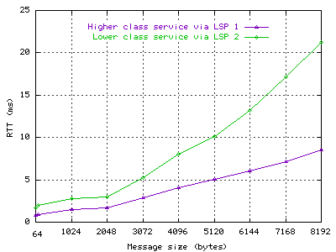
Results
Traffic from LSP1 is offered a higher service level and delivered with lower latency.
Service differentiation using MPLS CoS values has a significant impact on the performance of applications.

Slide 56
Conclusion
Providing QoS and traffic engineering capabilities in the Internet is very essential.
For this purpose, the current Internet must be enhanced with new technologies such as MPLS.
MPLS will play a key role in future service providers and carriers IP backbone networks.
The use of MPLS in IP backbone networks will facilitate the development of new services such as real-time applications in the Internet.

Slide 57
Indosat_MPLS

Slide 58
INP MPLS Planning 2005
Laveraging existing network for multi service chalange

Slide 59
Global IP Network Transformation
L2 & L3 VPN
Global IP Network (Indosat Internet Backbone)
Global MPLS Network (Internet & IPVPN)
Capacity & Network Upgrade
INP
INP
Capacity :
International transit :5x STM1 + 12 E1
International peering : 3x DS3
Domestik : 2 STM1
PoP
Hkg, Singapore,
Batam, Jakarta, Surabaya, Medan
Revenue (budget):
INP : Rp 85,7 billion
Global IP VPN : Rp 47,2 billion
Network Cost :
OPEX USD 2,9 M,(budget USD 1,57 M )
Capacity :
International :4x STM1 + 12 E1
Domestik : 4 E1
Utilization : 75 % →40 Mbps (Internal), 529 Mbps (external)
PoP
Hkg, Singapore,
Batam, Jakarta, Surabaya
Revenue (2004) :
USD 8,3 M (not include internal usage)
Network Cost (OPEX):
USD 1,563 M

Slide 60



Busines Model
IP VPN Customer
IP VPN Customer
IP VPN Partner
INP
Upstream Provider
buy
Local Loop Partner
settlement
buy
buy
No settlement
INP Peering Partner
settlement
settlement
buy
buy
INP Customer
IP VPN Customer
buy
buy
buy
buy
IP VPN Customer
ISP Customer
IP VPN Customer
ISP Customer

Slide 61
Service Offering & Coverage
PoP
  Jakarta, Singapore, Hongkong
  Surabaya, Medan, Batam
  Other cities provided by MPLS Group (IM2, Lintasarta) with Inter-AS mechanism.
Multiservice VPN ( L3 VPN)
  Inter-AS with :
    International partner : Global coverage
    Subsidiaries (IM2 & LA) : domestic Coverage
  Class of Service
    Real time Data (Voice , video)
    Premium Data
L2 VPN
  L2 VPN Services : point-to-point & point-to-multipoint using metro ethernet- CRO.
  As a transport service for: INP Network , IM2 & LA MPLS, Cellular MPLS

Slide 62
Plan Overview
Overview :
  Optimizing Peering for traffic growth
  Backbone Capacity Upgrade
  Upgrade Internet Backbone to MPLS Network,creating new MPLS VPN Service
  Projected Bandwidth
    Customer : 900 Mbps (tbd)
    Backbone : 5 STM1 + 3 DS3 peering (Reach, TM, KT)
Phase I : Capacity Upgrade & PoP Preparation
  Batam-Singapore Project Phase 2
    Upgrade local link Telepark Equinix to STM1 (Jan 2005)
  Hongkong internet backbone upgrade
    Upgrade link JKT - HKG STM1 bypass router INP Hkg (Jan 2005)
Phase II : MPLS Project
  Network Design (Jan 2005)
  Lab test (Feb 2005)
  BoQ approval.
  Procurement Process (Feb 2005)
  Upgrade Router Equinix to MPLS (Mar 2005)
      Equinix as PoI of Global VPN Business
      Telepark (Singtel) as INP PoP in Singapore
  INP Router Hkg Integration & upgrade to MPLS ( Mar 2005)
  Upgrade Router Batam

Slide 63



Logical Diagram-INP MPLS
IP transit
FT
INP
Customer
FE
IPVPN
Customer
IPVPN
Partner
2 FE
2 FE
IP transit
STIX
FE
DS3
STM1
Batam
Equinix
1 STM1
Telepark
IPVPN
Customer
DS3
1 STM1
IPVPN
Partner
IP transit
BtnAccess
1 STM1
INP
Customer
KPPPTI
STM1
FE
DS3/STM1
2 FE
1 STM1
2 FE
Medan
2 FE
Hongkong
Surabaya
DS3/STM1
FE
GE
2 STM1
IP Transit
UUnet
Metro Ethernet
GE
GE
INP
Customer
IPVPN
Customer
DS3
IP Peering
KT
INP
Network
DMA
EN
DS3
INP router
IP Peering
KDDI
IPVPN
Customer
INP
Customer
Jakarta
PE router
P router

Slide 64
lAB

Slide 65


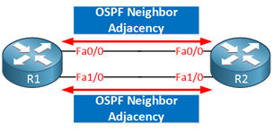
Customer 1 Site
Enabling MPLS On Cisco Routers
Customer 2 Site
MPLS Core
PE1
f0/0
f0/0
PE2
PE1# configure terminal
PE1(config)# ip cef
PE1(config)# mpls label protocol ldp
PE1(config)# interface fastethernet 0/0
PE1(config-if)# mpls ip
PE1(config-if)# end
f1/0
PE2# configure terminal
PE2(config)# ip cef
PE2(config)# mpls label protocol ldp
PE2(config)# interface fastethernet 0/0
PE2(config-if)# mpls ip
PE2(config-if)# end
f1/0
R1# configure terminal
R1(config)# ip cef
R1(config)# mpls label protocol ldp
R1(config)# interface fastethernet 0/0
R1(config-if)# mpls ip
R1(config-if)# exit
R1(config)# interface fastethernet 1/0
R1(config-if)# mpls ip
R1(config-if)# end
R2# configure terminal
R2(config)# ip cef
R2(config)# mpls label protocol ldp
R2(config)# interface fastethernet 0/0
R2(config-if)# mpls ip
R2(config-if)# exit
R2(config)# interface fastethernet 1/0
R2(config-if)# mpls ip
R2(config-if)# end
Notes:
https://itexamanswers.net/3-5-3-5-lab-configure-and-verify-ebgp-answers.html
https://ipcisco.com/lesson/enabling-mpls-on-cisco-routers/

