Slide 1
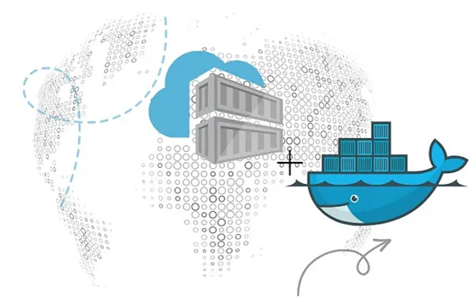
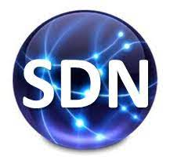

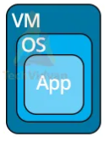


PDS
Computer Vision
Lab QoS :
github.com/amelcharolinesgn2/ANJAR/Qos
@ P. Siagian
https://github.com/siagianp
https://www.youtube.com/@AmelOline/videos
https://github.com/amelcharolinesgn2/IoT_simulator-mqtt-NodeRed
github.com/amelcharolinesgn2/ANJAR

Slide 2
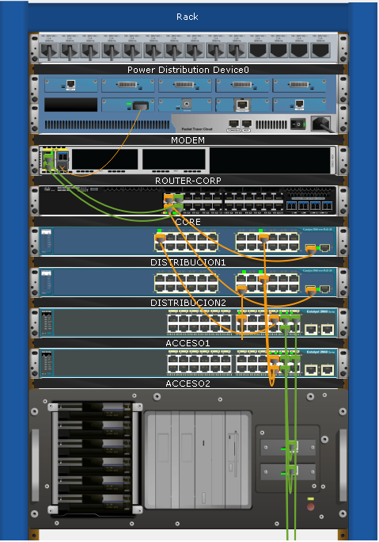
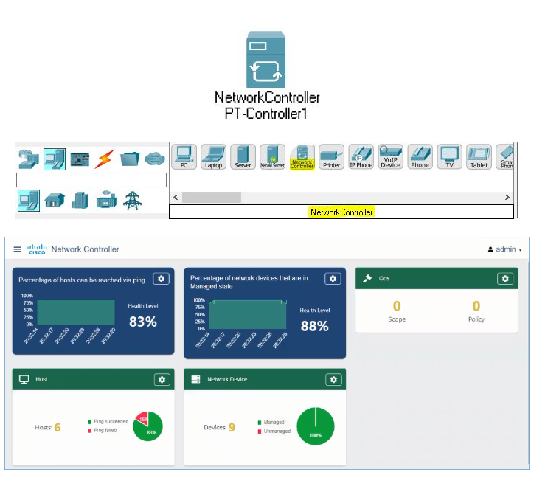
QoS

Slide 3



VoiP
256kbit
1000 MBit
1000 MBit
Notes:
https://networklessons.com/quality-of-service/introduction-qos-quality-service

Slide 4
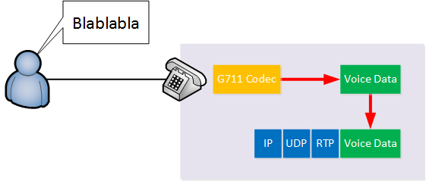
Voice and Video Application
Above we have a user that is speaking. With VoIP, we use a codec that processes the analog sound into a digital signal. The analog sound is digitized for a certain time period which is usually 20 ms. With the G711 codec, each 20 ms of audio is 160 bytes of data.
The phone will then create a new IP packet with an UDP and RTP (Realtime Transport Protocol) header, adds the voice data to it and forwards the IP packet to the destination. The IP, UDP and RTP header add 40 bytes of overhead so the IP packet will be 200 bytes in total.
For one second of audio, the phone will create 50 IP packets. 50 IP packets * 200 bytes = 10000 bytes per second. That’s 80 Kbps. The G.729 codec requires less bandwidth (but with reduced audio quality) and requires only about 24 Kbps.
Bandwidth isn’t much of an issue for VoIP but delay is. If you are speaking with someone on the phone, you expect it to be real-time. If the delay is too high, the conversation becomes a bit like a walkie talkie conversation where you have to wait a few seconds before you get a reply. Jitter is an issue because the codec expects a steady stream of IP packets with voice data that it must convert back into an analog signal. Codecs can work a bit around jitter but there are limitations.

Slide 5
Packet loss is also an issue, too many lost packets and your conversations will have gaps in it. Voice traffic on a data network is possible but you will need QoS to ensure there is enough bandwidth and to keep the delay, jitter and packet loss under control. Here are some guidelines you can follow for voice traffic:
One-way delay: < 150 ms.
Jitter: <30 ms.
Loss: < 1%
(Interactive) video traffic has similar requirements to voice traffic. Video traffic requires more bandwidth than voice traffic but this really depends on the codec and the type of video you are streaming. For example, if I record a video of my router console, 90% of the screen remains the same. The background image remains the same, only the text changes every now and then. A video with a lot of action, like a sports video, requires more bandwidth. Like voice traffic, interactive video traffic is sensitive to delay, jitter and packet loss. Here are some guidelines:
One-way delay: 200 – 400 ms.
Jitter: 30 – 50 ms.
Loss: 0.1% – 1%

Slide 6
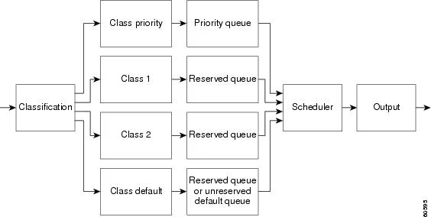


QoS Tools
Classification and Marking
https://www.cisco.com/c/en/us/td/docs/ios/solutions_docs/qos_solutions/QoSVoIP/QoSVoIP.html
The actual tools we can use to implement QoS:
Classification and marking: if we want to give certain packets a different treatment, we have to identify and mark them.
Queuing – Congestion Management: instead of having one big queue where packets are treated with FIFO, we can create multiple queues with different priorities.
Shaping and Policing: these two tools are used to rate-limit your traffic.
Congestion Avoidance: there are some tools we can use to manage packet loss and to reduce congestion.
ACL
Notes:
https://www.cisco.com/c/en/us/td/docs/ios/solutions_docs/qos_solutions/QoSVoIP/QoSVoIP.html

Slide 7
access-list 100 permit udp any any range 16384 32000
access-list 100 permit tcp any any eq 1720
access-list 101 permit tcp any any eq 80
access-list 102 permit tcp any any eq 23
!
class-map voip
match access-group 100
class-map data1
match protocol
class-map data2
match access-group 102!
policy-map llq
class voip
priority 32
class data1
bandwidth 64
class data2
bandwidth 32
class class-default
fair-queue !
interface Serial1/0
bandwidth 256
service-policy output llq

Slide 8
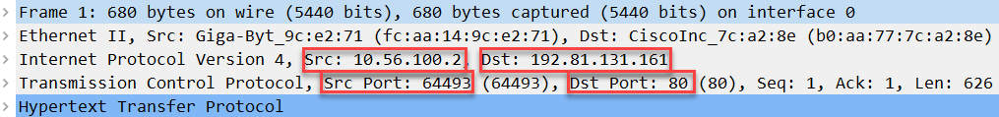
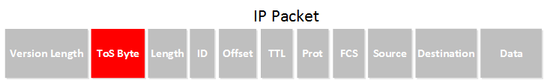
Access-list that matches on TCP destination port 80 is a quick way to classify all HTTP traffic.
Once the traffic is classified, it’s best practice to mark the packet.
Marking means we change one or more of the header fields in a packet or frame. For example, an IP packet has the ToS (Type of Service) field that we can use to mark the packet:

Slide 9
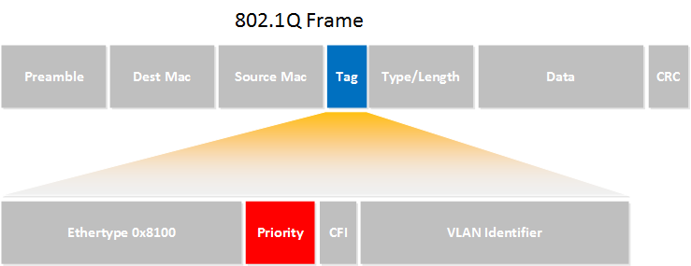

Slide 10
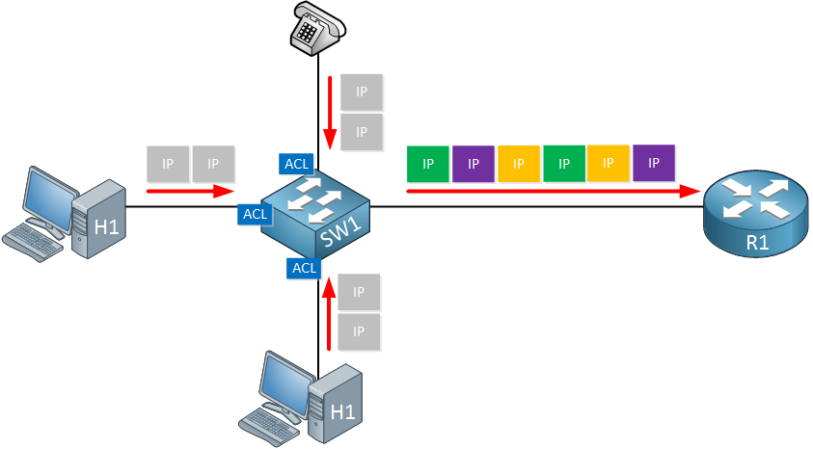
Illustration to help you visualize classification and marking
Above we see a switch with two hosts and one phone. The switch receives a number of packets from the hosts and phone and is configured to classify these packets using an access-list on its interfaces. The switch then marks the IP packets using the ToS field in the IP header.

Slide 11
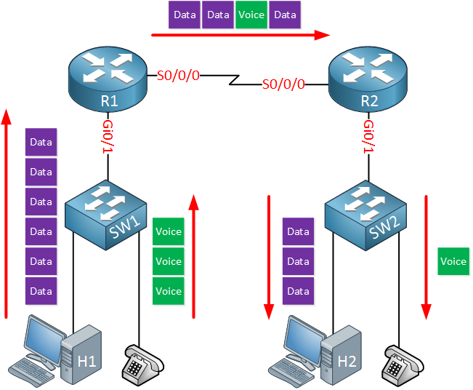
This forwarding logic is called best effort or FIFO (First In First Out)
Above we see a small network with two routers, two switches, two host devices and two IP phones. We use Gigabit Ethernet everywhere except between the two routers; this is a slow serial link of, let’s say 1.54 Mbps.
When the host and IP phone transmit data and voice packets destined for the host and IP phone on the other side, it is likely that we get congestion on the serial link. The router will queue packets that are waiting to be transmitted but the queue is not unlimited. What should the router do when the queue is full? drop the data packets? the voice packets? When you drop voice packets, the user on the other side will complain about poor voice quality. When you drop data packets, a user might complain that transfer speeds are poor.
QoS is about using tools to change how the router or switch deals with different packets. For example, we can configure the router so that voice traffic is prioritized before data traffic.

Slide 12
Characteristics of network traffic
Bandwidth
Delay
Jitter
Loss

Slide 13
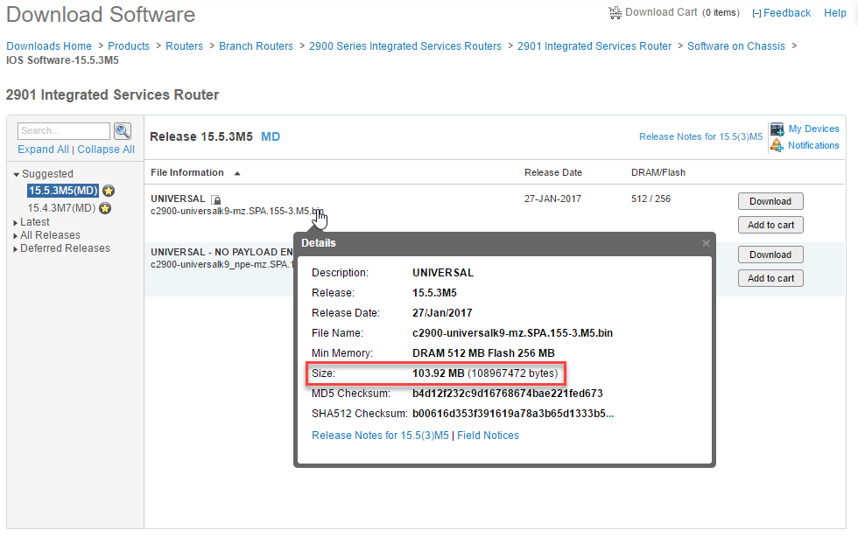
Batch Application

Slide 14
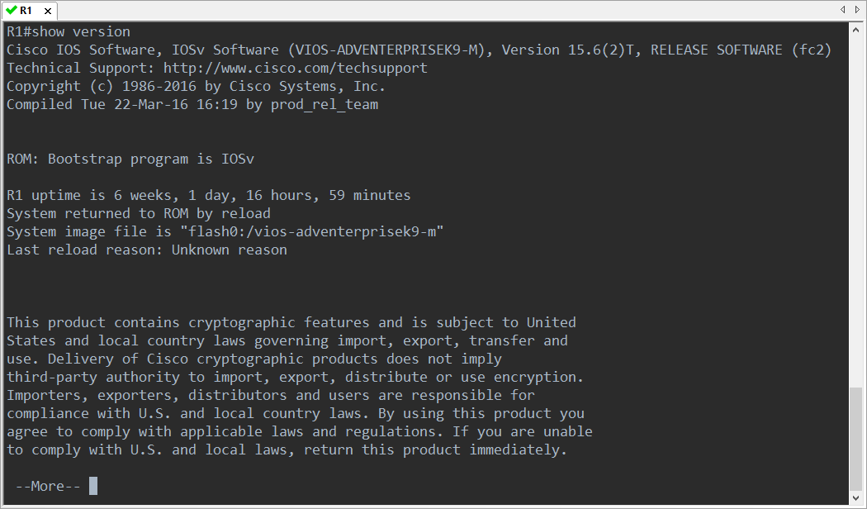
Interactive Application

Slide 15
Lab Qos
Topology
Qos.Pkt
Notes:
https://networklessons.com/quality-of-service/introduction-qos-quality-service

Slide 16

How to process:
In packet trace on QoS.pkt
We are going to start simulation mode and then on PC1 we’re going to open up a web browser and go to sysco.com. Now the first thing the PC needs to do is determine the IP address of sysco.com. So it's going to send out a DNS request message for sysco.com. So scrolling down here notice we've got a DNS query for sysco.com. Capture forward that gets sent to the router when it gets sent across the serial link, Notice the DSCP is set to zero. No quality of service is applied to this packet. So that will go to the DNS server. DNS server will reply back.Packet will go back to the PC and now the PC can send TCP traffic to the router. PC is going through the three way handshake. Notice now we get HTTP traffic.Notice on inbound HTTP traffic. In this case we've got an HTTP request.It doesn't have DSCP markings but on outbound out of the router the DSCP is set.So capture forward notice how this packet has a little square here showing us that DSCP was set on ingress. DSCP is also set on address. So capture forward what you'll notice is we have this little square to indicatethat a quality of service value has been specified on the packet. Inbound and outbound shows us the DSCP marking.On the return no quality of service has been applied because we applied the policy inbound on this interface and outbound on this interface.So on router one notice no quality of service is configured on the packet. You have to think about your direction when configuring quality of service.No quality of service is configured here. But notice on this packet going from the inside PC to the outside PC.Ingress has no DSCP, egress however does have a DSCP marking configured. So quality of service has been configured. Ingress on router two and egress on router two.So that was HTTP. Let's try the same thing using ICMP. So ping sysco.com. I'll put this to simulation mode.Press enter. Notice we have a DNS message. No quality of service is applied on this packet.So the packet receive from router one doesn't have the DSCP configured and router two is not setting DSCP on egress.Because back to the PC here's our ICMP message. Notice inbound no DSCP marking but outbound out of the router we do have a DSCP marking.And you can see the color here. Notice the little pink square. Inbound we've got this DSCP marking outbound. We don't have a DSCP marking.And that's because we configured the router to reset the DSCP or IP precedence of value to zero on egress.This is set to zero. Ingress a DSCP value is configured.Now these values can be difficult to read. Remember the type of service field is 8 bits in length.So you'd have to convert this into your DSCP value of AF11. AF11 has a decimal value of 10 or hexadecimal value of A. we can get details of all those calculations in and we can have a look online. Capture forward for that ICMP packet. There is no DSCP value. No precedence value because we reset it to zero.Let's do something similar with PC2. So in PC2 w'll ping facebook.com. First packet generated is DNS. DNS will not have DSCP values configured because we didn't configure that in our policy. But notice now when an ICMP packet hits a router 1, ingress DSCP 0, egress or outbound the DSCP value has been configured.Capture forward when it gets to router 2, ingress a value is this.Egress a value is set to zero because we overwrote it once again.Let's do something similar with HTTP. So in PC2 open up a web browser. Go to facebook.com.First packet generated is DNS. No quality of service is configured on this packet again.But when we get the HTTP packet from PC2 the DSCP value is configured accordingly to 1A, which is AF31.When it gets to router 2, ingress is DSCP 0x1A. Egress is DSCP 0x18.And that's forwarded into the internet. Not that the internet would do anything with the quality of service markings.But the slab shows you how to configure quality of service markings in packet tracer.So were you able to complete the slab? Were you able to configure quality of service in your network?Did you prove that it worked correctly?
English

Slide 17
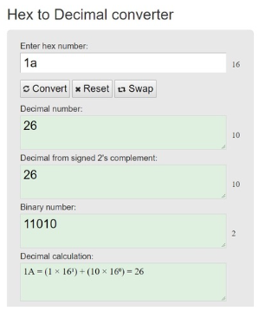
Setting Router1:
a) Match traffic:
O Voice traffic using NBAR (rtp)
→ Set DSCP to EF
O HTTP using NBAR (http)
→ Set DSCP to AF31
O ICMP using NBAR (icmp)
→ Set DSCP to AF11
b) Bind outbound on S0/1/0
O Voice should get priority bandwidth of 100kbps
O HTTP should get minimum bandwidth of 50kbps
O ICMP should get minimum bandwidth of 25kbps
Note:
1. TCP packet is being marked when it exits Router1's S0/1/0.
Why is it doing this?
Anwered : And can we tell what DSCP value it is by the Hex value of "0x1a"?
2. HTTP protocol uses TCP as its transport. If it is TCP with destination port 80, then it is HTTP, that's why it is matching the policy and is getting marked.
this packet is marked with AF31 when it entered Router1. But why? The QoS rule says only HTTP should be marked with AF31. This packet is TCP. I believe it's doing handshaking to establish communication with the web server before web data transfer. But it's not HTTP. So why is it marked with AF31?
HTTP protocol uses TCP as its transport. If it is TCP with destination port 80, then it is HTTP, that's why it is matching the policy and is getting marked.
Hex 0x1a is 26 in decimal
The 0x1a in Hex is 31 decimal. And why do you say that seeing a market packet on the egress is unexpected? Once the packet is marked with DSCP value, it is unchanged until the packet arrives to another device which does re-marking it. So, as packet enters the router, it gets marked with whatever value you set in your policy and that value stays in the packet when it exits the router. Everything is as expected here. I think your mistake is in marking the packet with the value of 31, when what is required is to set value to AF31 and that is not the same as just decimal 31. AF31 is 26 in decimal.

Slide 18

