Slide 1

This slide is taken
from Amazon
AWS Educate
Introduction to Cloud Computing
Slides are captured from AWS Educate.
This is only for learning tools in Cloud Computing Course
https://github.com/siagianp
https://www.youtube.com/@AmelOline/videos
https://github.com/amelcharolinesgn2/Cloud-Infrastructures
https://github.com/amelcharolinesgn2/ClouD-Infrastructure-SISKA-2025
https://github.com/amelcharolinesgn2/CCNA1
https://github.com/amelcharolinesgn2/CCNA2
https://github.com/amelcharolinesgn2/AWS Certificate
Notes:
PDS

Slide 2
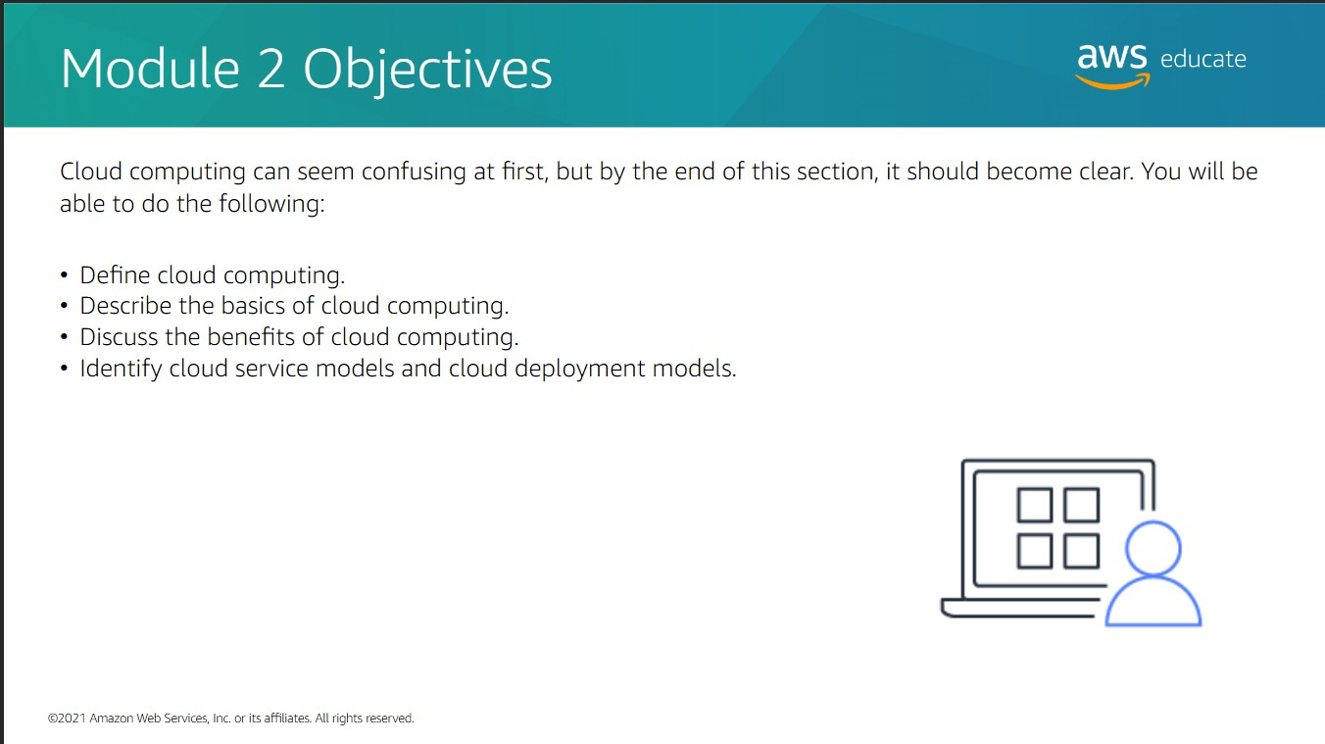

Slide 3
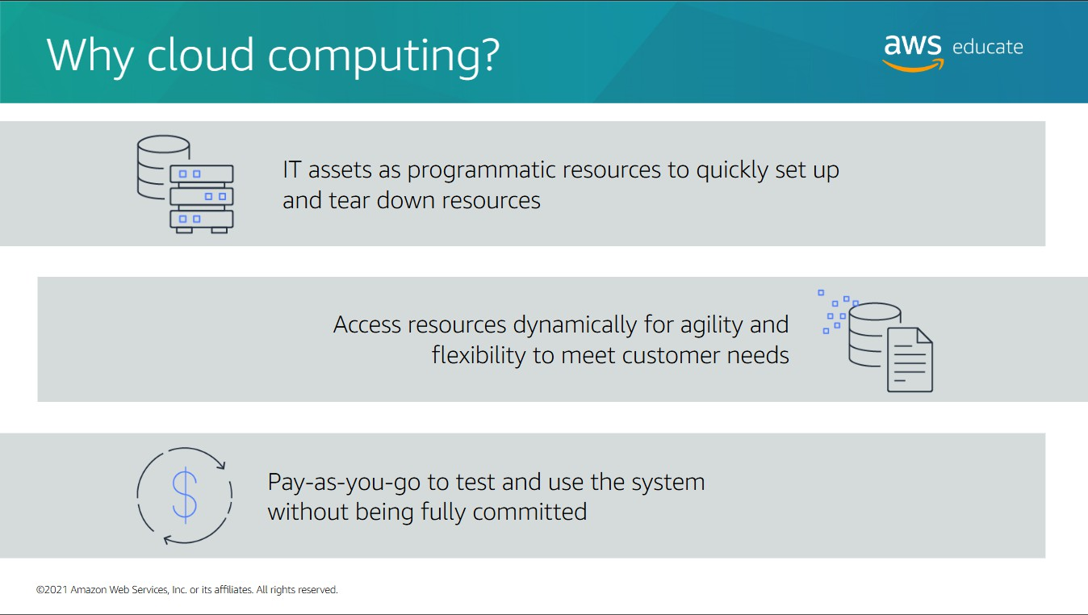

Slide 4
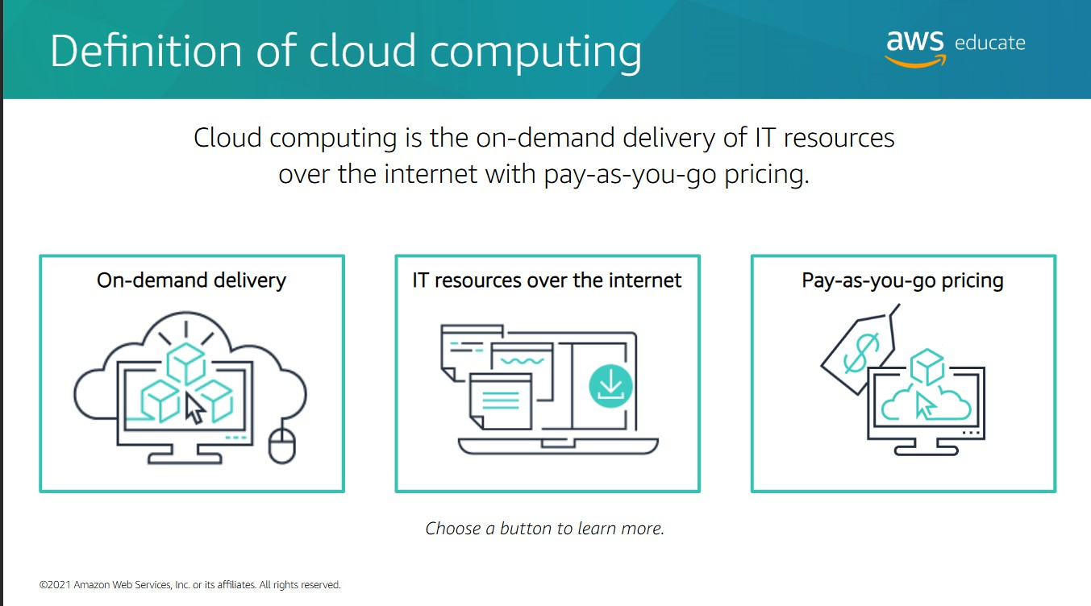

Slide 5
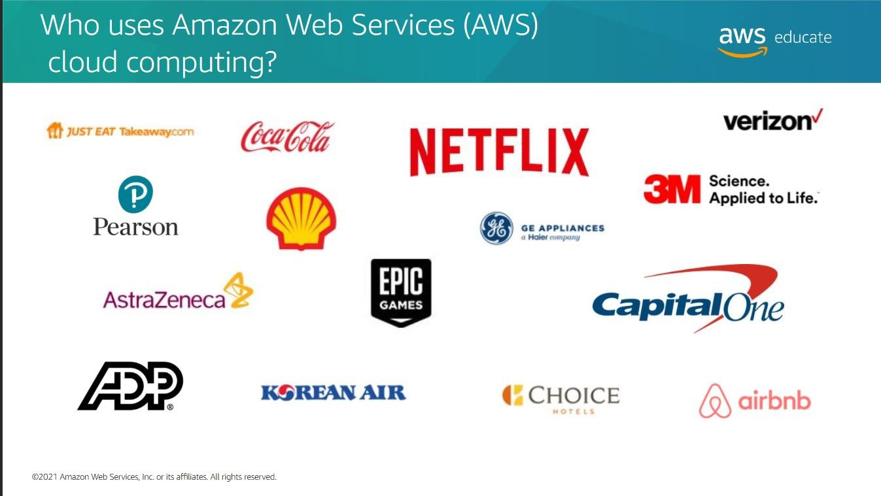

Slide 6
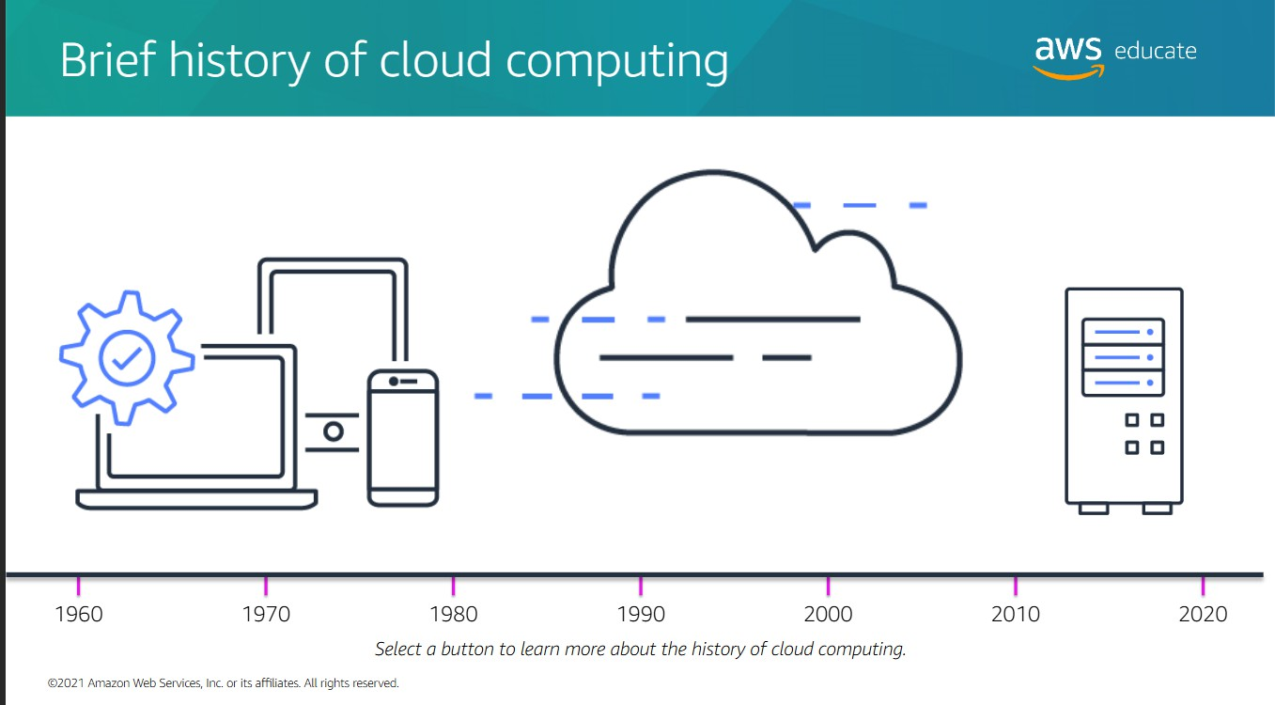

Slide 7
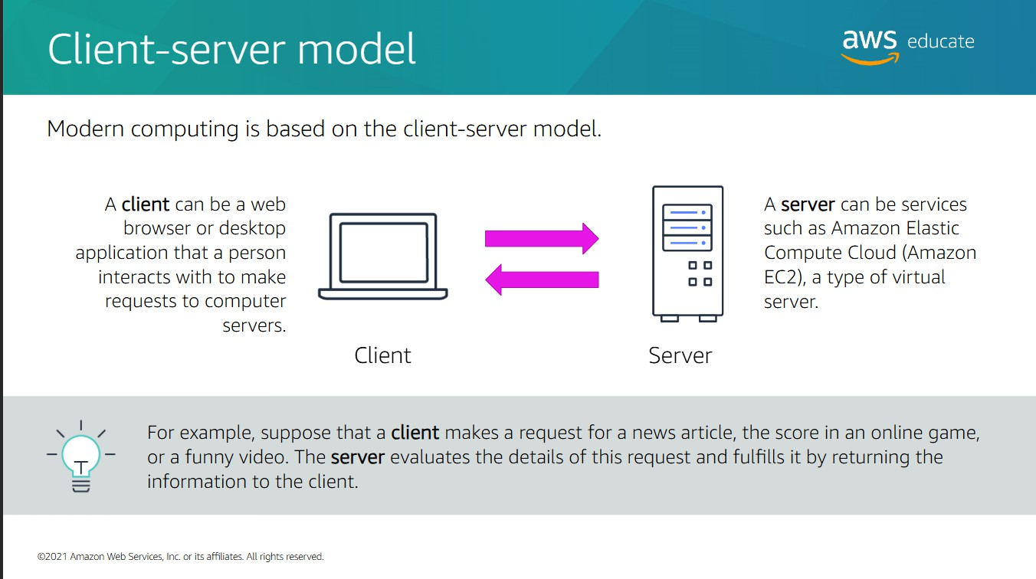

Slide 8
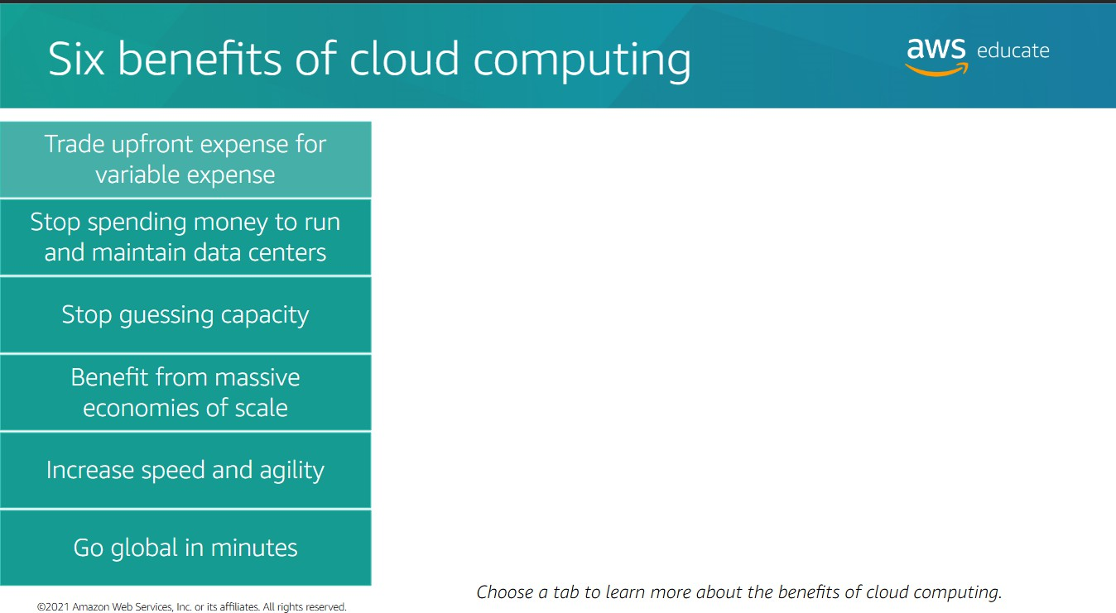

Slide 9
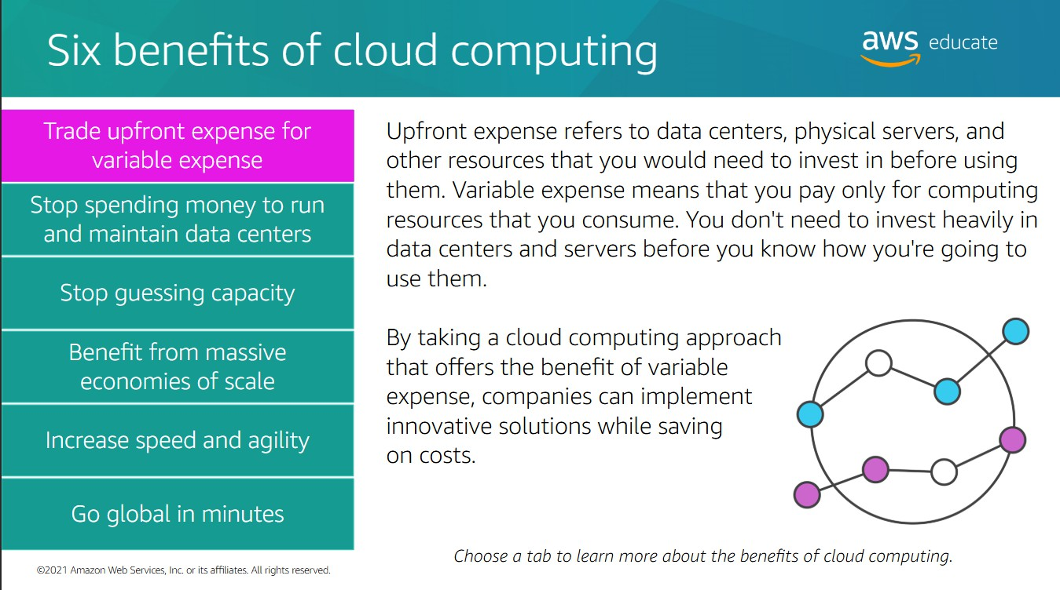

Slide 10
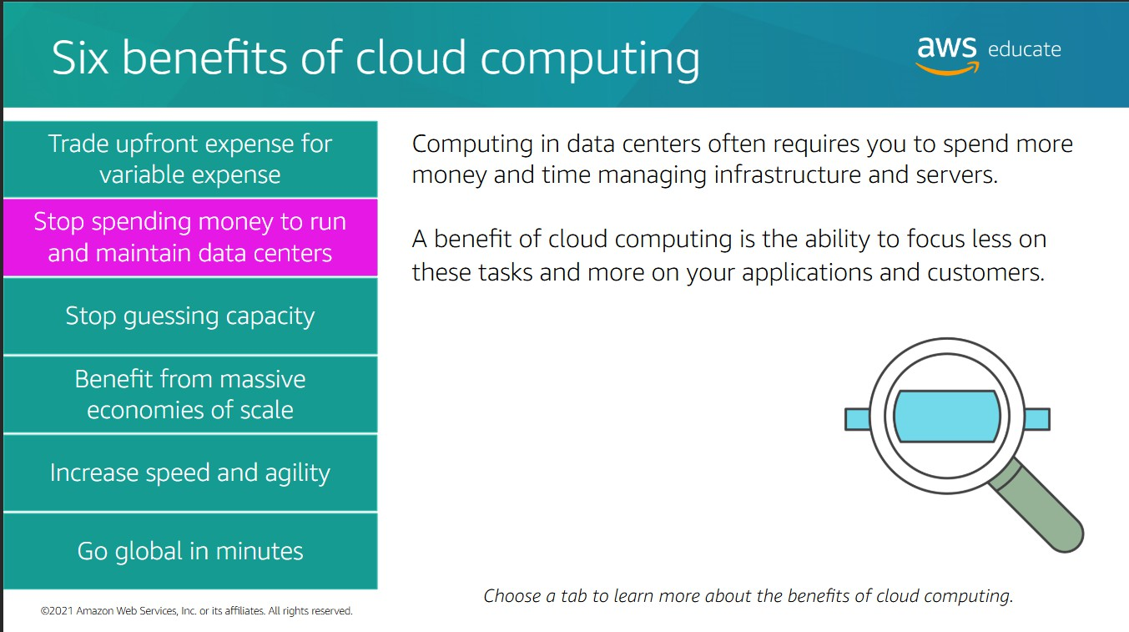

Slide 11
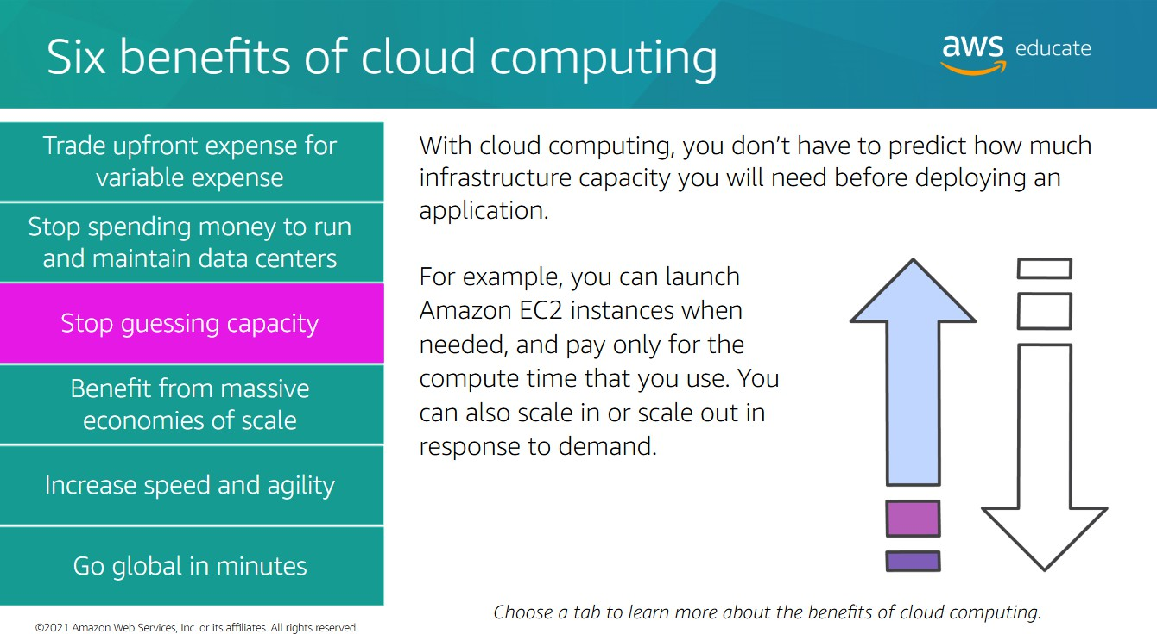

Slide 12
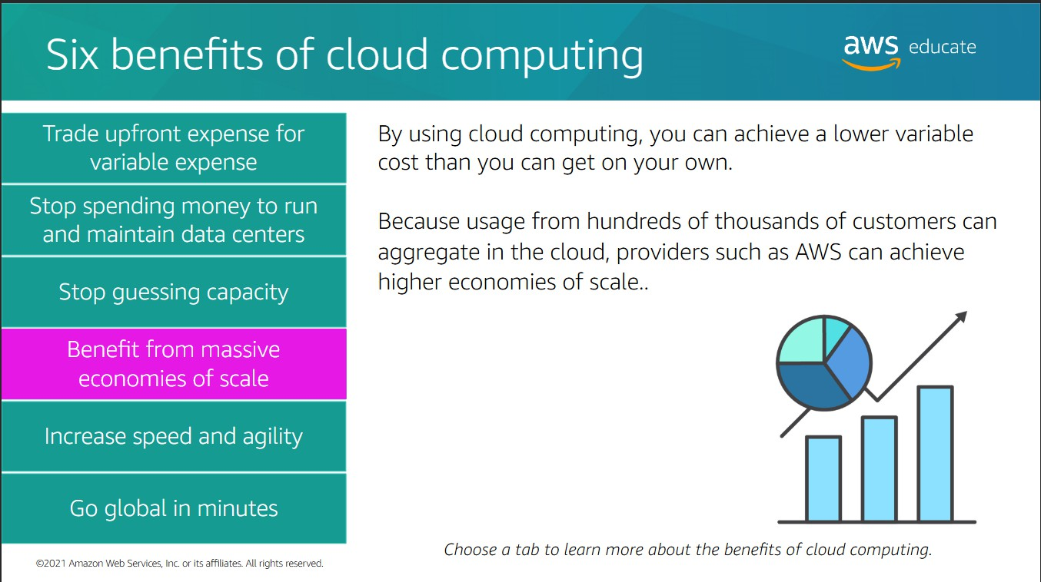

Slide 13
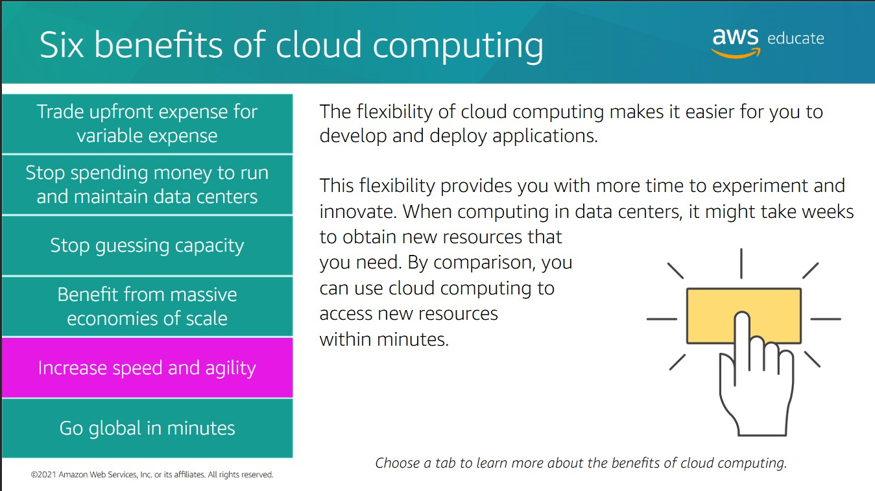

Slide 14
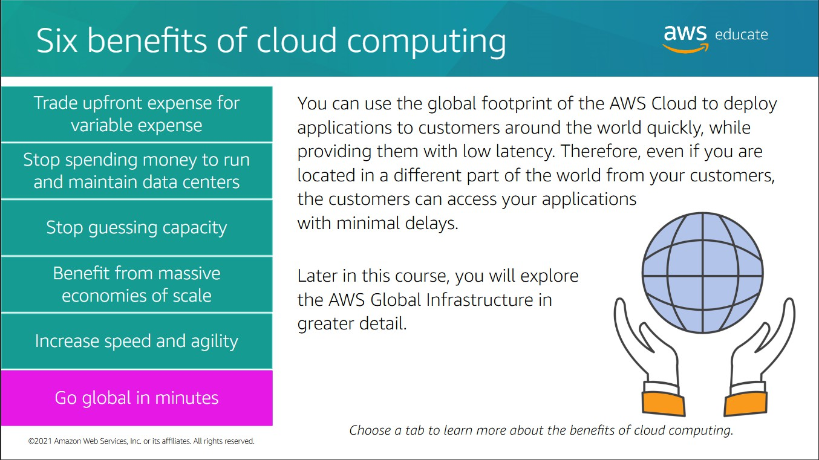

Slide 15
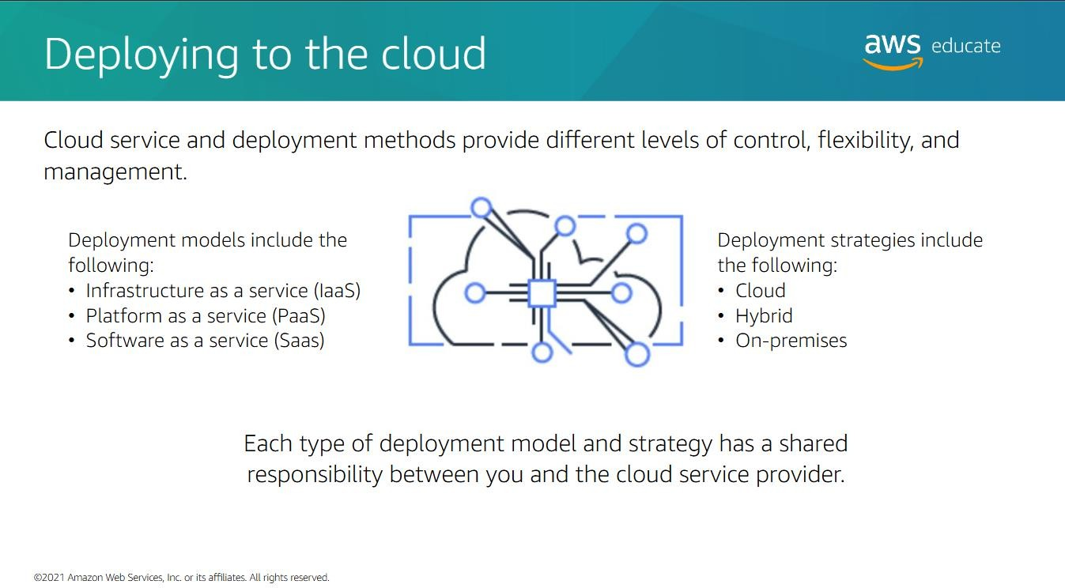

Slide 16
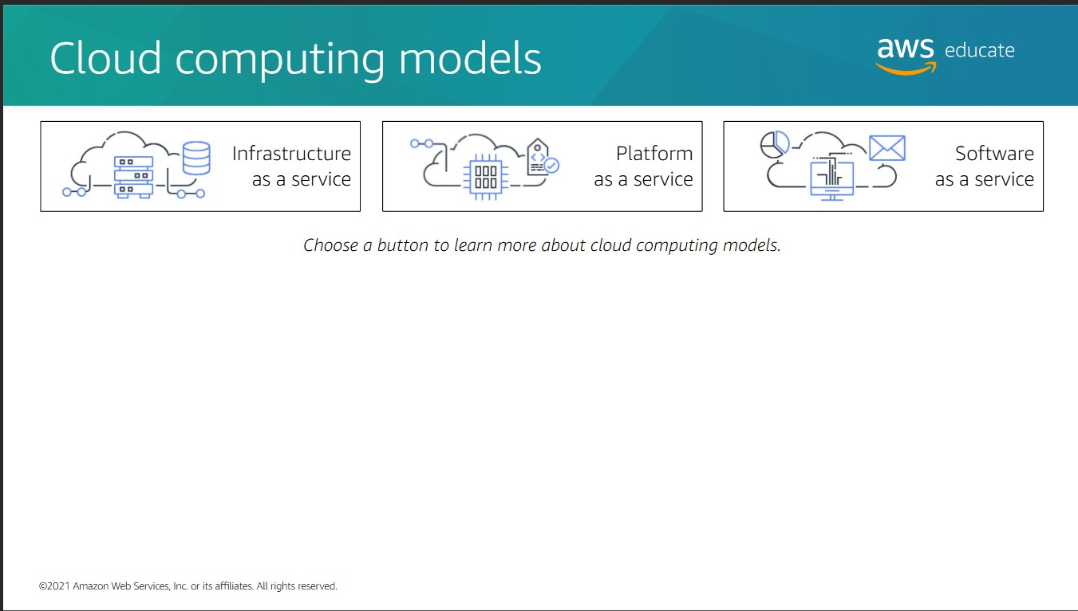

Slide 17
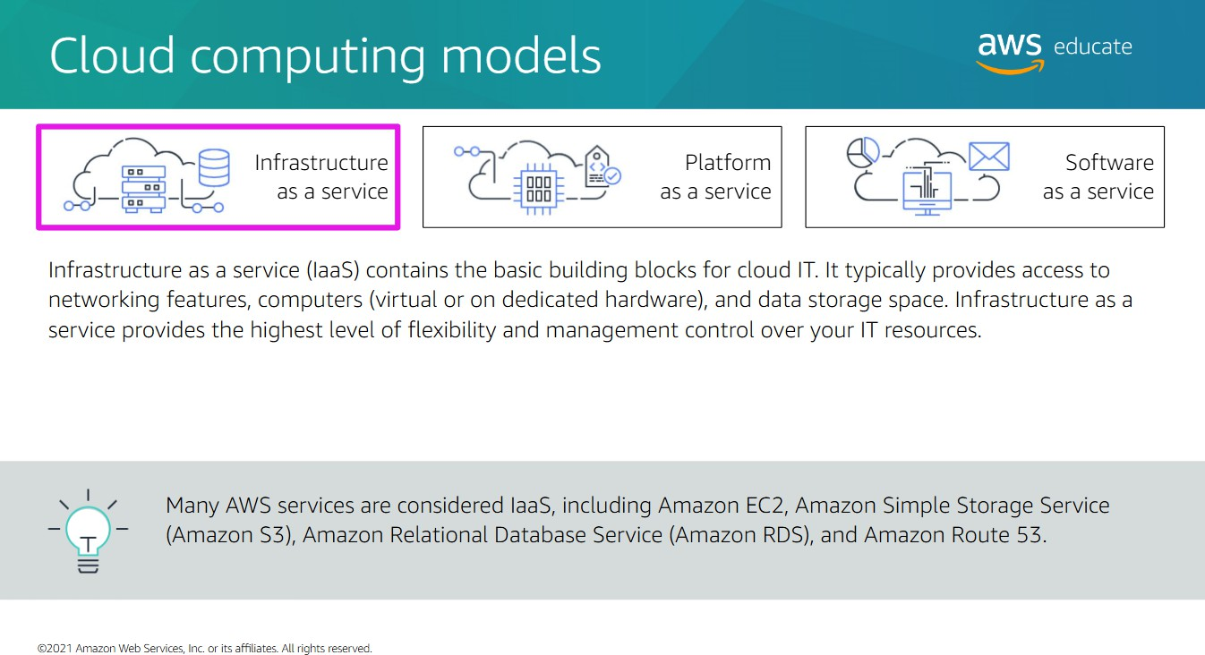

Slide 18
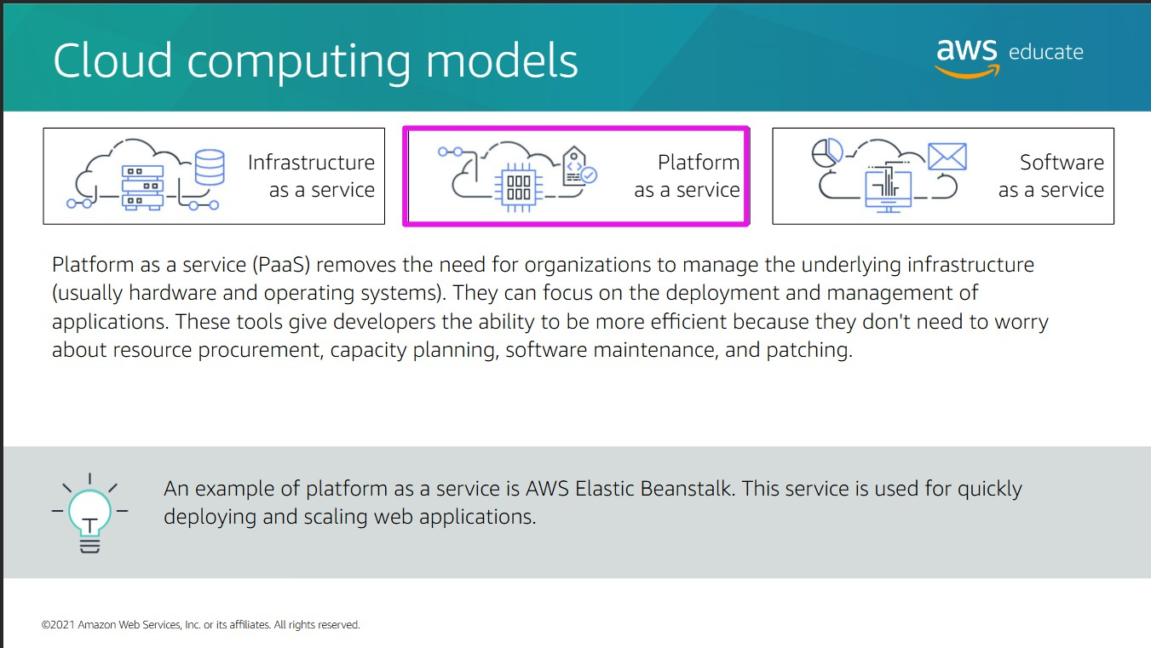

Slide 19
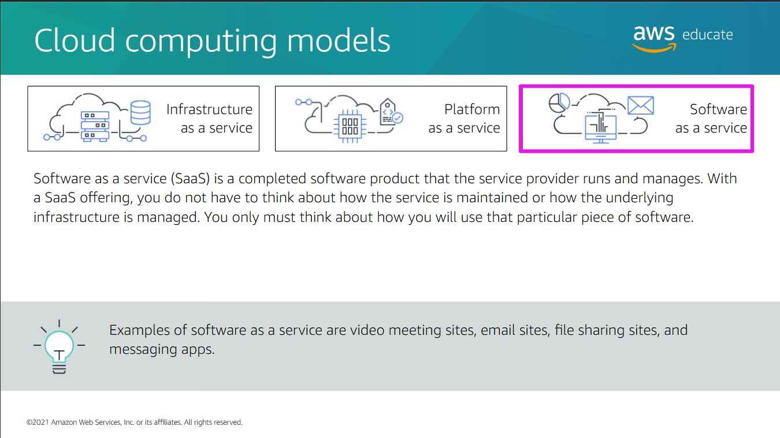

Slide 20
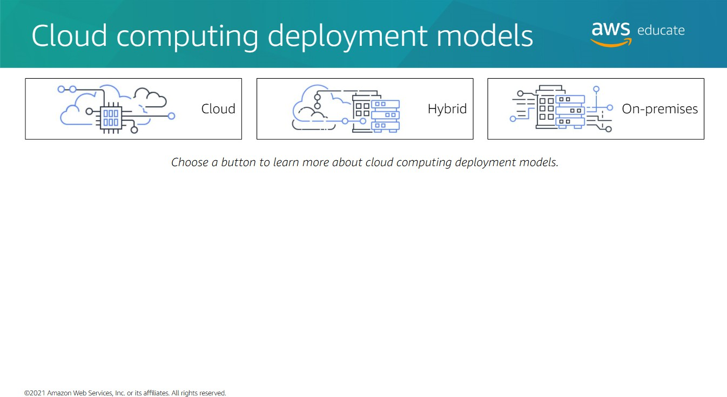

Slide 21
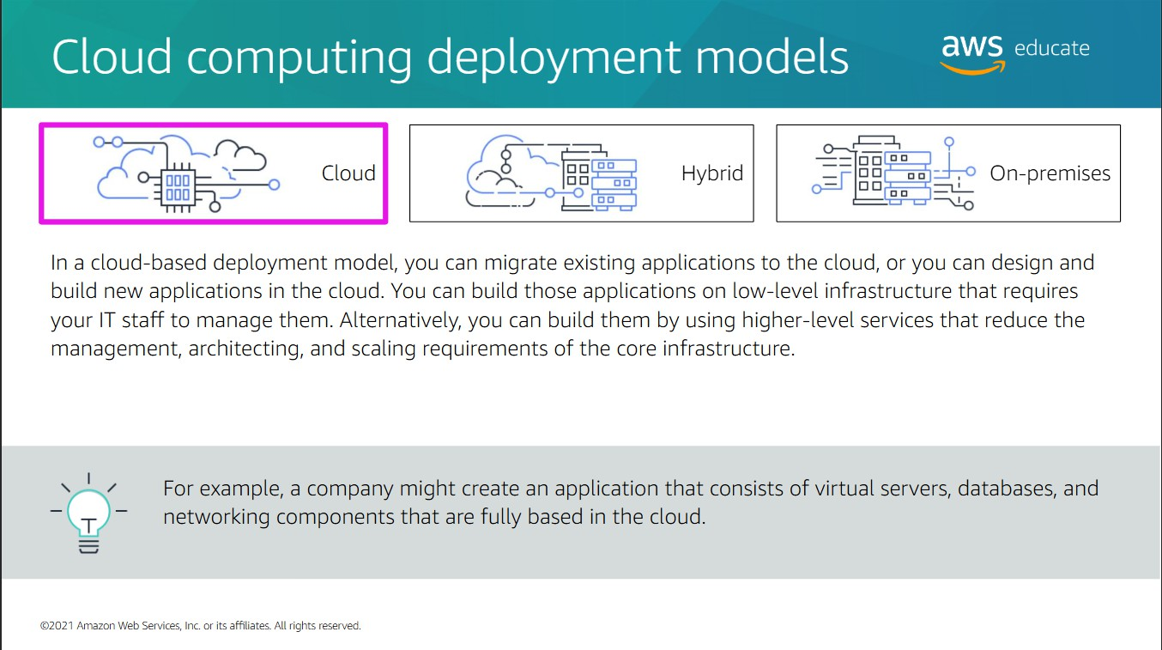

Slide 22
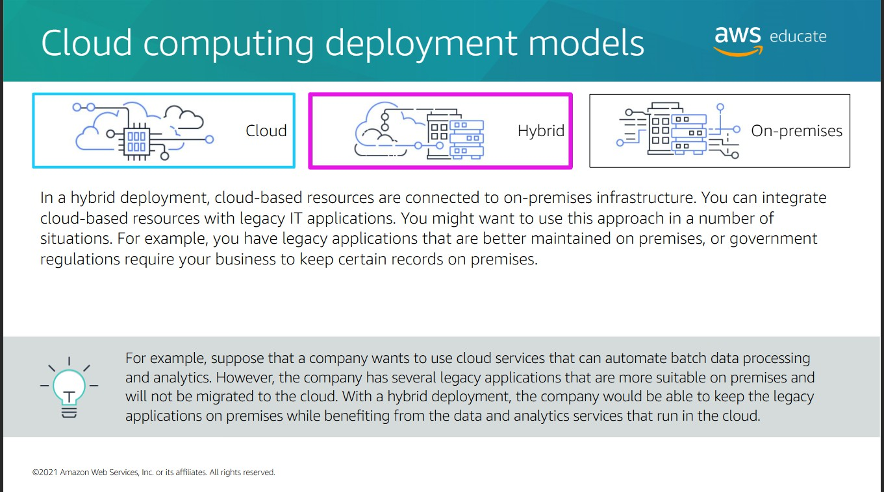

Slide 23
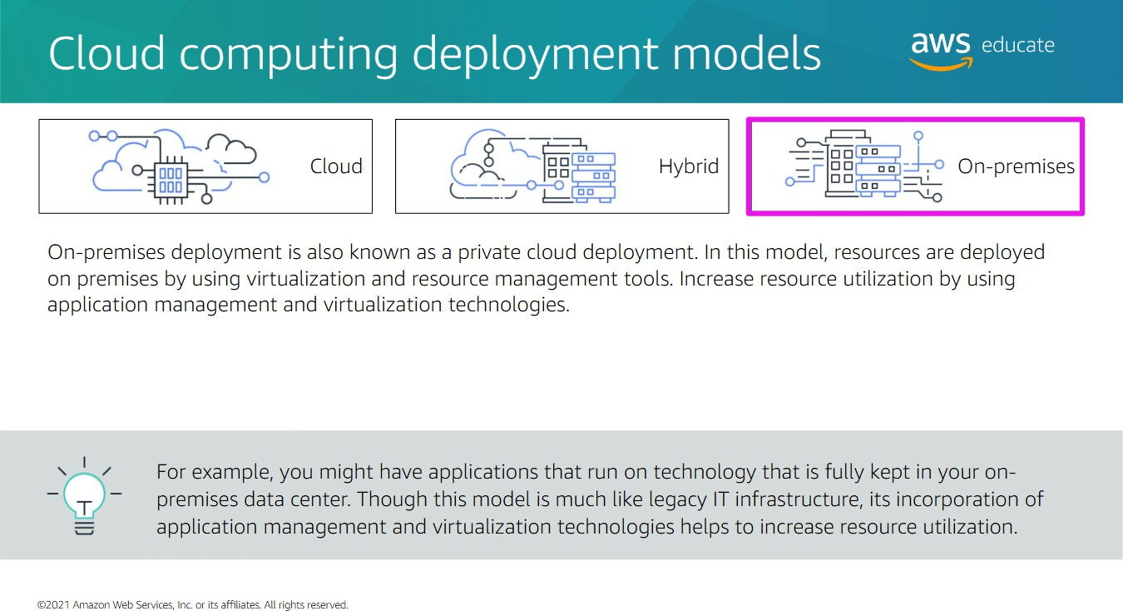

Slide 24
