Slide 1
Module 4
AWS Core Services
Slides are captured from AWS Educate.
This is only for learning tools in Cloud Computing Course
https://github.com/siagianp
https://www.youtube.com/@AmelOline/videos
https://github.com/amelcharolinesgn2/Cloud-Infrastructures
https://github.com/amelcharolinesgn2/ClouD-Infrastructure-SISKA-2025
https://github.com/amelcharolinesgn2/CCNA1
https://github.com/amelcharolinesgn2/CCNA2
https://github.com/amelcharolinesgn2/AWS Certificate
Notes:
PDS

Slide 2

AWS offers a broad set of global cloud-based products including compute, storage, databases, analytics, networking, mobile, developer tools, management tools, security and enterprise applications. These services help you build elastic, agile, resilient architectures. You will be able to:
Define the different types of services
Identify the main categories of services as part of an architecture
Describe each service, its use, features, and benefits
ti20J1 Amazon wee @wrce> inc or me aGiiares. At” ngnts reserY'e'd

Slide 3
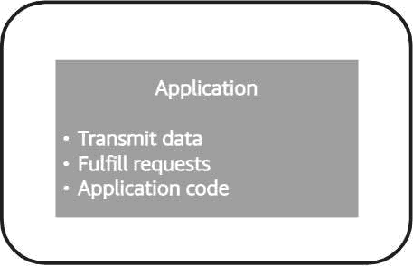
Monolithic architecture
u02a AmaxavebSe eą noormaÆ#aœs.M ngne eseneü

Slide 4
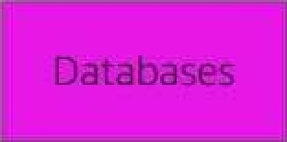
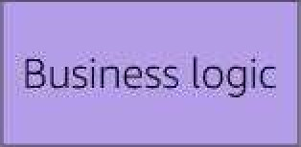
Monolithic architecture
äWS . ›
Servers
User interface
Business logic

Slide 5
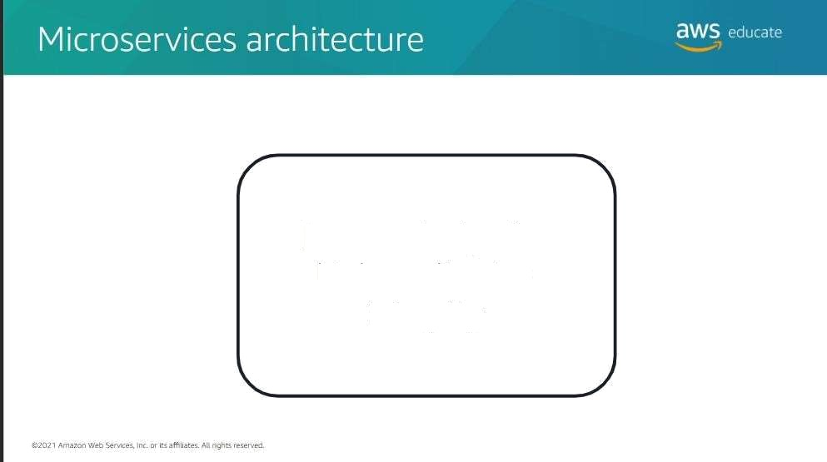
How to design for high application integrity

Slide 6
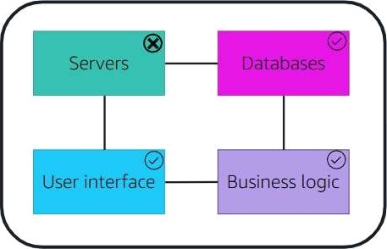
aws .. .
Microse vices architecture
Microservices architecture

Slide 7
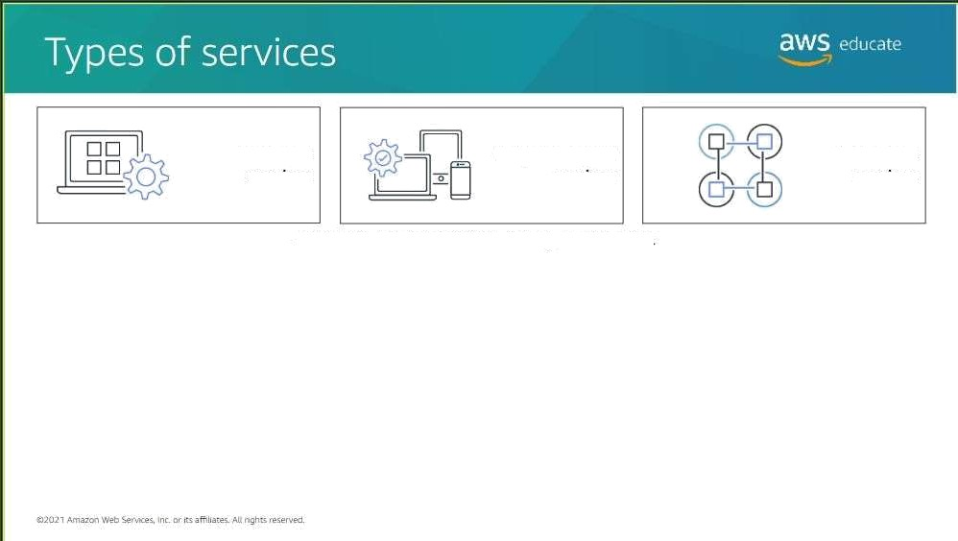
Managed services
Fully managed
services
Servertess services
Select a bur”con to learn more obout types of services

Slide 8

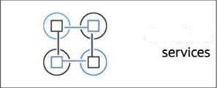

Types of se vices
aws
Fully managed
services
Managed services
Servertess
Select o button to leorn more about rypm oL services
A managed service is a way to describe the services that require you to manage infrastructure management tasks like patching, backup, and repair. These services grant you virtual access to the underlying operating system and servers. With managed services, you are responsible for scaling and building for high availability.
62p?.1 Amaze web W
\ inc. or me a1Tiltares. Ab nghls reserved

Slide 9




Managed service |  | Futty managed services |  | Serverless serviœs
Select a button to leorn mœe nbour types oL sewices
A fully managed service is a way to describe the services that automate infrastructure management tasks that AWS handles, like patching, backup, and repair. Thèse services do not grant you any vinual access to the underlying Operating system or servers. With a fully managed service, you are still responsible fOr scaling and building for high availability.
@2D21Amazœi weo bras Inc or ms afïlàaes. Ala ngha reserved.

Slide 10

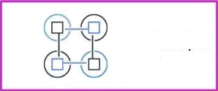

Types of se rices
aws
Fully managed
servÎceS
l'•Ianaged services
Servertess
5OIVIŒS
Select a button to learn more about types of semicez
Serverless ts a way to describe the services, praCtices, and Strategies that you can use to build more agile applications. In this way, you can innovate and respond to change faster. With serverless services, AWS handtes Infrastructure management tasks like capacity provisïoning and patching so that you can focus on building applications that serve your Customers. Serverless services come with automatic scaling, built-in high availability, and a pay-for-value billing model.
'020J1 Amas web Senl<eç inc or ns affiliares. Att nghts reserved.

Slide 11




Make sure to select each of the AWS service icons in the Architecture diagram to learn more about them. Choose START to begin.
Continue your journey in the cloud, by learning some basic knowledge of the core SWS services!

Slide 12
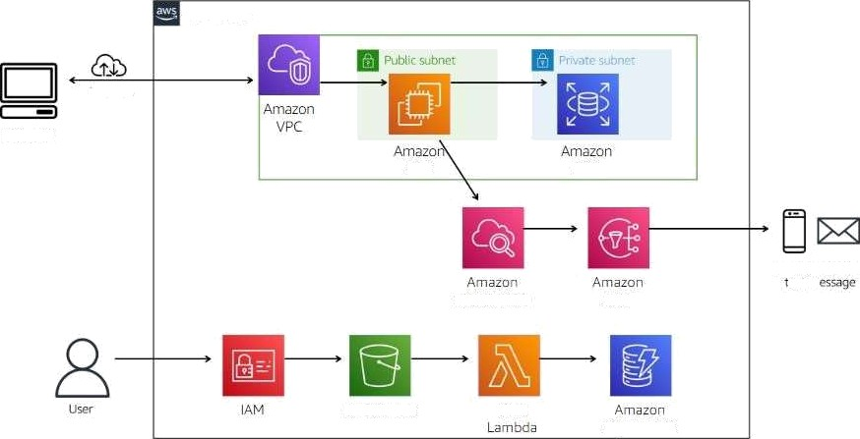
Μ… ……
service icon to team more.
ΜΝΞ (laud
Internet
Browser
EC2
ΜΒ
Email Μάϊ… SM‘S
ΕΠ Π'|
CloudWatch
SNS
Απ'ιazon Ξ
AW5
Dynam0 DB
&ΤΖ'.]λ'| Amarem WED Seen» c or … afﬁllares. Al:πως
reser'.-ed

Slide 13
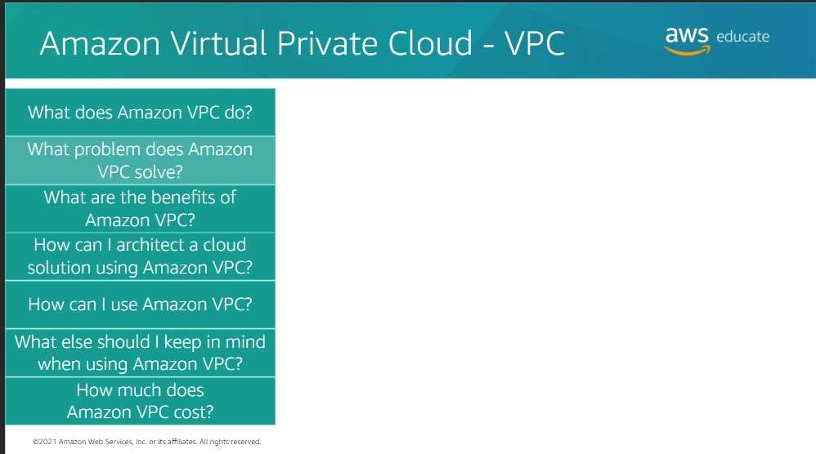

Slide 14
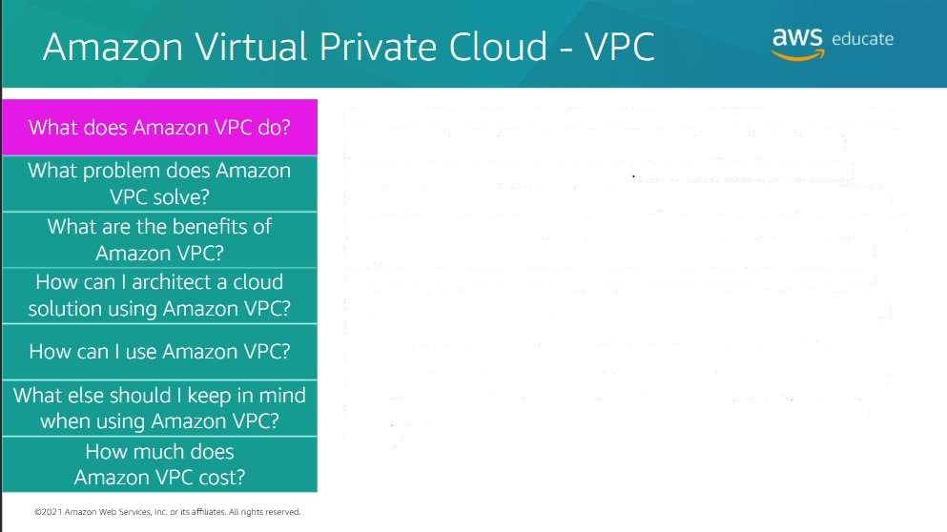
Amazon Virtual Private Cloud (Amazon VPC) is a service that you use to launch AWS resources in a logically isolated virtual network that you define As a foundational AWS service, Amazon VPC makes it easy to customize your VPC's network conñguration. You can create a public-facing subn et for your web servers that have access to the inter-net. You can also use Amazon VPC to place your backend systems, such as databases or application servers, in a private-facing subnet with no internet access. With Amazon VPC, you can use multiple layers of security to helo control access to Amazon EC2 instances in each subnet. These layers include security groups and network access control lists (network ACLs).

Slide 15
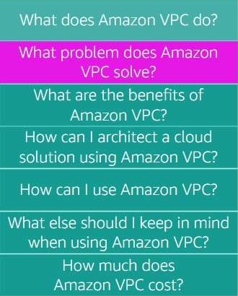
Amazon Virtual Private Cloud - VPC a^{W}s" '
Amazon VPC provides features that you can rise to increase and mon it or tne security for your virtual private' ClOLld (VPC) on demand. Therefore, you can create a data center as you need it and terminate it when you no longer need it.

Slide 16
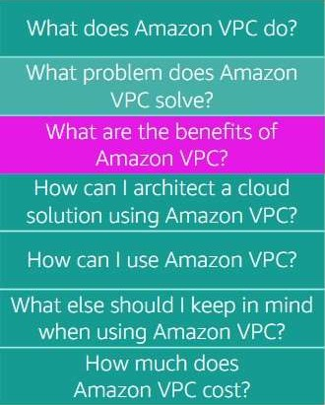
Amazon Virtual Private Cloud - VPC
ãWS_ educate
The following list describes a few of the beneñts that Amazon VPC offers.
Amazon VPC provides advanced security featu es that you can use to perform inbound and outbound Altering at the instance and subnet levels.
With simple setup of Amazon VPC, you spend less time sett in g up, managing, and validati ng. Therefore, you can concentrate on building applications that run in your VPCs.
Am BZO rl V PC helps yOLi COr›t rOI yOMr Vi rt LIB1 n etWO rki n g
e nVi rO n ment. By Li si n g Am a ZO rl V PC, yOLl Ca n Ch O Ose yO Mr
own IP Address range, create your own subnets, and
conñgure route table5 ID any available gateways.

Slide 17
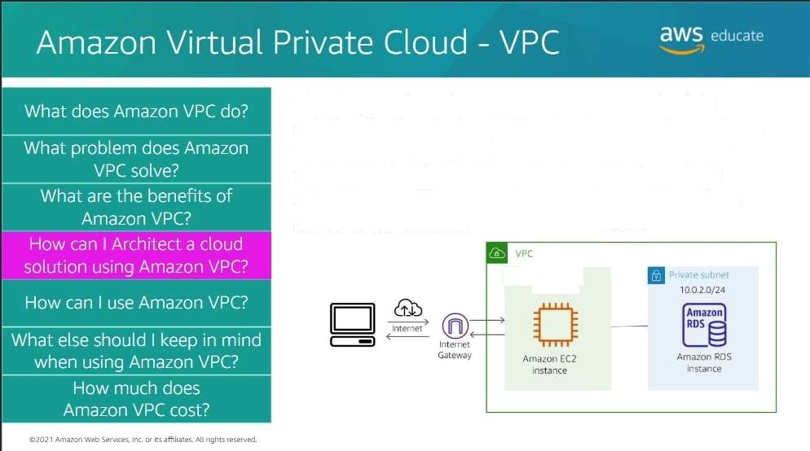

Tne diagram shows how you can use a VPC to build a solution that nas botn a public subnet and a private subnet. The oublic subnet has an EC2 instance that nosts a web application tnat has access to the internet. ThR FiVate subnet has an RDS instance that is protected from direct access to the internet.
0 O '0. 4

Slide 18
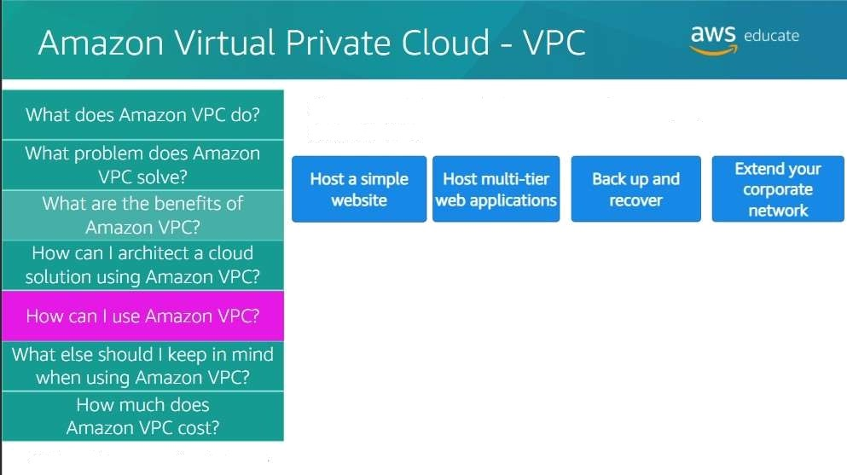
Choose each button to learn mOre abOut ways you can use
AmazOn VPC.
thuy 1 Amazon Web Ans
inc. or iLs affiliates. AO nghu reserved

Slide 19
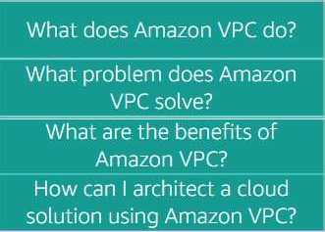




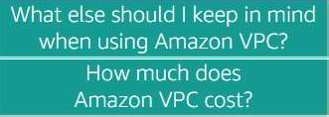
Amazon Virtual Private Cloud - VPC
SWS
'
What does Amazon \/PC do? What problem does Amazon
VPC solve*
What are the benefits of
Amazon \/PC*
How can I architect a cloud
solution using Amazon VPC?
How can I use Amazon VPN
What else should I keep in mind when using Amazon VPC?
How much does
AmazonUPCcoH2
Choose each button to learn more about ways you can use Amazon VPC.
You can use Amazon VPC to host a basic web application, such as a blop or simple website. You‘ll gain the additional layers of privacy and security that the VPC configuration options provide.

Slide 20
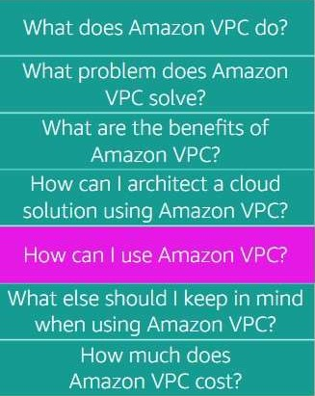


Choose each button to learn more about ways you can use
AmazOn VPC.
Mend your corporate network
You can use a VPC to host multi-tier web applications and strictly enforce access and security restrictions between your web servers, application servers, and databases. To achieve this result, you launch web servers in a publicly accessible subnet while running your application servers and databases in private subnets. This technique will ensure that application servers and databases cannot be directly accessed from the internet.

Slide 21
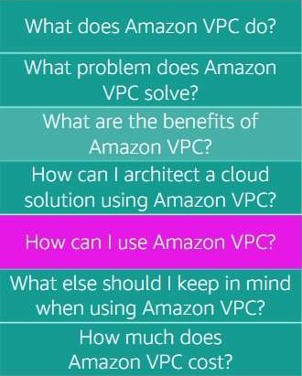


ChoOse each button to learn more about ways you can use
Amazon VPC.
”tend your ” corporate network
By using Amazon VPC for disaster recOvery, you receive all the benefits of a disaster recovery site at a fraction of the cost. You can periOdically back up critical data from your data center to a small number Ot AmaZOn EC2 instances. Aitematively, you can import your virtual machine images to Amazon EC2. To ensure bUsine5s continuity, you can use Amazon VPC to quickly launch replacement compute capacity in AWS. When the disaster is over, you can send your mission-critical data back to your data center.
20JJAmamnlSsnmm zorba€4aniflnghaéaeved

Slide 22
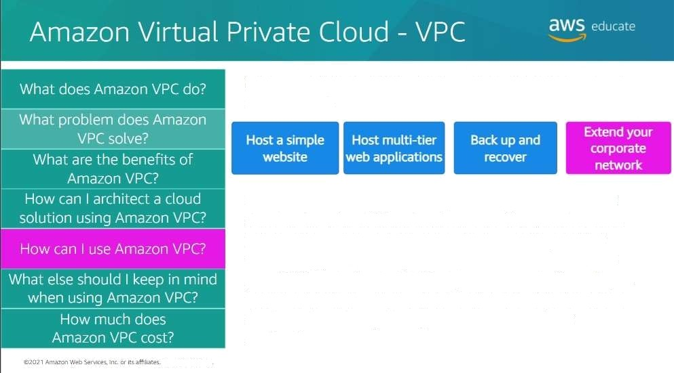
Choose each button to learn more about ways you can use Amazon VPC.
You can use a VPC to move corporate applications to the cloud or launch additional web servers. You can also use a VPC to add more compute capacity to your network by connecting your VPC to your corpOrate network. Because your VPC can be hosted behind your Corporate firewall, you can seamlessly move your IT resources intO the cloud. You don't need to chan9e how your users access these applications.
M Mghs reserve

Slide 23
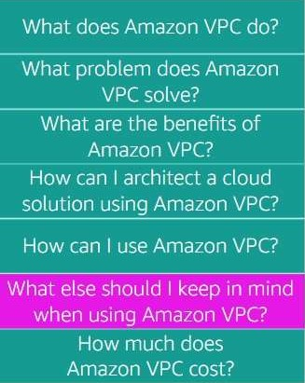
*wS
Amazon Vi tual Private Cloud - VPC
When you create a new AmazOn VPC, you have the option to
create one by using a template or create one from scratch.
When you create one frOm scratch, automatically it will create a route table, a network ACL, and a security group. Then, you conñgure them according to your needs.
If you must delete a VPC, be sure to first terminate any EC2 or RDS instances that you have provisioned in the VPC.
@âQ2 1 Annasan web Sen
inc. or fts aGiiares. Ag ngha resers'ed

Slide 24
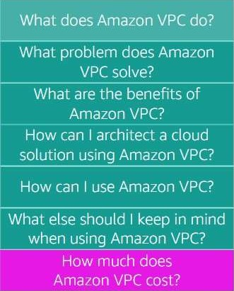
‘wS
Amazon Vî tual Private Cloud - VPC
An Amazon VPC doesn‘t cost you anything at a basic level. In fact, when you set up yOur AWS account, you are given a default VPC. A VPC consists of many components that dO not cost you anything, such as subnets, route tables, network ACLs, security groups, and an internet gateway.
However, you can also add features to your Amazon VPC such as a NAT gateway and elasticIPs that do have associated tharges
Also, any service that you place in your Amazon VPC, such as Amazon EC2, will carry with it the associated cost for that service.
@2UJ1 Amazon web tzr«tcea Inc or is affiliates. AIT nghts reserved

Slide 25
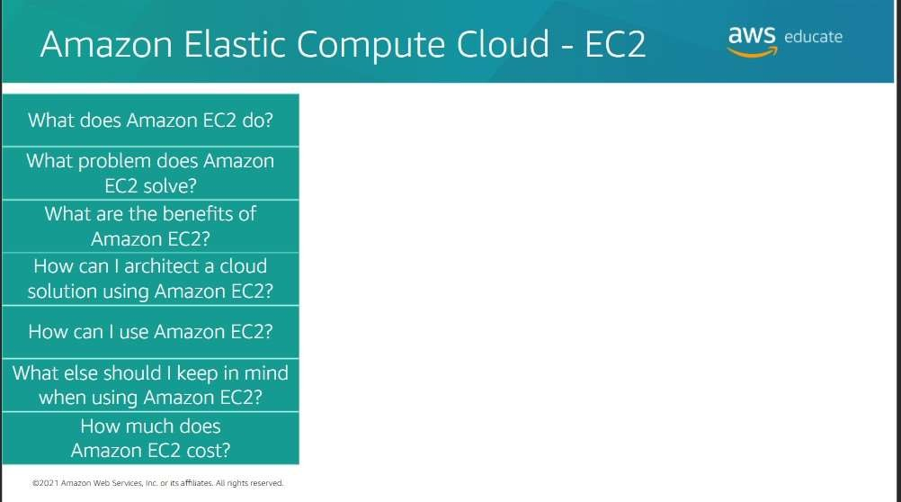

Slide 26
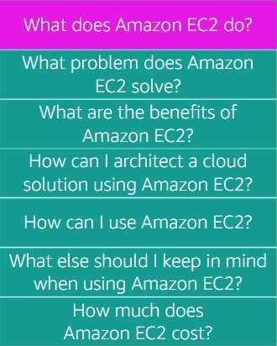
aW*
Amazon E łastic Compute Cloud - EC2
Amazon Elastic Compute Cloud (AmazOn EC2) is a web service that provides secure, resizable compute capacity in the cloud. It Is designed to make web scale cloud computing easier for developers. You can use the simple web interface of Amazon EC2 to obtain and configure capacity with minimal friction. It provides you with complete contro[ of your computing resources, and yOu can run it on the proven computing environment Oi Amazon.
@2021 Amam web
a inc or its affiliates. AI4 nghs reserved

Slide 27
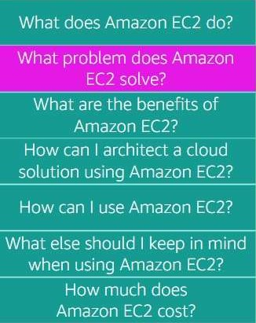
Amazon ECastle Compute Cloud - EC2
aWS
Amazon EC2 solves the problem of predicting upfront needs. Therefore, you don't need to know how much compute capacity or how much hard drive volume you will need when you set up yOur archKecture. You can scale up and down as you need to.
6202 1 Amaze web Wr tée§ inc. or its afñliabzs. Ak rrgha reserved

Slide 28
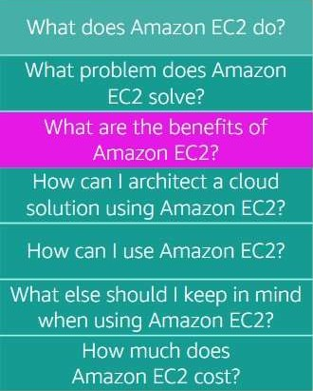
aW " '
Amazon Elastic Compute Cloud - EC2
The following list describes a few of tne be'ne'fits that
Amazon EC2 offers.
YDLJ Can pFOViSlOn an EC2 instance in as little as 5 minutes. It gives you the options to select the right CPU, storage, and operating system for your specific needs.
With Amazon EC2, you can cnange the Volume' SiZe and
the instance type without terminating the instance.
YDLJ Can use Amazon EC2 to scale up and down to meet seasonal needs. Vou don't need to have extra servers on hand tnat are used fOr only a feW TDFlths out of tne year.

Slide 29
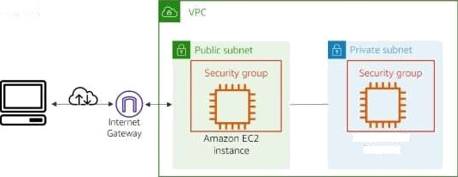
a^S
AmdZON ECastle Compute Cloud — EC2
With Amazon EC2, you can architect a solution to build a multi-tier application. To construct this solution, you create an instance in a public subnet that hosts a website with a security group that allows internet traffic in and out. Then, you can create another instance that hosts a database in a private subnet with a hardened security group. This security group restricts internet traffic, but alfOws the website İn5tance to acces5 the database instance.
What does Amazon EC2 do*
What prob en does Amazon
Wha are the benefits of
HOw can I use Amazon EC2?
What else should I keep in mind
when using AmdZOÜ EC2?
A,mąQn EC3 'nstanCe
exon1 Amazon web •erv+ces, inc. or lie aGliares. @ nghls reserved

Slide 30
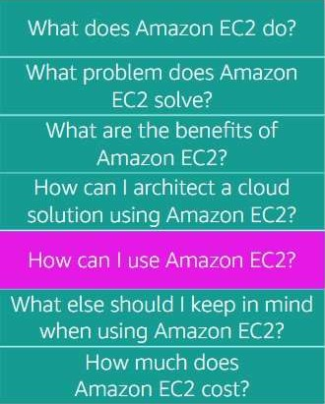


aW_{S} ed
Amazon Elastic Compute Cloud - EC2
Choose each button to learn more about ways you can use Amazon EC2.
Host databases
@202 1 Amazon weo Wrvtce\ inc or +ts afñflares. Ag nght reserred.

Slide 31


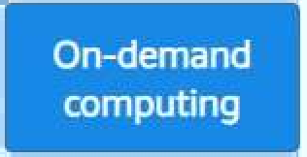
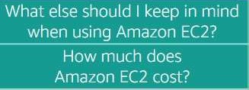
aw_{e} u'a
Amazon Elastic Compute Cloud - EC2
What does Amazon E 2 do?
What problem does Amazon
EC2 solve*
What are the benefits of
Amazon EC2?
How can I architect a cloud
solution using Amazon EC2?
How can I use Amazon EC2?
What else should I Leep in mind when using Amazon EC2?
How much does Amazon EC2 cost?
Choose each button to learn more about ways you can use Amazon EC2.
os1
Amazon EC2 can be used to create multi-tier web applications. With security groups, you control the ki nd of port traffic that can reach your instances. You conñgure your security group and attach it to your instances, and you control the traKc that can enter each layer of your architecture.

Slide 32
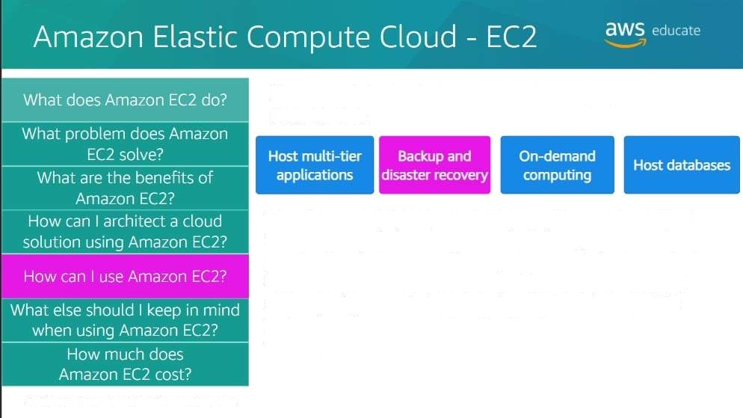
Choose each button to learn more about ways you Can use
Amazon EC2.
With Amazon EC2, you can create a backup instance if your main instances fail. In the event of a failure, you can scale up your baCkup instances until you get your main instances back online. Then, scale your backup instances back down when recovery Oi your main instances is complete. Amazon EC2 instances can act as a backup for Cloud or on-premises instances.
O2gal Aman
web' Wr +cee lv or me affiâares. Ag nghs resen*r<t

Slide 33
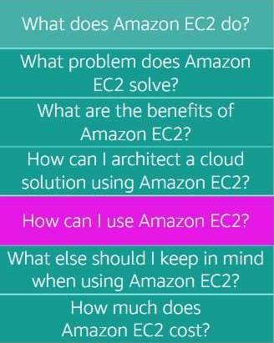

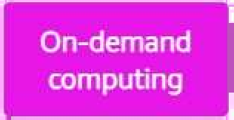

Amazon Elastic Compute Cloud - EC2
SWS
'
ChoOse each button to learn more about ways you can use
AmazOn EC2.
Host databases
Amazon EC2 lets you provision instances to perform computing jobs and terminate them when your are done. This arrangement can save you a lot of money, if you only need the computing resource for a few hours, days, or weeks.
@20J 1 Annas web Serv+eel inc or ns affiliares. Alt ngha reserved

Slide 34
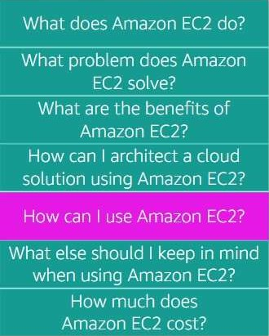


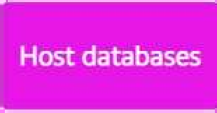
Amazon E łastic Compute Cloud EC2
aws
Choose each button to learn more about ways you can use
AmazOn EC2.
On-demand computing
AWS offers fully managed and server(ess database services that you Can provision for all your database needs. However, with both fully managed services and serverless services, you don't have access to the operating system of the database.
But you can host your own database on an EC2 instance, If
your company requires yOu to have that aCcess.
@2u2 1 Aman
w'•o @r«+eel Inc or +ts affiLares, At ngh•s reserved

Slide 35
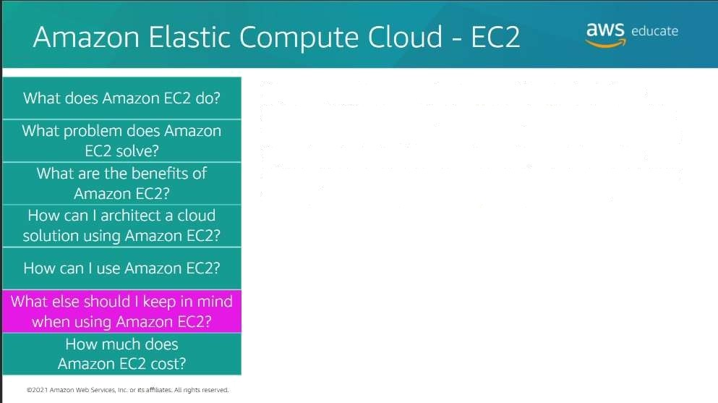
If you stop an instance, the Amazon Elastic BlOCk Store (Amazon EBS) volume that is attached will retain your data. You will still be charged for the use of the volume. However, if yOu terminate the instance, then all your data on the volume will be permanently deleted. The volume will return to AWS for available use to other AWS customers.

Slide 36




aWSe_{d}u e
Amazon Elastic Compute Cloud - EC2
What problem does Amazon
EC2 solve*
What are the benefits of Amazon EC2?
How can I architect a cloud
solution using Amazon EC2?
How can I use Amazon EC2?
What else should I keep in mind when using Amazon EC2?
How much does
Amazon EC2 cost?
Amazon EC2 has three main pricing models. Choose each to
learn more about them.
e2fi2 1 Amazon w'eo @wiczg inc or us aGliates. Ak nghs reser vec).

Slide 37
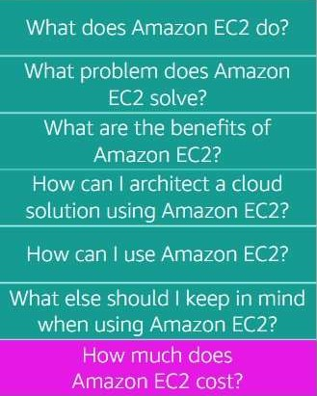


A uazon EMastic Compute Cloud - EC2 ^^^{S}
EC2 has three main pricing models. Choose each to learn more about them.
" Reserved
Instances
With On-Demand instances, you pay for instances only for the amount of time that you use them. No IOng-term commitments or upfrOnt payments are required. You can increase or decrease your compute capacity depending on the demands of your applicatiOn and pay only fOr the time that you use them.
Use case: Show-term computing workloads that cannot be interrupted; and users that need IOw-cost COmputing without any upfront or long-term commitment.
fM2AmaonWebSrvbe&Iu.wIaaV#aesflngnaeaeved

Slide 38
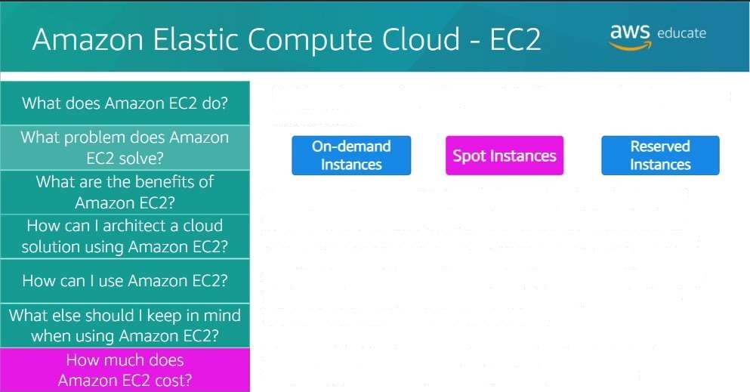
ECZ has three main pricing models. Choose each to learn more about them.
You can use Amazon EC2 Spot Instances to take advantage of unused Amazon EC2 capacity in the AWS cloud for a discount. You can save up to 90 percent compared to On—Demand prices. To get a Spot Instance, you submit a request with the instance speciﬁcations and the maximum price that you are Willing to pay per hour. When a Spot Instance is available at your submitted price, you will have access to the instance.
Use case: Workloads that can be paused and restarted vvhen computing prices meet your budget for Spot Instances.

Slide 39
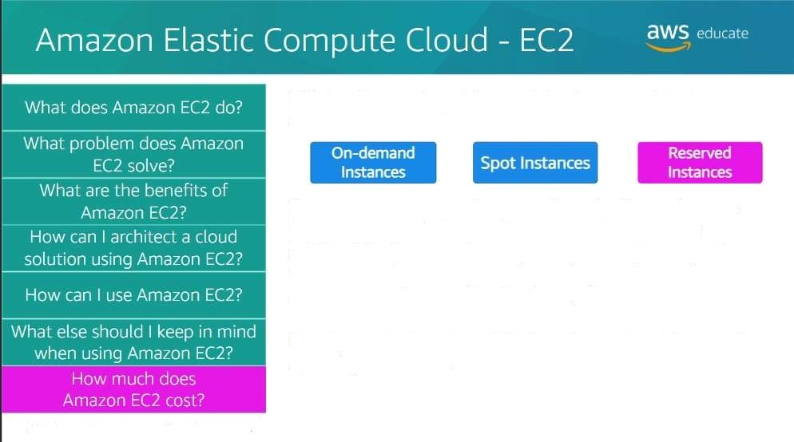
Reserved Instances provide you with a significant discount (up to 75 percent) compared to On-Demand Instance pricing.With Reservedlnsiances, you committO payngfOr the instance for 1 Or 3 years, depending on the conditions you agree to when purchasing them.
EC2 has three main pricing models. Choose each to learn more about them.
Use case: Computing needs with a steady amOunt usage of
up to 1 year Or more.
@2gJ1 Amazan Web @-s
Inc or me affiIiaas..Ah nghs reser ved

Slide 40
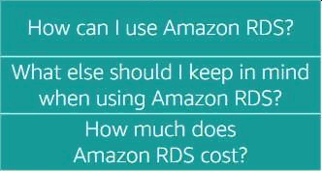
aws educate
Amazon Relational Database Service (Amazon RDS)
What does Amazon RDS do?
I
What problem does Amazon
RDS solve*
What are the benefits of
I
How can I architect a cloud
SOlUtiOÜ uSin9 Amazon RDS?

Slide 41
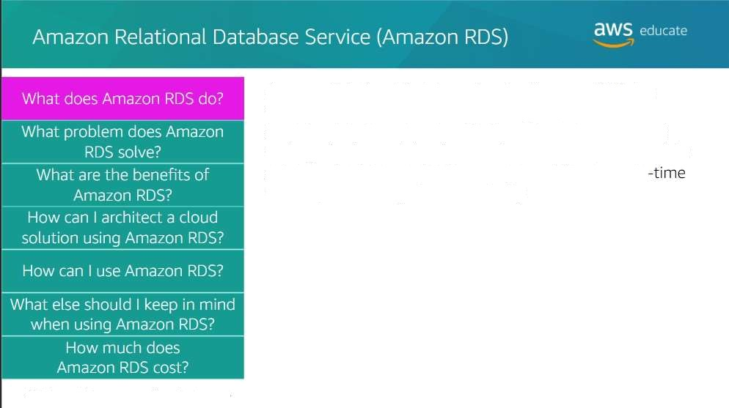
Amazon Relational Database Service (Amazon RDS) is a distributed relational database managed service. It is cloud-based and designed tO Simplify the setup, operation, and scaling of relational databases. Administrative processes like patching, backing up databases, and enabling point-in recOvery are managed automatically.
@2gJ1 Amazan Web @-s
Inc or me affiIiaas..Alt nghs reser ved

Slide 42
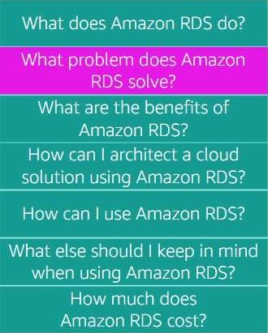
aws +duca e
Amazon Relational Database Service (Amazon RDS)
Amazon RDS solves the problem of purchasing a database witn a capacity that is either too large or too small for your use over time. With Amazon RDS, you can scale up and down based on your database capacity needs. As a result, you are never paying for more database capacity than you need.

Slide 43
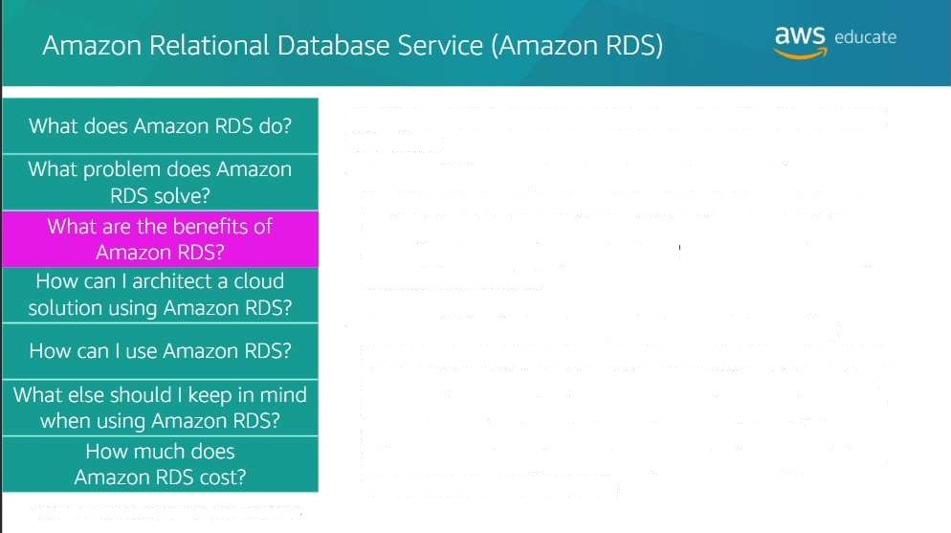
The following list describes a few of the beneñts that Amazon RDS offers:
Amazon RDS is easy to administer with no need for infrastructure provisioning, and no need for installing and maintaining database software. With a few mouse clicks or an API call, you can scale your database's compute and stOrage resOurces as needed.
Amazon RDS is fast and supports the most demanding database applications. You can run your database instances in Amazon Virtual Private Cloud (Amazon VPC), which enables you to isolate your database instances. Alternatively, you can connect your database instances to your existing IT infrastructure through an industry-standard encrypted lPsec virtual private network (VPN).
eJ0y 1 Amazon weo
met inc. oi me affi8arez its nghts reser ver

Slide 44
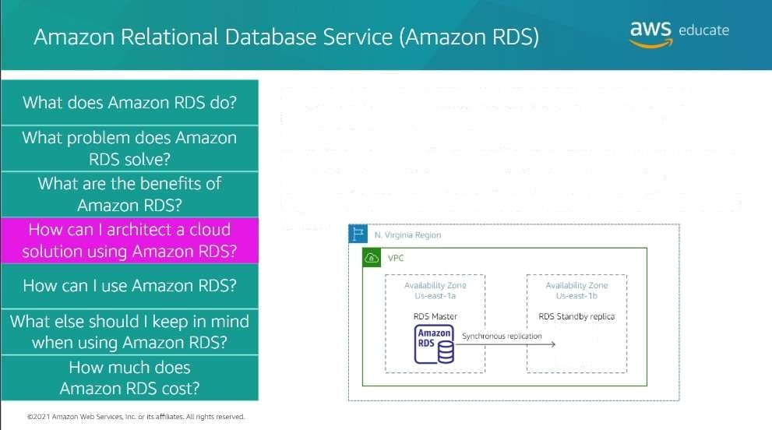

You can architect a solution to build for fault tolerance by configuring Amazon RDF for Multi-AZ deployment. To accomolish this task, you place your master RDS instance In one Availability Zone, and a standby replica of the master in another Availability Zone. If the primary fails, then tne standby automatically becomes the new master and your system remains active.

Slide 45



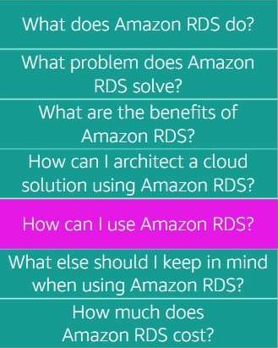



RDS)
Relational Database
aws
Choose each button to learn more abOUt ways you can use
AmazOn RDS.
Web and mobile applications
@2o2 1 Amazon v¥o toareg inc or its aGliares. Alt nghls reserved

Slide 46
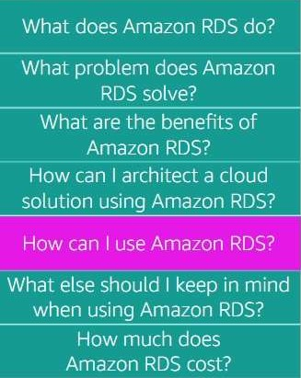
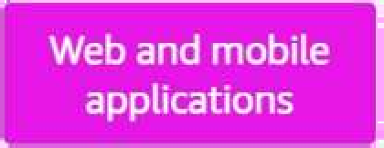


Amazon Relational Database Service (Amazon ROS)
aws
Choose each button to learn more about ways you can use Amazon R:DS.
Mob le and online
games
Web and mobile applications that are built to operate at very large scale need a database with high throughput, massive storage scalability, and high availability. Amazon RDS fulfills the needs of such highly demanding applications with room for future groMh. Because Amazon RDS does not have any licensing constraints, it perfectly fits the variable usage pattern of these applications.
@âQ2 1 Amaze web Sen
inc. or ItsaGliares. Ag ngha resers'ed

Slide 47





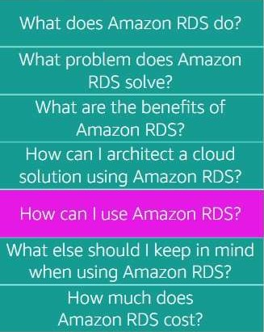



Relational
aws
Choose each button to learn more abOut ways you can use AmazOn RDS.
Web and mobile
applications
Amazon RDS offers small and large ecommerce businesses a flexible, secured, highly scalable, and low-cost database solution for online sales and retailing. Amazon RDS provides a managed database offering to help e-commerce companies meet payment card industry (PCI) compliance and focus on building high quality customer experiences. They don't need to worry about managing the underlying database.
62Q2 1 Amaze wa Lewes Inc. or me aGflares. Ah nghs reserved

Slide 48


Amazon Relational Database Se vice (Amazon PDSî
aws
Choose each button to learn more about ways you can use Amazon RDS.
Web and mobile applications
Mobile and On(ine games need a database platform with high throughput and high availability. Amazon RDS manages the database infrastructure so game developers don't have to worry about prOvisioning, scaling, or monitoring database servers. Amazon RDS provides familiar database engines that can rapidly grow capacity to meet user demand.
8i2o21 Amazon v¥b •,erv+cee inc or its affiliates. Ah nghs resented

Slide 49
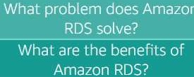


Amazon Relational Database Service (Amazon RDS)
SWS eõucate
What does Amazon RDS do*
How can I architect a cloud
solution using Amazon RDS?
How can I use Amazon RDS?
What else should I keep in mind
when using Amazon RDS?
How much does
Amazon RDS cost?
Amazon RDS is fully managed. “Fully managed’ means that AWS automates the maintenance and security of the database instance without yOur doing anything. However, you might need access to manage the operating systr'Iv and usdate security patches yourself. If so, then you can provision an EC2 instance and use it to host your own database.
Suppose that you decide to host your own database on an EC2 instance. Then, you are responsible for many of the automated tasks that Amazon RDS would automatically perform for you.

Slide 50
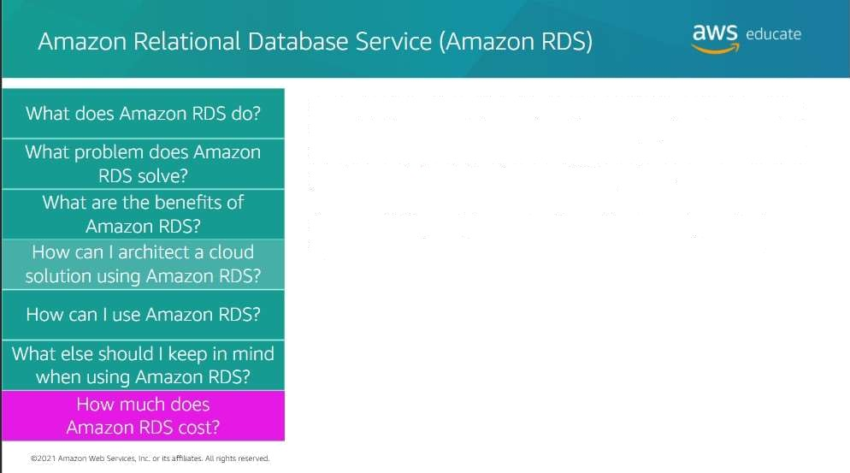
Amazon RDS pricing follows the pay-only-for-what-you use model. It has no minimum fee. You can pay for Amazon RDS by using On-Demand or Reserved Instances, similar to what you learned about the Amazon EC2 options.
Amazon RDS provides a selection OF instance types that are oDtimized to fit different relational database use cases.

Slide 51

Amazon CloudWatch
SWS educate

Slide 52

Amazon CloudWatch is a mon Storing and observation service
that is built for DevOps engineers, developers, sE’CMrity
engineers, and IT managers. CloudWatcn provides you with
data and actionabfR iFtslghts to monitor your applications, respond to system-wide performance changes, and optimize resource utilization. You get a united view of operational health.

Slide 53

Amazon CloudWatch solves the problem of responding to events and alarms, as they occur in yOur architecture.
Amazon CloudWatch co(lects monitoring and operational data in the form of logs, metrics, and events. It provides you with a united view of AWS resources, applications, and
services that run on AWS and on premises servers. You Can use CloudWatch to detect anomalous behavior in yOur environments, set alarms, and visualize logs and metrics side by side. Use it to take automated actions, troubleshoot issues, and discover insights to keep your applications running smoothly.

Slide 54

The follOwing list describes some of the benefits that AmazOn CloUdWatch offers.
You can use CloudWatch to collect metrics and logs from all yOur AWS resources, applications, and services that run on AWS and on-premises servers. You can monitor them from one platform.
You can use CloudWatch to maintain visibility across your services, applications, and infrastructure, so you can visualize key metrics like CPU utilization and memory.
You can use CloudWatch to set a(arms and take automated
actions. It frees up important resources sO yOu can focus
on adding business value.
or +ts aOiflab•s. Ag oghts résenred

Slide 55






What does s XdZO n
You can architect a solution by using Amazon CloudWatch to monitOr the CPU utilizatiOn and take action.
What p oblem does
What are the benefits
Amazon EC2 instance
Amazon CloudWatch
Amazon EC3 Auto Scaling
Amazon EC2 instance
In the diagram, CloudWatch receives data On the EC2 instance CPU utilization. When the CPU goes over a specifed percent, CloudWatch triggers Amazon EC2 Auto Scaling to provision an additional instance to help with the wOrkload.
Therefore, the €rst instance isn't overloaded.
How can I use CloudWatch?
What else should I keep in mind
when using CloudWatch?
@3O31 Amazon wee WrY¥@ !nc or me aGliares. AL nghts reserves

Slide 56



3AS
ChoOse each button to learn more about ways you can use Amazon CloudWatch.
Agpbœtion
monitoring
&i20J1 Ama.on. weo See+ces inc. or its afhliates. Alt nghts reserved

Slide 57

Choose each button to learn more about ways you can use Amazon CloudWatch.
You can use CloudWatch to monitor key metrics and logs, visualize your application and infrastructure stack, and create alarms. It correlates metrics and logs to understand and resolve the root cause of performance issues in your AWS resources.

Slide 58

Choose each button to learn more about ways you can use Amazon CloudWatch.
CloudWatch alarms watch your metric values against thresholds that you specify, or that CloudWatch creates by using machine learning models to detect anomalous behavior. For example, if an alarm is triggered, CloudWatch can take action automatically to enaDle Amazon EC2 Auto Scaling or stop an instance. In this way, you can automate capacity and resource planning.

Slide 59




Amazon CloudWatch
AWG educate
s. _
What does Amazon
CloudWatch do?
What problem does CloudWatch Solve* What are the benefits of CloudWatch?
How can I architect a cloud
solution using CtoudWatch?
How can I use CloudWatch?
What else should I Leep in mind when using CloudWatch?
How much does CloudWatch cost?
Choose each button to learn more about ways you can use Amazon CloudWatch.
monftodng and
troubteshoodng
CfoudWatch can monitor your applications that run on AWS (on Amazon EC2, containers, and serverless) or on-premises. CloudWatch collects data at every layer of the performance stack, including metrics and logs on automatic dashboards.

Slide 60

Amazon CloudWatch
SWS educate
.+a
Some services provide basic CloudWatch monito ing at no additional charpe with the option to upgrade to detailed monitoring, which comes with a charge.
For example, EC2 instances, by default, are enabled with basic CloudWatch monitoring. Thus, data is available automatically in 5-minute periods. If you dE'CIde to uograde to deta ited CloudWatch monitoring on your instances, data is available in -minute periods instead of 5-minute periods.

Slide 61

Amazon CloudWatch
2WS
Amazon CloudWatch does not require an upfront commitment or minimum fee: you pay for what you use. You are charged at the end of the month fOr your usage.
Amazon CloudWatch charges you for alarms, custom events, metrics collection and dashboards that you set up. However, you can get started with Amazon CloudWatch for free. Cost AWS services (Amazon EC2, Amazon SP, Amazon Kinesis, and others) send metrics automatically for free tO CloudWatch. Many applications should be able to operate within these free tier limits.

Slide 62

£tW_{S} ed
Amazon Simple Notification Service - SNS

Slide 63

Amazon Simple Notification Service (Amazon SNS) Is a web service that makes it easy to set up, operate, and send notifications from the cloud. It provides developers with a highly scalable, flexible, and cost-effective capability to publish messages from an application and immediately deliver them to subscribers. These subscribers can be notification recipients or other applications.
6i2u21 Ams
web $e @ inc or +Is affilianzs. AO nghts reserve)

Slide 64

Amazon SNS SOlves the problem of the appropriate subscribers not getting important information that they should be aware
of, as events occur in their applications or fnfrastructure.
e?u2 1 Amaze Weo li'acey inc. or me aRliates. At nghs reservecl

Slide 65

SWS‘
Amazon Simple Notification Service - SNS
The following list describes some of the benefits that Amazon SNS offers.
You can use Amazon SNS to send messages or notifications directly to users across 200 countries. Messages can be sent with SMS tE'Xt TeSSageS, mobllE' push on Apple, Android, and other platforms, or email (SMTP).
AmbZOG SNS uses a number of strategies that work together to provide message durabi lity. If a subscribed endpoint isn't available, Amazon SNS initiates a message delivery retry policy to resend the message.

Slide 66

You can use Amazon SNS tO create a solution to notify you of failuresin your architecture.
In this diagram, an Amazon EC2 instance fails and Amazon CloudWatch is notified. CloudWatch then triggers an action to create a new instance through AWS Auto Scaling. At the same time, CloudWatch triggers Amazon SNS to notify the appropriate subscribers, so that they can investigate the issue further.

Slide 67

You can use Amazon SNS to create topics. A topic is an access point, which identifies a specific subject or event type.
SNS topics are defined as standard topics or First-in-First-out (FIFO) topics. Choose each topic to learn more.
flo21Amazoi Wm li'acey inc. or me aff'Iia es. Ah nghs eservecl

Slide 68

You can use Amazon SNS to create topics. A topic is an access point, which identifies a specific subject or event type. SNS topics are defined as standard topics or First-in-First-out (FIFO) topics. Choose each topic to learn more.
Standard topics can be used in many scenarios if your application can process messages that arrive more than once and out of order. Examples include fanning out messages to media encoding, fraud detection, tax calculation, search index, and critical alerting systems.
O2o21 Arnam web Ser«toz> inc or me aGliares. All nghts rasen*ed

Slide 69

Amazon Simple Notification Service - SNS
£tW_{S} ed
You can use Amazon SNS to create topics. A topic is an access ooint, which identifies a speciGc subject or event type. SN S topics are defined as standard topics or First-in-First-out (FIFO) topics. Choose each topic IO lRarr! TORQ.
,
Standard
FIFO
FIFO topics are designed to enhance messaging between applications when the order of ooerations and e'VPOt5 is critical, or where duplicates can't be tolerated. Examples include fann ing out messages to bank transaction logging, stock monitoring, flight tracking, inventory management, and price update systems.

Slide 70

S召』召C亡 召口C獅 S召印『C召 『C〇打 〔。 team m0「召^
AWS Cluud
Browser
AmrJZlel’l\
RDSKQ
Email and-“or SMS Text mes
ﬁ-‘ﬁrﬂachzla SNSK‘?
CloudWatch
Amazon S3
{WS
DynamoDB
man Amazm waszemces. ーnf.nr usafﬁnares. m.nghTs reserved.
aws m =_ー=

Slide 71


Slide 72

£IWS• d
AWS Identity and Access Management (IAM) °'°
IAM is a centralized security management system tnat is included in every AWS account to control identity access to AWS services. By attaching IAM permission policies to identities, you can manage which services each identity can access and the kind of actions the identity can perform.
Identities in IAM are users, grouos and roles. Select each to
learn wore about them.
User
Group
Role

Slide 73


£\WS_{G}e u °’°
AWS Identity and Access Management (IAM)
RAM is a centralized security management syste'm that is included in every AWS account to control identity access to AWS services. By attach ing IAM permission policies to ide'ntities, you can manage which services each identity can access and the kind of actions the identity can perform.
Identities in IAM are users, groups and roles. Select each to learn mOre about them.
User
Group
Role
An IAM user is an entity that you create in AWS. The IAM user represents the person or service who uses the IAM user to interact with AWS.

Slide 74

IAM is a centralized security management system that is included in every AWS account to control identity access to AWS services. By attaching RAM permission policies to identities, you can manage which services each identity can access and the k no of actions the identity can perform
IdentitlE'S ID IAM are users, groups and roles. Select each to
learn more about them.
An AM user group is a collection of IAM users. You can use user
g FOMpS tO Sp 'Cify p 'rmisSiOn S fOF B COllQCti o n Of LJSeFS, WhiCrl
can make those permissions easier to manage for those users.

Slide 75

IAW is a centralized security management system that is included in every AWS account to control identity access to AWS services. By attaching IAM permission policies to identities, you can manage which services each identi can access and the kind Of actiOns the identity can perform.
Identities in IAM are users, groups and roles. Select each to learn more about them.
An RAM role is an identity with permission policies that are attached to it. An an IAM user or service can assume these policies to temporarily take on different permissions for a specihc task.
@2gJ1 Amazan Web @-s
Inc or me affiIiaas..Ah nghs reser ved

Slide 76

AWS Identity and Access Management (IAM)
SWS
IAM SOlVe5 the problem of users haVing mOre access than they should. IAM is built by using the principle of least privilege. This arincipfe states that an identity will not have access to any AWS service until you grant the identity access. By this method, no one should be able to provision or access resources that you have not explicitly granted them access IO.
For eXample, if yO Lt CFE'Bte a neW user, then that user cannot access the EC2 Dashboard by default. You must attach an IAM Dolicy to that user to grant them access to tnR EC2 Dashboard.

Slide 77

The following list describes a few of the benefits that IAM offers.
IAM has a simple used- interface that makes it easy to grant and control user access to AWS services
AM has many system-generated policies that you can use, and you can create additional custom policies that meet tne needs of your specific rca uirements.

Slide 78

Using IAM roles, you can grant sOmeone from a different AWS account access to your account to perform a specific task.
In the diagram, a user in the Dev account is assuming a rOle in the production account. The role returns a temporary security credential. It grants the user temporary access to the AWS service based on the policy that is attached to the role.

Slide 79

Choose each button to learn more about ways you can use RAM.
eJu21 Amazcn \veo Mi nice inc or me aGliares. AB rJghlz reserved

Slide 80

Choose each button to learn more about ways you can use IAM.
Your users can use IAM to control access to AWS service APls and to specific resources. You can use IAM to add sDecific conditions for how a user can use AWS resources or tneir originating IP address. These conditions might also determine whe’the’r they are using Secure Sockets Layer (SSL) or whether they have authenticated with a multi-factor authentication device.

Slide 81



Chooseeach button to learn more about ways you can use IAM.
Integrate with
 | your corporate
 |  | directory
With IAM, you can prOtect your AWS environment by using AWS multi-factor authentication (MFA). USA is a securi feature available at no extra cost that augments user name and password credentials. MFA requires users to prove physical possession of a hardware MFA token or MBA-enabled mobile dev‹ce by providing a valid MFA code.
O20JAmammWebVnmx
.orvsM#aiiflngnaeeoed

Slide 82

Choose each button to learn more about ways you can use IAf 1.
IAM helps you analyze access across your AWS environment. Your security teams and administrators can quickly validate that yOur policies only provide the intended public and cross-account access to your resources. You can also easily identify and refine your policies tO allow access to only the services that are being used. This practice helps you to better adhere to the principle of least privilege.
6202 1 Amaze web Serve z> Inc. or me affiliates. kg nghs reserueo

Slide 83




Choose each button tO learn more about ways you can use IAM.
IAM can be used to grant your employees and applications federated access to the AWS Management Console and AWS service APls. It uses your existing identi systems, such as Microsoft Active Directory. You can use any identity management solution that supports Security Assertion Markup Language (SAML) 2.0. You can also feel free to use one of the AWS federation samples, such as AWS Management Console single sign-on (SSO) or API federation.

Slide 84

AWS evaluates policies depends on the types of policies that apply. Choose each policy type to see how the logic is evaluated.
@2o2 1 Amazon v¥o toareg inc or its aGliares. Alt nghJs reserved

Slide 85

AWS evaluates policies depends on the types of policies that apply. Choose each policy type to see how the logic is evaluated.
An implicit deny denies a user, group, or role access to a service. This policy is the default setting for all new identities when they are created. For the identity to gain access tO a service, an explicit allow IAN policy must be attached to the identity. The explicit allow will then override the implicit
@2o2 1 Amazon web drrsuza Inc or its affiliates. Ab ngh c reserved

Slide 86




AWS evaluates policies depends on the types of policies that apply. ChoOse each policy type to see how the logic is evaluated.
An explicit allow wil[ override an implicit deny. The explicit allow can grant full access or partial access, depending on
the IAM policy that you attach.
For example, suppose that you attach an IAM policy to a user explicitly granting them access to read objects fn Amazon SP. Then, the implicit deny will still restrict the user frOm editing or deIetin.g the file. This restriction occurs because, in this example, the user has explicit permissions to only read the Ale.
rM2AmaonnebMr r& u. aa atflngnaeem

Slide 87



AWS Identity and Access Management (IAM)
SWS
AWS evaluates policies depends on the types of policies that apply. Ch.oose each policy type to see how the logic is evaluated.
What does IAM do*
What problem does IAM solve*
An explicit deny is an IAM policy that you attach to a user, group, or
What a e the benefits of IAM?
role. It restricts that identi from having access to the service or tO specified actions within the service. An explicit deny is similar to an implicit deny, with one important distinctiOn: an explicit allow
HOw can I arChitect a clOud
solution using RAM?
cannot override an explicit deny.
For example, suppose that a user has an explicit alloW tO full access to Amazon S3. The user is then put into a group that has an explicit deny to delete hles from Amazon 53. The result is that the user will have full access in everything Amazon S3, with the exception of the ability to delete hles.
How much does IAM cost*
Yyur 1 Amazon \veG ›erY+ozs inc or me aGiiares. AU n9nu reserved

Slide 88

IAM is a service in yOur AWS accOunt that is offered at no additional charge. You are charged only when you access other AWS services by using your IAM users' credentials.
s3ut 1 Amaze web S'z
ir+c. or me aGliares. Ag nghls reserved.

Slide 89


aWS
u"t
Amazon Simple Storage Service - SP

Slide 90

Amazon Simple Storage Service - S3 ^{aW}'" '
What does Amazon S3 do?
What problem does Amazon S3 solve?
What are the beneñts of Amazon S3?
How can I axhitect a cloud solution by usinp Amazon S3?
How can I use Amazon S3?
What else should I keep in mind
when usinp Amazon S3?
How much does
Amazon S3 cost?
Amazon SP is object storage tnat is built to store and retrieve any amount of data from anywhere at any time. It s a simple storage service that offers industry-leading
durabi lity, availability, performance, security, and virtually
unlimited scala bility Bt IDW COStS.

Slide 91

. Vou don’t rlr'ed to estimate now much storage space you will need. You create your bucket and add as many files as you neea to. YDM simply create your bucket and add as many files as you need to. Amazon S3 is e’lastiC and scales automatically to meet your storage requirements.
2. Files that are uploaded to Amazon SP are automatically replicated across multiple Availability Zones in the Region. Thus, your flies are always highly available and highly durable, so that you can access tnem when you need them.

Slide 92

The following list describes a few of the benefits that Amazon SP Offers.
- Amazon S3 offers you industry-leading performance,
scala ty, availability, and durability that you can use to easily build applications that use cloud native storage. As a
result, you consistently have your data when yOu need it.
Because Amazon SP is serverless, it is highly scalable. Therefore, you can start small and grOw your appliratiOn as you want, with no compromise on performance or
reliab!li .
- AmazOn SP also has unmatched securi , compliance, and
audit capa ities in the cloud.

Slide 93





Amazon Simple Storage Se vice - SP
aws
You can architect a solution by using Amazon SP to host a static website anywhere in the world.
Amazon CoodFoni
In this example, Amazon 53 is being used to host a static website. The website content Is uploaded to Amazon SP and directed to Amazon CloudFront (a content delivery service) to deliver the content to the internet. Users can then access the website on their browser.
@2u2 1 Aman
w'•o @r«+eel Inc or +ts affiLares, At ngh•s reserved

Slide 94

Choose each button to learn more about ways you can use Amazon SP.

Slide 95

Cnoose each button to learn more about ways you can use
Amazon SP.
Amazon SP can be used to build scalable, durable, and secure backup and restore solutions to augment or replace existing on-premises capabilities.

Slide 96



aWS.e u 'e
Amazon Simple Storage Service - SP
What does Amazon S3 do*
What problem does Amazon S3
solve?
What are the benefits of Amazon S3?
How can I architect a cloud
solution by using Amazon S3?
How can I use Amazon S3?
What else should I keep in mind when usin9 Amazon S3*
How much dOes
AmazOn S3 cost?
Cnoose each button to learn more about ways you can use
Amazon SP.
Data takes and
big data anal\rtîcs
You can protect critical data, applications, and IT systems with Amazon SP that are running in the AWS Cloud or in your on-premises environment. You can avoid tne expense of a second physical site.

Slide 97

Cnoose each button to learn more about ways you can use Amazon SP.
Retire physical infrastructure, and archive data with Amazon Simple Storage Service Glacier and SP Glacier Deep Archive. These' SP storage classes retain objects long-tern at the lowest rates. Vou create an SP Lifecycle Dolicy to archive objects throughout tneir lifecycles, or upload objects directly to tne archival storage classes.

Slide 98

Choose each button to learn more about ways you can use Amazon S3.
Accelerate innovation by building a data lake on Amazon SP, and extract valuable insights by using query-in place, analytics, and machine learning toOls. As your data lake grows, use S3 Access Points to easily configure access to your data, with specific permissions for each application or set of applications.
M Mghs reserve

Slide 99

Amazon SP is designed for object storage, not block storage.
Object storage is a storage option that is meant for read-intensive fi les that are not written to. If the file’ needs a change, then the file can be overwritten. Examples of object storage are pictures, videos, documents, and static websites.
Block storage is a more structured set of data hosting that is often written to Examples of obteCt storage arr' pict Llres, videos, documents, and static websites. Amazon SP is not designed for these uses. Amazon offers Amazon Elastic
Block Store’ IO Qet these needs.

Slide 100

With Amazon S3, you pay only fOr what you use. It has no minimum fee. Some prices vary across Amazon 53 Regions. Billing prices are based on the location Oi your S3 bucket.
Ak isghts reserveo

Slide 101

AWS Lambda
ãW educate
What does AWS Lambda do?
What problem does AWS
Lambda solve?
What are the benefits of AWS
How can I architect a cloud
SOlUtlOÜ using AWS Lambda*

Slide 102

AWS Lambda is a serverless compute service that you can use to run function COde without provisioning or managing servers. You can use Lambda to run function code for virtually any type of application or backend service. You upload your code, and Lambda takes care of everything that is required to run and scale your code with high availabili .

Slide 103

AWS Lambda
aws
AWS Lambda removes all administration for application or backend services that Can be processed in snippets of cOde. You upload your code as a .Zip file or container image. Then, Lambda automatically and precisely allocates compute power to run your code based on the incoming request or event, fOr any scale of traffic. You can set up your code to automatically trigger from over 200 services and software as a service (SaaS) applications or call it directly from any web or mobite app.
20JJAmamnlSsnmm zorba€4aniflnghaéaeved

Slide 104

The follOwing list describes the main benefits that AWS Lambda Offers.
AWS Lambda is serverless, so you have no servers to manage. Lambda automatical(y runs your code without requiring you to provision or manage Infrastructure. YOu write the code and upload it to Lambda either as a .zip file or as a container image.
AWS Lambda has built in continuous scaling that scales your application by running code in response to each event. It scales precisely with the size of th.e workload, from a few requests per day to hundreds of thousands per second.
alt ngh1s reserved

Slide 105



AWS Lambda
aws
You can architect with Lambda by configuring Lambda to perform an action when an event occurs in a triggering service.
Whdt does AWS Lambda do*
What problem does AWS
What are the benefits of AWS
6ucker B
In this example, a user uploads a photo into Amazon S3 - Bucket
A. This action triggers the Lambda code to run and resize the
photo and place the photo in Amazon S3 — Bucket B. From Bucket B, the user can download the resized photo. Lambda then sends an email or a text message to the appropriate users to alert them that the photo is ready to download.
How can I use AWS Lambda*
What else should I keep in mind
when using AWS Lambda?
&2.o2 4 Anna zon M Mr›nres, inc or its aT'1ianzs. n n3hu reser ver

Slide 106

AWS Lambda.
ChoOse each button to learn mOre about ways you can use

Slide 107



AWS Lambda
aws
ChoOse each button to learn more about ways you can use AWS Lambda.
Real-time soeam
By combining AWS Lambda with other AWS services, developers can build powerful web applications that autOTatically scale up and down. These applications run in a highly available configuratiOn across multiple data centers - with zero administrative effort required for scalability, backups, or multi-data redundancy.
@20J 1 Annas web Serv+eel inc or ns affiliares. Alt ngha reserved

Slide 108




aws
Choose each button to learn more about ways you can use AWS Lambda.
Real-time stream
processing
You can use AWS Lambda to execute code in response to triggers such as changes in data, shifts in system state, Or actions by users. Lambda can be directly triggered by AWS services such as Amazon S3, DynamoDB, Kinesis, Amazon SNS, and CiOudWatch, or it can be orchestrated into workflows by AWS Step Functions. Thus, you can build a varied of real-time serverless data processing systems.
8i2o21 Amazon v¥b •,erv+cee inc or its affiliates. Ah nghs resented

Slide 109




AWS Lambda
Choose each button to learn mOre abDut ways you can use AWS Lambda.
Real-time stream processing
You can use Amazon S3 to trigger AWS Lambda to process data immediately after an upload. YOu Carl alsO connect to an existing Amazon Elastic File System (Amazon EFS) file system directly, which enables massively parallel shared access for large-scale file prOcessing. For example, you can use Lambda to thumbnail images, transcOde videos, index files, process logs, validate content, and aggregate and filter data in real-time.

Slide 110




AWS Lambda ***
ChoOse each button to learn mOre abOut ways you can use
AWS Lambda.
You can use AWS Lambda and Amazon Kinesis to process real-time streaming data for application activity tracking, transaction order processing, and click stream analysts. You can also use it for data cleansing, metrics generation, log filtering, indexing, social media analysis, and Internet of Things (IoT) device data teiemetry and metering.
Bi2u21 Ams
web $e @ inc or +ts a1Tilianzs. Au nghts reserve)

Slide 111


Slide 112

Amazon DynamoDB
OWS
Amazon DynamoDB is a serverless non-relational database that can store and retrieve any amount of data and serve any level of reQuest traffic. You can scale your database tables' throughput capacity up or down without downtime. You can use the AWS Management Console to monitor resource utilization and performance metrics.

Slide 113

Amazon DynamoDB
SWS educa e
What does Amazon DynamoDB do?
What problem does DynamoDB solve?
What are the benefits of DynamoDB*
How can I architect a cloud
solution using DynamoDB?
How can I use DynamoDB?
What else should I keep in mind when using DynamoDB?
How much does DynamoDB cost?
You can use DynamoDB to offload the aaministrative burdens of operating and scaling a distriouted database. Therefore, you don't need to worry about hardware’ provisioning, setup and configuration, replication, software patching, or cluster scaling.

Slide 114

The following list describes a few of the benefits that
DynamoDB offers.
- DynamoDB suppous sOme Oi the world's largest scale applications by providing consistent, single digit millisecond respOnse times at any scale.
DynamoDB is serverless with nO servers to provision, patch, or manage and no software to install, maintain, or operate.
DynamoDB supports ACID transactions sO that you can build business-critical applicatiOns at scale. DynamODB encrypt all data by default and provides fine grained identity and access control on all your tables.
or its aGliares. Alt ngho reser ued

Slide 115

You can use Amazon DynaivoDB to store an application’s stored data.
In th is example, a user accesses an application that is stored in Amazon S3. The user chooses an option to receive data.
Amazon API Gateway will then trigger Lambda to retrieve
data from DynamoDB and send it back to the Msr'r's interface.

Slide 116

Choose each button to learn more about ways you can use Amazon DynamoDB.

Slide 117

Amazon DynamoDB
aws
Choose each button to learn more about ways you can use
Amazon DynamoDB.
Many companies in the retail space use common Dynam.oDB design patterns to deliver consistently low latency for mission-critical use cases. Being free from scaling concerns and operational burden is a key cOmpetitive advantage. It provides for high—velocity, extreme-scaled events such as Amazon Prime Day, whose magnitudes are difficult to forecast. By scaling up and down, these customers pay only for the capacity that they need. They can keep preciOus technical resources focused on innovations rather than operations.
1 20? 1 Amaze Weo er a•\ inc or me afhliares. Alt nghs reserved

Slide 118



Amazon DynamoDB *^*
Choose each bUtton tO learn more abOut ways you can use
Amazon DynamODB.
Ad TeclJ
Companies in the gaming vertica[ use DynamoDB in all capabi(ities of game platforms, including game state, player data, session history, and leaderboards. The main benefit that these companies get from DynamODB is Its ability to scale reliably to millions of concurrent users and requests while ensuring consistently low latency. This iatency can be measured in single digit milliseconds.
Bi2u21 Ams
web $e @ inc or +ts a1Tilianzs. Au nghts reserve)

Slide 119

Choose each button to learn more abOut ways you can use Amazon DynamoDB.
Banking and finance companies use DynamoDB to build more clOud-native applications to increase agility, reduce time to market, and minimize operational overhead. These companies also use DynamoDB to ensure the security. reliability, and continued high availability of their applicatiOns.
@2o2 1 Amazon web mrs zg Inc or its affiliates. Ab ngh c reserved

Slide 120

Choose each Dutton to learn more about ways you can use
Amazon DynamoDB.
Companies in advertising technology (ad tech) use DynamoDB as a key-value store for storing various kinds of marketing data. Examples of such aata would include user proxies, user events, clicks, and visited links.

Slide 121




Amazon DynamoDB
What does Amazon DynamoDB do?
What problem does
DynamoDB solve?
What are the benefits of DynamooB?
How can I architect a cloud solution usin D namoDB?
How can I use DynamoDB?
What else should I keep in mind when using DynamoDB*
How much does DynamoDB cost?
DynamoDB is a non-relational database. If you need a relational database, you would use Amazon RDS. Ch oose each option below to learn more about the differences between tnR two.

Slide 122

Choose the buttons below to learn more about the differences between relational and non-relational databases.
Relational databases store data in rows and columns. Rows contain all the information about One entry, and columns are the attributes that separate the data points. A relational database schema is hxed: columns must be locked before data entry. You can amend schemas if the databa5e is altered entirely and taken offline. Data in relational databases is queried by using structured query language (SQL), which can have complex queries.
Relational databases scale vertically by increasing hardware power. Relational databases are commonly used for traditional applications, enterprise resOurce planning (ERP), customer relationship management (CRM), and e-commerce.
Yyuy 1 Amaron weo jens inc. or its affiliates. Afi nphu reserved

Slide 123

Choose the buttons below to learn more about the differences between relational and non-relational databases.
Non-relational databases store data by using one of many storage models, including key value pairs, documents, and graphs. Non-relational Schemas are dynamic, and information can be added rapidly. Each row doesn't have tO contain data for each column. Data in non-relational databases is queried by focusing on collections of documents. Non-relational databases scale horizontally by increasing servers. Key-value databases are commonly used for internet-5cafe applications, real-time bidding, shopping carts, and customer preferences.
or its aGliares. Alt nghD reser ued

Slide 124

End of Module 4
You should now be able to:
Define the different types of services
Identify the main categoriRS of services as part of an architecture
Describe each service, its use. features, and benefits

