Slide 1

Machine Learning Foundations
aWS educate
Module 3
Machine Learning Pipeline
This slide was captured from AWS Educate Presented by Amel
Slides will automatically play. If you would like to stop the outoplay feature seleR the autoploy toggle. Some elements on sñdes moy be hidden until manually ployed.
Autoplay slides
https://github.com/siagianp
https://www.youtube.com/@AmelOline/videos
https://github.com/amelcharolinesgn2/Cloud-Infrastructures
https://github.com/amelcharolinesgn2/ClouD-Infrastructure-SISKA-2025
https://github.com/amelcharolinesgn2/CCNA1
https://github.com/amelcharolinesgn2/CCNA2
https://github.com/amelcharolinesgn2/AWS Certificate

Slide 2
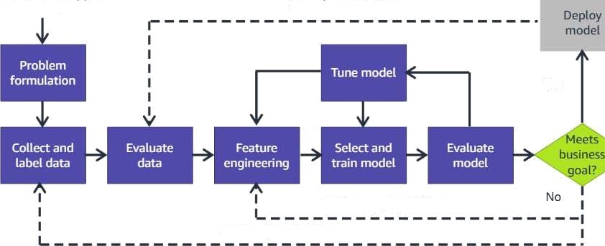
Introduction
To begin your journey, it's important to understand the components that make up the machine learning (ML) pipeline. The machine learning pipeline is the typical workflow for solving a business problem.
In this section, you will get a high-level overview of the workflow and an understanding of the basic steps for implementation.
Business problem
New data, retraining
Yes
Feature augmentation
To read the module objectives click here
Data augmentation

Slide 3
Introduction
J •
r
By the end of this course you will be able to:
Discuss the machine learning pipeline
Describe problem formulation
Describe data preparation and preprocessing
Describe model training and tuning
Describe model evaluation
Describe model deployment
Use an example to apply the steps of the machine learning pipeline

Slide 4
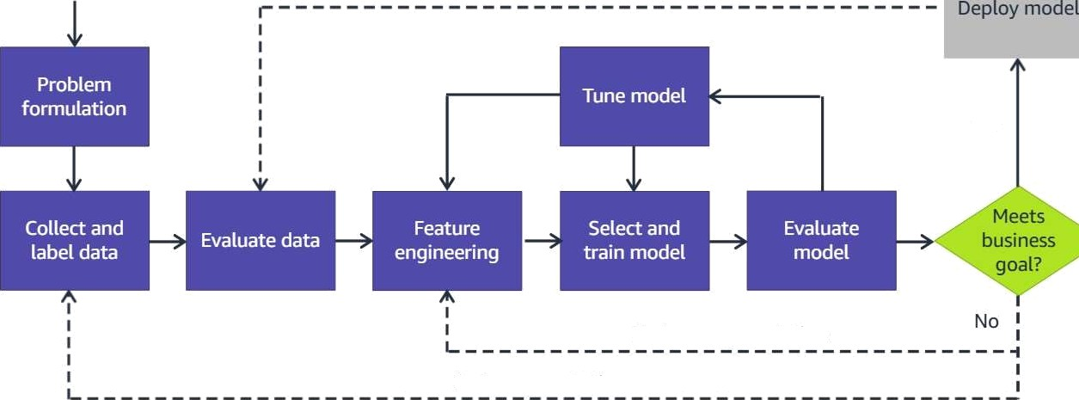
Machine learning pipeline
Business problem
New data, retraining
Yes
Feature augmentation
Data augmentation

Slide 5

Problem formulation
To begin, you should atways start with the business problem that you or your team believes can benefit from ML. From there, you want to do some problem formulation. This phase entails, in part, articulating your business problem and converting it to an ML problem.
Next, you'll review some critical questions to ask.
Critical questions to ask:
How is this task done today?
How will the business measure success?
How will the solution be used?
Do similar solutions exist, which you might learn from?
What assumptions have been made*
Who are the domain experts?

Slide 6
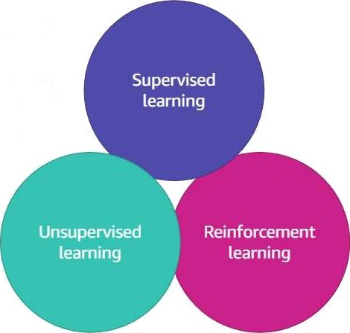
Framing the problem
With more information about the problem, you can begin to design an approach.
First, can machine learning solve the problem, or would a traditional approach make more sense?
Second, is this problem a supervised or unsupervised machine learning problem? Do you have labeled data to train a supervised model*
You have many questions to ask yourself and the business. Ultimately, you should try to validate the use of machine learning and confirm that you have access to the right people and data. Then, devise the simplest solution to the problem.

Slide 7



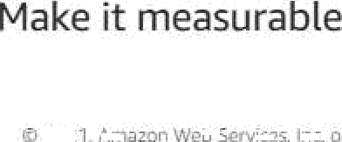
Example: Probtem formulation
Let's review an example. Reviewing the monthly membership numbers you notice that more customers are ending their credit card membership than in the past. You discover that there has also been an increase in fraudulent credit card transactions.
The problem
You want to identify fraudulent credit card transactions so that you can stop the transaction
before it processes. That‘s the stated problem.
The goal or intended outcome is to reduce the number of customers who end their
membership because of fraud.
Intended outcome
To solve this problem with machine learning you need to be able to easily measure it. That means you must move from qualitative statements to quantitative statement. You might define success for this problem with the following metric: a successful outcome is a 10 percent reduction in the number of customers who file ctaims for fraudulent transactions within a
6-month period.
You have now defined the business end of your problem. Next you will learn to make this a machine learning problem.

Slide 8

Make it a machine learning model
You start to think about the problem in terms of your NIL model. What output do you want to see from your model? Be specific—it should be a statement that reflects what an ML modet can output. An example might be the following: The model will output whether a credit card transaction is fraudulent or not fraudulent.
Now that you know what your ML model should achieve, you can use this information to determine the type of ML that you will work with.
Recall the two types of supervised ML: classification and regression. In the credit card example, your intended output is to classify a transaction as either frot/d or not froud. Therefore, in this case, you can see that you're dealing with a binary classification problem.
Fraud
Binary classification problem
Not fraud

Slide 9
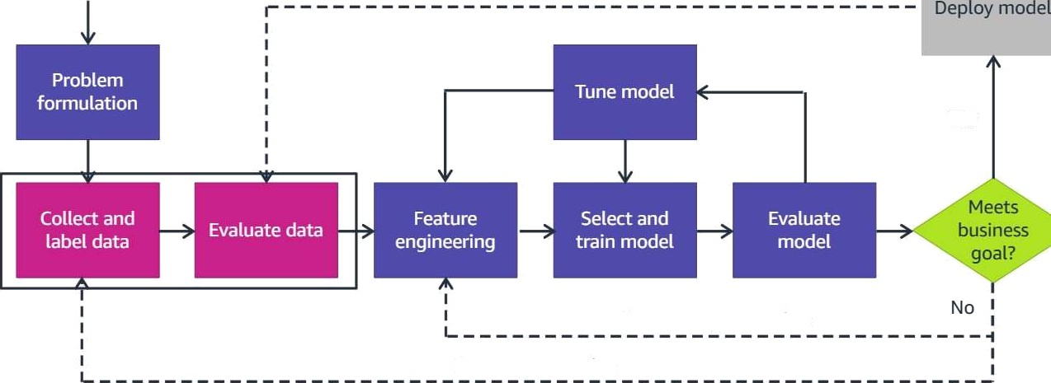
Machine learning pipeline — Data collection and evaluation
Business problem
Nevvdata,retraining
Yes
Feature augmentation
Data augmentation

Slide 10

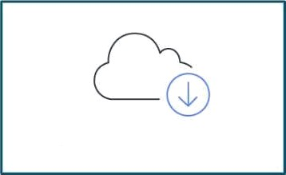

Data sources
Private data
Commercial data Open-source data
After the business problem is fully developed, you must ask yourself some questions. Which data do you need to train your model to reach the intended output and, subsequently, your specified business outcome? Do you have access to that data? If so, how much data do you have, and where is it? What solution can you use to bring all this data into one centralized repository? Answering these questions is essential at this stage.
There are three major types of data to consider. Choose the buttons to read more.

Slide 11

Data sources
Private data
Private data is data that you have in various existing systems. Everything from log files to customer invoice databases can be useful, depending on the problem that you want to solve. In some cases, data is found in many different systems.

Slide 12




Data sources
Commercial data
Commercial data is data that a commercial entity collected and made available. Companies such as Reuters, Change Healthcare, Dun & Bradstreet, and Foursquare maintain databases that you can subscribe to. These databases include curated news stories, anonymized healthcare transactions, global business records, and location data. Supplementing your own data with commercial data can provide useful insights that you would not have otherwise.

Slide 13


Data sources
Open-source data
This data comprises many different open-source datasets that range from scientific information to movie reviews. These datasets are usually available for use in research or for teaching purposes. You can find open-source datasets hosted by AWS, Kaggte, and the UC Irvine Machine Learning Repository. Government and health organizations are other sources of data that might be useful.

Slide 14
Data considerations
Understand the data
When choosing your data, you must consider several factors.
Additional questions to ask yourself include the following:
What data do you need to address the problem?
How much data do you have, and where is it?
Do you have access to that data?
Can you bring this data into one centralized repository?
Is the data representative?
Choose the tabs to learn more about data considerations.
Get a domain expert
Evaluate data quality
Identify features and labels
Identify labeled data needs

Slide 15
Data considerations
Understand the data
Get an understanding of your data
You have further formulated the problem, but what data do you need to actually train the model to reach the desired output and intended business outcome? Do you have access to that data? If so, how much data do you have and where is it?
What solution can you use to bring all of this data into one centralized repository? These questions are essential to answer at this stage.
Get a domain expert
Evaluate data Quality
To answer these questions, it's a good idea to start with an overview of the typical elements of an ML dataset.
Identify features and labels
Identify labeled data needs

Slide 16
Data considerations
Understand the data
Get a domain expert
Your data shoutd be representative of the data that you witl have when you are using the model to make a prediction.For example, if you want to predict credit card fraud, you must collect both positive (fraudulent transactions) and negative (non-fraudulent transactions) data. Both types are necessary for the machine learning algorithm to be able to find patterns that will distinguish between the two types. Suppose that your average amount of fraudulent transactions is actually 3 percent. However, your training dataset only includes a small fraction of fraudulent observations, maybe 0.4 percent. Then, it will be difficult for your model to truly learn patterns related to fraudulent transactions that it might encounter in production.
Get a domain expert
Evaluate data quality
Identify features and labels
Identify labeled data needs
Given what you know about the elements of an ML dataset, recall one of the original questions. Which data do you need to actually train the model to reach the desired output and intended business outcome* At this stage in the ML pipeline, it's vital to get domain expertise. With domain knowledge, you can begin to determine the features and target data that your model needs to make accurate predictions.

Slide 17
Data considerations
Understand the data
Evaluate the quality of your data too
A general rule in this case is that good data contains a signal about the phenomenon that you're trying to model. For instance, suppose that a wholesaler is trying to forecast demand for a few of their products. They might track the number of sales that they've had previously, which is a good start. However, what if they forget to log when certain products were out of stock? If you're trying to forecast demand, it's important to know when you were out of stock. Therefore, it is critical to have that data represent one of your features.
Get a dO0łain expert
Evaluate data quality
Identify features and labels
Soap | 1.99 | 20 | 14 | 49
Shampoo | 6.09 | 10
Hair brushes | 1 2.95 | 30 | 1 2 | 2
Toothpaste | 3.50 | ZO | 1Z | 49
Toothbrushes | 5.00 | 20
Lotion | B.7S | 10 | ? | ?
Identify labeled data needs

Slide 18





Data considerations
Understand the data
Start identifying features and labels you already have
Your data is made up of two elements: features and labels. A feature is an attribute that can be used to help identify patterns and predict future answers. A feature in the credit card example could be the date of transaction, vendor, or amount of the transaction, in dollars.
Get a domain expert
Evaluate data quality
Subsequently, data for which you already know the answer is called labeled data. The label is the answer that you want your model to predict. So in the credit card transaction example, the label of any given observation is either "fraud“ or “not fraud."
Identify features and labels
 |  |  |  |  | a |  | no | n
 | 10/S |  | Store 1 | 10.99 |  | No
DEF | 10/5 |  | Store 2 | 999.99 |  | Yes
GHI | 10/S |  | Store 2 | 15.00 |  | No
JKL | 10/6 |  | Store 2 | 699.99 |  | ?
MNO | 10/6 |  | Store 1 | 999.99 |  | Yes
Identify labeled data needs

Slide 19
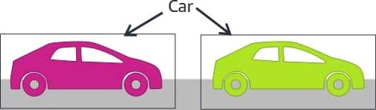

atDo siderations
Understand the data
Do you need a lot of labeled data?
/•1any of the examples that you've seen so far represent supervised learning and therefore include labeled data. But what if you don‘t have labeled data? in some cases, getting the labeled data that you need can be arduous.
Get a domain expert
Evaluate data quality
Consider the use case of autonomous driving. image data must be precisely labeled with where exactly the car is at any given moment. Labels atso must include where the car might be relative to some other object like the road, a building, or a road sign. Without this labeling, the trained model would not be as accurate and could lead to potentially fatal mistakes.
Identify features and labels
Identify labeled data needs
Example: Training data for autonomous driving requires many labels.
Sign
Road

Slide 20
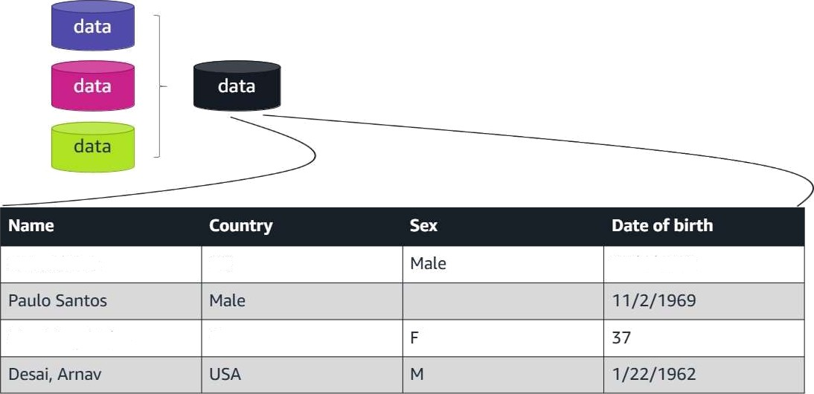
Data preparation and preprocessing
Richard Roe
UK
18/2/1972
Mrs. Mary Major
Denver

Slide 21
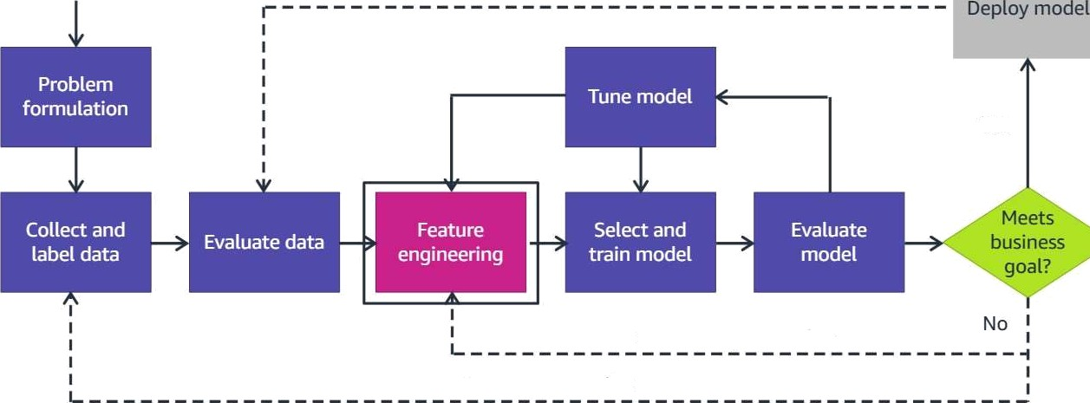
Machine learning pipeline — Feature engineering
Business problem
New data, retraining
Yes
Feature augmentation
Data augmentation

Slide 22
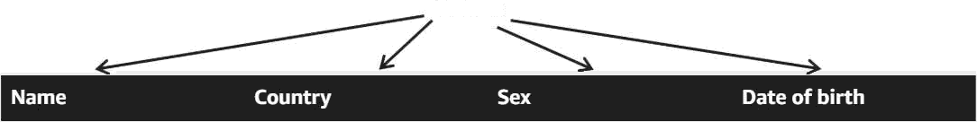

Feature engineering
Feature engineering is dealing with your data to make it usable. It is the process of selecting or creating the features that you will use to train your model. Features are the columns of data that you have within your dataset. The goal of the model is to try to correctly estimate the target value for new data. The ML algorithm uses the features to predict the target. In this example, the target data is the average number of steps taken in a week.
Feature
Richard Roe | UK | Male | 18/2/1972
Paulo Santos | Mate |  | 11/2/1969
Mrs. Mary Major | Denver |  | 37
Desai, Arnav | USA |  | 1/22/1962
b Services, Inc. oi its ath!

Slide 23
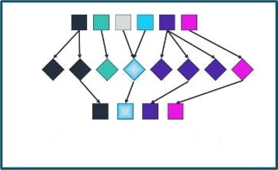
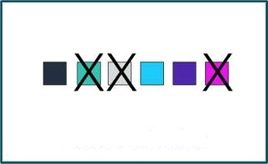
Feature extraction and feature selection
Two things can make your models more successful: feature extraction or creation and feature selection.
Feature extraction is about building up valuable information from raw data by reformatting, combining, and transforming primary features into new ones. This transformation continues until it yields a new set of data that the model can consume to achieve the goals.
Feature extraction
Feature selection is about selecting the features that are most relevant and discarding the rest. Feature selection is applied to prevent either redundancy or irrelevance in the existing features or to get a limited number of features to prevent overfitting.
Feature selection
Choose the buttons to read more about I'eature extraction and feature selection.

Slide 24
Preparing data
Encodi Jg data
The data that you gather won't be ready to be used. The data might be dirty, which means that it contains errors or duplicate data. Dirty data has possibly been collected by using the wrong method or population for your business problem or has some other data integrity issue. Using dirty data in your machine learning models will lead to incorrect results or an inability to run the model effectively.
Cleaning data
Finding missing data
For this reason, the data that you have gathered must be prepared for use in a machine learning model. There are four considerations for preparing your data.
Handling outhers
Choose the tabs to leorn more about preparing data.

Slide 25
Preparing data
Encodin g da ta
Nlost ML algorithms work best with numerical data. Therefore, you must make sure that all columns in your dataset contain numeric data by converting or encoding the data.
Cleaning data
You might need to make several passes through the dataset before you can encode it. For example, you might have variability in the text values (for example, some rows might contain both Medium and Medj.
Finding missing data
If the categorical data has order to it, you can encode the text into numerical vatues that capture this ordinal relationship. For data that shows maintenance costs, you might encode Low to 7, Medium to 2, High to S, and Very High to 4.
HandIing out Iiers
Tools are available to encode your categorical data after you make sure that it is all uniform. You will learn about tools later in this course.

Slide 26
rep ri g data
Encoding data
In addition to converting string data to numerical data, you must clean your dataset for several other potential problem areas. Before you encode the string data, you must make sure that the strings are atl consistent.
Cleaning data
Adjust variables to use a consistent scale.
Split items that capture more than one variable.
Finding missing da ta
Typ e Exampie
handling outhers
Variations in sbings
Variations in scale
Med. w f4adlum
Number of doors vs. number purchased
Safe fifgh maintenance
Co‹wertfo standard text
Normalize to a common scale
Columns with muhtpte data
Parse inta multiple cotumns
Missing data
Missing columns of data
Delete rows Or impute data

Slide 27















Preparing data
EncOding data
You might also find that you have missing data. For example, some columns in your dataset might be missing data because of a data collection error. Perhaps data wasn't collected on a particular feature until some time after the data collection process was in operation. Missing data can make it difficult to accurately interpret the relationship between the related feature and the target variable. Thus, regardless of what caused the data to be missed, it is important that you deal with the issue.
Cleaning data
Finding missing data
Unfortunately, most ML algorithms can't deal with missing values automatically. You must update missing values with something meaningful and relevant to the
problem.
Handling out tiers

Slide 28
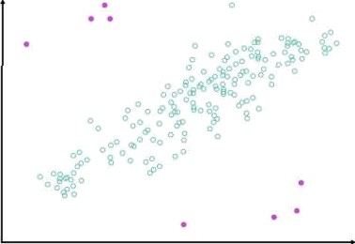
Preparing data
Encoding data
You might also need to clean your data because of any outliers that might exist. Outliers are points in your dataset that lie at an abnormal distance from other values. They are not always something that you want to clean up, because they can add richness to your dataset. However, they can also make it more difficult to make accurate predictions. The outliers affect accuracy because they skew values away from the other more normal values that are related to that feature. In addition, an outtier might indicate that the data point belongs to another column.
You can think of outliers as falling into two broad categories. The two categories are a singte variation for a single variable (univariate) and a variation of two or more variables (multivariate).
Cleaning data
Finding missing data
HandIing Outliers

Slide 29
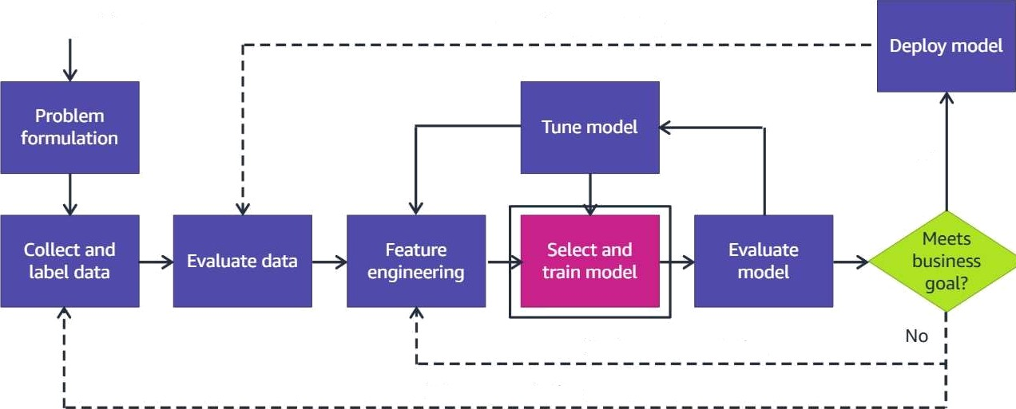
Machine learning pipeline — Select and train model
Business prOblem
New data, retraining
Yes
Feature augmentation
Data augmentation

Slide 30

Model training
After you clean your data and identify its features, it's time to train a model. You don't use all the data to train your model. Instead, you should hold some data back so that you can have some data to test with.
Training data feeds into the algorithm that you selected to produce your model. The model is then used to make predictions over the validation dataset.
10%-Testdata
10% - Validation data
The validation dataset is where you might notice things that
youwiñvvanttotweak,tune,andchange.
80% - Training data
The test dr/toset—which includes only features, because you want the labels to be predicted. The performance you get here with the test dataset is what you can reasonably expect to see in production.
Note: There are other methods for splitting and validating data that are not discussed in this course.

Slide 31
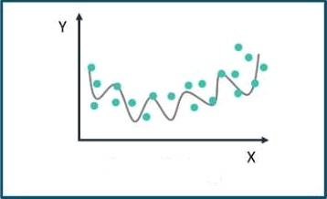
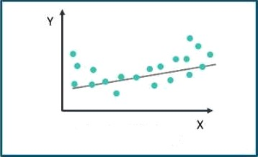
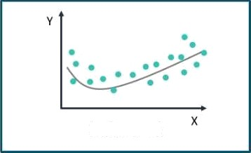
Overfitting and underfitting
Overfitting
Underfitting
Balanced
The goal of machine learning is to build a model that generalizes well. Put another way, you want your model to do well on both the data it already has and the data it does not have. When you train your model, recognize the danger of overfltting or underfltting the model. Therefore, splitting the data is important.
Choose the buttons to learn more about fitting the data.

Slide 32



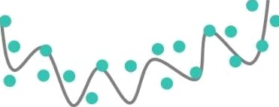
Overfitting and underfitting
“ ›
Overfitting
Your model is overfitting your training data when it performs well on the training data, but it doesn't perform well on the evaluation data. Overfitting is where the model learns the particulars of a data set too well. It's essentially memorizing the training data instead of actually learning the
relationships between features and labels. It's important for the model to learn the relationships and labels so that it can apply what it learns to new data in the future.
X

Slide 33




Overfftting and underfitting
Underfitting
Your model is underfitting the training data when the model performs poorly on the training data. The model can't capture the relationship between the input examples (often called and the target values (often called /. This inability causes the underfitting.
X

Slide 34
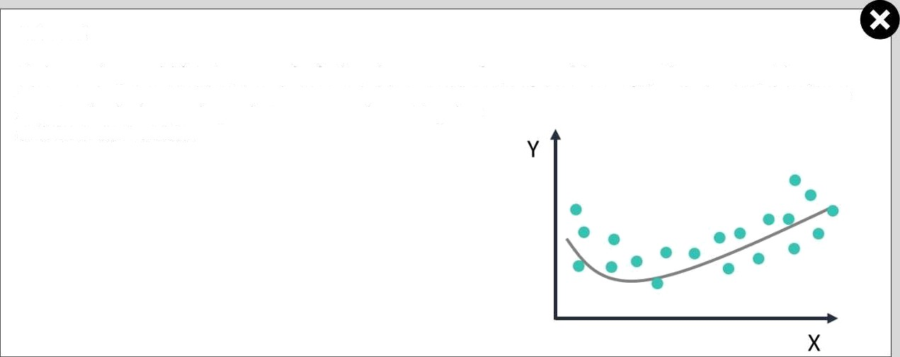
Overfitting and underfitting
Balanced
Understanding model fit is important for finding the root cause for poor model accuracy. This concept guides you to take corrective steps to determine whether a predictive model is underfitting or overfit:ting the training data. These steps involve looking at the prediction error on the training data
and the evaluation data.

Slide 35
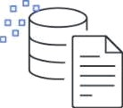
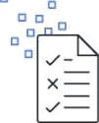


Choosing a machine Learning algorithm
The type of machine learning problem that you are solving will dictate the algorithm that you choose. Recall that the three types of machine learning algorithms are supervised learning, unsupervised learning, and reinforcement learning. Each type of algorithm will help you to solve a specific type of business problem.
Amazon SageMaker provides high-performance, scalable machine learning algorithms that are optimized for speed, scale, and accuracy. These algorithms are built into SageMaker.
Supervised learning
Unsupervised learning
Reinforcement learning

Slide 36
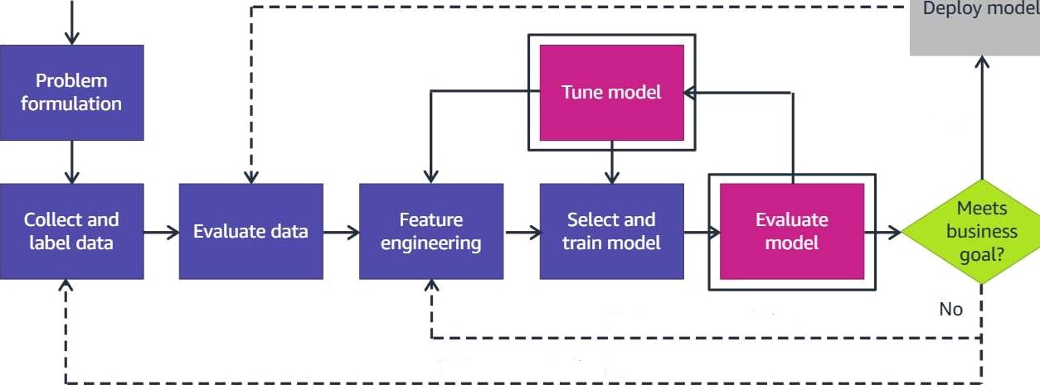
Machine learning pipeline — Tune and evaluate model
Business problem
New data, retraining
Yes
Feature augmentation
Data augmentation

Slide 37

Evaluate and tune
After you train and tune your models and decide which model is the best for your business problem, you must evaluate your model. You want to determine whether it will perform welt in predicting the target on new and future data.
During evaluation you are testing your model against the validation data you set aside. The validation data provides an unbiased evaluation of a model f1t while tuning model.
10% - Test data
1 0% - Validation data
The test data has known values and tets you assess the accuracy of the modet after tuning. If the model performs wetl on the test data it will likely perform well on new data with unknown target values.
80% - Training data
This is why it is important to set aside enough test data and
not use that data for training or validation.
Remember the normal split is 80a/a for training, 10% for validation, and 10% for testing.

Slide 38
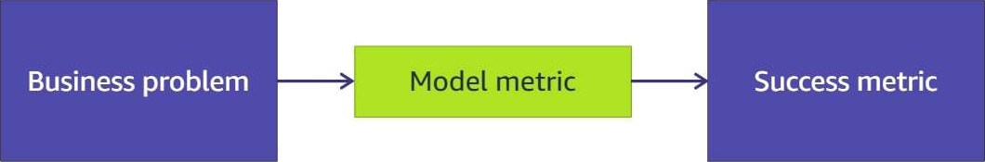
Success metric
Evaluation relies on an appropriate metric for your business situation. Think back to the earlier section on problem formulation. During that phase, you defined your business problem and outcome, and you crafted a business metric to evaluate success.
The model metric that you choose at this phase should be linked to that business metric as closely as possible. Frequently, the two metrics have a high correlation.
Fraudulent credit card transactions
10% reduction in fraud claim in 6-month period

Slide 39
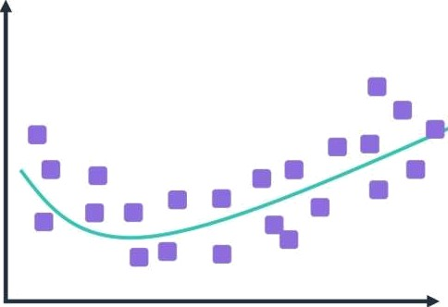
Tuning
You can take an instance that the model has not seen, and use it to perform a prediction. Because you already know the target in your test data, you can compare the two values. From these comparisons, you can calculate metrics, which give you data on how well the model performs. You then modify the model's data, features, or hyperparameters until you find the model that yields the best results.
The goal of training is a model that is balanced and generalizes well

Slide 40
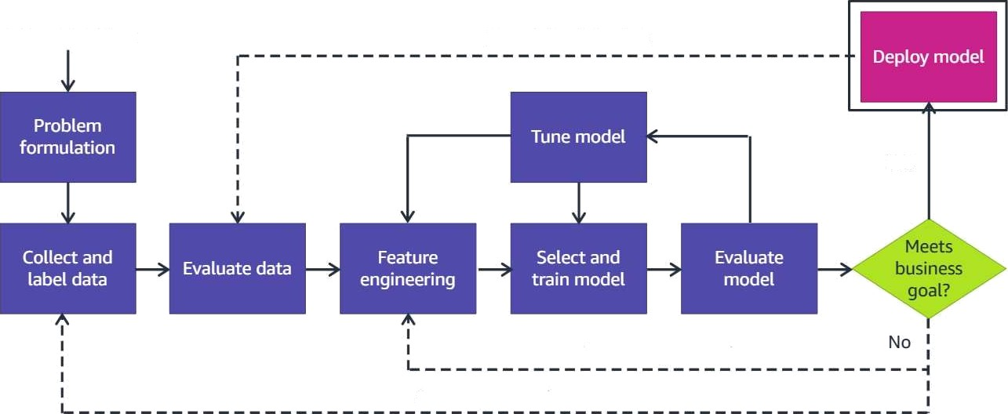
Machine learning pipeline — Deploy model
Business problem
New data, retraining
Yes
Feature augmentation
Data augmentation

Slide 41



Model deployment
After you have trained, tuned, and tested your model, you are ready to deploy it. To test and get performance metrics from your model, you must make inferences or predictions from the model—which typically requires deployment.
Deployment for testing is different from production, although the mechanics are the same. These assessments can involve anything from a few requests to deployments that handle tens of thousands of requests.
Trained
Tuned
Tested

Slide 42



Amazon caLL center case study
Several years ago, Amazon needed to improve the way it routed customer service calls, so it looked to machine learning for help. The original routing system worked like this.
Amazon determined that the current routing system was problematic. For Amazon, dealing with hundreds of millions of customer calls a year, it was inefficient. It cost a lot of money and wasted a lot of time. Worst of all, it was not a good way to get our customers the help that they needed.
Next, you'tl walk through how Amazon used ML to solve this business problem.

Slide 43




That's correct.
The business problem of routing customers to the correct agent must be converted into a machine learning problem. When it is converted to a machine learning problem, it becomes identifying patterns in customer data that could be used to predict accurate customer routing.
Based on the wording of this ML problem, it is clearly a multiclass classification problem. A multiclass problem is the problem of classifying instances into one of three or more classes. This case involves more than two options to direct a call. Predicting which class the customer call should be routed to can be identified with patterns in the customer data.

Slide 44
Data coLLection and feature engineering
After problem formulation is data collection and feature engineering. The dataset was private data that came from within Amazon systems. The data scientists gathered historical customer data with the correct labels and customer agent skills.
The data must be prepared for use.
What should the data science team do after they decide which features to select?
O
Use feature extraction to choose a machine learning algorithm
O
Use feature extraction to split the dataset
Use feature extraction to convert data into a usable form
Use feature extraction to choose new labels.

Slide 45

Select and train
Now that the data has been prepared and the features and algorithm have been chosen, the model can be trained. The fundamental goal of I’•1L is to generalize beyond the data instances that are used to train models. The dataset was split into 80 percent training data, 10 percent validation data, and 10 percent test data.
What is the benefit of splitting all available data into training, validation, and test subsets?
The model has less data to process so it will run faster.
The model will be evaluated on the same training data to see whether it is able to remember the training data.
The model can be validated as either a supervised, an unsupervised, or a reinforcement learning problem.
The model can be evaluated on data that was not used for training to assess how welt it is generalizing new information.

Slide 46

Tune and evaluate
Training the model requires deploying to a test environment. After running a training job, evaluate the model and make iterative tweaks to the model and data. The tuning and evaluation process is to understand how well the model is performing.
What is happening if a model is overfitting?
O
The model performs too fast and cannot reach an optimum value.
o
The model performs well on the training data, but it doesn't perform well on the evaluation data.
The model performs poorly on the training data and can't capture the relationship between the input examples and the target values.
O
The model performs too slowly and cannot reach an optimum value.

Slide 47




Amazoc caLt center case study
When the call center mod.el was deployed, the number of transfers did decrease, which resulted in a much better customer experience. This outcome shows that the model metric and the success metric were matched, and the model was designed wetl. With the machine learning modet in place, the customer gets directed to the correct agent the first time.
This change saved a lot of money, saved time, and was a good way to get our customers the help that they needed.

Slide 48
Knowledge check 01
Which option is true about a model if it is memorizing the training data, as opposed to actually learning the relationships between features and labels?
It is overfitted
O
It is ready for deployment
O
It is balanced
It is underfitted

Slide 49
Knowledge check 02
At which stage of data preparation would a developer make sure that aII the data strings are consistent?
Cleaning data
Finding missin9 data Encoding data Handling outliers

Slide 50
Knowledge check 04
In which phase of the ML pipeline does a developer determine whether the model will perform well in predicting the target on new and future data?
Feature engineering Evaluating and tuning Training the model Collecting and labeling data

Slide 51
End of ModuLe 3
key takeaways from this module
You should now be able to:
Discuss the machine learning pipeline
Describe problem formulation
Describe data preparation and preprocessing
Describe model training and tuning
Describe model evaluation
Describe model deployment
Use an example to apply the steps of the machine learning pipeline
Machine Leai ning Tools and Services
In the next section yoLi will learn bo t the tools and services avaiIab(e for solvii q
machine learning pi oblE'ms. You will e\sO have a brief introduction to Amazon SageMaker
aws

