Slide 1
Virtualisation
@Amel Charoline

Slide 2
Reading list
Docker overview: https://docs.docker.com/v17.09/engine/docker-overview/#what-can-i-use-docker-for
ECS, ECR and Fargate: https://docs.aws.amazon.com/AmazonECS/latest/developerguide/Welcome.html
Lambda: https://docs.aws.amazon.com/lambda/latest/dg/welcome.html

Slide 3
Virtualisation
Term is somewhat ill-defined, generally
  A machine that’s implemented in software, rather than hardware
  A self-contained environment that acts like a computer
  An abstract specification for a computing device (instruction set, etc.)
Common distinction:
  (language-based) virtual machines
    Instruction set usually does not resemble any existing architecture
    Java VM, .Net CLR, many others
  Virtual Machine Monitors (VMM) or Hypervisor
    instruction set fully or partially taken from a real architecture

Slide 4
Properties of Virtual Machines
Partitioning
  Run multiple operating systems on one physical machine.
  Divide system resources between virtual machines.
Isolation
  Provide fault and security isolation at the hardware level.
  Preserve performance with advanced resource controls.
Encapsulation
  Save the entire state of a virtual machine to files.
  Move and copy virtual machines as easily as moving and copying files.
Hardware Independence
  Provision or migrate any virtual machine to any physical server.

Slide 5
History
First VM architected by IBM in 1972 VM/370 to provide full VM of mainframe machine
1997 Virtual PC for Mac by Connectix
1999 VMware’s VMware Virtual Platform
2003 Open Source hypervisor Xen
2005 VMware Player – free VM player
2007 VirtualBox

Slide 6
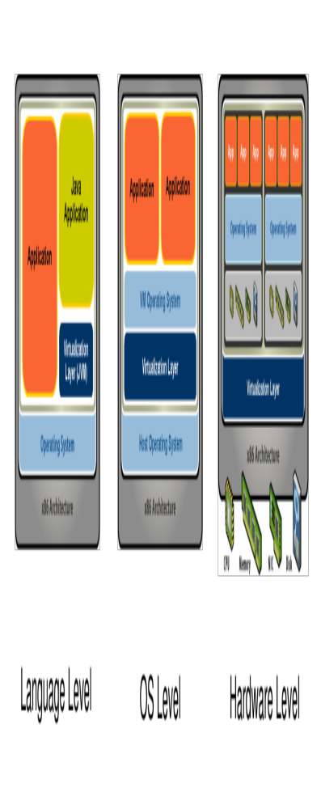
Types of Virtualisation
Type 2 Virtualisation
Type 1 Virtualisation
Courtesy VMWare

Slide 7
VM Components
Virtualise hardware
  CPU
  Memory
  Network interfaces
  Disks
VM is stored as a file and so can be saved and migrated along with apps and configuration information
The aim is to run Operating Systems unchanged however, there is Parvirtualisation
  VM OS knows about virtualization and makes specific calls (approach taken by Xen VM)

Slide 8
How it works
Operating systems normally run in privileged mode
VM OSs run in user mode
Most instructions can execute by hardware without hypervisor intervening
Resource management (memory, peripherals) handled by hypervisor
In VM privileged instructions are “trapped” by the hypervisor and emulated
  Intel and AMD have added instructions to make this possible (not used by VMware)

Slide 9
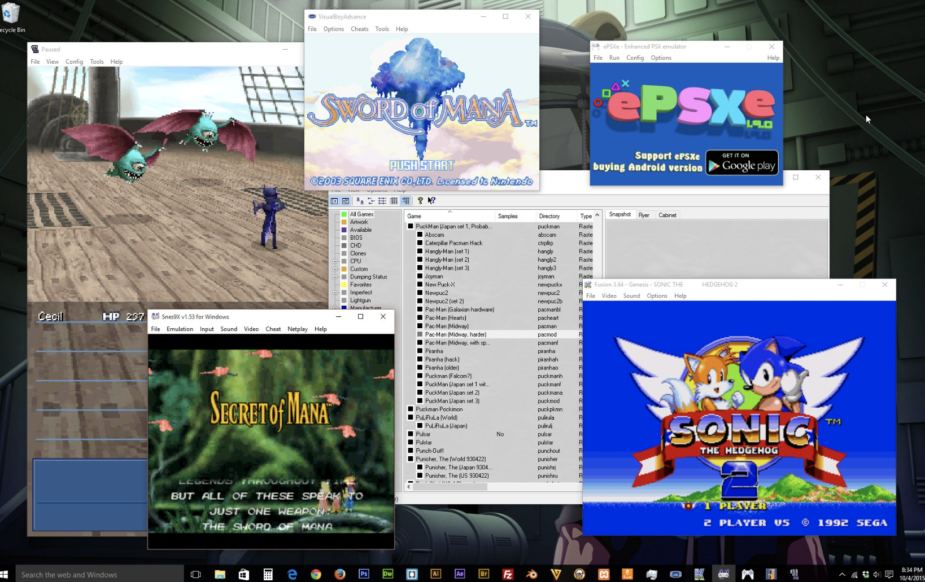
Binary Translation
• Emulation:
– Guest code is traversed and instruction classes are mapped to routines that emulate them on the target architecture.
• Binary translation:
– The entire program is translated into a binary of another architecture.
– Each binary source instruction is emulated by some binary target instructions.

Slide 10
Dynamic Binary Translation
Guest Code
Translation Cache
vPC
mov ebx, eax
mov ebx, eax
start
cli
mov [CPU_IE], 0
and ebx, ~0xfff
and ebx, ~0xfff
mov ebx, cr3
mov [CO_ARG], ebx
sti
call HANDLE_CR3
ret
mov [CPU_IE], 1
test [CPU_IRQ], 1
jne
call HANDLE_INTS
jmp HANDLE_RET
Courtesy Scott Define VMware Inc
Notes:
• Emulation: – Guest code is traversed and instruction classes are mapped to routines that emulate them on the target architecture. • Binary translation: – The entire program is translated into a binary of another architecture. – Each binary source instruction is emulated by some binary target instructions.

Slide 11
AWS VM
AWS uses different configurations that use Xen
AWS Nitro – a hypervisor based on KVM
AWS also offers actual ”bare metal” machines – with no virtualization
Different VM types are represented by AMIs that are either
  PV paravirtual (Linux only)
  HVM hardware virtual machine (Linux and Windows)
Notes:
The AWS Nitro System is the underlying platform for our next generation of EC2 instances that enables AWS to innovate faster, further reduce cost for our customers, and deliver added benefits like increased security and new instance types.
AWS has completely re-imagined our virtualization infrastructure. Traditionally, hypervisors protect the physical hardware and bios, virtualize the CPU, storage, networking, and provide a rich set of management capabilities. With the Nitro System, we are able to break apart those functions, offload them to dedicated hardware and software, and reduce costs by delivering all of the resources of a server to your instances.

Slide 12
VMs and Security
Hypervisor security
  Hypervisor, applications, drivers and libraries are loaded in randomized memory locations to stop exploites
  VMWare uses digital signatures to verify modules drivers and applications – much as iOS and Android do
  However – Hypervisor represents an “attack surface” not present in native OSs and so they are subject to vulnerabilities
Virtualized OS
  Same vulnerabilities as a non-virtualized OS
VM to VM
  Theoretically possible to access memory in one VM from another but very hard to do
AWS itself introduces security vulnerabilities – e.g. access to keys, usernames and passwords

Slide 13
Other types of virtualization
Web Server
  Virtual hosts using a different hostname, configuration file
Virtual Environments
  Java, Python and Ruby amongst others have the ability to configure separate versions of language and libraries
Containers
  Like VMs but run in user space and packages binaries and libraries
  Docker, Kubernetes, AWS Containers (Docker)
Serverless Environments
  Code is executed in response to an event, including HTTP

Slide 14
Containers
Containers are cut down VMs used to execute code in a isolated environment
Docker
  Originally based on Linux Containers (LXC) but now on runC
  All Docker containers use the same underlying OS but present various parts of the OS as if they were dedicated to the running system

Slide 15
Docker Architecture
Server (dockerd) long running daemon process
  Manages data, network, processes, communication, etc
REST API used to communicate with server
CLI to execute docker containers
Instructions for creating a container is placed in an image
Services orchestrate docker containers in swarms

Slide 16
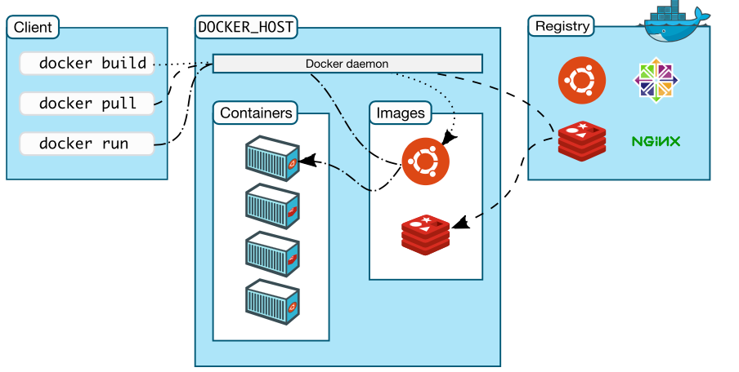
Docker

Slide 17
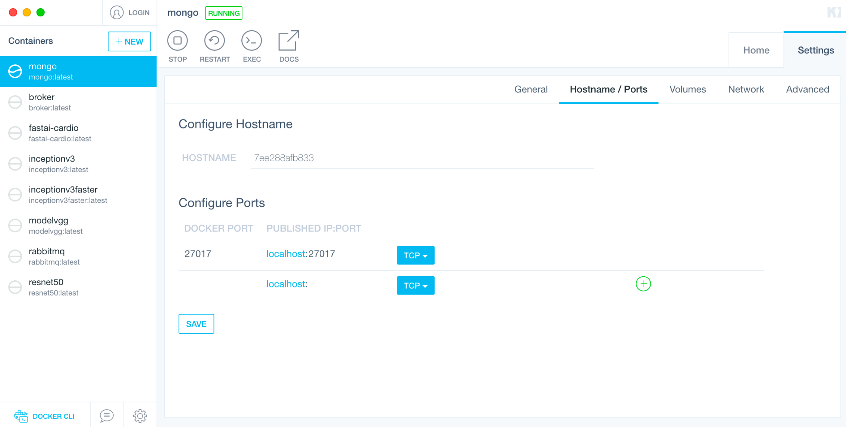
Docker Kitematic

Slide 18
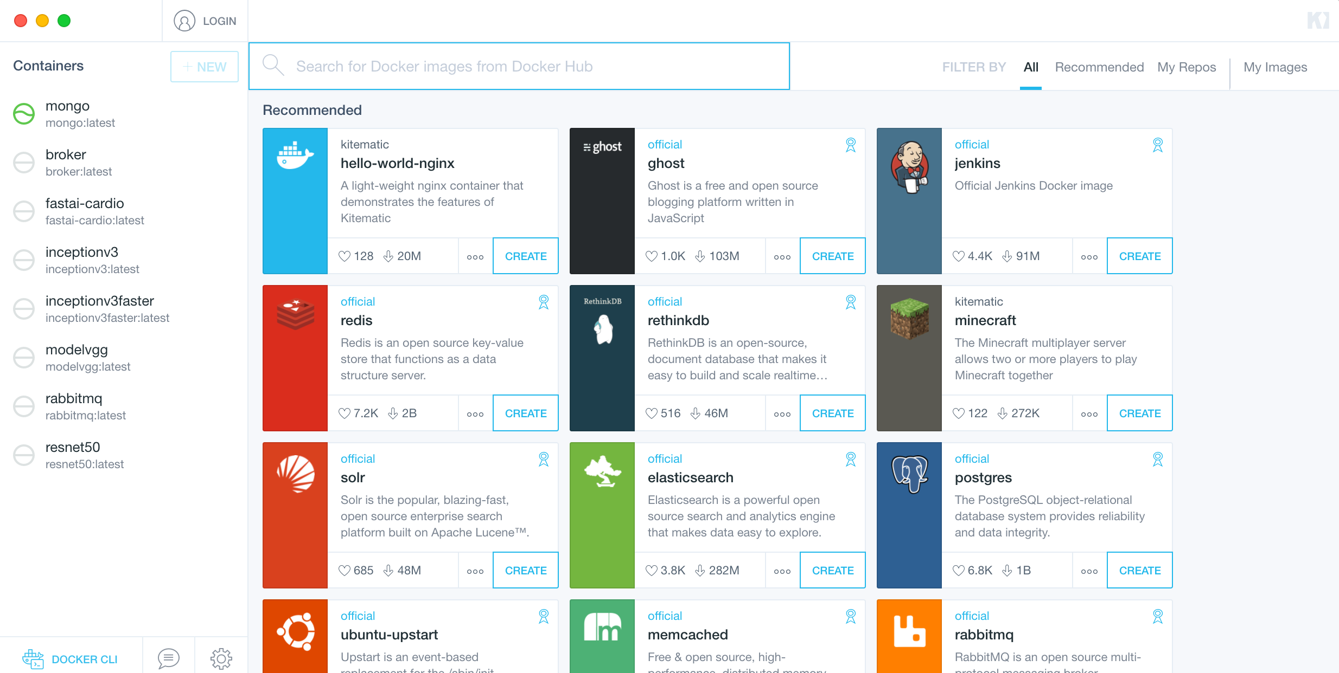
Docker Kitematic

Slide 19
Docker
Docker Registry
  Contains Docker Images
    Instructions to create a Docker Container
    Images provide applications, libraries and operating system files
  Docker Images can be pulled down to Docker Host
Docker Host
  Host running the containers
  Docker daemon – server process that manages the Docker containers
Docker Client
  Client app that allows users to issue Docker commands

Slide 20
Docker underlying technology
Linux namespaces provide isolation:
  Process isolation: pid namespace
  Network interfaces: net namespace
  Interprocess communication: ipc namespace
  Filesystem: mnt namespace
  Kernel and version identifiers: uts namespace
Control groups (cgroups)
  Limits resources such as CPU, memory, network bandwidth, device access control
UnionFS
  Layered files used for containers
Container format
  libcontainer – Docker may use other formats in the future

Slide 21
Properties of Containers
Remember the properties of VMs?
Partitioning
  🚫 Run multiple operating systems on one physical machine.
  ✅ Divide system resources between containers.
Isolation
  Provide fault and security isolation at the software level.
  Preserve performance with resource controls.
Encapsulation
  Containers not really designed to save state – they are temporary.
  Can create numerous instances rapidly
Hardware Independence
  Provision containers on any physical server.

Slide 22
AWS ECS (Elastic Container Service)
Although Docker can be run on a client machine like a Mac or Windows, it is easier to run it on a Linux VM or AWS
Hello World example

Slide 23
Docker example
Create a Dockerfile
  FROM httpd:2.4
  COPY ./public-html/ /usr/local/apache2/htdocs/
Create a file index.html in ./public-html and add “hello world”
docker build -t my-apache2 .
docker run -dit -p 8080:80 --name my-app my-apache2
Open browser and check hell world

Slide 24
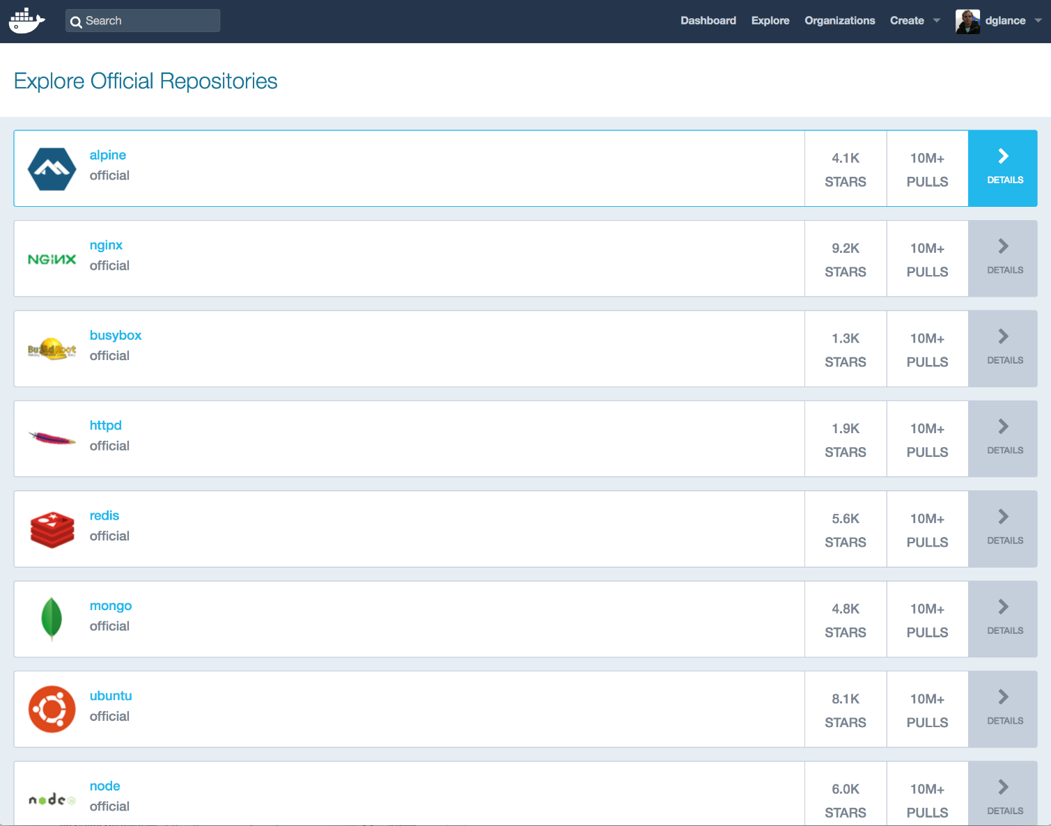
Docker Hub

Slide 25
Push to Docker Hub
Create a private repository on Docker Hub
Login to docker on command line:
  docker login –u <username> -p <password>
Add tag
  docker tag cits5503demo dglance/cits5503demo
Push to Docker Hub
  docker push dglance/cits5503demo
Now can run using dglance/cits5503demo

Slide 26
Basic Docker commands
docker run – Runs a command in a new container.
docker start – Starts one or more stopped containers
docker stop – Stops one or more running containers
docker build – Builds an image form a Docker file
docker pull – Pulls an image or a repository from a registry
docker push – Pushes an image or a repository to a registry
docker export – Exports a container’s filesystem as a tar archive
docker exec – Runs a command in a run-time container
docker search – Searches the Docker Hub for images
docker attach – Attaches to a running container
docker commit – Creates a new image from a container’s changes

Slide 27
Compose example: Dockerfile
FROM python:3.4-alpine
ADD . /code
WORKDIR /code
RUN pip install -r requirements.txt
CMD ["python", "app.py"]

Slide 28
Compose example app.py
import time
import redis
from flask import Flask
app = Flask(__name__)
cache = redis.Redis(host='redis', port=6379)
def get_hit_count():
retries = 5
while True:
try:
return cache.incr('hits')
except redis.exceptions.ConnectionError as exc:
if retries == 0:
raise exc
retries -= 1
time.sleep(0.5)
@app.route('/')
def hello():
count = get_hit_count()
return 'Hello World! I have been seen {} times.\n'.format(count)
if __name__ == "__main__":
app.run(host="0.0.0.0", debug=True)

Slide 29
Compose example: docker-compose.yml
version: '3'
services:
web:
build: .
ports:
- "5000:5000"
redis:
image: "redis:alpine"

Slide 30
Compose example: requirements.txt
flask
redis
And run…
>$ docker-compose up
test with: http://0.0.0.0:5000

Slide 31
Containers on AWS: Elastic Container Service
AWS provides a service to deploy a cluster of containers running on EC2 instances
Allows the creation of a Docker registry (Elastic Container Registry) to store and run container images
Benefits are that other AWS services can be integrated with containers to manage production use

Slide 32
Using ECR
Using the existing code, use ‘aws ecr’ to create an image entry in the repository and push the image
aws ecr get-login --no-include-email --region ap-southeast-2 # use the output to login
docker build -t csprepo .
docker tag csprepo:latest 276536715930.dkr.ecr.ap-southeast-2.amazonaws.com/csprepo:latest
docker push 276536715930.dkr.ecr.ap-southeast-2.amazonaws.com/csprepo:latest

Slide 33
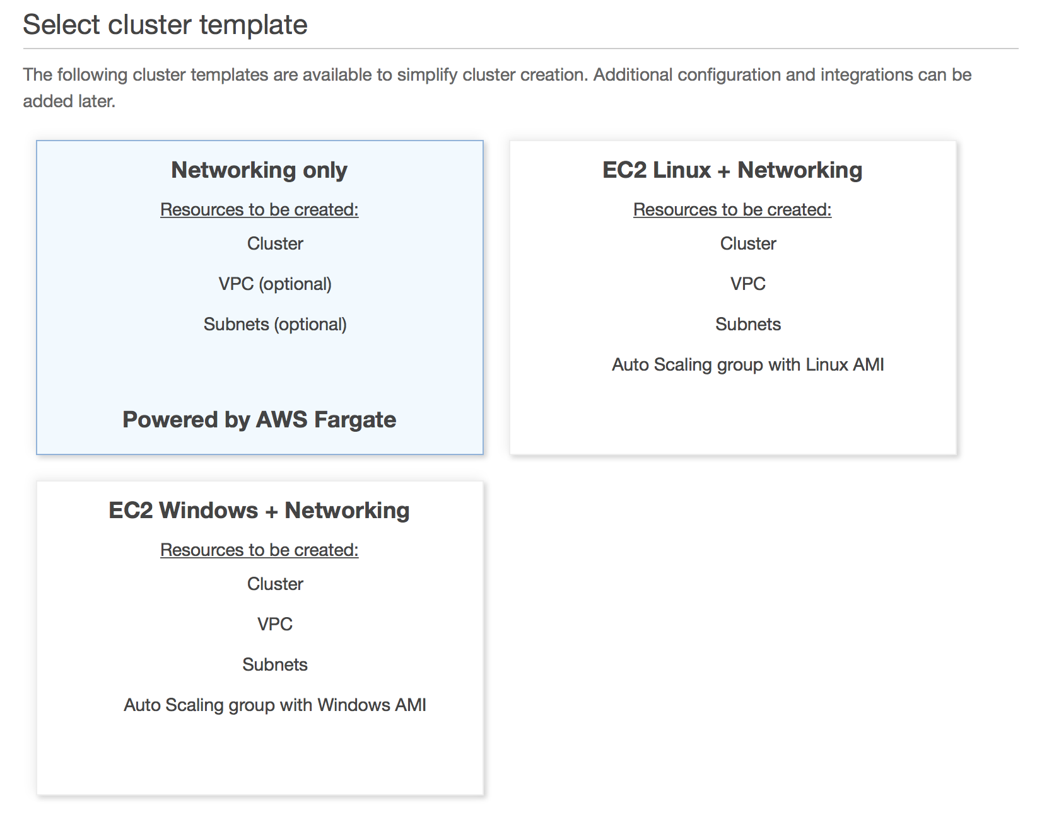
Select a cluster template

Slide 34
Click create cluster
Create will create resources based on CloudFormation Stack:
  VPC
  Subnets
  Internet Gateway
  Route tables
Note that it doesn’t provision EC2 instances!

Slide 35
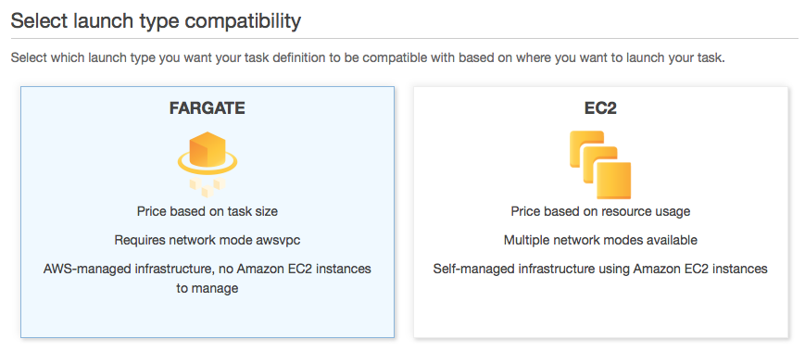
Create Task
Use Fargate
  Select the permissions, Task Memory and Task CPU
  Add container
    Pull from ECR or other repository
    Specify port mappings
    Can specify range of other parameters
      Healthcheck: is it still functioning
      Environment variables
      Network settings
      Storage and logging
      Resource limits

Slide 36
Run task
Associate cluster
Choose VPC, subnets
Allocate memory
Allocate roles
Run

Slide 37
Serverless Computing
Fargate is an example of serverless computing
Don’t need to worry about operating systems or maintaining VMs
Other environment for this is Kubernetes
Execution is simply a container or in the case of AWS Lambda just a piece of code
  Difference is between how applications get executed and the choice of development environment
Fits in with Micro Service architectures

Slide 38
AWS Lambda
AWS Lambda removes the container details and allows “functions” to be written
Supports different programming environments:
  Java, Javscript, Python, C#
Functions can be connected to “events” coming from a number of different environments:
  HTTP
  IoT
  Mobile
  Other AWS services like Kinesis

Slide 39
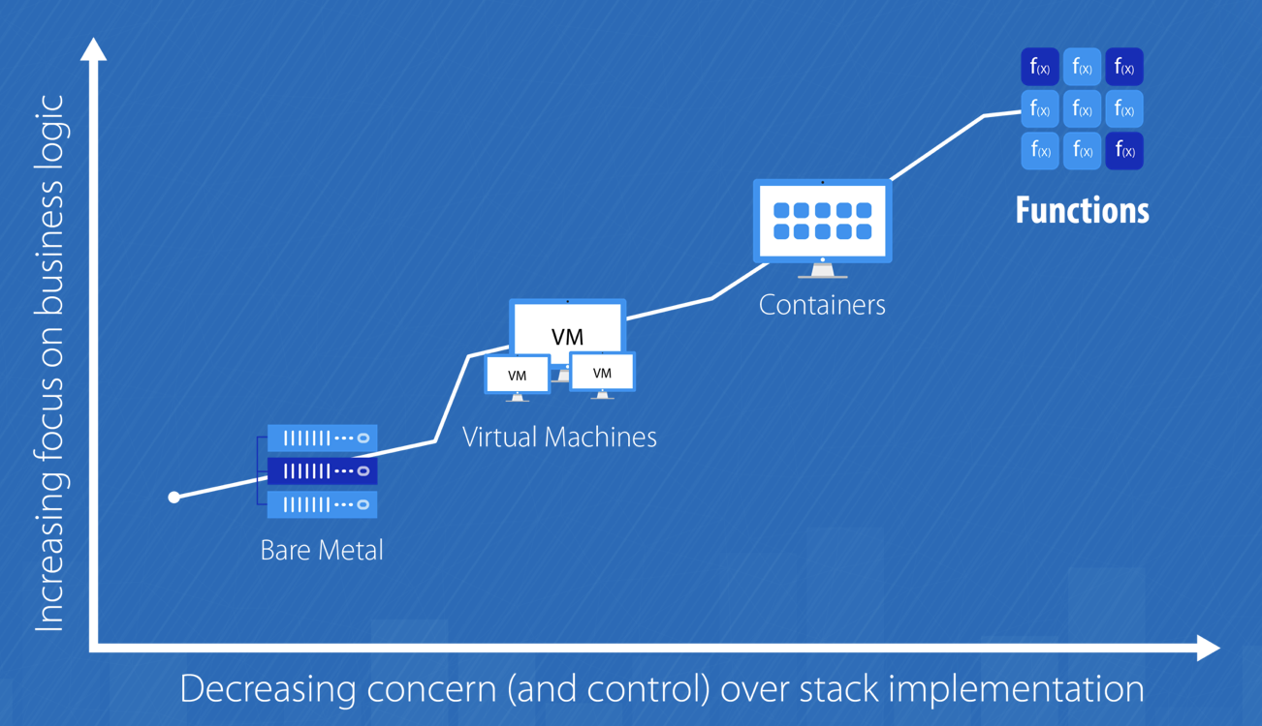
AWS Lambda
Credits: https://medium.com/@amiram_26122/the-hidden-costs-of-serverless-6ced7844780b

Slide 40
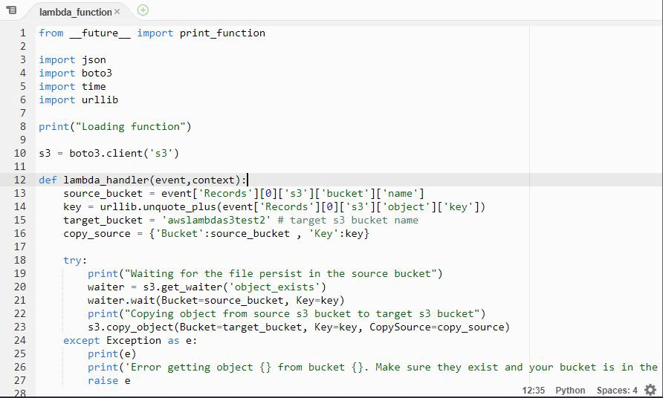
AWS Lambda

Slide 41
Example
Functions need to be packaged and uploaded as zip files
Can be tested locally using SAM CLI – doing much of the same thing as Docker
functions can also be edited using AWS Lambda Console Editor
Create a function
  Choose language
  Role
  Template
Edit code and test

Slide 42
Add an API Gateway
Simple way to associate a URL with a specific function
Allows the specification of functions associated with specific HTTP operations (GET, POST, etc)
Supports CORS Cross Origin Resource Sharing
Makes taking parameters easy

Slide 43
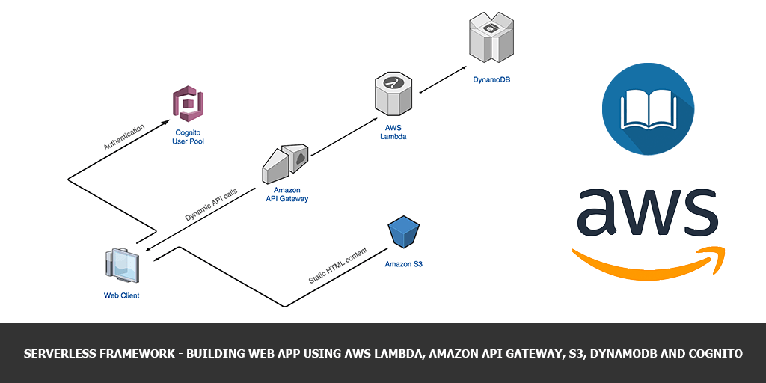
Typical Serverless Architecture in AWS
Courtesy AWS

