Slide 1
Git and GitHub
@Amel Charoline

Slide 2
Notices
Some content for this presentation was obtained from:
  https://try.github.io
  https://en.wikipedia.org/wiki/Version_control

Slide 3
What is Source Code Control?
Provides a number of solutions to various problems:
  Allows for the storage of source code
    Problem: source code being on a specific developer’s machine
  Allows for the distribution of source code
    Problem: source code needs to be shared with development team and also public
  Allows versioning and branches of source code
    Problem: a bug needs to be fixed in existing version of product whilst development continues on next version
  Allows for multiple people to collaborate on code
    Problem: One developer’s changes overwriting another
  Allows for formal review of code and merging
    Problem: Bad code accepted that “breaks the build” or “breaks the product”

Slide 4
What does Source Code Control need to do?
Manage a collection of files as a repository
Keep metadata and history of who did what to what files
  Important for auditing and *blame*
Be able to detect differences in files and potentially merge different changes
  In practice this is difficult
Allow developer to switch easily between various versions (commits) on the same or other branches

Slide 5
Source code control system
SCCS: First code version control system
  Bell Labs in 1972
Revision Control System (RCS)
  1982
  Changes of files stored as “diffs”
  Used exclusive locks on single files
Centralised systems
  CVS Concurrent Version System
    Check out entire project
    Support for multiple users
  SVN Subversion

Slide 6
Then there was Git…
Created by Linus Torvalds in 2005 for Linux Kernel development
They were using BitKeeper but this was proprietary
The name came from Linus Torvalds:
  “I’m an egotistical bastard, and I name all my projects after myself. First ‘Linux’, now ‘git’.”
Really gained popularity through GitHub, web-based hosting service for Git repositories
GitHub has recently been bought by Microsoft – nobody is sure if this is a good thing or not

Slide 7
Git Basics
Source is kept in a “repository” or “repo”
Copying repo from GitHub or other remote server to local disk is called “cloning”
Updating local files from repo involves a “pull” from remote repo
Updating remote repo from working directory involves a “push”
Main branch of repo is called “master” branch
When a branch is merged into master the process is called a “merge” or this is done using a “Pull Request”
PR is a way of getting code reviewed before it is merged

Slide 8
Getting started
You can use a GUI (GitHub app or IDE like PyCharm, XCode, Visual Studio) but easier if you learn how to use command line
Creating a git repository:
  $ cd ~/DevProjects
  $ mkdir myproject
  $ cd myproject
  $ git init

Slide 9
What did that do?
Created a directory called .git
  $ ls
total 24
-rw-r--r-- 1 dglance staff 23 30 Jul 11:15 HEAD
drwxr-xr-x 2 dglance staff 64 30 Jul 11:15 branches
-rw-r--r-- 1 dglance staff 137 30 Jul 11:15 config
-rw-r--r-- 1 dglance staff 73 30 Jul 11:15 description
drwxr-xr-x 12 dglance staff 384 30 Jul 11:15 hooks
drwxr-xr-x 3 dglance staff 96 30 Jul 11:15 info
drwxr-xr-x 4 dglance staff 128 30 Jul 11:15 objects
drwxr-xr-x 4 dglance staff 128 30 Jul 11:15 refs

Slide 10
Key file is exclude
info/exclude allows you to specify which files you want git to ignore (also done with a file called .gitignore)
  $ cat info/exclude
# git ls-files --others --exclude-from=.git/info/exclude
# Lines that start with '#' are comments.
# For a project mostly in C, the following would be a good set of
# exclude patterns (uncomment them if you want to use them):
# *.[oa]
# *~

Slide 11
Add a file
Create a file and check status
  $ touch afile.txt
  $ ls
  afile.txt
  $ git status
On branch master
No commits yet
Untracked files:
(use "git add <file>..." to include in what will be committed)
afile.txt
nothing added to commit but untracked files present (use "git add" to track)

Slide 12
Add for commit
Do as it suggests – add the file
  $ git add afile.txt
  $ git status
On branch master
No commits yet
Changes to be committed:
(use "git rm --cached <file>..." to unstage)
new file: afile.txt

Slide 13
And commit…
Commit the file
  $ git commit –m “Committing initial file”
1 file changed, 0 insertions(+), 0 deletions(-)
create mode 100644 afile.txt

Slide 14
Meanwhile, we switch to GitHub
We will now create a repository in GitHub
And then push the files to the “master” branch
And check they end up on GitHub
  $ git remote add origin https://github.com/uwacsp/IoT1.git
  $ git push –u origin master
Counting objects: 3, done.
Writing objects: 100% (3/3), 231 bytes | 231.00 KiB/s, done.
Total 3 (delta 0), reused 0 (delta 0)
To https://github.com/uwacsp/gitlecture1.git
* [new branch] master -> master
Branch 'master' set up to track remote branch 'master' from 'origin'.

Slide 15
Making changes
Once the file is changed you can repeat the last process of commit and push, or add any new files
Demo
You can delete files using git rm
  *DANGER* Be very careful with this – you can recover from a previous version but not changes you made since the last commit

Slide 16
Getting other people’s updates
If the repo changes because another developer has changed a file, you have to get that update before changing it yourself
People still shouldn’t be generally working on the same files
Can use branches

Slide 17
Using branches
Create a new branch with:
  git checkout –b anewbranch
Confirm that you are on that branch
  git branch
Now, any changes made on the branch will not be seen by anyone working on master and vice-versa
Once the branch is ready to merge back into master, we can merge using:
  first checkout master
  git merge <branch to merge>

Slide 18
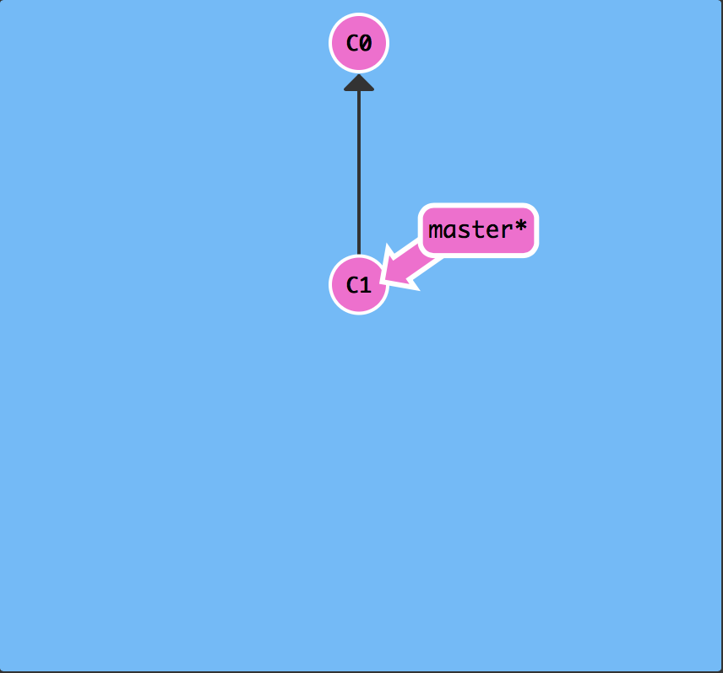
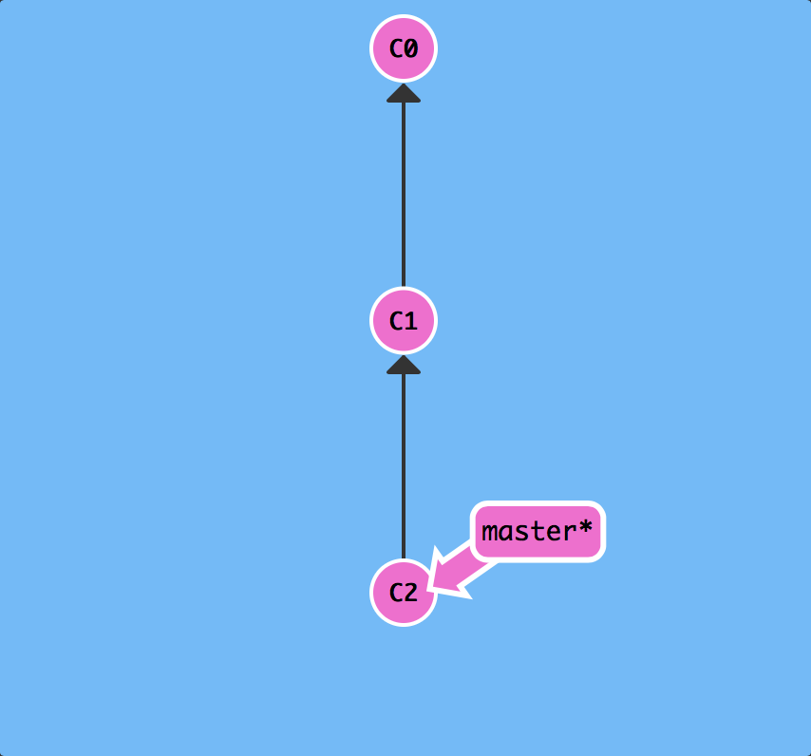
git commit

Slide 19
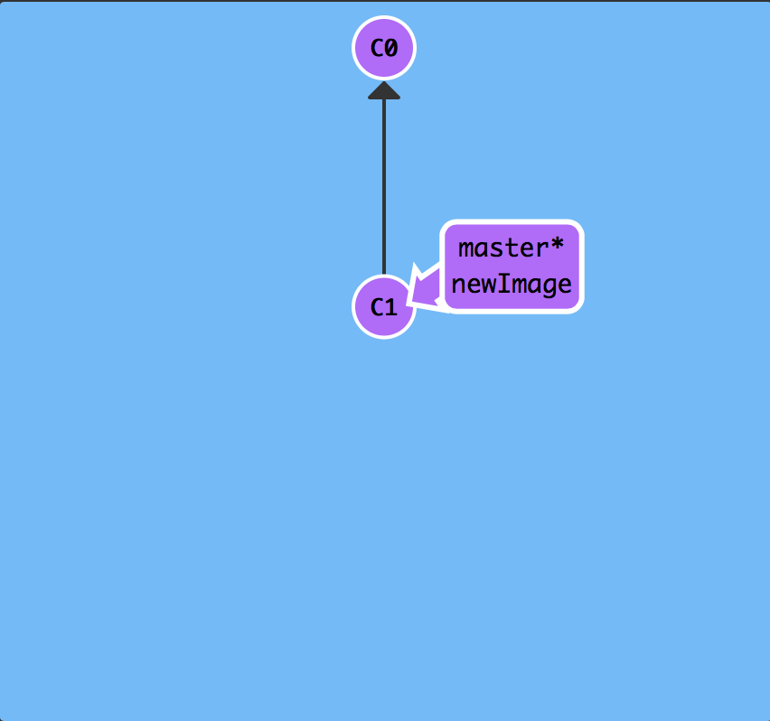
git branch newImage

Slide 20
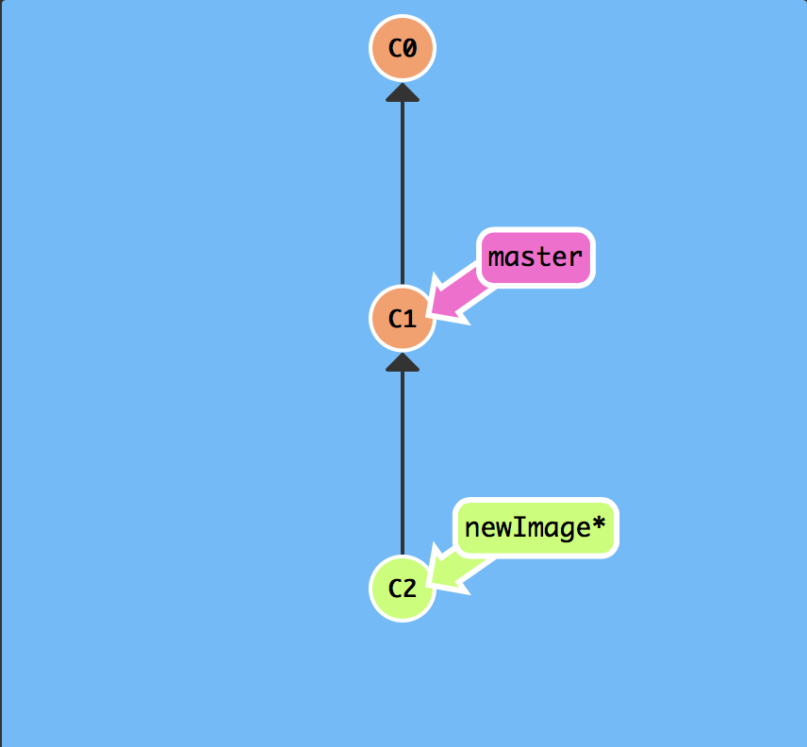
git checkout newImage; git commit

Slide 21
git checkout –b newImage
same as 2 commands:
  git branch newImage
  git checkout newImage

Slide 22
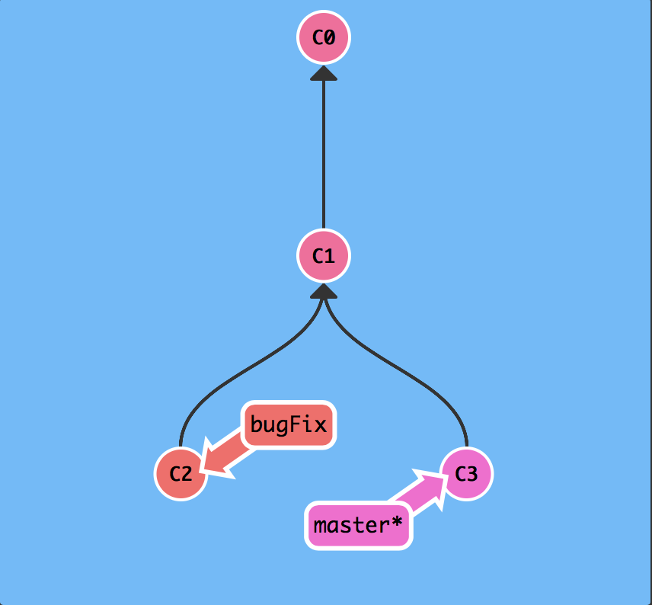
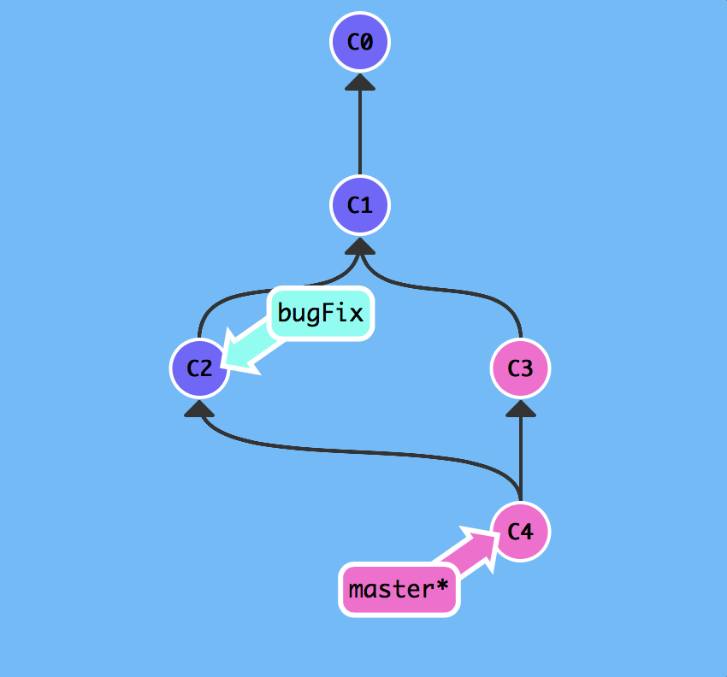
git merge bugFix

Slide 23
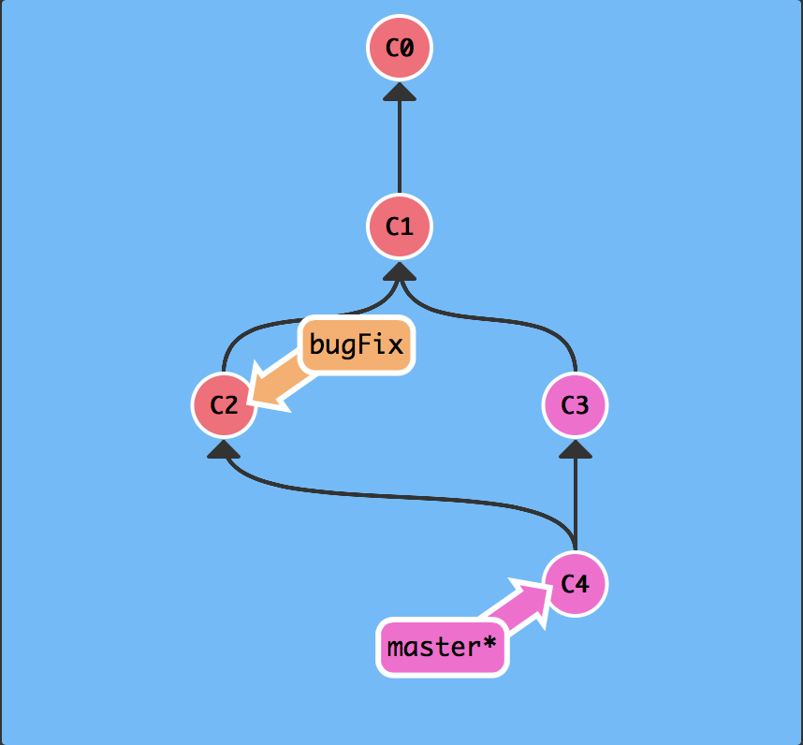
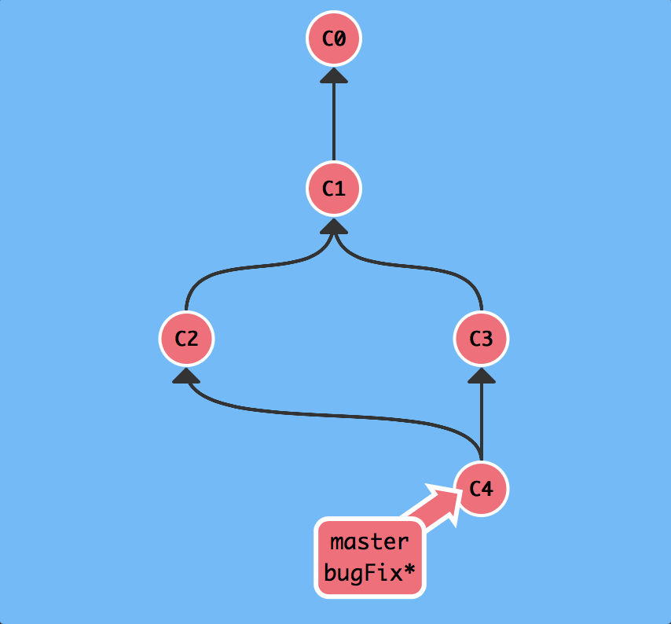
git checkout bugFix; git merge master

Slide 24
Pull Request
A pull request allows Git to merge code changes from a branch into the master (or other branch)
Once code has been pushed to a branch, the option to create a Pull Request becomes available
Demo…
Pull Requests can be created by collaborators who don’t have the rights to merge the request. This way, someone can review the request and changes can be made before it is accepted and pulled in

Slide 25
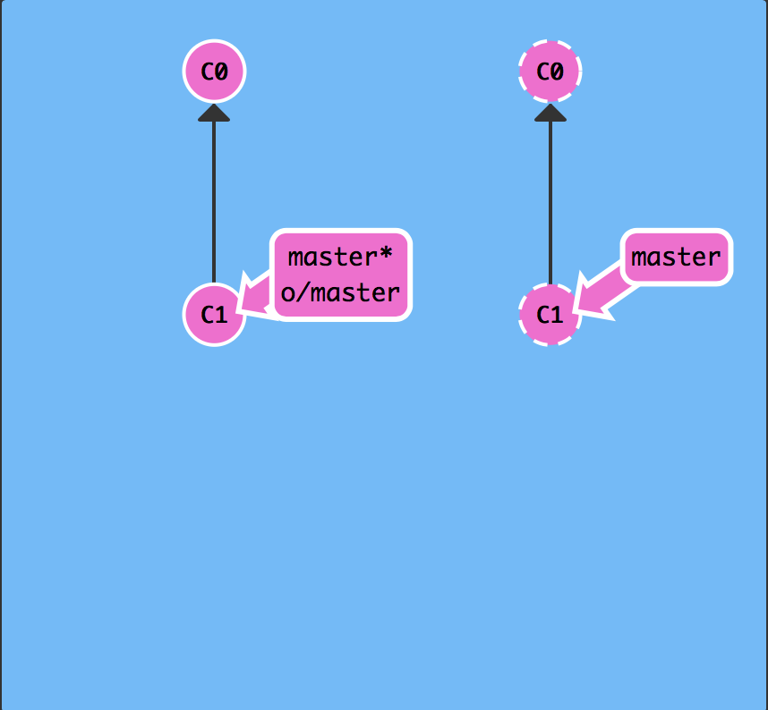
git clone

Slide 26
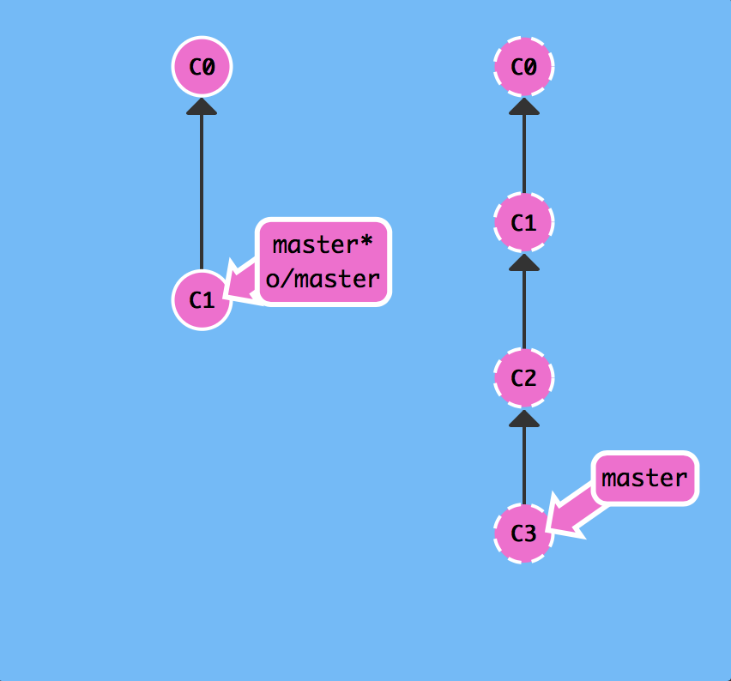
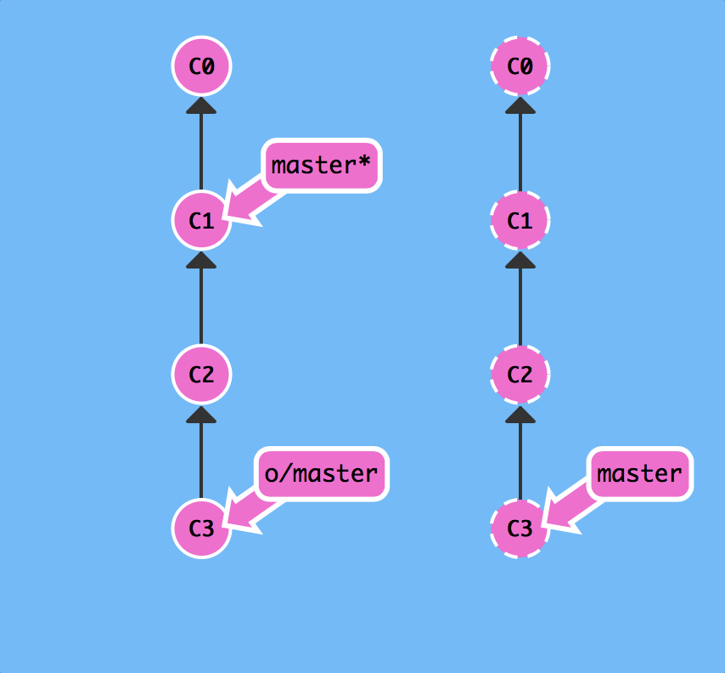
git fetch

Slide 27
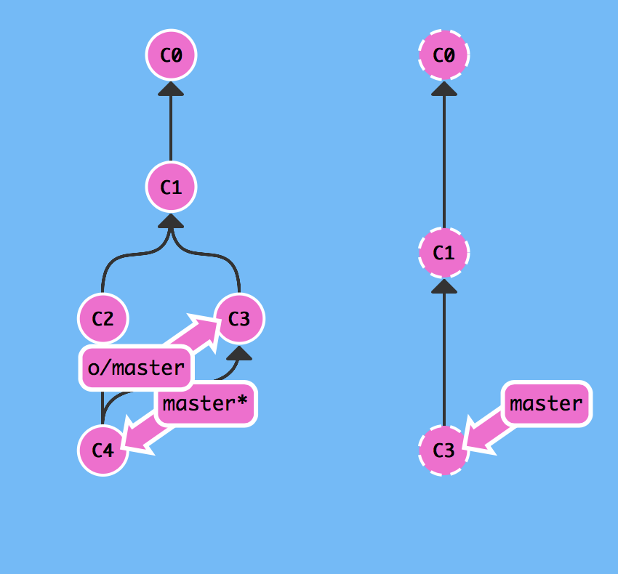
git merge o/master (both steps with git pull)

Slide 28
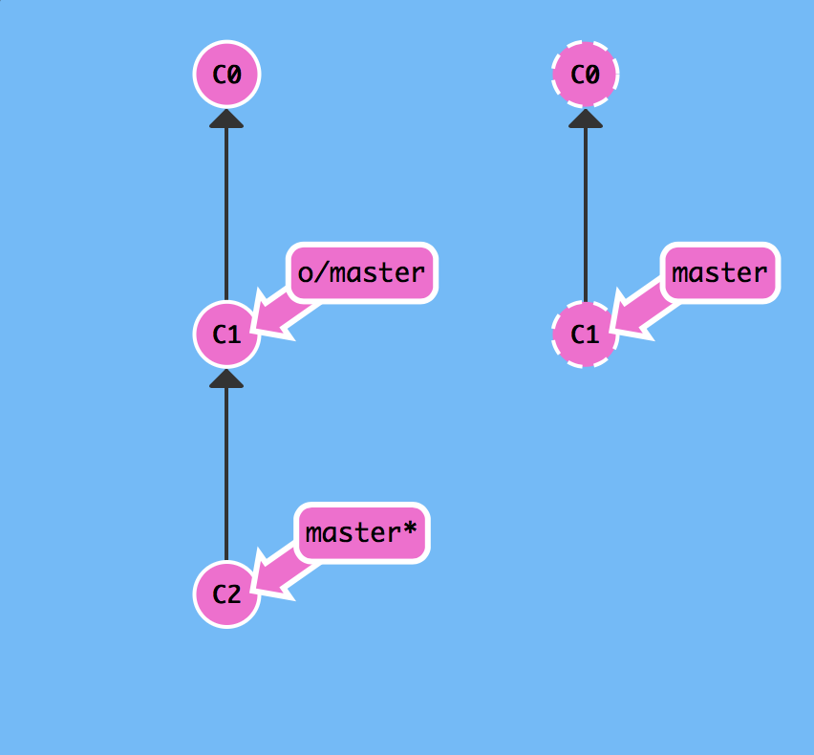
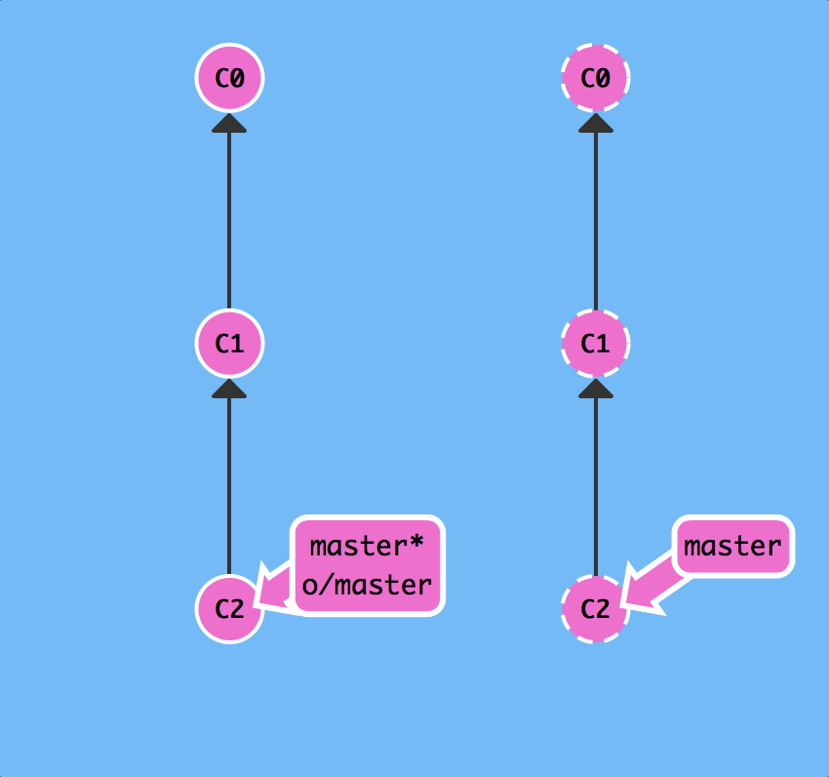
git push

Slide 29
Continuous Integration
Git can be used to provide code for continuous integration
On commit, code can be built and tests run automatically with the results provided back to the developer
Can optionally update a Pull Request
Systems that allow this type of integration include (next slide)

Slide 30
DevOps
Git is also fundamental to deployments of code into test and production environments
This is now done in an automated fashion and Git provides an easy and reliable way of doing this
We cover this in Cloud Computing

Slide 31
Git and Employment
Many companies are now asking to see evidence of development skills
They use sites like:
GitHub
Stack Overflow (and related)
It is worth hosting projects publicly so that you can use the site as a type of electronic portfolio

Slide 32
When shouldn’t you use Git?
Git is optimised for developers working on code – it *is not* a collaborative document management system like Google Docs, Apple iCloud, Microsoft Office 360, etc.
If you are working on documents collaboratively, Google Docs is a better option
People can edit and see changes from multiple people in real time
Changes are on a character by character level – not just lines
Git does not work well with binary files like word documents

Slide 33
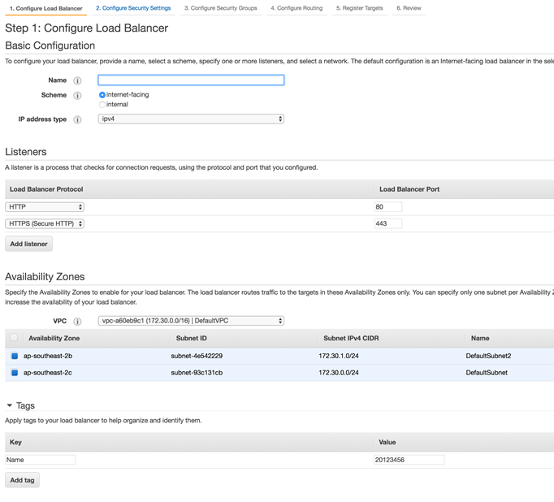
VESTECHEELBSG
VESTECH-ELB

