Slide 1
What is Cloud Computing?
@Amel Charoline

Slide 2
Intro to Cloud Computing: Agenda
Computing at scale
  The need for scalability; scale of current services
  Scaling up: From PCs to data centers
  Problems with 'classical' scaling techniques
Utility computing and cloud computing
  What are utility computing and cloud computing?
  What kinds of clouds exist today?
  What kinds of applications run on the cloud?
  Virtualization: How clouds work 'under the hood'
  Some cloud computing challenges

Slide 3
How many users and objects?
Flickr has 10 billion photos
Facebook has 1.4 billion daily active users
Google is serving 3.5 billion queries/day on over 130 trillion pages
5 billion videos/day watched on YouTube

Slide 4
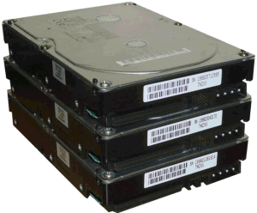
How much data?
Modern applications use massive data:
  Rendering 'Avatar' movie required >1 petabyte of storage
  eBay has >6.5 petabytes of user data
  CERN's LHC will produce about 15 petabytes of data per year
  In 2008, Google processed 20 petabytes per day
  German Climate computing center dimensioned for 60 petabytes of climate data
  Google now designing for 1 exabyte of storage
  NSA Utah Data Center is said to have 5 zettabyte
How much is a zettabyte?
  1,000,000,000,000,000,000,000 bytes
  A stack of 1TB hard disks that is 25,400 km high
25,400 km

Slide 5
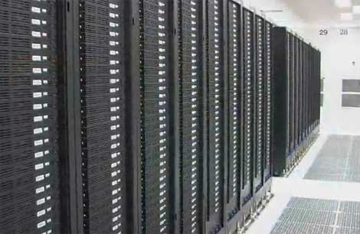
How much computation?
No single computer can process that much data
  Need many computers!
How many computers do modern services need?
  Facebook is thought to have more than 60,000 servers
  1&1 Internet has over 70,000 servers
  Akamai has 95,000 servers in 71 countries
  Intel has ~100,000 servers in 97 data centers
  Microsoft reportedly had at least 200,000 servers in 2008
  Google is thought to have more than 1 million servers, is planning for 10 million

Slide 6
Why should I care?
Suppose you want to build the next Google
How do you...
  ... download and store billions of web pages and images?
  ... quickly find the pages that contain a given set of terms?
  ... find the pages that are most relevant to a given search?
  ... answer 1.2 billion queries of this type every day?
Suppose you want to build the next Facebook
How do you...
  ... store the profiles of over 500 million users?
  ... avoid losing any of them?
  ... find out which users might want to be friends?

Slide 7
Intro to Cloud Computing: Agenda
Computing at scale
  The need for scalability; scale of current services
  Scaling up: From PCs to data centers
  Problems with 'classical' scaling techniques
Utility computing and cloud computing
  What are utility computing and cloud computing?
  What kinds of clouds exist today?
  What kinds of applications run on the cloud?
  Virtualization: How clouds work 'under the hood'
  Some cloud computing challenges

Slide 8
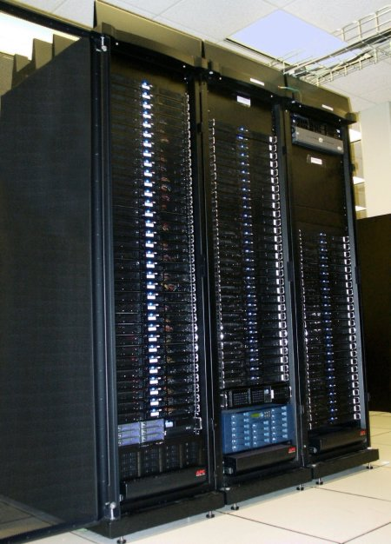
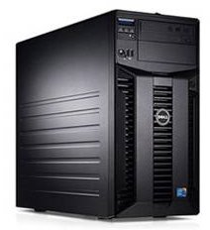
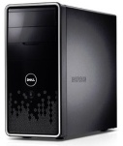
Scaling up
PC
Server
Cluster
What if one computer is not enough?
  Buy a bigger (server-class) computer
What if the biggest computer is not enough?
  Buy many computers

Slide 9
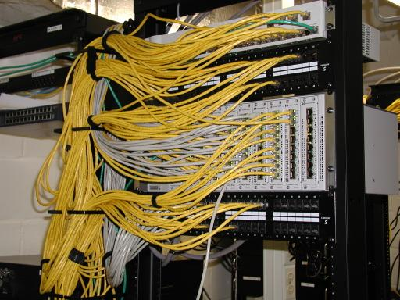
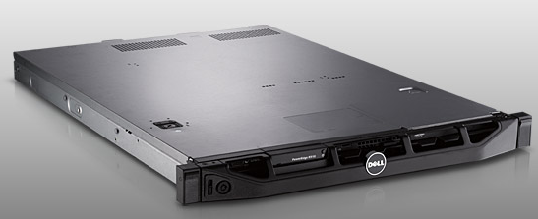
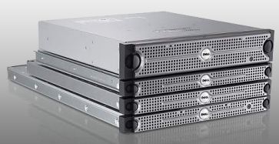
Clusters
Network switch
(connects nodes with
each other and
with other racks)
Rack
Many nodes/blades
(often identical)
Storage device(s)
Characteristics of a cluster:
  Many similar machines, close interconnection (same room?)
  Often special, standardized hardware (racks, blades)
  Usually owned and used by a single organization

Slide 10
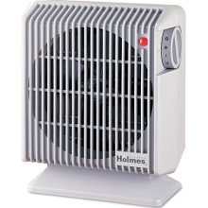
Power and cooling
Clusters need lots of power
  Example: 140 Watts per server
  Rack with 32 servers: 4.5kW (needs special power supply!)
  Most of this power is converted into heat
Large clusters need massive cooling
  4.5kW is about 3 space heaters
  And that's just one rack!

Slide 11
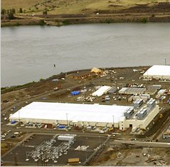
Scaling up
PC
Server
Cluster
Data center
What if your cluster is too big (hot, power hungry) to fit into your office building?
  Build a separate building for the cluster
  Building can have lots of cooling and power
  Result: Data center

Slide 12
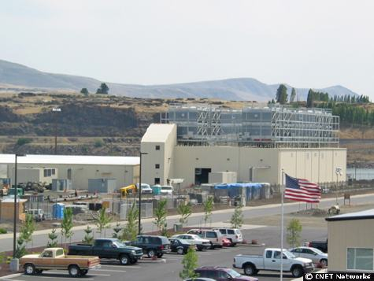
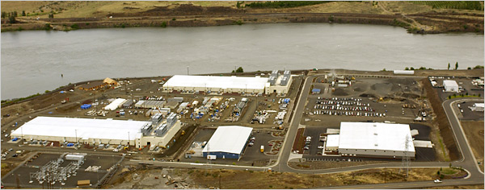
What does a data center look like?
Cooling
plant
Data centers
(size of a
football field)
Google data center in The Dalles, Oregon
A warehouse-sized computer
  A single data center can easily contain 10,000 racks with 100 cores in each rack (1,000,000 cores total)

Slide 13
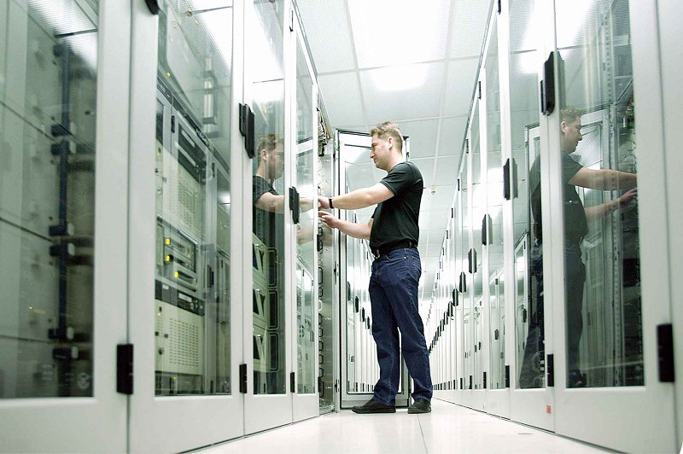
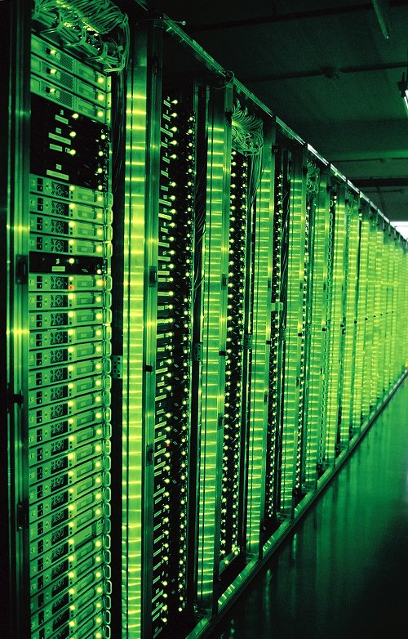
What's in a data center?
Source: 1&1
Hundreds or thousands of racks

Slide 14
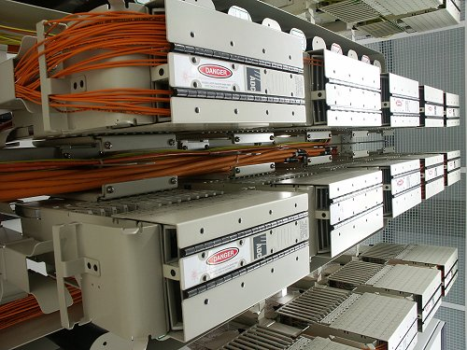
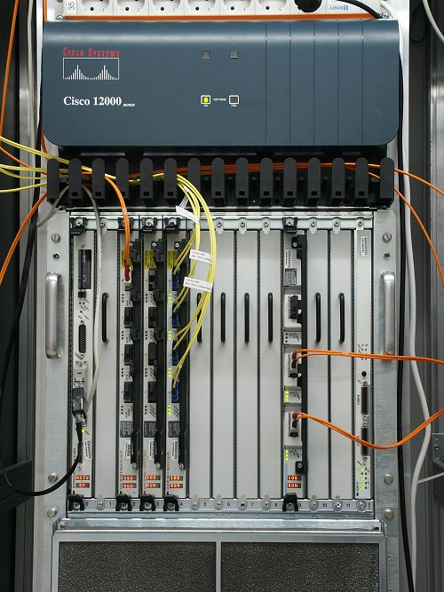
What's in a data center?
Source: 1&1
Massive networking

Slide 15
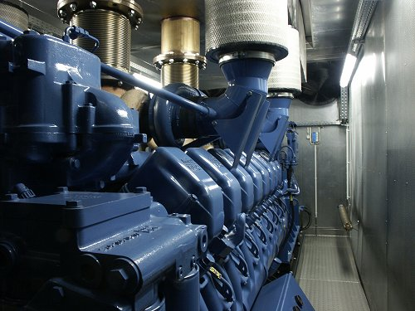
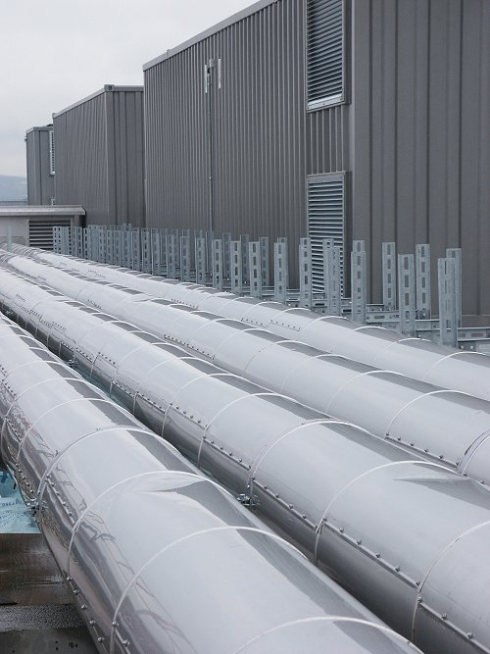
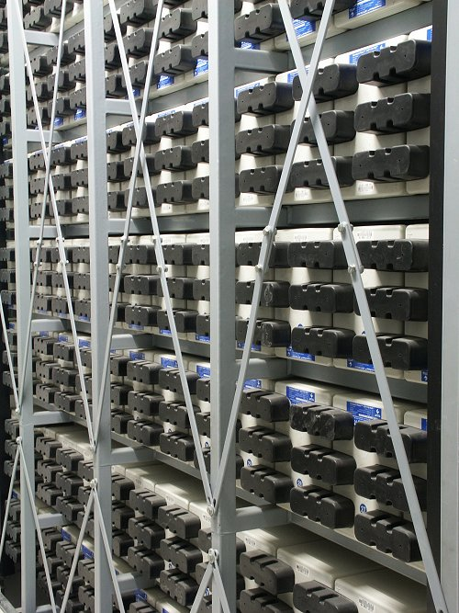
What's in a data center?
Source: 1&1
Emergency power supplies

Slide 16
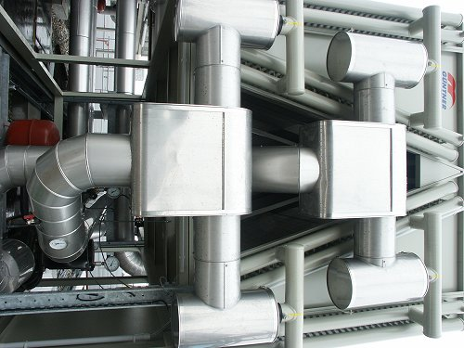
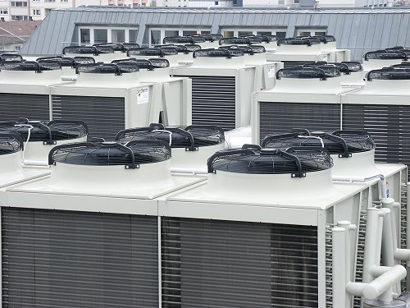
What's in a data center?
Source: 1&1
Massive cooling

Slide 17
Energy matters!
Company | Servers | Electricity | Cost
eBay | 16K | ~0.6*10⁵ MWh | ~$3.7M/yr
Akamai | 40K | ~1.7*10⁵ MWh | ~$10M/yr
Rackspace | 50K | ~2*10⁵ MWh | ~$12M/yr
Microsoft | >200K | >6*10⁵ MWh | >$36M/yr
Google | >500K | >6.3*10⁵ MWh | >$38M/yr
USA (2006)
10.9M
610*10⁵ MWh
$4.5B/yr
Source: Qureshi et al., SIGCOMM 2009
Data centers consume a lot of energy
  Makes sense to build them near sources of cheap electricity
  Example: Price per KWh is 3.6ct in Idaho (near hydroelectric power), 10ct in California (long distance transmission), 18ct in Hawaii (must ship fuel)
  Most of this is converted into heat → Cooling is a big issue!

Slide 18
Energy matters!
There are even bigger energy consumers:
  http://motherboard.vice.com/read/bitcoin-could-consume-as-much-electricity-as-denmark-by-2020
  2020 14 Gigawatts (Total power generation capacity of Denmark)
  1 Bitcoin in 2020 would consume half the annual household usage emitting 4,000 kg of CO₂
  This is a big issue because of the enthusiasm for the Blockchain driving new functionality

Slide 19
Scaling up
PC
Server
Cluster
Data center
Network of data centers
What if even a data center is not big enough?
  Build additional data centers
  Where? How many?

Slide 20
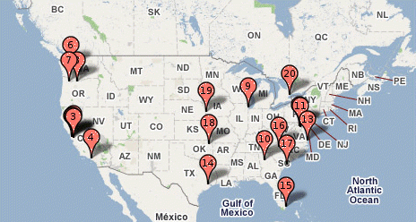
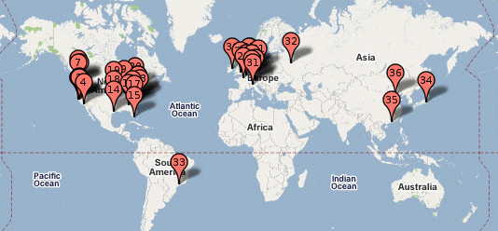
Global distribution
Data centers are often globally distributed
  Example above: Google data center locations (inferred)
Why?
  Need to be close to users (physics!)
  Cheaper resources
  Protection against failures

Slide 21
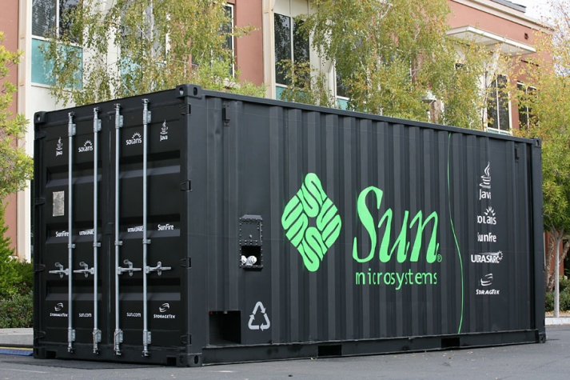
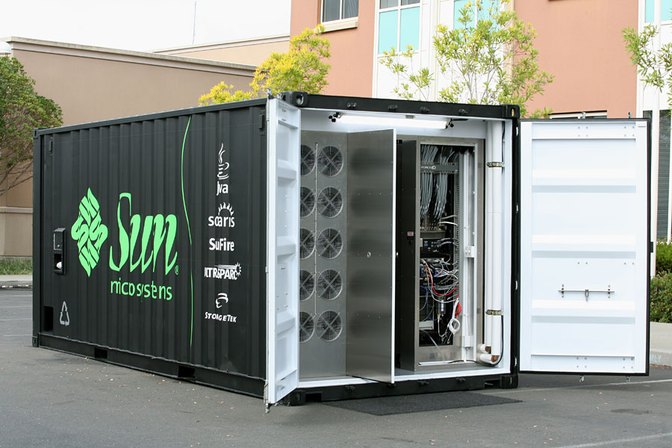
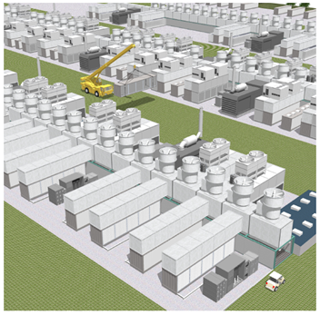
Trend: Modular data center
Need more capacity? Just deploy another container!

Slide 22
Plan for today
Computing at scale
  The need for scalability; scale of current services
  Scaling up: From PCs to data centers
  Problems with 'classical' scaling techniques
Utility computing and cloud computing
  What are utility computing and cloud computing?
  What kinds of clouds exist today?
  What kinds of applications run on the cloud?
  Virtualization: How clouds work 'under the hood'
  Some cloud computing challenges

Slide 23
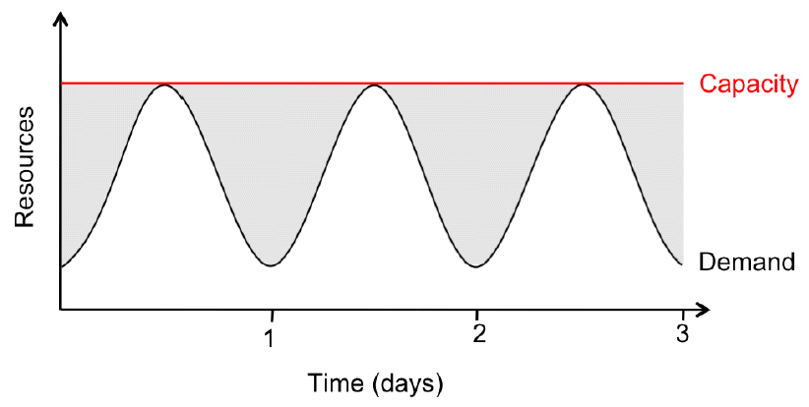
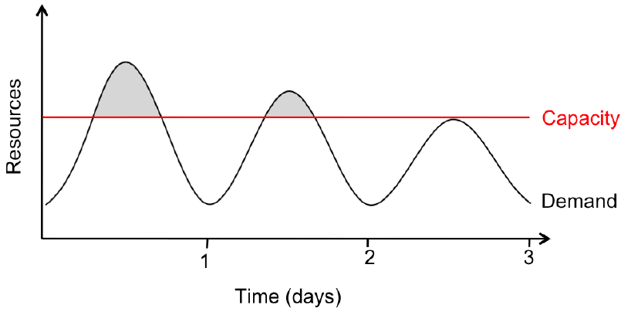
Problem #1: Difficult to dimension
Jobs cannot
be completed
Dissatisfied
customers
leave
2x-10x
Provisioning for the peak load
Provisioning below the peak
Problem: Load can vary considerably
  Peak load can exceed average load by factor 2x-10x [Why?]
  But: Few users deliberately provision for less than the peak
  Result: Server utilization in existing data centers ~5%-20%!!
  Dilemma: Waste resources or lose customers!

Slide 24
Problem #2: Expensive
Need to invest many $$$ in hardware
  Even a small cluster can easily cost $100,000
  Microsoft recently invested $499 million in a single
  data center
Need expertise
  Planning and setting up a large cluster is highly nontrivial
  Cluster may require special software, etc.
Need maintenance
  Someone needs to replace faulty hardware, install software upgrades, maintain user accounts, ...

Slide 25
Problem #3: Difficult to scale
Scaling up is difficult
  Need to order new machines, install them, integrate with existing cluster - can take weeks
  Large scaling factors may require major redesign, e.g., new storage system, new interconnect, new building (!)
Scaling down is difficult
  What to do with superfluous hardware?
  Server idle power is about 60% of peak → Energy is consumed even when no work is being done
  Many fixed costs, such as construction

Slide 26
Recap: Computing at scale
Modern applications require huge amounts of processing and data
  Measured in petabytes, millions of users, billions of objects
  Need special hardware, algorithms, tools to work at this scale
Clusters and data centers can provide the resources we need
  Main difference: Scale (room-sized vs. building-sized)
  Special hardware; power and cooling are big concerns
Clusters and data centers are not perfect
  Difficult to dimension; expensive; difficult to scale

Slide 27
Plan for today
Computing at scale
  The need for scalability; scale of current services
  Scaling up: From PCs to data centers
  Problems with 'classical' scaling techniques
Utility computing and cloud computing
  What are utility computing and cloud computing?
  What kinds of clouds exist today?
  What kinds of applications run on the cloud?
  Virtualization: How clouds work 'under the hood'
  Some cloud computing challenges

Slide 28
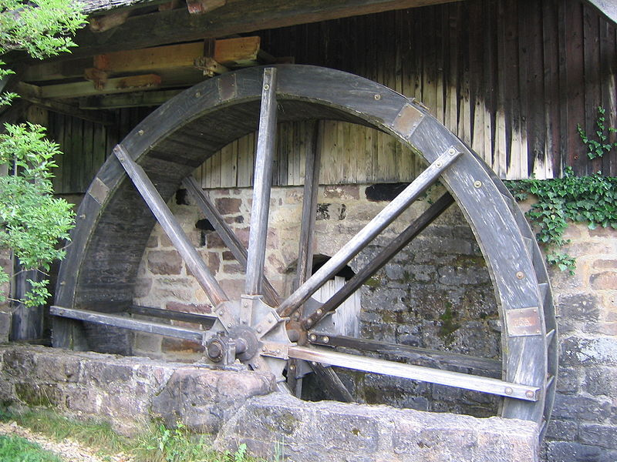
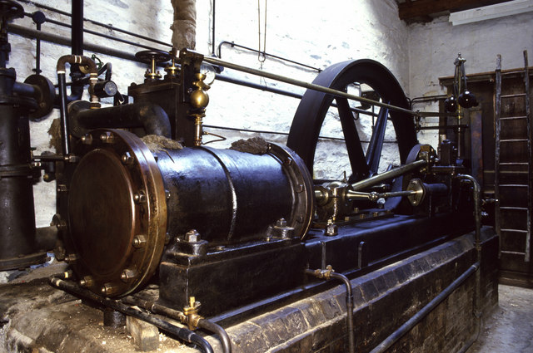
The power plant analogy
Steam engine at Stott Park Bobbin Mill
Waterwheel at the Neuhausen ob Eck Open-Air Museum
It used to be that everyone had their own power source
  Challenges are similar to the cluster: Needs large up-front investment, expertise to operate, difficult to scale up/down...

Slide 29
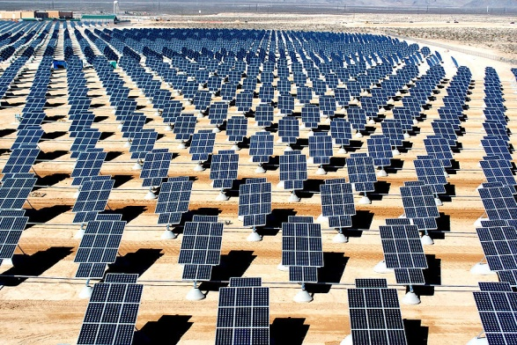
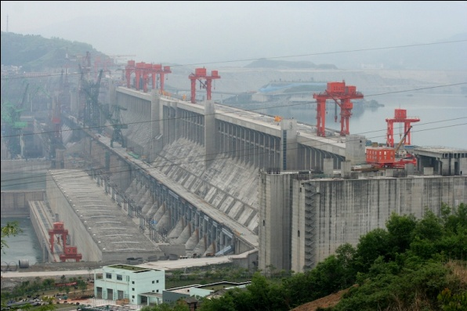
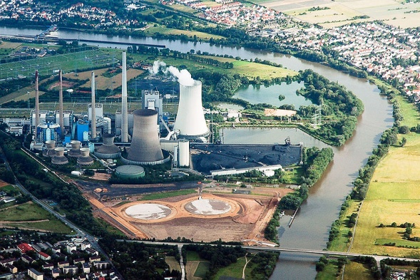
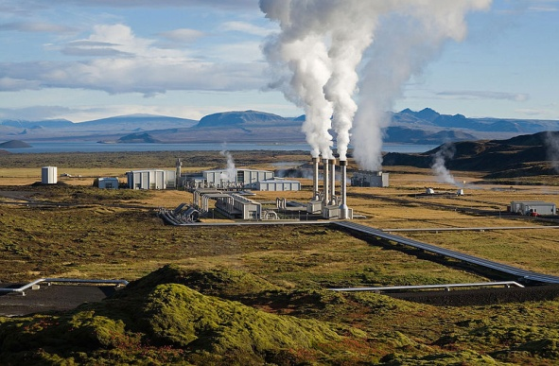
Scaling the power plant
Then people started to build large, centralized power plants with very large capacity...

Slide 30
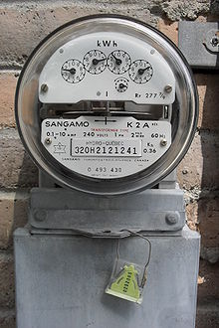
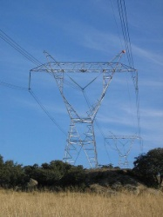
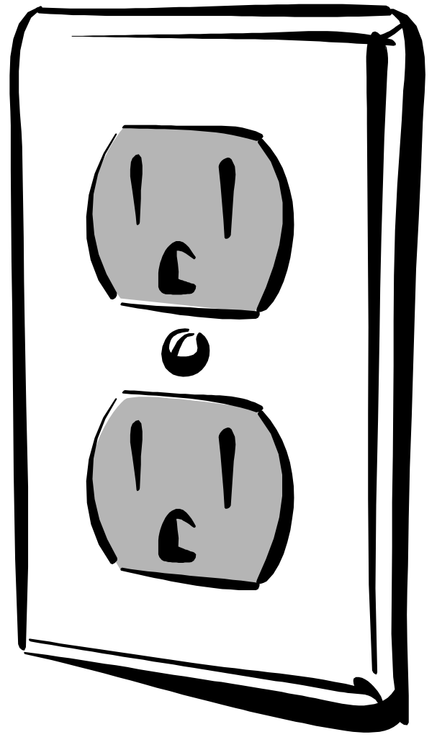
Metered usage model
Power source
Network
Metering
device
Customer
Power plants are connected to customers by a network
Usage is metered, and everyone (basically) pays only for what they actually use

Slide 31
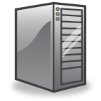
Why is this a good thing?
Electricity
Computing
Economies of scale
  Cheaper to run one big power
  plant than many small ones
Statistical multiplexing
  High utilization!
No up-front commitment
  No investment in generator;
  pay-as-you-go model
Scalability
  Thousands of kilowatts
  available on demand; add
  more within seconds
  Cheaper to run one big data
  center than many small ones
  High utilization!
  No investment in data center;
  pay-as-you-go model
  Thousands of computers available on demand; add
  more within seconds

Slide 32
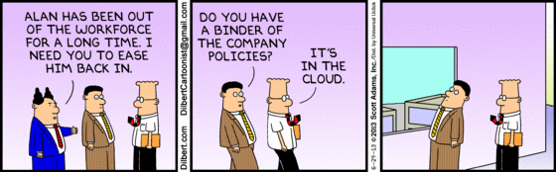
What is cloud computing?
http://www.dilbert.com/fast/2013-06-29/

Slide 33
What is cloud computing?
The interesting thing about Cloud Computing is that we've
redefined Cloud Computing to include everything that we
already do.... I don't understand what we would do differently
in the light of Cloud Computing other than change the
wording of some of our ads.
Larry Ellison, quoted in the Wall Street Journal, September 26, 2008
A lot of people are jumping on the [cloud] bandwagon, but
I have not heard two people say the same thing about it.
There are multiple definitions out there of "the cloud".
Andy Isherwood, quoted in ZDnet News, December 11, 2008

Slide 34
So what is it, really?
According to NIST:
Essential characteristics:
  On-demand self service
  Broad network access
  Resource pooling
  Rapid elasticity
  Measured service
Cloud computing is a model for enabling convenient,
on-demand network access to a shared pool of configurable
computing resources (e.g., networks, servers, storage,
applications, and services) that can be rapidly provisioned
and released with minimal management effort or
service provider interaction.

Slide 35
Other terms you may have heard
Utility computing
  The service being sold by a cloud
  Focuses on the business model (pay-as-you-go), similar to classical utility companies
The Web
  The Internet's information sharing model
  Some web services run on clouds, but not all
The Internet
  A network of networks.
  Used by the web; connects (most) clouds to their customers

Slide 36
Plan for today
Computing at scale
  The need for scalability; scale of current services
  Scaling up: From PCs to data centers
  Problems with 'classical' scaling techniques
Utility computing and cloud computing
  What are utility computing and cloud computing?
  What kinds of clouds exist today?
  What kinds of applications run on the cloud?
  Virtualization: How clouds work 'under the hood'
  Some cloud computing challenges

Slide 37
Everything as a Service
What kind of service does the cloud provide?
  Does it offer an entire application, or just resources?
  If resources, what kind / level of abstraction?
Three types commonly distinguished:
  Software as a service (SaaS)
    Analogy: Restaurant. Prepares&serves entire meal, does the dishes, ...
  Platform as a service (PaaS)
    Analogy: Take-out food. Prepares meal, but does not serve it.
  Infrastructure as a service (IaaS)
    Analogy: Grocery store. Provides raw ingredients.
  Other xaaS types have been defined, but are less common
    Desktop, Backend, Communication, Network, Monitoring, ...

Slide 38



Software as a Service (SaaS)
User
Application
Middleware
Hardware
Cloud
provider
Cloud provides an entire application
  Word processor, spreadsheet, CRM software, calendar...
  Customer pays cloud provider
  Example: Google Apps, Salesforce.com

Slide 39

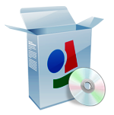
Platform as a Service (PaaS)
SaaS
provider
User
Application
Middleware
Hardware
Cloud
provider
Cloud provides middleware/infrastructure
  For example, Microsoft Common Language Runtime (CLR)
  Customer pays SaaS provider for the service; SaaS provider pays the cloud for the infrastructure
  Example: Windows Azure, Google App Engine

Slide 40
Infrastructure as a Service (IaaS)
SaaS
provider
User
Application
Middleware
Hardware
Cloud
provider
Cloud provides raw computing resources
  Virtual machine, blade server, hard disk, ...
  Customer pays SaaS provider for the service; SaaS provider pays the cloud for the resources
  Examples: Amazon Web Services, Rackspace Cloud, GoGrid

Slide 41




Private/hybrid/community clouds
Company
A
Company
B
Public
Community
Private
Who can become a customer of the cloud?
  Public cloud: Commercial service; open to (almost) anyone. Example: Amazon AWS, Microsoft Azure, Google App Engine
  Community cloud: Shared by several similar organizations.
  Example: Google's "Gov Cloud"
  Private cloud: Shared within a single organization.
  Example: Internal datacenter of a large company.
Focus of
this class
Is this a
'real' cloud?

Slide 42
Plan for today
Computing at scale
  The need for scalability; scale of current services
  Scaling up: From PCs to data centers
  Problems with 'classical' scaling techniques
Utility computing and cloud computing
  What are utility computing and cloud computing?
  What kinds of clouds exist today?
  What kinds of applications run on the cloud?
  Virtualization: How clouds work 'under the hood'
  Some cloud computing challenges

Slide 43
Examples of cloud applications
Application hosting
Backup and Storage
Content delivery
E-commerce
High-performance computing
Media hosting
On-demand workforce
Search engines
Web hosting

Slide 44

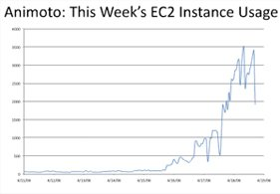
Case study:
http://animoto.com/blog/company/amazon-com-ceo-jeff-bezos-on-animoto/
Animoto: Lets users
create videos from
their own photos/music
  Auto-edits photos and aligns
  them with the music, so it
  "looks good"
Built using Amazon EC2+S3+SQS
Released a Facebook app in mid-April 2008
  More than 750,000 people signed up within 3 days
  EC2 usage went from 50 machines to 3,500 (x70 scalability!)
Source: Jeff Bezos' talk at Stanford on 4/19/08

Slide 45

Case study:
March 19, 2008: Hillary Clinton's official White House schedule released to the public
  17,481 pages of non-searchable, low-quality PDF
  Very interesting to journalists, but would have required hundreds of man-hours to evaluate
  Peter Harkins, Senior Engineer at The Washington Post:
  Can we make that data available more quickly, ideally within the same news cycle?
  Tested various Optical Character Recognition (OCR) programs; estimated required speed
  Launched 200 EC2 instances; project was completed within nine hours using 1,407 hours of VM time ($144.62)
  Results available on the web only 26 hours after the release
http://aws.amazon.com/solutions/case-studies/washington-post/

Slide 46

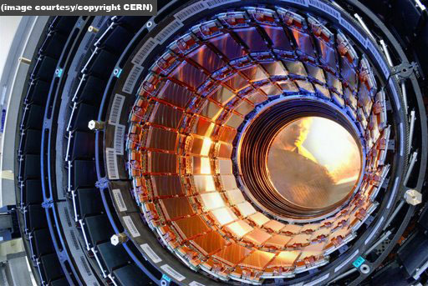

Other examples
DreamWorks is using the Cerelink
cloud to render animation movies
  Cloud was already used to render parts of
  Shrek Forever After and How to Train
  your Dragon
CERN is working on a "science
cloud" to process experimental
data
Virgin atlantic is hosting their new
travel portal on Amazon AWS

Slide 47
Recap: Utility/cloud computing
Why is cloud computing attractive?
  Analogy to 'classical' utilities (electricity, water, ...)
  No up-front investment (pay-as-you-go model)
  Low price due to economies of scale
  Elasticity - can quickly scale up/down as demand varies
Different types of clouds
  SaaS, PaaS, IaaS; public/private/community clouds
What runs on the cloud?
  Many potential applications: Application hosting, backup/storage, scientific computing, content delivery, ...
  Not yet suitable for certain applications (sensitive data, compliance requirements)

Slide 48
Is the cloud good for everything?
No.
Sometimes it is problematic, e.g., because of auditability requirements
Example: Processing medical records
  HIPAA (Health Insurance Portability and Accountability Act) privacy and security rule
Example: Processing financial information
  Sarbanes-Oxley act
Would you put your medical data on the cloud?
  Why / why not?

Slide 49
Recap: Cloud applications
Clouds are good for many things...
  Applications that involve large amounts of computation, storage, bandwidth
  Especially when lots of resources are needed quickly (Washington Post example) or load varies rapidly (TicketLeap example)
... but not for all things

Slide 50

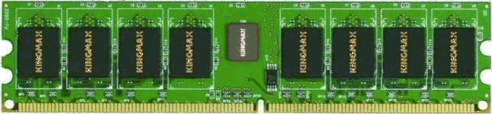

What is virtualization?
Bob
Charlie
Alice
Physical machine
Daniel
Suppose Alice has a machine with 4 CPUs and 8 GB of memory, and three customers:
  Bob wants a machine with 1 CPU and 3GB of memory
  Charlie wants 2 CPUs and 1GB of memory
  Daniel wants 1 CPU and 4GB of memory
What should Alice do?

Slide 51


What is virtualization?
Bob
Virtual
machine
monitor
Charlie
Alice
Physical machine
Virtual machines
Daniel
Alice can sell each customer a virtual machine (VM) with the requested resources
  From each customer's perspective, it appears as if they had a physical machine all by themselves (isolation)

Slide 52
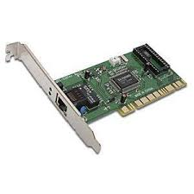
How does it work?
App
VM 1
VM 2
VM | Virt | Phys
1 | 0-99 | 0-99
1 | 299-399 | 100-199
2 | 0-99 | 300-399
2 | 200-299 | 500-599
2 | 600-699 | 400-499
App
App
OS 1
OS 2
VMM
Translation table
Physical machine
Resources (CPU, memory, ...) are virtualized
  VMM ("Hypervisor") has translation tables that map requests for virtual resources to physical resources
  Example: VM 1 accesses memory cell #323; VMM maps this to memory cell 123.
  For which resources does this (not) work?
  How do VMMs differ from OS kernels?

Slide 53

Benefit: Migration
Emil
Bob
Virtual
machine
monitor
Alice
Charlie
Virtual machines
Daniel
Physical machines
What if the machine needs to be shut down?
  e.g., for maintenance, consolidation, ...
  Alice can migrate the VMs to different physical machines without any customers noticing

Slide 54

Benefit: Time sharing
Emil
Bob
Virtual
machine
monitor
Charlie
Alice
Physical machine
Virtual machines
Daniel
What if Alice gets another customer?
  Multiple VMs can time-share the existing resources
  Result: Alice has more virtual CPUs and virtual memory than physical resources (but not all can be active at the same time)

Slide 55
Benefit and challenge: Isolation
Emil
Bob
VMM
Charlie
Alice
Physical machine
Virtual machines
Daniel
Good: Emil can't access Charlie's data
Bad: What if the load suddenly increases?
  Example: Emil's VM shares CPUs with Charlie's VM, and Charlie suddenly starts a large compute job
  Emil's performance may decrease as a result
  VMM can move Emil's software to a different CPU, or migrate it to a different machine

Slide 56
Recap: Virtualization in the cloud
Gives cloud provider a lot of flexibility
  Can produce VMs with different capabilities
  Can migrate VMs if necessary (e.g., for maintenance)
  Can increase load by overcommitting resources
Provides security and isolation
  Programs in one VM cannot influence programs in another
Convenient for users
  Complete control over the virtual 'hardware' (can install own operating system own applications, ...)
But: Performance may be hard to predict
  Load changes in other VMs on the same physical machine may affect the performance seen by the customer

Slide 57
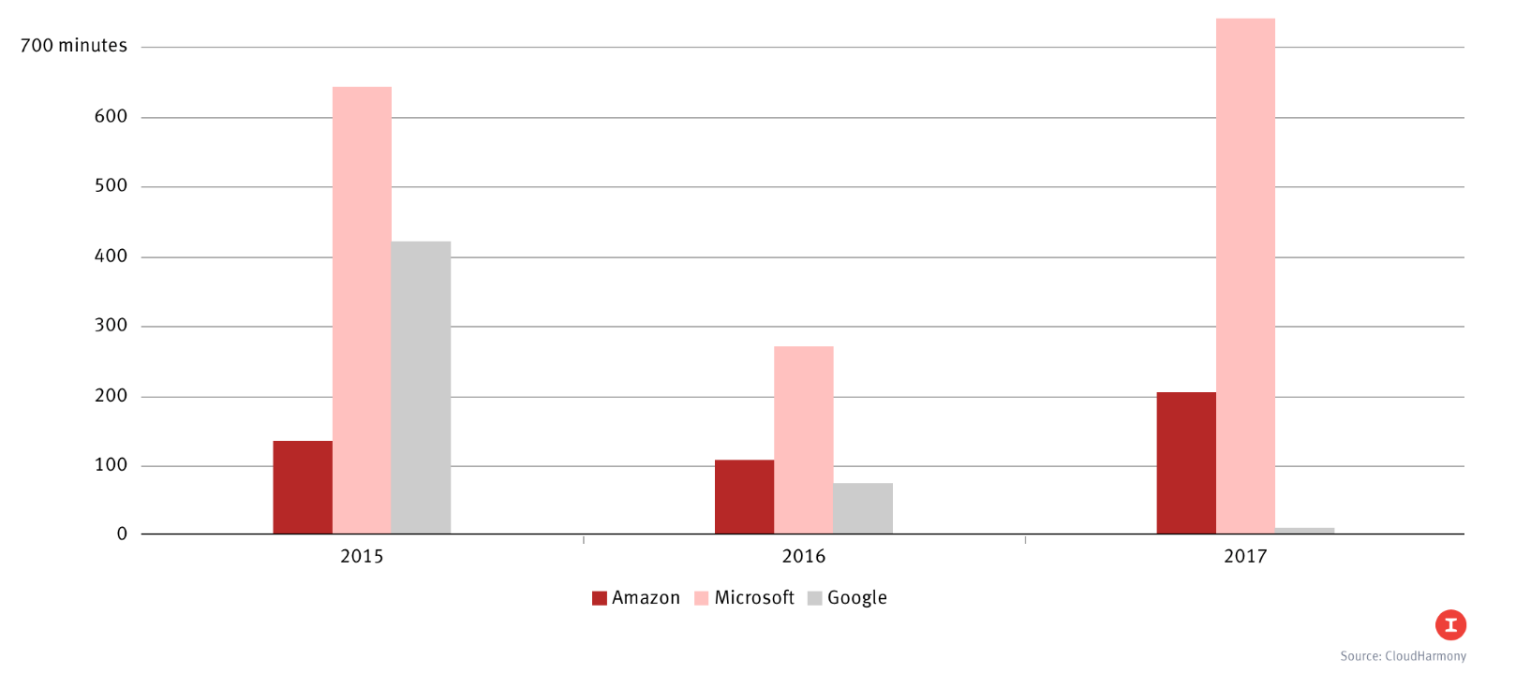
10 obstacles and opportunities
Availability
  What happens to my business if
  there is an outage in the cloud?
Data lock-in
  How do I move my data from
  one cloud to another?
Data confidentiality and auditability
  How do I make sure that the cloud doesn't leak my confidential data?
  Can I comply with regulations like HIPAA and Sarbanes/Oxley?

Slide 58
10 obstacles and opportunities
Data transfer bottlenecks
  How do I copy large amounts of
  data from/to the cloud?
  Example: 10 TB from UC Berkeley
  to Amazon in Seattle, WA
  Motivated Import/Export
  feature on AWS
Performance unpredictability
  Example: VMs sharing the same
  disk → I/O interference
  Example: HPC tasks that require
  coordinated scheduling
Method | Time
Internet (20Mbps)
FedEx
45 days
1 day
Time to transfer 10TB [AF10]
Primitive | Mean perf. | Std dev
Memory bandwidth | 1.3GB/s | 0.05GB/s (4%)
Disk bandwidth | 55MB/s | 9MB/s (16%)
Performance of 75 EC2 instances
in benchmarks

Slide 59
10 obstacles and opportunities
Scalable storage
  Cloud model (short-term usage, no up-front cost, infinite capacity on demand) does not fit persistent storage well
Bugs in large distributed systems
  Many errors cannot be reproduced in smaller configs
Scaling quickly
  Problem: Boot time; idle power
  Fine-grain accounting?

Slide 60
10 obstacles and opportunities
Reputation fate sharing
  One customer's bad behavior can affect the reputation of others using the same cloud
  Example: Spam blacklisting, FBI raid after criminal activity
Software licensing
  What if licenses are for specific computers?
    Example: Microsoft Windows
  How to scale number of licenses up/down?
    Need pay-as-you-go model as well

