Slide 1




PDS
Computer Vision
IoT
Developer Cloud
.
https://github.com/siagianp
https://www.youtube.com/@AmelOline/videos
https://github.com/amelcharolinesgn2/Cloud-Infrastructures
https://github.com/amelcharolinesgn2/ClouD-Infrastructure-SISKA-2025
https://github.com/amelcharolinesgn2/CCNA-1-v7
https://github.com/amelcharolinesgn2/CCNA-2-v7
https://github.com/amelcharolinesgn2/CCNA-3-v7
https://github.com/amelcharolinesgn2/CCNA-4-v7
https://github.com/amelcharolinesgn2/ANJAR_CCNP_Lab
https://github.com/amelcharolinesgn2/CloudSim
https://github.com/amelcharolinesgn2/AWS Certificate
https://github.com/amelcharolinesgn2/OpenStack
https://github.com/amelcharolinesgn2/IoT_simulator-mqtt-NodeRed
Notes:
https://github.com/mikeroyal/Google-Cloud-Guide

Slide 2
ACANETS/genai-labs
https://github.com/ACANETS/genai-labs
Notes:
https://github.com/ACANETS/genai-labs

Slide 3
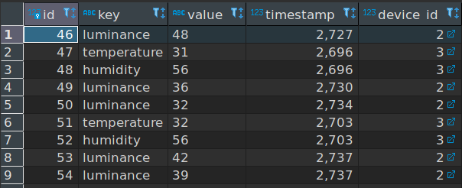
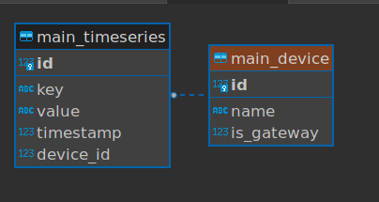
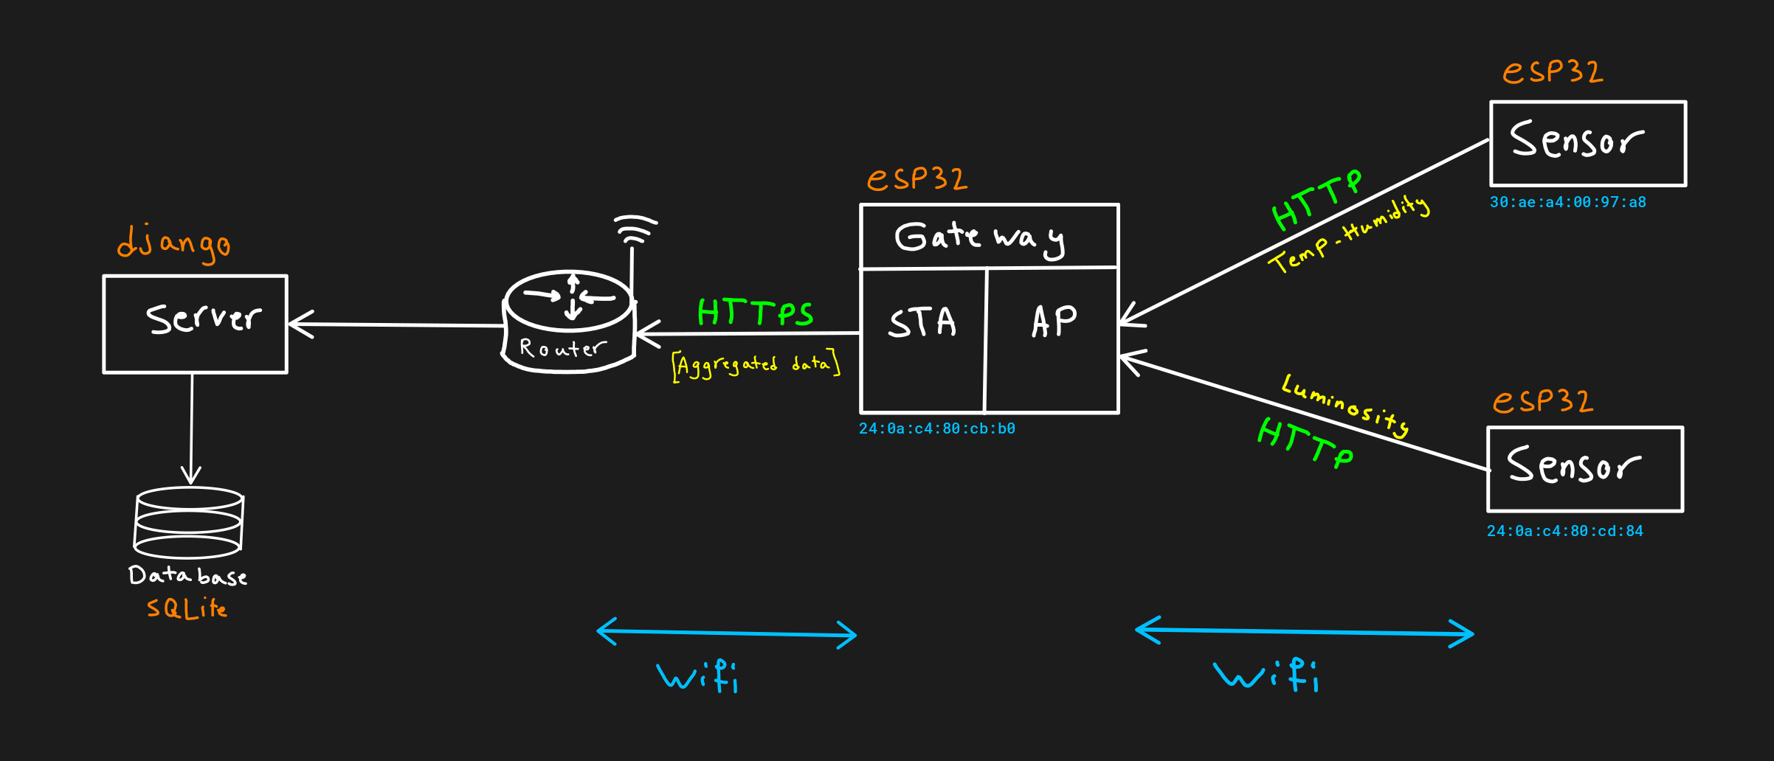
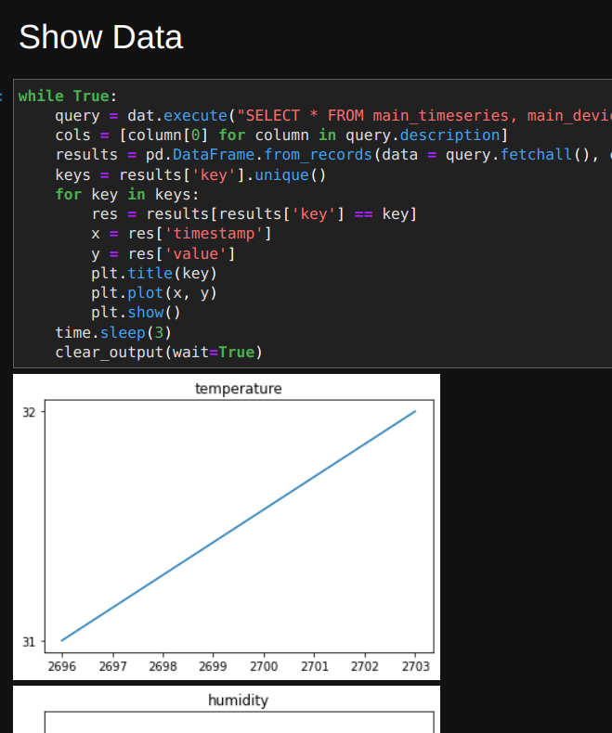
Full Stack IoT Platform
A simple implementation of an IoT platform using esp-idf. Including Sensors, Gateway, and a Server.
Introduction
Sensors
Gateway
Sever
Building and Running
Dependencies
https://github.com/arashsm79/full-stack-iot
Notes:
https://github.com/arashsm79/full-stack-iot

Slide 4
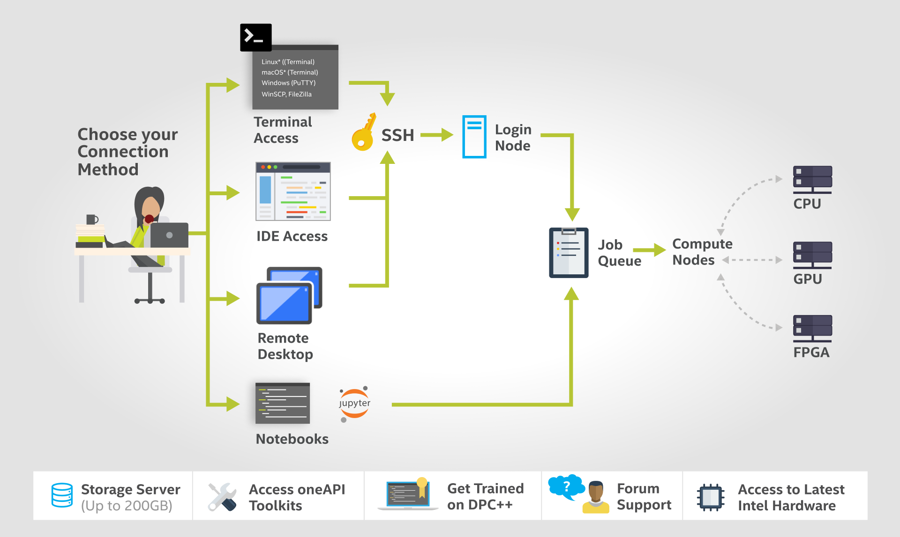
Apply for a free account on Intel Developer Cloud (DevCloud)
DevCloud has two categories of "nodes": Head Node and Compute Node
https://github.com/ACANETS/eece-6540-labs
Notes:
https://github.com/ACANETS/eece-6540-labs

Slide 5
Mauliate Godang
https://github.com/siagianp
https://www.youtube.com/@AmelOline/videos
https://github.com/amelcharolinesgn2/IoT_simulator-mqtt-NodeRed
https://github.com/amelcharolinesgn2/Cloud-Infrastructures
https://github.com/amelcharolinesgn2/ClouD-Infrastructure-SISKA-2025
https://github.com/amelcharolinesgn2/Gyroscope-Sensor-Data-Accelerometer

Slide 6
Embended
Microprocessor II & Embedded System
https://github.com/ACANETS/eece-4510-5510-labs
https://github.com/ACANETS/eece-4520-5520-labs/blob/main/lab3/assembly%20guide.md
https://github.com/ACANETS/eece-4520-5520-labs
Notes:
https://github.com/ACANETS/eece-4520-5520-labs
https://github.com/ACANETS/iot-labs

Slide 7
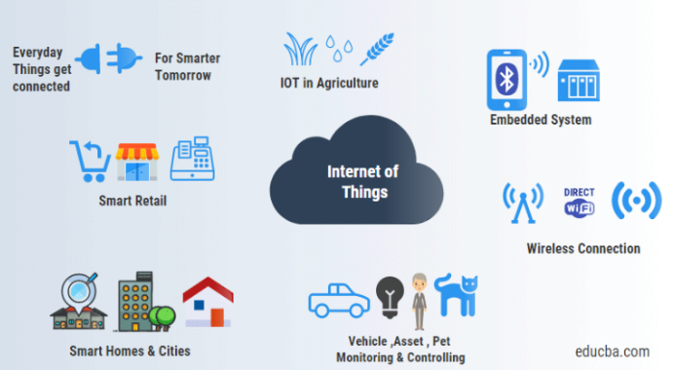
IoT
https://github.com/golu19102003/IOT-Lab
Notes:
https://github.com/golu19102003/IOT-Lab
https://github.com/ExploreLab/IoT---Online-learning
https://github.com/ExploreLab?tab=repositories

Slide 8
IoT-LAB virtual machine
https://github.com/redhat-iot/Virtual_IoT_Gateway
https://iotvirtuallab.github.io/vlab/Experiments/index.html
https://github.com/Devanshu-Parikh/Internship-Project-AC-Control-IOT
https://github.com/iot-lab/iot-lab-packer
Notes:
https://github.com/iot-lab/iot-lab-packer

Slide 9
IoT Virtual Laboratory
To simulate interfacing of basic input components (Pushbutton, Potentiometer and Slider Switch) with Arduino.
To simulate interfacing of basic output components (RGB Led, 7 segments and LCD 16*2) with Arduino.
To simulate interfacing of multiple motors (DC Motor, Servo Motor, and Stepper Motor) with Arduino.
To simulate interfacing of multiple sensors (Ultrasonic sensor, PIR Sensor, Soil Moisture, MQ135 Sensors) with Arduino.
Simulation of sending live sensors data on IoT Platform using HTTP Protocols and ESP8266/ESP32.
Simulation of sending live sensors data on IoT Platform using MQTT Protocols and ESP8266/ESP32.
Simulation of establishing master-slave model using Arduino and I2C Protocols.
Simulation of establishing interrelation between cloud (AWS, Microsoft Azure, ThingSpeak, and IBM Bluemix) and ESP2866/ESP32.
To create IoT Dashboard for remote monitoring.
To create IoT Application using LORAWAN and ESP8266/ESP32.
https://iotvirtuallab.github.io/vlab/Experiments/index.html#
Notes:
https://iotvirtuallab.github.io/vlab/Experiments/index.html#

Slide 10
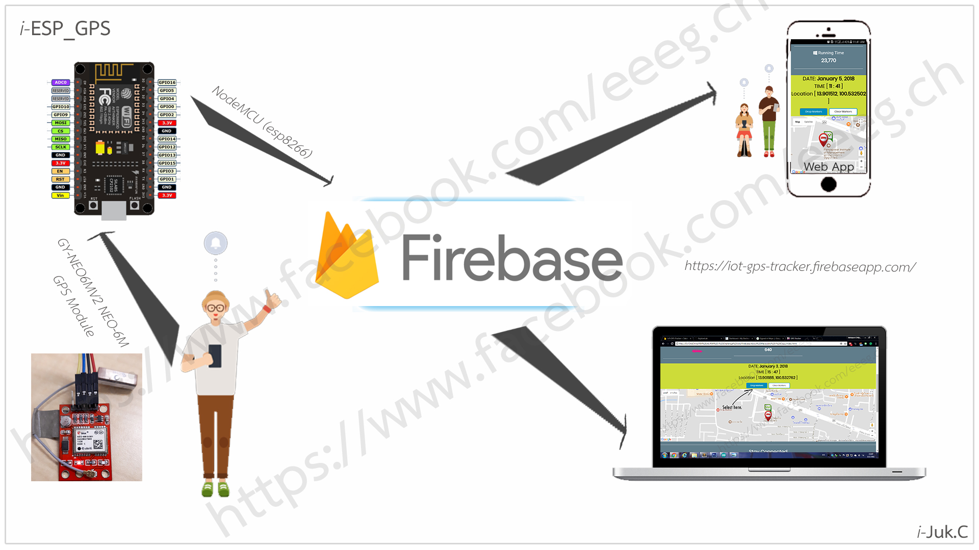
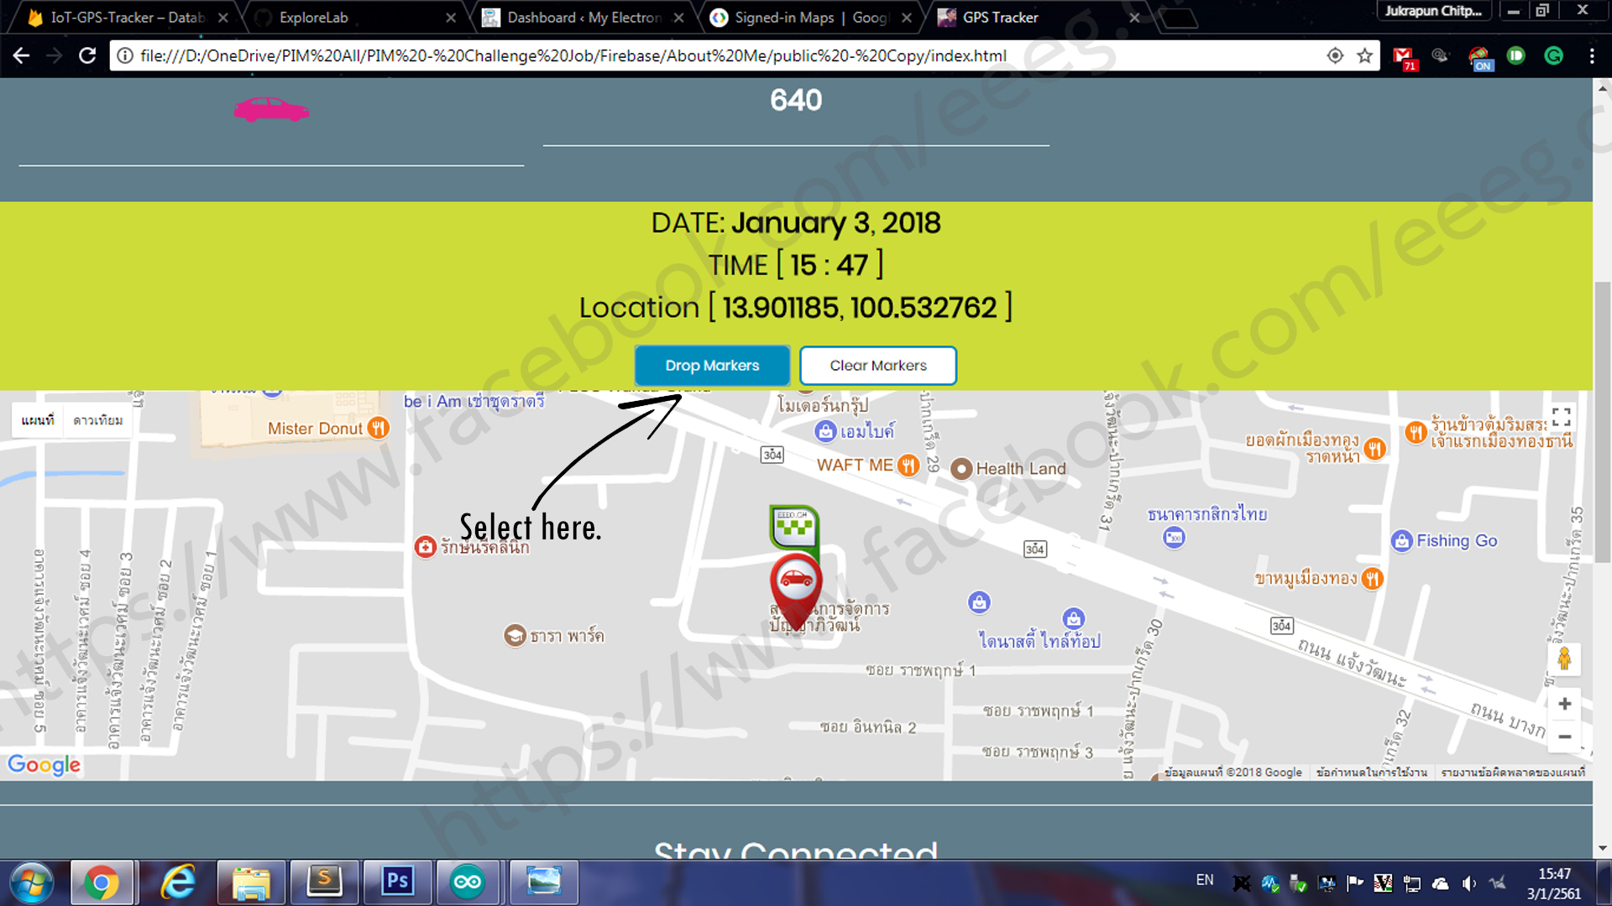
IoT-GPS-Tracker
https://github.com/ExploreLab/IoT-GPS-Tracker
Notes:
https://github.com/ExploreLab/IoT-GPS-Tracker

Slide 11
IoT Monitoring System
A comprehensive IoT monitoring and control system using ESP32, featuring a modern web interface and powerful backend API with advanced NoSQL query capabilities.
Table of Contents
Overview
System Architecture
Key Features
Quick Start
Installation and Setup
API Documentation
Project Structure
MQTT Topics
Development
Troubleshooting
┌─────────────────┐ ┌─────────────────┐ ┌──────────--───────┐
│ ESP32 Device │ │ Backend API │ | Frontend │
│ │ │ (Flask) │ │ (HTML/JS) │
│ │ MQTT │ │ HTTP │ │
│ - DHT11 Sensor │ ──────► │ - MQTT Client │ ◄── │ - Real-time UI │
│ - Light Sensor │ │ - REST API │ │ - Charts │
│ - 3x LED Control │ │ - MongoDB │ │ - Data Tables │
│ - WiFi + MQTT │ │ - NoSQL Queries │ │ - LED Controls │
└─────────────────┘ └─────────────────┘ └─────────────────┘
https://github.com/PhucHuwu/IoT_Project
Notes:
https://github.com/PhucHuwu/IoT_Project
https://github.com/Devanshu-Parikh/Internship-Project-AC-Control-IOT
┌─────────────────┐ ┌──────────────────┐ ┌─────────────────┐ │ ESP8266 │ │ FastAPI │ │ Next.js │ │ Firmware │◄──►│ Backend │◄──►│ Frontend │ │ │ │ │ │ │ │ • IR Control │ │ • REST API │ │ • Dashboard │ │ • MQTT Client │ │ • WebSockets │ │ • Device Mgmt │ │ • OTA Updates │ │ • MQTT Broker │ │ • Zone Control │ │ • WiFi Config │ │ • PostgreSQL │ │ • Real-time UI │ └─────────────────┘ └──────────────────┘ └─────────────────┘

Slide 12
IoT Monitoring System
┌─────────────────┐ ┌─────────────────┐ ┌──────────--───────┐
│ ESP32 Device │ │ Backend API │ | Frontend │
│ │ │ (Flask) │ │ (HTML/JS) │
│ │ MQTT │ │ HTTP │ │
│ - DHT11 Sensor │ ──────► │ - MQTT Client │ ◄── │ - Real-time UI │
│ - Light Sensor │ │ - REST API │ │ - Charts │
│ - 3x LED Control │ │ - MongoDB │ │ - Data Tables │
│ - WiFi + MQTT │ │ - NoSQL Queries │ │ - LED Controls │
└─────────────────┘ └─────────────────┘ └─────────────────┘
https://github.com/PhucHuwu/IoT_Project
Notes:
https://github.com/PhucHuwu/IoT_Project
IoT_Project/ ├── .gitignore ├── README.md │ ├── backend/ │ ├── .env │ ├── .env.example │ ├── main.py # Entry point │ ├── requirements.txt # Python dependencies │ ├── app/ │ │ ├── __init__.py │ │ ├── api/ # API routes and blueprints │ │ │ ├── routes.py │ │ │ ├── swagger_config.py │ │ │ ├── __init__.py │ │ │ └── v1/ │ │ │ ├── sensors.py │ │ │ ├── sensors_swagger.py │ │ │ └── __init__.py │ │ │ │ │ ├── core/ # Configuration and database │ │ │ ├── config.py │ │ │ ├── database.py │ │ │ ├── logger_config.py │ │ │ ├── timezone_utils.py │ │ │ └── __init__.py │ │ │ │ │ ├── models/ # Data models │ │ │ ├── device.py │ │ │ ├── sensor_data.py │ │ │ └── __init__.py │ │ │ │ │ └── services/ # Business logic │ │ ├── data_service.py │ │ ├── led_control_service.py │ │ ├── mqtt_service.py │ │ ├── status_service.py │ │ ├── validation_service.py │ │ └── __init__.py │ │ │ └── tests/ │ └── __init__.py │ ├── frontend/ │ ├── public/ # HTML pages │ │ ├── action-history.html │ │ ├── home-page.html │ │ ├── profile.html │ │ └── sensor-data.html │ │ │ └── src/ │ ├── components/ # UI components │ │ └── update-indicator.js │ │ │ ├── control/ # Controllers │ │ ├── action-history-table-control.js │ │ ├── home-page-chart-control.js │ │ ├── home-page-led-control.js │ │ ├── home-page-sensor-card-control.js │ │ ├── profile-control.js │ │ └── sensor-data-table-control.js │ │ │ ├── pages/ # Page loaders │ │ ├── action-history-loader.js │ │ ├── home-page-loader.js │ │ └── sensor-data-loader.js │ │ │ ├── services/ # API services │ │ └── api.js │ │ │ ├── styles/ # CSS files │ │ ├── main.css │ │ ├── pages.css │ │ └── profile.css │ │ │ └── view/ # Views and templates │ ├── charts/ │ │ ├── home-page-chart.js │ │ │ ├── sensors/ │ │ └── home-page-sensor-card.js │ │ │ └── table/ │ ├── action-history-table.js │ └── sensor-data-table.js │ └── hardware/ └── IoT_Device/ ├── IoT_Device.ino # ESP32 code └── pubsub.txt # MQTT test commands
MQTT Topics
esp32/iot/data: Sensor data from ESP32 (temperature, humidity, light)
esp32/iot/control: LED control commands from backend to ESP32
esp32/iot/action-history: LED status changes and action history
MQTT Message Formats
Sensor Data (esp32/iot/data)
{ "temperature": 25.5, "humidity": 60.2, "light": 45.8 }
LED Control (esp32/iot/control)
LED1_ON LED1_OFF LED2_ON LED2_OFF LED3_ON LED3_OFF
Action History (esp32/iot/action-history)
{ "type": "led_status", "led": "LED1", "state": "ON" }
Development
Backend Development
Backend uses Flask with modular architecture:
Blueprints for API organization
Services for business logic
Models for data structures
Core for configuration and utilities
Frontend Development
Frontend uses vanilla JavaScript with MVC architecture:
Controllers handle logic and API calls
Views display UI components
Services manage API communication
Components reusable UI elements
Testing MQTT
Use mosquitto client to test MQTT (example commands in hardware/IoT_Device/pubsub.txt):
# Subscribe to sensor data mosquitto_sub -h your-hivemq-broker -p 8883 -u username -P password -t "esp32/iot/data" # Subscribe to action history mosquitto_sub -h your-hivemq-broker -p 8883 -u username -P password -t "esp32/iot/action-history" # Send LED control command mosquitto_pub -h your-hivemq-broker -p 8883 -u username -P password -t "esp32/iot/control" -m "LED1_ON" # Send test sensor data mosquitto_pub -h your-hivemq-broker -p 8883 -u username -P password -t "esp32/iot/data" -m '{"temperature":25.0,"humidity":60.0,"light":80.0}'
Troubleshooting
Common Issues
Hardware Issues
ESP32 cannot connect to WiFi:
Check SSID and password in hardware/IoT_Device/IoT_Device.ino
Ensure WiFi is in 2.4GHz mode
Verify signal strength
LED control not working:
Check MQTT broker connection
Verify LED control topic subscription
Check ESP32 MQTT client status
Backend Issues
MQTT connection failed:
Check broker host and port in .env file
Verify username/password
Test with mosquitto client (see Testing MQTT)
Backend not receiving data:
Check MQTT broker connection
Verify topic names match configuration
Check MongoDB connection
NoSQL queries not working:
Verify MongoDB connection
Check collection names and indexes
Review query syntax and parameters
Frontend Issues
Frontend not displaying data:
Check browser console for errors
Verify API endpoints are accessible at http://localhost:5000
Check CORS configuration
Ensure backend is running on correct port
Contributing
We welcome contributions! Here's how you can help:
Fork the repository
Create a feature branch (git checkout -b feature/amazing-feature)
Commit your changes (git commit -m 'Add some amazing feature')
Push to the branch (git push origin feature/amazing-feature)
Open a Pull Request
Development Guidelines
Follow the existing code structure and patterns
Add appropriate comments and documentation
Test your changes thoroughly
Ensure all existing tests pass

Slide 13
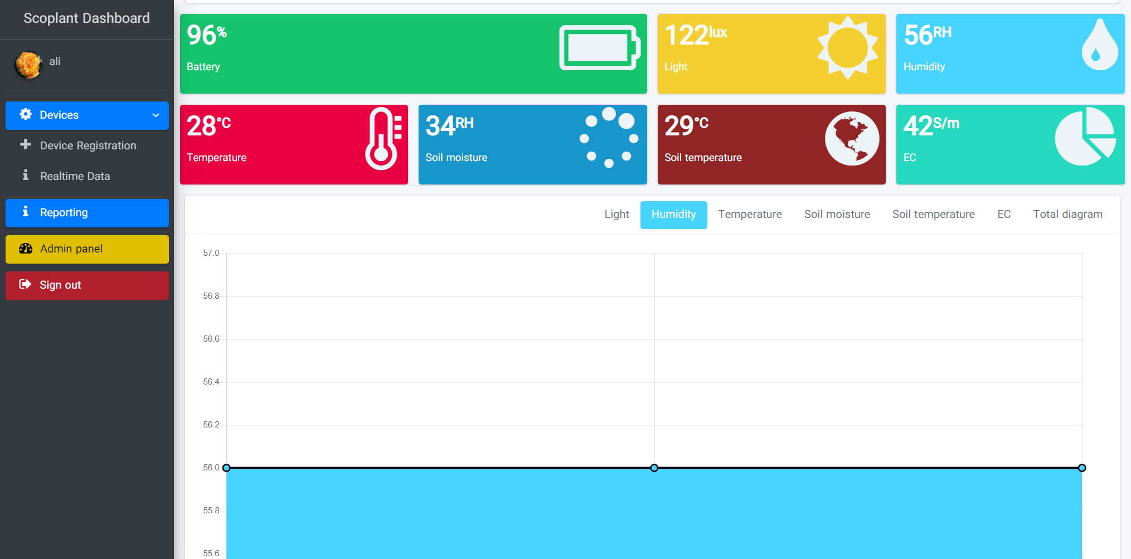
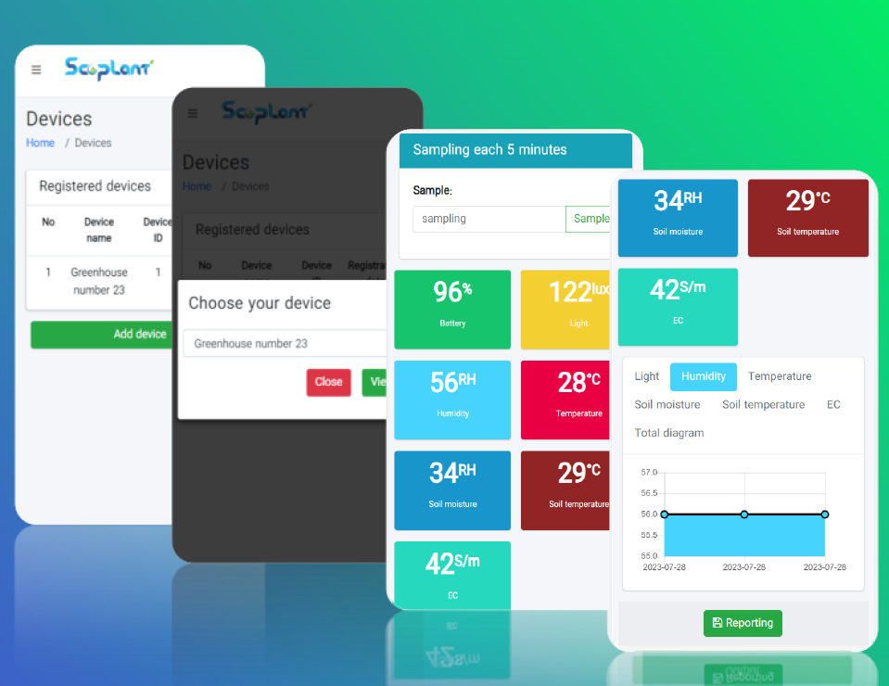
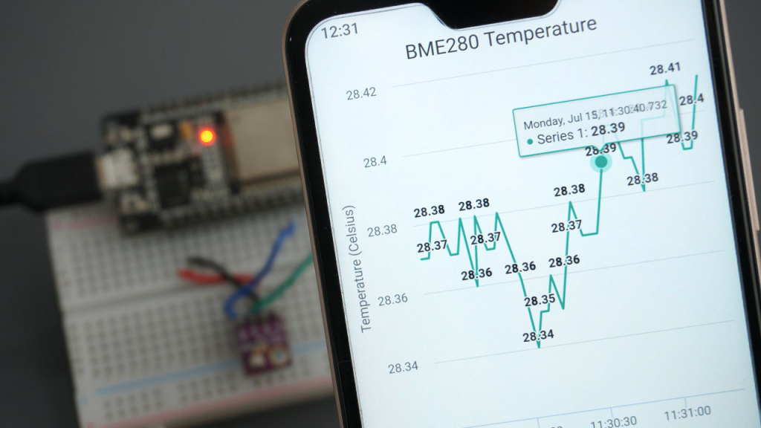
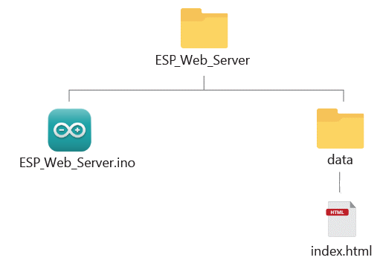
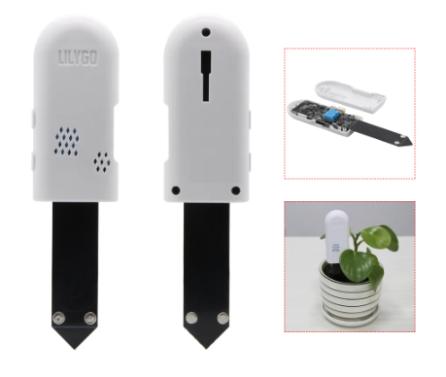
alialaei1/IOT-MQTT-Dashboard-for-ESP32-Plant-Sensor
Notes:
https://github.com/alialaei1/IOT-MQTT-Dashboard-for-ESP32-Plant-Sensor
https://randomnerdtutorials.com/esp32-esp8266-input-data-html-form/
https://binnes.github.io/esp8266Workshop/pdf/esp8266Workshop.pdf
https://randomnerdtutorials.com/esp32-esp8266-plot-chart-web-server/

Slide 14
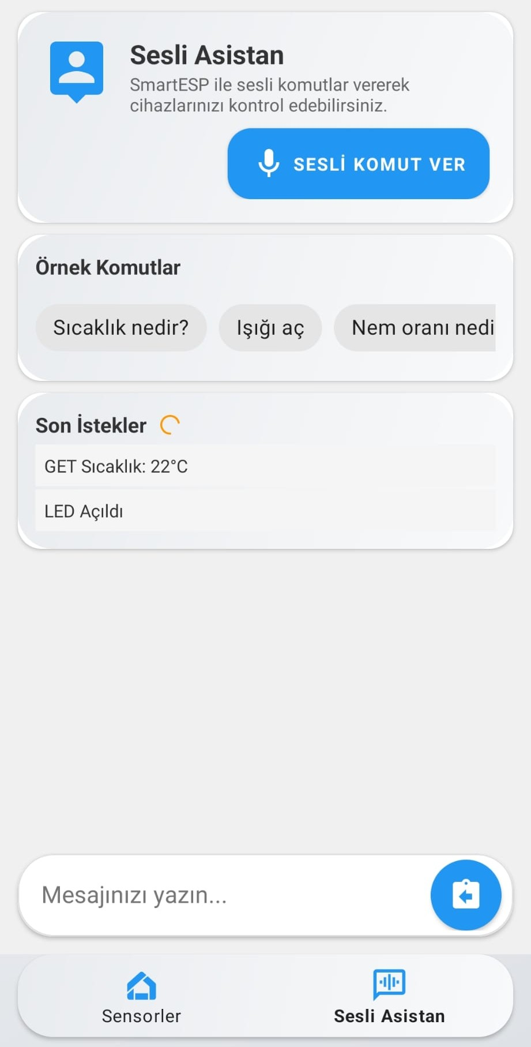
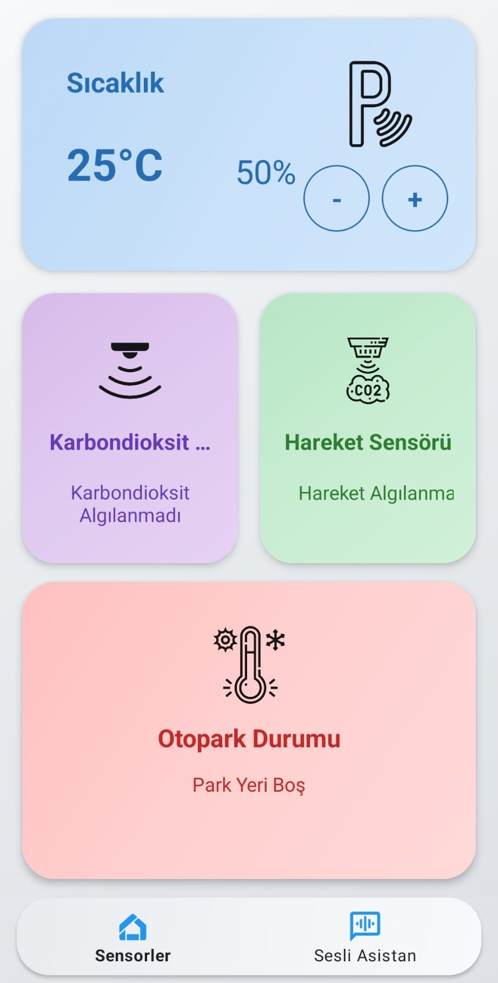
https://github.com/TunahanDilercan/SmartESPApp
IoT Sensor Management
https://github.com/TunahanDilercan/SmartESPApp
Notes:
https://github.com/TunahanDilercan/SmartESPApp

Slide 15
