Slide 1

GCP
Create a new Windows VM Instance
https://github.com/siagianp
https://www.youtube.com/@AmelOline/videos
https://github.com/amelcharolinesgn2/Cloud-Infrastructures
https://github.com/amelcharolinesgn2/ClouD-Infrastructure-SISKA-2025
https://github.com/amelcharolinesgn2/CCNA-1-v7
https://github.com/amelcharolinesgn2/CCNA-2-v7
https://github.com/amelcharolinesgn2/CCNA-3-v7
https://github.com/amelcharolinesgn2/CCNA-4-v7
https://github.com/amelcharolinesgn2/ANJAR_CCNP_Lab
https://github.com/amelcharolinesgn2/CloudSim
https://github.com/amelcharolinesgn2/AWS Certificate
https://github.com/amelcharolinesgn2/OpenStack
https://github.com/amelcharolinesgn2/IoT_simulator-mqtt-NodeRed
Notes:
https://blog.matrixpost.net/google-cloud-create-and-connect-to-a-new-windows-vm-instance/

Slide 2
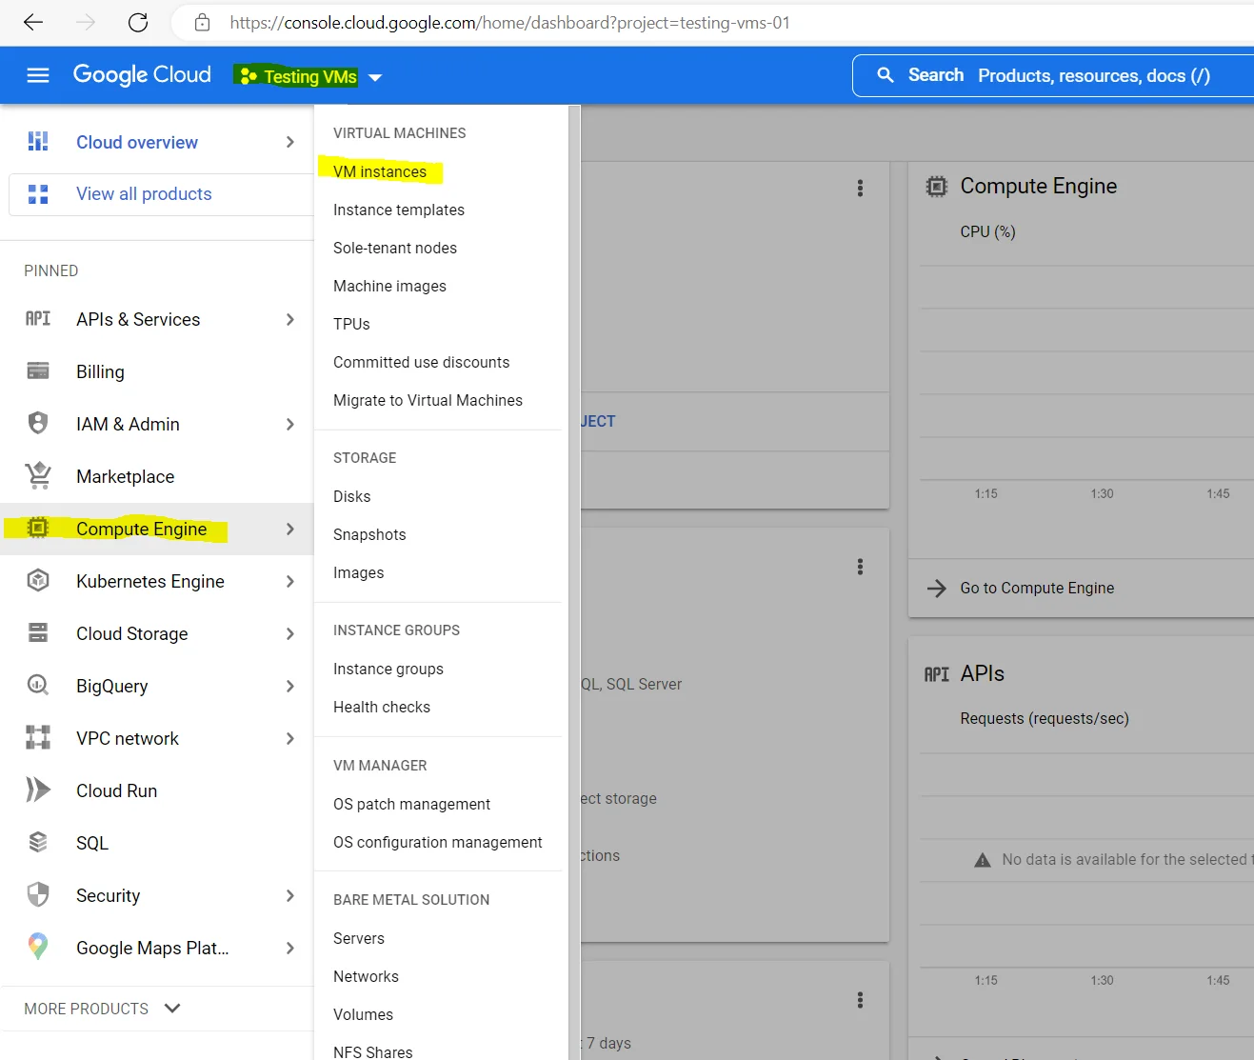
Create a new Windows VM Instance
GCP console –> Compute Engine –> VM instances
Click on Create Instance
Below you can see that I already created two instances, the first VM had assigned a network interface and IP address from the project’s default VPC network and the IP address 10.156.0.2.
New projects start with a default network (an auto mode VPC network) that has one subnetwork (subnet) in each region. So no matter in which region you deploy your instance, a corresponding subnet will be available for.
The second VM had an network interface and IP address assigned from my organizations Shared VPC network.
Notes:
https://blog.matrixpost.net/google-cloud-create-and-connect-to-a-new-windows-vm-instance/

Slide 3
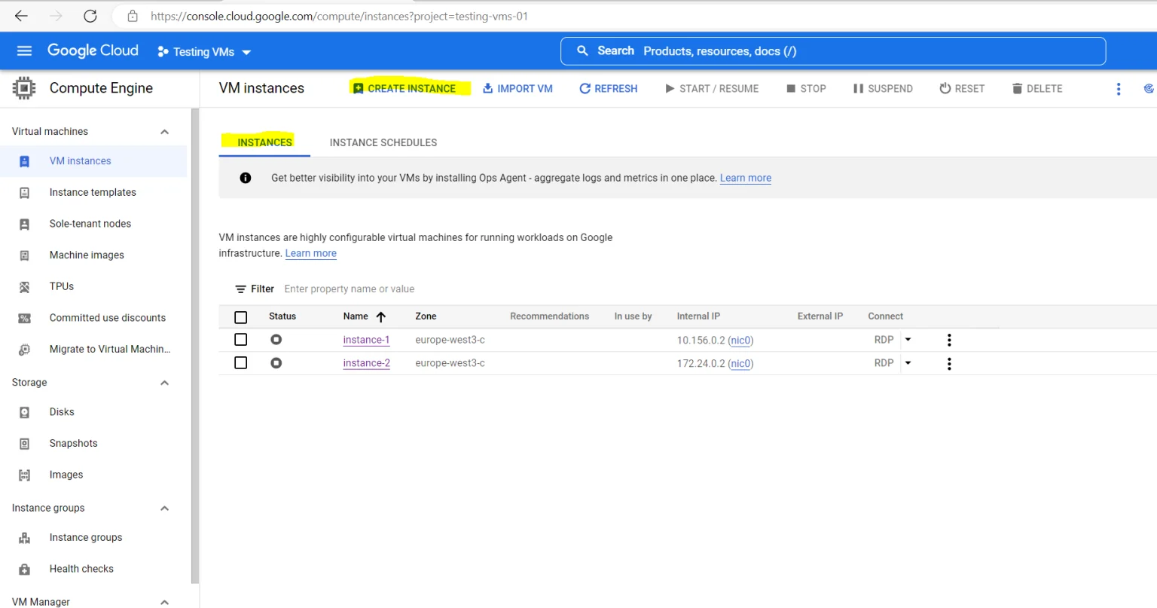
Create a new Windows VM Instance
The second VM had an network interface and IP address
For the new instance we first need to provide a name and the region and zone we want to deploy it to.
For the region you choose please be aware of the following fact:
Because subnets are regional objects, the region that you select for a resource determines the subnets that it can use.
In a nutshell –> When you want to use instead of the project’s default network a different for example your shared VPC network, you need to choose the region the VPC network (and its subnet) you want to use is hosted in order to be available to choose.
For Shared VPC networks you further need to attach the project you created the VM instance within to the Shared VPC network.

Slide 4
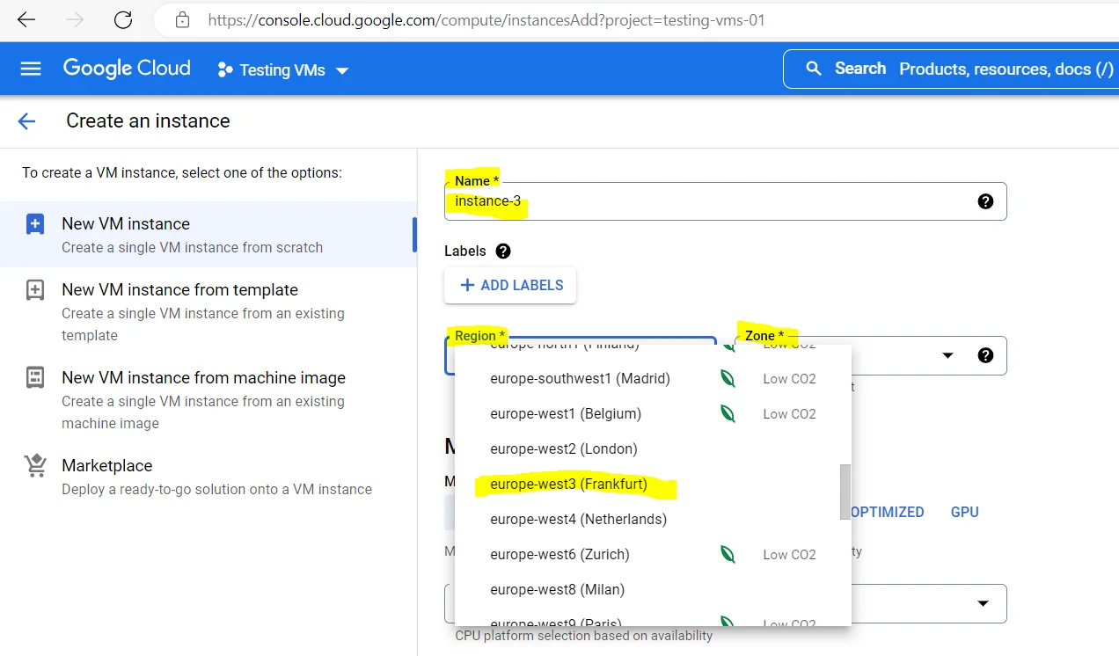
Create a new Windows VM Instance created the VM instance within to the Shared VPC network.
Regions and zones
A region is a specific geographical location where you can host your resources. Regions have three or more zones. For example, the us-west1 region denotes a region on the west coast of the United States that has three zones: us-west1-a, us-west1-b, and us-west1-c.
Putting resources in different zones in a region reduces the risk of an infrastructure outage affecting all resources simultaneously. Putting resources in different regions provides an even higher degree of failure independence. This lets you design robust systems with resources spread across different failure domains.
Regions are collections of zones and a zone is a deployment area within a region.
Source: https://cloud.google.com/compute/docs/regions-zones

Slide 5
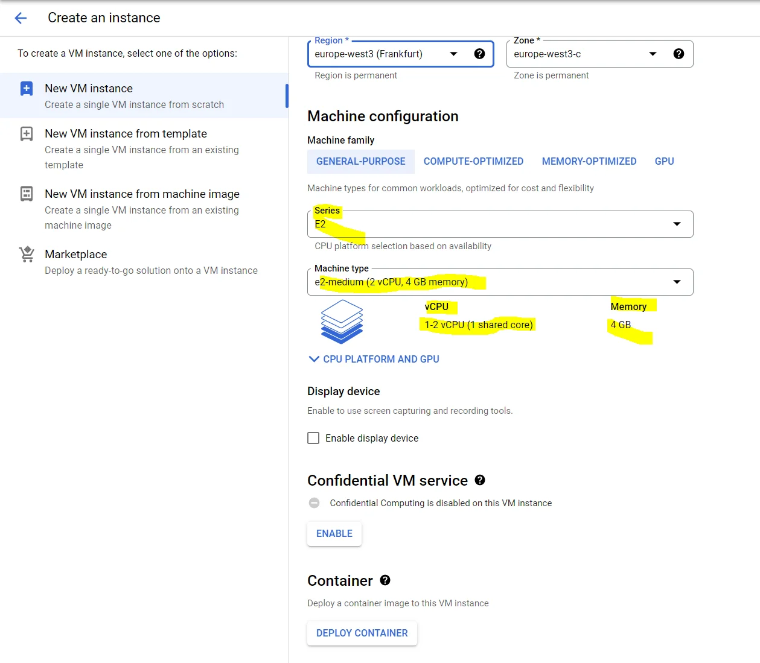
Create a new Windows VM Instance
This test VM instance.
Under the Boot disk section I need to change the image from Debian to Windows Server 2022.

Slide 6
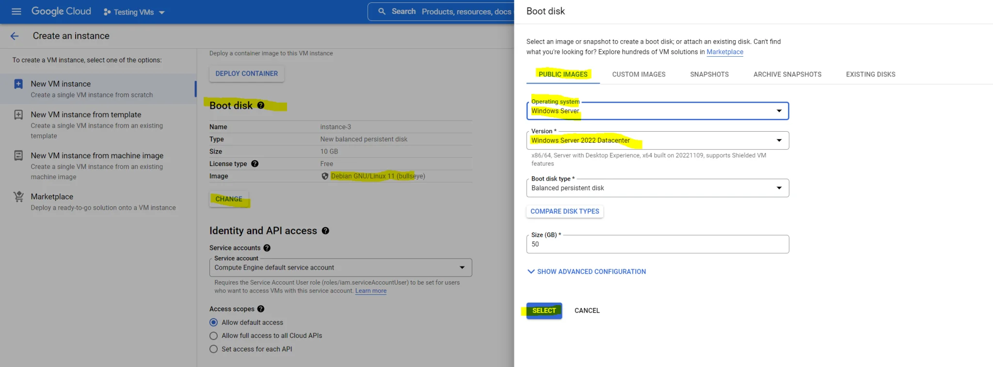
Create a new Windows VM Instance change the image from Debian to Windows Server 2022.
The rest of the settings besides Networking I will leave on default and is fine for me.
When leaving the Network settings on default, an interface and IP address from the project’s default VPC network and subnet, hosted in the region the VM will be deployed, is assigned.

Slide 7
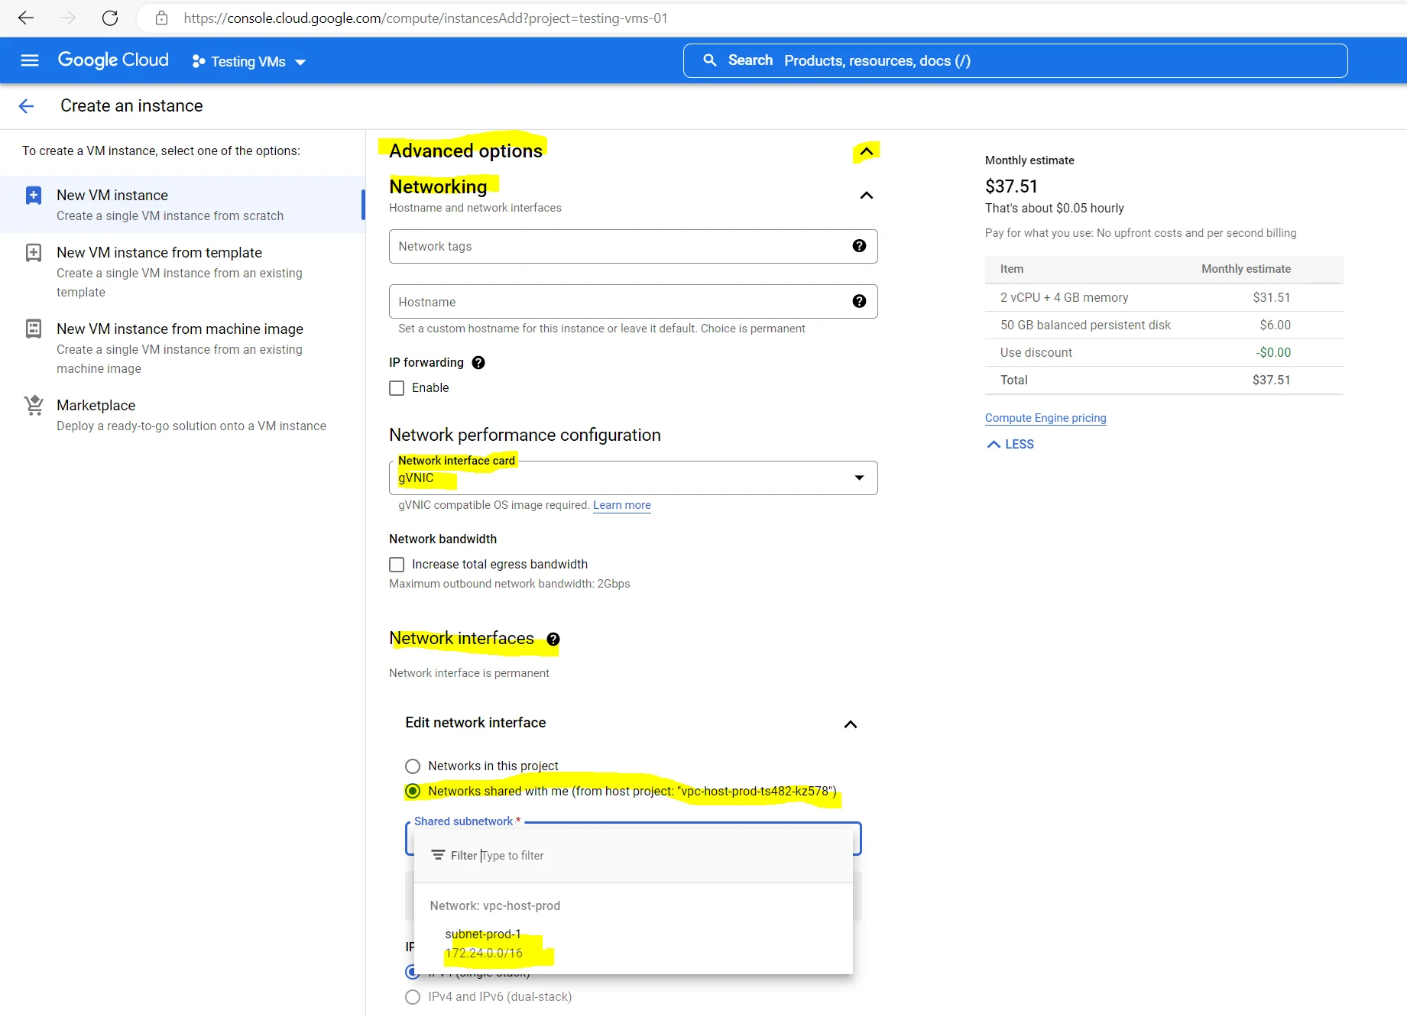
Create a new Windows VM Instance hosted in the region the VM will be deployed, is assigned.
I want to use a network interface and IP address from my organizations Shared VPC network and one of its subnets 172.24.0.0./16 homed in the region europe-west3 (Frankfurt).
So I need to expand the Advanced options settings below, select a network interface card (type) and also need to expand the Edit network interface menu in order to select my Shared VPC network.
As already mentioned, you first need to attach the project you created the VM instance within to your Shared VPC network in order to be able to use it here.

Slide 8
Create a new Windows VM Instance network interface card type (gVNIC or VirtIO) and Shared VPC network .
Regarding the above network interface card type (gVNIC or VirtIO) and Shared VPC network you can read more about in my following post.
Working Basics with the Google Cloud Platform (GCP)
In this post I want to show some basics good to know when working with the Google Cloud Platform (GCP). … Continue reading
https://blog.matrixpost.net/working-basics-with-google-cloud/

Slide 9
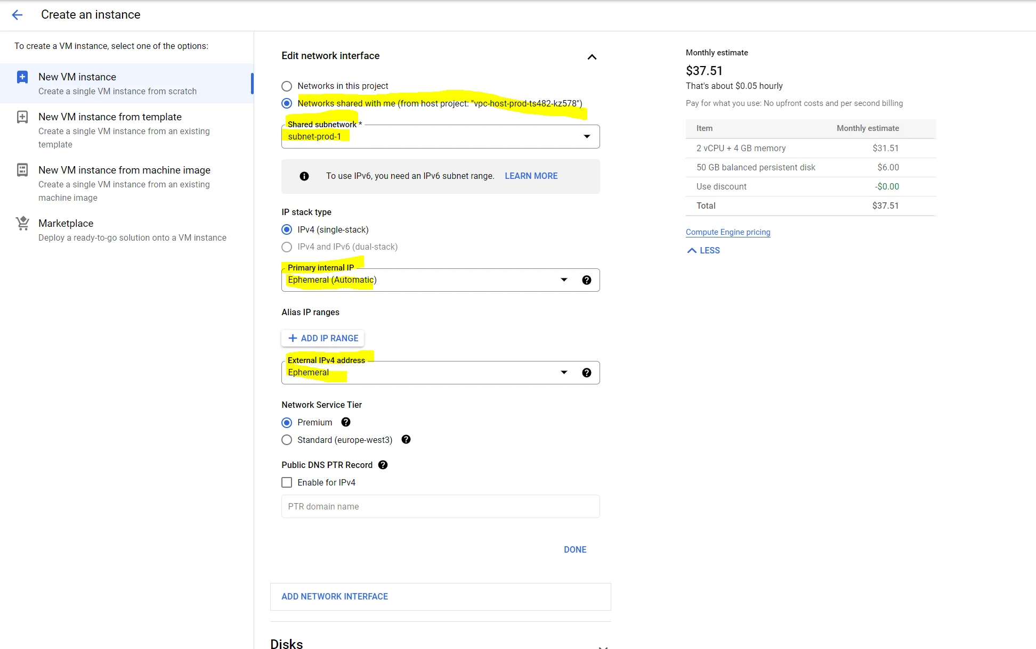
Create a new Windows VM Instance ephemeral internal and external IPv4 address.
The rest of the settings as mentioned I will leave on default and finally I can click on Create.
Below you can see by default will be assigned an ephemeral internal and external IPv4 address.
Restarting the VM won’t change ephemeral IP addresses, just deleting, stopping and recreating the VM. When using for internal (automatic), a random IP address from the subnet range will be assinged and with (custom) you can manually assign one from the subnet.
In general, the ephemeral IP address is released if you stop or delete the resource.
By default an internal IPv4 and external IPv4 address will be assigned. In case you have set up an IPSec S2S VPN tunnel between your on-premise network and the Google Cloud VPC network, the VM will be deployed, you can also change the external IPv4 address to None and just use the internal to connect to.

Slide 10
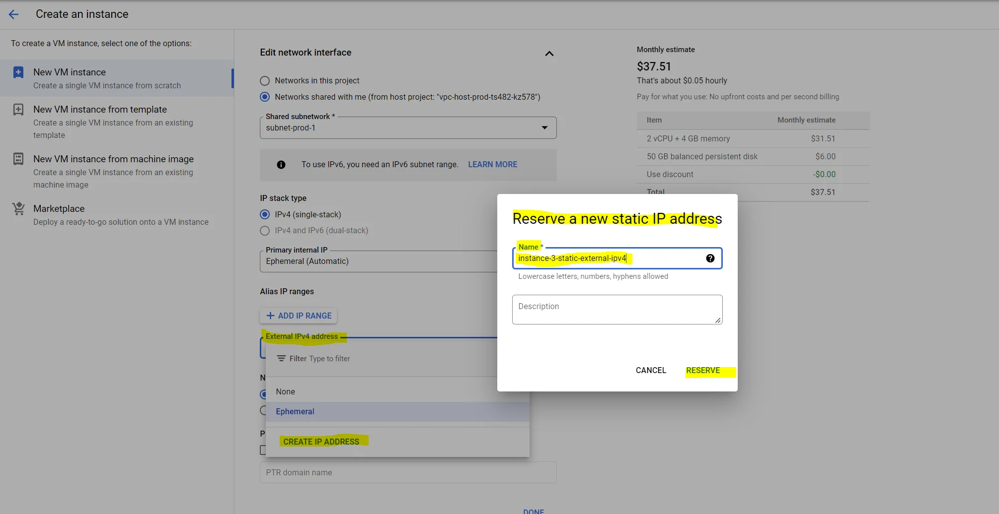
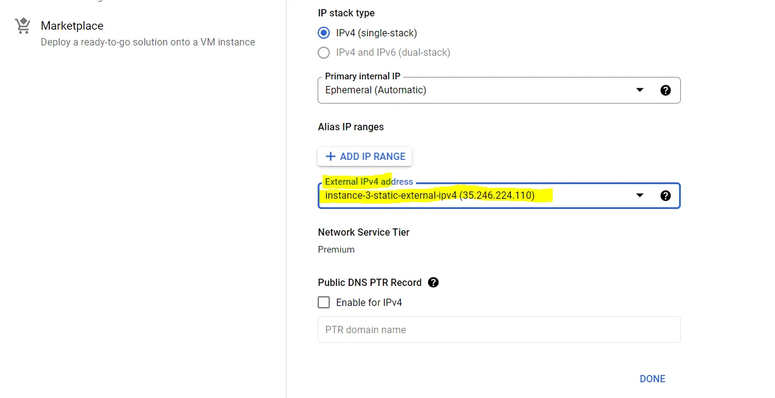
Create a new Windows VM Instance new static IP address for the external IPv4 address,
If you want to use a new static IP address for the external IPv4 address, you can click on Create IP Address as shown below.

Slide 11
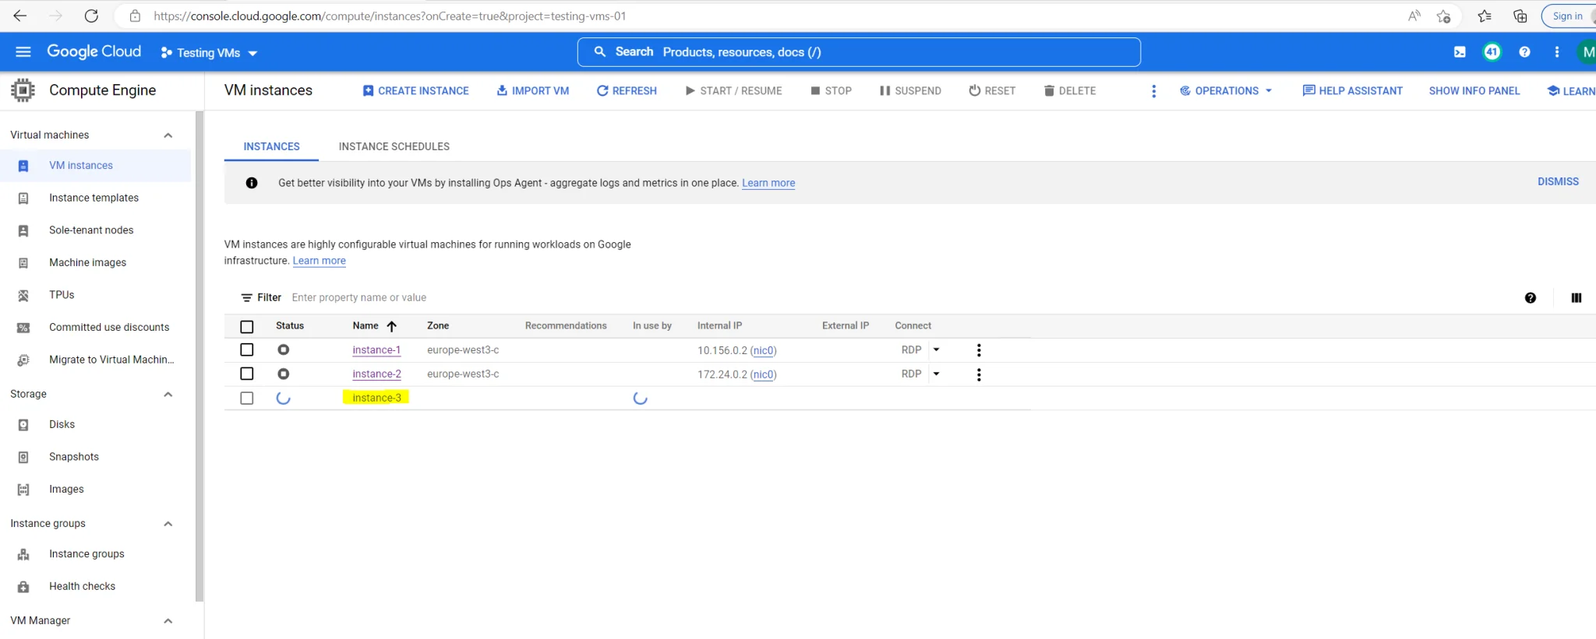
Create a new Windows VM Instance
Testing VMs project.
The new Windows Server 2022 VM instance will be deployed to my Testing VMs project.
Finally my new instance is deployed and I can access it by using RDP.
As you can see the both other VM instances only had assigned an internal IPv4 address, the reason for is that I had set up an IPSec S2S VPN tunnel between my on-premise network and my organization Shared VPC network in Google Cloud.

Slide 12
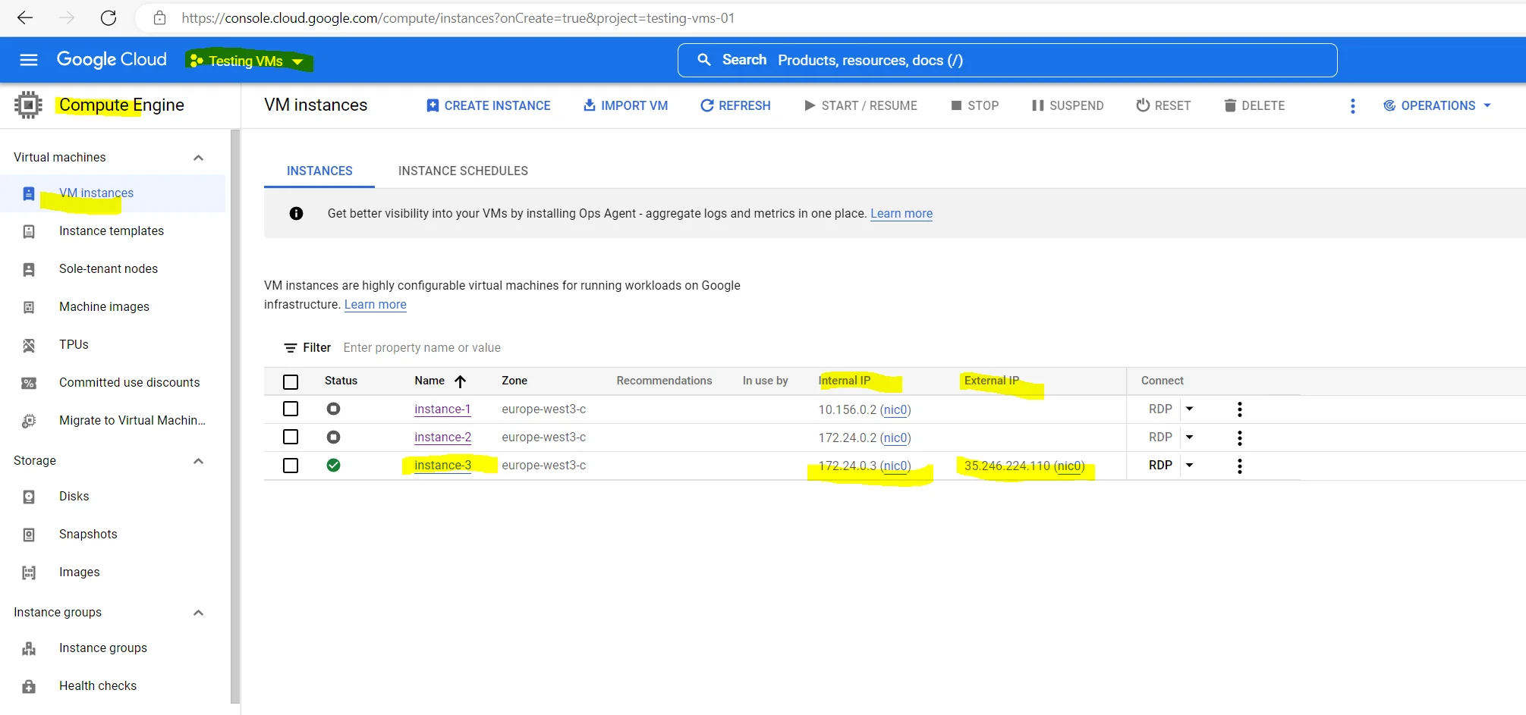
Create a new Windows VM Instance my organization Shared VPC network in Google Cloud.
About how to set up IPSec S2S VPN between your on-premise network and Google Cloud VPC, you can read my following post.

Slide 13
Create a new Windows VM Instance
Set up IPSec route-based S2S VPN between pfSense and Google Cloud VPC
In this post I want to show how you can set up an IPSec route-based S2S VPN between your Google Cloud VPC and your on-premise network by using pfSense.
On Google’s site we can use therefore Cloud VPN which offers two types of Cloud VPN gateways: HA VPN and Classic VPN as described below.
As Classic VPN is partial deprecated, I will use HA VPN therefore.
In this post I want to show how you can set up an IPSec route-based S2S VPN between your Google Cloud VPC and … Continue reading
https://blog.matrixpost.net/set-up-ipsec-route-based-s2s-vpn-between-pfsense-and-google-cloud-vpc/

Slide 14
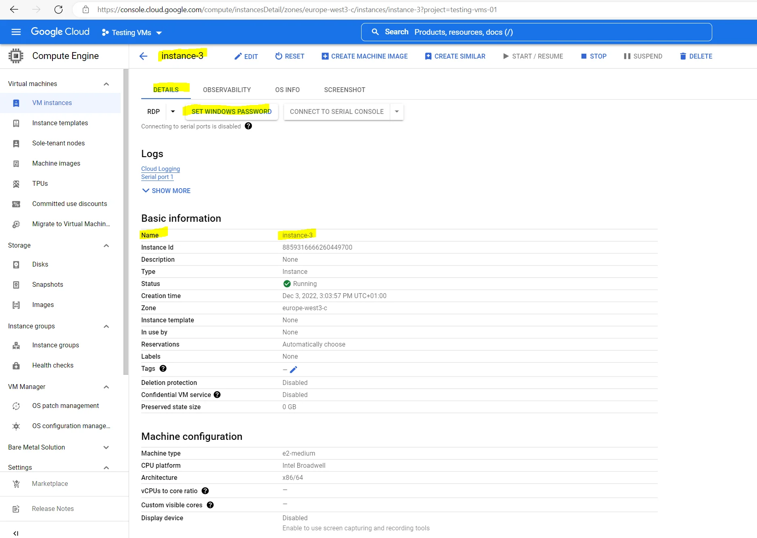
https://blog.matrixpost.net/google-cloud-create-and-connect-to-a-new-windows-vm-instance/

Slide 15
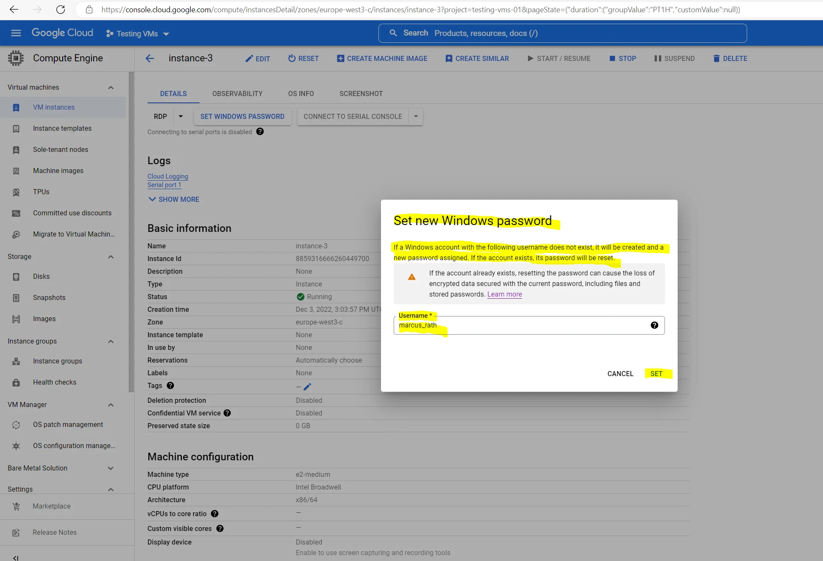
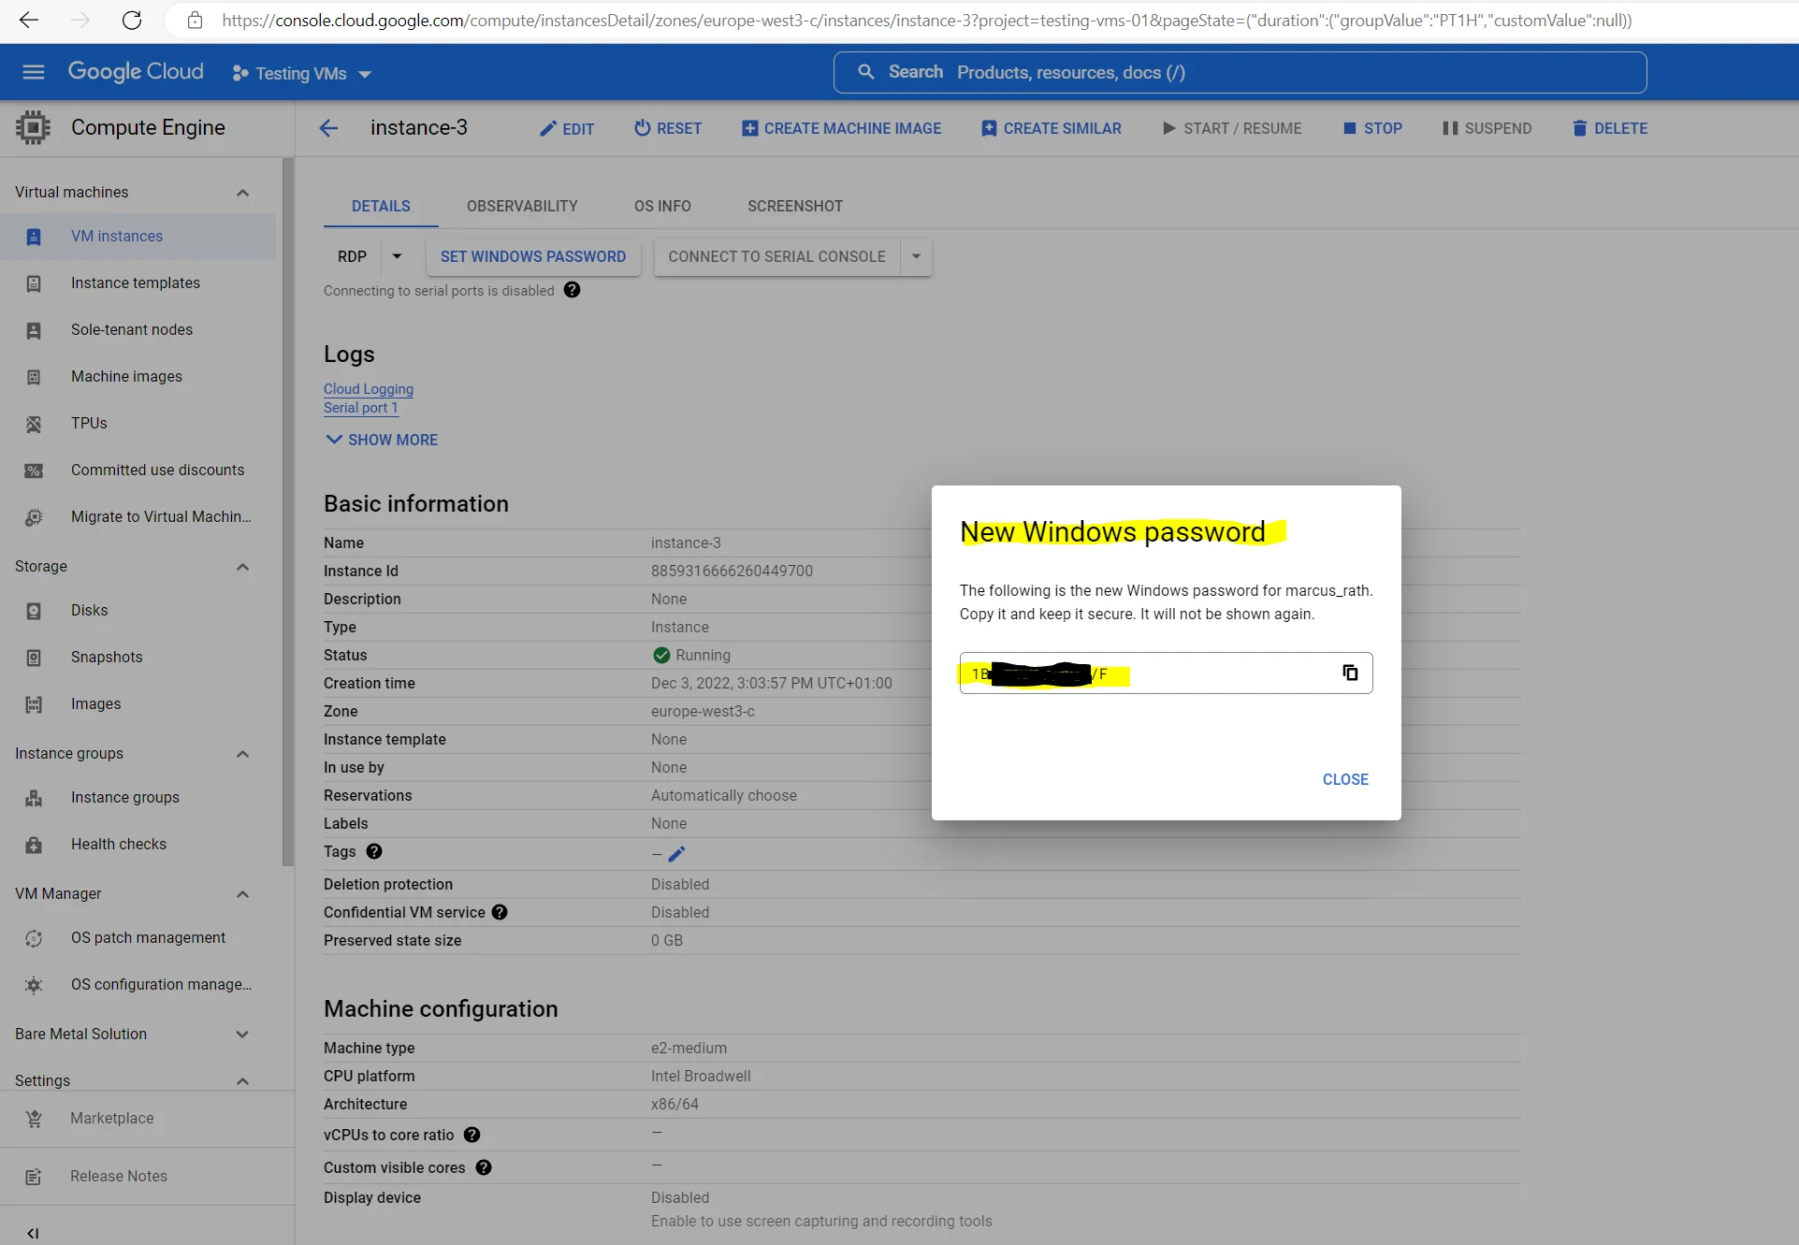

Slide 16
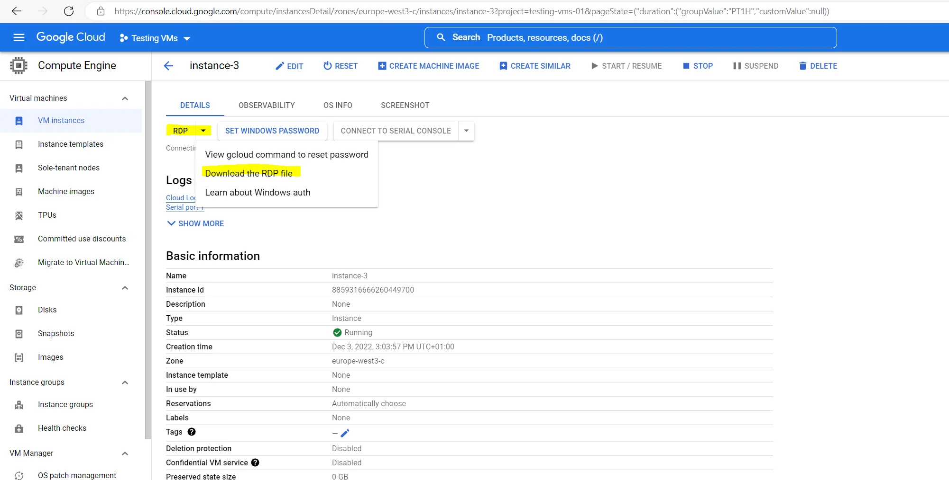
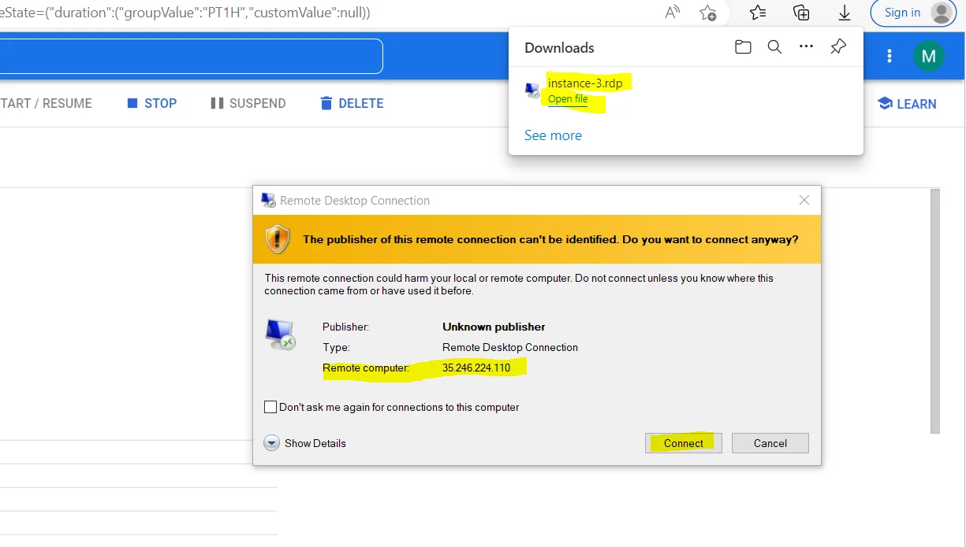
Connecting by using RDP to the Windows VM

Slide 17
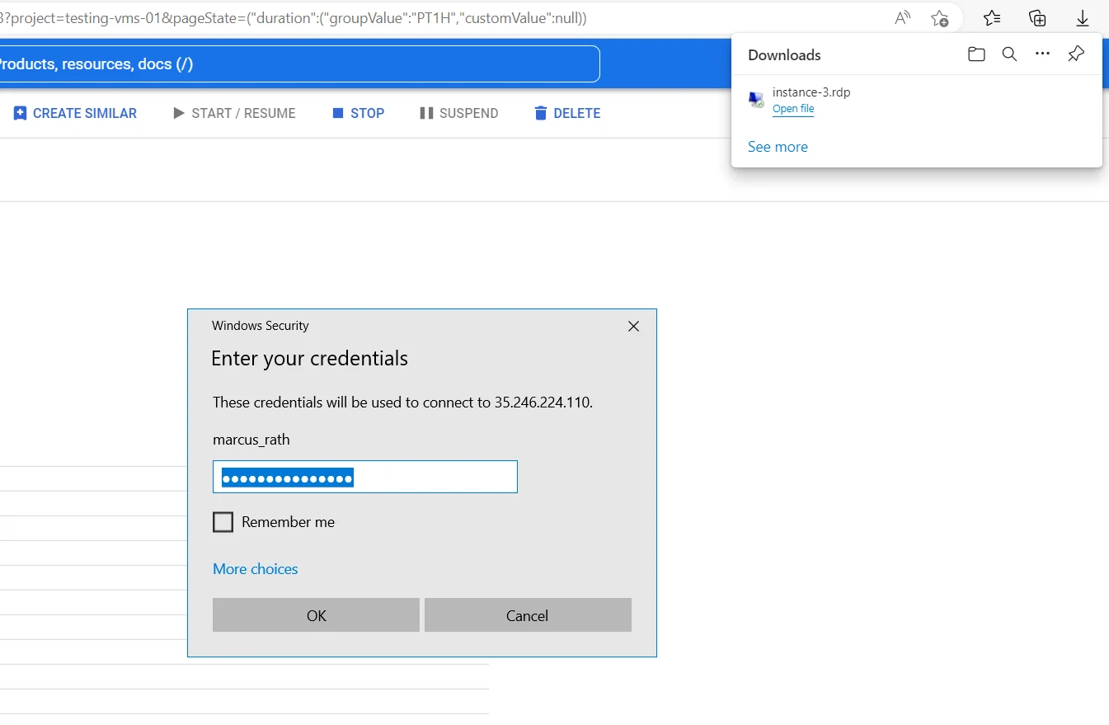
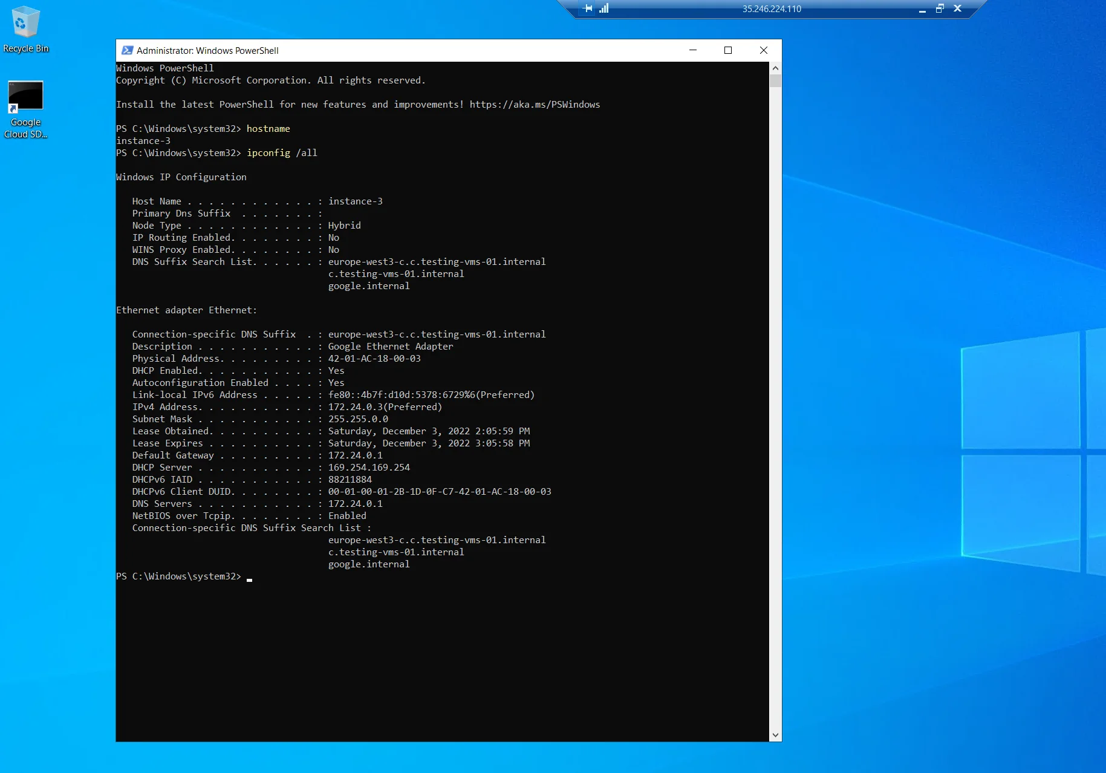

Slide 18
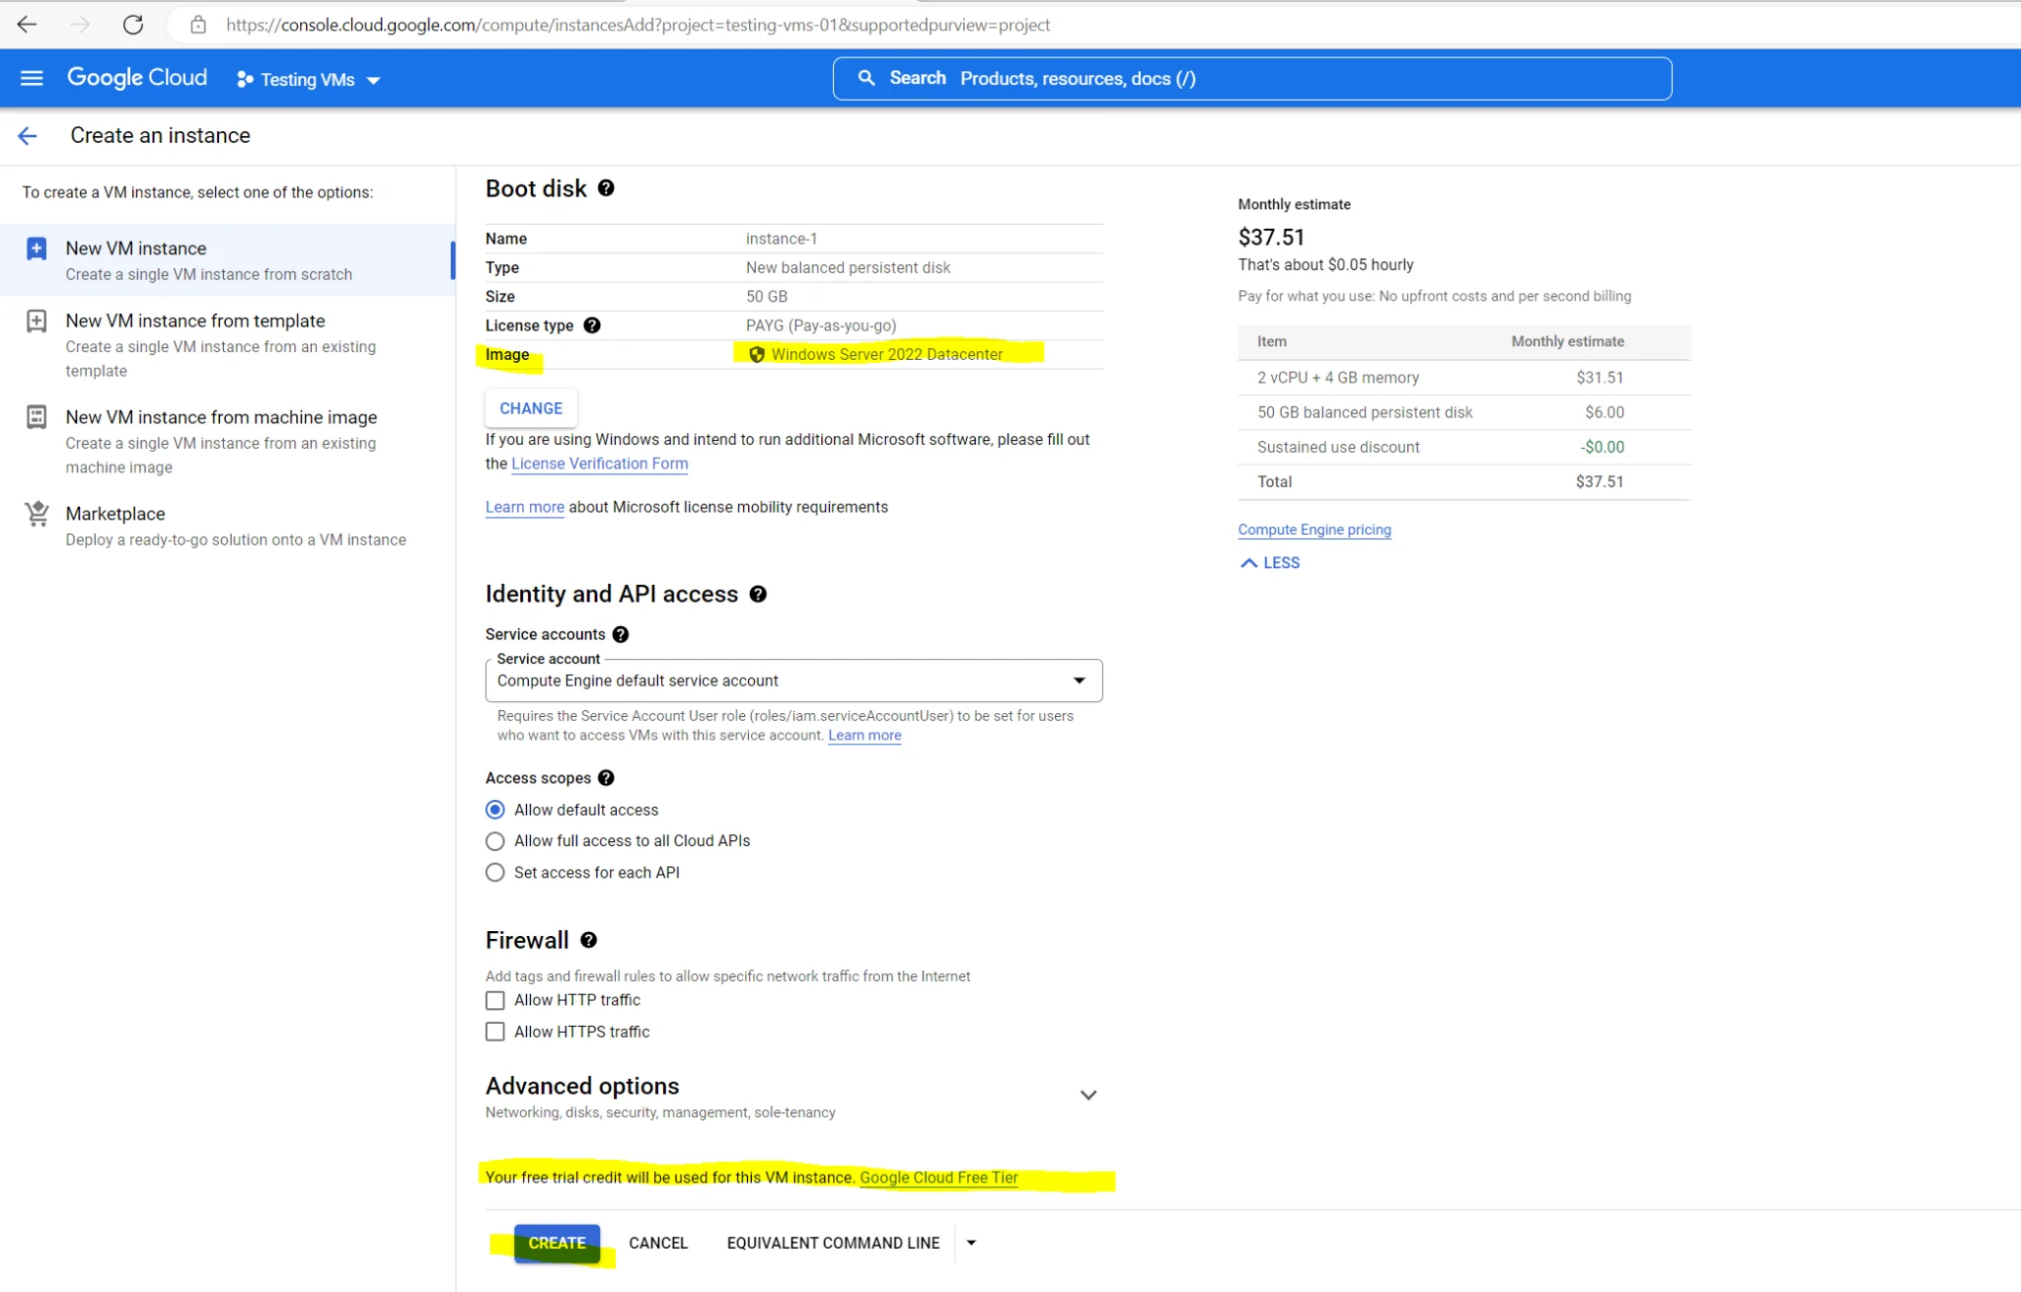
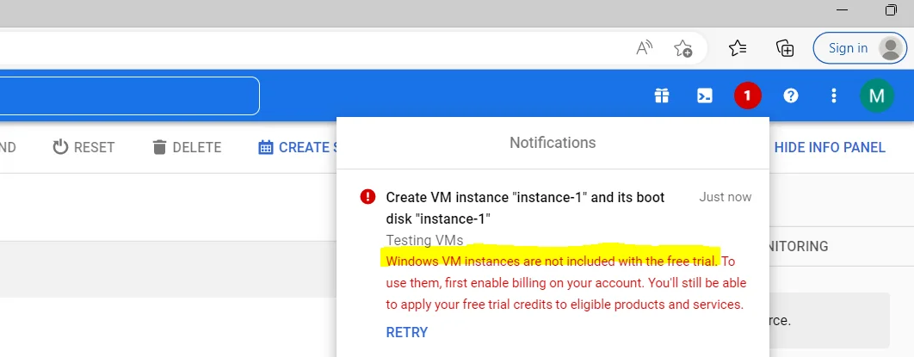
Troubleshooting

