Slide 1
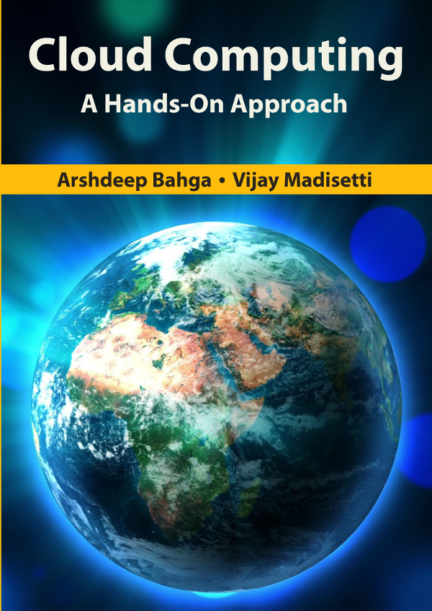
Chapter 2
Concepts & Technologies

Slide 2
Outline
Concepts and enabling technologies of cloud computing
Virtualization
Load balancing
Scalability & Elasticity
Deployment
Replication
Monitoring
MapReduce
Identity and Access Management
Service Level Agreements
Billing
Book website: www.cloudcomputingbook.info
Bahga & Madisetti, © 2014

Slide 3
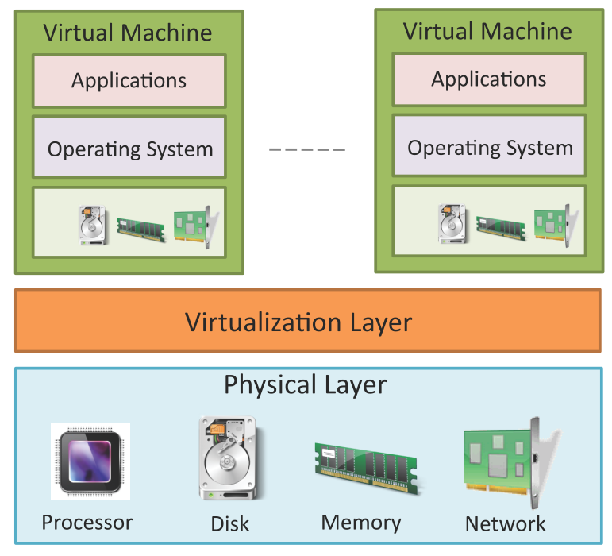
Virtualization
Virtualization refers to the partitioning the resources of a physical system (such as computing, storage, network and memory) into multiple virtual resources.
Key enabling technology of cloud computing that allow pooling of resources.
In cloud computing, resources are pooled to serve multiple users using multi-tenancy.
Book website: www.cloudcomputingbook.info
Bahga & Madisetti, © 2014

Slide 4
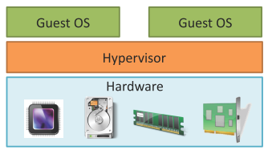
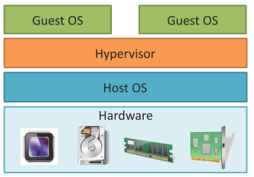
Hypervisor
The virtualization layer consists of a hypervisor or a virtual machine monitor (VMM).
Hypervisor presents a virtual operating platform to a guest operating system (OS).
Type-1 Hypervisor
Type-I or the native hypervisors run directly on the host hardware and control the hardware and monitor the guest operating systems.
Type-2 Hypervisor
Type 2 hypervisors or hosted hypervisors run on top of a conventional (main/host) operating system and monitor the guest operating systems.
Type-1 Hypervisor
Type-2 Hypervisor
Book website: www.cloudcomputingbook.info
Bahga & Madisetti, © 2014

Slide 5
Types of Virtualization
Full Virtualization
In full virtualization, the virtualization layer completely decouples the guest OS from the underlying hardware. The guest OS requires no modification and is not aware that it is being virtualized. Full virtualization is enabled by direct execution of user requests and binary translation of OS requests.
Para-Virtualization
In para-virtualization, the guest OS is modified to enable communication with the hypervisor to improve performance and efficiency. The guest OS kernel is modified to replace non-virtualizable instructions with hyper-calls that communicate directly with the virtualization layer hypervisor.
Hardware Virtualization
Hardware assisted virtualization is enabled by hardware features such as Intel’s Virtualization Technology (VT-x) and AMD’s AMD-V. In hardware assisted virtualization, privileged and sensitive calls are set to automatically trap to the hypervisor. Thus, there is no need for either binary translation or para-virtualization.
Book website: www.cloudcomputingbook.info
Bahga & Madisetti, © 2014

Slide 6
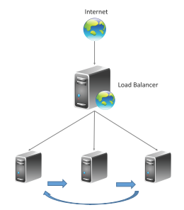
Load Balancing
Cloud computing resources can be scaled up on demand to meet the performance requirements of applications.
Load balancing distributes workloads across multiple servers to meet the application workloads.
The goals of load balancing techniques include:
Achieve maximum utilization of resources
Minimizing the response times
Maximizing throughput
Book website: www.cloudcomputingbook.info
Bahga & Madisetti, © 2014

Slide 7
Load Balancing Algorithms
Round Robin load balancing
Weighted Round Robin load balancing
Low Latency load balancing
Least Connections load balancing
Priority load balancing
Overflow load balancing
Book website: www.cloudcomputingbook.info
Bahga & Madisetti, © 2014

Slide 8
Load Balancing - Persistence Approaches
Since load balancing can route successive requests from a user session to different servers, maintaining the state or the information of the session is important.
Persistence Approaches
Sticky sessions
Session Database
Browser cookies
URL re-writing
Book website: www.cloudcomputingbook.info
Bahga & Madisetti, © 2014

Slide 9
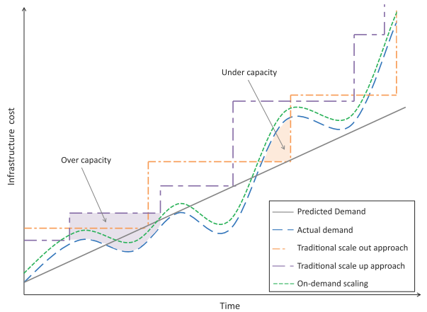
Scalability & Elasticity
Multi-tier applications such as e-Commerce, social networking, business-to-business, etc. can experience rapid changes in their traffic.
Capacity planning involves determining the right sizing of each tier of the deployment of an application in terms of the number of resources and the capacity of each resource.
Capacity planning may be for computing, storage, memory or network resources.
Book website: www.cloudcomputingbook.info
Bahga & Madisetti, © 2014

Slide 10
Scaling Approaches
Vertical Scaling/Scaling up:
Involves upgrading the hardware resources (adding additional computing, memory, storage or network resources).
Horizontal Scaling/Scaling out
Involves addition of more resources of the same type.
Book website: www.cloudcomputingbook.info
Bahga & Madisetti, © 2014

Slide 11
Deployment
Cloud application deployment design is an iterative process that involves:
Deployment Design
The variables in this step include the number of servers in each tier, computing, memory and storage capacities of severs, server interconnection, load balancing and replication strategies.
Performance Evaluation
To verify whether the application meets the performance requirements with the deployment.
Involves monitoring the workload on the application and measuring various workload parameters such as response time and throughput.
Utilization of servers (CPU, memory, disk, I/O, etc.) in each tier is also monitored.
Deployment Refinement
Various alternatives can exist in this step such as vertical scaling (or scaling up), horizontal scaling (or scaling out), alternative server interconnections, alternative load balancing and replication strategies, for instance.
Book website: www.cloudcomputingbook.info
Bahga & Madisetti, © 2014

Slide 12
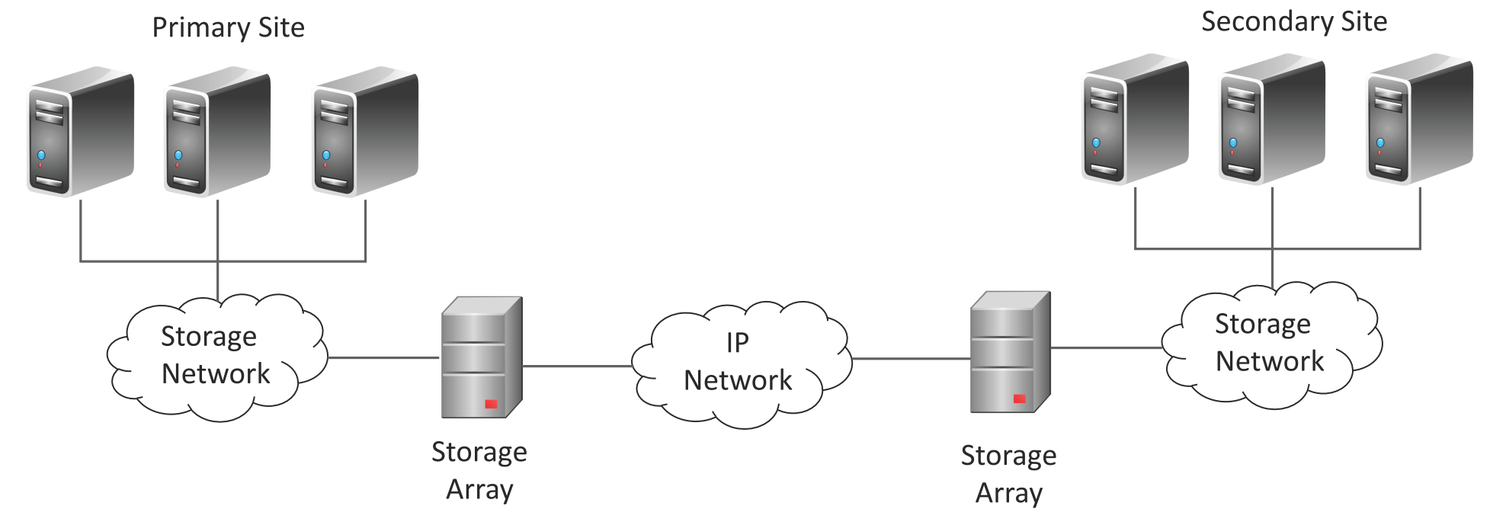
Replication
Replication is used to create and maintain multiple copies of the data in the cloud.
Cloud enables rapid implementation of replication solutions for disaster recovery for organizations.
With cloud-based data replication organizations can plan for disaster recovery without making any capital expenditures on purchasing, configuring and managing secondary site locations.
Types:
Array-based Replication
Network-based Replication
Host-based Replication
Array-based Replication
Book website: www.cloudcomputingbook.info
Bahga & Madisetti, © 2014

Slide 13
Monitoring
Monitoring services allow cloud users to collect and analyze the data on various monitoring metrics.
A monitoring service collects data on various system and application metrics from the cloud computing instances.
Monitoring of cloud resources is important because it allows the users to keep track of the health of applications and services deployed in the cloud.
Examples of Monitoring Metrics
Type | Metrics
CPU | CPU-Usage, CPU-Idle
Disk | Disk-Usage, Bytes/sec (read/write), Operations/sec
Memory | Memory-Used, Memory-Free, Page-Cache
Interface | Packets/sec (incoming/outgoing), Octets/sec(incoming/outgoing)
Book website: www.cloudcomputingbook.info
Bahga & Madisetti, © 2014

Slide 14
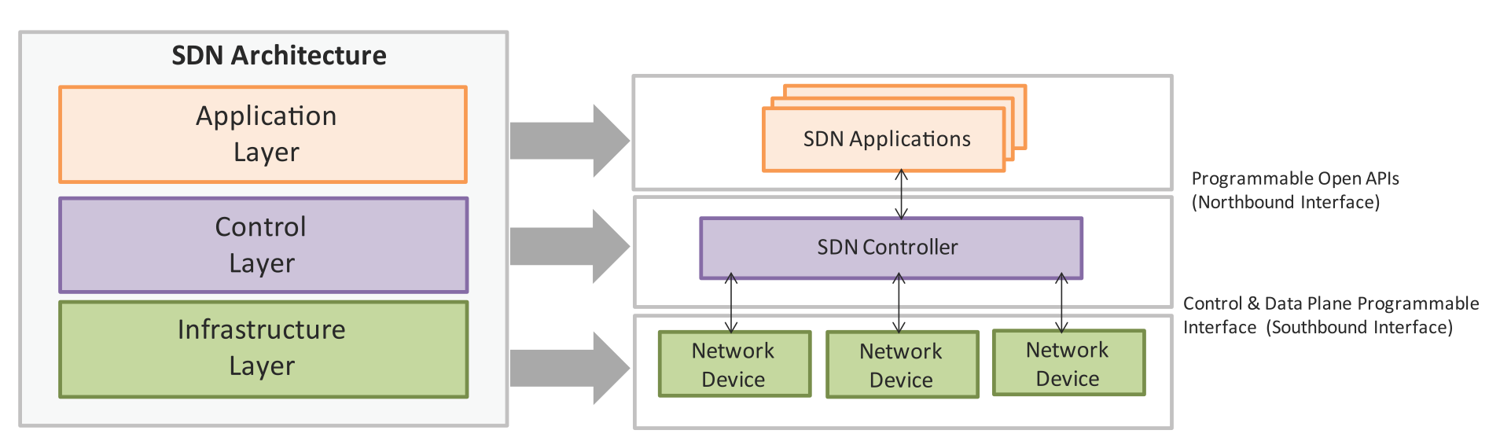
Software Deﬁned Networking
Software-Defined Networking (SDN) is a networking architecture that separates the control plane from the data plane and centralizes the network controller.
Conventional network architecture
The control plane and data plane are coupled. Control plane is the part of the network that carries the signaling and routing message traffic while the data plane is the part of the network that carries the payload data traffic.
SDN Architecture
The control and data planes are decoupled and the network controller is centralized.
Book website: www.cloudcomputingbook.info
Bahga & Madisetti, © 2014

Slide 15
SDN - Key Elements
Centralized Network Controller
With decoupled the control and data planes and centralized network controller, the network administrators can rapidly configure the network.
Programmable Open APIs
SDN architecture supports programmable open APIs for interface between the SDN application and control layers (Northbound interface). These open APIs that allow implementing various network services such as routing, quality of service (QoS), access control, etc.
Standard Communication Interface (OpenFlow)
SDN architecture uses a standard communication interface between the control and infrastructure layers (Southbound interface). OpenFlow, which is defined by the Open Networking Foundation (ONF) is the broadly accepted SDN protocol for the Southbound interface.
Book website: www.cloudcomputingbook.info
Bahga & Madisetti, © 2014

Slide 16
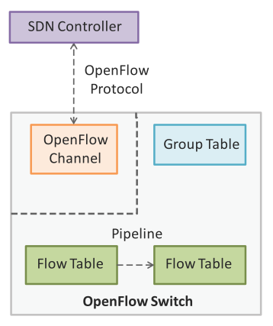
OpenFlow
OpenFlow is the broadly accepted SDN protocol for the Southbound interface.
With OpenFlow, the forwarding plane of the network devices can be directly accessed and manipulated.
OpenFlow uses the concept of flows to identify network traffic based on pre-defined match rules.
Flows can be programmed statically or dynamically by the SDN control software.
OpenFlow protocol is implemented on both sides of the interface between the controller and the network devices.
OpenFlow switch comprising of one or more flow tables and a group table, which perform packet lookups and forwarding, and OpenFlow channel to an external controller.
Book website: www.cloudcomputingbook.info
Bahga & Madisetti, © 2014

Slide 17
Network Function Virtualization
Network Function Virtualization (NFV) is a technology that leverages virtualization to consolidate the heterogeneous network devices onto industry standard high volume servers, switches and storage.
Relationship to SDN
NFV is complementary to SDN as NFV can provide the infrastructure on which SDN can run.
NFV and SDN are mutually beneficial to each other but not dependent.
Network functions can be virtualized without SDN, similarly, SDN can run without NFV.
NFV comprises of network functions implemented in software that run on virtualized resources in the cloud.
NFV enables a separation the network functions which are implemented in software from the underlying hardware.
Book website: www.cloudcomputingbook.info
Bahga & Madisetti, © 2014

Slide 18
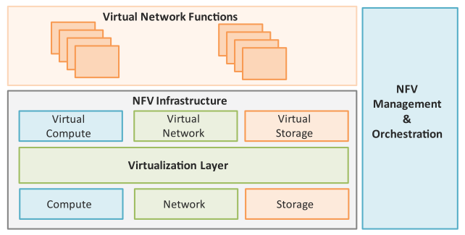
NFV Architecture
Key elements of the NFV architecture are
Virtualized Network Function (VNF): VNF is a software implementation of a network function which is capable of running over the NFV Infrastructure (NFVI).
NFV Infrastructure (NFVI): NFVI includes compute, network and storage resources that are virtualized.
NFV Management and Orchestration: NFV Management and Orchestration focuses on all virtualization-specific management tasks and covers the orchestration and lifecycle management of physical and/or software resources that support the infrastructure virtualization, and the lifecycle management of VNFs.
Book website: www.cloudcomputingbook.info
Bahga & Madisetti, © 2014

Slide 19
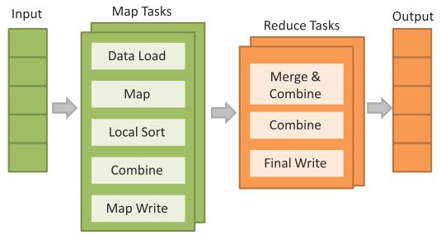
MapReduce
MapReduce is a parallel data processing model for processing and analysis of massive scale data.
MapReduce phases:
Map Phase: In the Map phase, data is read from a distributed file system, partitioned among a set of computing nodes in the cluster, and sent to the nodes as a set of key-value pairs.
The Map tasks process the input records independently of each other and produce intermediate results as key-value pairs.
The intermediate results are stored on the local disk of the node running the Map task.
Reduce Phase: When all the Map tasks are completed, the Reduce phase begins in which the intermediate data with the same key is aggregated.
Book website: www.cloudcomputingbook.info
Bahga & Madisetti, © 2014

Slide 20
Identity and Access Management
Identity and Access Management (IDAM) for cloud describes the authentication and authorization of users to provide secure access to cloud resources.
Organizations with multiple users can use IDAM services provided by the cloud service provider for management of user identifiers and user permissions.
IDAM services allow organizations to centrally manage users, access permissions, security credentials and access keys.
Organizations can enable role-based access control to cloud resources and applications using the IDAM services.
IDAM services allow creation of user groups where all the users in a group have the same access permissions.
Identity and Access Management is enabled by a number of technologies such as OpenAuth, Role-based Access Control (RBAC), Digital Identities, Security Tokens, Identity Providers, etc.
Book website: www.cloudcomputingbook.info
Bahga & Madisetti, © 2014

Slide 21
Billing
Cloud service providers offer a number of billing models described as follows:
Elastic Pricing
In elastic pricing or pay-as-you-use pricing model, the customers are charged based on the usage of cloud resources.
Fixed Pricing
In fixed pricing models, customers are charged a fixed amount per month for the cloud resources.
Spot Pricing
Spot pricing models offer variable pricing for cloud resources which is driven by market demand.
Book website: www.cloudcomputingbook.info
Bahga & Madisetti, © 2014

Slide 22
Further Reading
Network Functions Virtualization, http://www.etsi.org/technologies-clusters/technologies/nfv, Retrieved 2013.
OpenFlow Switch Specification, https://www.opennetworking.org, Retrieved 2013.
J. Dean, S. Ghemawat, MapReduce: Simplified Data Processing on Large Clusters, OSDI 2004.
VMware, Understanding Full Virtualization, Paravirtualization, and Hardware Assist, 2007.
Book website: www.cloudcomputingbook.info
Bahga & Madisetti, © 2014

