Slide 1
Chapter 1
Introduction & Concepts
Book website: www.cloudcomputingbook.info

Slide 2
Outline
Cloud Computing definition
Characteristics of cloud computing
Cloud deployment models
Cloud service models
Cloud Services
Cloud Applications
Book website: www.cloudcomputingbook.info

Slide 3
Deﬁnition of Cloud Computing
The U.S. National Institute of Standards and Technology (NIST) deﬁnes cloud computing as:
Cloud computing is a model for enabling ubiquitous, convenient, on-demand network access to a shared pool of conﬁgurable computing resources (e.g., networks, servers, storage, applications, and services) that can be rapidly provisioned and released with minimal management effort or service provider interaction.
Book website: www.cloudcomputingbook.info

Slide 4
Characteristics of Cloud Computing
On-demand self service:
Cloud computing resources can be provisioned on-demand by the users, without requiring interactions with the cloud service provider. The process of provisioning resources is automated.
Broad network access:
Cloud computing resources can be accessed over the network using standard access mechanisms that provide platform-independent access through the use of heterogeneous client platforms such as workstations, laptops, tablets and smartphones.
Book website: www.cloudcomputingbook.info

Slide 5
Characteristics of Cloud Computing
Resource pooling:
The computing and storage resources provided by cloud service providers are pooled to serve multiple users using multi-tenancy. Multi-tenant aspects of the cloud allow multiple users to be served by the same physical hardware.
Rapid elasticity:
Cloud computing resources can be provisioned rapidly and elastically. Cloud resources can be rapidly scaled up or down based on demand.
Book website: www.cloudcomputingbook.info

Slide 6
Characteristics of Cloud Computing
Measured service:
Cloud computing resources are provided to users on a pay-per-use model. The usage of the cloud resources is measured and the user is charged based on some speciﬁc metric.
Performance:
Cloud computing provides improved performance for applications since the resources available to the applications can be scaled up or down based on the dynamic application workloads.
Book website: www.cloudcomputingbook.info
Bahga & Madisetti, © 2014

Slide 7
Characteristics of Cloud Computing
Reduced costs:
Cloud computing provides cost beneﬁts for applications as only as much computing and storage resources as required can be provisioned dynamically, and upfront investment in purchase of computing assets to cover worst case requirements is avoid.
Outsourced Management:
Cloud computing allows the users (individuals, large organizations, small and medium enterprises and governments) to outsource the IT infrastructure requirements to external cloud providers.
Book website: www.cloudcomputingbook.info
Bahga & Madisetti, © 2014

Slide 8
Characteristics of Cloud Computing
Reliability:
Applications deployed in cloud computing environments generally have a higher reliability since the underlying IT infrastructure is professionally managed by the cloud service.
Multi-tenancy:
The multi-tenanted approach of the cloud allows multiple users to make use of the same shared resources.
In virtual multi-tenancy, computing and storage resources are shared among multiple users.
In organic multi-tenancy every component in the system architecture is shared among multiple tenants
Book website: www.cloudcomputingbook.info

Slide 9
Cloud Service Models
Software as a Service (SaaS)
Applications, management and user interfaces provided over a network
Platform as a Service (PaaS)
Application development frameworks, operating systems and deployment frameworks
Infrastructure as a Service (IaaS)
Virtual computing, storage and network resource that can be provisioned on demand
Book website: www.cloudcomputingbook.info

Slide 10
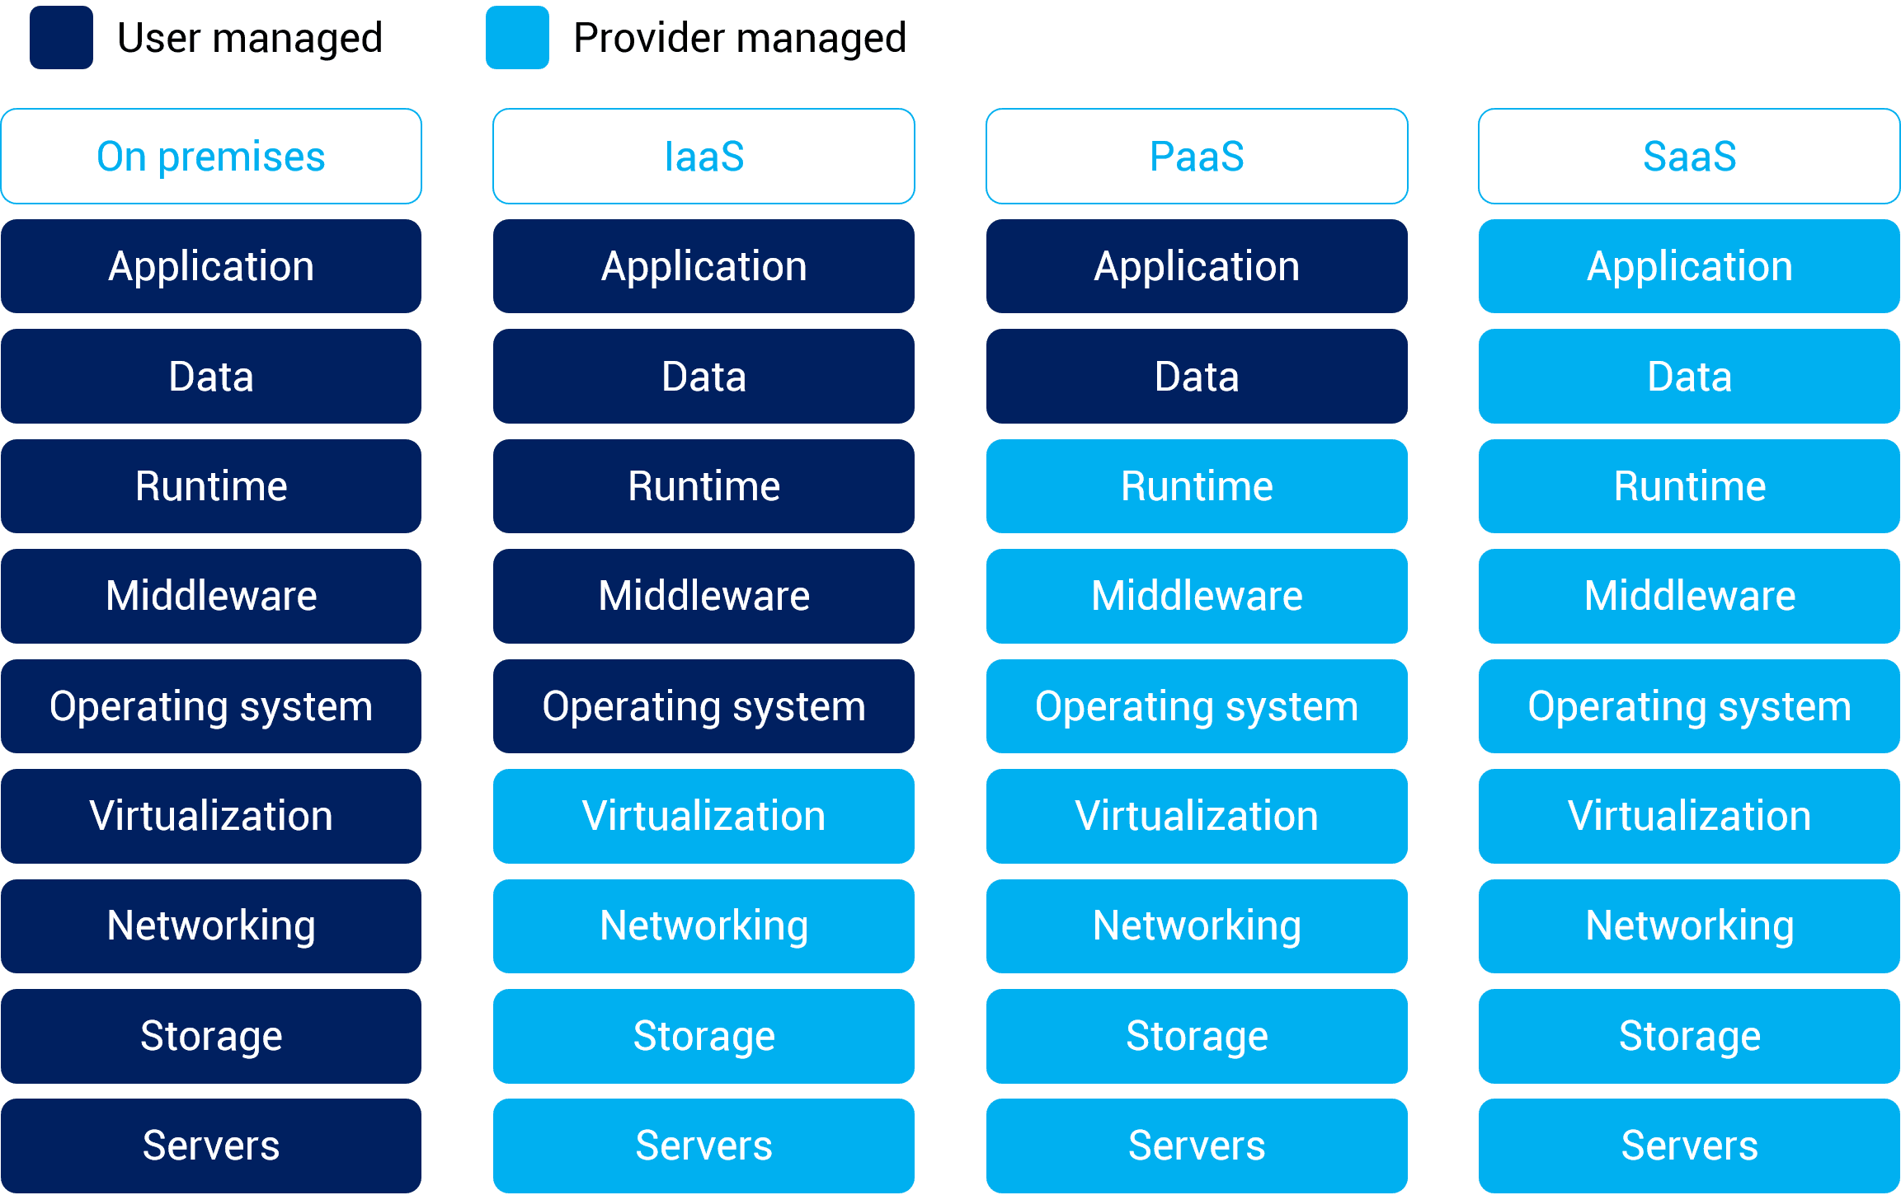
Cloud Service Models
Book website: www.cloudcomputingbook.info

Slide 11
Software-as-a-Service (SaaS)
Software/Interface
SaaS provides the users a complete software application or the user interface to the application itself.
Outsourced Management
The cloud service provider manages the underlying cloud infrastructure including servers, network, operating systems, storage and application software, and the user is unaware of the underlying architecture of the cloud.
Thin client interfaces
Applications are provided to the user through a thin client interface (e.g., a browser). SaaS applications are platform independent and can be accessed from various client devices such as workstations, laptop, tablets and smartphones, running different operating systems.
Ubiquitous Access
Since the cloud service provider manages both the application and data, the users are able to access the applications from anywhere.
Book website: www.cloudcomputingbook.info

Slide 12
Software-as-a-Service (SaaS)
Benefits
- Lower costs
- No infrastructure required
- Seamless upgrades
- Guaranteed performance
- Automated backups
- Easy data recovery
- Secure
- High adoption
- On-the move access
Characteristics
- Multi-tenancy
- On-demand software
- Open integration protocols
- Social network integration
Adoption
- Individual users: High - Small & medium enterprises: High - Large organizations: High
- Government: Medium
Examples
- Google Apps
- Salesforce.com
- Facebook
- Zoho
- Dropbox
- Taleo
- Microsoft Office 365
- Linkedin
- Slideshare
- CareCloud
SaaS
Book website: www.cloudcomputingbook.info

Slide 13
Platform-as-a-Service (PaaS)
Development & Deployment:
PaaS provides the users the capability to develop and deploy application in the cloud using the development tools, application programming interfaces (APIs), software libraries and services provided by the cloud service provider.
Provider Manages Infrastructure:
The cloud service provider manages the underlying cloud infrastructure including servers, network, operating systems and storage.
User Manages Application:
The users, themselves, are responsible for developing, deploying, conﬁguring and managing applications on the cloud infrastructure.
Book website: www.cloudcomputingbook.info

Slide 14
Platform-as-a-Service (PaaS)
Benefits
- Lower upfront & operations costs
- No IT infrastructure management costs
- Improved scalability
- Higher performance
- Secured access
- Quick & easy development
- Seamless integration
Characteristics
- Multi-tenancy
- Open integration protocols
- App development tools & SDKs
- Analytics
Adoption
- Individual users: Low - Small & medium enterprises: Medium - Large organizations: High
- Government: Medium
Examples
- Google App Engine
- Windows Azure Platform
- Force.com
- RightScale
- Heroku
- Github
- Gigaspaces
- AppScale
- OpenStack
- LongJump
PaaS
Book website: www.cloudcomputingbook.info

Slide 15
Infrastructure-as-a-Service (IaaS)
Resource Provisioning
Provides the users the capability to provision computing and storage resources.
Virtual Machines
These resources are provided to the users as virtual machine instances and virtual storage. Users can start, stop, conﬁgure and manage the virtual machine instances and virtual storage.
Provider Managers Infrastructure:
The cloud service provider manages the underlying infrastructure.
Pay-per-use/Pay-as-you-go:
Virtual resources provisioned by the users are billed based on a pay-per-use/pay-as-you-go paradigm.
Book website: www.cloudcomputingbook.info

Slide 16
Infrastructure-as-a-Service (IaaS)
IaaS
Benefits
- Shift focus from IT management to core activities
- No IT infrastructure management costs
- Pay-per-use/pay-per-go pricing
- Guaranteed performance
- Dynamic scaling
- Secure access
- Enterprise grade infrastructure
- Green IT adoption
Characteristics
- Multi-tenancy
- Virtualized hardware
- Management & monitoring tools
- Disaster recovery
Adoption
- Individual users: Low - Small & medium enterprises: Medium - Large organizations: High
- Government: High
Examples
- Amazon Elastic Compute Cloud (EC2)
- RackSpace
- GoGrid
- Eucalyptus
- Joyent
- Terremark
- OpSource
- Savvis
- Nimbula
- Enamoly
Book website: www.cloudcomputingbook.info

Slide 17
Cloud Deployment Models
Public Cloud
Available for public use or a large industry group
Private Cloud
Operated for exclusive use of a single organization
Community Cloud
Available for shared use of several organizations supporting a speciﬁc community
Hybrid Cloud
Combines multiple clouds (public and private) that remain unique but bound together to oﬀer application and data portability
Book website: www.cloudcomputingbook.info

Slide 18
Cloud Service Examples
IaaS:
Amazon EC2
Google Compute Engine
Windows Azure VMs
PaaS:
Google App Engine
Huawei Cloud
SaaS:
Salesforce
Book website: www.cloudcomputingbook.info

Slide 19
Cloud Computing Applications
Banking & Financial Apps
E-Commerce Apps
Social Networking
Healthcare Systems
Energy Systems
Intelligent Transportation Systems
E-Governance
Education
Mobile Communications
Book website: www.cloudcomputingbook.info

Slide 20
Further Reading
Peter Mell, Timothy Grance, The NIST Definition of Cloud Computing, NIST Special Publication 800-145, Sep 2011.
VMware, Understanding Full Virtualization, Paravirtualization, and Hardware Assist, 2007.
A. Bahga, V. Madisetti, Analyzing Massive Machine Maintenance Data in a Computing Cloud, IEEE Transactions on Parallel & Distributed Systems, Vol. 23, Iss. 10, Oct 2012.
A. Bahga, V. Madisetti, On a Cloud-Based Information Technology Framework for Data Driven Intelligent Transportation Systems, Journal of Transportation Technologies, Vol. 3, No. 2, April 2013.
A. Bahga, V. Madisetti, A Cloud-Based Approach to Interoperable Electronic Health Records (EHRs), IEEE Journal of Biomedical and Health Informatics, Vol. 17, Iss. 5, Sep 2013.
Network Functions Virtualization, http://www.etsi.org/technologies-clusters/technologies/nfv, Retrieved 2013.
Amazon Elastic Compute Cloud, http://aws.amazom.com/ec2, 2012.
Google Compute Engine, https://developers.google.com/compute/, Retrieved 2013.
Windows Azure, http://www.windowsazure.com/, Retrieved 2013.
Google App Engine, http://appengine.google.com, 2012.
Salesforce, http://salesforce.com, 2012.
Book website: www.cloudcomputingbook.info

