Slide 1
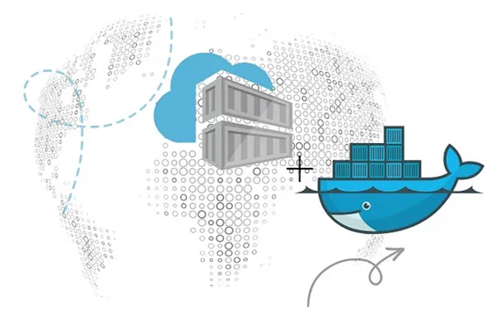
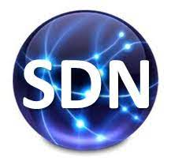
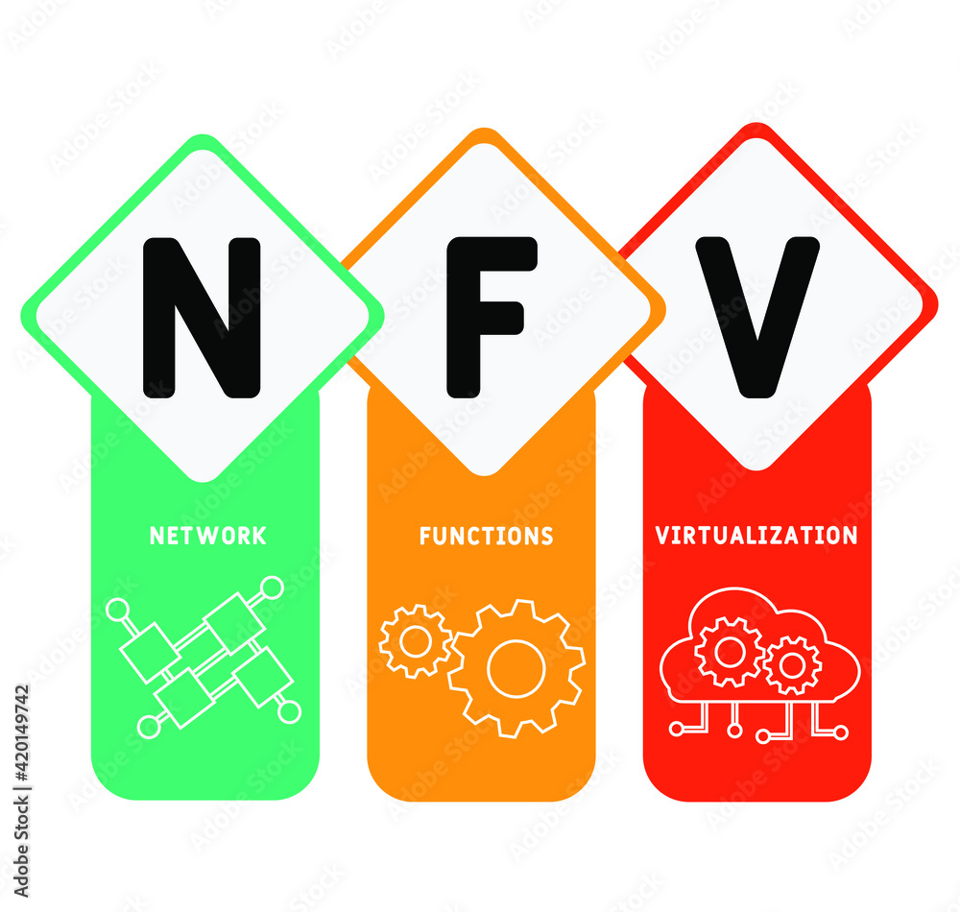
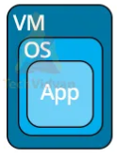
PDS
Computer Vision
AWS
.
https://github.com/siagianp
https://www.youtube.com/@AmelOline/videos
https://github.com/amelcharolinesgn2/IoT_simulator-mqtt-NodeRed
https://github.com/amelcharolinesgn2/Cloud-Infrastructures
https://github.com/amelcharolinesgn2/ClouD-Infrastructure-SISKA-2025
Notes:
https://github.com/mikeroyal/Google-Cloud-Guide

Slide 2
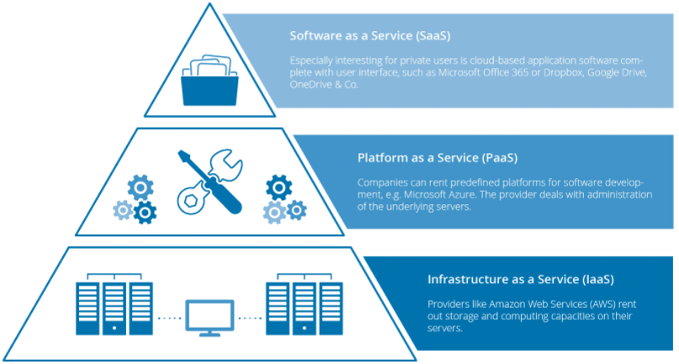
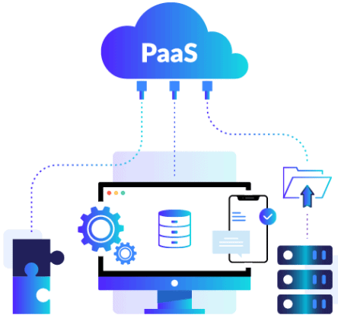
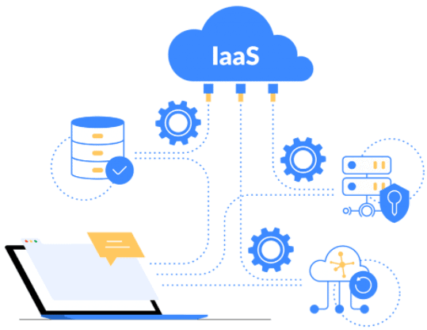
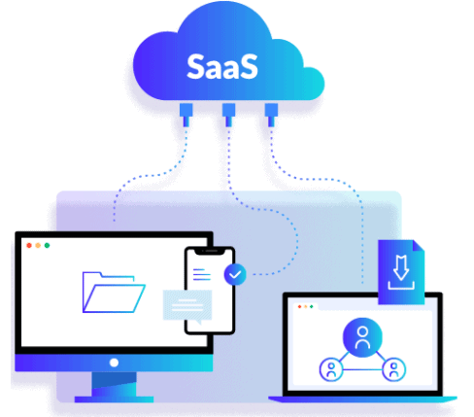
Notes:
IaaS are virtual Machines or AWS EC2, Storage or Networking. DigitalOcean, Amazon Web Services (AWS), Microsoft Azure, Google Cloud Platform (GCP), Oracle Cloud Infrastructure (OCI), and Alibaba Cloud.
PaaS: AWS Elastic Beanstalk, Azure App Service, Google App Engine, Google Cloud Run. (For serverless compute, Function-as-a-Service like AWS Lambda, Azure Functions, or Google Cloud Functions can be considered related models.
SaaS: Microsoft Office 365, Oracle ERP/HCM Cloud, Salesforce, Gmail, or Dropbox.
https://k21academy.com/amazon-web-services/cloud-service-models/

Slide 3
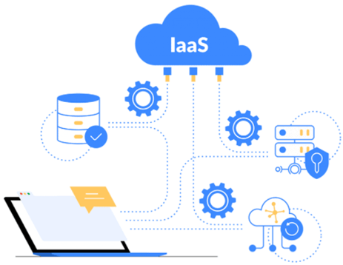
virtual Machines
Containers (Docker) vs Virtual Machines (VM): Pros, Cons, and Use Cases
Table of Contents:
Exploring Virtual Machines
Virtual Machine: Architecture and Benefits
Pros & Cons of VMs
What Are Containers?
How Do Containers Work?
Pros & Cons of Containers
Difference Between Physical Server and VM
Container (Docker) vs Virtual Machine (VM)
Conclusion: What is Better?
Frequently Asked Questions
IaaS are virtual Machines or AWS EC2, Storage or Networking.
Notes:
IaaS are virtual Machines or AWS EC2, Storage or Networking. DigitalOcean, Amazon Web Services (AWS), Microsoft Azure, Google Cloud Platform (GCP), Oracle Cloud Infrastructure (OCI), and Alibaba Cloud.
https://k21academy.com/amazon-web-services/cloud-service-models/
https://k21academy.com/docker-kubernetes/docker-vs-virtual-machine/

Slide 4
AWS EC2
AWS EC2 Instance | Steps to Connect Windows EC2 Instance
Optimize your workload performance and cost-effectiveness.
General Purpose Instances: These instances are suitable for a wide range of workloads, such as small to medium-sized databases, web servers, and development environments. For example, a t2.micro instance can be used for running a small-scale WordPress website, while an m5.large instance can be used for running a small-scale e-commerce website. Examples of general-purpose instances include t2, m5, and m6g.
Compute Optimized Instances: These instances are ideal for compute-intensive workloads, such as high-performance computing (HPC), scientific modeling, and data analytics. Examples of compute-optimized instances include c5, c6g, and c6gd.
Memory Optimized Instances: These instances are designed for workloads that require large amounts of memory, such as in-memory databases, big data processing, and analytics. Examples of memory-optimized instances include r5, r6g, and x1e.
Storage Optimized Instances: These instances are suitable for storage-intensive workloads that require high disk throughput and low latency, such as data warehousing and log processing. Examples of storage-optimized instances include i3, i3en, and d3.
GPU Instances: These instances are designed for workloads that require high-performance GPU resources, such as machine learning, deep learning, and graphics rendering. Examples of GPU instances include p3, g4, and inf1.
High-Performance Computing Instances: These instances are designed for high-performance computing (HPC) workloads that require high network performance and low latency, such as scientific modeling, financial simulations, and engineering simulations. Examples of HPC instances include hpc6id and hpc6a.
IaaS are virtual Machines or AWS EC2, Storage or Networking.
Notes:
IaaS are virtual Machines or AWS EC2, Storage or Networking. DigitalOcean, Amazon Web Services (AWS), Microsoft Azure, Google Cloud Platform (GCP), Oracle Cloud Infrastructure (OCI), and Alibaba Cloud.
https://k21academy.com/amazon-web-services/cloud-service-models/
https://k21academy.com/docker-kubernetes/docker-vs-virtual-machine/
https://k21academy.com/amazon-web-services/aws-ec2-instance/

Slide 5
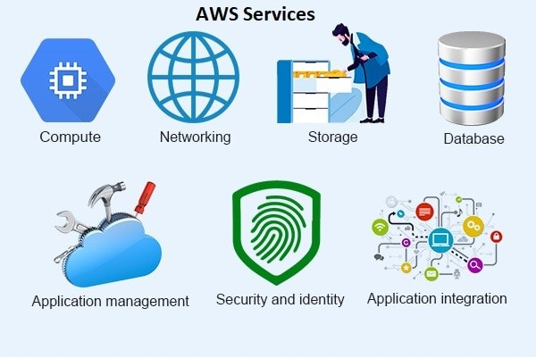
**Amazon Web Services (AWS)**
Cloud providers**
Notes:
https://k21academy.com/amazon-web-services/aws-for-testers-and-qa/

Slide 6
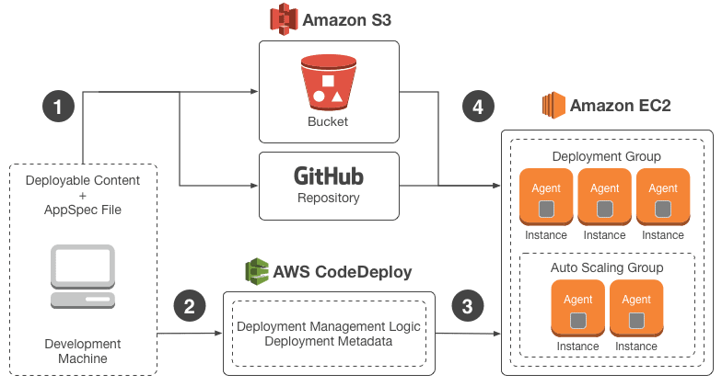
AWS CodeDeploy?

Slide 7
Mauliate Godang

