Slide 1




PDS
Computer Vision
Google-cloud-platform
.
https://github.com/siagianp
https://www.youtube.com/@AmelOline/videos
https://github.com/amelcharolinesgn2/Cloud-Infrastructures
https://github.com/amelcharolinesgn2/ClouD-Infrastructure-SISKA-2025
https://github.com/amelcharolinesgn2/CCNA-1-v7
https://github.com/amelcharolinesgn2/CCNA-2-v7
https://github.com/amelcharolinesgn2/CCNA-3-v7
https://github.com/amelcharolinesgn2/CCNA-4-v7
https://github.com/amelcharolinesgn2/ANJAR_CCNP_Lab
https://github.com/amelcharolinesgn2/CloudSim
https://github.com/amelcharolinesgn2/AWS Certificate
https://github.com/amelcharolinesgn2/OpenStack
https://github.com/amelcharolinesgn2/IoT_simulator-mqtt-NodeRed
Notes:
https://github.com/ultralytics/yolov5/issues/7307
https://docs.ultralytics.com/yolov5/environments/google_cloud_quickstart_tutorial/#step-1-create-and-configure-your-deep-learning-vm

Slide 2
Docker Multi-GPU DDP training
YOLOv5 may be run in any of the following up-to-date verified environments (with all dependencies including CUDA/CUDNN, Python and PyTorch preinstalled):
Google Colab and Kaggle notebooks with free GPU:
Google Cloud Deep Learning VM. See GCP Quickstart Guide
Amazon Deep Learning AMI. See AWS Quickstart Guide
Docker Image. See Docker Quickstart Guide
https://github.com/ultralytics/yolov5/issues/7307
Notes:
https://github.com/ultralytics/yolov5/issues/7307

Slide 3
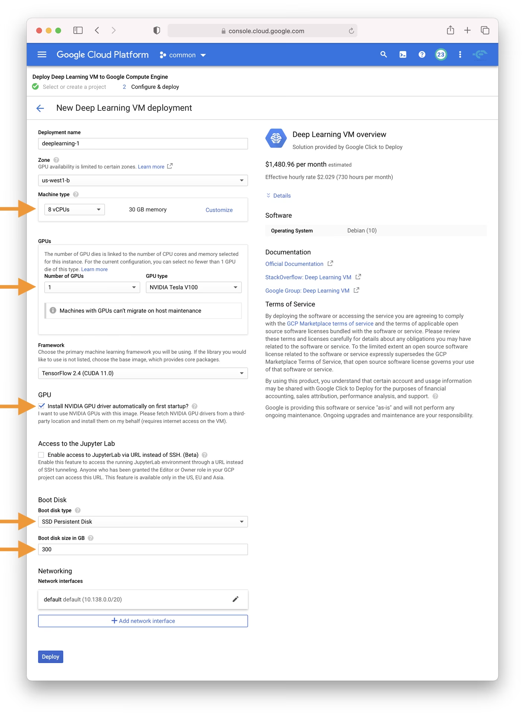
YOLOv5 Deployment on Google Cloud Platform (GCP) Deep Learning VM
Notes:
https://docs.ultralytics.com/yolov5/environments/google_cloud_quickstart_tutorial/

Slide 4
Thank you!
PDS
Computer Vision
Q&A
Thank you For being a great class!
https://github.com/siagianp
https://www.youtube.com/@AmelOline/videos
https://github.com/amelcharolinesgn2/IoT_simulator-mqtt-NodeRed
https://github.com/amelcharolinesgn2/Cloud-Infrastructures
https://github.com/amelcharolinesgn2/ClouD-Infrastructure-SISKA-2025
Notes:
https://medium.com/buildpiper/simplifying-containerization-with-docker-run-command-2f74e114f42a
https://github.com/IBA-Group-IT/IoT-data-simulator
https://www.bevywise.com/blog/docker-mqtt-broker-easy-service-manageability/

Slide 5
Reference
https://docs.ultralytics.com/yolov5/environments/google_cloud_quickstart_tutorial/#step-1-create-and-configure-your-deep-learning-vm

