Slide 1

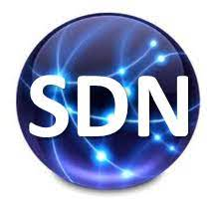
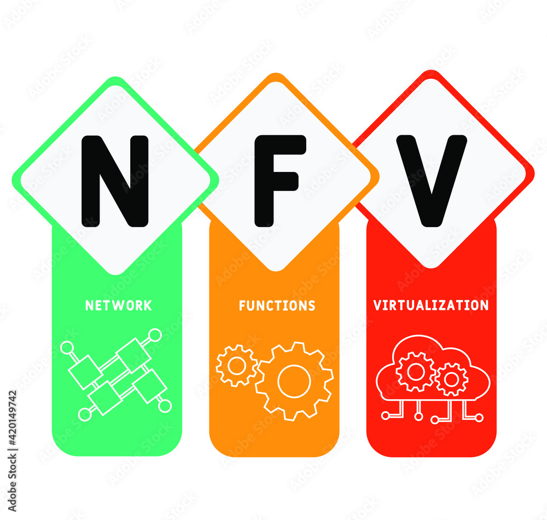

PDS
Computer Vision
AWS
AWS-cloud-platform
.
https://github.com/siagianp
https://www.youtube.com/@AmelOline/videos
https://github.com/amelcharolinesgn2/IoT_simulator-mqtt-NodeRed
https://github.com/amelcharolinesgn2/Cloud-Infrastructures
https://github.com/amelcharolinesgn2/ClouD-Infrastructure-SISKA-2025
Notes:
https://github.com/mikeroyal/Google-Cloud-Guide

Slide 2
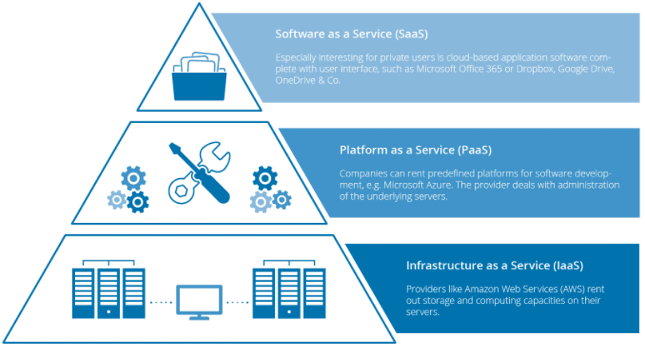
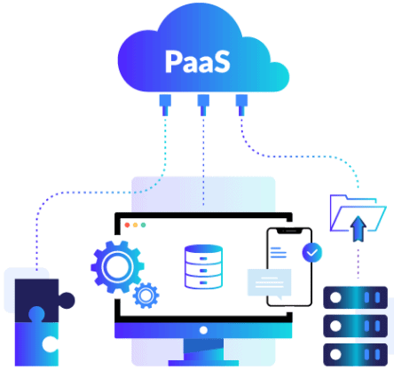
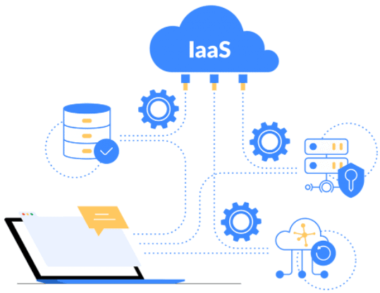
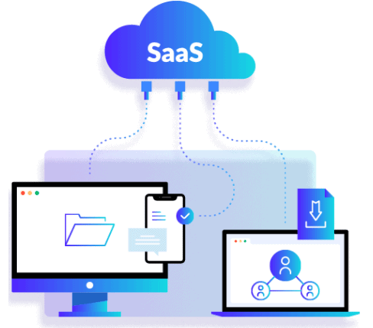
Notes:
IaaS are virtual Machines or AWS EC2, Storage or Networking. DigitalOcean, Amazon Web Services (AWS), Microsoft Azure, Google Cloud Platform (GCP), Oracle Cloud Infrastructure (OCI), and Alibaba Cloud.
PaaS: AWS Elastic Beanstalk, Azure App Service, Google App Engine, Google Cloud Run. (For serverless compute, Function-as-a-Service like AWS Lambda, Azure Functions, or Google Cloud Functions can be considered related models.
SaaS: Microsoft Office 365, Oracle ERP/HCM Cloud, Salesforce, Gmail, or Dropbox.
https://k21academy.com/amazon-web-services/cloud-service-models/

Slide 3
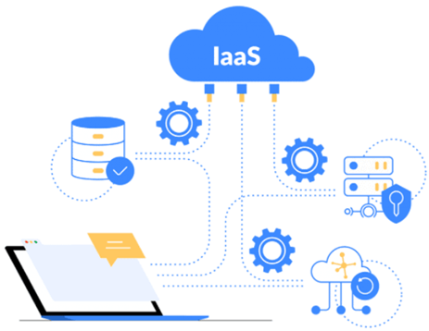
virtual Machines
Containers (Docker) vs Virtual Machines (VM): Pros, Cons, and Use Cases
Table of Contents:
Exploring Virtual Machines
Virtual Machine: Architecture and Benefits
Pros & Cons of VMs
What Are Containers?
How Do Containers Work?
Pros & Cons of Containers
Difference Between Physical Server and VM
Container (Docker) vs Virtual Machine (VM)
Conclusion: What is Better?
Frequently Asked Questions
IaaS are virtual Machines or AWS EC2, Storage or Networking.
Notes:
IaaS are virtual Machines or AWS EC2, Storage or Networking. DigitalOcean, Amazon Web Services (AWS), Microsoft Azure, Google Cloud Platform (GCP), Oracle Cloud Infrastructure (OCI), and Alibaba Cloud.
https://k21academy.com/amazon-web-services/cloud-service-models/
https://k21academy.com/docker-kubernetes/docker-vs-virtual-machine/

Slide 4
AWS EC2
AWS EC2 Instance | Steps to Connect Windows EC2 Instance
Optimize your workload performance and cost-effectiveness.
General Purpose Instances: These instances are suitable for a wide range of workloads, such as small to medium-sized databases, web servers, and development environments. For example, a t2.micro instance can be used for running a small-scale WordPress website, while an m5.large instance can be used for running a small-scale e-commerce website. Examples of general-purpose instances include t2, m5, and m6g.
Compute Optimized Instances: These instances are ideal for compute-intensive workloads, such as high-performance computing (HPC), scientific modeling, and data analytics. Examples of compute-optimized instances include c5, c6g, and c6gd.
Memory Optimized Instances: These instances are designed for workloads that require large amounts of memory, such as in-memory databases, big data processing, and analytics. Examples of memory-optimized instances include r5, r6g, and x1e.
Storage Optimized Instances: These instances are suitable for storage-intensive workloads that require high disk throughput and low latency, such as data warehousing and log processing. Examples of storage-optimized instances include i3, i3en, and d3.
GPU Instances: These instances are designed for workloads that require high-performance GPU resources, such as machine learning, deep learning, and graphics rendering. Examples of GPU instances include p3, g4, and inf1.
High-Performance Computing Instances: These instances are designed for high-performance computing (HPC) workloads that require high network performance and low latency, such as scientific modeling, financial simulations, and engineering simulations. Examples of HPC instances include hpc6id and hpc6a.
IaaS are virtual Machines or AWS EC2, Storage or Networking.
Notes:
IaaS are virtual Machines or AWS EC2, Storage or Networking. DigitalOcean, Amazon Web Services (AWS), Microsoft Azure, Google Cloud Platform (GCP), Oracle Cloud Infrastructure (OCI), and Alibaba Cloud.
https://k21academy.com/amazon-web-services/cloud-service-models/
https://k21academy.com/docker-kubernetes/docker-vs-virtual-machine/
https://k21academy.com/amazon-web-services/aws-ec2-instance/

Slide 5
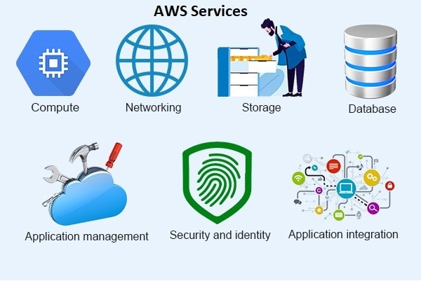
**Amazon Web Services (AWS)**
Cloud providers**
Notes:
https://k21academy.com/amazon-web-services/aws-for-testers-and-qa/

Slide 6
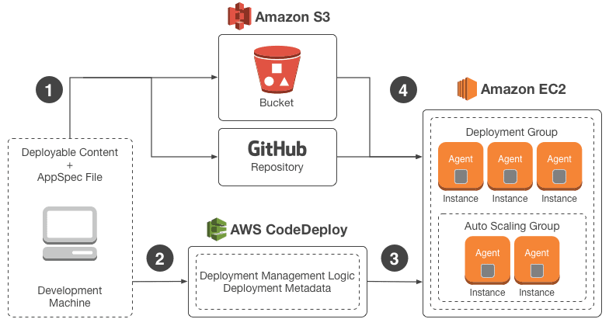
AWS CodeDeploy?

Slide 7
Creating Virtual Machines on Cloud Platforms: AWS, Azure, and GCP
Cloud providers**
AWS (Amazon Web Services)
AWS offers a robust and scalable cloud computing environment. The Elastic Compute Cloud (EC2) service is commonly used to create and manage virtual machines.
Step-by-Step Guide to Creating an EC2 Instance
Sign in to the AWS Management Console.
Navigate to the EC2 Dashboard.
Launch Instance: Click on the “Launch Instance” button.
Choose an Amazon Machine Image (AMI): Select an AMI. For this example, we’ll use the Amazon Linux 2 AMI.
Choose an Instance Type: Select an instance type. The t2.micro instance is a good choice for beginners.
Configure Instance Details: Configure settings like the number of instances, network, and IAM role.
Add Storage: Specify the storage size and type.
Add Tags: Add tags to organize and manage your instances.
Configure Security Group: Configure firewall settings to control traffic to your instance.
Review and Launch: Review your settings and click “Launch”. Choose an existing key pair or create a new one for SSH access.
Notes:
https://k21academy.com/amazon-web-services/aws-for-testers-and-qa/
https://dev.to/iaadidev/-creating-virtual-machines-on-cloud-platforms-aws-azure-and-gcp-2553
https://www.emma.ms/tutorials/how-to-deploy-virtual-machines-with-emma

Slide 8
Creating Virtual Machines on Cloud Platforms: AWS, Azure, and GCP
Cloud providers**
Notes:
https://k21academy.com/amazon-web-services/aws-for-testers-and-qa/

Slide 9
**Amazon Web Services (AWS)**
Cloud providers**
Notes:
https://k21academy.com/amazon-web-services/aws-for-testers-and-qa/

Slide 10
**Amazon Web Services (AWS)**
Cloud providers**
Notes:
https://k21academy.com/amazon-web-services/aws-for-testers-and-qa/
https://dev.to/iaadidev/-creating-virtual-machines-on-cloud-platforms-aws-azure-and-gcp-2553

Slide 11
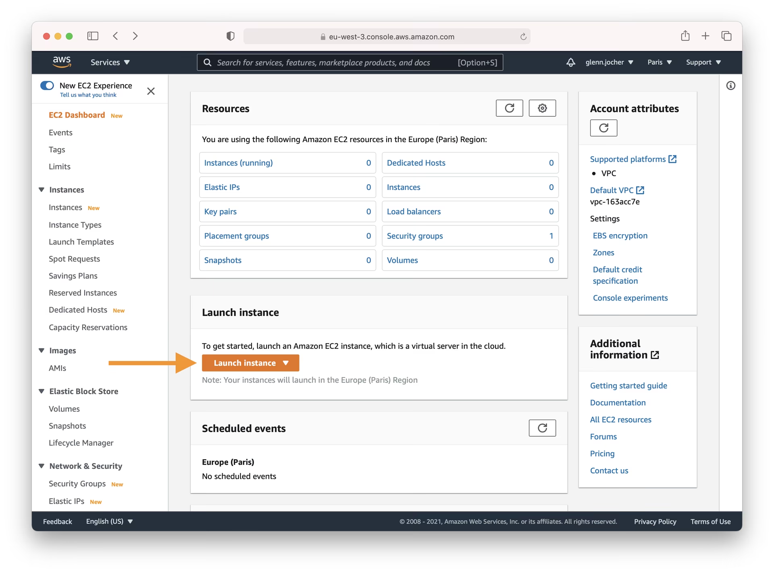
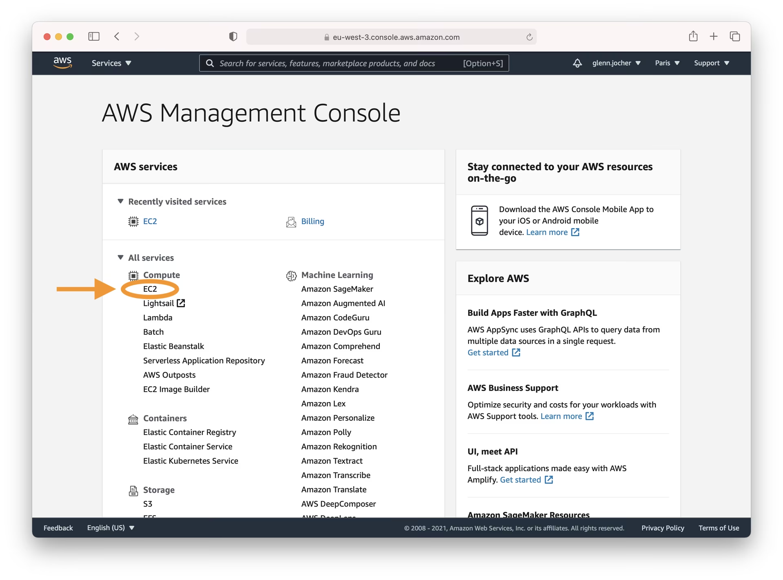
Exampe 1
YOLOv5 🚀 on AWS Deep Learning Instance
Step 1: AWS Console Sign-In
Begin by creating an account or signing in to the AWS Management Console. Once logged in, navigate to the EC2 service dashboard, where you can manage your virtual servers (instances).
Step 2: Launch Your Instance
From the EC2 dashboard, click the Launch Instance button. This initiates the process of creating a new virtual server tailored to your needs.
Notes:
https://docs.ultralytics.com/yolov5/environments/aws_quickstart_tutorial/

Slide 12
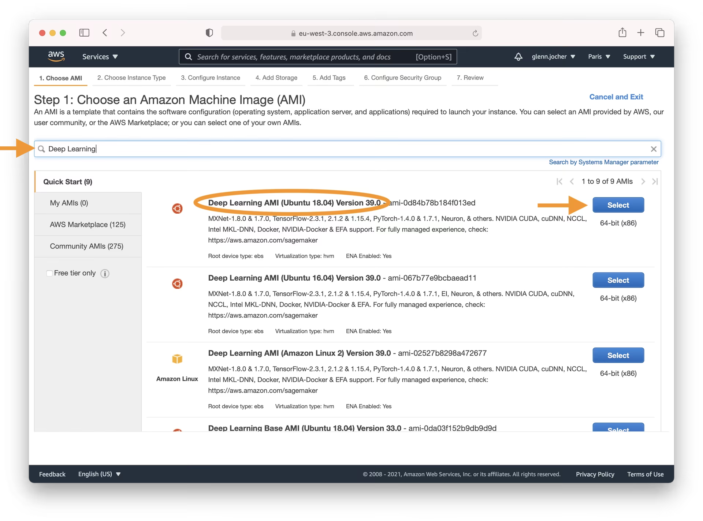
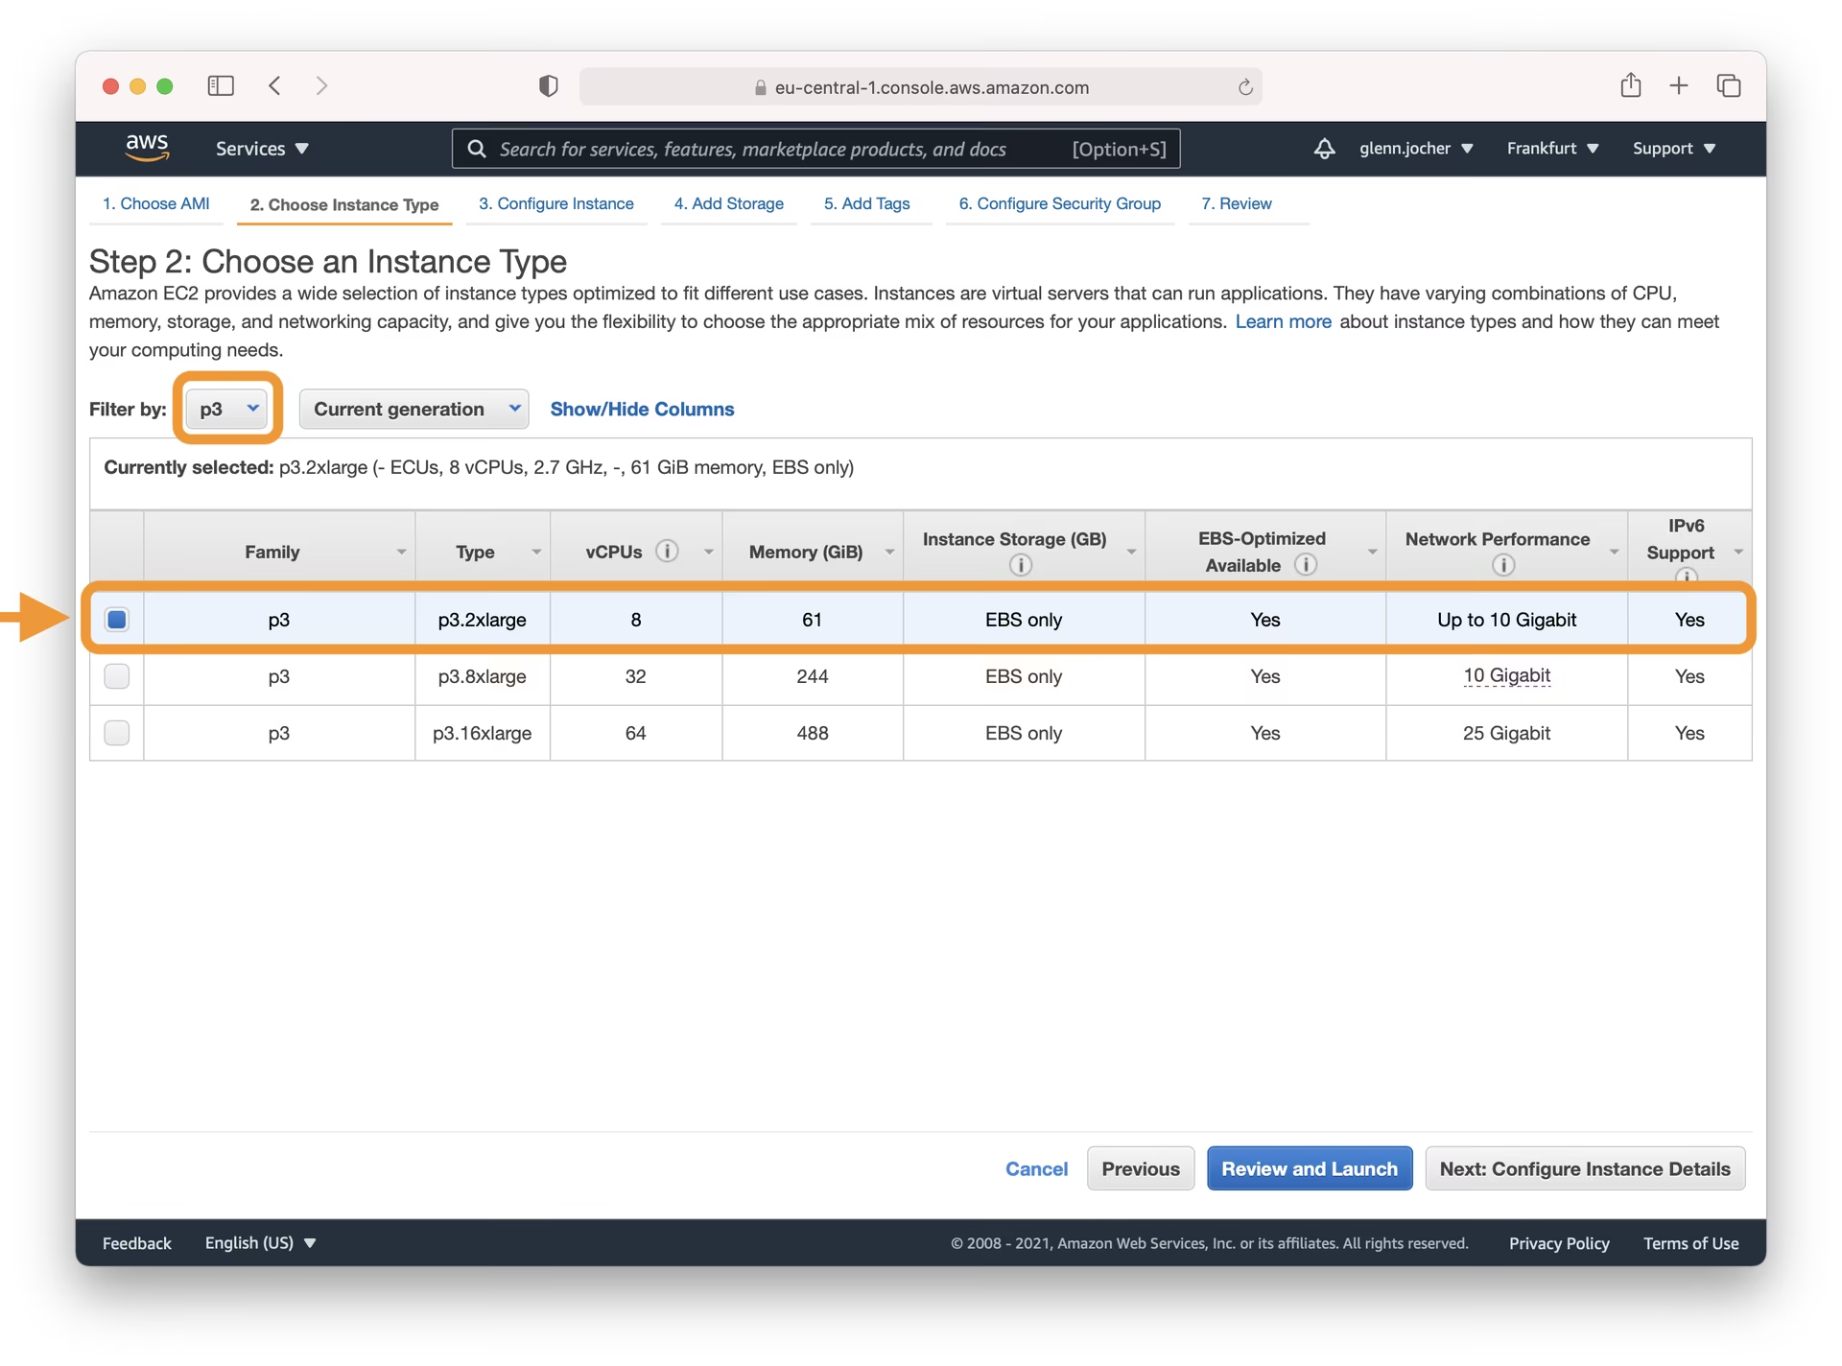
Exampe 1
YOLOv5 🚀 on AWS Deep Learning Instance (Cons’t)
Selecting the Right Amazon Machine Image (AMI)
Choosing the correct AMI is crucial. This determines the operating system and pre-installed software for your instance. In the search bar, type 'Deep Learning' and select the latest Ubuntu-based Deep Learning AMI (unless you have specific requirements for a different OS). Amazon's Deep Learning AMIs come pre-configured with popular deep learning frameworks (like PyTorch, used by YOLOv5) and necessary GPU drivers, significantly streamlining the setup process.
Picking an Instance Type
For demanding tasks like training deep learning models, selecting a GPU-accelerated instance type is highly recommended. GPUs can dramatically reduce the time required for model training compared to CPUs. When choosing an instance size, ensure its memory capacity (RAM) is sufficient for your model and dataset.
Note: The size of your model and dataset are critical factors. If your ML task requires more memory than the selected instance provides, you'll need to choose a larger instance type to avoid performance issues or errors.
Explore the available GPU instance types on the EC2 Instance Types page, particularly under the Accelerated Computing category.
Notes:
https://docs.ultralytics.com/yolov5/environments/aws_quickstart_tutorial/

Slide 13
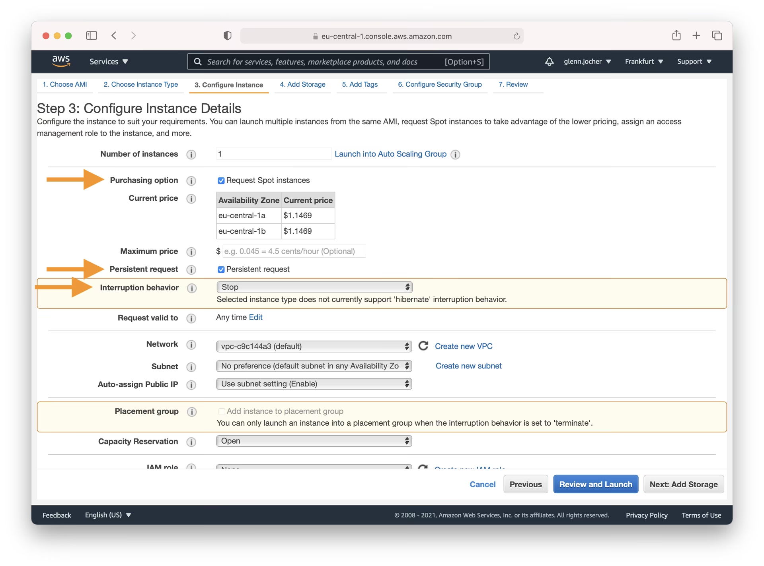
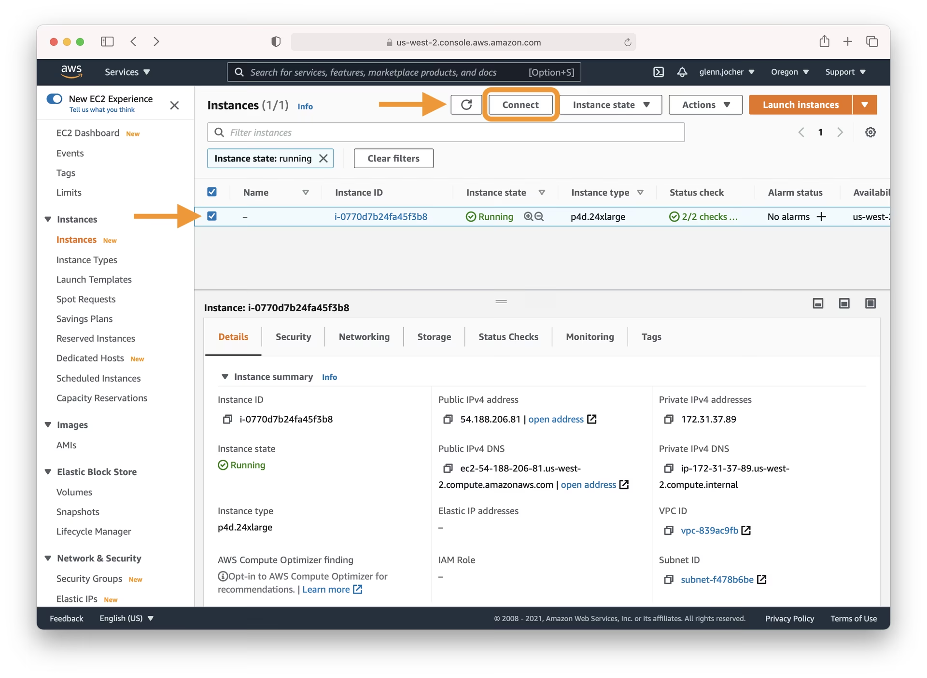
Exampe 1
YOLOv5 🚀 on AWS Deep Learning Instance (Cons’t)
Configuring Your Instance
Step 3: Connect to Your Instance
Once your instance state shows as 'running', select it from the EC2 dashboard. Click the Connect button to view connection options. Use the provided SSH command example in your local terminal (like Terminal on macOS/Linux or PuTTY/WSL on Windows) to establish a secure connection. You'll need the private key file (.pem) you created or selected during launch.
Notes:
https://docs.ultralytics.com/yolov5/environments/aws_quickstart_tutorial/

Slide 14
Exampe 1
YOLOv5 🚀 on AWS Deep Learning Instance (Cons’t)
Step 4: Running Ultralytics YOLOv5
Now that you're connected via SSH, you can set up and run YOLOv5. First, clone the official YOLOv5 repository from GitHub and navigate into the directory. Then, install the required dependencies using pip. It's recommended to use a Python 3.8 environment or later. The necessary models and datasets will be downloaded automatically from the latest YOLOv5 release when you run commands like training or detection.
Optional Extras: Increasing Swap Memory
# Allocate a 64GB swap file (adjust size as needed) sudo fallocate -l 64G /swapfile # Set correct permissions sudo chmod 600 /swapfile # Set up the file as a Linux swap area sudo mkswap /swapfile # Enable the swap file sudo swapon /swapfile # Verify the swap memory is active free -h
# Clone the YOLOv5 repository git clone https://github.com/ultralytics/yolov5 cd yolov5 # Install required packages pip install -r requirements.txt
With the environment ready, you can start using YOLOv5 for various tasks:
# Train a YOLOv5 model on a custom dataset (e.g., coco128.yaml)
python train.py --data coco128.yaml --weights yolov5s.pt --img 640
# Validate the performance (Precision, Recall, mAP) of a trained model (e.g., yolov5s.pt)
python val.py --weights yolov5s.pt --data coco128.yaml --img 640
# Run inference (object detection) on images or videos using a trained model
python detect.py --weights yolov5s.pt --source path/to/your/images_or_videos/ --img 640
# Export the trained model to various formats like ONNX, CoreML, TFLite for deployment
# See https://docs.ultralytics.com/modes/export/ for more details
python export.py --weights yolov5s.pt --include onnx coreml tflite --img 640
Refer to the Ultralytics documentation for detailed guides on Training, Validation, Prediction (Inference), and Exporting.
Notes:
https://docs.ultralytics.com/yolov5/environments/aws_quickstart_tutorial/

Slide 15
Mauliate Godang

