Slide 1

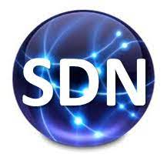
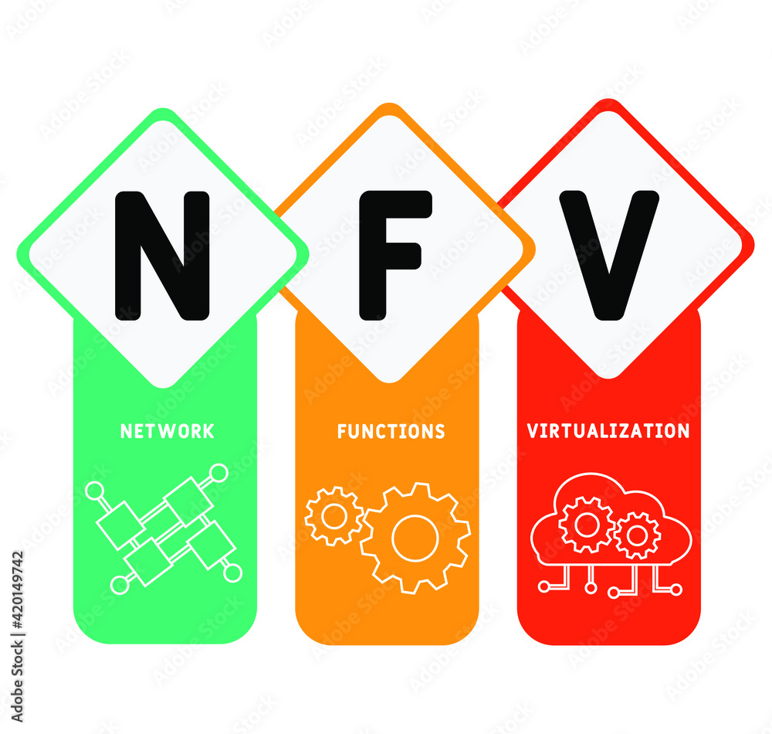

PDS
Computer Vision
Google-cloud-platform
.
https://github.com/siagianp
https://www.youtube.com/@AmelOline/videos
https://github.com/amelcharolinesgn2/IoT_simulator-mqtt-NodeRed
https://github.com/amelcharolinesgn2/Cloud-Infrastructures
https://github.com/amelcharolinesgn2/ClouD-Infrastructure-SISKA-2025
Notes:
https://github.com/mikeroyal/Google-Cloud-Guide

Slide 2
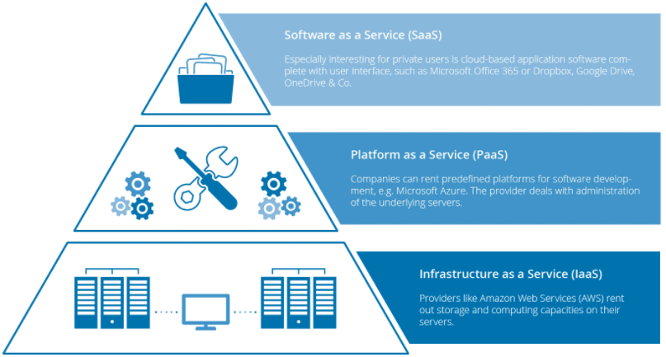
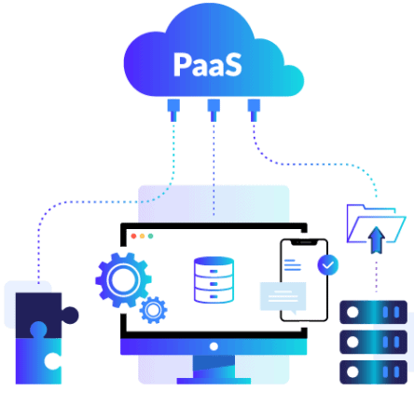
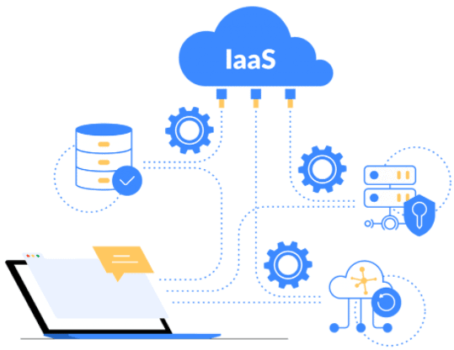
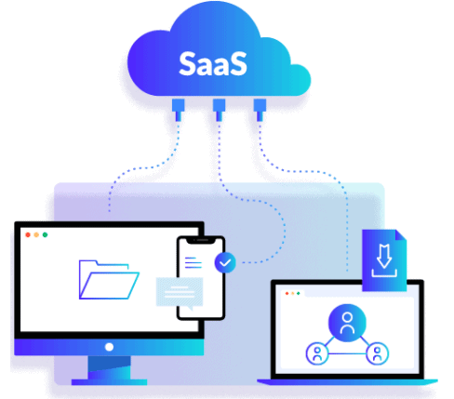
Notes:
IaaS are virtual Machines or AWS EC2, Storage or Networking. DigitalOcean, Amazon Web Services (AWS), Microsoft Azure, Google Cloud Platform (GCP), Oracle Cloud Infrastructure (OCI), and Alibaba Cloud.
PaaS: AWS Elastic Beanstalk, Azure App Service, Google App Engine, Google Cloud Run. (For serverless compute, Function-as-a-Service like AWS Lambda, Azure Functions, or Google Cloud Functions can be considered related models.
SaaS: Microsoft Office 365, Oracle ERP/HCM Cloud, Salesforce, Gmail, or Dropbox.
https://k21academy.com/amazon-web-services/cloud-service-models/

Slide 3
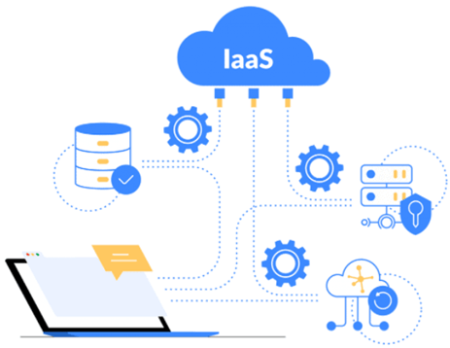
virtual Machines
Containers (Docker) vs Virtual Machines (VM): Pros, Cons, and Use Cases
Table of Contents:
Exploring Virtual Machines
Virtual Machine: Architecture and Benefits
Pros & Cons of VMs
What Are Containers?
How Do Containers Work?
Pros & Cons of Containers
Difference Between Physical Server and VM
Container (Docker) vs Virtual Machine (VM)
Conclusion: What is Better?
Frequently Asked Questions
IaaS are virtual Machines or AWS EC2, Storage or Networking.
Notes:
IaaS are virtual Machines or AWS EC2, Storage or Networking. DigitalOcean, Amazon Web Services (AWS), Microsoft Azure, Google Cloud Platform (GCP), Oracle Cloud Infrastructure (OCI), and Alibaba Cloud.
https://k21academy.com/amazon-web-services/cloud-service-models/
https://k21academy.com/docker-kubernetes/docker-vs-virtual-machine/

Slide 4
AWS EC2
AWS EC2 Instance | Steps to Connect Windows EC2 Instance
Optimize your workload performance and cost-effectiveness.
General Purpose Instances: These instances are suitable for a wide range of workloads, such as small to medium-sized databases, web servers, and development environments. For example, a t2.micro instance can be used for running a small-scale WordPress website, while an m5.large instance can be used for running a small-scale e-commerce website. Examples of general-purpose instances include t2, m5, and m6g.
Compute Optimized Instances: These instances are ideal for compute-intensive workloads, such as high-performance computing (HPC), scientific modeling, and data analytics. Examples of compute-optimized instances include c5, c6g, and c6gd.
Memory Optimized Instances: These instances are designed for workloads that require large amounts of memory, such as in-memory databases, big data processing, and analytics. Examples of memory-optimized instances include r5, r6g, and x1e.
Storage Optimized Instances: These instances are suitable for storage-intensive workloads that require high disk throughput and low latency, such as data warehousing and log processing. Examples of storage-optimized instances include i3, i3en, and d3.
GPU Instances: These instances are designed for workloads that require high-performance GPU resources, such as machine learning, deep learning, and graphics rendering. Examples of GPU instances include p3, g4, and inf1.
High-Performance Computing Instances: These instances are designed for high-performance computing (HPC) workloads that require high network performance and low latency, such as scientific modeling, financial simulations, and engineering simulations. Examples of HPC instances include hpc6id and hpc6a.
IaaS are virtual Machines or AWS EC2, Storage or Networking.
Notes:
IaaS are virtual Machines or AWS EC2, Storage or Networking. DigitalOcean, Amazon Web Services (AWS), Microsoft Azure, Google Cloud Platform (GCP), Oracle Cloud Infrastructure (OCI), and Alibaba Cloud.
https://k21academy.com/amazon-web-services/cloud-service-models/
https://k21academy.com/docker-kubernetes/docker-vs-virtual-machine/
https://k21academy.com/amazon-web-services/aws-ec2-instance/

Slide 5
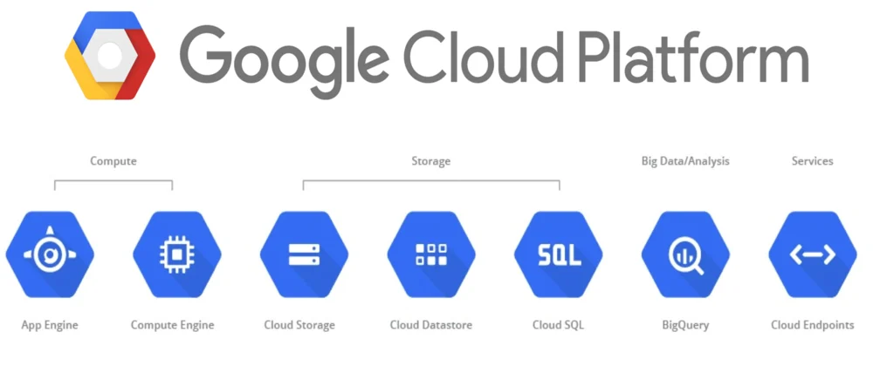
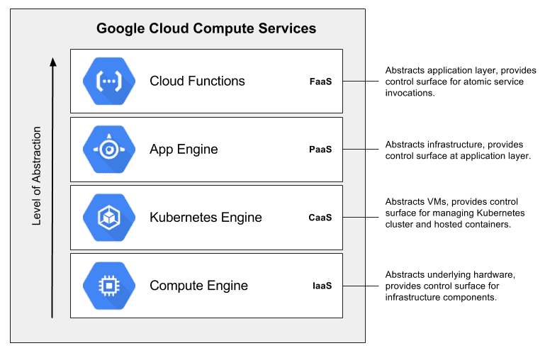
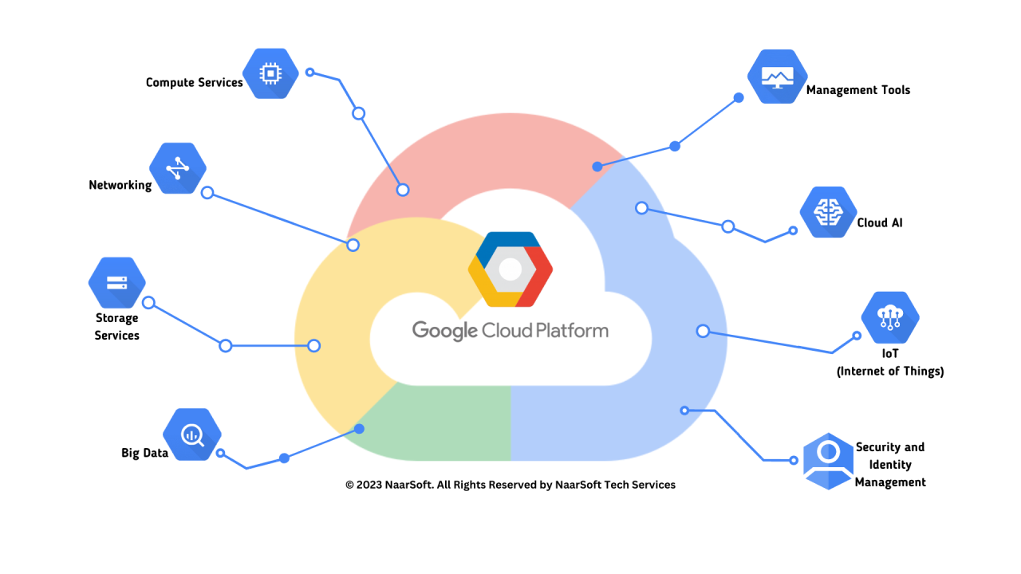
**Google Cloud Platform as a Service**
Cloud providers**
Notes:
https://www.linkedin.com/pulse/google-cloud-platform-service-naarsoft
https://k21academy.com/google-cloud/google-cloud-compute-services/
https://www.linkedin.com/pulse/what-google-cloud-platform-shruti-anand

Slide 6
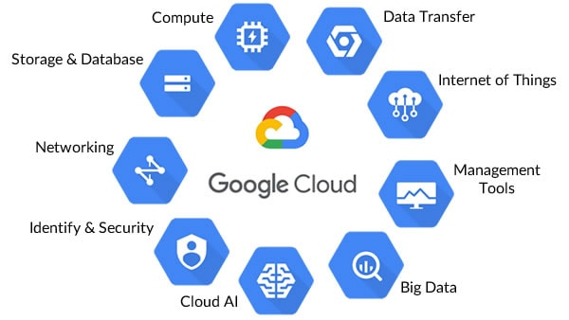
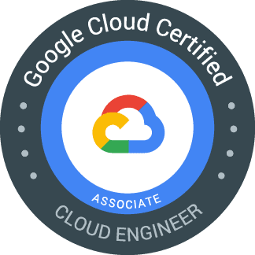
**Google Cloud Platform as a Service**
Cloud providers**
Google Associate Cloud Engineer Certification
FREE Google Cloud Beginners MasterClass
Notes:
https://www.linkedin.com/pulse/google-cloud-platform-service-naarsoft
https://k21academy.com/google-cloud/gcp-associate-cloud-engineer-all-you-need-to-know-about/
https://k21academy.com/google-cloud/introduction-to-google-cloud-platform/

Slide 7
What is Google Cloud Platform?
GCP is a public cloud vendor — like competitors Amazon Web Services (AWS) and Microsoft Azure. With GCP and other cloud vendors, customers are able to access computer resources housed in Google’s data centers around the world for free or on a pay-per-use basis.
GCP offers a suite of computing services to do everything from GCP cost management to data management to delivering web and video over the web to AI and machine learning tools.
Each GCP region offers a category of services. Some services are limited to specific regions. Major services of Google Cloud Platform include:
Computing and hosting
Storage and database
Networking
Big Data
Machine learning
Notes:
https://www.linkedin.com/pulse/what-google-cloud-platform-shruti-anand

Slide 8
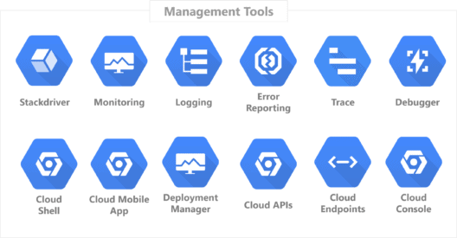
Google-cloud-services-tools-for-beginners
Google Cloud Services is a set of Computing, Networking, Storage, Big Data, Machine Learning, and Management services offered by Google which runs on the same cloud infrastructure
Computing Service
Storage and Database Service
Networking Service
Big Data Service
Machine Learning Service
Identity and Security Service
Management and Developer Tools
Notes:
https://k21academy.com/google-cloud/google-cloud-services-tools-for-beginners/
https://k21academy.com/google-cloud/google-cloud-services-tools-for-beginners/

Slide 9
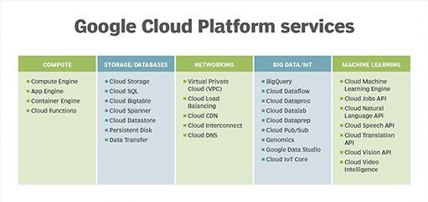
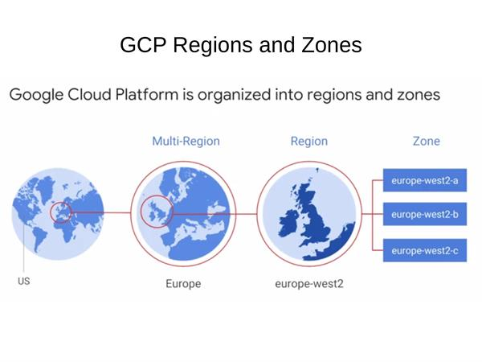
Google-cloud-services-tools-for-beginners(Cont’s)

Slide 10
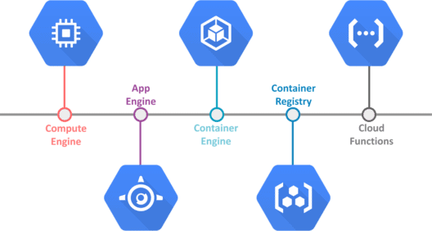
Google-cloud-services-tools-for-beginners(Cont’s)
1. Computing Services
Google Cloud provides users with the facility of computing and hosting where you can choose to do the following:
Work in a serverless environment
Use a managed application platform
Build a cloud-based infrastructure to have maximum control and flexibility
Leverage container technologies to achieve maximum flexibility
Notes:
https://k21academy.com/google-cloud/google-cloud-services-tools-for-beginners/

Slide 11
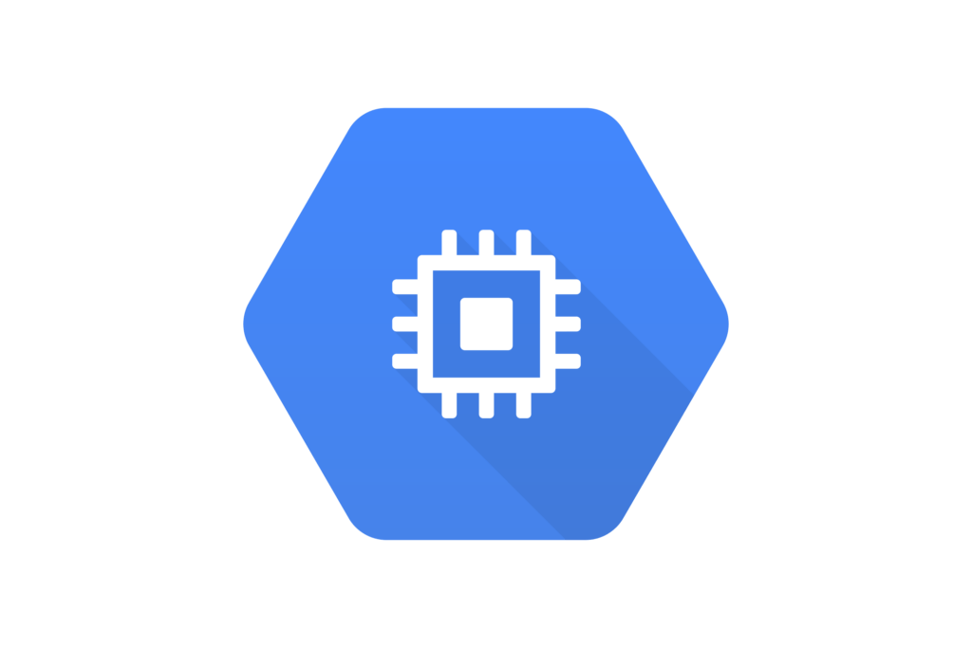
Google-cloud-services-tools-for-beginners(Cont’s)
1.1. Compute Engine (Virtual Machine)
Compute engine is an unmanaged compute service of Google Cloud. It is an IaaS (Infrastructure As A Service) service that provides virtual machines (VMs) hosted on Google’s infrastructure. Users can perform many tasks after building a compute engine like:
Choose the regions and zones to deploy resources, giving users control over where the data is stored and used.
Choose the required operating systems, development stacks, languages, frameworks, services, and other software technologies as per users’ preference.
Make use of Google Cloud Storage or any third-party technologies.
Use virtual machines (VMs), called instances, to build applications similar to that of as you build your own hardware infrastructure.
To know more about Compute Engine on Google Compute Engine Below.
Notes:
https://k21academy.com/google-cloud/google-cloud-services-tools-for-beginners/

Slide 12
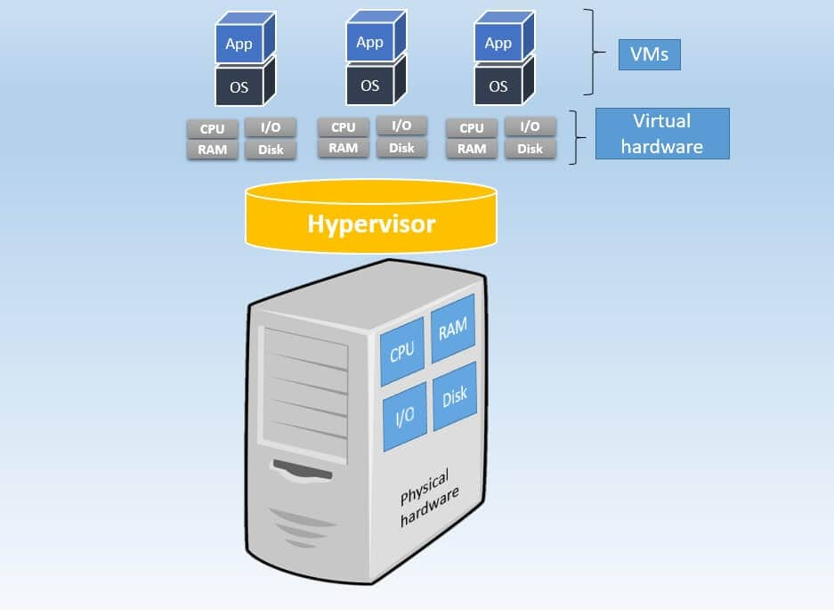
A Compute Engine read on Google Compute Engine.
Google-cloud-services-tools-for-beginners(Cont’s)
Google Compute Engine
Virtual Machine
Google Compute Engine is a virtual machine (VM) service that allows users to create and run VMS on Google’s infrastructure. Compute Engine provides a variety of VM types, including standard, high-memory, high-CPU, and custom machine types. It is an unmanaged computing service and is generally referred to as customizable virtual machines in Google Cloud.
Virtual Machines in layman’s language can be understood as a digital version of the physical computer. It is a virtualized instance of a computer that can perform almost all the functions as that of a computer. Each virtual machine consists of a complete operating system and a set of virtualized hardware resources, including CPU, memory, storage, and network interfaces.
Notes:
https://k21academy.com/google-cloud/google-compute-engine/

Slide 13
Google-cloud-services-tools-for-beginners(Cont’s)
Usage of Virtual Machine
Create development and test environments — For testing and development, isolated environments can be built using virtual machines (VMS). In a controlled and separated environment, developers may simply create and test new software without affecting the production environment
Enable workload migration-Virtual machines (VMS) are used to deliver cloud computing services by cloud service providers like Google Cloud Platform (GCP). For the purpose of running their applications and workloads, customers can construct and manage VMS in the cloud.
Improve disaster recovery and business continuity- VMS can be used as a part of a disaster recovery strategy. In the event of a disaster, virtual machines can be easily migrated to a backup site, reducing downtime and data loss.
Consolidated servers– Virtualization enables businesses to combine their physical servers into a smaller number of more potent ones. This lowers hardware expenses and makes management easier.
Notes:
https://k21academy.com/google-cloud/google-cloud-services-tools-for-beginners/

Slide 14
Google-cloud-services-tools-for-beginners(Cont’s)
Google Cloud Compute Engine
Applications Of Compute Engine
Google Compute Engine is Google’s Infrastructure-as-a-Service virtual machine offering. It allows customers to use virtual machines in the cloud as server resources instead of acquiring and managing server hardware. Google Compute Engine offers virtual machines running in Google’s data centers connected to the worldwide fiber network. The tooling and workflow offered by compute engine enable scaling from single instances to global, load-balanced cloud computing.
Applications of the Google compute engine:
Virtual Machine (VM) migration to Comput Engine: It provides tools to fast-track the migration process from on-premise or other clouds to GCP. If a user is starting with the public cloud, then they can leverage these tools to seamlessly transfer existing applications from their data center, AWS, or Azure to GCP. Users can have their applications running on Compute Engine within minutes while the data migrate transparently in the background.
DevOps: GCE provides an easy-to-use platform for building and deploying applications using popular tools such as Docker, Kubernetes, and Jenkins.
Disaster recovery: GCE provides a reliable infrastructure that can be used for disaster recovery purposes. Users can easily create backups and replicas of their infrastructure in case of unexpected outages or failures.
High-performance computing (HPC): GCE provides access to powerful computing resources for running high-performance computing workloads such as simulations, rendering, and scientific computing.
Genomics Data Processing: Processing genomic data is computationally intensive because the information is enormous with vast sets of sequencing. With the Compute Engine’s potential, users can process such large data sets. The platform is not only flexible but also scalable when it comes to processing genomic sequences.
Notes:
https://k21academy.com/google-cloud/google-cloud-services-tools-for-beginners/

Slide 15
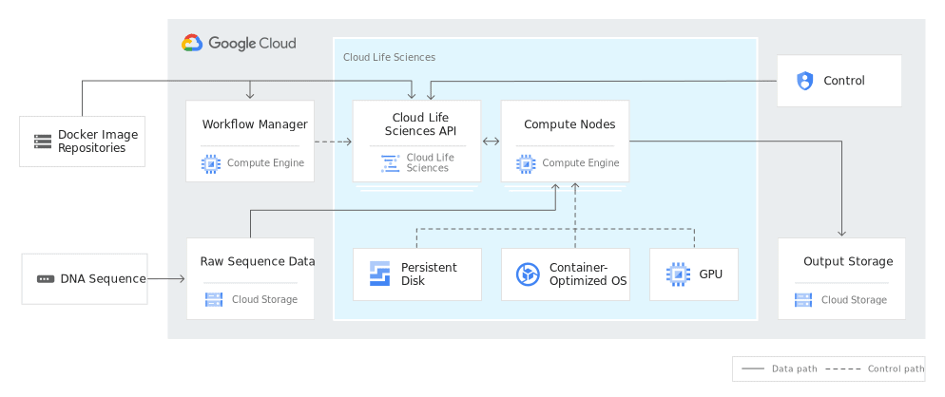
Google-cloud-services-tools-for-beginners(Cont’s)
Notes:
https://k21academy.com/google-cloud/google-cloud-services-tools-for-beginners/

Slide 16
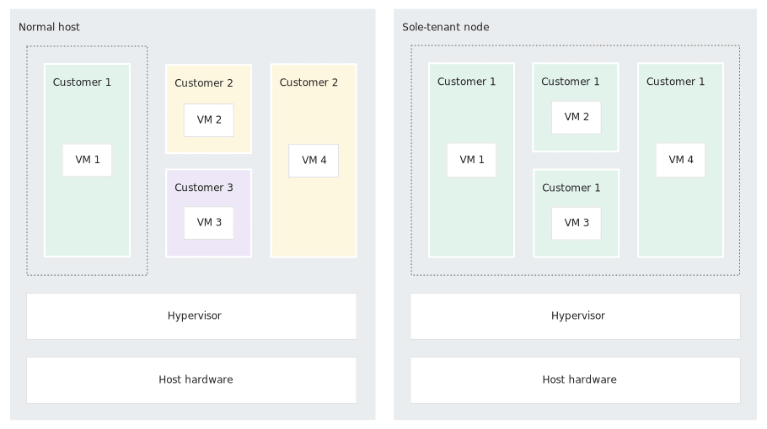
Google-cloud-services-tools-for-beginners(Cont’s)
Applications Of Compute Engine (Cont’s)
Advantages Of Compute Engine
f. BYOL or Bring Your Own License images: A Compute Engine can help you run Windows apps in GCP by bringing their licenses to the platform as either license-included images or sole-tenant nodes. When users migrate to GCP, they can flexibly optimize their license and promote the bottom line.
Storage Efficiency: The persistent disks support up to 257 TB of storage which is more than 10 times higher than what Amazon Elastic Block Storage (EBS) can accommodate. Organizations that require more scalable storage options can go for Compute Engine
Cost: Within the GCP ecosystem, users pay only for the computing time that they have consumed. The per-second billing plan is used by the Google compute engine.
Stability: It offers more stable services because of its ability to provide live migration of VMs between the hosts.
Backups: Google Cloud Platform has a robust, inbuilt, and redundant backup system. The Compute Engine uses this system for flagship products like Search Engine and Gmail.
Scalability: It makes reservations to help ensure that applications have the capacity they need as they scale.
Security: Google Compute Engine is a more secure and safe place for cloud applications.
Notes:
https://k21academy.com/google-cloud/google-cloud-services-tools-for-beginners/

Slide 17
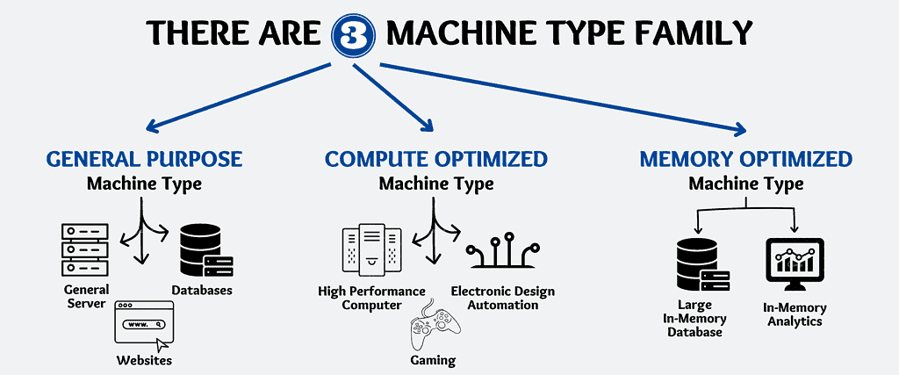
Google-cloud-services-tools-for-beginners(Cont’s)
Benefits Of Compute Engine
Google Compute Engine Features (Cons’t)
Easy Integration: It allows to easily integrate with other Google Cloud services like AI/ML and data analytics.
Compute globally as per requirement: Rendering reservations for supporting and securing applications having the strength as per measurement and requirement.
Gain Infinite Value: Preventing cost only for executing Compute with sustained-use discounts, and obtaining huge profits while implementing devoted-use discounts.
Confidential Computing: Confidential VMs is a kind of advanced technology that enables users to encode delicate data into the cloud while data is being processed.
Google Compute Engines has many features and some of them are discussed in detail below.
1.) Machine Types
It describes the virtual hardware that is attached to an instance which also includes RAM and CPUs.
Notes:
https://k21academy.com/google-cloud/google-cloud-services-tools-for-beginners/

Slide 18
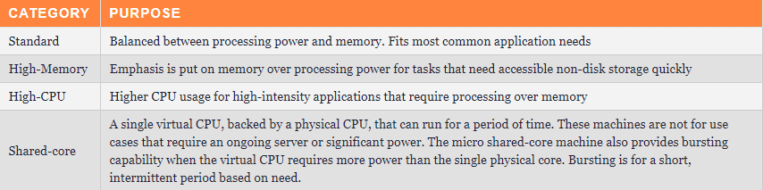
Google-cloud-services-tools-for-beginners(Cont’s)
Google Compute Engine Features (Cons’t)
Predefined Machine Types: These are pre-configured virtual machine templates that can be used to set up virtual machines. The configurations have been pre-optimized by Google and meet most of the requirements. The predefined machine types are divided into four categories:
Standard VMs
High-memory VMs
High-CPU VMs
Shared-core VMs
Custom Machine Types: The virtual hardware can be configured manually for a Compute Engine VM instance. Users can select the number of virtual CPUs (vCPUs) and memory, provided they are within Google’s set limits.
There are several types of machine families:
General purpose machine types:- Machines with a general purpose are the most prevalent and can handle a variety of workloads. They come in various sizes and offer a balance of CPU and memory resources. n1-standard, e2-standard, and e2-highcpu are some examples.
Compute-optimized machine types:- These are made to handle workloads that demand on a lot of memory. Compared to general-purpose computers, they feature a larger memory-to-CPU ratio. N1-highmem and e2-highmem are two examples.
CPU-optimized machine types:- These are developed for applications like video transcoding, gaming, and simulation that demand a lot of CPU power. They have more virtual CPUs per unit of RAM than general-purpose computers. N1-highcpu and e2-highcpu are two examples.
Accelerated computing machine types:- These are produced for activities that call for specialized hardware, such GPUs or TPUs. They are enhanced for scientific computing, machine learning, and deep learning. Examples include n1-highmem-96 and n1-standard-gpu.
Notes:
https://k21academy.com/google-cloud/google-cloud-services-tools-for-beginners/

Slide 19
Google-cloud-services-tools-for-beginners(Cont’s)
Google Compute Engine Features (Cons’t)
5.) Images
An image contains the OS and the root file system that users leverage to run VM instances. Google Cloud Platform provides two main types of images:
Public Images: These are a collection of open-source and proprietary options. They serve as a starting point for most virtual machine instances and come packaged with only the operating system.
Custom Images: Public images are a good starting point, but they are designed to be built upon and turned into custom images to match the needs of the customers. A custom image has the software needed along with all the scripts necessary for the instance to work automatically without administrator intervention. These are automatically brought up and shut down for load balancing or recovery needs.
6.) Global Load Balancing
It helps in distributing incoming requests across pools of instances across multiple regions so that users can achieve maximum performance, throughput, and availability at a low cost.
2.) Persistent Disks
These are durable, high-performance block storage for VM instances which can be created in HDD or SSD formats. Users can take snapshots and create new persistent disks from that snapshot. If a VM instance is terminated, the data is retained by the persistent disk which can be attached to another instance. There are two types of persistent disks:
Shared
SSD
3.) Local SSD
Google Compute Engine offers always-encrypted local solid-state drive (SSD) block storage which is physically attached to the virtual machine running it. It improves performance and reduces latency.
4.) GPU Accelerators
GPUs are added to accelerate computationally intensive workloads like machine learning, virtual workstation applications, etc.
Notes:
https://k21academy.com/google-cloud/google-cloud-services-tools-for-beginners/

Slide 20
Finish: A Compute Engine read on Google Compute Engine.
Google-cloud-services-tools-for-beginners(Cont’s)
Compute Engine Pricing
ompute Engine pricing in Google Cloud Platform (GCP) is based on several factors, including the type of machine instance selected, the duration of usage, and the amount of storage and network bandwidth used.
Businesses can use the GCP Pricing Calculator to estimate the cost of running particular workloads on Compute Engine and have a better understanding of Compute Engine pricing in GCP. In addition, Compute Engine provides sustained use discounts, which are automatic reductions based on the length of usage, with reductions rising with usage.
Notes:
https://k21academy.com/google-cloud/google-cloud-services-tools-for-beginners/

Slide 21
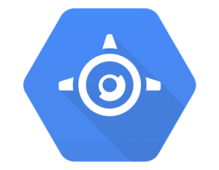
Google-cloud-services-tools-for-beginners(Cont’s)
1.2. Google App Engine
Google App Engine is an industry-leading Platform as a Service (PaaS) from the company that pioneered much of the microservices technology
Google App Engine is a fully managed serverless platform for developing and hosting web applications at a scale. Users can choose from several popular languages, libraries, and frameworks to develop their applications and then App Engine takes care of provisioning servers and scaling app instances based on demand. It is a PaaS for building scalable applications.
The App Engine is a PaaS (Platform As A Service) offering of Google Cloud used for building scalable web applications and IoT backends. It scales applications automatically depending upon the traffic received. It provides users with built-in services and APIs, such as Datastores, NoSQL, and a user authentication API.
Read more about it on App Engine
Note: Read on Google Cloud Functions.
Notes:
https://k21academy.com/google-cloud/google-app-engine/
https://k21academy.com/google-cloud/google-cloud-services-tools-for-beginners/
https://k21academy.com/google-cloud/google-app-engine/
https://k21academy.com/google-cloud/google-cloud-functions/

Slide 22
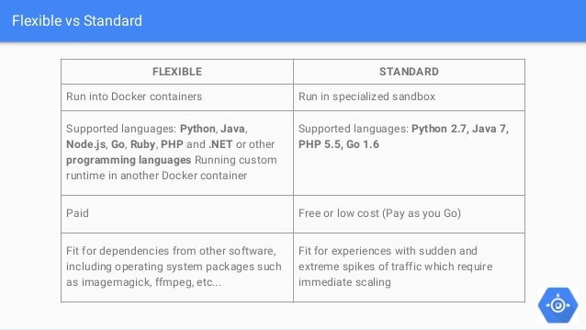
Google-cloud-services-tools-for-beginners(Cont’s)
Google App Engine Environments
1.) Standard Environment
It is based on the container which runs on the Google infrastructure. It provides users with the facility to easily build and deploy an application that runs under heavy load and a large amount of data. It supports the following languages: Python, JAVA, Node.js, Ruby, PHP, and Go.
Features of Standard Environment:
Persistent storage with queries, sorting, and transactions.
Automatic scaling and load balancing.
Asynchronous task queues for performing work outside the scope of a request.
Scheduled tasks for triggering events at regular intervals or specific time intervals.
Integration with other Google cloud services and APIs.
2.) Flexible Environment
App Engine Flexible Environment allows users to concentrate on writing code. Based on Google Compute Engine, it automatically scales the app up and down and along with it also balances the load. It allows users to customize their runtime and the operating system of their virtual machines using Dockerfiles.
Features of Flexible Environment:
Infrastructure Customization: App Engine flexible environment instances are Compute Engine virtual machines, which implies that users can take advantage of custom libraries, use SSH for debugging, and deploy their own Docker containers.
It is an open-source community.
Native feature support: Features such as microservices, authorization, SQL and NoSQL databases, traffic splitting, logging, etc are natively supported.
Performance: Users can take advantage of a wide array of CPU and memory configurations.
Google Cloud provides 2 environments to use App Engine, one is a standard environment with constrained environments and support for languages such as Python, Go, node.js. The other one is the Flexible Environment where developers have more freedom such as running custom runtimes using docker, longer request & response timeout, and ability to install custom dependencies/software, and SSH into the virtual machine.
Notes:
https://k21academy.com/google-cloud/google-cloud-services-tools-for-beginners/
https://k21academy.com/google-cloud/google-cloud-functions/

Slide 23
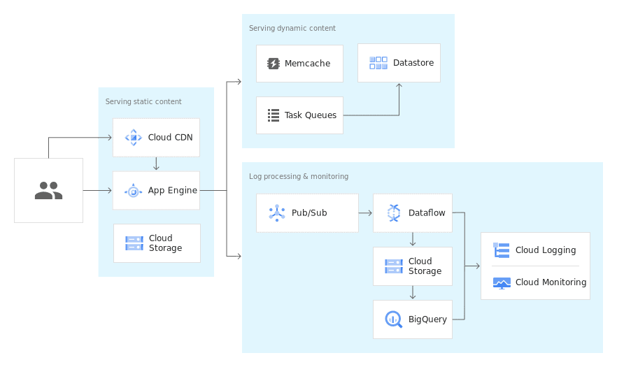
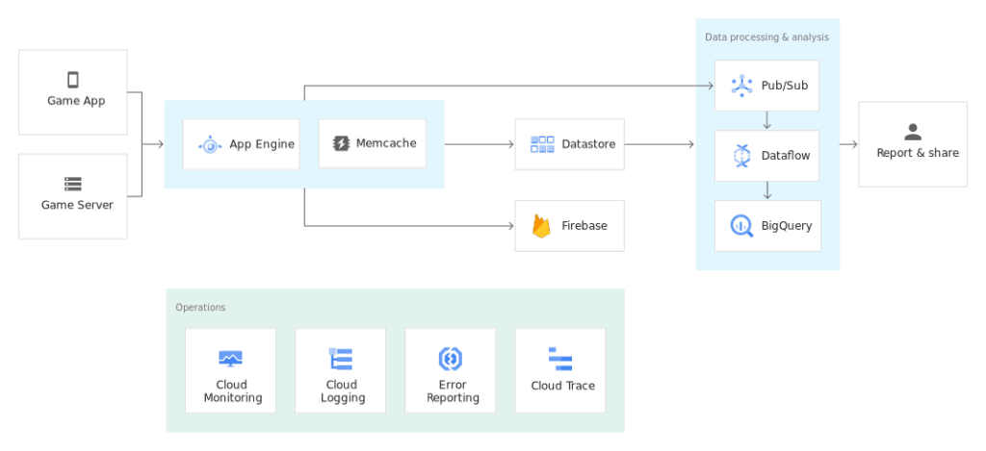
Google-cloud-services-tools-for-beginners(Cont’s)
Google App Engine Use-Cases
1.) Scalable Mobile Backends: App Engine automatically scales the hosting environment for users who are building their first mobile application or looking to reach out to existing users via a mobile experience. It offers seamless integration with Firebase which provides an easy-to-use frontend mobile platform along with a scalable and reliable back end.
2.) Modern Web-Applications: Quickly reach customers and end-users by deploying web apps on App Engine. With zero-config deployments and zero server management, It allows users to focus on just writing code. In addition to this, it automatically scales to support sudden traffic spikes without provisioning, patching, or monitoring.
Notes:
https://k21academy.com/google-cloud/google-cloud-services-tools-for-beginners/
https://k21academy.com/google-cloud/google-cloud-functions/

Slide 24
Google-cloud-services-tools-for-beginners(Cont’s)
Benefits of Google App Engine
Features of App Engine
Open and familiar languages and tools: Users can build and deploy apps quickly using popular languages or bring their own language runtimes and frameworks, they can also manage resources from the command line, debug source code, and run API back ends easily.
Just add code: App Engine protects from security threats using firewall capabilities, IAM rules, and managed SSL/ TLS certificates so that it helps users to write code without any underlying infrastructure.
Pay only for what you use: It naturally scales relying upon the application traffic and expends resources just when the code is running
Popular language: Users can build the application using language runtimes such as Java, Python, C#, Ruby, PHP or build their own runtimes.
Open and flexible: Custom runtimes allow users to bring any library and framework to App Engine by supplying a Docker container.
Fully managed: It allows users to add your web application code to the platform while it manages the infrastructure. The engine ensures that web apps are secure and running and enables the firewall to save them from malware and threats.
Powerful application diagnostics: Google App engine uses cloud monitoring and cloud logging to monitor the health and performance of the app and to diagnose and fix bugs quickly it uses cloud debugger and error reporting.
Application versioning: It easily hosts different versions of the app, and create development, test, staging, and production environments.
Application security: Google App Engine helps safeguard the application by defining access rules with an App Engine firewall and leverage managed SSL/TLS certificates by default on the custom domain without incurring any additional cost.
Notes:
https://k21academy.com/google-cloud/google-cloud-services-tools-for-beginners/
https://k21academy.com/google-cloud/google-cloud-functions/

Slide 25
Google-cloud-services-tools-for-beginners(Cont’s)
1.3. Cloud Function
Google Cloud Functions
It is a function as a service (FaaS) offering which provides a serverless execution environment for building and connecting cloud services. It is an event-based, asynchronous computing solution allowing users to create microservices (small, single-purpose functions) that respond to cloud events without the need for an explicitly managed server or a runtime environment. It can be written using JavaScript, Python 3, Go, or Java.
Google Cloud Functions is a serverless computing platform provided by Google Cloud that enables developers to build and deploy applications on cloud infrastructure without having to worry about managing servers or infrastructure.
Google Cloud Function is a serverless execution environment for building and connecting cloud services. With Cloud Functions, users can write simple, single-purpose functions that are attached to events emitted from their cloud infrastructure and services. The Cloud Function is triggered when an event being watched is fired.
To create your first cloud Function
Notes:
https://k21academy.com/google-cloud/google-cloud-services-tools-for-beginners/
https://k21academy.com/google-cloud/google-cloud-functions/
To create your first cloud Function, read our blog at Cloud Function

Slide 26
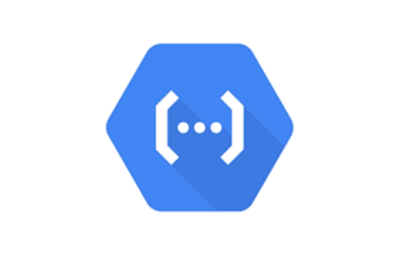
Google-cloud-services-tools-for-beginners(Cont’s)
Key Features of Google Cloud Functions
Developers may create and publish event-driven functions with Cloud Functions that automatically grow based on usage. The platform enables developers to create serverless apps that react to events like incoming HTTP requests, messages from messaging systems, or changes to database data.
The code executes in a fully managed environment and there is no need to provision any infrastructure or manage servers. Cloud Functions can be written using JavaScript, Python 3, Go, or Java runtimes on the Google Cloud Platform ( integrates with other Google Cloud services such as Cloud Storage, Cloud Pub/Sub, and Cloud Firestore.)
Serverless Computing: Google Cloud Functions is a serverless computing platform, which means that developers can write code without worrying about underlying infrastructure management such as servers, operating systems, or virtual machines.
Event-driven Computing: Google Cloud Functions is event-driven, which means that it automatically runs code in response to events, such as changes to data in a database or messages from a messaging system.
Scalability: Cloud Functions automatically scale up or down based on the amount of traffic it receives. This means that developers don’t need to worry about overprovisioning resources or paying for unused resources.
Support for Multiple Languages: Google Cloud Functions supports several programming languages including Node.js, Python, Go, Java, and .NET.
Integration with other Google Cloud Services: Cloud Functions integrates with other Google Cloud services, such as Cloud Storage, Cloud Pub/Sub, and Cloud Firestore, making it easy to build complex applications that require multiple services.
Cost-efficient: Google Cloud Functions is a cost-efficient way to run serverless applications as it only charges for the time the code is executed, and there are no upfront costs or minimum fees.
Easy to deploy: Cloud Functions can be deployed quickly using the Google Cloud Console, the gcloud command-line tool, or even using source code repositories like GitHub.
Versatile Use Cases: Cloud Functions can be used to build various applications, including webhooks, chatbots, data processing pipelines, and more. Developers can use it to create a wide range of event-driven applications.
High Availability: Google Cloud Functions offers high availability, which means that functions are automatically replicated across multiple availability zones, providing redundancy and minimizing downtime.
Security: Google Cloud Functions offers built-in security features such as secure connections and authorization, and developers can also use their own custom security measures to secure their code and data.
Notes:
https://k21academy.com/google-cloud/google-cloud-services-tools-for-beginners/
https://k21academy.com/google-cloud/google-cloud-functions/
To create your first cloud Function, read our blog at Cloud Function

Slide 27
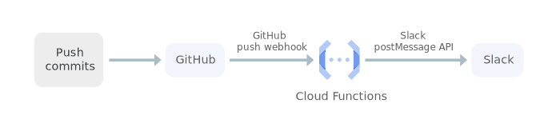
Google-cloud-services-tools-for-beginners(Cont’s)
Use-Case Of Google Cloud Functions (Cont’s)
1.) Integrate with third-party services and APIs: Cloud Functions can be used by a customer to surface their own microservices via HTTP APIs or integrate with third-party services that offer webhook integrations to quickly extend the application with powerful capabilities such as sending a confirmation email after a successful Stripe payment or responding to Twilio text message events.
2.) Serverless mobile back ends: It can be used directly from Firebase to extend application functionality without spinning up a server. Customers can run their code in response to user actions, analytics, and authentication events to keep their users engaged with event-based notifications and offload CPU- and networking-intensive tasks to Google Cloud.
Notes:
https://k21academy.com/google-cloud/google-compute-engine/

Slide 28
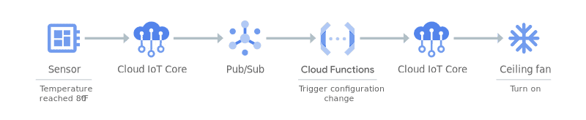
Google-cloud-services-tools-for-beginners(Cont’s)
Use-Case Of Google Cloud Functions (Cont’s)
3.) Serverless IoT back ends: Google Cloud Functions can be used with Cloud IoT Core and other fully managed services to build back ends for IoT device telemetry data collection, real-time processing, and analysis. It allows users to apply custom logic to each event as it arrives.
4.) Real-time file processing: It can be sued for executing code in response to changes in data. Cloud Functions can respond to events from Google Cloud services such as Cloud Storage, Pub/Sub, and Cloud Firestore to process files immediately after upload and generate thumbnails from image uploads, process logs, validate content, transcode videos, validate aggregate, and filter data in real-time.
5.) Real-time stream processing: Use Cloud Functions to respond to events from Pub/Sub to process, transform, and enrich streaming data in transaction processing, click-stream analysis, application activity tracking, IoT device telemetry, and other types of applications.
Notes:
https://k21academy.com/google-cloud/google-cloud-services-tools-for-beginners/

Slide 29
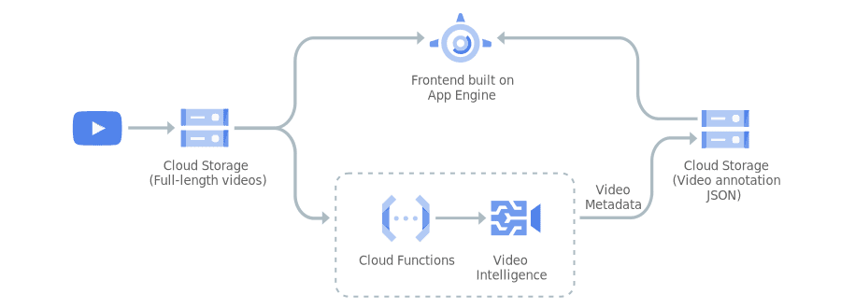
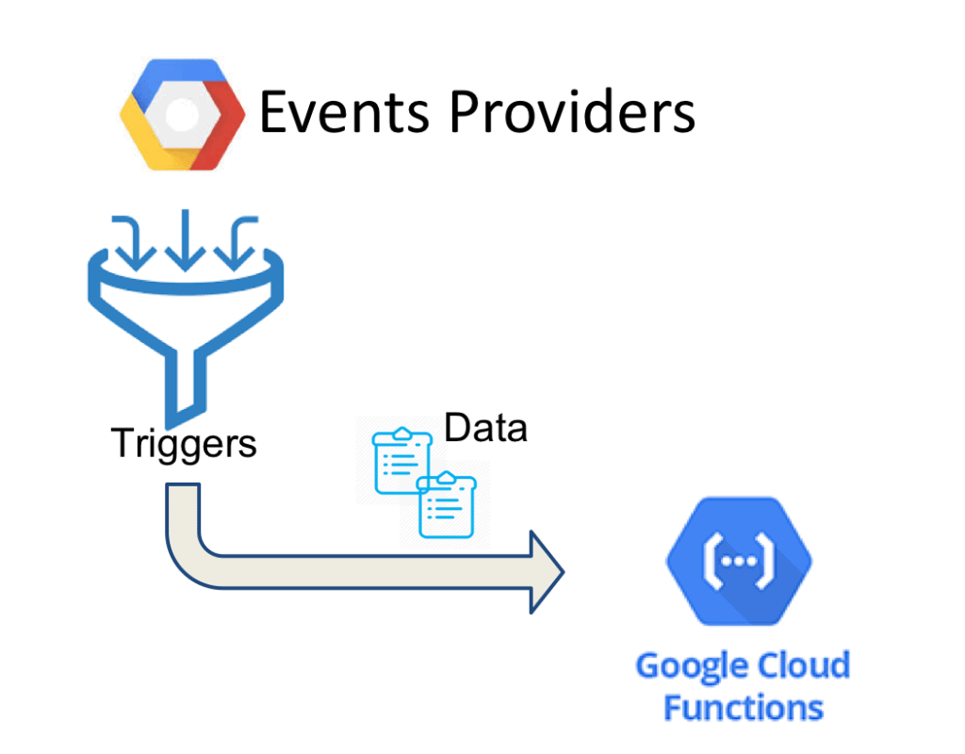
Google-cloud-services-tools-for-beginners(Cont’s)
6.) Video and image analysis: Use Cloud Functions with Video Intelligence API and Cloud Vision API to retrieve relevant information from videos and images, enabling you to search, discover, and derive insight from your media content.
Events, Triggers & Event Data
Events: They occur in Google Cloud Platform Services like File Uploaded to Storage, a Message published to a queue, Direct HTTP Invocation, etc. Currently, Google Cloud Functions support events from the following providers- HTTP, Cloud Storage, Cloud Firestore, Pub/Sub, Firebase, and Stackdriver.
Triggers: Users can choose to respond to events via a Trigger. It can be referred to as an event with the data associated with the event.
Event Date: This is the data that is passed to the Cloud Function when the event trigger results in function execution.
Notes:
https://k21academy.com/google-cloud/google-cloud-services-tools-for-beginners/

Slide 30
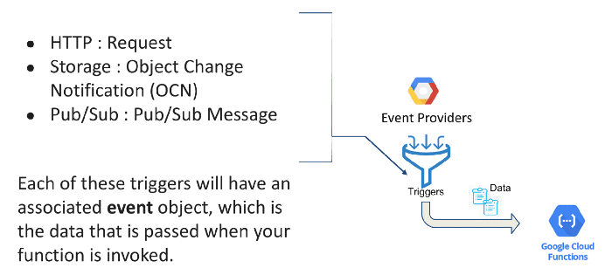
Google-cloud-services-tools-for-beginners(Cont’s)
Types Of Google Cloud Functions
Distinctly there are 2 types of Cloud functions: HTTP functions and Event-driven functions.
1.) HTTP Functions: They are invoked from standard HTTP Requests. These HTTP requests wait for the response and support handling of common HTTP request methods like GET, PUT, POST, DELETE, and OPTIONS. When users use cloud functions, a TLS certificate is automatically provisioned so that all HTTP functions can be invoked via a secure connection.
2.) Event-driven Functions: These functions are used to handle events from the Cloud infrastructure, such as messages on a Pub/Sub topic, or changes in a Cloud Storage bucket. There are 2 sub-types of event-driven functions:
Background functions: Functions written for the Node.js, Python, Go, and Java Cloud Functions runtimes are known as background functions.
CloudEvent functions: Functions written for the .NET Cloud Functions runtime are known as CloudEvent functions.
Notes:
https://k21academy.com/google-cloud/google-cloud-services-tools-for-beginners/

Slide 31
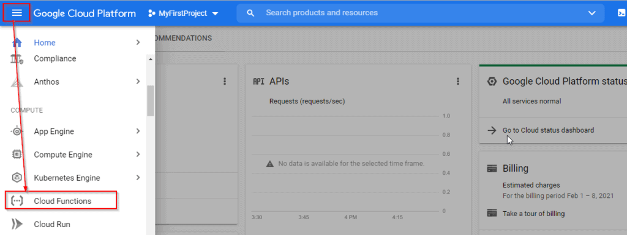
Google-cloud-services-tools-for-beginners(Cont’s)
Create & Deploy a Cloud Function using Google Cloud Console
Now that we have understood what Google Cloud Functions are, let’s look at the steps to create our first cloud function using the GCP console.
Note: To perform the steps you will require a Google Cloud Account. So make sure you create one in case you are a new user.
Step 1: Navigate to Google Cloud Console and log in with your registered Email ID.
Step 2: In the console, click the Navigation menu and click on Cloud Functions.
Notes:
https://k21academy.com/google-cloud/google-cloud-services-tools-for-beginners/

Slide 32
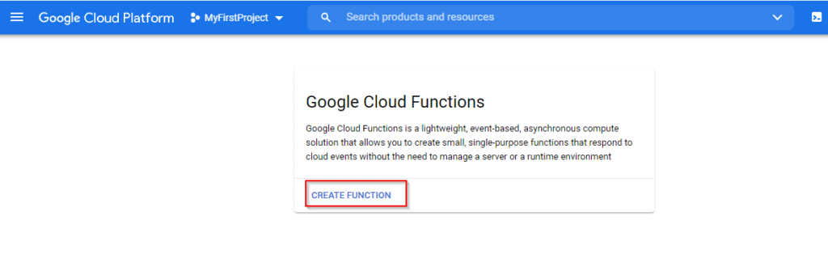
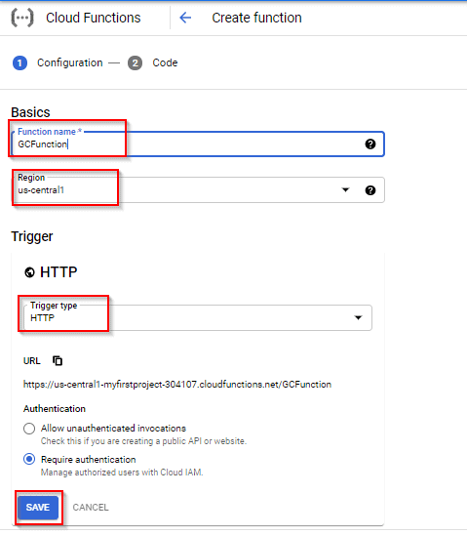
Google-cloud-services-tools-for-beginners(Cont’s)
Step 3: Click on Create Function.
Step 4: Enter the following values and click Save.
Function Name: GCPFunction
Region: us-central1
Trigger: HTTP
Notes:
https://k21academy.com/google-cloud/google-cloud-services-tools-for-beginners/

Slide 33
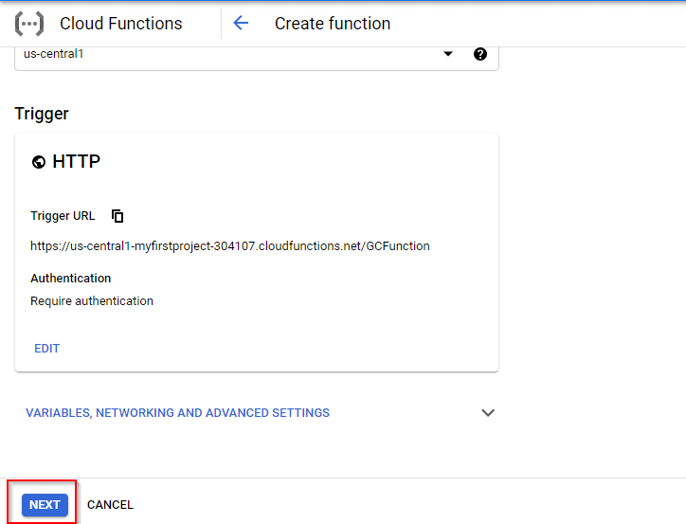
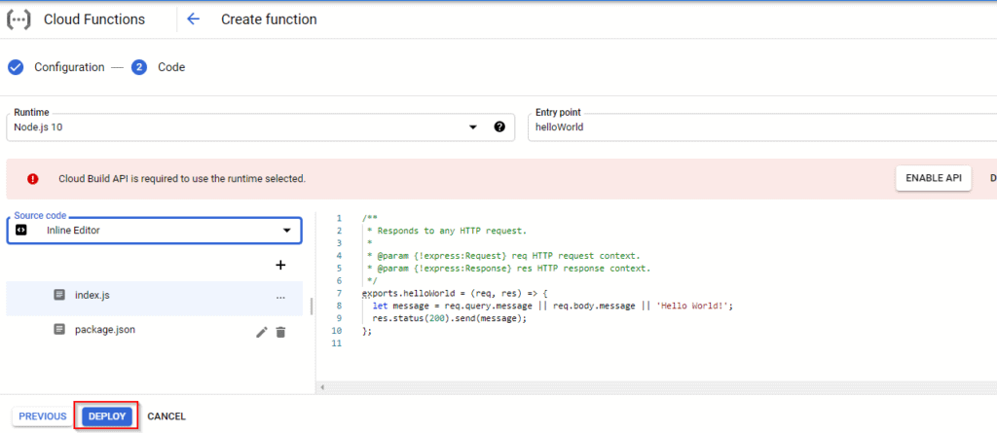

Google-cloud-services-tools-for-beginners(Cont’s)
Step 5: Click on Next.
Step 6: Next step is to deploy the function. Leave the default details and click on Deploy.
Step 7: You can see the Google Cloud Function is deployed successfully.
Variables, Networking and Adventage Settings
Notes:
https://k21academy.com/google-cloud/google-cloud-services-tools-for-beginners/

Slide 34
Google-cloud-services-tools-for-beginners(Cont’s)
1.4. Google Kubernetes Engine/ Container Engine
Google Kubernetes Engine For Beginners
Google Kubernetes Engine (GKE) offers a managed environment for deploying, managing, and scaling containerized applications using Google infrastructure.
This blog post covers the following topics:
Need For Kubernetes
Why Choose Google Kubernetes Engine?
Features of GKE
GKE: Workloads & Mode of Operation
GKE Architecture
Applications of Kubernetes
GKE Use-Cases
Kubernetes Engine Security
Kubernetes Engine Storage
Kubernetes Engine Networking
A strong Cluster Manager and balanced system for running Docker containers. Kubernetes Engine schedules your containers into the cluster, keeps them healthy, and manages them automatically based on the requirements defined by the user.
Notes:
https://k21academy.com/google-cloud/google-cloud-services-tools-for-beginners/
https://k21academy.com/google-cloud/google-kubernetes-engine/

Slide 35
Google-cloud-services-tools-for-beginners(Cont’s)
A. Containers
The solution to this is using “containers“, which make the Virtual Machine or the programs independent of the underlying Operating System. Containers are deployed upon compatible Operating systems, and we can even have multiple containers.
Containers essentially are a simple way to deploy and use cloud-based services. However, in practical application, one may end up with many many containers – and managing them manually might get too taxing. Deploying, managing, connecting, and updating those many containers would need a separate department or a dedicated team- which would make the process inefficient. Hence we need a management system, or “Container Schedulers”, to do all these tasks. One such system is Kubernetes.
Containers for Beginners: What, Why and Types
Container technology is almost as old as VMs, although the IT industry wasn’t employing containers until 2013-14 when Docker and Kubernetes and other tech made waves were born that caused craziness in the industry. Containers have become a major trend in software development as an alternative or companion to Virtual Machine. Containerization helps developers to create and deploy applications faster and more securely.
Over the past few years, we’ve been teaching new technology- Docker & Kubernetes and we cover all about Containers in detail because the rapid growth of Containers in the span of the last two decades has changed the dynamic of the modern IT industry.
Notes:
https://k21academy.com/google-cloud/google-cloud-services-tools-for-beginners/
https://k21academy.com/docker-kubernetes/what-are-containers/
https://k21academy.com/docker-kubernetes/what-are-containers/

Slide 36
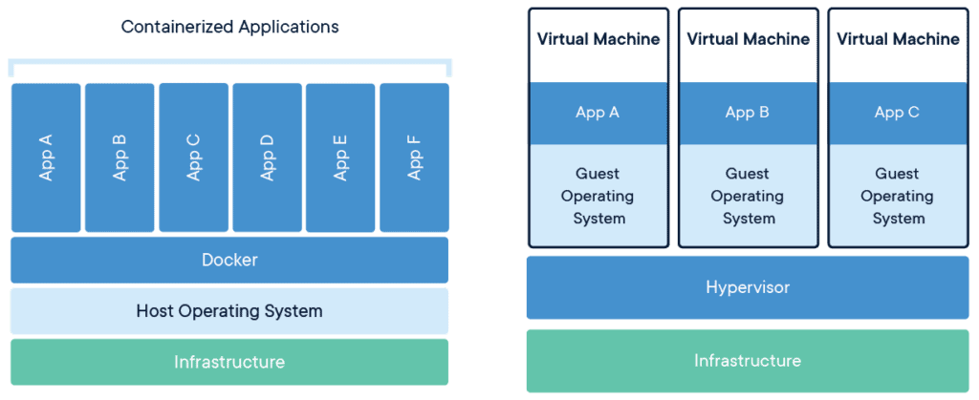
Google-cloud-services-tools-for-beginners(Cont’s)
Containers

Slide 37
Containers are used for deploying Microservices applications in an easy way. It’s difficult to talk about microservices without talking about containers. If you are interested to know more about Microservices, then you check out our blog on Monolithics vs Microservices.
In this blog, we will be covering the following topics:
What are Containers?
Why do we need Containers?
Different Types of Containers
Docker
LXC
CRI-O
rkt
Podman
runc
containerd
Different between Virtualization and Containers
Difference between Docker and Containers
Google-cloud-services-tools-for-beginners(Cont’s)
What Are Containers?
Containers are a software package into a logical box with everything that the application needs to run. The software package includes an operating system, application code, runtime, system tools, system libraries, and binaries and etc.
Containers run directly within the Host machine kernels. They share the Host machine’s resources (like Memory, CPU, disks and etc.) and don’t need the extra load of a Hypervisor. This is the reason why Containers are “lightweight“. Containers are much smaller in size than a VM and that is why, they require less time start, and we can run many containers on the same compute capacity as a single VM. This helps in high server efficiencies and therefore reduces server and licensing costs.
Notes:
https://k21academy.com/google-cloud/google-cloud-services-tools-for-beginners/

Slide 38
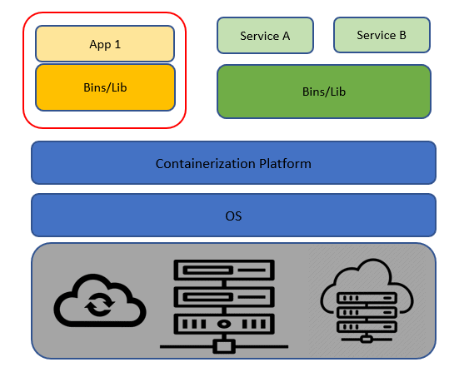
Google-cloud-services-tools-for-beginners(Cont’s)
Why Do We Need Containers?
The main advantage of containers is that they are lightweight and portable and thus helps the developer a lot in configuring and deploying their application. There are many reasons for using Containers but only some of them are listed below:
Lightweight: Containers share the machine OS kernel and therefore they don’t need a full OS instance per application. This makes the container files smaller and This is the reason why Containers are smaller in size, especially compared to virtual machines. As they are lightweight, thus they can spin up quickly and can be easily scaled horizontally.
Portable: Containers are a package having all their dependencies with them, this means that we have to write the software once and the same software can be run across different laptops, cloud, and on-premises computing environments without the need of configuring the whole software again.
Supports CI/CD: Due to a combination of their deployment portability/consistency across platforms and their small size, containers are an ideal fit for modern development and application patterns—such as DevOps, serverless, and microservices.
Improves utilization: Containers enable developers and operators to improve CPU and memory utilization of physical machines.
Notes:
https://k21academy.com/google-cloud/google-cloud-services-tools-for-beginners/

Slide 39
Google-cloud-services-tools-for-beginners(Cont’s)
Containers (Docker) vs Virtual Machines (VM): Pros, Cons, and Use Cases
Table of Contents:
Exploring Virtual Machines
Virtual Machine: Architecture and Benefits
Pros & Cons of VMs
What Are Containers?
How Do Containers Work?
Pros & Cons of Containers
Difference Between Physical Server and VM
Container (Docker) vs Virtual Machine (VM)
A couple of decades ago, it seemed impossible to run an application using just a tiny ~10 MB file. Today, Containers (Docker) and Virtual Machines (VMs) have made this possible, and understanding their differences is crucial for modern computing.
The development of VMs significantly enhanced our computing capabilities, allowing multiple OS instances to run on the same hardware.
Virtual Machine’s Architecture
Underlying System (Hardware/Infrastructure): This includes the physical machine and its operating system. Bare metal hypervisors operate directly on this layer without needing an additional OS.
Hypervisor: Acting as an intermediary between hardware and infrastructure, the hypervisor manages and allocates resources.
Multiple Virtual Machines: These utilize host resources and communicate with the hypervisor.
Applications and Processes: These run on each guest OS within the VM.
Notes:
https://k21academy.com/google-cloud/google-cloud-services-tools-for-beginners/
https://k21academy.com/docker-kubernetes/docker-vs-virtual-machine/

Slide 40
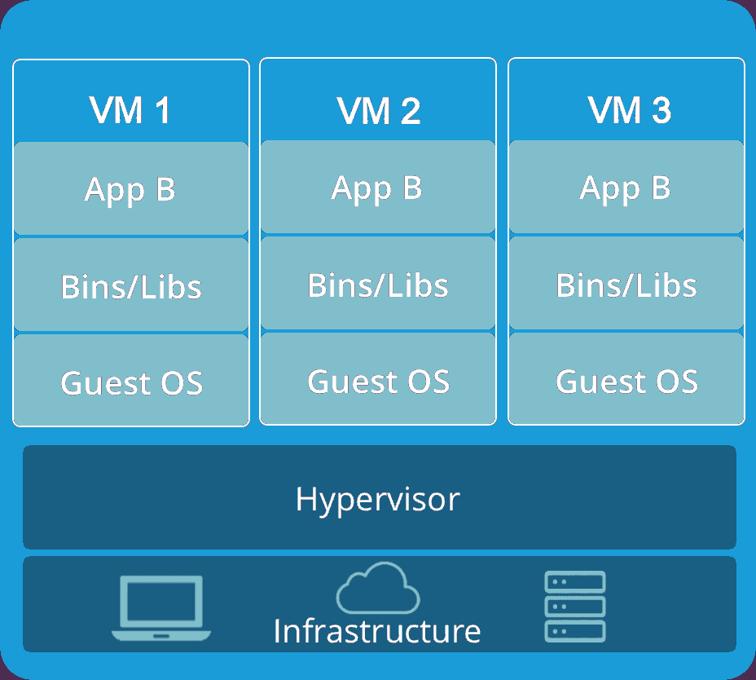
Proper configuration of the hypervisor precedes the deployment of virtual machines. Technologies like KVM, integrated into Linux, allow administrators to create VMs via command-line interfaces.
Category | Pros | Cons
OS Environments | Enable multiple operating system environments on a single computer. | Running multiple VMs can lead to unstable performance.
System Reliability | Enhance system reliability by isolating crashes from the host OS. | VMs are generally less efficient and slower than physical machines.
Security | Provide security layers to prevent malware breaches on the host OS. | VMs can inherit vulnerabilities from the host machine.

Slide 41
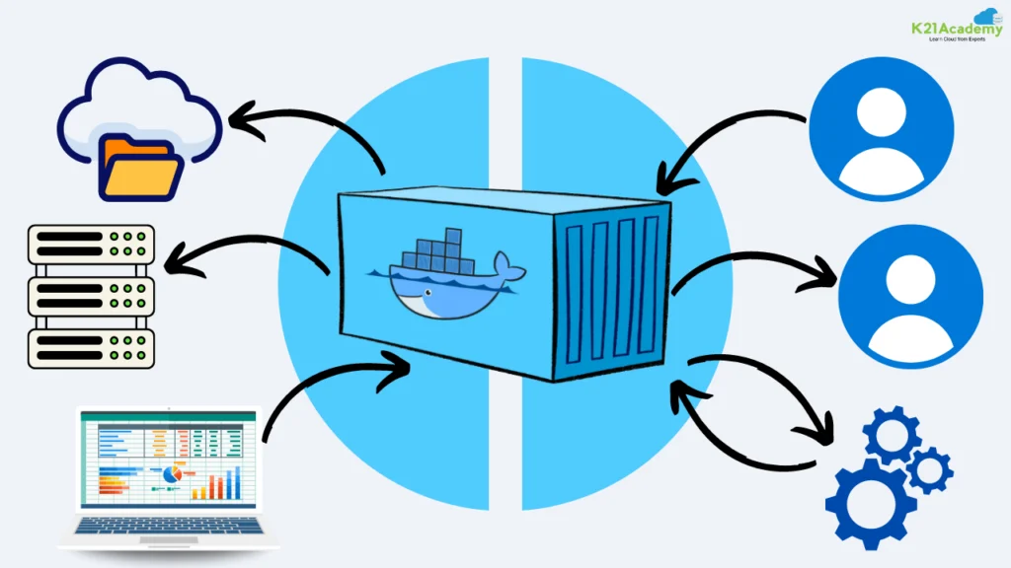
What are Containers
Containers are like virtual compartments that can run software applications. Imagine them as small, self-contained boxes that hold everything an application needs to run smoothly, like the program itself and all the tools it requires.
Before containers became popular, Virtual Machines (VMs) were used. These were like complete computers within a computer, each running its operating system. While VMs are still important, containers are now widely used because they are much lighter and faster.

Slide 42
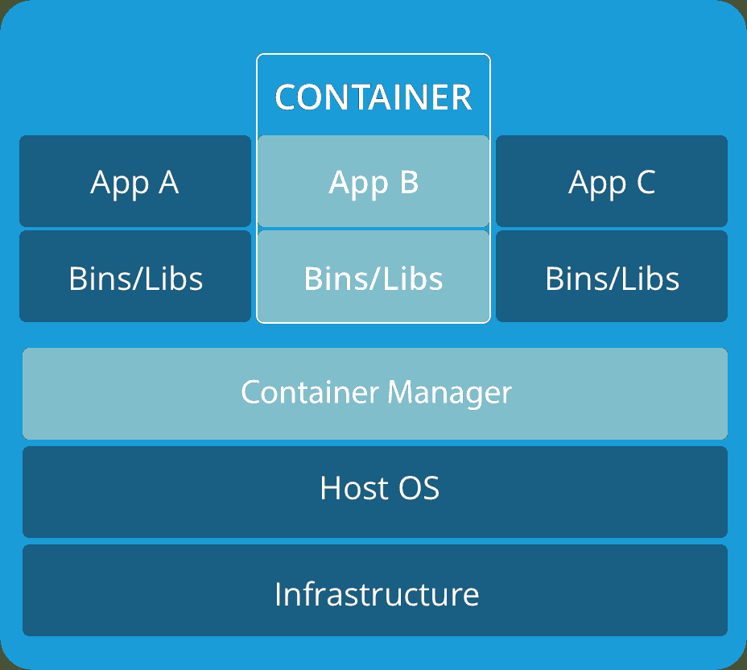
How do Containers work ?
Containers need an operating system, along with supporting software and resources, to run a specific program. Inside a container, you can set up an environment template that ensures your application behaves consistently every time it runs.
Containers share the main operating system (called the “kernel”) of the computer they are on. Each container only needs the essential tools and libraries to function.
Category | Pros | Cons
Lightweight | Containers can be very small, sometimes only 10MB, and you can control how much memory and processing power they use. | Dependency on Host OS: Containers rely on the main operating system of the host computer.
Fast Startup | Because they are small, containers start up quickly and can be scaled up (more containers added) quickly. | Security: Containers alone can’t provide strong security.
Great for CI/CD | Containers are perfect for Continuous Integration and Continuous Deployment, making it easier to update and release software. | Data Loss: If a container is deleted, any data inside it is lost unless you use Data Volumes to save the data.

Slide 43
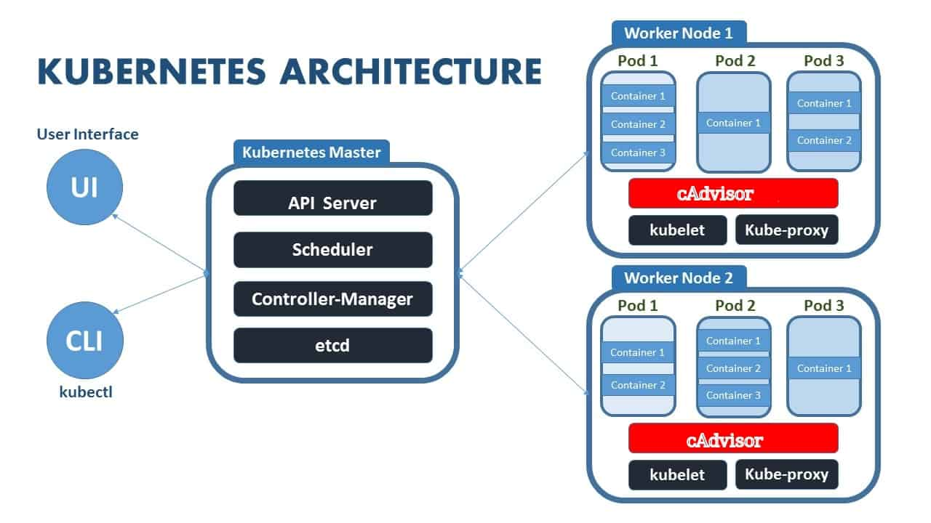
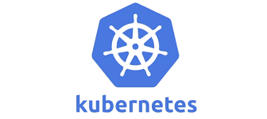
Google-cloud-services-tools-for-beginners(Cont’s)
B. Kubernetes
Kubernetes is a portable, extensible, open-source platform for managing containers. Developed by Google, Kubernetes (also written as K8s) takes the whole group of computers and makes them work as a single unit. Using Kubernetes ensures that multiple people can use containerized applications, and be able to work together – even if they’re on different platforms.
Basic objects include:
Pod. A group of one or more containers, a simple deployable unit of K8S.
Service. An abstraction that defines a logical set of pods as well as the policy for accessing them.
Volume. An abstraction that lets us persist data. This is necessary because containers are ephemeral—meaning data is deleted when the container is deleted.
Namespace. A segment of the cluster dedicated to a certain purpose, for example, a certain project or team of devs.
Notes:
https://k21academy.com/google-cloud/google-cloud-services-tools-for-beginners/
https://k21academy.com/docker-kubernetes/what-are-containers/
https://k21academy.com/docker-kubernetes/kubernetes-for-beginners/
https://k21academy.com/docker-kubernetes/kubernetes-for-beginners/

Slide 44
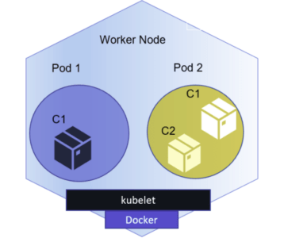
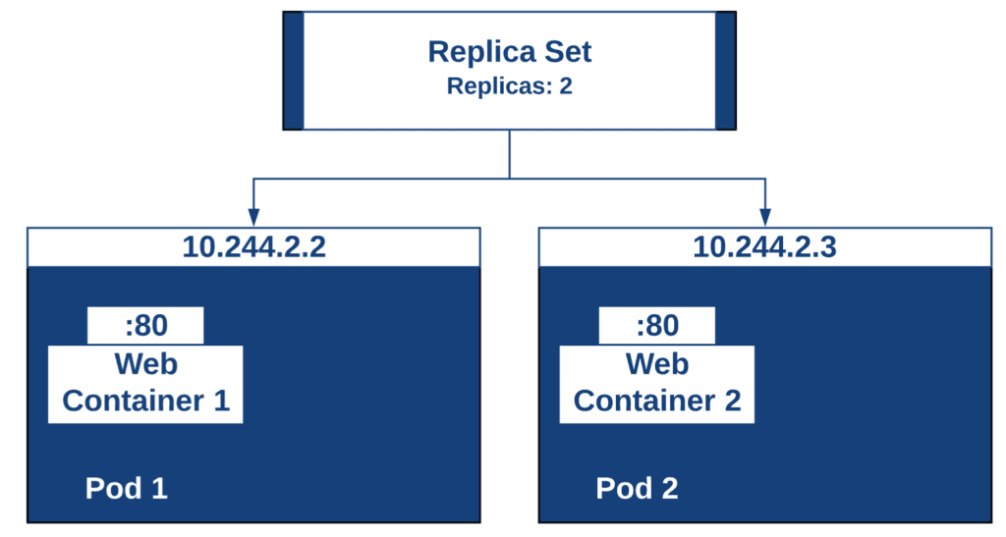
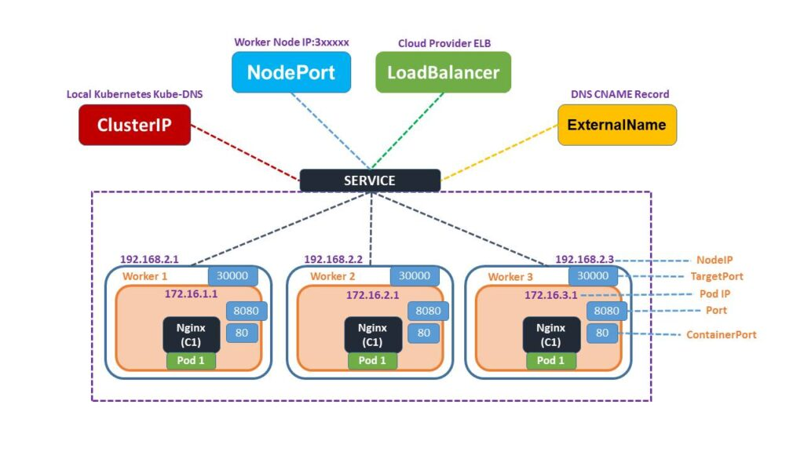
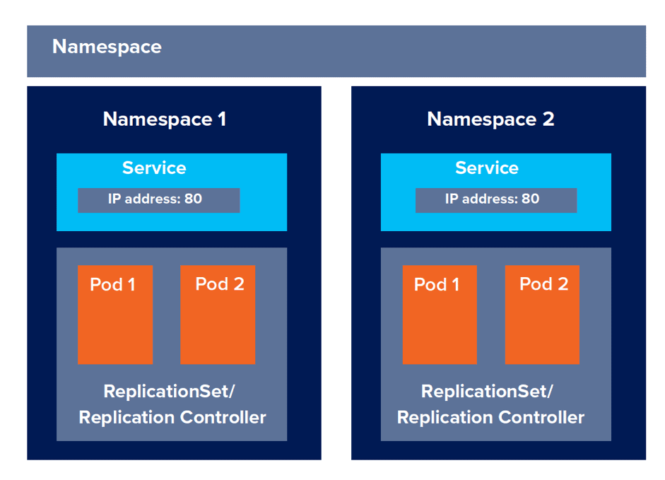
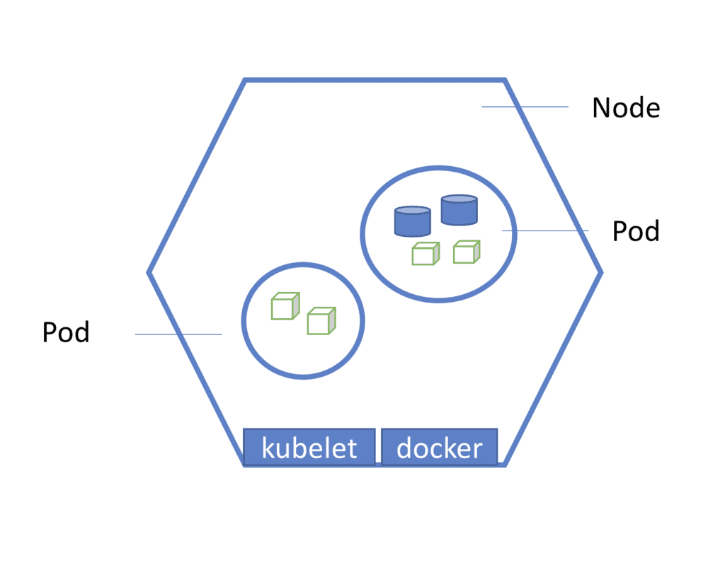
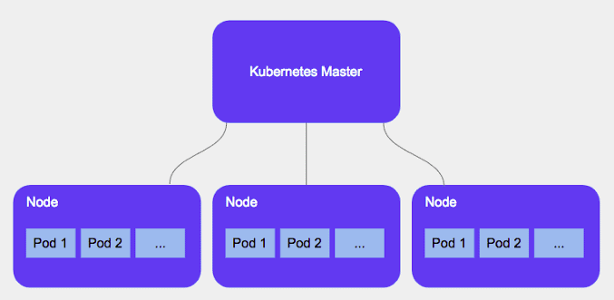


Kubernetes Pods
Replica Set
Services
Namespaces
Deployments
Nodes
Cluster
Kubernetes Security
Notes:
https://k21academy.com/docker-kubernetes/kubernetes-for-beginners/

Slide 45




Oracle Kubernetes Engine by Oracle Cloud (OKE)

Slide 46


Google-cloud-services-tools-for-beginners(Cont’s)
Why Choose Google Kubernetes Engine?
The next step in the process is choosing the right platform to manage the container workload. Most of the big cloud vendors like Microsoft (Azure Container Service), Amazon (Amazon Kubernetes Services), and Google itself (Google Kubernetes Engine) use Kubernetes- as discussed above.
Features Of GKE
Some of the key features of Kubernetes Engine include:
Pod and Cluster Autoscaling: Based on the particular user’s CPU utilization and other custom metrics, Google provides horizontal pod autoscaling (adjusting the number of machines based on requirements) and based on CPU and memory usage, vertical pod autoscaling (varying the power of available machines).
Kubernetes Applications: Google provides pre-built applications that are enterprise-ready, with included licensing, billing, and portability. Such applications increase the productivity of the user, as their work is now cut out.
Integrated logging and monitoring: GKE offers Cloud Logging and Cloud Monitoring with simple checkbox configurations which makes it easier to gain insight into how an application is running.
Fully Managed: GKE clusters are fully managed by Google Site Reliability Engineers (SREs), ensuring that the cluster is available and up-to-date.
Notes:
https://k21academy.com/google-cloud/google-cloud-services-tools-for-beginners/
https://k21academy.com/docker-kubernetes/what-are-containers/
Azure:
Azure Kubernetes Service & Azure Container Instances For Beginners
https://k21academy.com/microsoft-azure/architect/azure-container-instances-and-kubernetes-service/

Slide 47




GKE Use-Cases
Notes:
https://k21academy.com/google-cloud/google-kubernetes-engine/
https://k21academy.com/google-cloud/google-kubernetes-engine/

Slide 48
Google-cloud-services-tools-for-beginners(Cont’s)
1.5. Google Cloud Container Registry
Google Kubernetes Engine For Beginners
Google Kubernetes Engine (GKE) offers a managed environment for deploying, managing, and scaling containerized applications using Google infrastructure.
This blog post covers the following topics:
Need For Kubernetes
Why Choose Google Kubernetes Engine?
Features of GKE
GKE: Workloads & Mode of Operation
GKE Architecture
Applications of Kubernetes
GKE Use-Cases
Kubernetes Engine Security
Kubernetes Engine Storage
Kubernetes Engine Networking
The container registry is a private Docker repository to manage Docker Images and works with the popular continuous delivery systems. Customers can decide who can access what with fine-grained access control.
Notes:
https://k21academy.com/google-cloud/google-cloud-services-tools-for-beginners/
https://k21academy.com/google-cloud/google-kubernetes-engine/

Slide 49

Google-cloud-services-tools-for-beginners(Cont’s)
2. Storage And Database Services
2.1. Google Cloud Storage
2.2 Cloud SQL
2.3 Cloud Bigtable
2.4 Cloud Datastore
2.5 Persistent Disk
2.6 Cloud Spanner
Notes:
https://k21academy.com/google-cloud/google-cloud-services-tools-for-beginners/

Slide 50

Google-cloud-services-tools-for-beginners(Cont’s)
3. Network Services
3.1 Virtual Private Cloud (VPC)
3.2 Cloud Load Balancing
3.3 Cloud DNS (Domain Naming System)
3.4 Cloud CDN (Content Delivery Network)
3.5 Google Cloud Interconnect
Notes:
https://k21academy.com/google-cloud/google-cloud-services-tools-for-beginners/

Slide 51

Google-cloud-services-tools-for-beginners(Cont’s)
4. Big Data Services
4.1 BigQuery
4.2 Cloud Dataflow
4.3 Google Cloud Pub/Sub
4.4 Cloud Dataproc
4.5 Cloud Datalab
Notes:
https://k21academy.com/google-cloud/google-cloud-services-tools-for-beginners/

Slide 52

Google-cloud-services-tools-for-beginners(Cont’s)
5. Machine Learning Services
5.1 Cloud Machine Learning
5.2 Cloud AutoML
5.3 Cloud Vision API
5.4 Cloud Speech API
5.5 Cloud Natural Language API
5.6 Translate API
Notes:
https://k21academy.com/google-cloud/google-cloud-services-tools-for-beginners/

Slide 53

Google-cloud-services-tools-for-beginners(Cont’s)
6. Identity And Security Services
6.1 Google Cloud Cloud Identity and Access Management (IAM)
6.2 Cloud Resource Manager
6.3 Cloud Security Scanner
Notes:
https://k21academy.com/google-cloud/google-cloud-services-tools-for-beginners/

Slide 54

Google-cloud-services-tools-for-beginners(Cont’s)
7. Management And Developer Tools
7.1 Stackdriver
7.2 Console App
7.3 Google Cloud SDK
7.4 Cloud Deployment Manager
Notes:
https://k21academy.com/google-cloud/google-cloud-services-tools-for-beginners/
https://k21academy.com/google-cloud/google-cloud-services-tools-for-beginners/#

Slide 55
Cource_LAB_GCP_1_Google-cloud-platform
Google-cloud-platform
https://www.cloudskillsboost.google/course_templates/754/labs/461560
https://cloud.google.com/compute/docs/instances/creating-instance-with-custom-machine-type?hl=id
https://arubanetworking.hpe.com/techdocs/central/2.5.7/content/sd-branch/vgw/vgw_man-gcp-crt-vm.htm
https://medium.com/@binaabdulrahim/creating-a-gcp-vm-instance-6798f5498f09
Grup instance
https://cloud.google.com/compute/docs/instance-groups?hl=id
Creating Custom Google Compute Engine Instances
https://www.youtube.com/watch?v=mZsdm9mRc94
Notes:
https://github.com/mikeroyal/Google-Cloud-Guide

Slide 56

Buat instance Deep Learning VM menggunakan konsol Google Cloud
https://cloud.google.com/deep-learning-vm/docs/create-vm-instance-console?hl=id
Notes:
How to Deploy a Machine Learning Model to Google Cloud for 20% Software Engineers (CS329s tutorial)
https://www.youtube.com/watch?v=fw6NMQrYc6w
Uploading large files to Google Storage using a VM Instance
https://www.youtube.com/watch?v=OwPLyKj2g48

