Slide 1
Cloud computing and Cloudsim
PDS
PDS
https://github.com/siagianp
https://www.youtube.com/@AmelOline/videos
https://github.com/amelcharolinesgn2/IoT_simulator-mqtt-NodeRed
https://github.com/amelcharolinesgn2/Cloud-Infrastructures
https://github.com/amelcharolinesgn2/ClouD-Infrastructure-SISKA-2025
https://github.com/amelcharolinesgn2/Gyroscope-Sensor-Data-Accelerometer
https://github.com/amelcharolinesgn2/cloudSim
https://github.com/amelcharolinesgn2/CCNA 1
https://github.com/amelcharolinesgn2/CloudSim
Notes:
https://drive.google.com/drive/folders/10Jn-lD_ae6PH-ixi1LViORn1hEgi-vII
https://github.com/Azure/opendigitaltwins-smartcities/blob/main/README.md
Flourish Farm Aquaponic Systems | The Aquaponic SourceLainnya

Slide 2


Slide 3
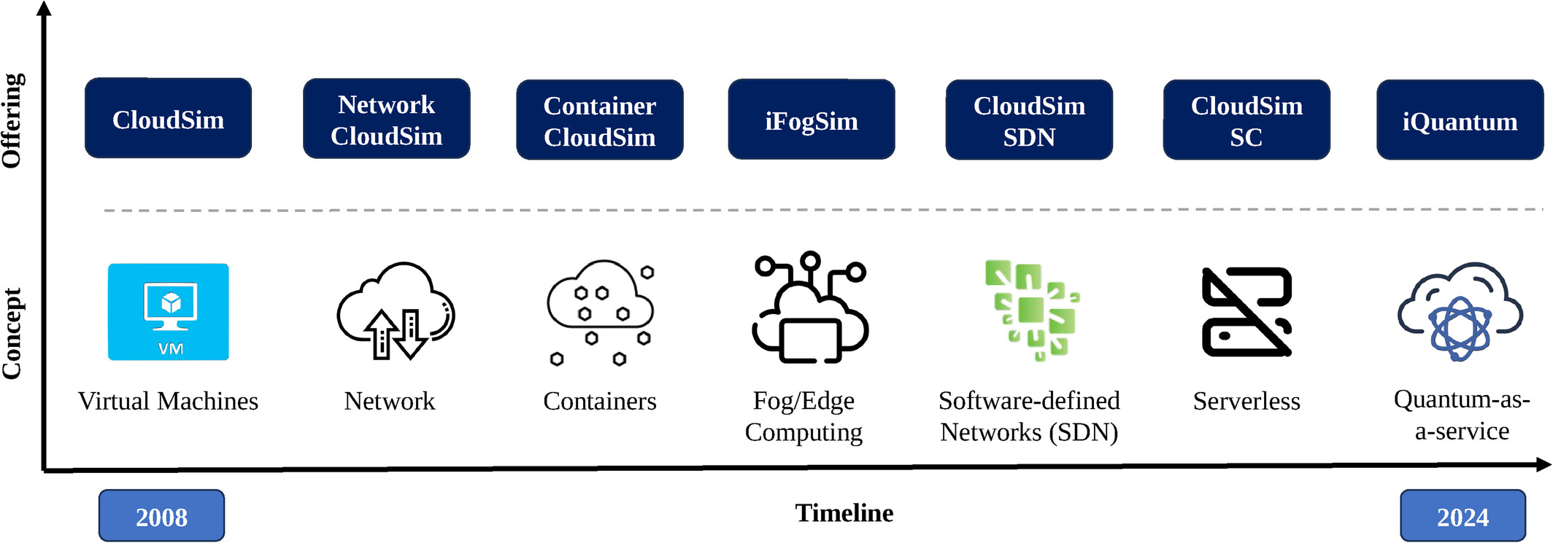
CloudSim 7G: An Integrated Toolkit for Modeling and Simulation of Future Generation Cloud Computing Environments
Fig.1. The evolution of CloudSim.
Notes:
The evolution of CloudSim.
IF THIS IMAGE HAS BEEN PROVIDED BY OR IS OWNED BY A THIRD PARTY, AS INDICATED IN THE CAPTION LINE, THEN FURTHER PERMISSION MAY BE NEEDED BEFORE ANY FURTHER USE. PLEASE CONTACT WILEY'S PERMISSIONS DEPARTMENT ON PERMISSIONS@WILEY.COM OR USE THE RIGHTSLINK SERVICE BY CLICKING ON THE 'REQUEST PERMISSIONS' LINK ACCOMPANYING THIS ARTICLE. WILEY OR AUTHOR OWNED IMAGES MAY BE USED FOR NON-COMMERCIAL PURPOSES, SUBJECT TO PROPER CITATION OF THE ARTICLE, AUTHOR, AND PUBLISHER.

Slide 4
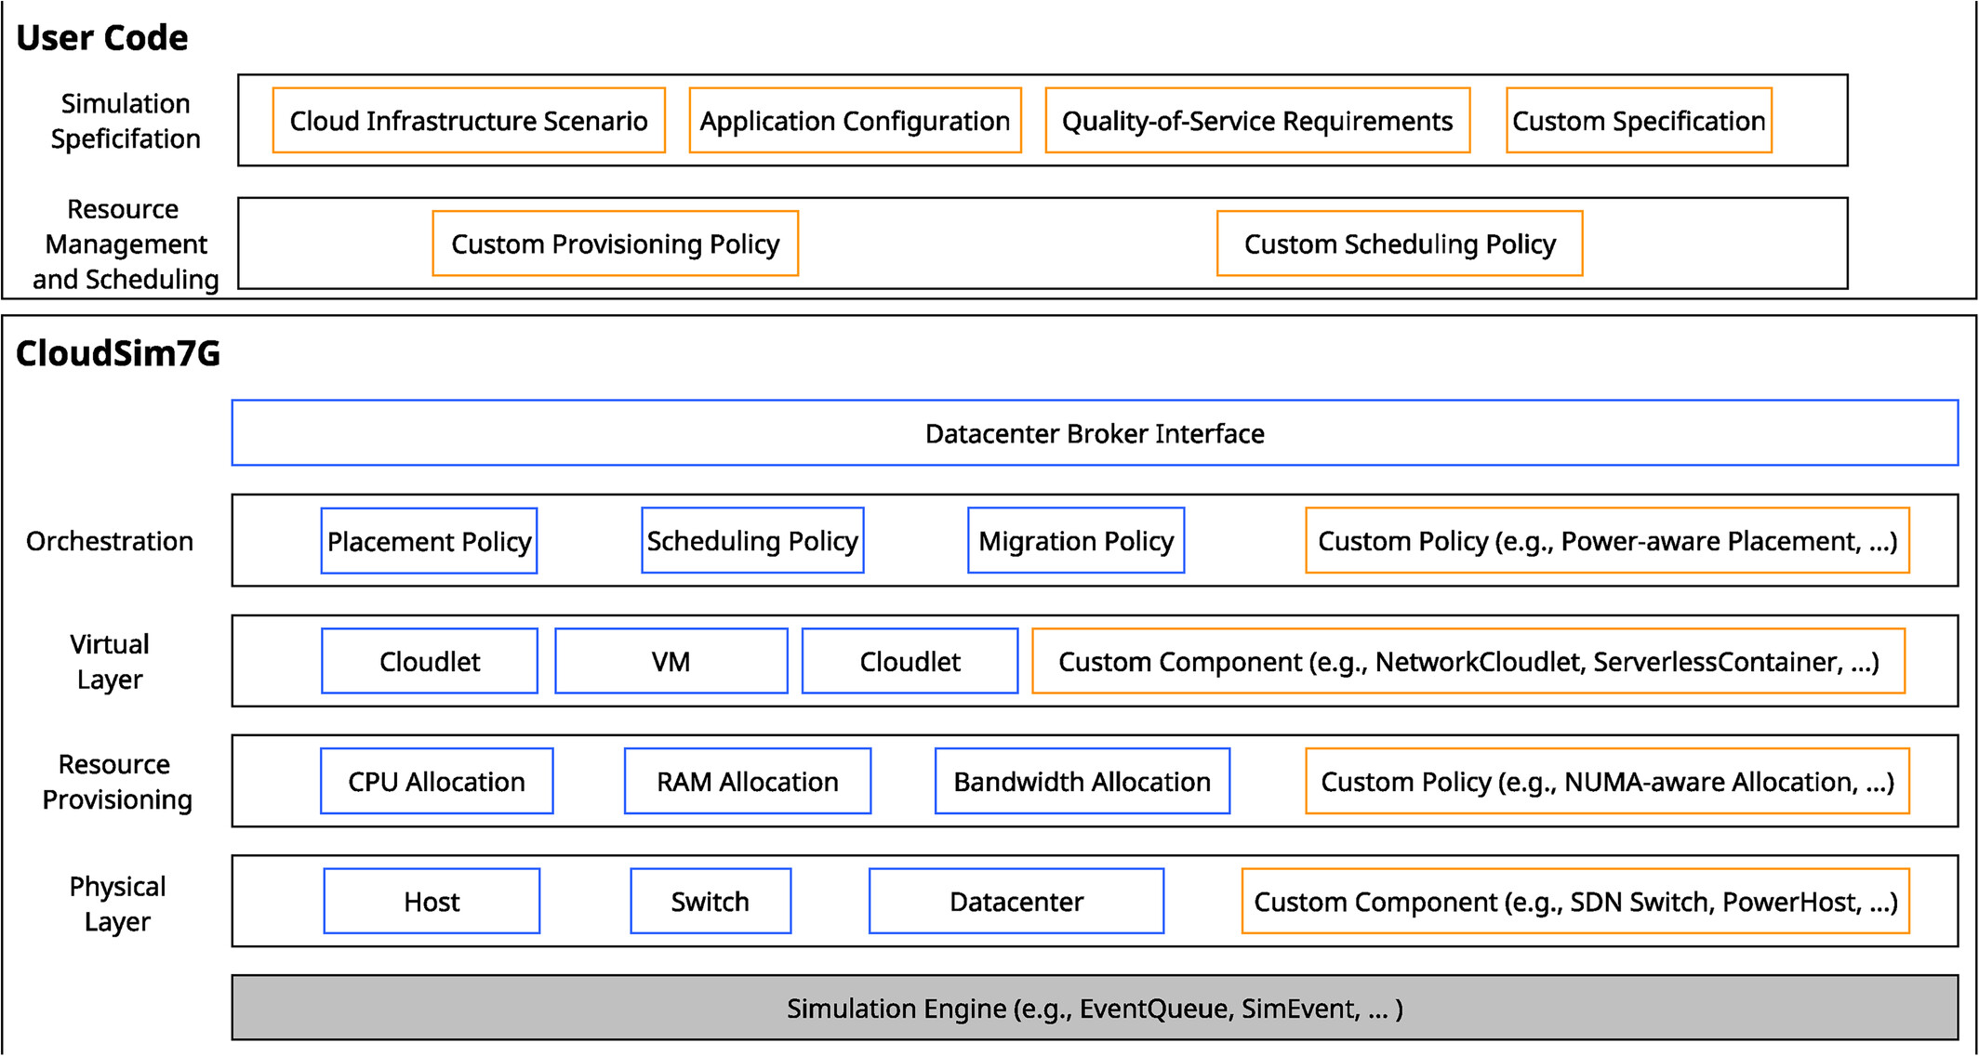
CloudSim 7G: An Integrated Toolkit for Modeling and Simulation of Future Generation Cloud Computing Environments
Notes:
The architecture of CloudSim 7G. Blue boxes correspond to the CloudSim components of the base layer. Orange boxes correspond to user‐defined policies and configurations, as well as newly created or extended CloudSim components.
IF THIS IMAGE HAS BEEN PROVIDED BY OR IS OWNED BY A THIRD PARTY, AS INDICATED IN THE CAPTION LINE, THEN FURTHER PERMISSION MAY BE NEEDED BEFORE ANY FURTHER USE. PLEASE CONTACT WILEY'S PERMISSIONS DEPARTMENT ON PERMISSIONS@WILEY.COM OR USE THE RIGHTSLINK SERVICE BY CLICKING ON THE 'REQUEST PERMISSIONS' LINK ACCOMPANYING THIS ARTICLE. WILEY OR AUTHOR OWNED IMAGES MAY BE USED FOR NON-COMMERCIAL PURPOSES, SUBJECT TO PROPER CITATION OF THE ARTICLE, AUTHOR, AND PUBLISHER.

Slide 5
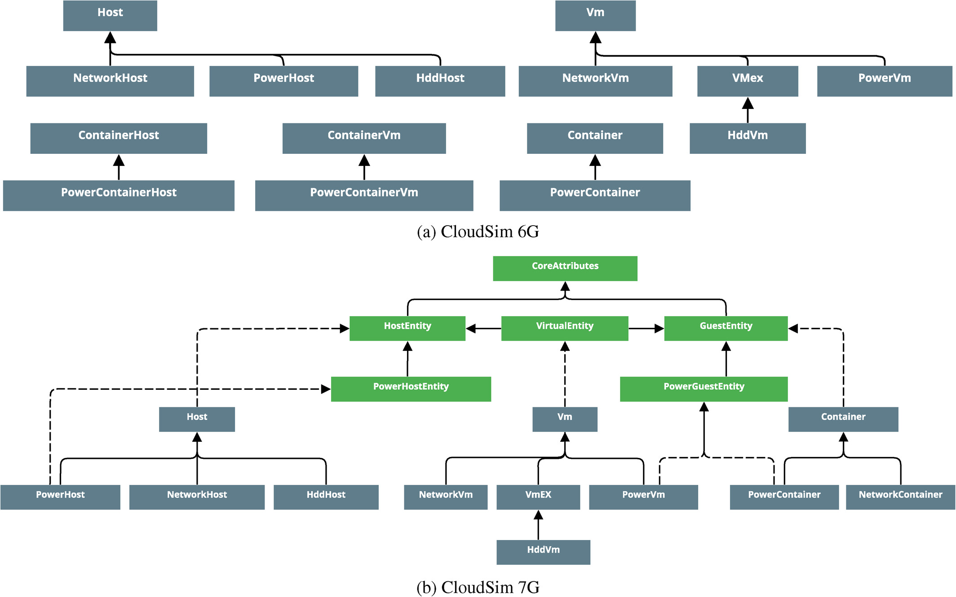
CloudSim 7G: An Integrated Toolkit for Modeling and Simulation of Future Generation Cloud Computing Environments
Notes:
UML class diagram of host and guest entities in CloudSim. Green boxes depict Java interfaces, and blue boxes represent Java classes. The relationship arrows follow the UML relations notation style: A dashed line represents a realization/implementation, and a full line represents inheritance.
IF THIS IMAGE HAS BEEN PROVIDED BY OR IS OWNED BY A THIRD PARTY, AS INDICATED IN THE CAPTION LINE, THEN FURTHER PERMISSION MAY BE NEEDED BEFORE ANY FURTHER USE. PLEASE CONTACT WILEY'S PERMISSIONS DEPARTMENT ON PERMISSIONS@WILEY.COM OR USE THE RIGHTSLINK SERVICE BY CLICKING ON THE 'REQUEST PERMISSIONS' LINK ACCOMPANYING THIS ARTICLE. WILEY OR AUTHOR OWNED IMAGES MAY BE USED FOR NON-COMMERCIAL PURPOSES, SUBJECT TO PROPER CITATION OF THE ARTICLE, AUTHOR, AND PUBLISHER.

Slide 6
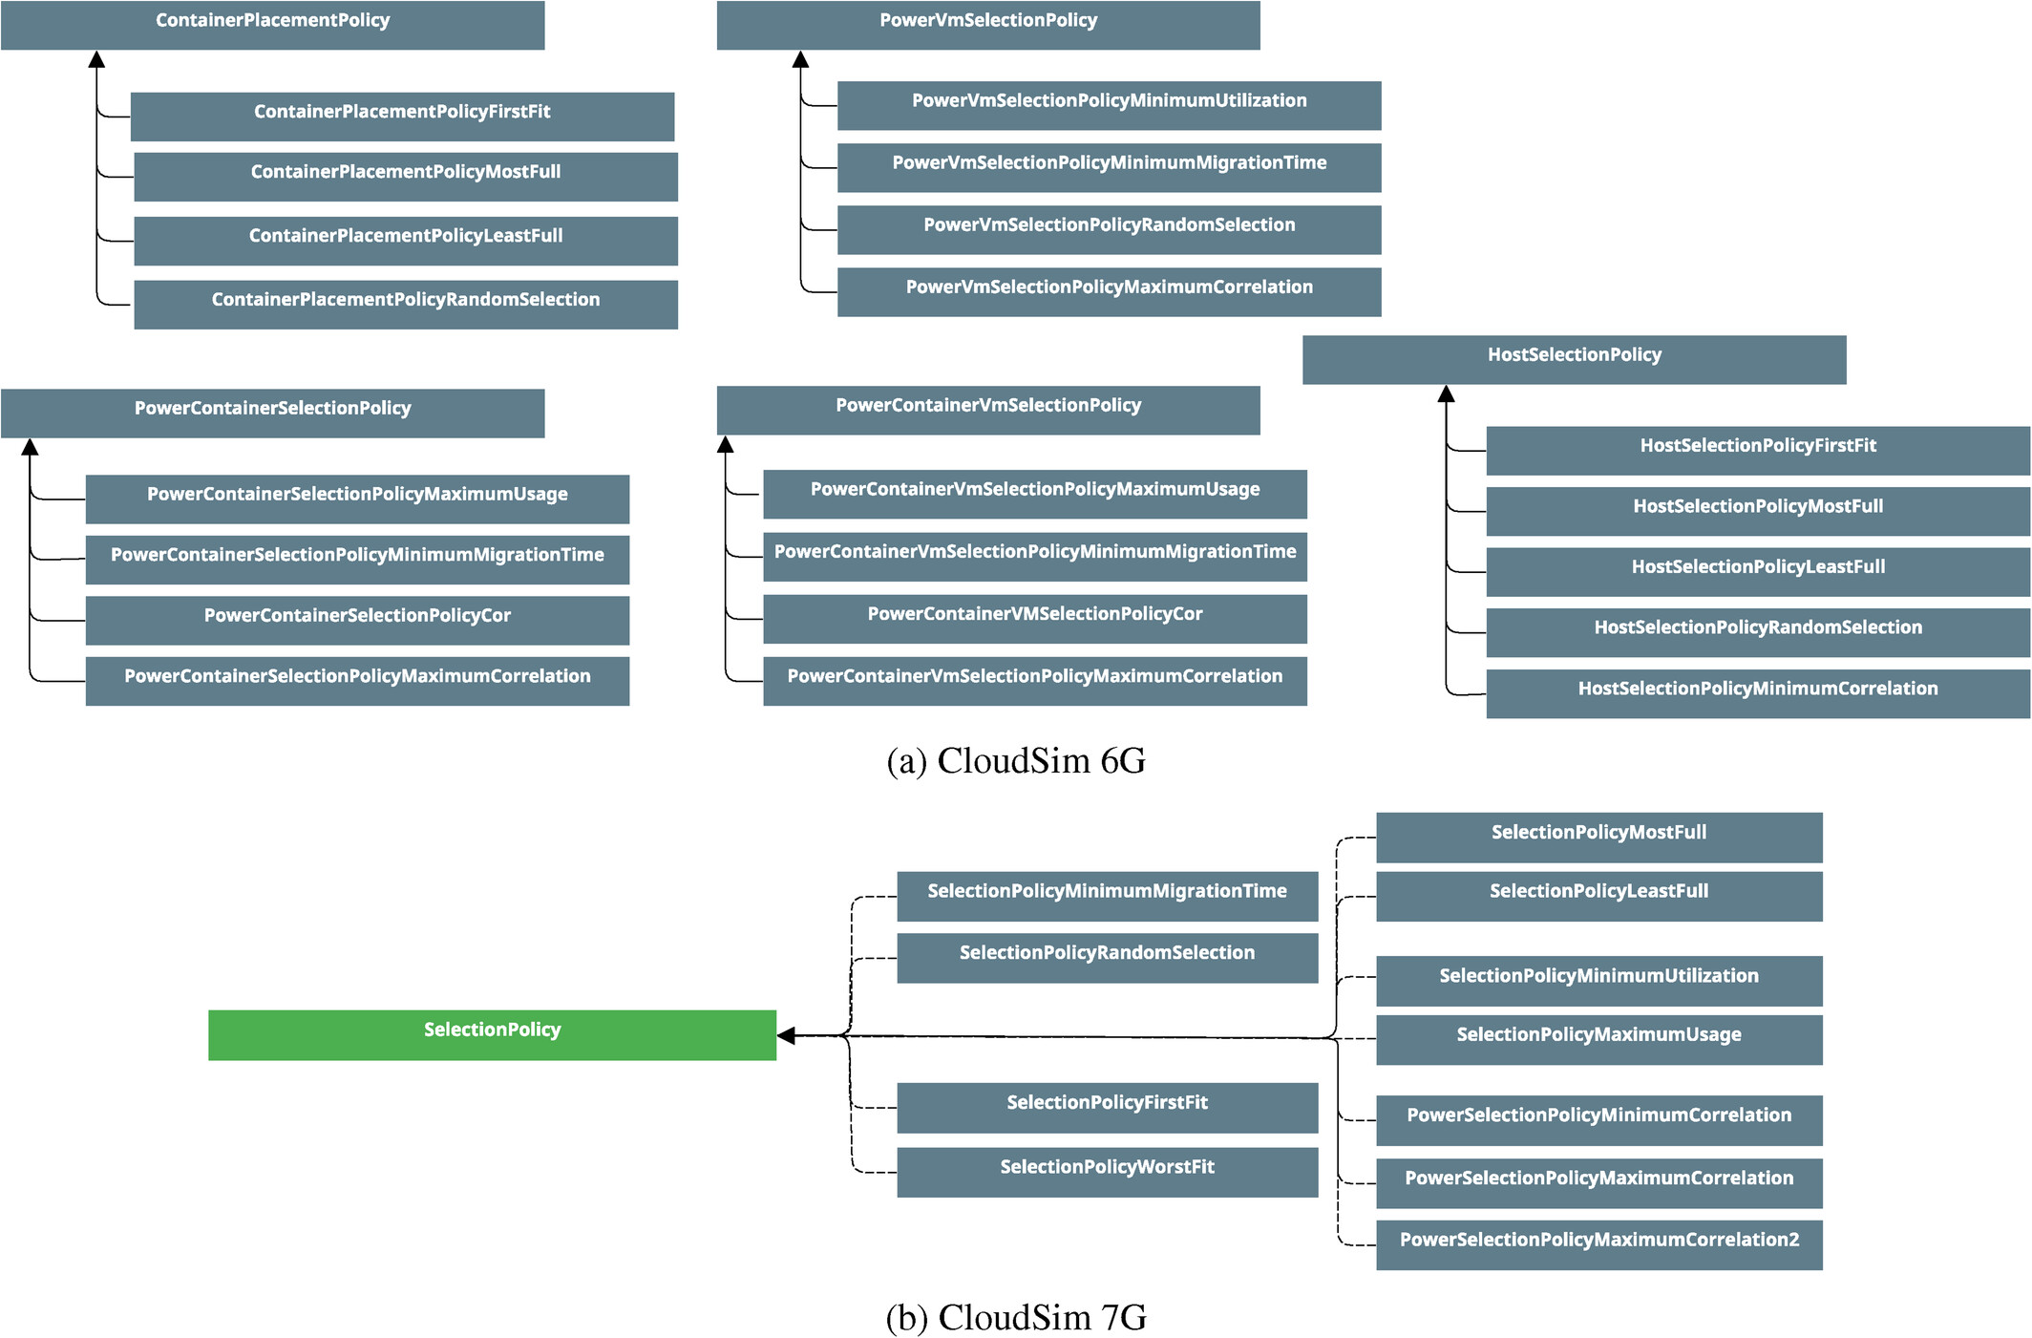
CloudSim 7G: An Integrated Toolkit for Modeling and Simulation of Future Generation Cloud Computing Environments
Softw Pract Exp, Volume: 55, Issue: 6, Pages: 1041-1058, First published: 04 February 2025, DOI: (10.1002/spe.3413)
Notes:
UML class diagram of the host and guest selection policies in CloudSim. Green boxes depict Java interfaces, and blue boxes represent Java classes. The relationship arrows follow the UML relations notation style: A dashed line represents a realization/implementation, and a full line represents inheritance. Line colors are for presentation purposes only.
IF THIS IMAGE HAS BEEN PROVIDED BY OR IS OWNED BY A THIRD PARTY, AS INDICATED IN THE CAPTION LINE, THEN FURTHER PERMISSION MAY BE NEEDED BEFORE ANY FURTHER USE. PLEASE CONTACT WILEY'S PERMISSIONS DEPARTMENT ON PERMISSIONS@WILEY.COM OR USE THE RIGHTSLINK SERVICE BY CLICKING ON THE 'REQUEST PERMISSIONS' LINK ACCOMPANYING THIS ARTICLE. WILEY OR AUTHOR OWNED IMAGES MAY BE USED FOR NON-COMMERCIAL PURPOSES, SUBJECT TO PROPER CITATION OF THE ARTICLE, AUTHOR, AND PUBLISHER.

Slide 7
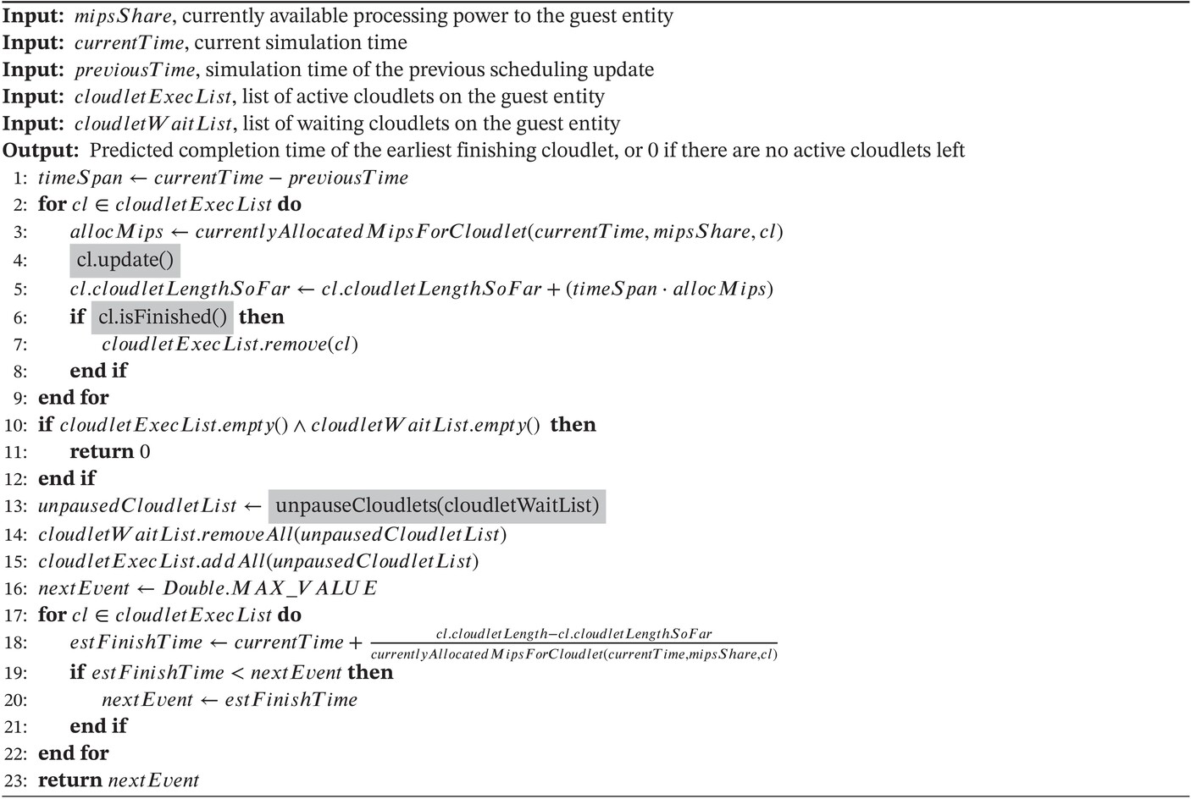

Slide 8
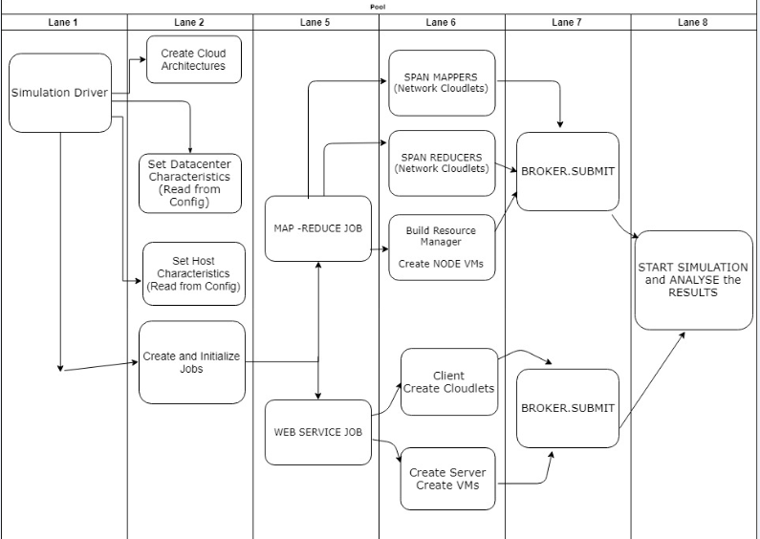
1. CloudSim Plus
CloudSim: A Framework For Modeling And Simulation Of Cloud Computing Infrastructures And Services
Notes:
https://cloudsimplus.org/
https://github.com/Cloudslab/cloudsim
https://github.com/mayankrastogi/cloud-simulation
https://github.com/cloudsimplus/cloudsimplus-automation/tree/cloudsim-version
https://github.com/mayankrastogi/cloud-simulation
https://groups.google.com/g/cloudsimplus?pli=1

Slide 9
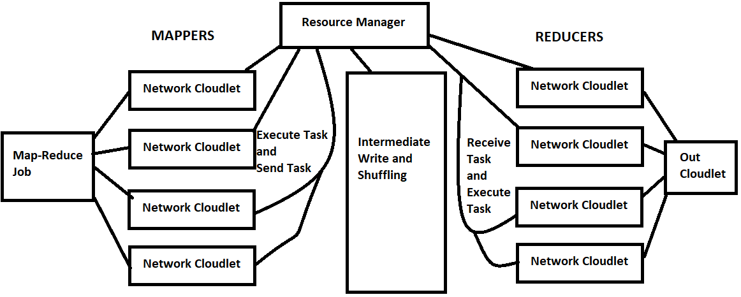
CloudSim Plus
Arsitektur
We Split the Job into three different tasks: Mapper, Reducer and ResourceManager.
Mappers: Defines an individual mapper which will work on a particular file split and executes the map task [CloudletExecutionTask]. After done with execution it will emit/write the map result simulated using the [CloudletSendTask].
Reducers: Defines an individual reducer task which will take the output written by the mapper from the intermediate storage, processes it and writes/persists to the output node.
Resource Manager: Models a resource manager, which takes in the Job requests allocated/schedules the jobs among the different available nodes as specified by the job conf.
Worker Nodes and VMs: Each of the above cloudlets are executed on these worker nodes which are nothing but the VMs allocated to the job by the resource manager.
Notes:
https://cloudsimplus.org/
https://github.com/mayankrastogi/cloud-simulation
[1] R. Buyya, R. Ranjan, and R. N. Calheiros, "CloudSim: A Toolkit for Modeling and Simulation of Cloud Computing Infrastructures and Services," Software: Practice and Experience, vol. 41, no. 1, pp. 23-50, 2011.[2] Cloudslab, "CloudSim: A Framework For Modeling And Simulation Of Cloud Computing Infrastructures And Services," GitHub Repository, 2026. [Online]. Available: https://github.com

Slide 10
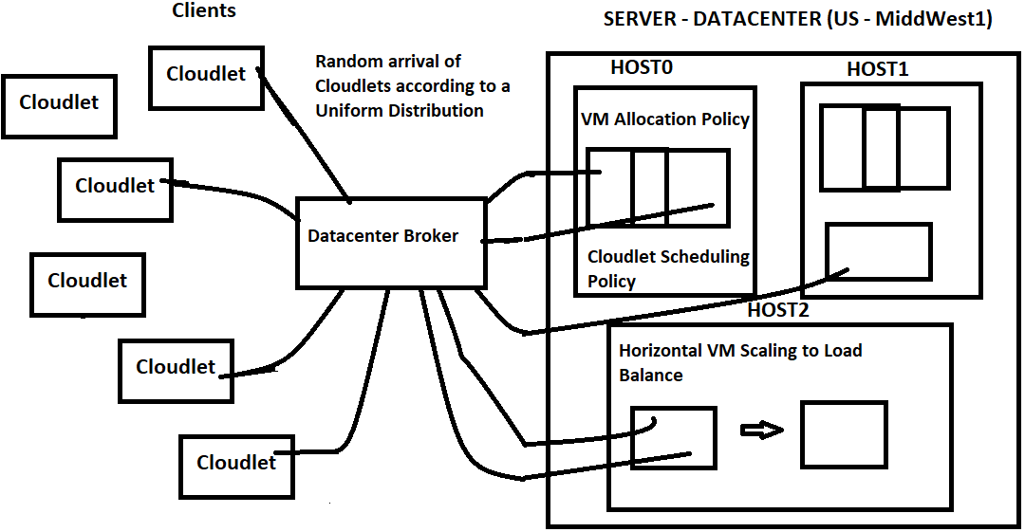
CloudSim Plus
A Webservice job simulates the execution of Dynamic User requests in the form of dynamic arrival of cloudlets using a Uniform Distribution prediction. These dynamic User requests are submitted to Data Center Broker, who decides the allocation of these cloudlets on to the VM using the custom min-min and max-min scheduling and load balancing policy.
The execution of these jobs for different cloud architectures has been compared and the results been analyzed to choose an optimum architecture with a greater return on investments.
Notes:
https://cloudsimplus.org/

Slide 11
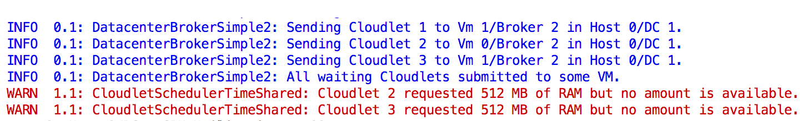
CloudSim Plus
Main Exclusive Features
CloudSim Plus provides lots of exclusive features, from the most basic ones to build simple simulations, to advanced features for simulating more realistic cloud scenarios:
21. Colors log messages
It is easier to use. A complete and easy-to-understand simulation scenario can be built in few lines of code.
Multi-cloud simulations with inter-datacenter VM migrations (#361).
Creation of joint power- and network-aware simulations (#45).
Vertical (#7) and Horizontal VM scaling (#41).
Highly accurate power usage computation (#153).
Built-in computation of CPU utilization history and energy consumption for VMs (and Hosts) (#168).
Virtual Memory and Reduced bandwidth allocation when RAM and BW are oversubscribed. (#170).
Automatically power Hosts on and off according to demand (#128) and support defining a startup and shutdown delay/power consumption (#238).
Parallel execution of simulations in multi-core computers, allowing multiple simulations to be run simultaneously in an isolated way (#38).
Delay creation of submitted VMs and Cloudlets, enabling simulation of dynamic arrival of tasks (#11, #23).
Allow dynamic creation of VMs and Cloudlets in runtime, enabling VMs to be created on-demand (#43).
Listeners to enable simulation configuration, monitoring and data collection.
Create simulations from Google Cluster Data trace files. (#149).
Strongly object-oriented, allowing chained calls such as cloudlet.getVm().getHost().getDatacenter() without even worrying about NullPointerException (#10).
Classes and interfaces for implementing heuristics such as Tabu Search, Simulated Annealing, Ant Colony Systems and so on (example here).
Implementation of the Completely Fair Scheduler used in recent versions of the Linux Kernel (example here) (#58).
Host Fault Injection and Recovery Mechanism to enable injection of random failures into Hosts CPU cores and replication of failed VMs (#81).
Creation of Hosts at Simulation Runtime to enable physical expansion of Datacenter capacity (#124).
Enables the simulation to keep running, waiting for dynamic and even random events such as the arrival of Cloudlets and VMs (#130).
TableBuilder objects that are used in all examples and enable printing simulation results in different formats such as Markdown Table, CSV or HTML.
Colors log messages and enables filtering the level of messages to print (#24). If you want to just see messages from warning level, call Log.setLevel(ch.qos.logback.classic.Level.WARN);
Enables running the simulation synchronously, making it easier to interact with it and collect data inside a loop, as the simulation goes on. This brings freedom to implement your simulations (#205).
Allows placing a group of VMs into the same Host. (#90).
Enables Broker to try selecting the closest Datacenter to place VMs, according to their time zone. (#212).
Non-Live VM migration from/to public-cloud datacenters (#437).
Support VM startup/shutdown delay and boot overhead (#435)
It outperforms CloudSim 4, as can be seen here.
Notes:
https://cloudsimplus.org/

Slide 12
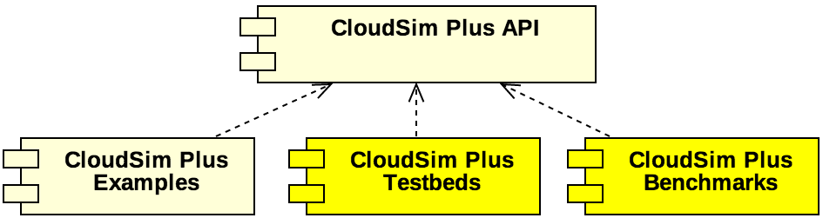
CloudSim Plus
Notes:
https://cloudsimplus.org/

Slide 13
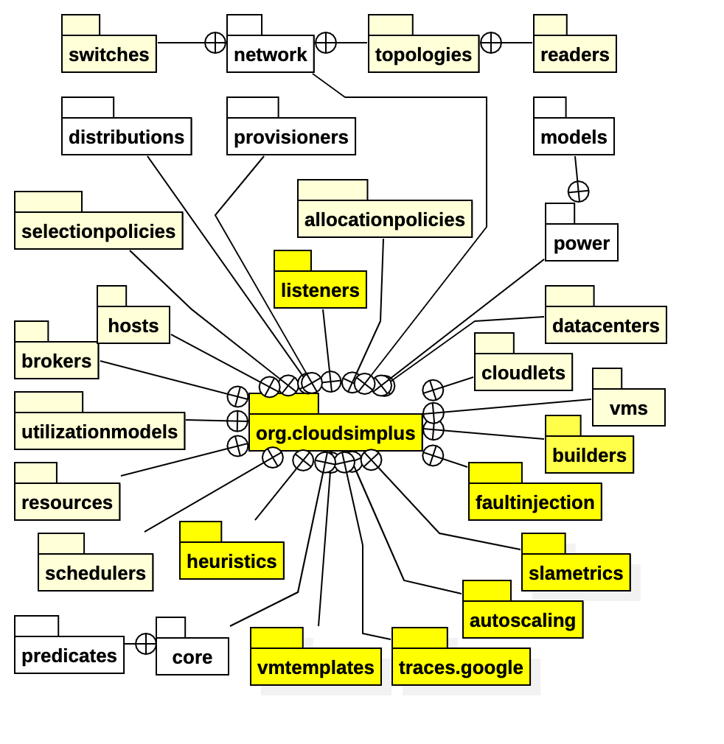
CloudSim Plus
Notes:
https://cloudsimplus.org/

Slide 14
CloudSim Plus
In order to build a simulation scenario, you have to create at least:
a datacenter with a list of physical machines (Hosts);
a broker that allows submission of VMs and Cloudlets to be executed, on behalf of a given customer, into the cloud infrastructure;
a list of customer’s virtual machines (VMs);
and a list of customer’s cloudlets (objects that model resource requirements of different applications).
Notes:
https://cloudsimplus.org/

Slide 15
CloudSim Plus
Max-Min
Max-Min start with the set of all unassigned tasks in the make-span. This algorithm also works in two phases. First, the maximum expected completion time for all the tasks is calculated. The completion time for all the tasks is calculated on all the machines. In the second phase, the task with the maximum expected completion time from make-span is selected and that tasks assigned to the corresponding resource. Then the task which is completed that is removed from the make-span and this process is repeated until all tasks are completed.
A data center broker that uses Max-min load balancing algorithm to place Cloudlets on the available VMs. The algorithm prioritizes smaller cloudlets (ones with smaller estimated execution time) over larger cloudlets and assigns them to VMs first.
VM Allocation Policies
These policies define the allocation of VMs to the Host.
Random Allocation
A Random allocation policy defines the random allocation of Vms to its Hosts. The Host list is shuffled and a random Host is picked. This picked Host is first prioritized for allocation of VMs. Once VMs are allocated to this Host and the Host is at maximum utilization, another Host is picked according to the defined Random policy to get it allocated to the future VMs
Nearest Host Allocation
A more sophisticated allocation policy than the Random allocation. The nearest host allocation policy will first allocate the VMs in the Same Host till the maximum utilization, once its utilization capacity is reached, it will try to allocate the VM in the same Rack through scanning the EDGE SWITCH for any under-utilized Host. If it doesn't find any Host in the Edge Switches, it will start scanning the AGGREGATE SWITCH to identify any underutilized Host. Finally, if it is not able to find the Host through the Aggregate Switches also, Then it will try to look into another datacenters with the help of ROOT SWITCH Scan and Datacenter Broker dynamic table list.
Notes:
https://cloudsimplus.org/

Slide 16
CloudSim Plus
Implemented and done simulations for 3 VM Allocation Policy :
First-Fit VM allocation policy
Random VM Allocation
Nearest Host VM Allocation Policy
We also implemented the following Load Balancer, balancing bursts of loads over the varied jobs Policy:
Round-Robin load balancing
Min-Min Load Balancing
Max-Min Load Balancing
We were changing one variable at a time. Keeping other factors as constant. Essentially, we ran 3 different map-reduce jobs, 3 different web services at the same time. The load on the data center was allocated randomly, with the following set of atomic executions on the machines :
Architecture:
96 Hosts per Datacenter
For Map-Reduce Job:
No of Mappers = 30 * 3 = 90
No of Reducers= 30 * 3 = 90
For the web services :
Had 3 services running with random number of clients, and auto scalable servers based on the load.
Thus, our analysis is divided into 9 parts:
Part 1: First Fit VM Allocation and Round Robin Load Balancer
which will compare RoundRobin balancer and First fit VM allocation based on our dynamic job runs.
Part 2: First Fit VM Allocation and Min-Min Load balancing
Part 3: First Fit VM Allocation and Max-Min Load Balancing
Part 4:Random VM Allocation and Round Robin Load Balancer
Part 5: :Random VM Allocation and Min-Min Load balancing
Part 6: Random VM Allocation and Max-Min Load Balancing
Part 7: Nearest Host VM Allocation Policy and Round Robin Load Balancer
Part 8: Nearest Host VM Allocation Policy and Min-Min Load Balancing
The expected result analysis would generate the statistical average of the executions, resource usages and the costs over large number of iterations (say 100).
The implementation for the above hypothesis was constructed and simulation was ran.
Notes:
https://cloudsimplus.org/

Slide 17
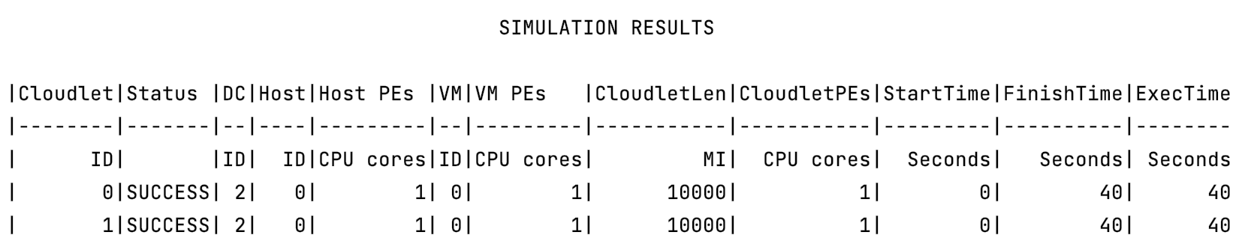
CloudSim Plus
Notes:
https://cloudsimplus.org/

Slide 18
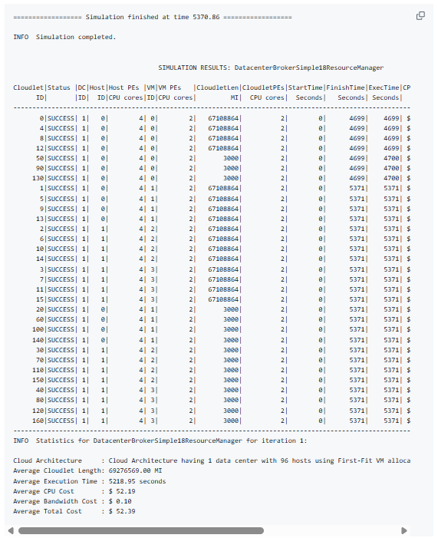
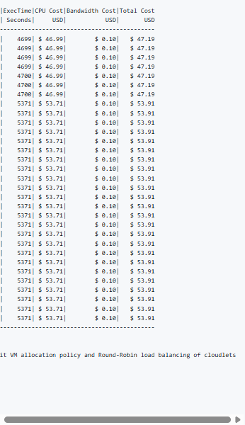
CloudSim Plus
Result Snap:
INFO Statistics for DatacenterBrokerSimple18ResourceManager for iteration 1:
Cloud Architecture : Cloud Architecture having 1 data center with 96 hosts using First-Fit VM allocation policy and Round-Robin load balancing of cloudlets
Average Cloudlet Length: 69276569.00 MI
Average Execution Time : 5218.95 seconds
Average CPU Cost : $ 52.19
Average Bandwidth Cost : $ 0.10
Average Total Cost : $ 52.39
Notes:
https://cloudsimplus.org/
https://github.com/mayankrastogi/cloud-simulation
INFO Statistics for DatacenterBrokerSimple18ResourceManager for iteration 1:
Cloud Architecture : Cloud Architecture having 1 data center with 96 hosts using First-Fit VM allocation policy and Round-Robin load balancing of cloudlets
Average Cloudlet Length: 69276569.00 MI
Average Execution Time : 5218.95 seconds
Average CPU Cost : $ 52.19
Average Bandwidth Cost : $ 0.10
Average Total Cost : $ 52.39
================== Simulation finished at time 5370.86 ==================
INFO Simulation completed.
SIMULATION RESULTS: DatacenterBrokerSimple18ResourceManager
Cloudlet|Status |DC|Host|Host PEs |VM|VM PEs |CloudletLen|CloudletPEs|StartTime|FinishTime|ExecTime|CPU Cost|Bandwidth Cost|Total Cost
ID| |ID| ID|CPU cores|ID|CPU cores| MI| CPU cores| Seconds| Seconds| Seconds| USD| USD| USD
----------------------------------------------------------------------------------------------------------------------------------------
0|SUCCESS| 1| 0| 4| 0| 2| 67108864| 2| 0| 4699| 4699| $ 46.99| $ 0.10| $ 47.19
4|SUCCESS| 1| 0| 4| 0| 2| 67108864| 2| 0| 4699| 4699| $ 46.99| $ 0.10| $ 47.19
8|SUCCESS| 1| 0| 4| 0| 2| 67108864| 2| 0| 4699| 4699| $ 46.99| $ 0.10| $ 47.19
12|SUCCESS| 1| 0| 4| 0| 2| 67108864| 2| 0| 4699| 4699| $ 46.99| $ 0.10| $ 47.19
50|SUCCESS| 1| 0| 4| 0| 2| 3000| 2| 0| 4699| 4700| $ 46.99| $ 0.10| $ 47.19
90|SUCCESS| 1| 0| 4| 0| 2| 3000| 2| 0| 4699| 4700| $ 46.99| $ 0.10| $ 47.19
130|SUCCESS| 1| 0| 4| 0| 2| 3000| 2| 0| 4699| 4700| $ 46.99| $ 0.10| $ 47.19
1|SUCCESS| 1| 0| 4| 1| 2| 67108864| 2| 0| 5371| 5371| $ 53.71| $ 0.10| $ 53.91
5|SUCCESS| 1| 0| 4| 1| 2| 67108864| 2| 0| 5371| 5371| $ 53.71| $ 0.10| $ 53.91
9|SUCCESS| 1| 0| 4| 1| 2| 67108864| 2| 0| 5371| 5371| $ 53.71| $ 0.10| $ 53.91
13|SUCCESS| 1| 0| 4| 1| 2| 67108864| 2| 0| 5371| 5371| $ 53.71| $ 0.10| $ 53.91
2|SUCCESS| 1| 1| 4| 2| 2| 67108864| 2| 0| 5371| 5371| $ 53.71| $ 0.10| $ 53.91
6|SUCCESS| 1| 1| 4| 2| 2| 67108864| 2| 0| 5371| 5371| $ 53.71| $ 0.10| $ 53.91
10|SUCCESS| 1| 1| 4| 2| 2| 67108864| 2| 0| 5371| 5371| $ 53.71| $ 0.10| $ 53.91
14|SUCCESS| 1| 1| 4| 2| 2| 67108864| 2| 0| 5371| 5371| $ 53.71| $ 0.10| $ 53.91
3|SUCCESS| 1| 1| 4| 3| 2| 67108864| 2| 0| 5371| 5371| $ 53.71| $ 0.10| $ 53.91
7|SUCCESS| 1| 1| 4| 3| 2| 67108864| 2| 0| 5371| 5371| $ 53.71| $ 0.10| $ 53.91
11|SUCCESS| 1| 1| 4| 3| 2| 67108864| 2| 0| 5371| 5371| $ 53.71| $ 0.10| $ 53.91
15|SUCCESS| 1| 1| 4| 3| 2| 67108864| 2| 0| 5371| 5371| $ 53.71| $ 0.10| $ 53.91
20|SUCCESS| 1| 0| 4| 1| 2| 3000| 2| 0| 5371| 5371| $ 53.71| $ 0.10| $ 53.91
60|SUCCESS| 1| 0| 4| 1| 2| 3000| 2| 0| 5371| 5371| $ 53.71| $ 0.10| $ 53.91
100|SUCCESS| 1| 0| 4| 1| 2| 3000| 2| 0| 5371| 5371| $ 53.71| $ 0.10| $ 53.91
140|SUCCESS| 1| 0| 4| 1| 2| 3000| 2| 0| 5371| 5371| $ 53.71| $ 0.10| $ 53.91
30|SUCCESS| 1| 1| 4| 2| 2| 3000| 2| 0| 5371| 5371| $ 53.71| $ 0.10| $ 53.91
70|SUCCESS| 1| 1| 4| 2| 2| 3000| 2| 0| 5371| 5371| $ 53.71| $ 0.10| $ 53.91
110|SUCCESS| 1| 1| 4| 2| 2| 3000| 2| 0| 5371| 5371| $ 53.71| $ 0.10| $ 53.91
150|SUCCESS| 1| 1| 4| 2| 2| 3000| 2| 0| 5371| 5371| $ 53.71| $ 0.10| $ 53.91
40|SUCCESS| 1| 1| 4| 3| 2| 3000| 2| 0| 5371| 5371| $ 53.71| $ 0.10| $ 53.91
80|SUCCESS| 1| 1| 4| 3| 2| 3000| 2| 0| 5371| 5371| $ 53.71| $ 0.10| $ 53.91
120|SUCCESS| 1| 1| 4| 3| 2| 3000| 2| 0| 5371| 5371| $ 53.71| $ 0.10| $ 53.91
160|SUCCESS| 1| 1| 4| 3| 2| 3000| 2| 0| 5371| 5371| $ 53.71| $ 0.10| $ 53.91
----------------------------------------------------------------------------------------------------------------------------------------
INFO Statistics for DatacenterBrokerSimple18ResourceManager for iteration 1:
Cloud Architecture : Cloud Architecture having 1 data center with 96 hosts using First-Fit VM allocation policy and Round-Robin load balancing of cloudlets
Average Cloudlet Length: 69276569.00 MI
Average Execution Time : 5218.95 seconds
Average CPU Cost : $ 52.19
Average Bandwidth Cost : $ 0.10
Average Total Cost : $ 52.39

Slide 19
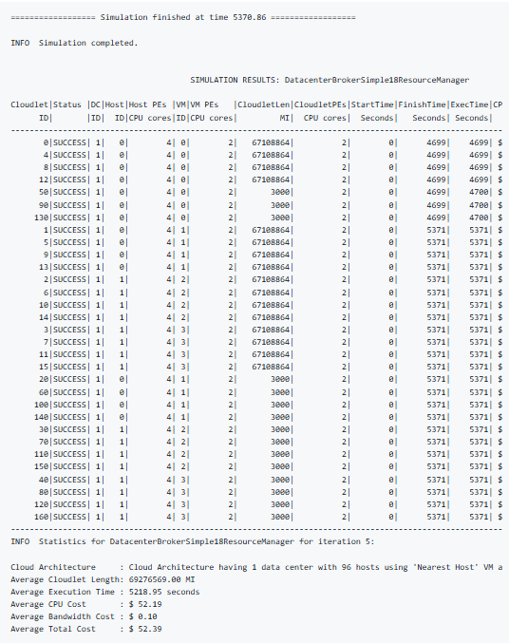
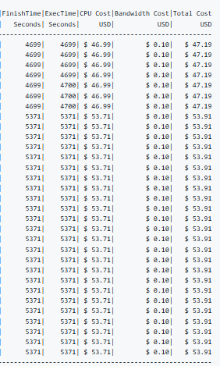
CloudSim Plus
The simulation kept on running based on the configs structured and generated the log files of about 10 GB. And the aggregated statistical results were resembling the above replica like the following result summary :
INFO Statistics for DatacenterBrokerSimple18ResourceManager for iteration 5:
Cloud Architecture : Cloud Architecture having 1 data center with 96 hosts using 'Nearest Host' VM allocation policy and Round-Robin load balancing of cloudlets
Average Cloudlet Length: 69276569.00 MI
Average Execution Time : 5218.95 seconds
Average CPU Cost : $ 52.19
Average Bandwidth Cost : $ 0.10
Average Total Cost : $ 52.39
Notes:
================== Simulation finished at time 5370.86 ==================
INFO Simulation completed.
SIMULATION RESULTS: DatacenterBrokerSimple18ResourceManager
Cloudlet|Status |DC|Host|Host PEs |VM|VM PEs |CloudletLen|CloudletPEs|StartTime|FinishTime|ExecTime|CPU Cost|Bandwidth Cost|Total Cost
ID| |ID| ID|CPU cores|ID|CPU cores| MI| CPU cores| Seconds| Seconds| Seconds| USD| USD| USD
----------------------------------------------------------------------------------------------------------------------------------------
0|SUCCESS| 1| 0| 4| 0| 2| 67108864| 2| 0| 4699| 4699| $ 46.99| $ 0.10| $ 47.19
4|SUCCESS| 1| 0| 4| 0| 2| 67108864| 2| 0| 4699| 4699| $ 46.99| $ 0.10| $ 47.19
8|SUCCESS| 1| 0| 4| 0| 2| 67108864| 2| 0| 4699| 4699| $ 46.99| $ 0.10| $ 47.19
12|SUCCESS| 1| 0| 4| 0| 2| 67108864| 2| 0| 4699| 4699| $ 46.99| $ 0.10| $ 47.19
50|SUCCESS| 1| 0| 4| 0| 2| 3000| 2| 0| 4699| 4700| $ 46.99| $ 0.10| $ 47.19
90|SUCCESS| 1| 0| 4| 0| 2| 3000| 2| 0| 4699| 4700| $ 46.99| $ 0.10| $ 47.19
130|SUCCESS| 1| 0| 4| 0| 2| 3000| 2| 0| 4699| 4700| $ 46.99| $ 0.10| $ 47.19
1|SUCCESS| 1| 0| 4| 1| 2| 67108864| 2| 0| 5371| 5371| $ 53.71| $ 0.10| $ 53.91
5|SUCCESS| 1| 0| 4| 1| 2| 67108864| 2| 0| 5371| 5371| $ 53.71| $ 0.10| $ 53.91
9|SUCCESS| 1| 0| 4| 1| 2| 67108864| 2| 0| 5371| 5371| $ 53.71| $ 0.10| $ 53.91
13|SUCCESS| 1| 0| 4| 1| 2| 67108864| 2| 0| 5371| 5371| $ 53.71| $ 0.10| $ 53.91
2|SUCCESS| 1| 1| 4| 2| 2| 67108864| 2| 0| 5371| 5371| $ 53.71| $ 0.10| $ 53.91
6|SUCCESS| 1| 1| 4| 2| 2| 67108864| 2| 0| 5371| 5371| $ 53.71| $ 0.10| $ 53.91
10|SUCCESS| 1| 1| 4| 2| 2| 67108864| 2| 0| 5371| 5371| $ 53.71| $ 0.10| $ 53.91
14|SUCCESS| 1| 1| 4| 2| 2| 67108864| 2| 0| 5371| 5371| $ 53.71| $ 0.10| $ 53.91
3|SUCCESS| 1| 1| 4| 3| 2| 67108864| 2| 0| 5371| 5371| $ 53.71| $ 0.10| $ 53.91
7|SUCCESS| 1| 1| 4| 3| 2| 67108864| 2| 0| 5371| 5371| $ 53.71| $ 0.10| $ 53.91
11|SUCCESS| 1| 1| 4| 3| 2| 67108864| 2| 0| 5371| 5371| $ 53.71| $ 0.10| $ 53.91
15|SUCCESS| 1| 1| 4| 3| 2| 67108864| 2| 0| 5371| 5371| $ 53.71| $ 0.10| $ 53.91
20|SUCCESS| 1| 0| 4| 1| 2| 3000| 2| 0| 5371| 5371| $ 53.71| $ 0.10| $ 53.91
60|SUCCESS| 1| 0| 4| 1| 2| 3000| 2| 0| 5371| 5371| $ 53.71| $ 0.10| $ 53.91
100|SUCCESS| 1| 0| 4| 1| 2| 3000| 2| 0| 5371| 5371| $ 53.71| $ 0.10| $ 53.91
140|SUCCESS| 1| 0| 4| 1| 2| 3000| 2| 0| 5371| 5371| $ 53.71| $ 0.10| $ 53.91
30|SUCCESS| 1| 1| 4| 2| 2| 3000| 2| 0| 5371| 5371| $ 53.71| $ 0.10| $ 53.91
70|SUCCESS| 1| 1| 4| 2| 2| 3000| 2| 0| 5371| 5371| $ 53.71| $ 0.10| $ 53.91
110|SUCCESS| 1| 1| 4| 2| 2| 3000| 2| 0| 5371| 5371| $ 53.71| $ 0.10| $ 53.91
150|SUCCESS| 1| 1| 4| 2| 2| 3000| 2| 0| 5371| 5371| $ 53.71| $ 0.10| $ 53.91
40|SUCCESS| 1| 1| 4| 3| 2| 3000| 2| 0| 5371| 5371| $ 53.71| $ 0.10| $ 53.91
80|SUCCESS| 1| 1| 4| 3| 2| 3000| 2| 0| 5371| 5371| $ 53.71| $ 0.10| $ 53.91
120|SUCCESS| 1| 1| 4| 3| 2| 3000| 2| 0| 5371| 5371| $ 53.71| $ 0.10| $ 53.91
160|SUCCESS| 1| 1| 4| 3| 2| 3000| 2| 0| 5371| 5371| $ 53.71| $ 0.10| $ 53.91
----------------------------------------------------------------------------------------------------------------------------------------
INFO Statistics for DatacenterBrokerSimple18ResourceManager for iteration 5:
Cloud Architecture : Cloud Architecture having 1 data center with 96 hosts using 'Nearest Host' VM allocation policy and Round-Robin load balancing of cloudlets
Average Cloudlet Length: 69276569.00 MI
Average Execution Time : 5218.95 seconds
Average CPU Cost : $ 52.19
Average Bandwidth Cost : $ 0.10
Average Total Cost : $ 52.39
https://cloudsimplus.org/

Slide 20
CloudSim Plus
Notes:
https://cloudsimplus.org/

