Slide 1
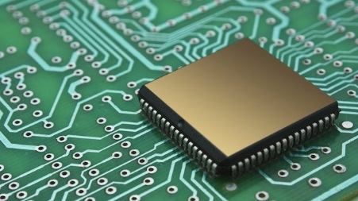

DE
Week 2.ii
4.1 Diode Circuit
INSTITUT TEKNOLOGI DEL
Jl Sisingamangaraja, Tobasamosir (22381), Sumatera Utara, Indonesia
telp +62632331234, fax +626323311116, www.del.ac.id
Notes:
Malvino e Books https://www.dacc.edu/bjun/
https://www.dacc.edu/bjun/ELEC167_Malvino_PDF/Chapter02.pdf
portal.unimap.edu.my/portal/page/portal30/.../Chapter2_modified.ppt

Slide 2
4-1 Half-Wave Rectifiers
Diode – ability to conduct current in one direction and block current in other direction
→ used in circuit called RECTIFIER (ac →dc)
Objective:
Discuss the operation of half-wave rectifiers
Describe a basic dc power supply & half-wave rectifications
Determine the average value, V_{AVG} of half-waves rectified voltage
Discuss the effect of barrier potential, V_{P} on a half-wave rectifier output
Define Peak Inverse Voltage (PIV)
Describe Transformer-couple half-wave rectifier

Slide 3
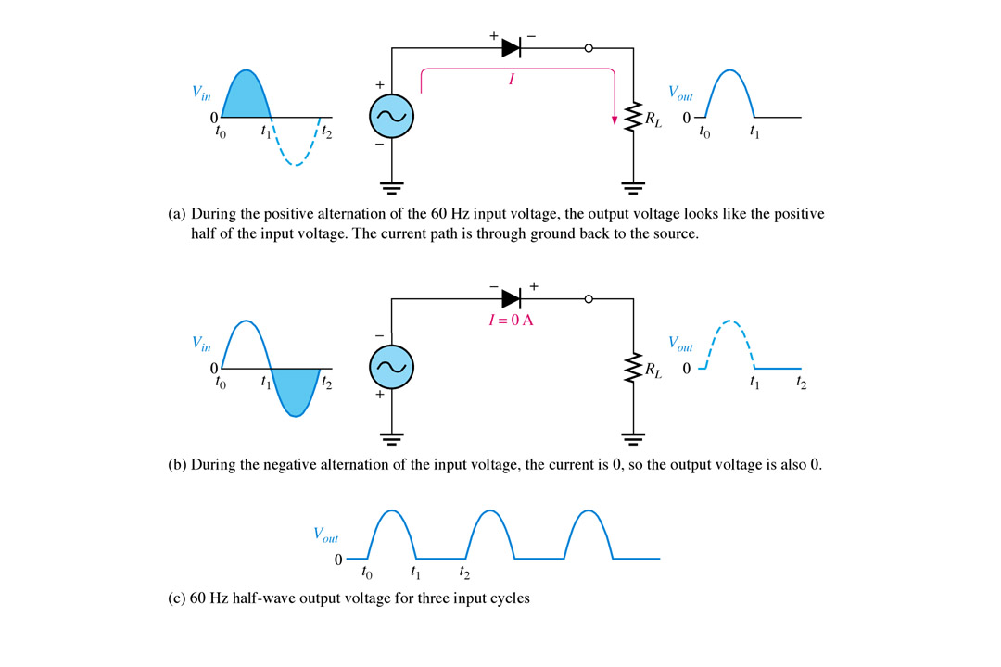
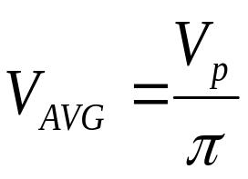
4-2 Half-Wave Rectifiers (cont.)
(The Half-Wave Rectifier)
ac source
load resistor
A half wave rectifier(ideal) allows conduction for only 180° or half of a complete cycle.
During first one cycle:
-Vin goes positive – diode FB – conduct current
-Vin goes negative – diode RB – no current- 0V
The output frequency is the same as the input (same shape).
The average value V_{DC} or V_{AVG} :
Ideal diode model
-Measure on dc voltmeter
Notes:
Fig 2-2 a,b,&c

Slide 4
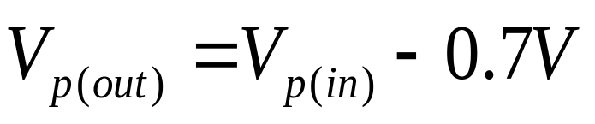
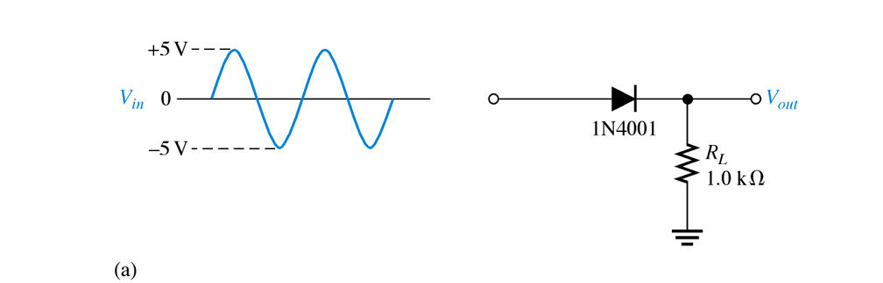
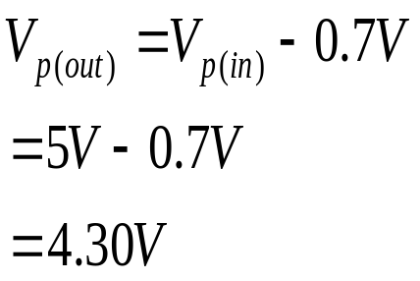
4-3 Half-Wave Rectifiers (cont.)
(Effect of the Barrier Potential on the Half-Wave Rectifier Output)
Practical Diode – barrier potential of 0.7V (Si) taken into account.
During +ve half-cycle – V_{in} must overcome V_{potential} for forward bias.
Example 1: Calculate the peak o/p voltage, Vp(out)?
The peak o/p voltage:

Slide 5
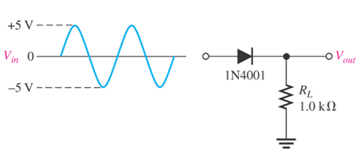
4-4 Half-Wave Rectifiers (cont.)
(Effect of the Barrier Potential on the Half-Wave Rectifier Output)
Example 2:
Sketch the output V₀ and determine the output level voltage for the
network in above figure.

Slide 6
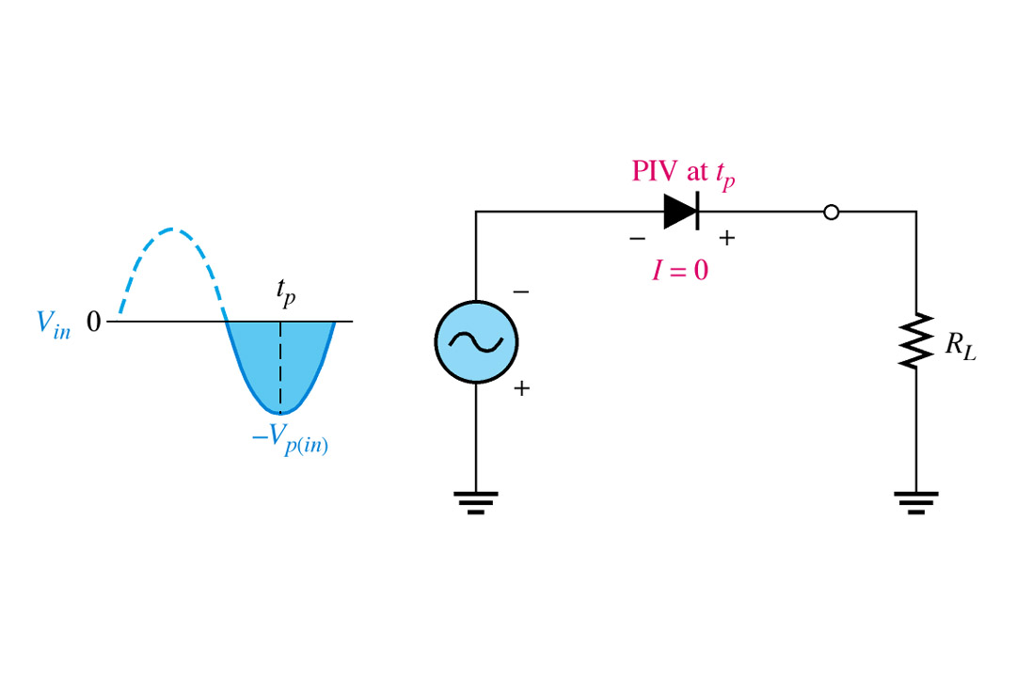
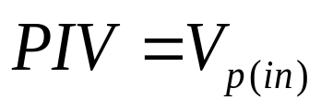
4-5 Half-Wave Rectifiers (cont.)
[Peak Inverse Voltage (PIV)]
- Peak inverse voltage (PIV) is the maximum voltage across the diode when it is in reverse bias.
The diode must be capable of withstanding this amount of voltage.
Notes:
Fig 2-8 PIV

Slide 7
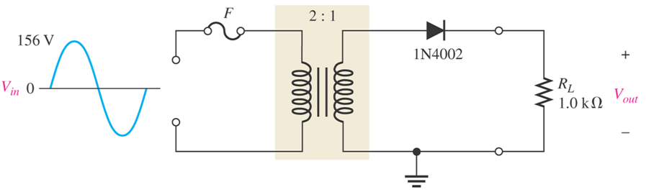
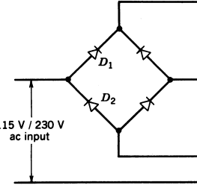
Example 1:
Determine the peak value of output voltage as shown in below Figure.

Slide 8
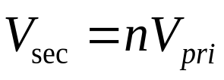
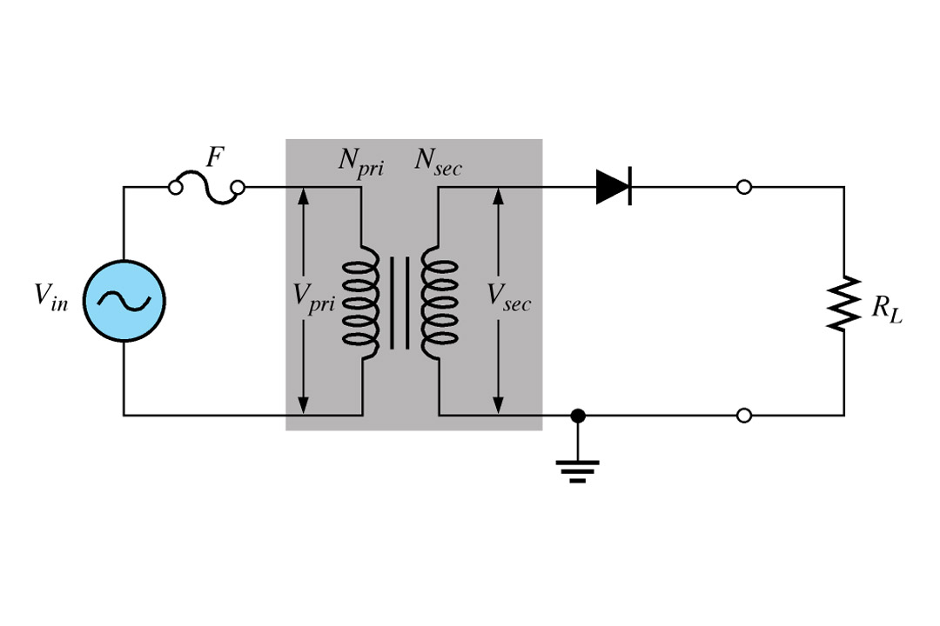
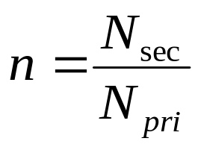
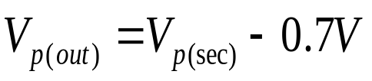

4-6 Half-Wave Rectifiers (cont.)
(Half-Wave Rectifier with Transformer-Coupled Input Voltage)
Transformers are often used for voltage change and isolation.
The turns ratio, n of the primary to secondary determines the output versus the input.
The advantages of transformer coupling:
1) allows the source voltage to be stepped up or down
2) the ac source is electrically isolated from the rectifier, thus
prevents shock hazards in the secondary circuit.
to couple ac input
to the rectifier
If n>1, Vsec is greater than Vpri.
If n<1, Vsec is less than Vpri.
If n=1, Vsec= Vpri.
Notes:
Fig 2-9 Transformer Input

Slide 9
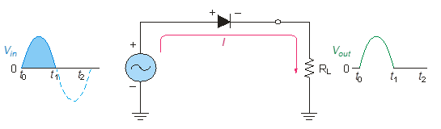
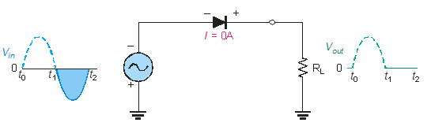
The Half wave Rectifiers
As diodes conduct current in one direction and block in other.
When connected with ac voltage, diode only allows half cycle passing through it and hence convert ac into dc.
As the half of the wave get rectified, the process called half wave rectification.
    A diode is connected to an ac source and a load resistor forming a half wave rectifier.
    Positive half cycle causes current through diode, that causes voltage drop across resistor.
Notes:
Random topics just for revising some concepts.

Slide 10
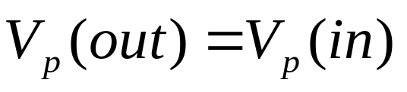
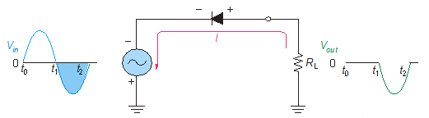
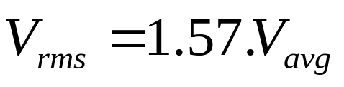
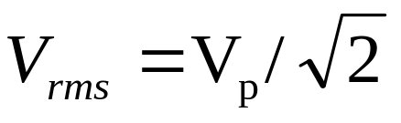


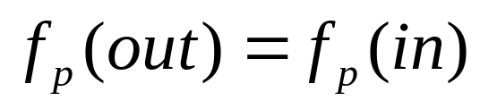
Diode as Rectifiers
Ideal Half Wave
Reversing diode.
DC Value of Half Wave Signal
Half Wave (Vdc ), Average value of Half wave output voltage:
Vdc =VAVG = VP /
Vdc = 0,318 Vp
VAVG is approx 31.8% of Vp
PIV: Peak Inverse Voltage = Vp

Slide 11
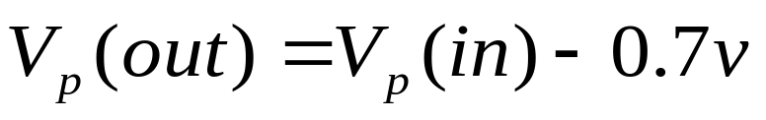
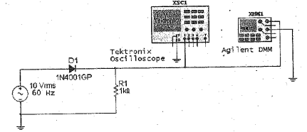
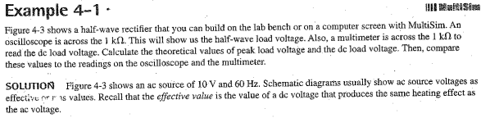
2d Half Wave

Slide 12
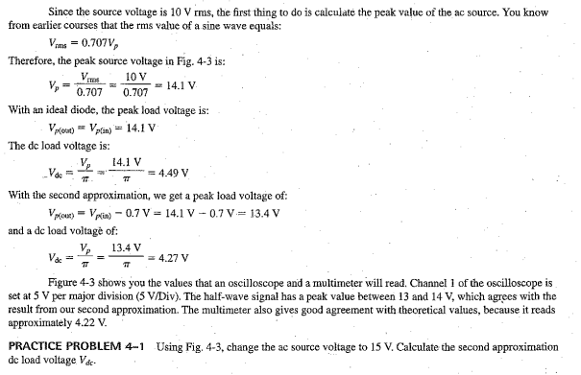

Slide 13
4-1 The Basic DC Power Supply
Power supply is a group of circuits that convert the standard ac voltage (120 V, 60 Hz) provided by the wall outlet to constant dc voltage.
The voltage produced is used to power all types of electronic circuits including:
  Consumer electronics (ex: radio, television, DVD, etc.)
  Computers
  Industrial controllers
  Most laboratory instrumentation systems and equipment
The dc voltage level required depends on the application, but most applications require relatively low voltage.
There are two basic types of power supplies: a linear power supply and a switching power supply. These components are described as follows:
  A linear power supply is one that provides a constant current path between its input and its load.
  A switching power supply provides an intermittent current path between its input and its output.

Slide 14
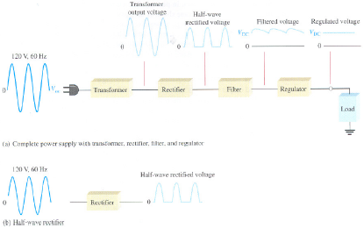
4-2 The Basic DC Power Supply(cont.)
The basic function of a DC power supply is to convert an AC voltage to a constant DC voltage (AC → DC)
Maintains a constant dc
voltage
Eliminates the fluctuations
- produce smooth dc voltage
Either half or full-wave
rectifier convert ac input voltage
to a pulsating dc voltage.
(a) Complete power supply with transformer, rectifier, filter, and regulator
(b) Half-wave rectifier
Fig. 4-1: Block diagram of a dc power supply with a load and rectifier.

Slide 15
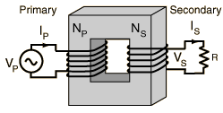

The Basic DC Power Supply(cont.)
Transformer
A transformer is a device that changes ac electric power at one voltage level to ac electric power at another voltage level through the action of a magnetic field.
Simple transformer consist of:
1. Primary winding (input winding)
2. Secondary winding (output winding)
3. Magnetic core
If the secondary has more turns than the primary, the output voltage across the secondary will be higher and the current will be smaller. If the secondary has fewer turns than the primary, the output voltage across the secondary will be lower and the current will be higher.
The core has a function to concentrate the magnetic flux.
Fig.2-2: The general arrangement of a transformer

Slide 16

The Basic DC Power Supply(cont.)
There are three types of transformers: step-up, step-down, and isolation.
These components are described as follows:
The step-up transformer provides a secondary voltage that is greater than the primary voltage. Ex: a step-up transformer may provides a 240 V_{ac} output with a 120 V_{ac} input.
The step-down transformer provides a secondary voltage that is less than the primary voltage. Ex: a step-down transformer may provides a 30 V_{ac} output with a 120 V_{ac} input.
An isolation transformer provides an output voltage that is equal to the input voltage. This type of transformer is used to isolate the power supply electrically from the ac power line.
+
N_{P}
N_{S}
+
+
N_{P}
N_{S}
+
+
N_{P}
N_{S}
+
120 V_{ac}
240 V_{ac}
120 V_{ac}
30 V_{ac}
120 V_{ac}
120 V_{ac}
-
-
-
-
-
-
Step-up
Step-down
Isolation
(a)
(b)
(c)
Fig.2-3

Slide 17
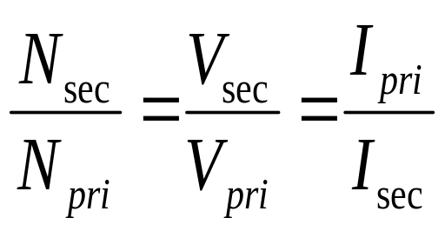
The Basic DC Power Supply(cont.)
The turns ratio of a transformer is equal to the voltage ratio of the component and since, the voltage ratio is the inverse of the current ratio. By formula:
(2-1)
where
N_{Sec} = the number of turns in the secondary
N_{Pri} = the number of turns in the primary
V_{Sec} = the secondary voltage
V_{Pri} = the primary voltage
I_{Sec} = the secondary current
I_{Pri} = the primary current
By the equation (2-1) can be stated that:
Step-down transformer secondary current is greater than its primary current
(I_{Sec} > I_{Pri}).
Step-up transformer secondary current is less than its primary current (I_{Pri} > I_{Sec}).

Slide 18
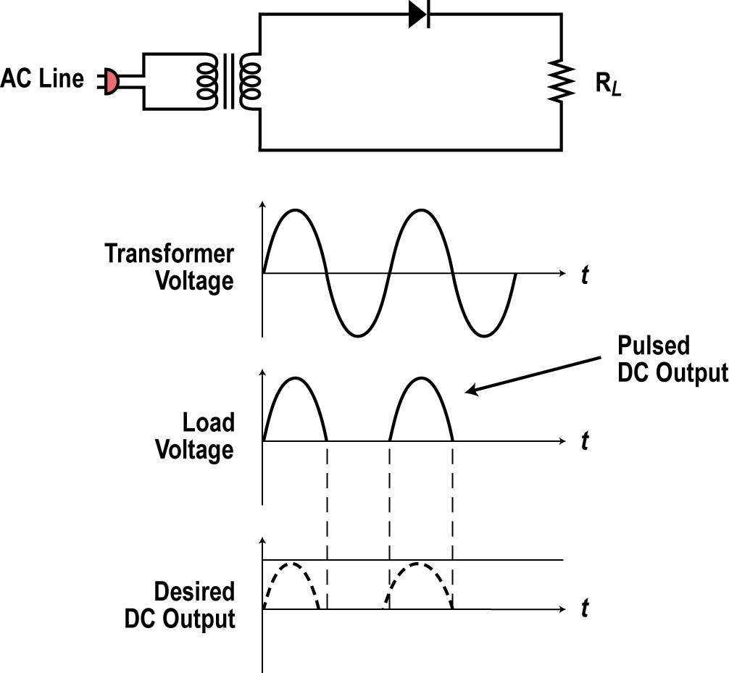
The Transformer
The simplest form of rectifier is the half wave rectifier shown.
Only the transformer, rectifier diode, and load (R_{L}) are shown without the filter and other components.
The half wave rectifier produces one sine pulse for each cycle of the input sine wave.
When the sine wave goes positive, the anode of the diode goes positive causing the diode to be forward biased. The diode conducts and acts like a closed switch letting the positive pulse of the sine wave to appear across the load resistor.
N1
N2

Slide 19
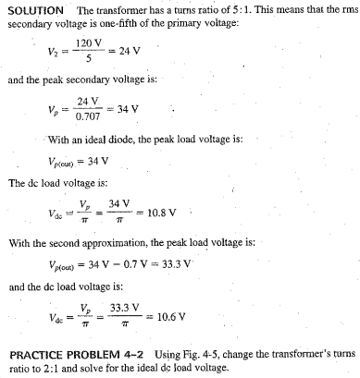
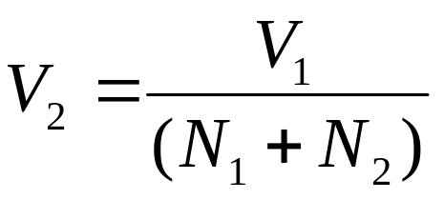
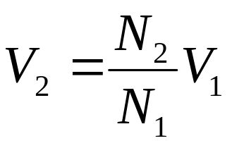
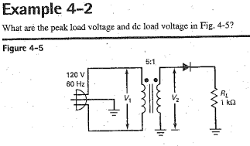
Turn Rasio
Step Down Trafo :

Slide 20
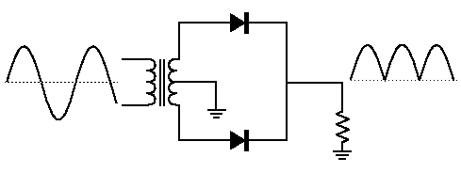

The Full wave rectifiers
A full wave rectifier allows unidirectional current through the load during the entire 360 degree of input cycle.
The output voltage have twice the input frequency.
VAVG is 63.7% of Vp
Full Wave Rectifier
VAVG = 2VP /
Notes:
Random topics just for revising some concepts.

Slide 21
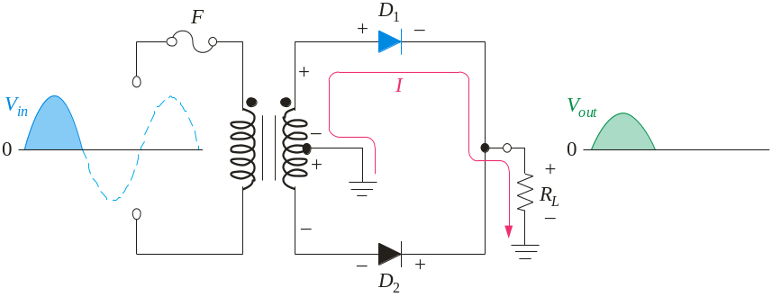
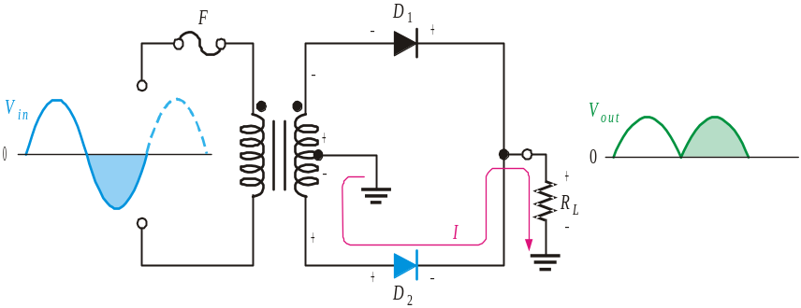
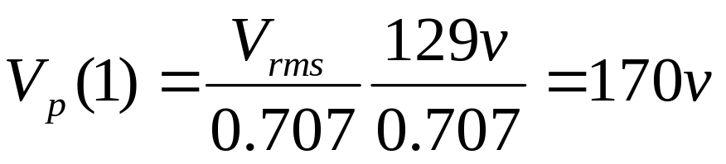
The Center-Tapped Full wave rectifiers
A center-tapped transformer is used with two diodes that conduct on alternating half-cycles.
During the positive half-cycle, the upper diode is forward-biased and the lower diode is reverse-biased.
During the negative half-cycle, the lower diode is forward-biased and the upper diode is reverse-biased.
Notes:
Random topics just for revising some concepts.

Slide 22
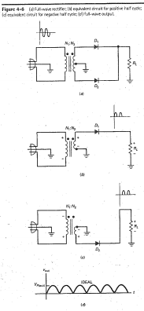
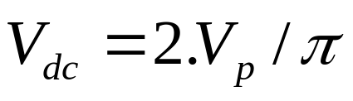

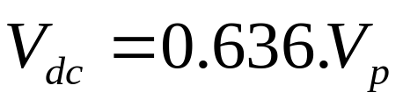
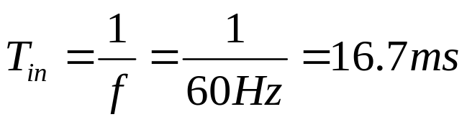

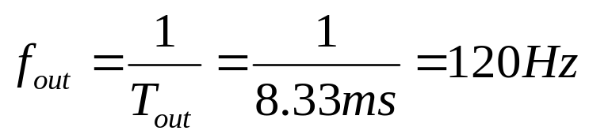

Full Wave :
equal
If Full Wave signal : 100 V
Vdc = V avg = 63.6 V
Out Frequency
Full Wave :

Slide 23
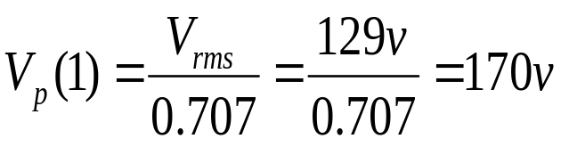
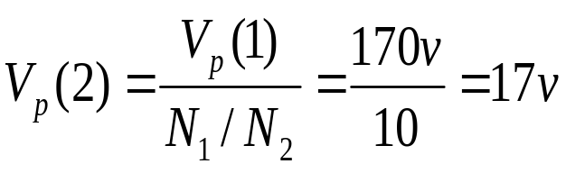
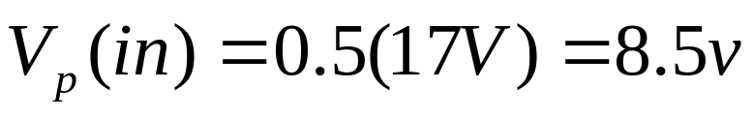
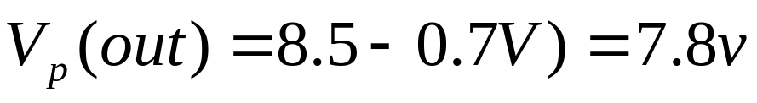
The Bridge Full-Wave Rectifier
EX 2
10 : 1
Solution:
Step Up
Step Down
Only half the secondary

Slide 24
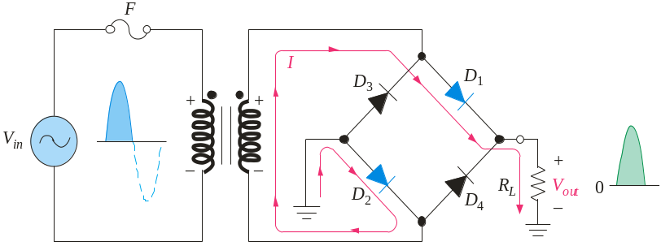
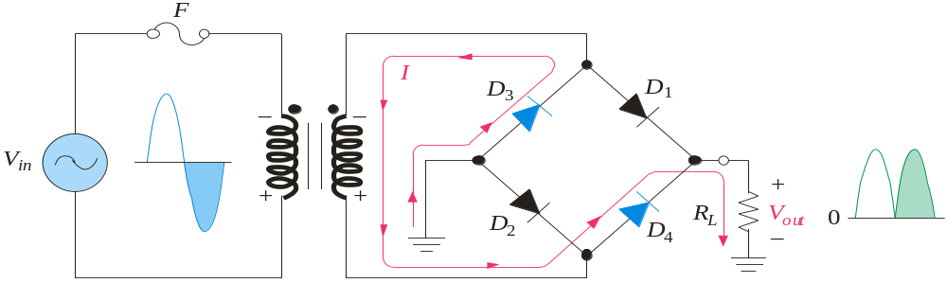
The Bridge Full-wave rectifiers
The Bridge Full-Wave rectifier uses four diodes connected across the entire secondary as shown.
Conduction path for the positive half-cycle.
Conduction path for the negative half-cycle.
Notes:
Random topics just for revising some concepts.

Slide 25
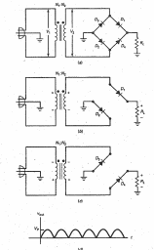



V average
Out Frequency
2 nd Bridge

Slide 26


The Bridge Full-Wave Rectifier
10 : 1
Solution:

Slide 27




The Bridge Full-Wave Rectifier
Example:
Determine the peak output voltage and current in the 3.3 kΩ load resistor if V_{sec} = 24 V_{rms}. Use the practical diode model.
Solution:
The peak output voltage is:
= 32.5 V
Applying Ohm’s law,
I_{p(out)} = 9.8 mA

Slide 28






4-5 The Choke Input Filter
LC voltage Divider
XL >> Xc
The average value of a rectified signal
passes to the load resistor
If XL = 10 kohm, Xc=100 ohm, Vin=15 V
Notes:
http://www.cameron.edu/~mpolson/fall13/EET_2013/

Slide 29

The choke-input filter

Slide 30



4.6 The Capacitor-input filter
• Most widely used
• The peak value of the rectified signal passes to the load resistor
• With a large capacitor, ripple is small
Where VR is the peak-to-peak ripple voltage

Slide 31





Full Wave Filtering
Ripple voltage
The peak-to-peak ripple voltage is half wave rectifier
t = 16,67
If FullWave Rectifier : 8,33 ms
If load current 10 mA, C 200 uF
Calculate a ripple voltage ...
The Ripple Formula

Slide 32



Slide 33






Slide 34



Slide 35





Slide 36

4.7 Peak inverse voltage And Surge Current
Non Conducting diode :
PIV = 2 Vp
If the peak secondary voltage 15 V, see fig 4-18 a
So PIV are 30 V
Maximum voltage across the nonconducting
diode of a rectifier circuit
• Voltage must be less than diode breakdown voltage
Diode ratings
• Half-wave rectifier with capacitor-input filter:
PIV = 2VP Idiode = Idc
• Full-wave rectifier with capacitor-input filter:
PIV = VP Idiode = 0.5Idc
• Bridge rectifier with capacitor-input filter:
PIV = V P Idiode = 0.5Idc

Slide 37



Slide 38


Power supply topics
Real transformers usually specify secondary voltage at a rated load current
Slow-blow fuses are often used to protect against surge current
Average diode current in a half-wave rectifier equals the dc load current
In a full-wave or bridge, the average current in any diode is half the dc load
current

Slide 39

Calculating Fuse Current

Slide 40

Calculating Diode Current
• Half-wave rectifier with capacitor-input filter: PIV = 2VP Idiode = Idc
• Full-wave rectifier with capacitor-input filter: PIV = VP Idiode = 0.5Idc
• Bridge rectifier with capacitor-input filter: PIV = V P Idiode = 0.5Idc
Calculate for Fiuse 2 A

Slide 41





Stiff clamper: RLC > 100T
Stiff Clipper : 100 RB < RS < 0.01 RL

Slide 42




labdasaritdel@gmail.com

