Slide 1


ELS 2202 Electronics I
Week 4.i
5.1 Special Diode Types
INSTITUT TEKNOLOGI DEL
Jl Sisingamangaraja, Tobasamosir (22581), Sumatera Utara, Indonesia
telp +62652551254, fax +626525511116, www.del.ac.id
Notes:
http://www.ee.cityu.edu.hk/~ee2501/lecture.htm

Slide 2
Clippers & Clampers
Zener diode application

Slide 3
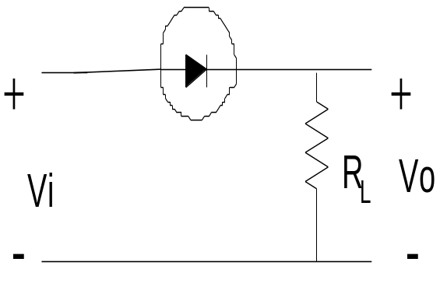
Clippers
Clippers or diode limiting is a diode network that have the ability to “clip” off a portion on the i/p signal without distorting the remaining part of the alternating waveform.
Clippers are used to eliminate amplitude noise or to fabricate new waveforms from an existing signal.
2 general of clippers:
a) Series clippers
b) Parallel clippers
Series Clippers
The series configuration is defined as one where the diode is in series with the load.
A half-wave rectifier is the simplest form of diode clipper-one resistor and diode.

Slide 4
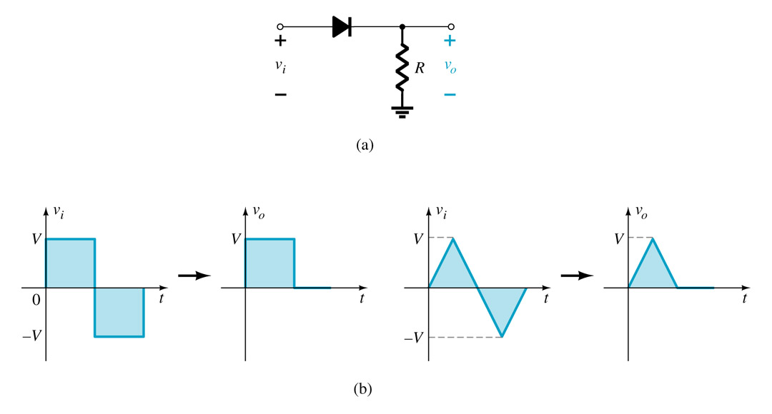
Clipper Diode Circuit
The diode “clips” any voltage that does not put it in forward bias. That would be a reverse biasing polarity and a voltage less than 0.7V for a silicon diode.

Slide 5
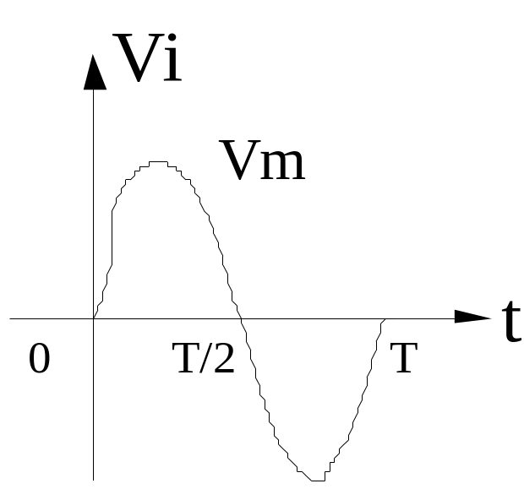
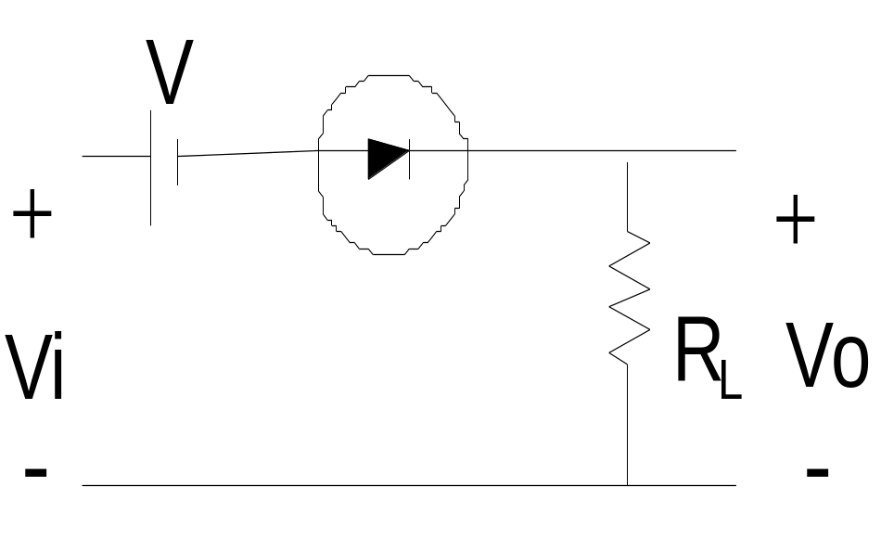
The half-wave rectifier with addition of dc supply is shown in following figure. The cct known as biased series clipper. The dc supply have pronounced effect on the o/p of a clipper.
Our initial discussion will be limited to ideal diode.
Biased series clipper

Slide 6
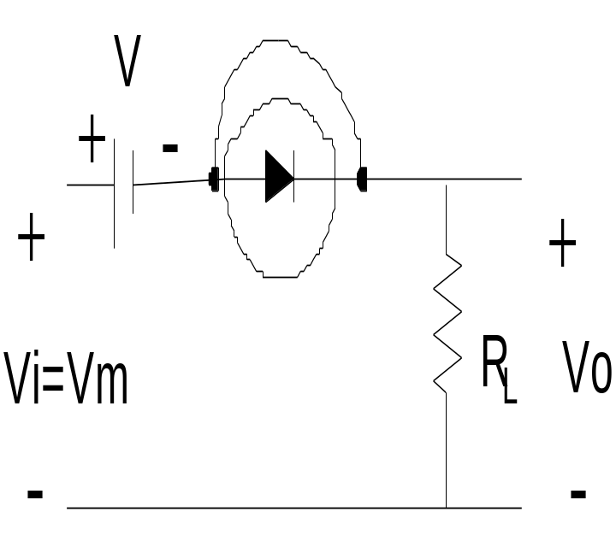
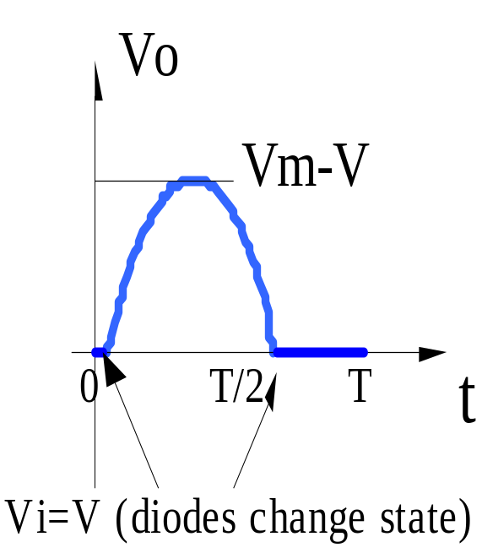
+ve region turn the diode ON.
-ve region turn the diode OFF.
Vi > V to turn ON the diode
In general diode is open cct (OFF state) and short cct (ON state)
For Vi > V the Vo = Vi – V
For Vi = V the Vo= 0 V
The complete cct shown above

Slide 7
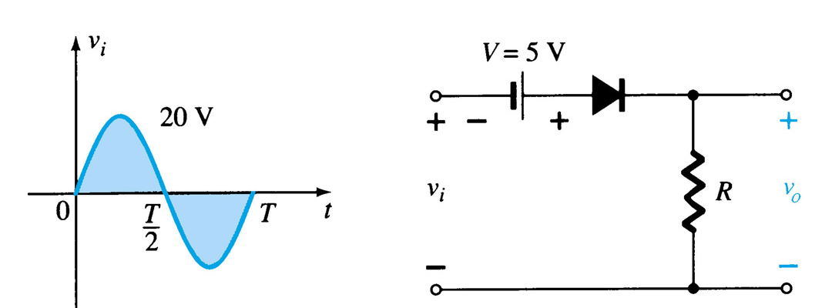
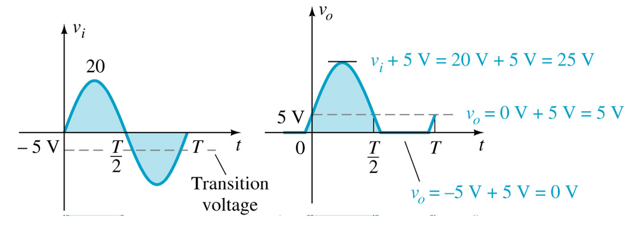
Example: Variations of the Clipper Circuit
Determine the o/p waveform for the network below:
Solution:

Slide 8
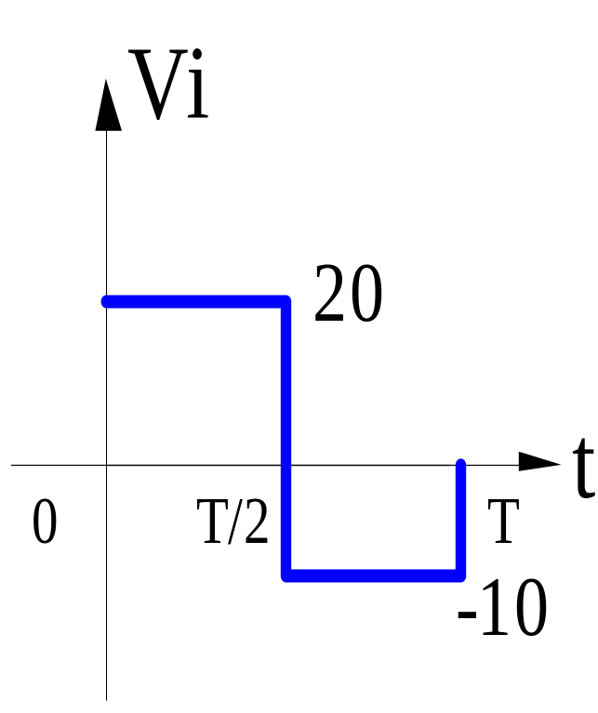
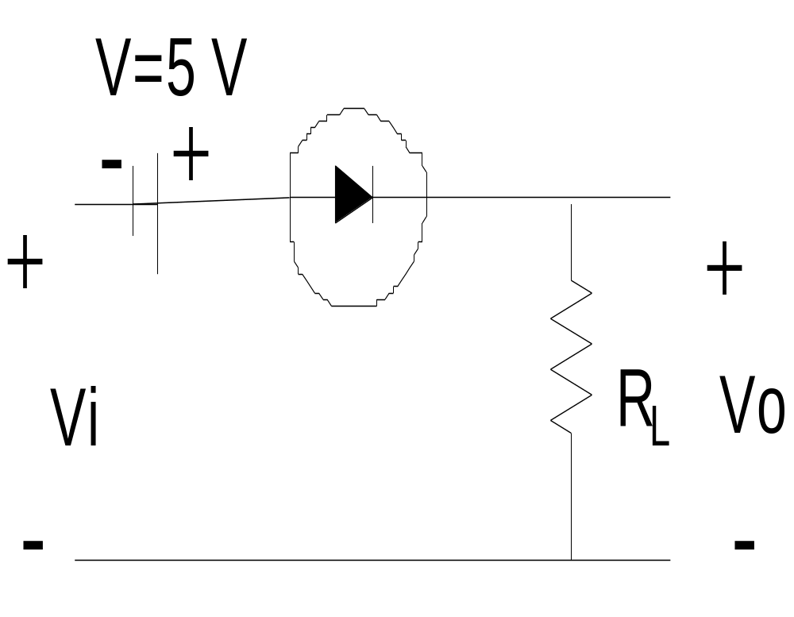
More Example:
Repeat previous example for the square-wave i/p.

Slide 9
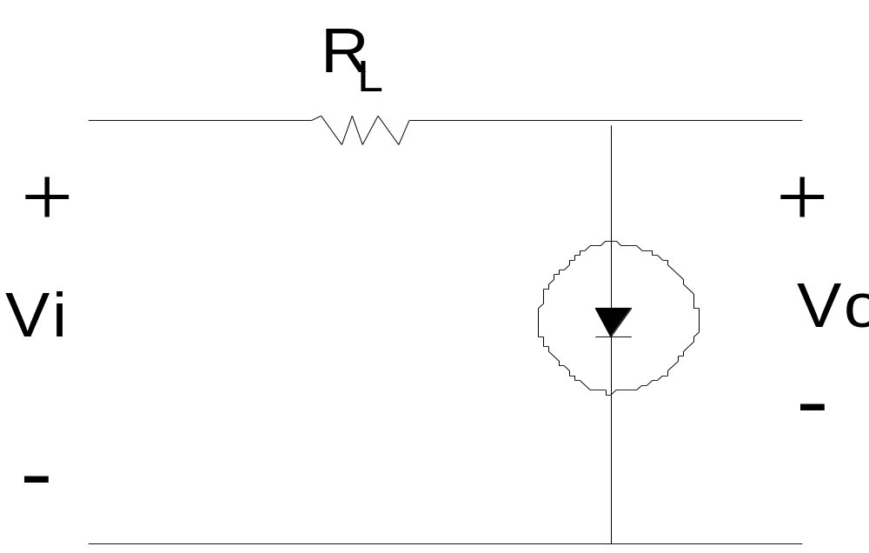
Parallel Clippers
The diode connection is in parallel configuration with the o/p.
Diode is ideal

Slide 10
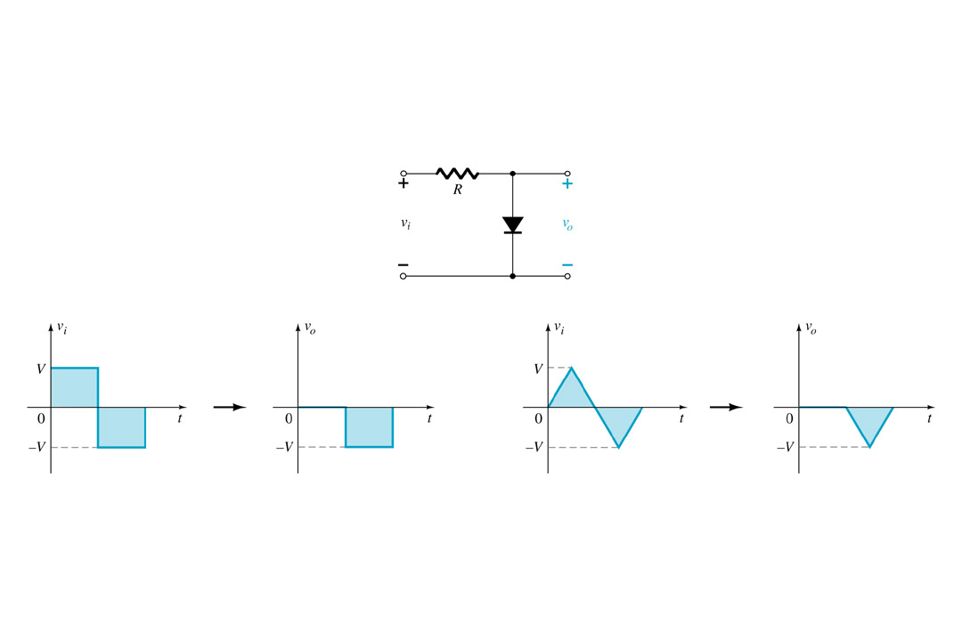
Changing Output Perspective
By taking the output across the diode, the output is now the voltage when the diode is not conducting.
A DC source can also be added to change the diode’s required forward bias voltage.

Slide 11
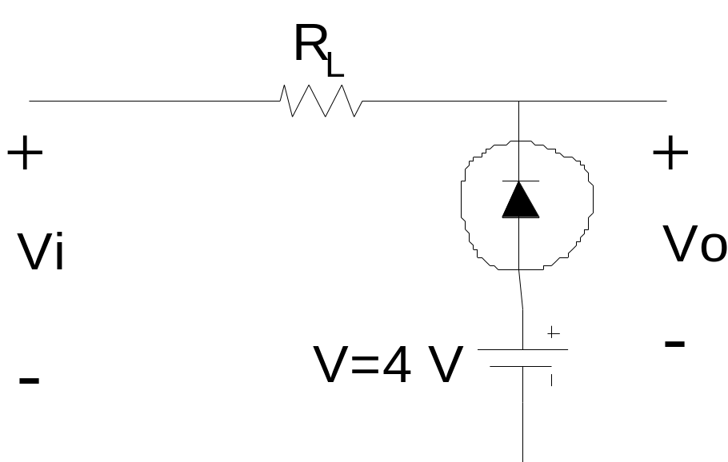
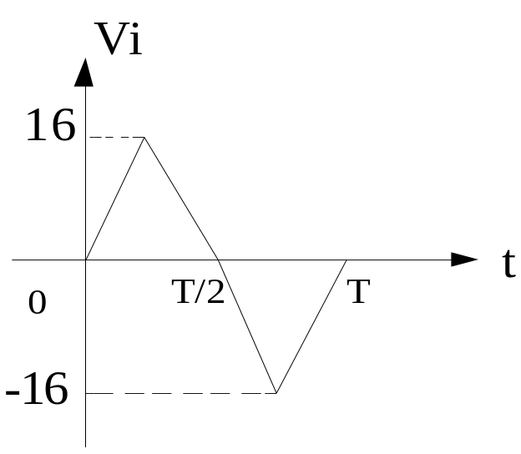
Example :
Determine the Vo and sketch the o/p waveform for the below network

Slide 12
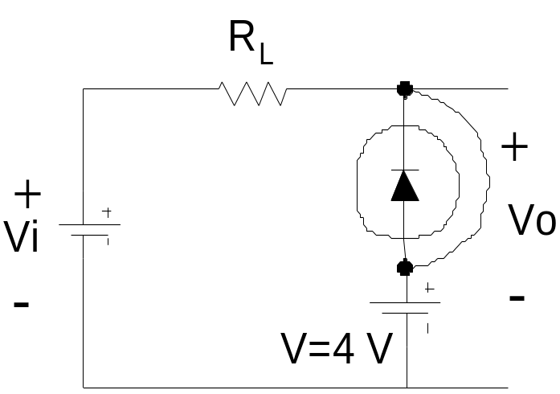
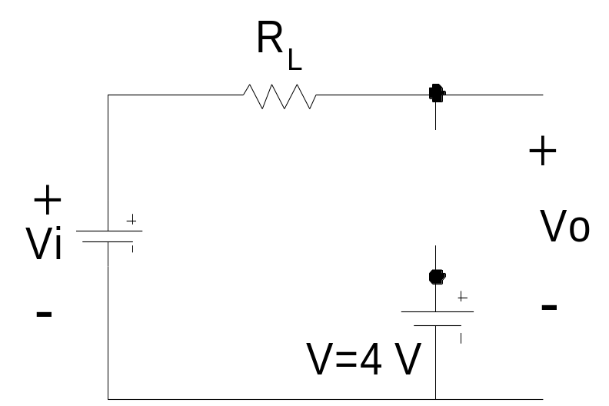
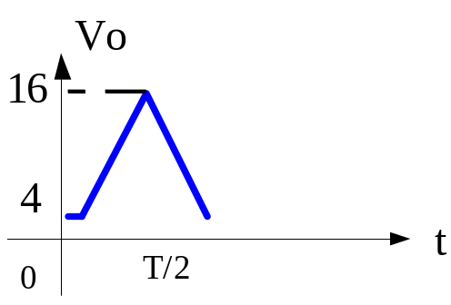
Vi
Diode state
Vo
Solution:
+ ve region
1
ON
V=Vo
2
ON
V=Vo
3
ON
V=Vo
4
ON
V=Vo
5
OFF
Vi=Vo
6
OFF
Vi=Vo
7
OFF
Vi=Vo
16
OFF
Vi=Vo

Slide 13
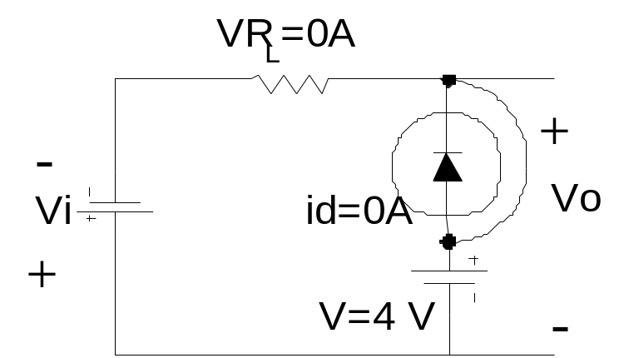
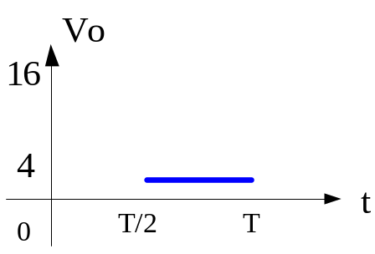
Solution (continued):
- ve region
Vi
Diode state
Vo
-1
ON
V=Vo
-2
ON
V=Vo
-3
ON
V=Vo
-4
ON
V=Vo
-5
ON
V=Vo
-6
ON
V=Vo
-7
ON
V=Vo
-16
ON
V=Vo

Slide 14
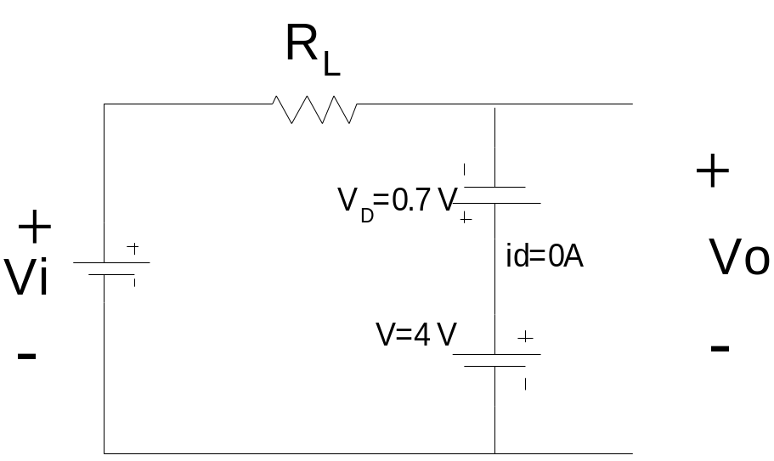
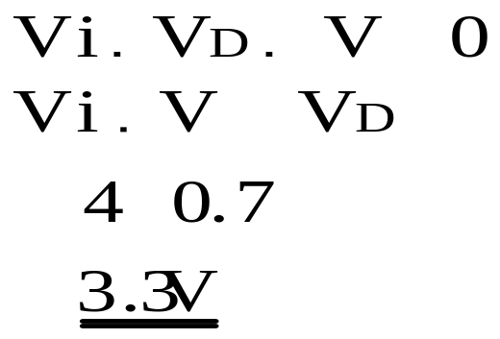
Example :
Repeat the previous example using a silicon diode with V_{D}=0.7 V
Solution:

Slide 15
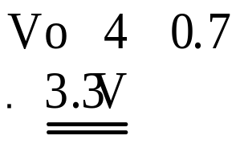
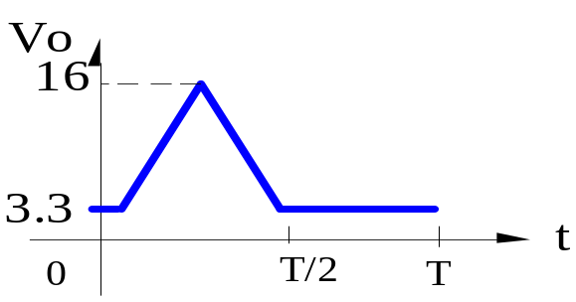
Solution (continued):
For i/p voltages greater than 3.3 V the diode open cct and Vo=Vi.
For i/p voltages less than 3.3 V the diode short cct and the network result as/;
The resulting o/p waveform 

Slide 16
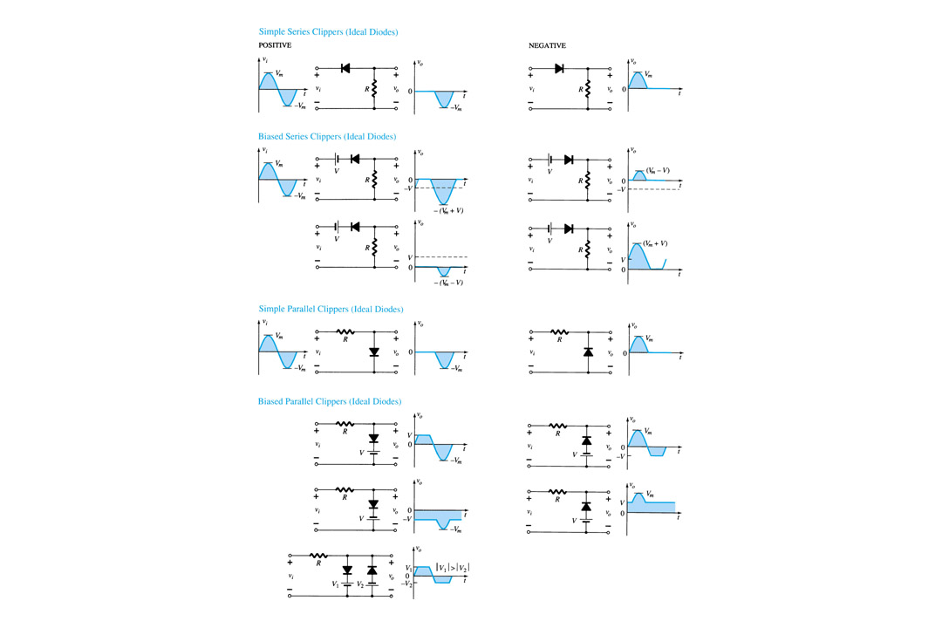
Clipper Circuits Summary

Slide 17
Clipper Circuits Summary

Slide 18
Clampers
The clamping network is to “clamp” a signal to a different dc level. Also known as dc restorers. The clamping cct is often used in TV receivers as a dc restorer.
The network consists of:
a) Capacitor
b) Diode
c) Resistive element
d) Independent dc supply (option)
The magnitude of R and C must be chosen such that the time constant
τ = RC is large enough to ensure that the voltage across the capacitor does not discharge significantly during the interval the diode is nonconducting.
Our analysis basis that all capacitor is fully charge and discharge in 5 time constant.

Slide 19
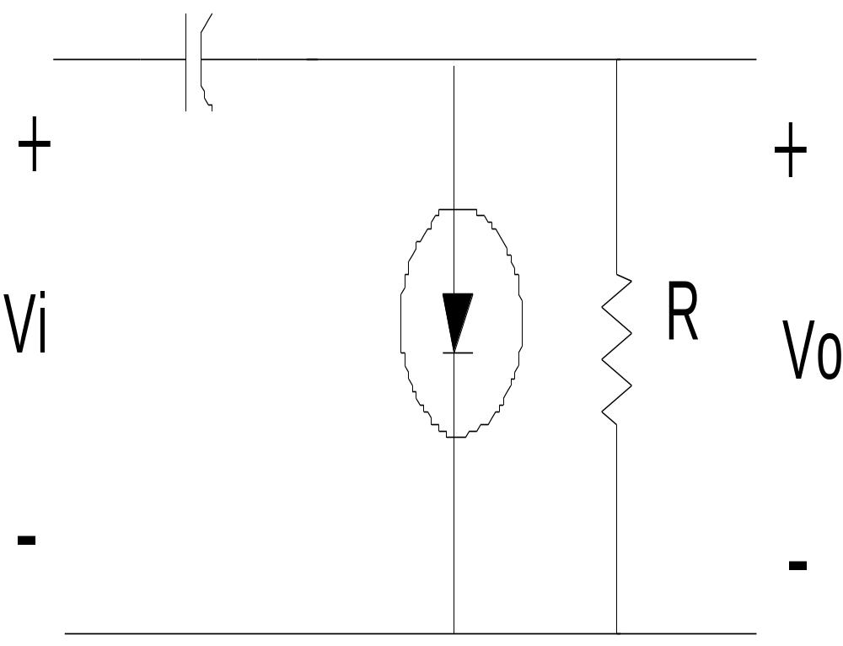
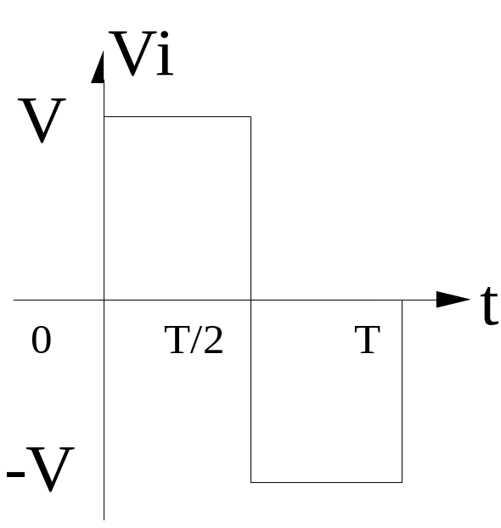

Slide 20
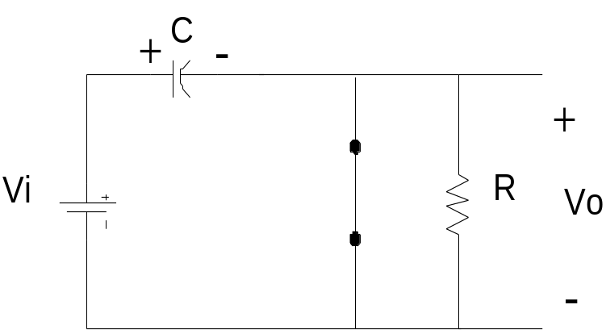
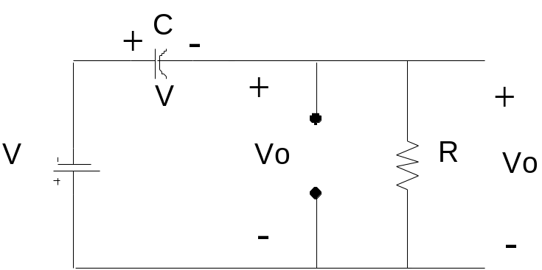
Operation of clamper
+ ve region
0 - T/2: Diode is ON state (short-cct equivalent)
Assume RC time is small and capacitor charge to V volts very quickly
Vo=0 V (ideal diode)
- ve region
T/2  T: Diode is OFF state (open-cct equivalent)
Both for the stored voltage across capacitor and applied signal current through cathode to anode
KVL: - V- V- Vo = 0 and
Vo = -2V

Slide 21
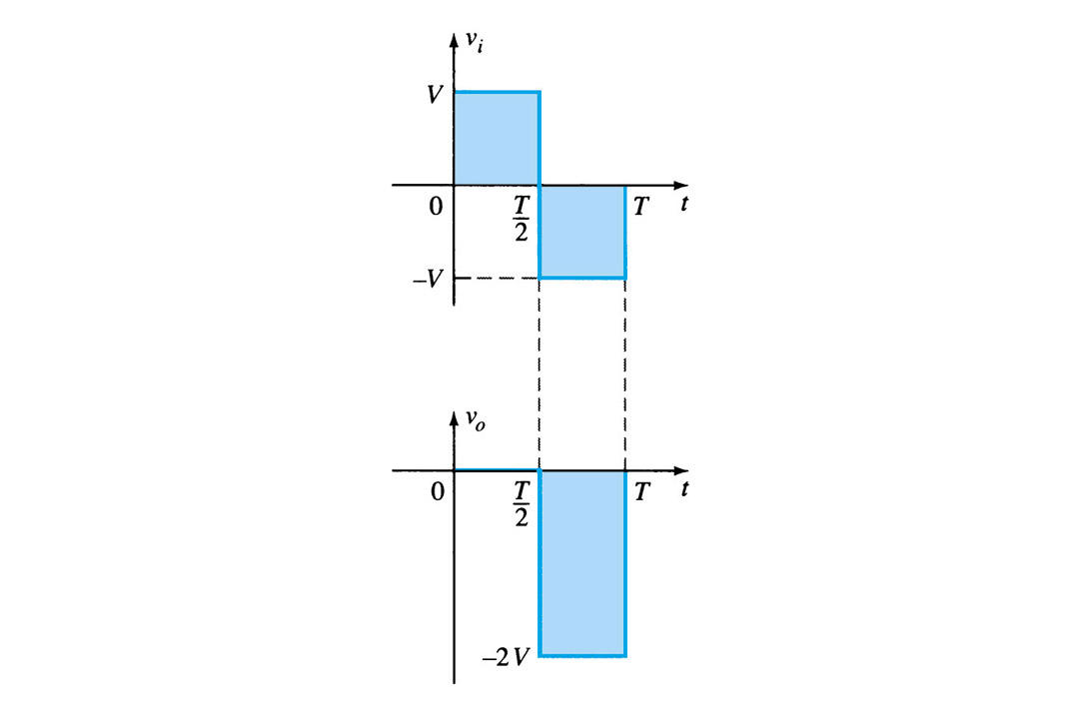
Tips : Clamping network
Total swing o/p signal = the total swing i/p signal

Slide 22
Example:
Determine Vo for the network below:

Slide 23
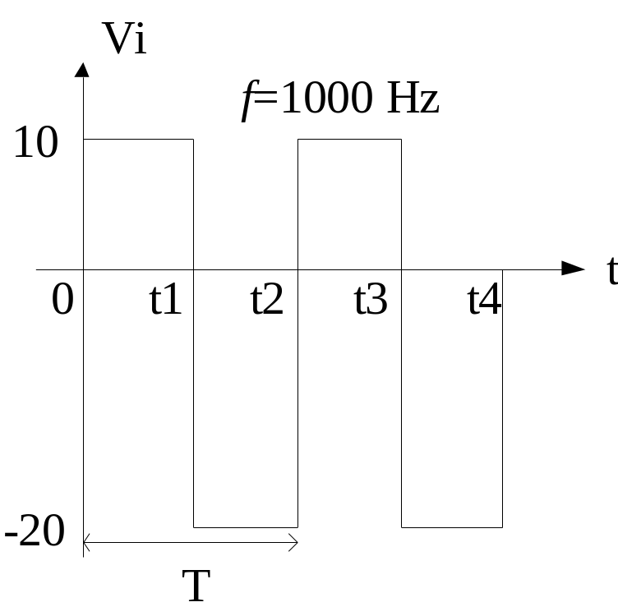
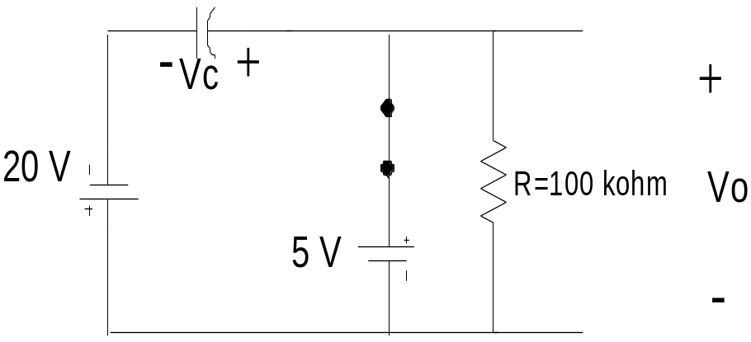
Solution:
Step 1: Consider the part of i/p signal that will forward bias the diode. From network (t1 - t2:-ve region)
Step 2: During ON state assume capacitor will charge to a voltage level determined by the network. Find the store voltage capacitor & obtained Vo
KVL: -20 +Vc – 5 = 0
Vc = 25v
Vo = 5

Slide 24
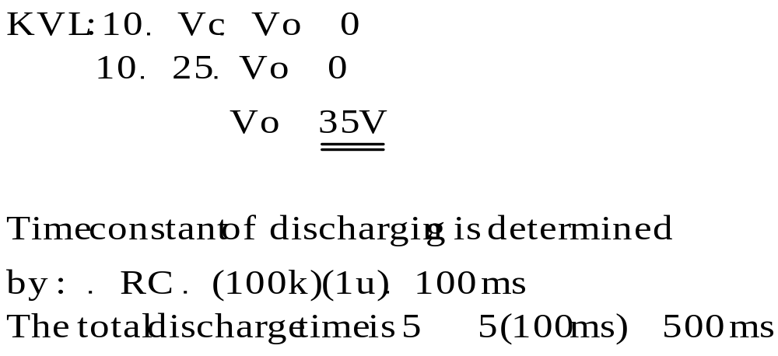
Solution (cntd):
Step 3: During OFF state assume capacitor will hold on its established voltage level. From network (t2 - t3:+ve region)
C
-
+
+
Vc
10 V
R=100 kohm
Vo
5 V
-
KVL
Step 4: Obtained Vo

Slide 25
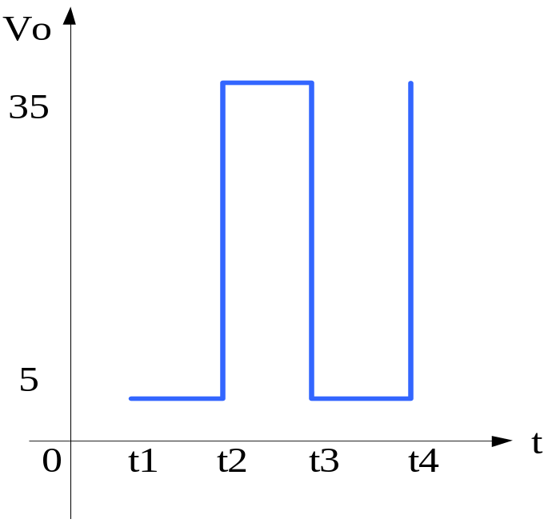
Solution (cntd):
Step 5: Checking!!! total swing o/p signal = total swing i/p signal
From network (t2 - t3: +ve region)

Slide 26
Example:
Repeat the previous example using a germanium diode !!!

Slide 27
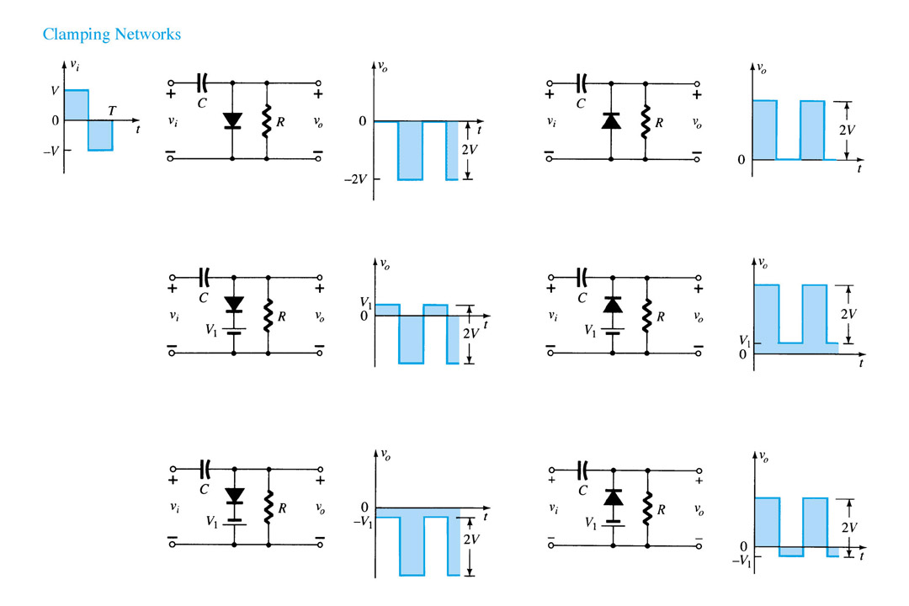
Summary of Clamper Circuits

Slide 28
Zener Diodes
The zener diode is a special type of diodes that is designed to work in the reverse breakdown region.
But it also can operate in the forward bias region.
Zener diode is a main component to design voltage regulator circuit for DC power supply.
Zener Diodes Characteristic
The I-V characteristics of a diode in Fig 3.19 shows that the breakdown voltage of a diode is nearly constant over a wide-range of reverse-bias currents.

Slide 29
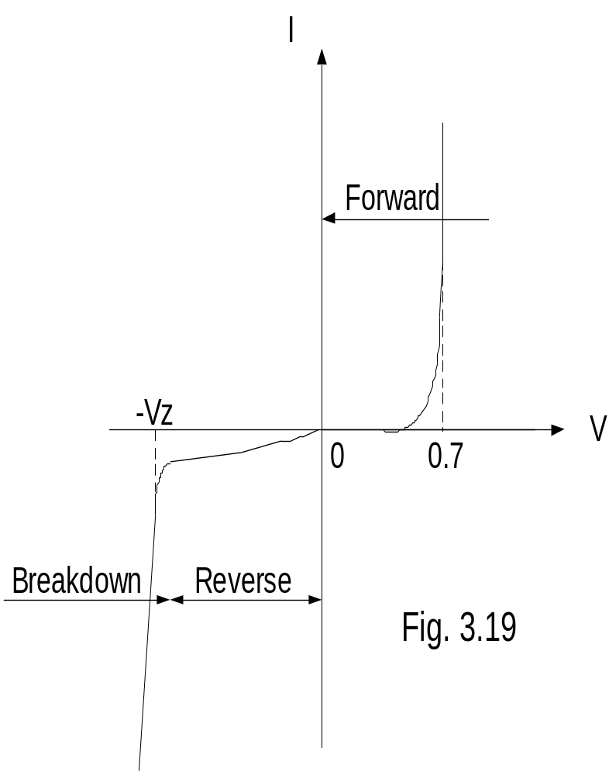
Operation region:
Forward bias-operate same as
normal diode
Reverse bias-small current flow
Breakdown-big current flow. This is the region where the voltage zener is constant
For normal diode breakdown voltage is capable to destroy the diode but with zener diode the current is limited by connecting series resistor.

Slide 30
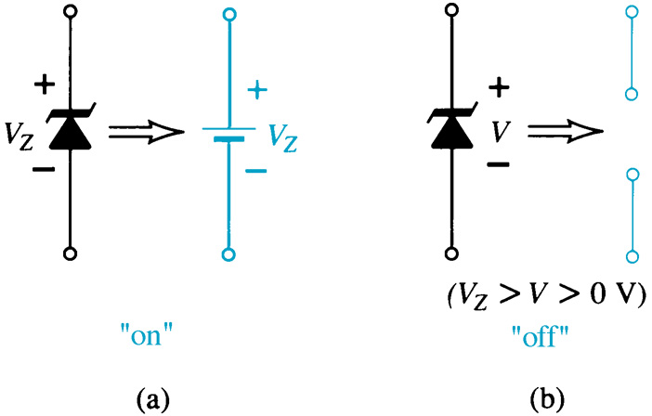
Zener Diode
The Zener is a diode operated in reverse bias at the Zener Voltage (V_{z}).

Slide 31
Vi and R fixed
Fixed DC voltage is applied in network below, as is the load resistor.
The analysis can be determined with 2 steps.

Slide 32
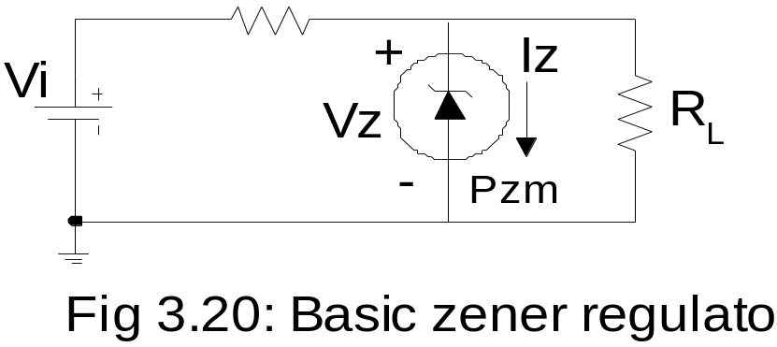
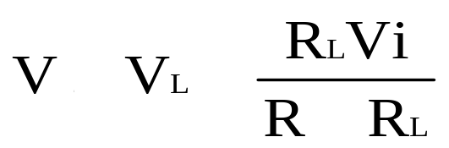
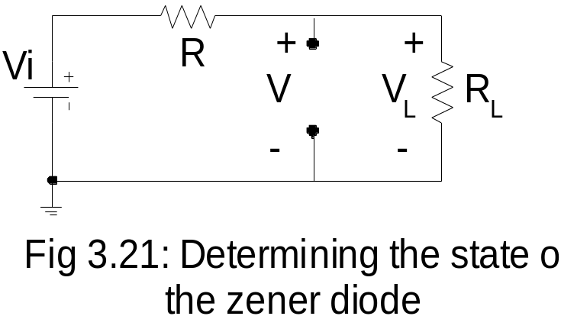
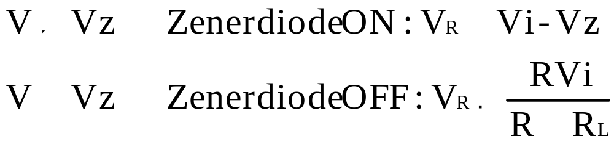
Step 1:
Determine the state of zener diode by removing it from the network and calculating the voltage across the resulting open cct.

Slide 33
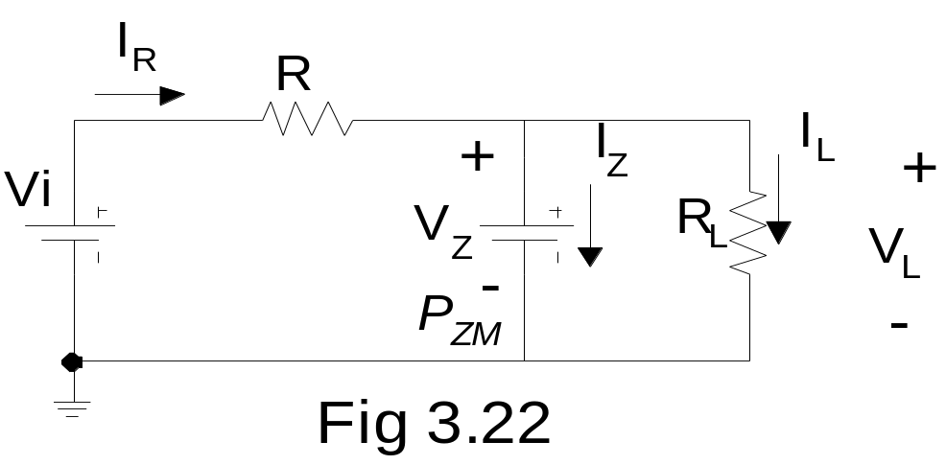

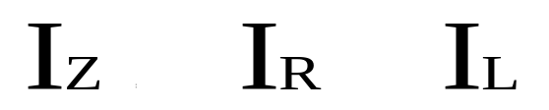
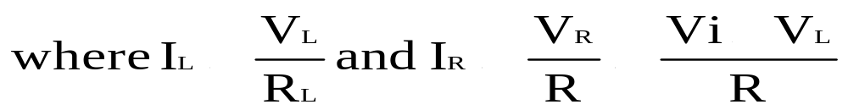
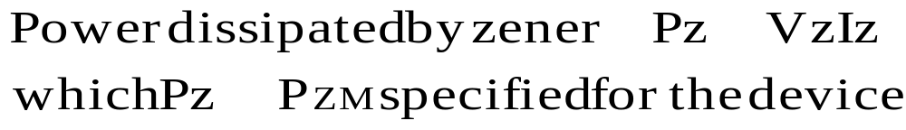
Step 2:
Subtitute the appropriate equivalent cct and solve for the desired unknowns.
The ON state will obtained the equivalent cct in
Fig below

Slide 34
Example:
a) Determine V_{L}, V_{R}, I_{Z} and P_{Z} in the network below.
b) Repeat part (a) with R_{L}=3 kΩ

Slide 35
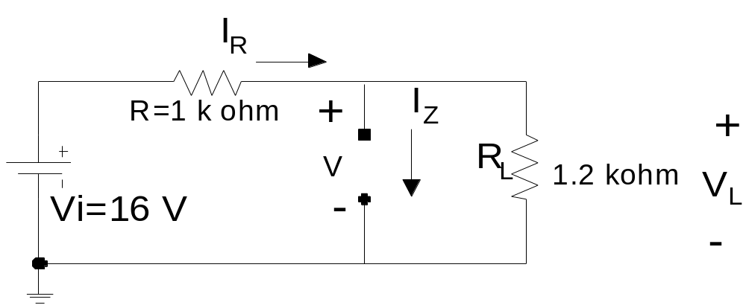
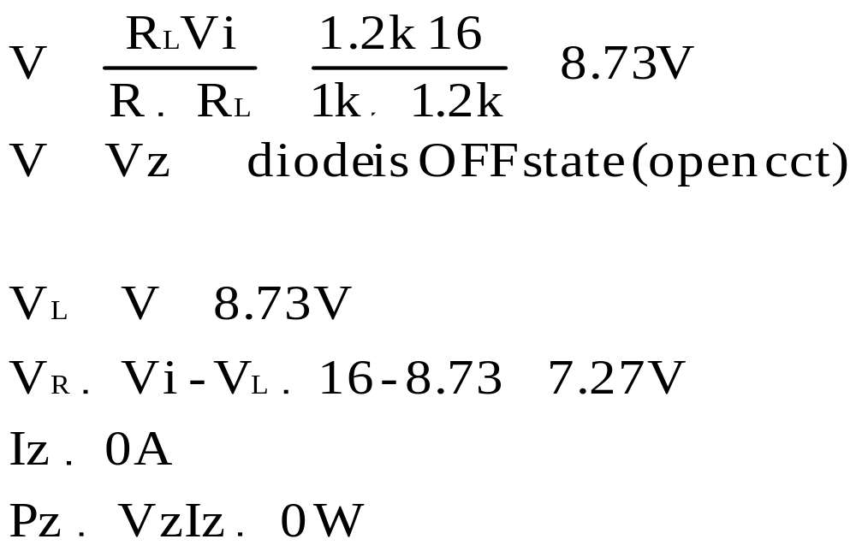
Solution:
Step 1: Remove zener diode & obtained the zener state
10
8.73
Resulting operating point

Slide 36
Repeat part (a) with R_{L}=3 kΩ

Slide 37
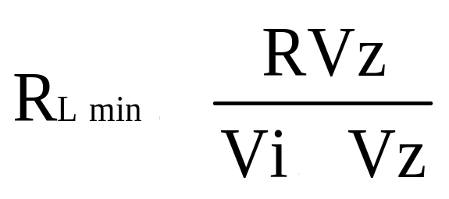
Fixed Vi, Variable R_{L}
For an offset Vz a specific range of resistor values need to be choose to ensure zener diode is ON state.
Too small a load resistance will cause V_{L} < Vz - diode is OFF state.
Thus the minimum load resistance in previous example need to be calculate. This can be expressed by the equation below:
R_{L} > R_{Lmin} zener diode is ON state diode can replaced by Vz source equivalent

Slide 38
With R_{L} changes the I_{L} also changes. The table below described relationship between R_{L} ,I_{L}, I_{R}
Notes: Izmax = Izm

Slide 39
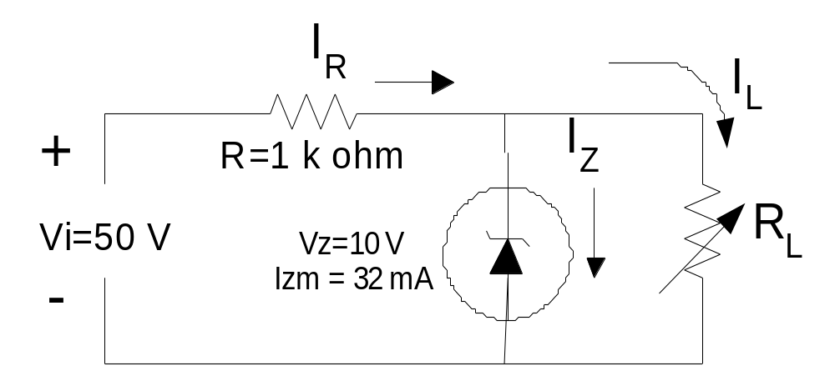
Example:
a) For the network below, determine the range of R_{L} and I_{L} that will result in V_{RL} being maintained at 10 V.
b) Determine the maximum wattage rating of the diode.

Slide 40
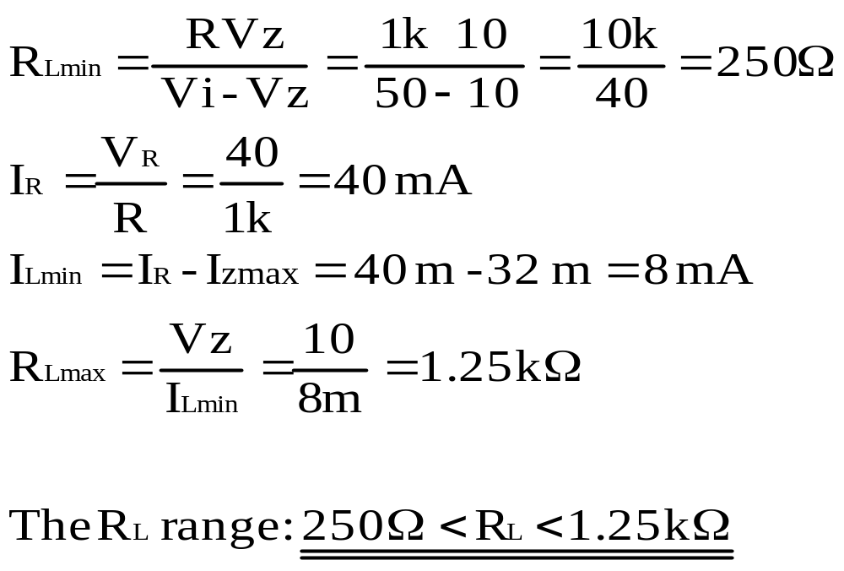
Solution:(a)
Solution: (b)

Slide 41
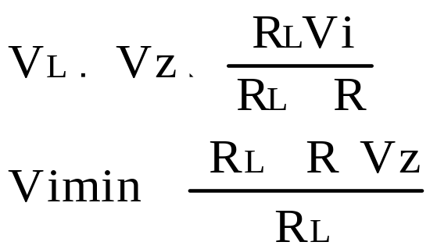

Fixed R_{L}, Variable Vi
For a fixed values of R_{L} in the network below, Vi must be sufficiently LARGE to turn zener diode ON.
The minimum turn-ON voltage Vi=Vimin is expressed by :

Slide 42


The maximum value of Vi is limited by the maximum zener current, Izmax, thus
I_{L} is fixed at Vz/R_{L} and Izmax is the maximum value so the maximum value of Vi is expressed below:

Slide 43

Example:
Determine the range of values of Vi that will maintain the
zener diode of network below:

Slide 44


Solution:

Slide 46
Practical Applications of Diode Circuits
  Rectifier Circuits
Conversions of AC to DC for DC operated circuits
Battery Charging Circuits
  Simple Diode Circuits
Protective Circuits against Overcurrent
Polarity Reversal Currents caused by an inductive kick in a relay circuit
  Zener Circuits
Overvoltage Protection
Setting Reference Voltages

