Slide 1


ELS 2202 Electronics I
Electronics I
Week 5.ii
5.2 Special Diode Types
INSTITUT TEKNOLOGI DEL
Jl Sisingamangaraja, Tobasamosir (22581), Sumatera Utara, Indonesia
telp +62652551254, fax +626525511116, www.del.ac.id
Notes:
http://www.ee.cityu.edu.hk/~ee2501/lecture.htm

Slide 2
Acknowledgement
I want to express my gratitude to Prentice Hall giving me the permission to use instructor’s material for developing this module. I would like to thank the Department of Electrical Engineering. I hope this module is helpful to enhance our students’ academic performance.

Slide 3
Outlines
Introduction to Zener Diode
Voltage regulation and limiting
The varactor diode
LEDs and photodiodes
Special Diodes
Key Words: Zener Diode, Voltage Regulation, LED, Photodiode, Special Diode
EI 1.1 Electronics – Special Purpose Diodes ITDel 2

Slide 4
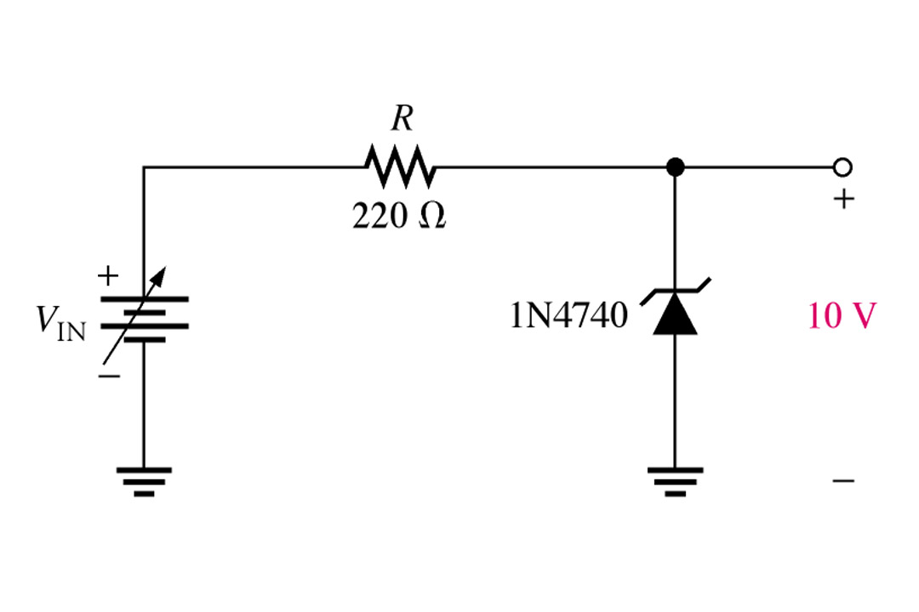
Introduction
The zener diode is a silicon pn junction devices that differs from rectifier diodes because it is designed for operation in the reverse-breakdown region. The breakdown voltage of a zener diode is set by carefully controlling the level during manufacture. The basic function of zener diode is to maintain a specific voltage across it’s terminals within given limits of line or load change. Typically it is used for providing a stable reference voltage for use in power supplies and other equipment.
This particular zener circuit will work to maintain 10 V across the load.
EI 1.1 Electronics – Special Purpose Diodes ITDel 5
Notes:
Fig. 5-9 Simple zener diode reg. circuit & label zener terminals

Slide 5
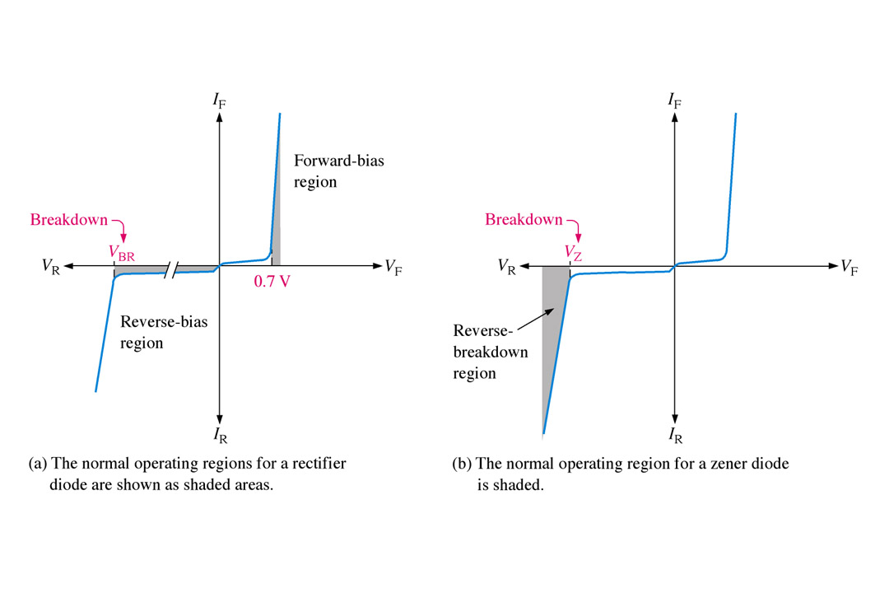
Zener Diodes
A zener diode is much like a normal diode. The exception being is that it is placed in the circuit in reverse bias and operates in reverse breakdown. This typical characteristic curve illustrates the operating range for a zener. Note that it’s forward characteristics are just like a normal diode.
Volt-ampere characteristic is shown in this Figure with normal operating regions for rectifier diodes and for zener diodes shown as shaded areas.
4
Notes:
Fig 5-2 b zener curve

Slide 6
Zener Breakdown
Zener diodes are designed to operate in reverse breakdown. Two types of reverse breakdown in a zener diode are avalanche and zener. The avalanche break down occurs in both rectifier and zener diodes at a sufficiently high reverse voltage. Zener breakdown occurs in a zener diode at low reverse voltages.
A zener diode is heavily doped to reduced the breakdown voltage. This causes a very thin depletion region. As a result, an intense electric field exists within the depletion region. Near the zener breakdown voltage (V_{z}), the field is intense enough to pull electrons from their valence bands and create current. The zener diodes breakdown characteristics are determined by the doping process
Low voltage zeners less than 5V operate in the zener breakdown range. Those designed to operate more than 5 V operate mostly in avalanche breakdown range. Zeners are commercially available with voltage breakdowns of 1.8 V to 200 V.
EI 1.1 Electronics – Special Purpose Diodes ITDel 5
Notes:
Fig 5-5

Slide 7
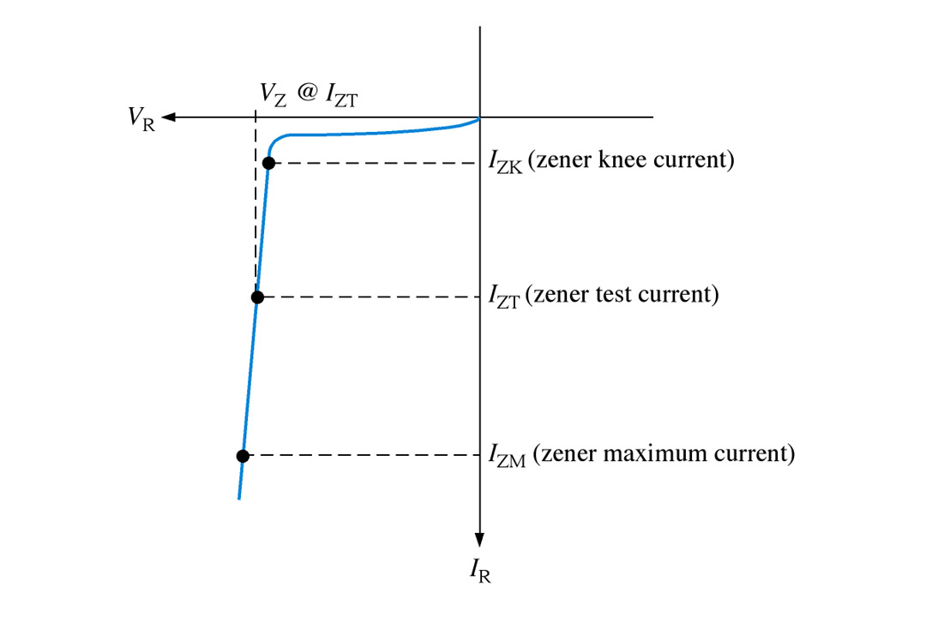
Breakdown Characteristics
Figure shows the reverse portion of a zener diode’s characteristic curve. As the reverse voltage (V_{R}) is increased, the reverse current (I_{R}) remains extremely small up to the “knee” of the curve. The reverse current is also called the zener current, I_{Z}. At this point, the breakdown effect begins; the internal zener resistance, also called zener impedance (Z_{Z}), begins to decrease as reverse current increases rapidly.
EI 1.1 Electronics – Special Purpose Diodes ITDel 6

Slide 8
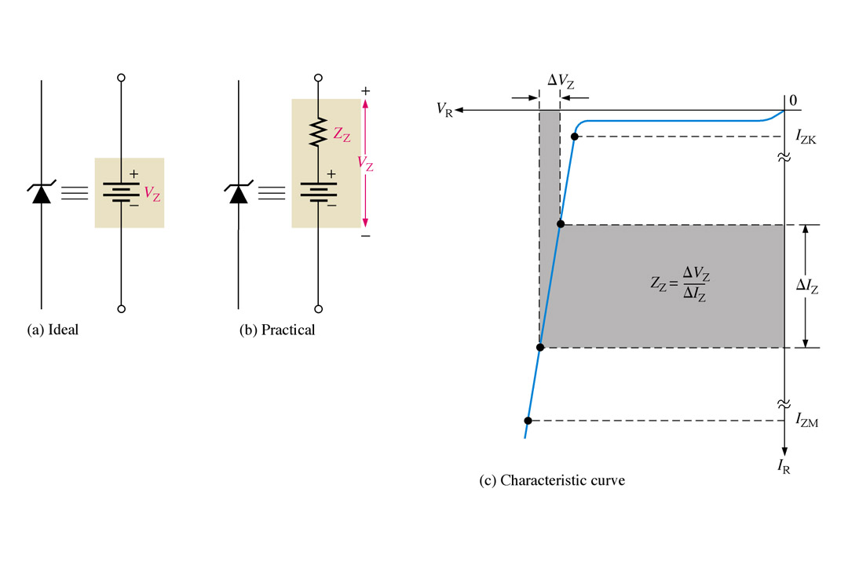
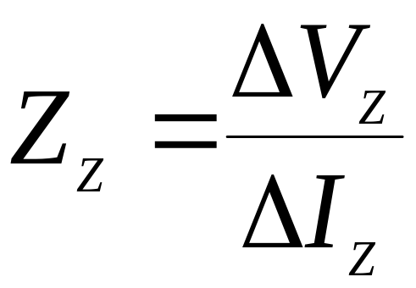
Zener Equivalent Circuit
Figure (b) represents the practical model of a zener diode, where the zener impedance (Z_{Z}) is included. Since the actual voltage curve is not ideally vertical, a change in zener current (ΔI_{Z}) produces a small change in zener voltage (ΔV_{Z}), as illustrated in Figure (c).
Zener diode equivalent circuit models and the characteristic curve illustrating Z_{Z}.
EI 1.1 Electronics – Special Purpose Diodes ITDel 7

Slide 9
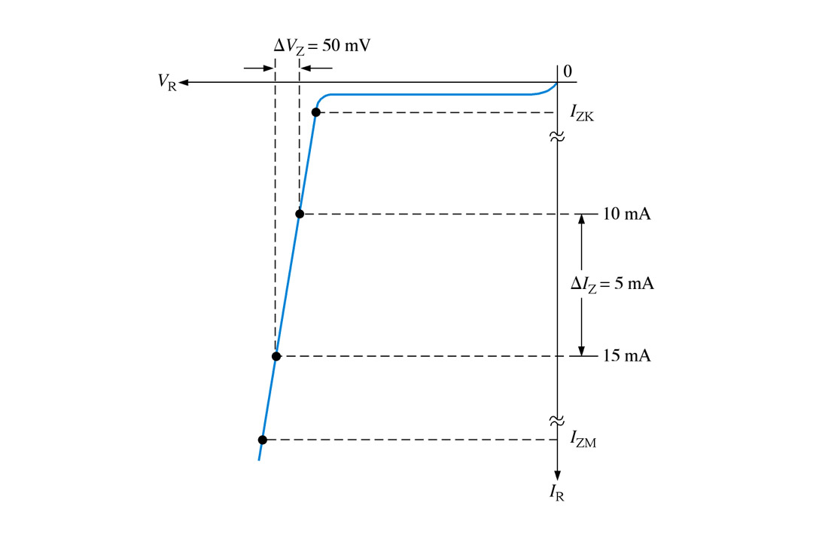
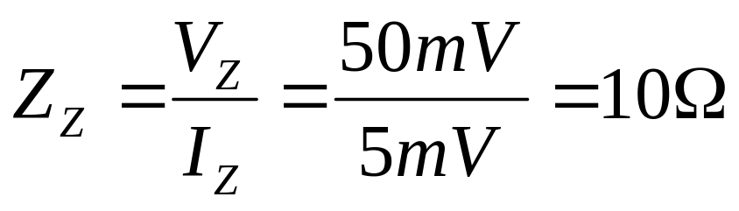
Ex 5-1 A zener diode exhibits a certain change in V_{Z} for a certain change in I_{Z} on a portion of the linear characteristic curve between I_{ZK} and I_{ZM} as illustrated in Figure. What is the zener impedance?
EI 1.1 Electronics – Special Purpose Diodes ITDel 8

Slide 10
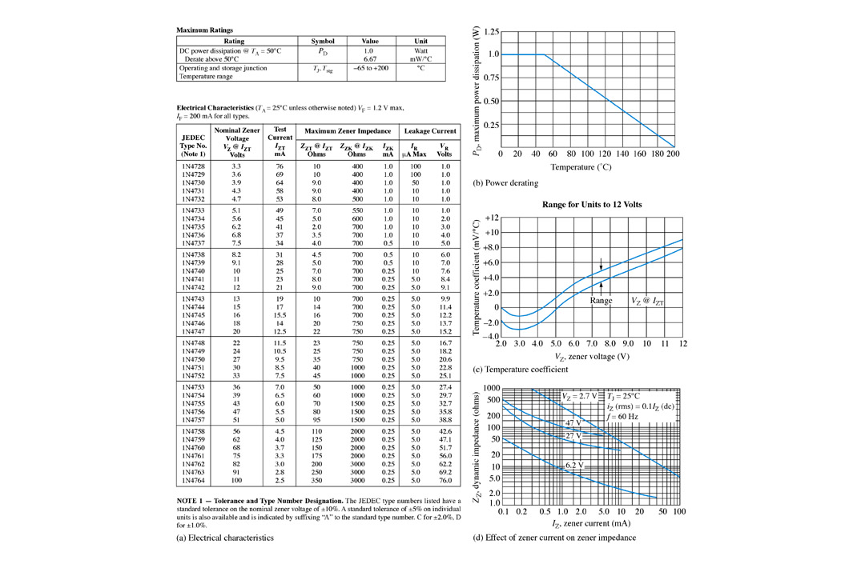
Zener diode Data Sheet Information
As with most devices, zener diodes have given characteristics such as temperature coefficients and power ratings that have to be considered. The data sheet provides this information.
V_{Z}: zener voltage I_{ZT}: zener test current Z_{ZT}: zener Impedance I_{ZK}: zener knee current I_{ZM}: maximum zener current
Partial data sheet for the 1N4728-1N4764 series 1 W zener diodes.
EI 1.1 Electronics – Special Purpose Diodes ITDel 9

Slide 11
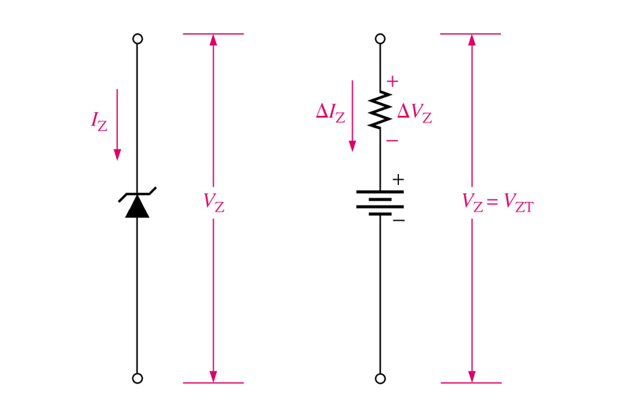
Ex 5-2 A IN4756 zener diode has a Z_{ZT} of 5.5 Ω. The data sheet gives V_{ZT} = 6.8 V at I_{ZT} = 57 mA and I_{ZK} = 1 mA. What is the voltage across the zener terminals when the current is 50 mA? When the current is 25 mA?
ΔI_{Z} = I_{Z} – I_{ZT} = + 15 mA
ΔV_{Z} = ΔI_{Z} Z_{ZT} = (15 mA)(5.5 Ω)
= +45.5mV
V_{Z} = 6.8 V + ΔV_{Z}
= 6.8 V + 45.5 mV = 6.85V
ΔI_{Z} = - 12 mA
ΔV_{Z} = ΔI_{Z} Z_{ZT}
= (-12 mA)(5.5 Ω)
= - 42 mV
V_{Z} = 6.8 V - ΔV_{Z} = 6.8 V - 42 mV = 6.76V
EI 1.1 Electronics – Special Purpose Diodes ITDel 10

Slide 12
Ex 5-5 An 8.2 V zener diode (8.2 V at 25 ºC) has a positive temperature coefficient of 0.05 %/ºC. What is the zener voltage at 60 ºC?
The temperature coefficient specifies the percent change in zener voltage for each ºC change in temperature. For example, a 12 V zener diode with a positive temperature coefficient of 0.01%/ºC will exhibit a 1.2 mV increase in V_{Z} when the junction temperature increases one Celsius degree. ΔV_{Z} = V_{Z} × TC × ΔT
Where V_{Z} is the nominal zener voltage at 25 ºC, TC is the temperature coefficient, and ΔT is the change in temperature.
The change in zener voltage is
ΔV_{Z} = V_{Z} × TC × ΔT = (8.2 V)(0.05 %/ºC)(60 ºC – 25 ºC)
= (8.2 V)(0.0005/ºC)(55 ºC) = 144 mV
Notice that 0.05%/ºC was converted to 0.0005/ºC. The zener voltage at 60 ºC is
V_{Z} + ΔV_{Z} = 8.2 V + 144 mV = 8.54 V
EI 1.1 Electronics – Special Purpose Diodes ITDel 11

Slide 13
Zener Power Dissipating and Derating
Zener diodes are specified to operate at a maximum power called the maximum dc power dissipation, P_{D(max)}.
P_{D} = V_{Z}I_{Z}
The maximum power dissipation of a zener diode is typically specified for temperature at or below a certain value (50 ºC, for example). The derating factor is expressed in mW/ºC. The maximum derated power can be determined with the following formula:
P_{D(derated)} = P_{D(max)} – (mW/ºC)ΔT
Ex 5-4 A certain zener diode has a maximum power rating of 400 mW at 50 ºC and a derating factor of 5.2 mW/ºC. Determine the maximum power the zener can dissipate at a temperature of 90 ºC.
P_{D(derated)} = P_{D(max)} – (mW/ºC)ΔT
= 400 mW – (5.2 mW/ºC)(90ºC – 50 ºC)
= 400 mW – 128 mW = 272 mW
EI 1.1 Electronics – Special Purpose Diodes ITDel 12

Slide 14
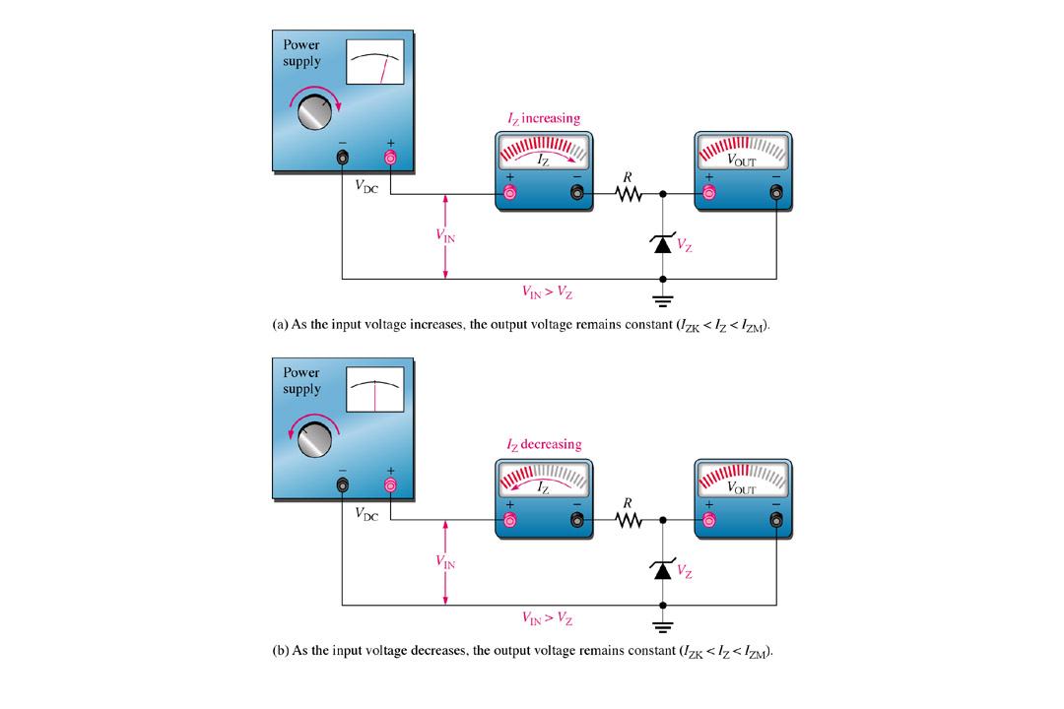
Zener Diode Applications –
Zener Regulation with a Varying Input Voltage
EI 1.1 Electronics – Special Purpose Diodes ITDel 15

Slide 15
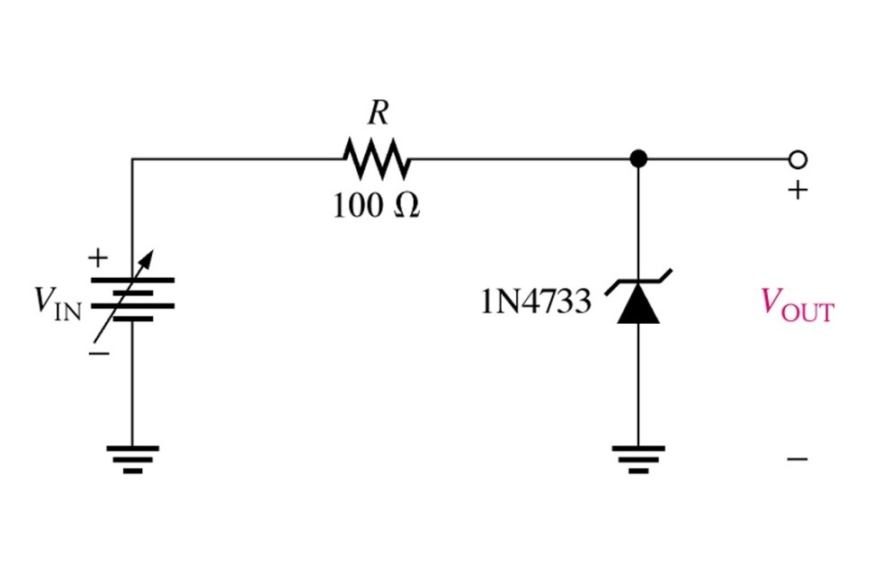
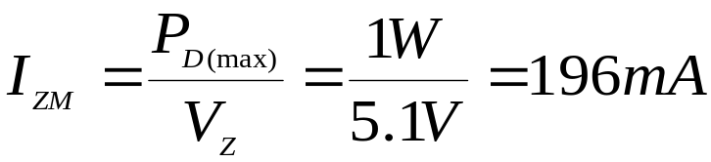
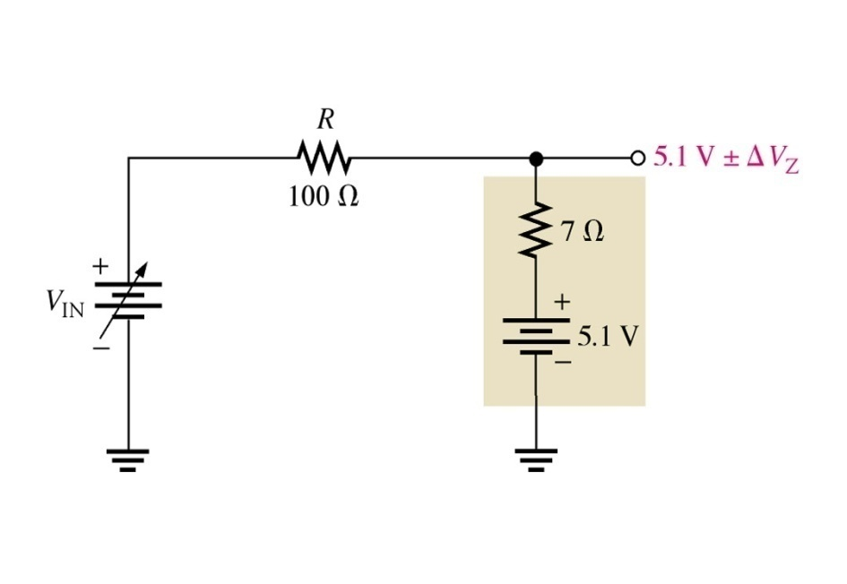
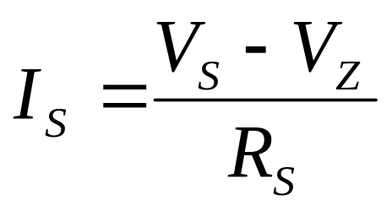
Ex 5-5 Determine the minimum and the maximum input voltages that can be regulated by the zener diode in Figure.
From the data sheet in Figure, the following information for the IN4755 is obtained:
V_{Z} = 5.1 V at I_{ZT} = 49 mA, I_{ZK} = 1 mA, and
Z_{Z} = 7 Ω at I_{ZT}.
V_{OUT} ≈ 5.1V – ΔV_{Z} = 5.1 V – (I_{ZT} – I_{ZK})Z_{Z}
= 5.1 V – (48 mA)(7 Ω) = 5.1 V – 0.556 V
= 4.76 V
V_{IN(min)} = I_{ZK}R + V_{OUT}
= (1 mA)(100 Ω) + 4.76 V = 4.86 V
V_{OUT} ≈ 5.1V – ΔV_{Z} = 5.1 V + (I_{ZM} – I_{ZT})Z_{Z}
= 5.1 V + (147 mA)(7 Ω) = 5.1 V + 1.05 V
= 6.15 V
V_{IN(min)} = I_{ZM}R + V_{OUT}
= (196 mA)(100 Ω) + 6.15 V = 25.7 V
EI 1.1 Electronics – Special Purpose Diodes ITDel 14

Slide 16
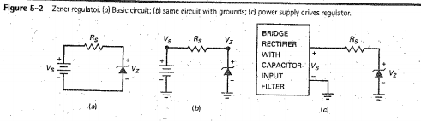
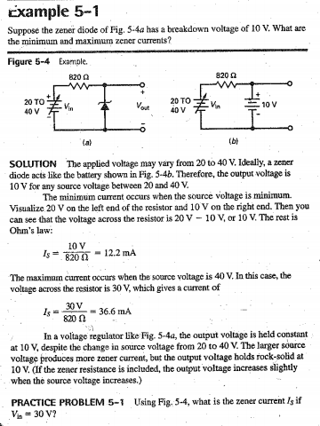

Slide 17
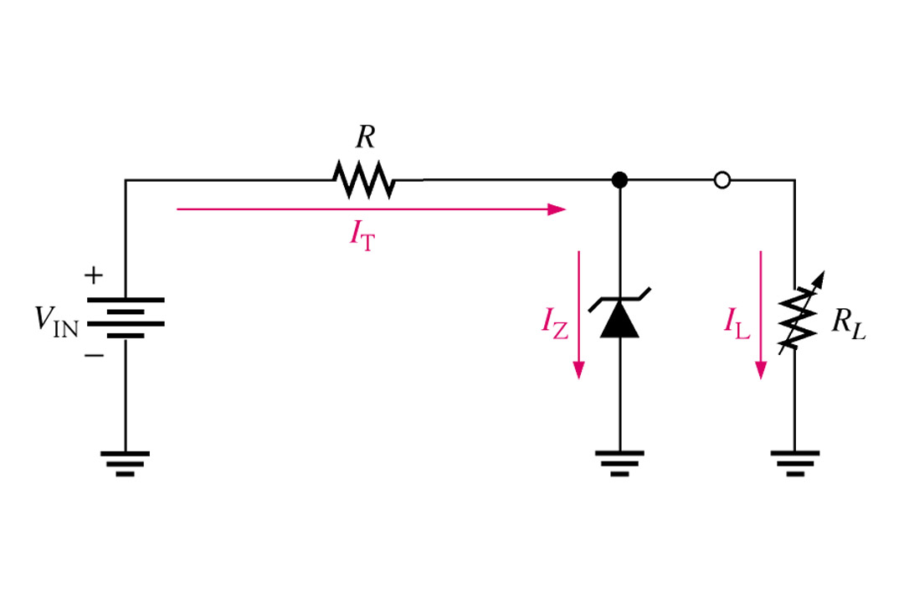

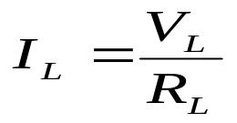


Zener Regulation with a Variable Load
In this simple illustration of zener regulation circuit, the zener diode will “adjust” its impedance based on varying input voltages and loads (R_{L}) to be able to maintain its designated zener voltage. Zener current will increase or decrease directly with voltage input changes. The zener current will increase or decrease inversely with varying loads. Again, the zener has a finite range of operation.
EI 1.1 Electronics – Special Purpose Diodes ITDel 15
Notes:
Fig. 5-12 Zener Reg.

Slide 18
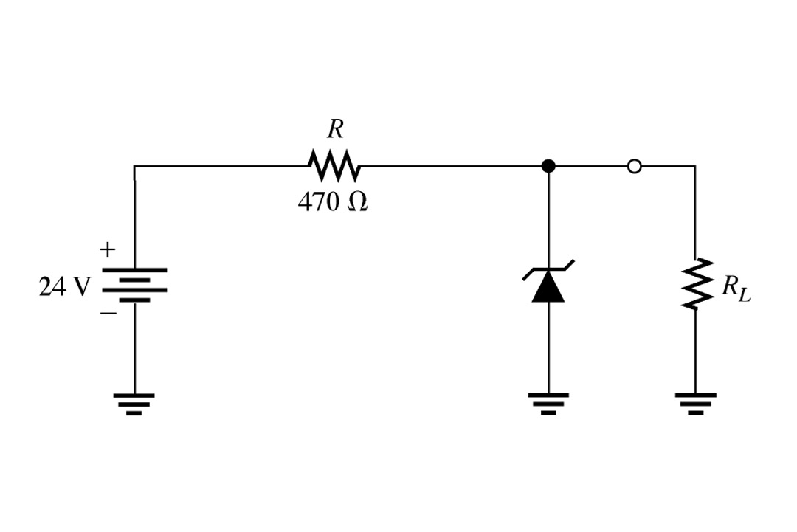
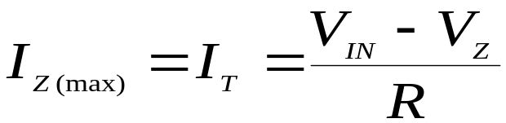
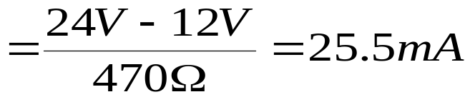
Ex 5-6 Determine the minimum and the maximum load currents for which the zener diode in Figure will maintain regulation. What is the minimum R_{L} that can be used? V_{Z} = 12 V, I_{ZK} = 1 mA, and I_{ZM} = 50 mA. Assume Z_{Z} = 0 Ω and V_{Z} remains a constant 12 V over the range of current values, for simplicity.
When I_{L} = 0 A (R_{L} = ∞), I_{Z} is maximum
Since I_{Z(max)} is less than I_{ZM}, 0 A is an acceptable minimum value for I_{L} because the zener can handle all of the 25.5 mA. I_{L(min)} = 0 A
The maximum value of I_{L} occurs when I_{Z} is minimum (I_{Z} = I_{ZK}),
I_{L(max)} = I_{T} – I_{ZK} = 25.5 mA – 1mA = 24.5 mA
The minimum value of RL is
R_{L(min)}=V_{Z}/I_{L(max)} = 12 V/24.5 mA = 490 Ω
EI 1.1 Electronics – Special Purpose Diodes ITDel 16

Slide 19
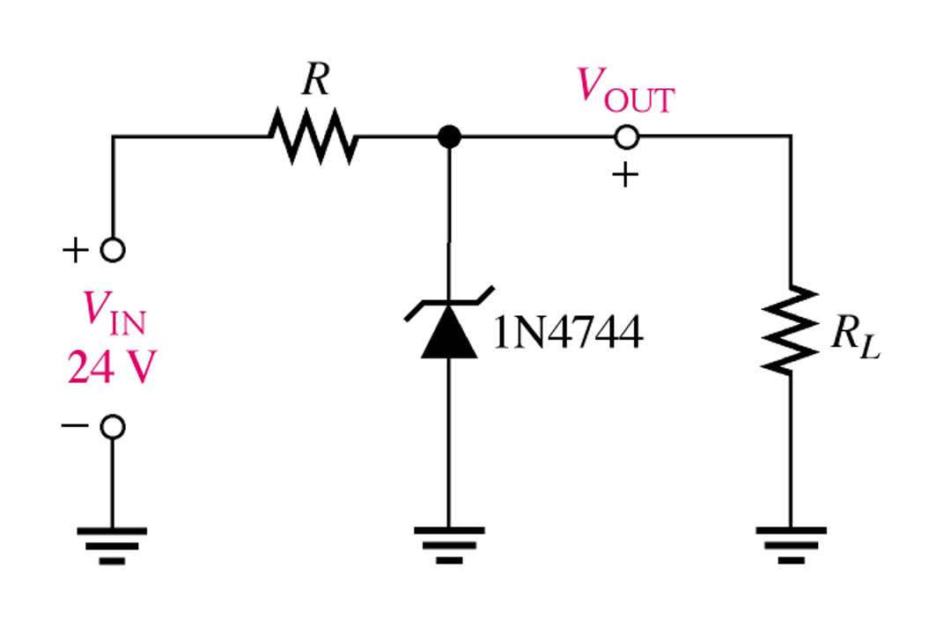
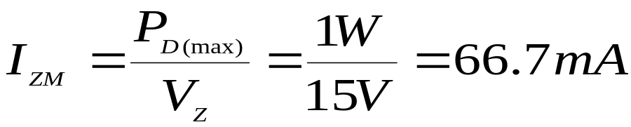
Ex 5-7 For the circuit in Figure:
(a) Determine V_{OUT} at I_{ZK} and I_{ZM}.
(b) Calculate the value of R that should be used.
(c) Determine the minimum value of R_{L} that can be used.
For I_{ZK}:
V_{OUT} = V_{Z} = 15 V – ΔI_{Z}Z_{ZT}
= 15 V – (I_{ZT} – I_{ZK})Z_{ZT}
= 15 V – (16.75 mA)(14Ω)
= 15 V – 0.255 V = 14.76 V
Calculate the zener maximum current.
The power dissipation is 1 W.
For I_{ZM}:
V_{OUT} = V_{Z} = 15 V + ΔI_{Z}Z_{ZT} = 15 V + (I_{ZM} – I_{ZT})Z_{ZT}
= 15 V + (49.7 mA)(14Ω) = 15.7 V
EI 1.1 Electronics – Special Purpose Diodes ITDel 17

Slide 20
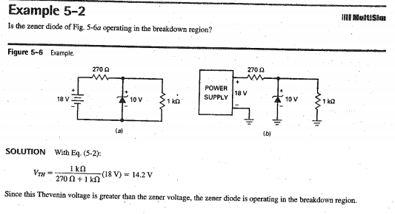
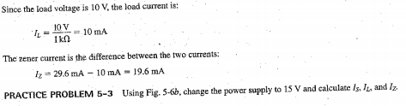
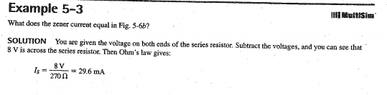

Slide 21
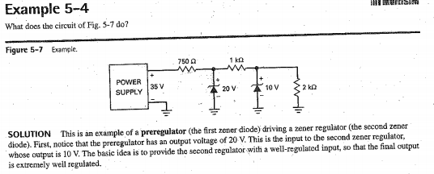
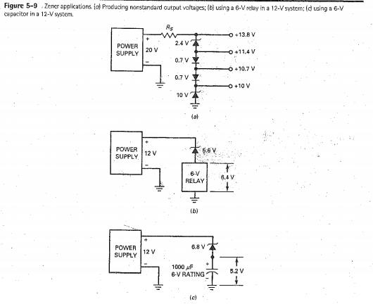

Slide 22
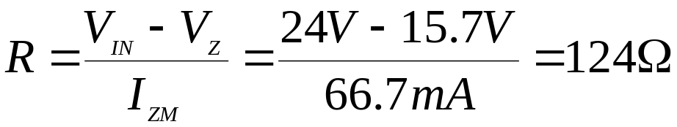
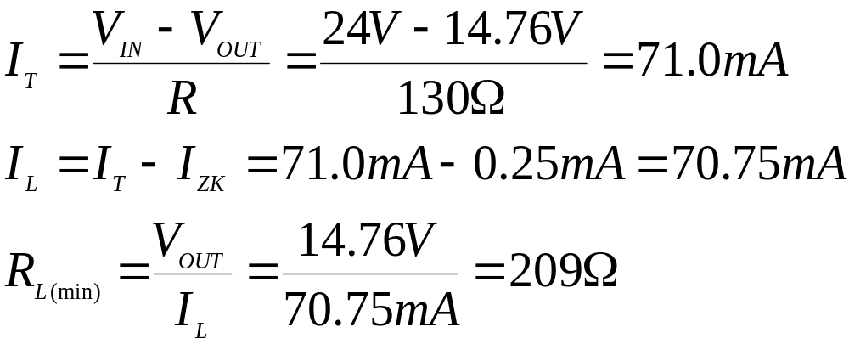
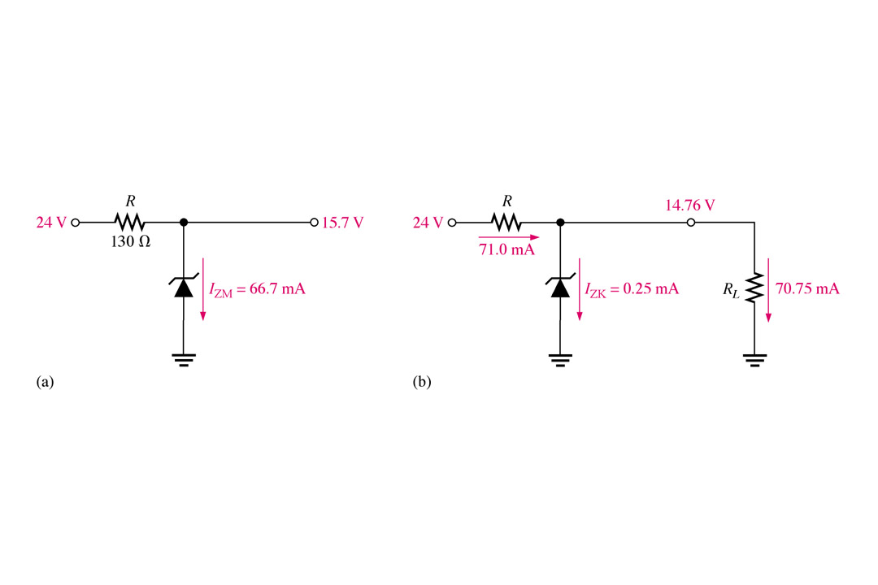
(b) The value of R is calculated for the maximum zener current that occurs when there is no load as shown in Figure (a).
R = 150 Ω (nearest larger standard value).
(c) For the minimum load resistance (maximum load current), the zener current is minimum (I_{ZK} = 0.25 mA) as shown in Figure (b).
EI 1.1 Electronics – Special Purpose Diodes ITDel 18

Slide 23
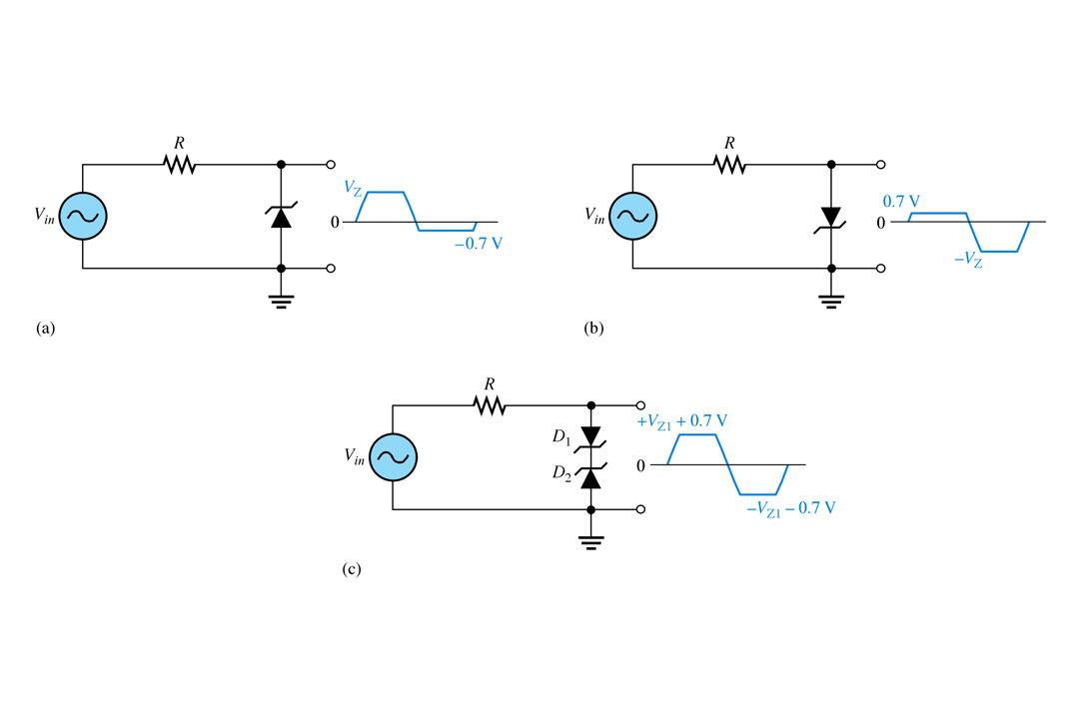
Zener Limiting
Zener diodes can used in ac applications to limit voltage swings to desired levels. Part (a) shows a zener used to limit the positive peak of a signal voltage to the selected voltage. When the zener is turned around, as in part (b), the negative peak is limited by zener action and the positive voltage is limited to + 0.7 V.
EI 1.1 Electronics – Special Purpose Diodes ITDel 19
Notes:
Fig 5-16a,b,&c

Slide 24
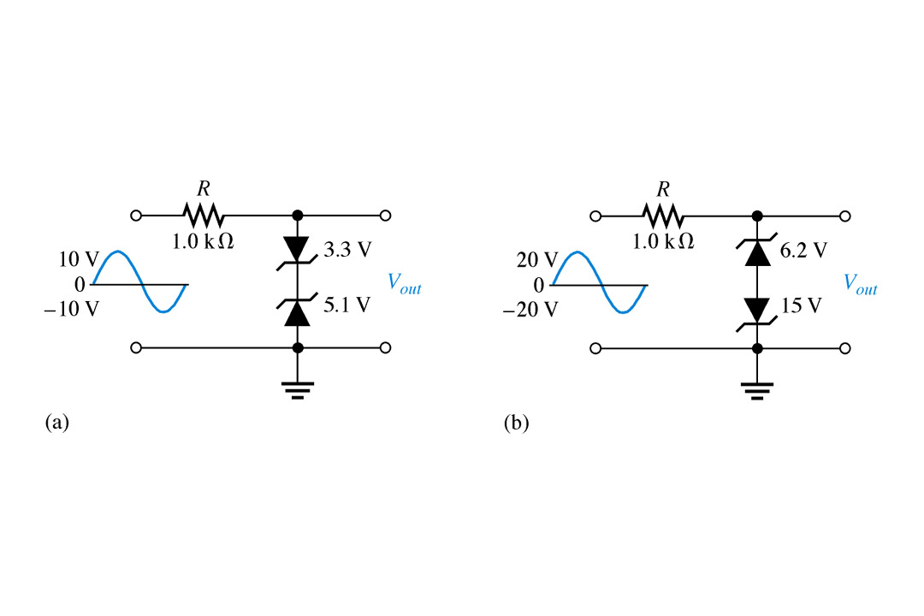
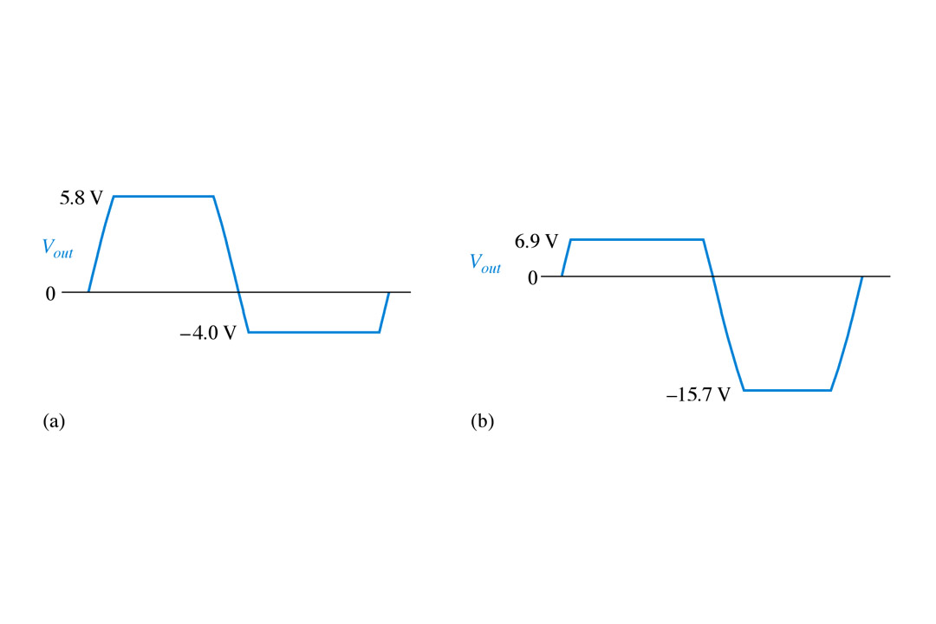
Ex 5-8 Determine the output voltage for each zener limiting circuit in Figure.
EI 1.1 Electronics – Special Purpose Diodes ITDel 20

Slide 25
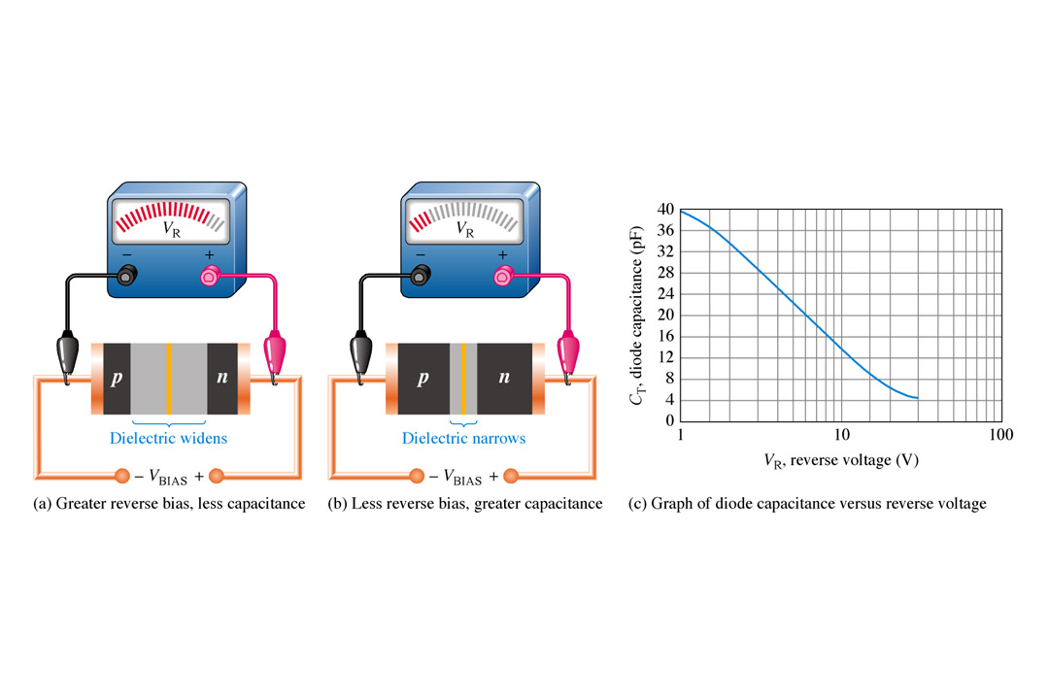
Varactor Diodes
A varactor diode is best explained as a variable capacitor. Think of the depletion region a variable dielectric. The diode is placed in reverse bias. The dielectric is “adjusted” by bias changes.
EI 1.1 Electronics – Special Purpose Diodes ITDel 21
Notes:
Fig 5-20 depletion region

Slide 26
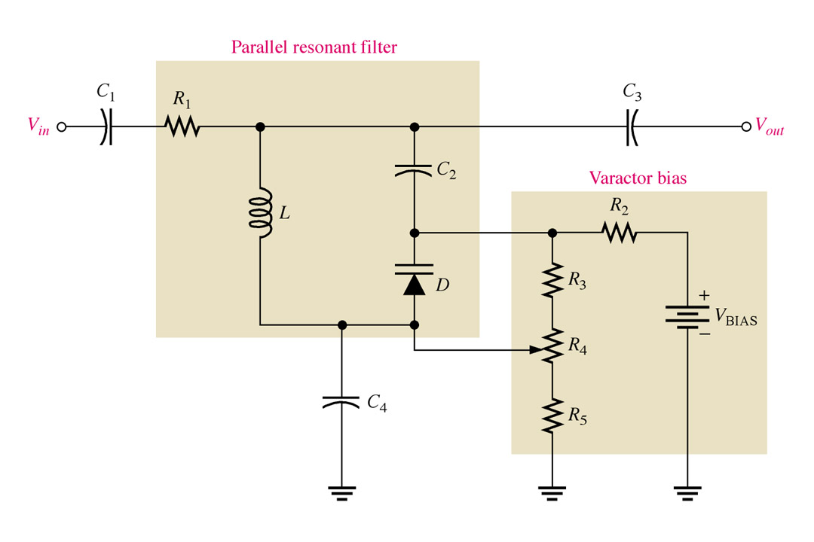
Varactor Diodes
The varactor diode can be useful in filter circuits as the adjustable component.
EI 1.1 Electronics – Special Purpose Diodes ITDel 22
Notes:
Fig 5-25

Slide 27
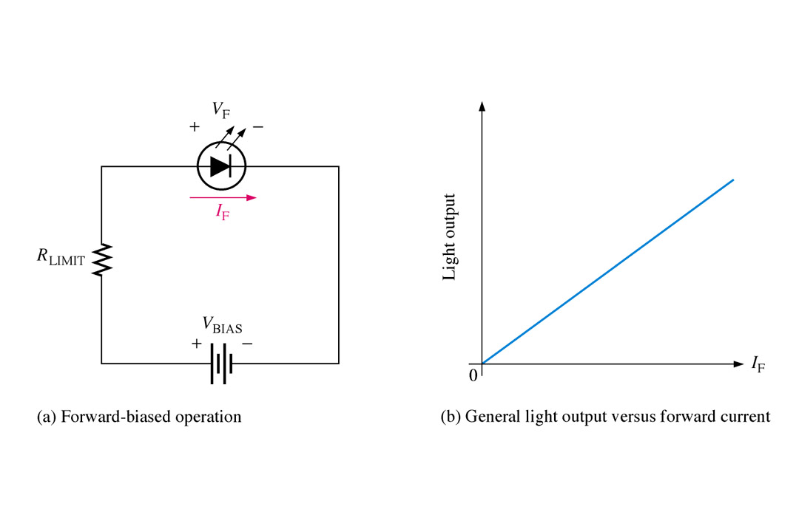
Optical Diodes
The light-emitting diode (LED) emits photons as visible light. It’s purpose is for indication and other intelligible displays. Various impurities are added during the doping process to vary the color output.
EI 1.1 Electronics – Special Purpose Diodes ITDel 25
Notes:
Fig 5-27

Slide 28
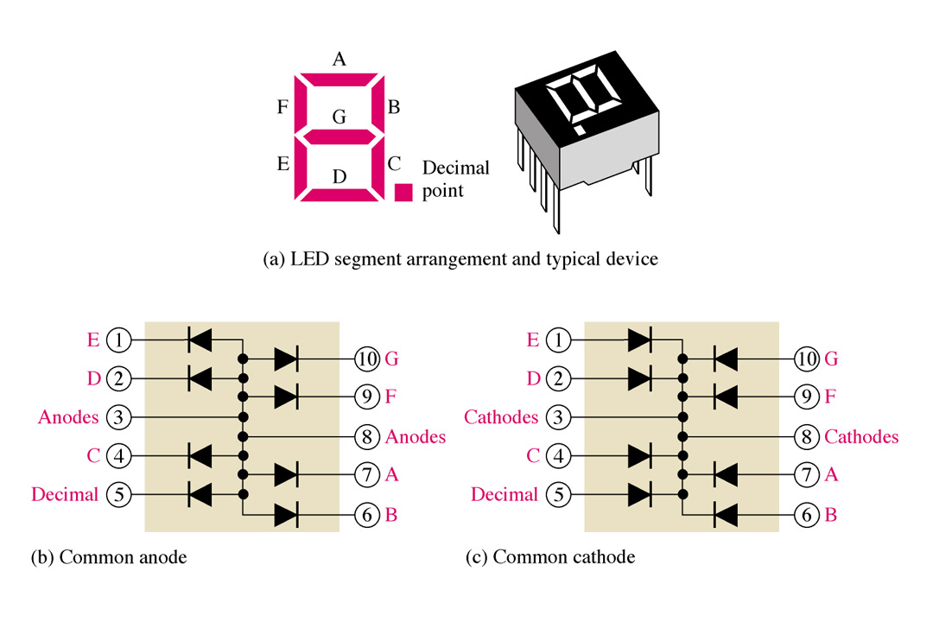
Optical Diodes
The seven segment display is an example of LEDs use for display of decimal digits.
EI 1.1 Electronics – Special Purpose Diodes ITDel 24
Notes:
Fig 5-52

Slide 29
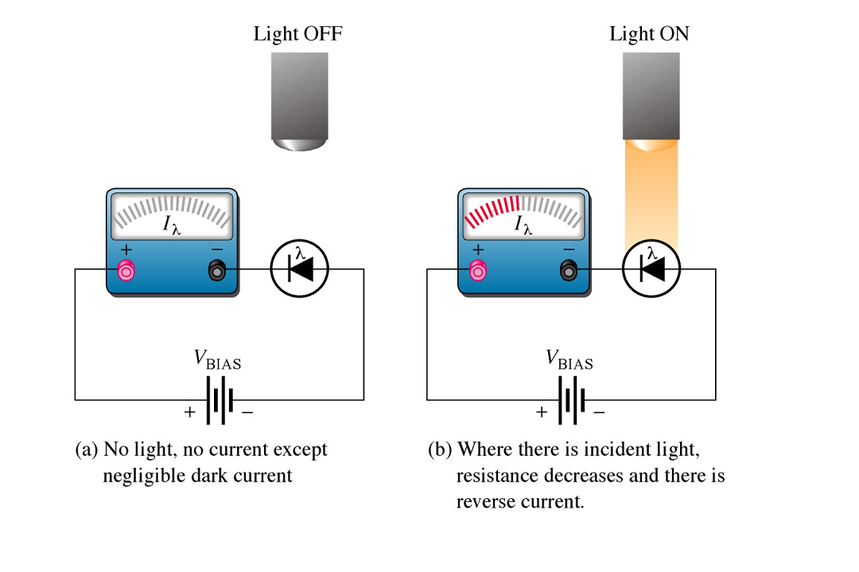
Optical Diodes
The photodiode is used to vary current by the amount of light that strikes it. It is placed in the circuit in reverse bias. As with most diodes when in reverse bias, no current flows when in reverse bias, but when light strikes the exposed junction through a tiny window, reverse current increases proportional to light intensity.
EI 1.1 Electronics – Special Purpose Diodes ITDel 25
Notes:
Fig 5-55

Slide 30
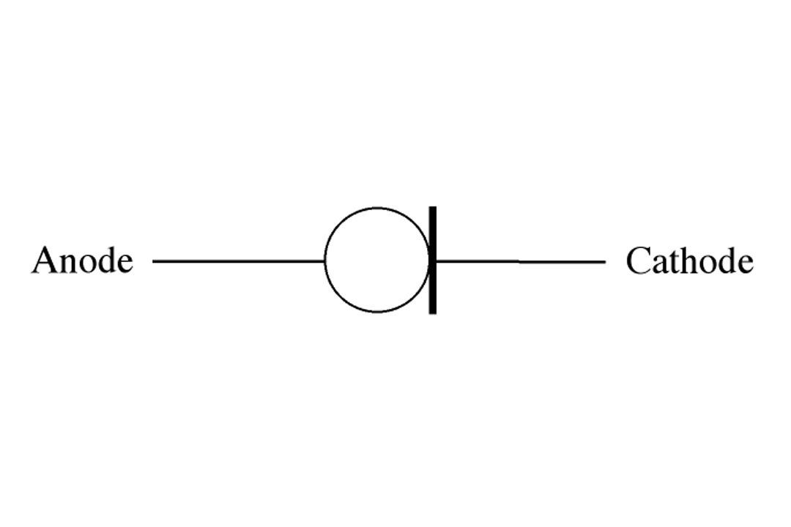
Other Diode Types
Current regulator diodes keeps a constant current value over a specified range of forward voltages ranging from about 1.5 V to 6 V.
EI 1.1 Electronics – Special Purpose Diodes ITDel 26
Notes:
Fig 5-57 schem. current reg. diode

Slide 31
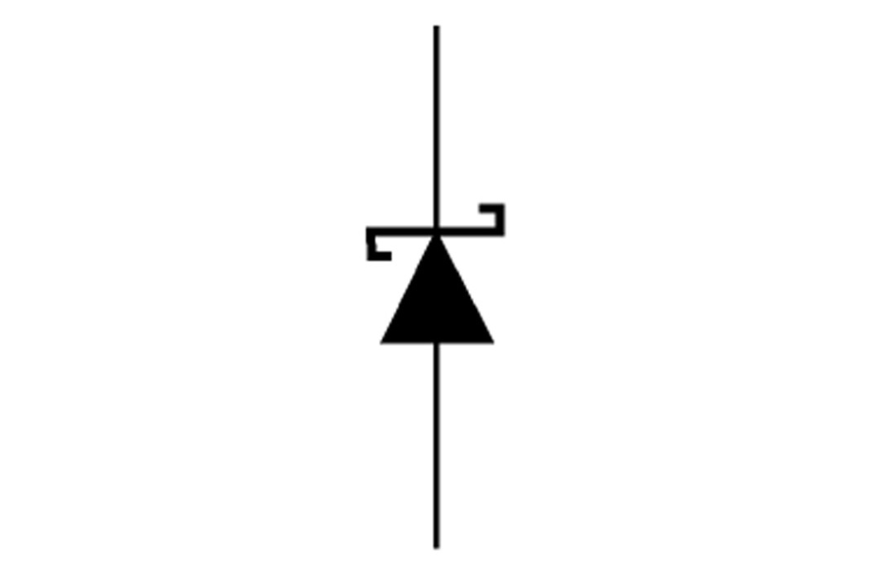
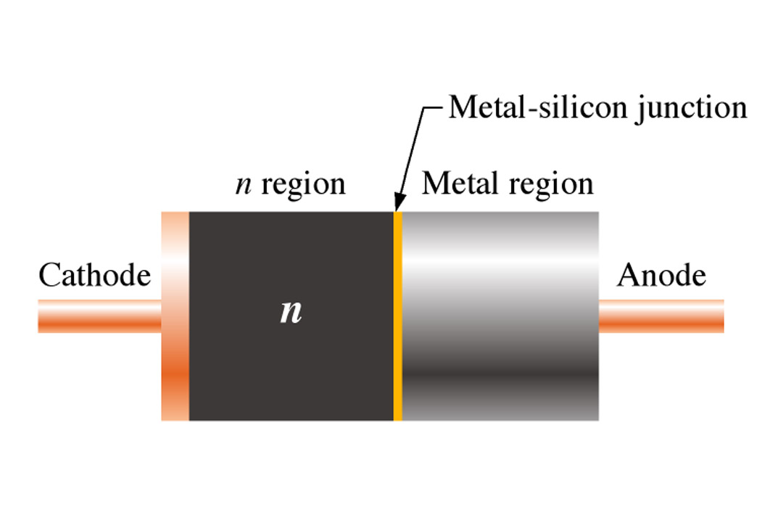
Other Diode Types
The Schottky diode’s significant characteristic is it’s fast switching speed. This is useful for high frequencies and digital applications. It is not a typical diode in the fact that it does not have a p-n junction, instead it consists of a heavily doped n-material and metal bound together.
EI 1.1 Electronics – Special Purpose Diodes ITDel 27
Notes:
Fig 5-59 Schottky schem.
& Fig 5-40.

Slide 32
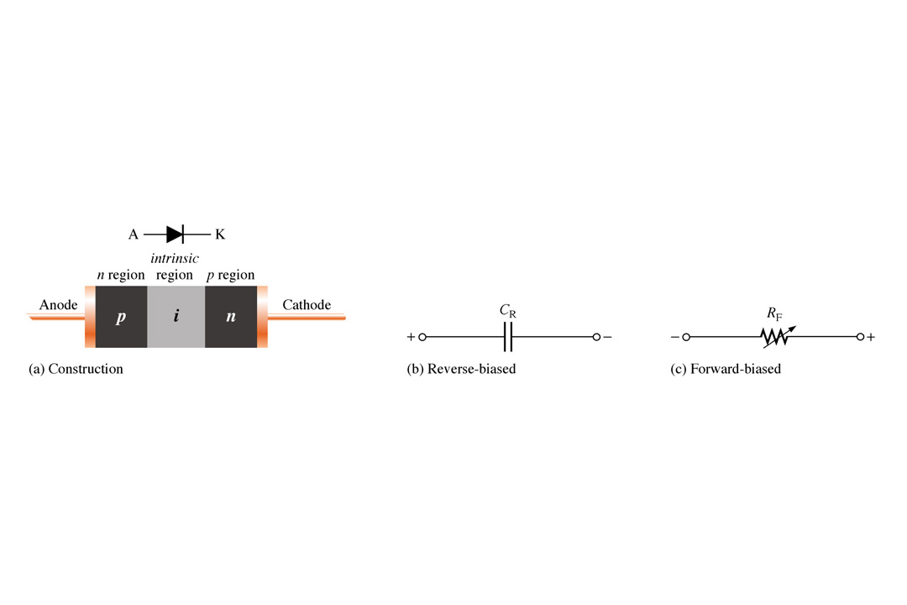
Other Diode Types
The pin diode is also used in mostly microwave frequency applications. It’s variable forward series resistance characteristic is used for attenuation, modulation, and switching. In reverse bias exhibits a nearly constant capacitance.
EI 1.1 Electronics – Special Purpose Diodes ITDel 28
Notes:
Fig 5-41 schem symbol and diagram

Slide 33
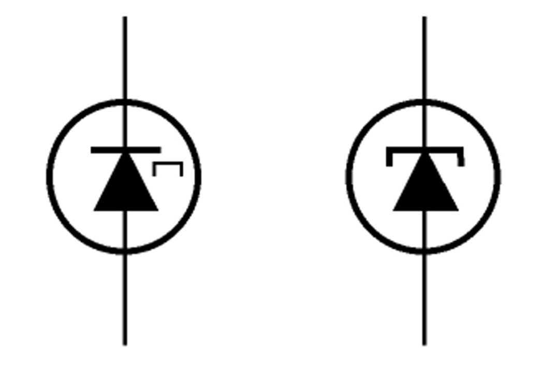
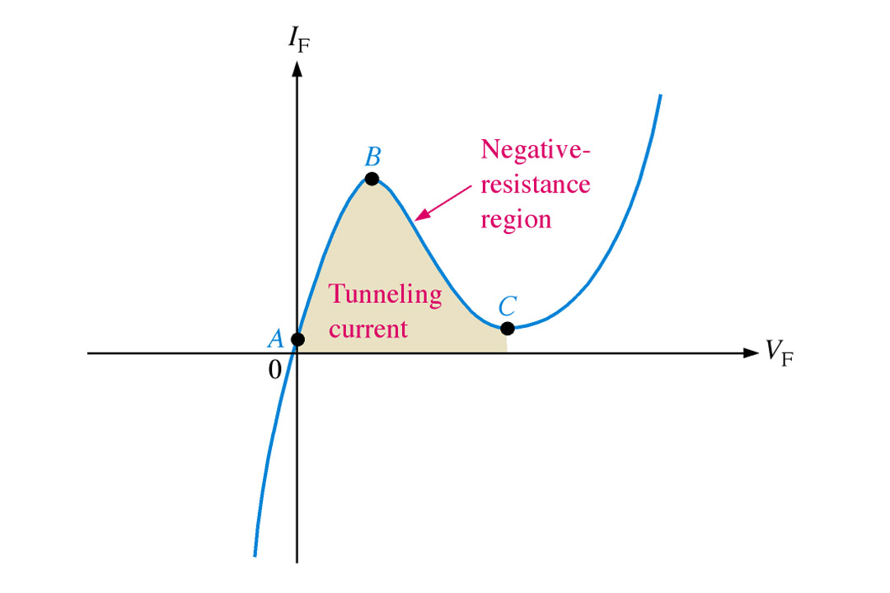
Other Diode Types
The step-recovery diode is also used for fast switching applications. This is achieved by reduced doping at the junction.
EI 1.1 Electronics – Special Purpose Diodes ITDel 29
Notes:
Fig 5-45 schem & 5-44 curve

Slide 34
Other Diode Types
The tunnel diode has negative resistance. It will actually conduct well with low forward bias. With further increases in bias it reaches the negative resistance range where current will actually go down. This is achieved by heavily doped p and n materials that creates a very thin depletion region.
EI 1.1 Electronics – Special Purpose Diodes ITDel 50

Slide 35
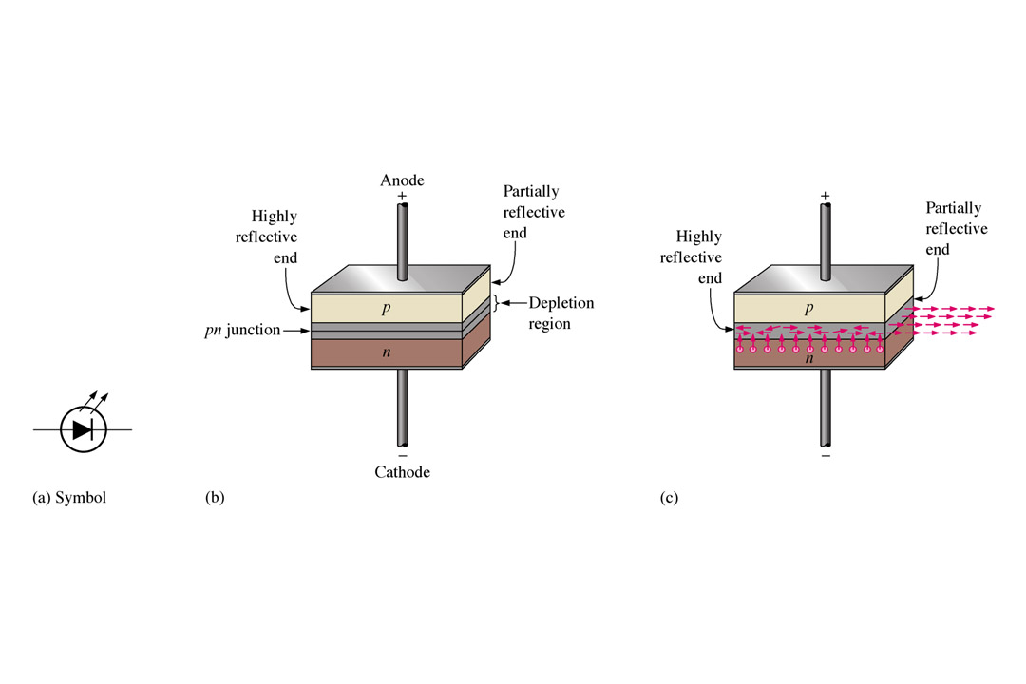
Other Diode Types
The laser diode (light amplification by stimulated emission of radiation) produces a monochromatic (single color) light. Laser diodes in conjunction with photodiodes are used to retrieve data from compact discs.
EI 1.1 Electronics – Special Purpose Diodes ITDel 51
Notes:
Fig 5-47 a, b, & c

Slide 36
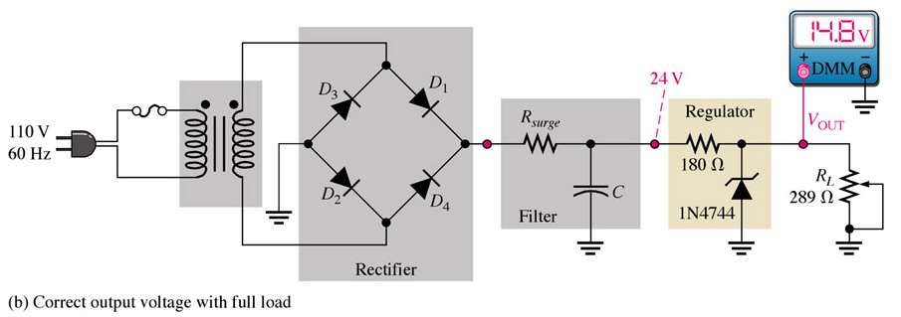
Troubleshooting
Although precise power supplies typically use IC type regulators, zener diodes can be used alone as a voltage regulator. As with all troubleshooting techniques we must know what is normal.
A properly functioning zener will work to maintain the output voltage within certain limits despite changes in load.
EI 1.1 Electronics – Special Purpose Diodes ITDel 52
Notes:
Fig 5-48b

Slide 37
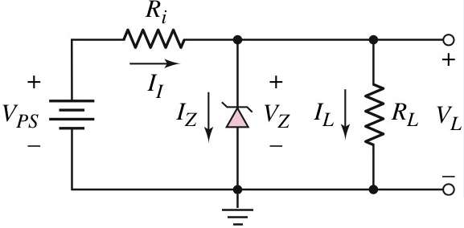
Example
A Zener diode is connected in a voltage regulator circuit. It is given that V_{PS} = 20V, the Zener voltage, V_{Z} = 10V, R_{i} = 222 Ω and P_{Z(max)} = 400 mW.
Determine the values of I_{L}, I_{Z} and I_{I} if R_{L} = 580 Ω.
Determine the value of R_{L} that will establish P_{Z(max)} = 400 mW in the diode.

Slide 38


For proper function the circuit the following conditions must be satisfied the following conditions.
The power dissipation in the Zener diode is less than the rated value
When the power supply is a minimum, V_{PS}(min), there must be minimum current in the zener diode I_{Z}(min), hence the load current is a maximum, I_{L}(max),
When the power supply is a maximum, V_{PS}(max), the current in the diode is a maximum, I_{Z}(max), hence the load current is a minimum, I_{L}(min)
AND
Or, we can write

Slide 39
For general thumb of rule for design this circuit is, so from the last Equation
Maximum power dispassion in the Zener diode is
EXAMPLE 1 (Example 5.5 from textbook)
Design a Zener diode voltage regulator circuit as shown
in Figure . Consider voltage regulator is used to power the cell phone at 2.5 V from the lithium ion battery, which voltage may vary between 5 and 5.6 V. The current in the phone will vary 0 (off) to 100 mA(when talking).
simple Zener diode voltage regulator circuit

Slide 40
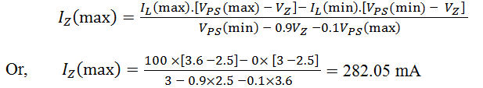
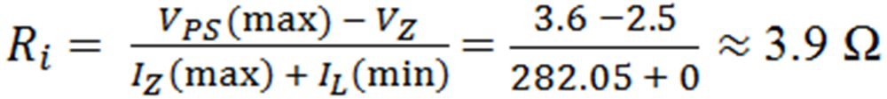
Solution:
The stabilized voltage V_{L} = 2.5 V, so the Zener diode voltage must be VZ = 2.5 V. The maximum Zener diode current is
The maximum power dispassion in the Zener diode is
The value of the current limiting resistance is

Slide 41





Optocoupler

Slide 42



Slide 43





