Slide 1




Institut Teknologi Del
Jl. Sisingamangaraja Sitoluama, Laguboti 22381
Toba Samosir – Sumatera Utara
http://www.del.ac.id/
PDS
Electronics Basic
7.0
Transistors
BJT Datasheet
https://www.youtube.com/@AmelOline
INSTITUT TEKNOLOGI DEL
Jl Sisingamangaraja, Tobasamosir (22381), Sumatera Utara, Indonesia
telp +62632331234, fax +626323311116, www.del.ac.id
PDS
https://github.com/amelcharolinesgn2/DE/upload
Notes:
http://www.ittc.ku.edu/~jstiles/412/handouts/section%205.4%20BJT%20Characteristics%20at%20DC/
http://homepages.wmich.edu/~miller/ECE3200.html
http://www.ittc.ku.edu/~jstiles/412/handouts/section%205.4%20BJT%20Characteristics%20at%20DC/
http://my.ece.msstate.edu/faculty/winton/CDNuE/OpenSource/
http://www.ee.cityu.edu.hk/~ee2301/lecture.htm
http://people.seas.harvard.edu/~jones/es154/lectures/lecture_2/diode_circuits/diode_appl.html
https://www.dacc.edu/bjun/ELEC167_Malvino_PDF/Chapter04.pdf
https://wiki.analog.com/university/courses/electronics/text/chapter-6
http://www.zen22142.zen.co.uk/Design/bjtbias.htm

Slide 2
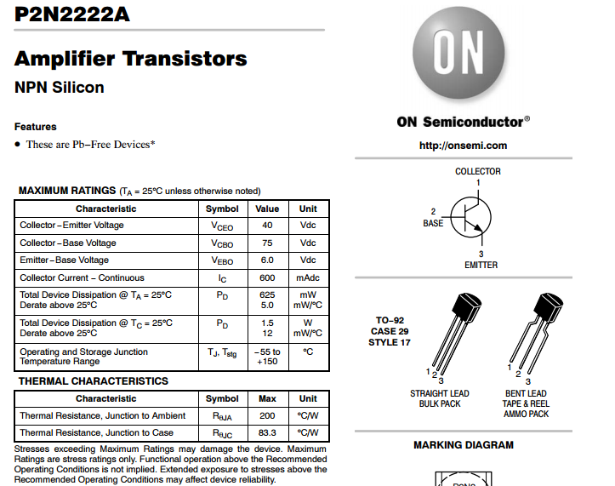
https://www.onsemi.com/pub/Collateral/P2N2222A-D.PDF

Slide 3
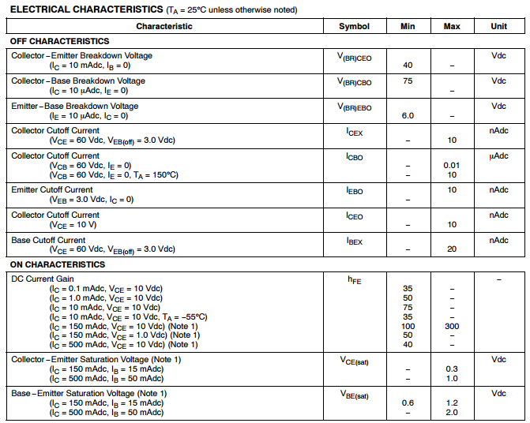

Slide 4
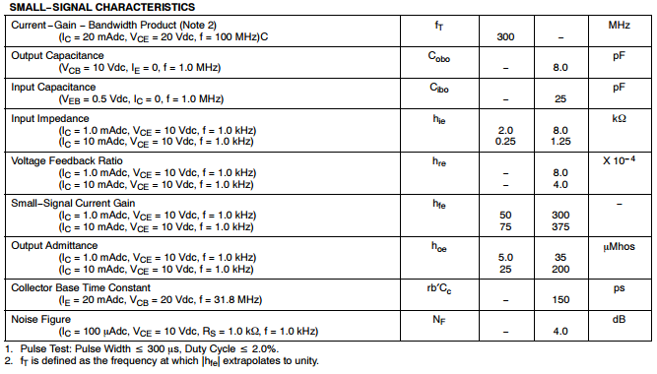

Slide 5
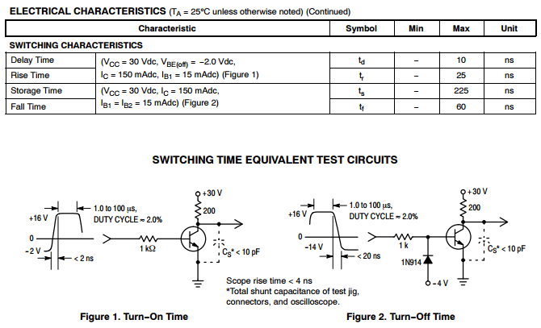

Slide 6
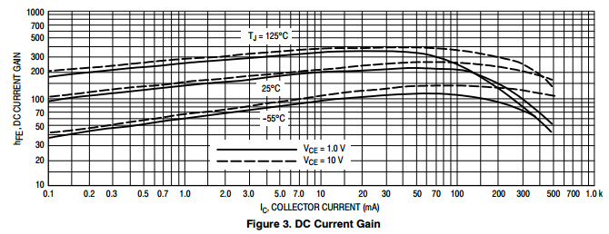
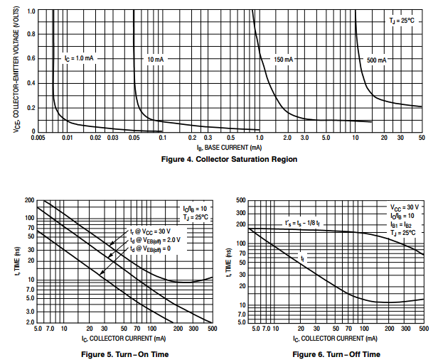

Slide 7
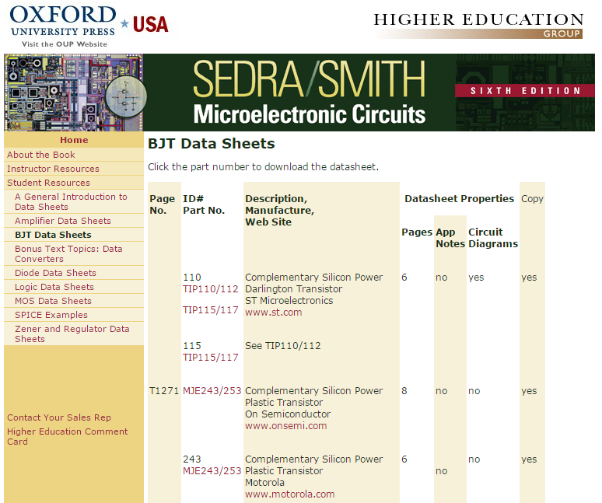
https://global.oup.com/us/companion.websites/9780195323030/student/bjt/

Slide 8
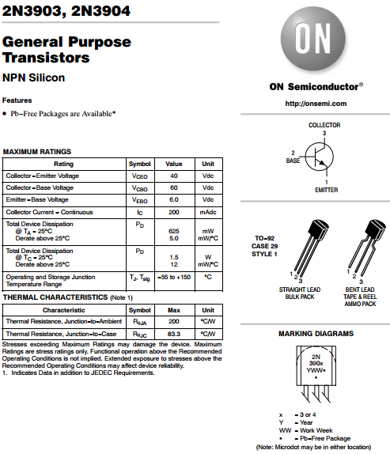
2N3903, 2N3904

Slide 9
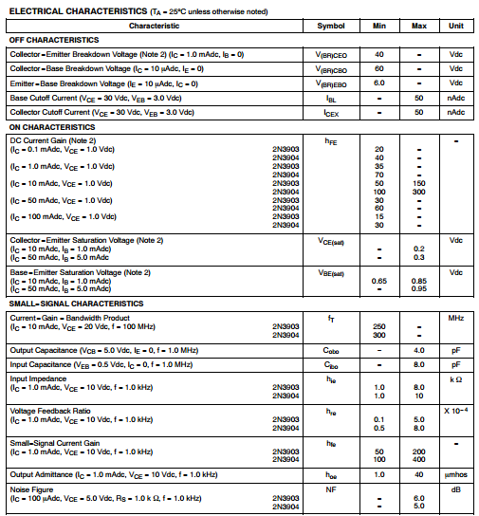

Slide 10
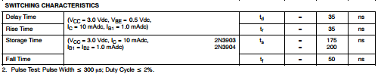
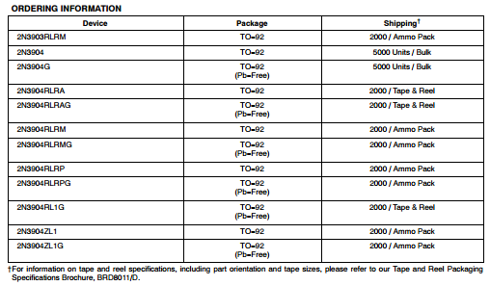

Slide 11
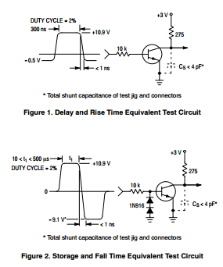

Slide 12
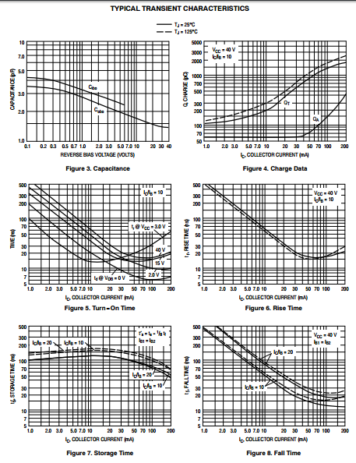
Notes:
https://www.onsemi.com/pub/Collateral/2N3903-D.PDF

Slide 13



Terima Kasih
Thank You
Thank You
PDS

