Slide 1


ELS 2202 Electronics I
Electronics I
Week 5.i
5.1 Special Diode Types
INSTITUT TEKNOLOGI DEL
Jl Sisingamangaraja, Tobasamosir (22581), Sumatera Utara, Indonesia
telp +62652551254, fax +626525511116, www.del.ac.id
Notes:
http://www.ee.cityu.edu.hk/~ee2501/lecture.htm

Slide 2
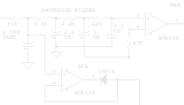


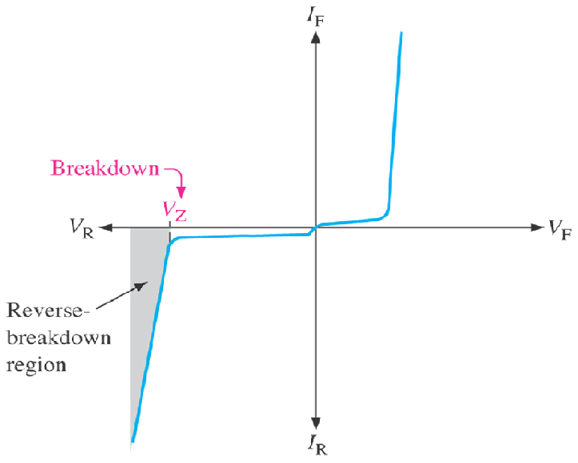
Special Diode Types
Cathode (K)
K
5.1 Zener Diode
Fig.5-1: Zener diode symbol.
+
Zener diode is a p-n junction diode that is designed to operate in the reverse breakdown region.
Two things happen when the reverse breakdown voltage (V_{BR}) is reached:
The diode current increases
drastically.
The reverse voltage (V_{R}) across
the diode remains relatively
constant.
In other words, the voltage across a zener diode operated in this region is relatively constant over a range of reverse current and nearly equal to its zener voltage (V_{Z}) rating.
V_{Z}
I_{Z}
−
Anode (A)
A
V_{BR}
Fig.5-2: Zener diode voltage-curent (V-I) characteristic.

Slide 3
Special Diode Types
5.1.1 Zener Breakdown
There are two types of reverse breakdown:
Avalanche breakdown.
Zener breakdown.
Avalanche breakdown is a high-field effect that occurs when the electrostatic field
strength associated with the p-n junction is strong enough to pull electrons out of the
valence band within the depletion region.
Zener breakdown is a type of reverse breakdown that occurs at relatively low reverse
voltages. The n-type and p-type materials of a zener diode are heavily doped, resulting
in a very narrow depletion region. Therefore, the electric field existing within this region
is intense enough to pull electrons from their valence bands and create current at a low
reverse voltage (V_{R}).
Note:
Zener diodes with low V_{Z} ratings experience zener breakdown, while those with high V_{Z}
ratings usually experience avalanche breakdown.

Slide 4
Special Diode Types
5.1.2 Breakdown Characteristics
The characteristic that indicates the ability
of the zener diode to keep the reverse voltage
across its terminals nearly constant makes the
diode is useful as a voltage regulator.
Four main characteristics of the zener diode are:
Zener voltage (V_{Z}) is the nominal zener
voltage at the breakdown voltage.
Zener knee current (I_{ZK}) is the minimum current
required to maintain the diode in breakdown for
the voltage regulation.
Zener test current (I_{ZT}) is the current level at
which the V_{Z} rating of the diode is measured.
Zener maximum current (I_{ZM}) is the maximum
reverse current, which may not be exceeded. At
this current level, the diode can work without
being damaged or destroyed.
I_{Z}
V_{Z}
V_{BR}
V_{R}
Zener knee current
I_{ZK}
ΔI_{R}
Zener test current
I_{ZT}
I_{ZM}
maximum Zener current
ΔV_{R}
Fig.5-5: Reverse characteristic of a zener diode.

Slide 5
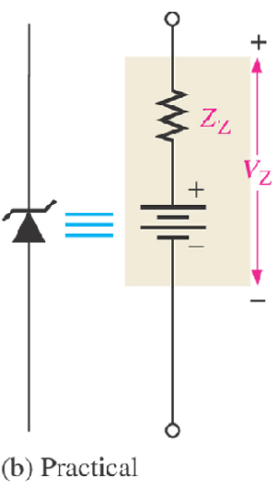
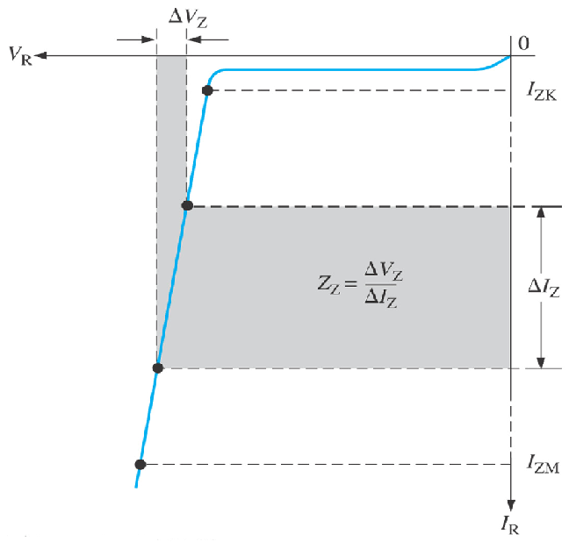
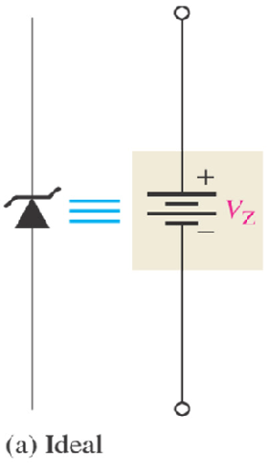
Special Diode Types
5.1.5 Ideal-and-Practical Zener Equivalent Circuits
I_{F}
V_{Z}
V_{R}
V_{F}
I_{R}
Fig.5-4: Ideal model and characteristic curve of a zener diode in reverse breakdown.
Fig.5-5: Practical model and characteristic curve of a zener diode, where the zener impedance (resistance), Z_{Z} is included.
The constant voltage drop = the nominal zener voltage.
A change in zener current (ΔI_{Z}) produces a small change in zener voltage (ΔV_{Z}).

Slide 6


Special Diode Types
5.1.4 Temperature Coefficient
The zener voltage of a zener diode is very sensitive to the temperature of operation.
The formula for calculating the change in zener voltage due to a change in temperature is
(5-1)
where, V_{Z} = nominal zener voltage at the reference temperature of 25ºC.
T_{C} = temperature coefficient.
T₁ = new temperature level.
T₀ = reference temperature of 25ºC.
5.1.4 Zener Power Dissipation and Derating
The maximum current that may be carried by a given zener diode depends on both the zener voltage and the maximum dc power dissipation capability of the diode. The dc power dissipation of the zener diode is given by the formula,
(5-2)

Slide 7

Special Diode Types
The maximum power dissipation of a zener diode is specified for temperature at or below a certain value (50ºC, for example).
Above the specified temperature, the maximum power dissipation is reduced according to a derating factor. The derating factor is expressed in mW/ºC.
The maximum derated power can be determined with the following formula:
(5-5)

Slide 8
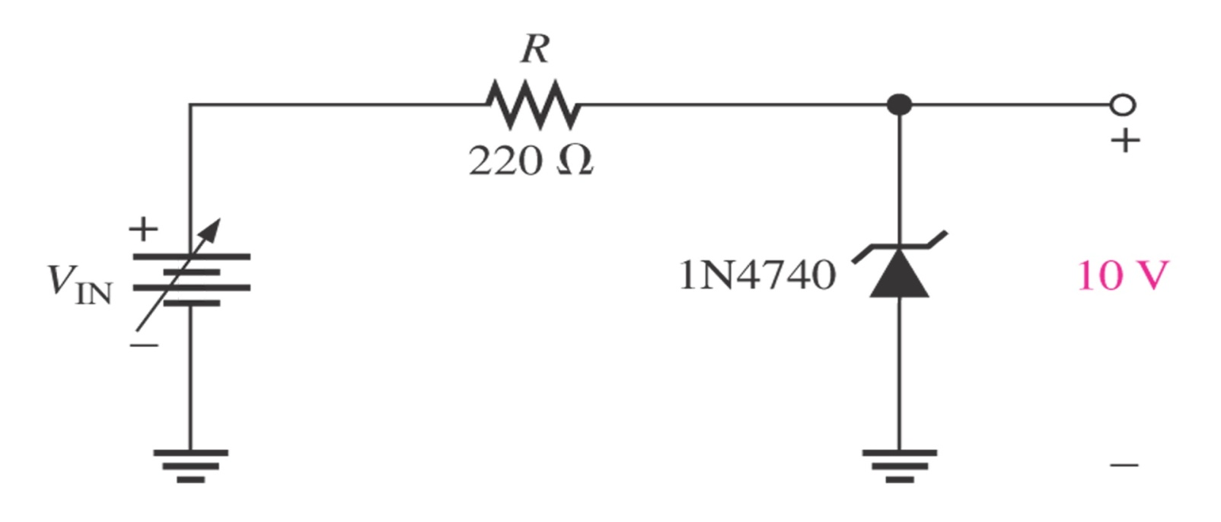
Special Diode Types
5.2 Zener Diode Applications
The zener diode can be used as a type of voltage regulator for providing stable reference voltages.
5.2.1 Zener Regulation with a Varying Input voltage
V_{OUT}
Fig.5-6: Zener regulation with a no-load.

Slide 9
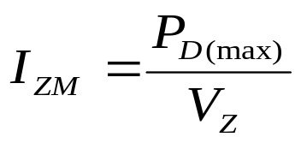


Special Diode Types
For an ideal model of a certain zener diode, the minimum zener current (I_{ZK}) is specified on datasheet. However, the maximum zener current is not given on datasheet but can calculated from the maximum diode power specification, which is given on datasheet by using the equation:
(5-4)
For the minimum zener current, the voltage across the resistor is determined by:
(5-5)
Thus, the minimum input voltage that can be regulated by the zener diode,
(5-6)

Slide 10


Special Diode Types
For the maximum zener current, the voltage across the resistor is determined by:
(5-7)
Thus, the maximum input voltage that can be regulated by the zener diode,
(5-8)

Slide 11
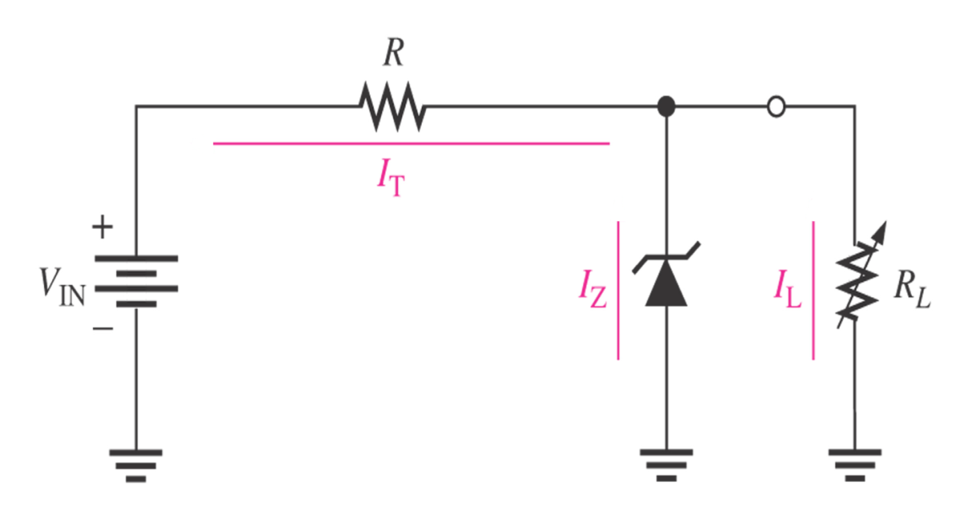
Special Diode Types
5.2.2 Zener Regulation with a Variable Load
The zener diode maintains a nearly constant voltage across R_{L} as long as the zener current is greater than I_{ZK} and less than I_{ZM}.
Fig.5-7: Zener voltage regulation with a variable load
When the output terminals of the zener regulator are open (R_{L} = ∞) or a no-load condition, the load current (I_{L}) = 0 and all of the current is through the zener.
When a load resistor (R_{L}) is connected, a part of the total current is through the zener and an other part through R_{L}.
As R_{L} is decreased, the load current I_{L} increases and I_{Z} decreases. The zener diode continues to regulate the voltage until I_{Z} reaches its minimum value, I_{ZK}. At this point I_{L} is maximum, and a full-load condition exists.

Slide 12

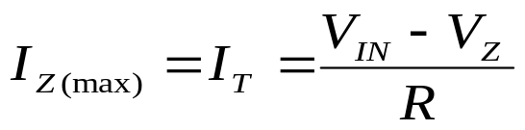

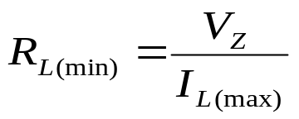
Special Diode Types
By using mathematically formula, when I_{L} is maximum, we obtain:
(5-9)
thus,
(5-10)
When I_{L} is minimum (I_{Z} = I_{ZK}), so
(5-11)
(5-12)

Slide 13
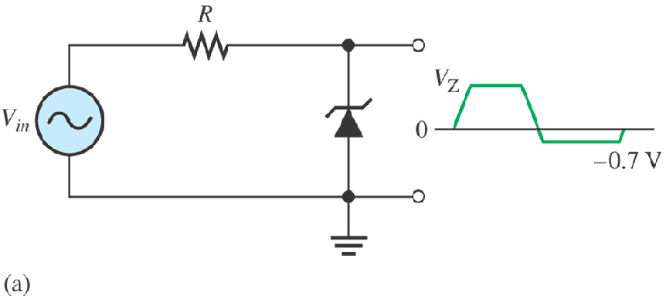
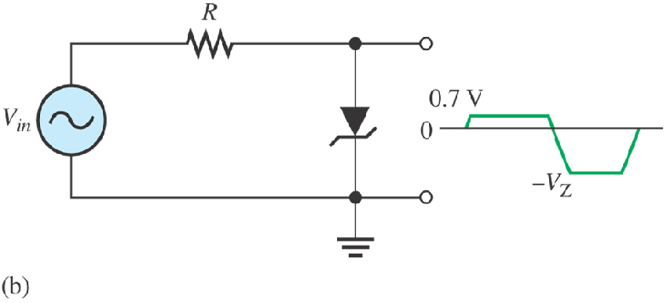
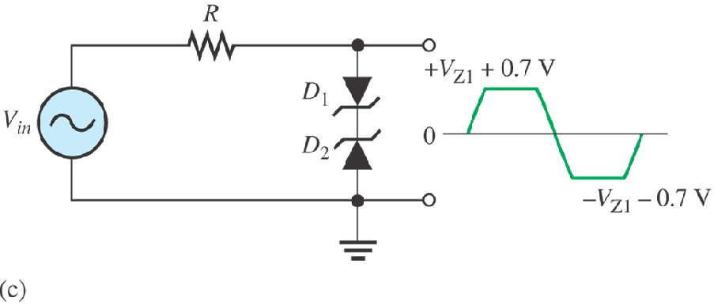
Special Diode Types
5.2.5 Zener Regulation with a Variable Load
In addition to voltage regulation applications, zener diode can be used in ac applications to limit voltage swings to desired levels.
Part (a) shows a zener used to limit the positive peak of a signal voltage to the selected zener voltage.
During the negative alternation, the zener acts as a forward-biased diode and limits the negative voltage to -0.7 V.
When the zener is turned around, as in part (b), the negative peak is limited by zener action and the positive voltage is limited to +0.7 V.
Two back-to-back zeners limit both peaks to the zener voltage ±0.7 V, as shown in part (c).
During the positive alternation, D₂ is functioning as the zener limiter and D₁ is functioning as a forward-biased diode. During the negative alternation, the roles are reversed.
Fig.5-8.

Slide 14
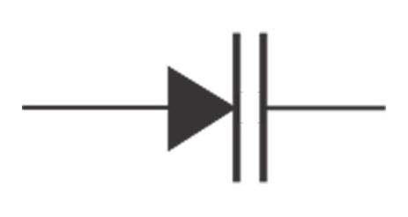
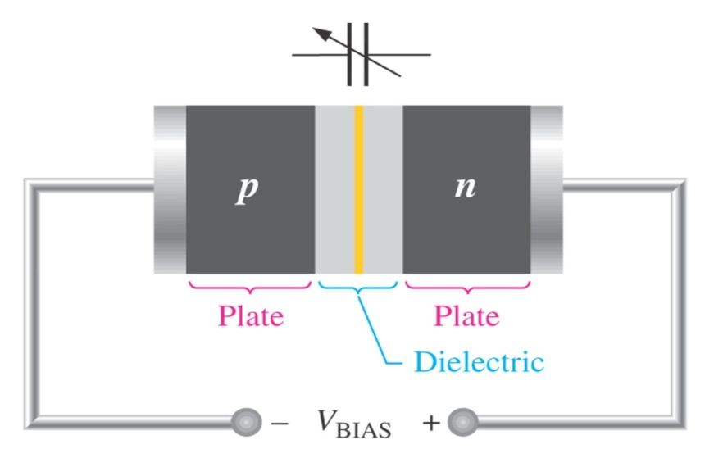
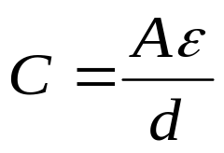
Special Diode Types
5.5 Varactor Diode
Varactor is a type of p-n junction diode that operates in reverse bias. The capacitance of the junction is controlled by the amount of reverse bias.
Varactor diodes are also referred to as varicaps or tuning diodes and they are commonly used in communication systems.
5.5.1 Basic Operation
The capacitance of a reverse-biased varactor junction is found as:
Fig.5-9: Varactor diode symbol
(5-15)
where, C = the total junction capacitance.
A = the plate area.
ε = the dielectric constant (permittivity).
d = the width of the depletion region
(plate separation).
Fig.5-10: Reverse-biased varactor diode acts as a variable capacitor.

Slide 15
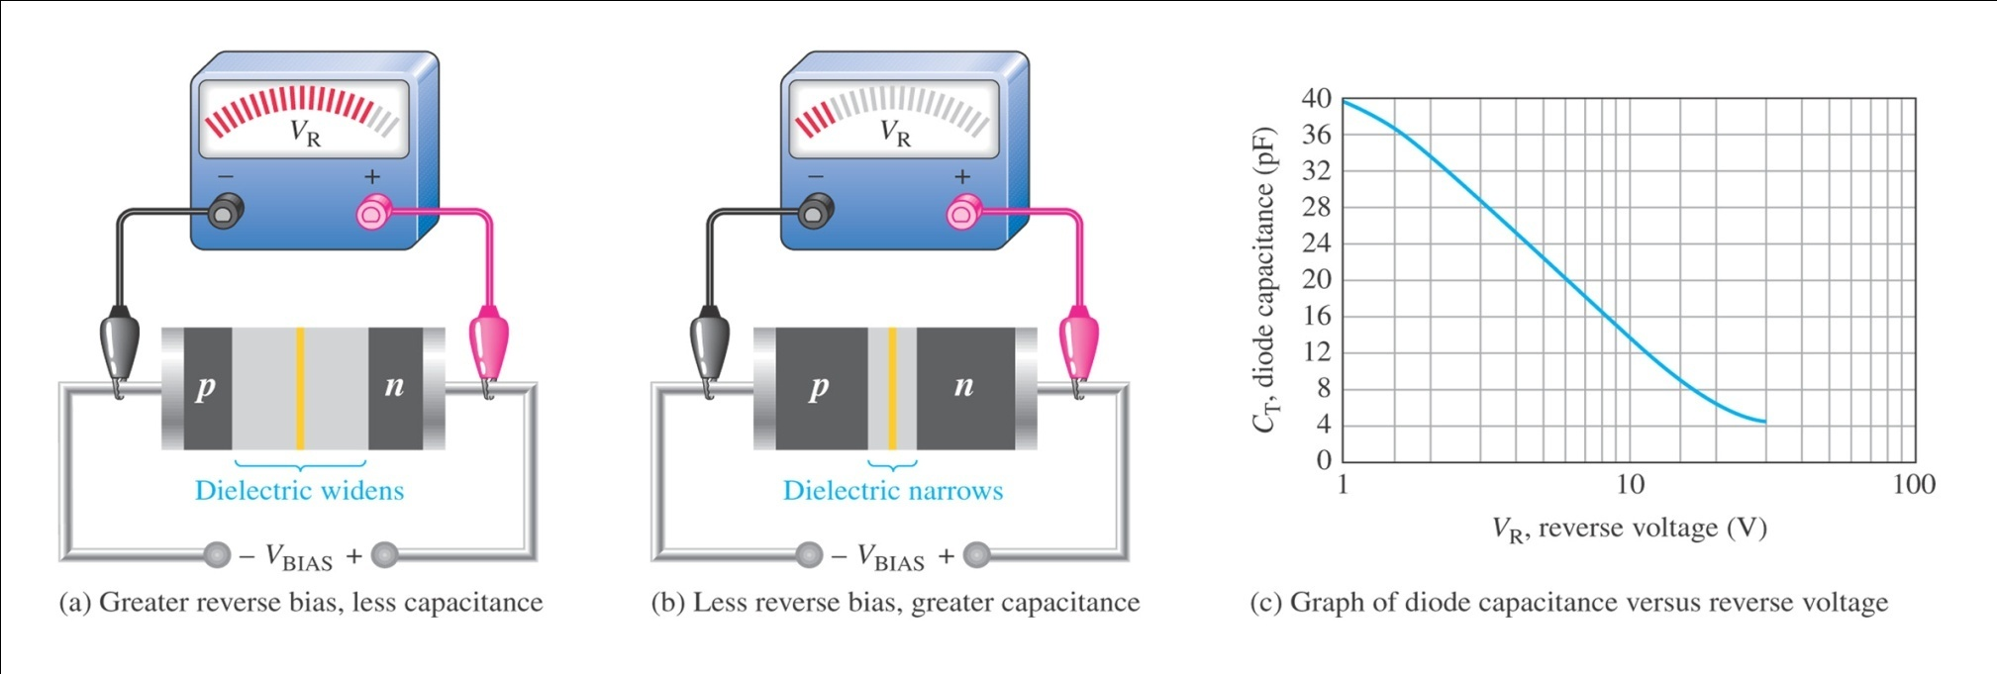
Special Diode Types
The ability of a varactor to act as a voltage-controlled capacitor is demonstrated in Fig. 5-10.
Fig.5-10: Varactor diode capacitance varies with reverse voltage.
As the reverse-bias voltage increases, the depletion region widens, increasing the plate separation, thus decreasing the capacitance.
When the reverse-bias voltage decreases, the depletion region narrows, thus increasing the capacitance.

Slide 16
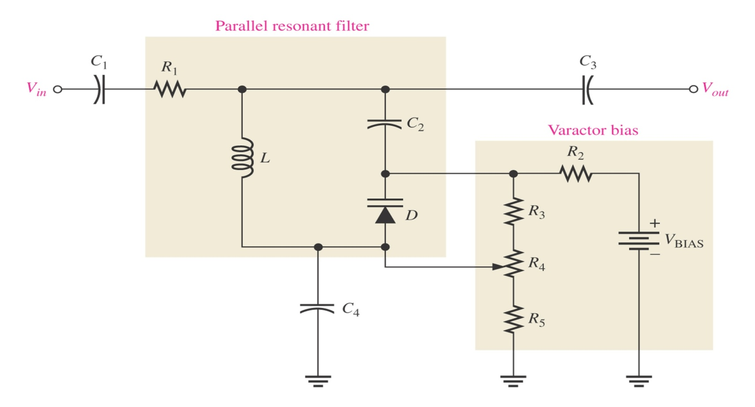
Special Diode Types
5.5.2 Varactor Application
A major application of varactor is in turning circuits, for example, VHF, UHF, and satelite receivers utilize varactors. Varactors are also used in cellular communications.
When used in a parallel resonant circuit, as shown in Fig. 5-11, the varactor acts as a variable capacitor, thus allowing the resonant frequency to be adjusted by a variable voltage level.
Fig.5-11: A resonant band-pass filter.

Slide 17
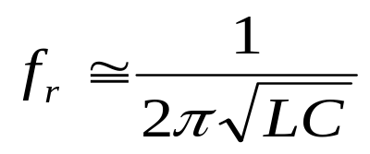
Special Diode Types
C₁ prevents a dc path from potentiometer wiper back to the ac source through the
inductor and R₁.
C₂ prevents a dc path from cathode to the anode of the varactor through the inductor.
C₅ prevents a dc path from the wiper to a load on the output through the inductor.
C₄ prevents a dc path from the wiper to ground.
R₂, R₅, R₄ and R₅ function as a variable dc voltage divider for biasing the varactor.
The parallel resonant frequency of the LC circuit is
(5-14)
where, L = the inductance of an inductor (H)
C = the capacitance of a capacitor (F).

Slide 18
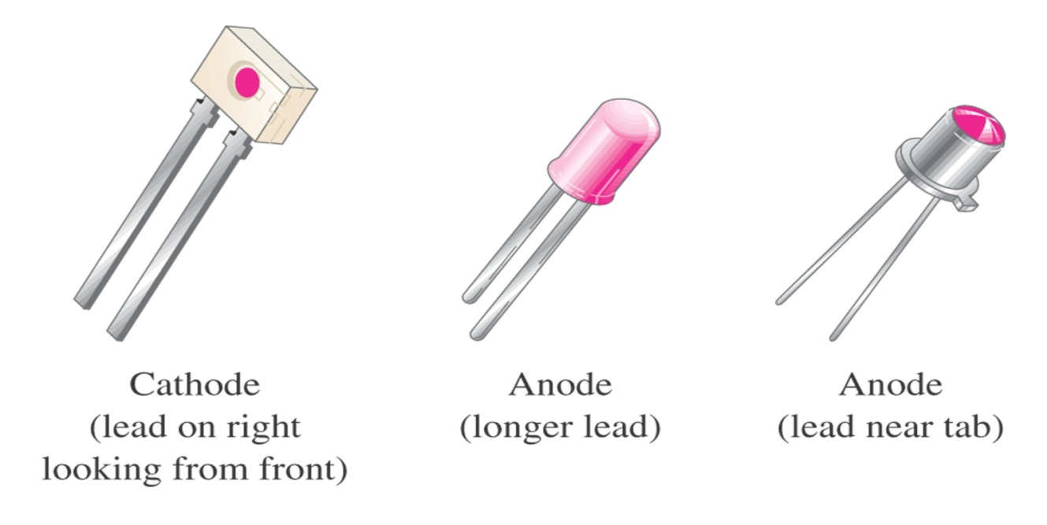
Special Diode Types
5.4 Optical Diodes
There are two popular types of optoelectronic devices: light-emitting diode (LED) and photodiode.
5.4.1 The Light-Emitting Diode (LED)
LED is diode that emits light when biased in the forward direction of p-n junction.
Anode
Cathode
(b)
(c)
Fig.5-12: The schematic symbol and construction features.

Slide 19
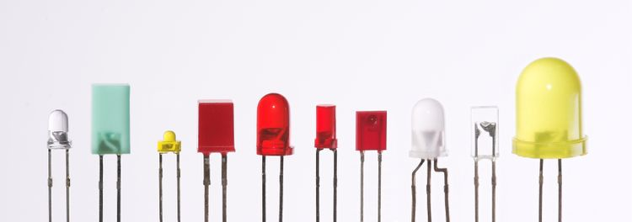
Diode
Fig.5-15: LED that are produced in an array of shapes and sizes.
LED characteristics:
characteristic curves are very similar to those for p-n junction diodes
higher forward voltage (V_{F})
lower reverse breakdown voltage (V_{BR}).

Slide 20
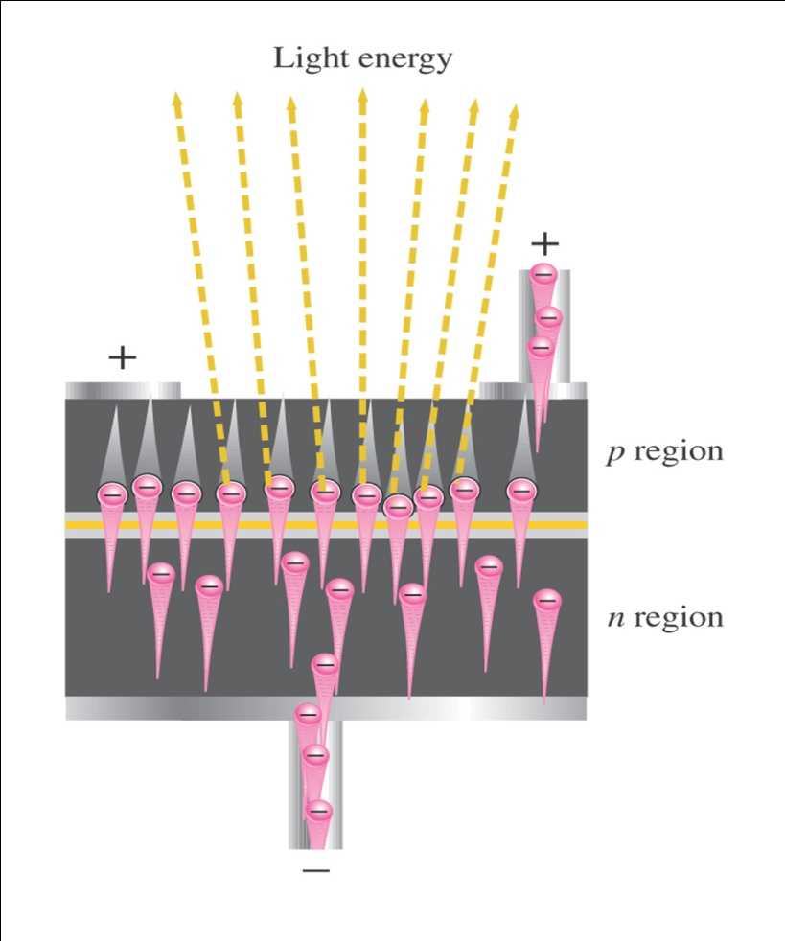
Special Diode Types
The basic operation of LED is as illustrated in Fig. 5-14:
“When the device is forward-biased, electrons cross the p-n junction from the n-type material and recombine with holes in the p-type material. These free electrons are in the conduction band and at a higher energy than the holes in the valence band.
When recombination takes place, the recombining electrons release energy in the form photons.
A large exposed surface area on one layer of the semiconductive material permits the photons to be emitted as visible light.”
This process is called electroluminescence.
Various impurities are added during the doping process to establish the wavelength of the emitted light. The wavelength determines the color of visible light.
Fig.5–15: Electroluminescence in a forward-biased LED.

Slide 21
Special Diode Types
LED Semiconductor Materials
The color emitted by a given LED depends on the combination of elements used to produce the component. Some common element combinations are identified in Table 5-1.
TABLE 5-1: Common LEDs
Compound | Forward Voltage (V_{F}) | Color Emitted
GaAs | 1.5 V | Infrared (invisible)
AlGaAs | 1.8 V | Red
GaP | 2.4 V | Green
GaAsP | 2.0 V | Orange
GaN | 4.1 V | White
AlGaInP | 2.0 V | Amber (yellow)
AlGaInN | 5.6 V | Blue
V_{F} is measured at I_{F} = 20 mA in each case.

Slide 22
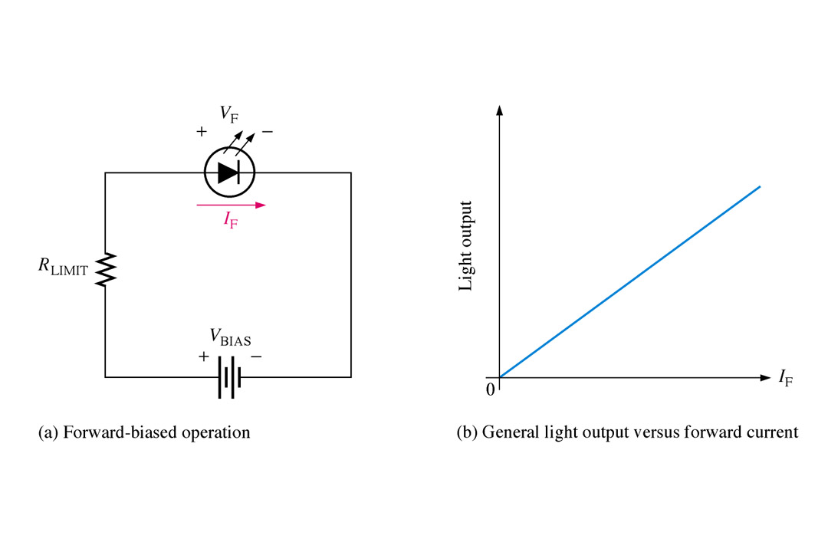
Special Diode Types
Current-Limiting Resistor
When used in most practical applications, LED require the use of a series current-limiting resistor, as shown in Fig. 5-16 (a). The resistor ensures that the maximum current rating of the LED can not be exceeded by the circuit current.
The amount of power output translated into light is directly proportional to the forward current, as indicated in Fig. 5-16 (b)
Fig.5-16: Basic operation of a LED.

Slide 23
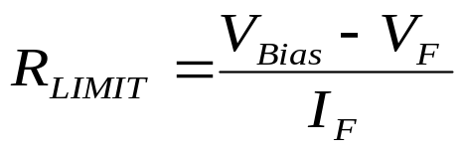
Special Diode Types
The limiting resistor (R_{LIMIT}) is determined using the following question:

Slide 24
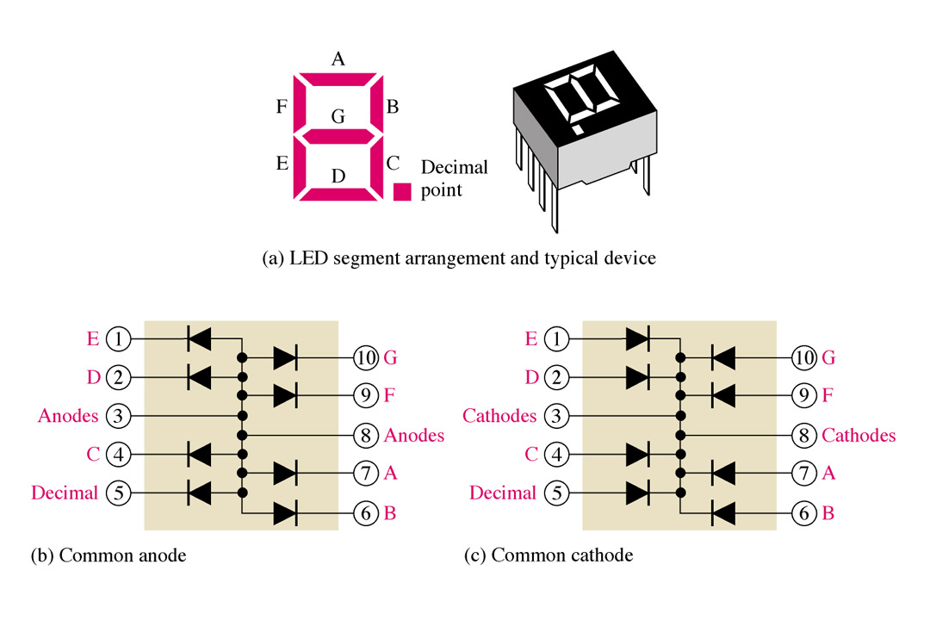
Special Diode Types
Application
The seven segment display is an example of LEDs use for display of decimal digits.
Fig.5-17: The 7-segment LED display.

Slide 25
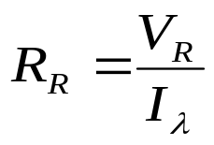
Special Diode Types
5.4.2 The Photodiode
Photodiode is a p-n junction that can convert light energy into electrical energy.
It operates in reverse bias voltage (V_{R}), as shown in Fig. 5-18, where I_{λ} is the reverse light current.
It has a small transparent window that allows light to strike the p-n junction.
The resistance of a photodiode is calculated by the formula as follows:
Fig.5-18: Photodiode.

Slide 26
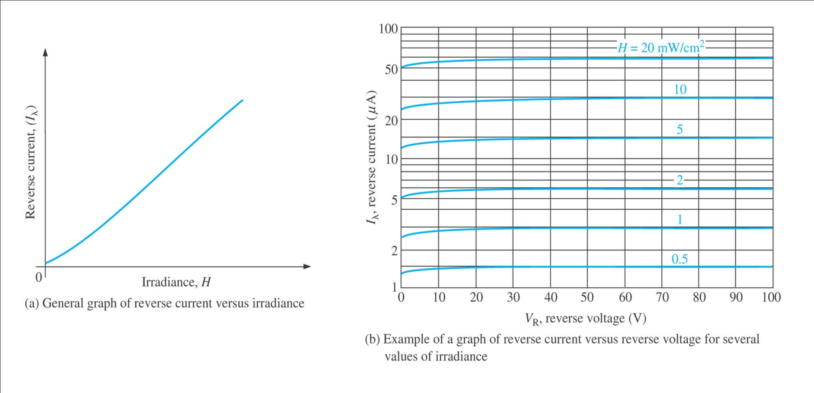
Special Diode Types
When its p-n junction is exposed to light, the reverse current increases with the light intensity as shown by the graph in Fig. 5-19 expressed as irradiance (mW/cm²).
When there is no incident light, the reverse current is almost negligible and is called the dark current.
Fig.5-19: Typical photodiode characteristics.

Slide 27
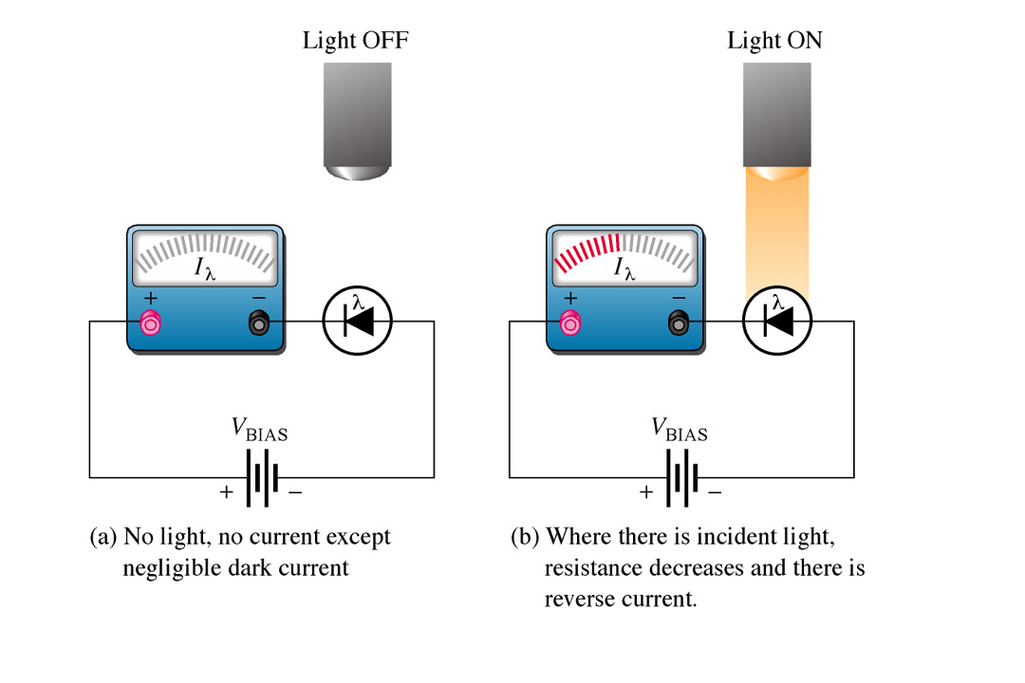
Special Diode Types
Fig. 5-20 illustrates that the photodiode is placed in the circuit in reverse bias. As with most diodes when in reverse bias, no current flows when in reverse bias, but when light strikes the exposed junction through a tiny window, reverse current increases proportional to light intensity.
Fig.5-20: Operation of photodiode.

Slide 28
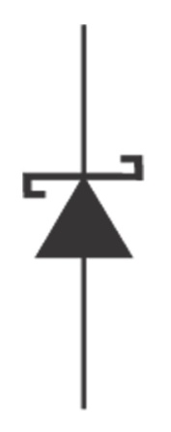
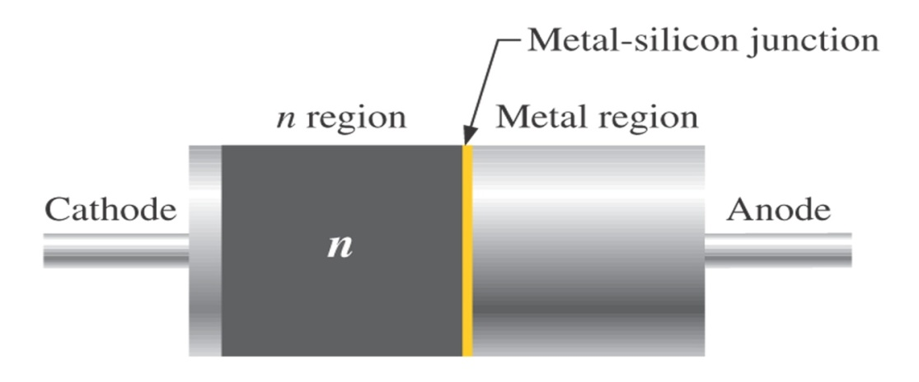
Special Diode Types
5.5 Other Types of Diodes
5.5.1 The Schottky Diode
A Schottky diode symbol is shown in Fig. 5-21(a). The Schottky diode’s significant characteristic is its fast switching speed. This is useful for high frequencies and digital applications. It is not a typical diode in that it does not have a p-n junction. Instead, it consists of a doped semiconductor (usually n-type) and metal bound together, as shown in Fig. 5-21(b).
Fig.5-21: (a) Schottky diode symbol and (b) basic internal construction of a Schottky diode.

Slide 29
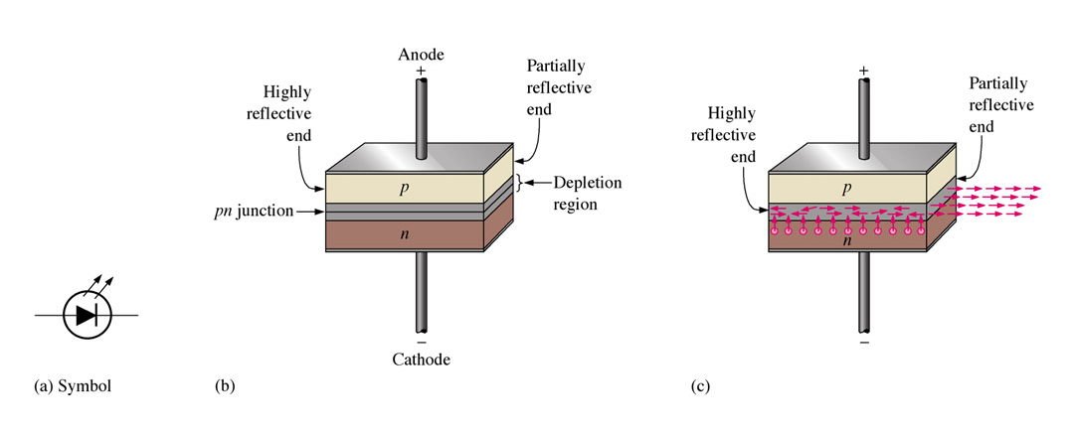
Special Diode Types
5.5.2 The Laser Diode
The laser diode (light amplification by stimulated emission of radiation) produces a monochromatic (single color) light. Laser diodes in conjunction with photodiodes are used to retrieve data from compact discs.
Fig.5-22: Basic laser diode construction and operation.

Slide 30
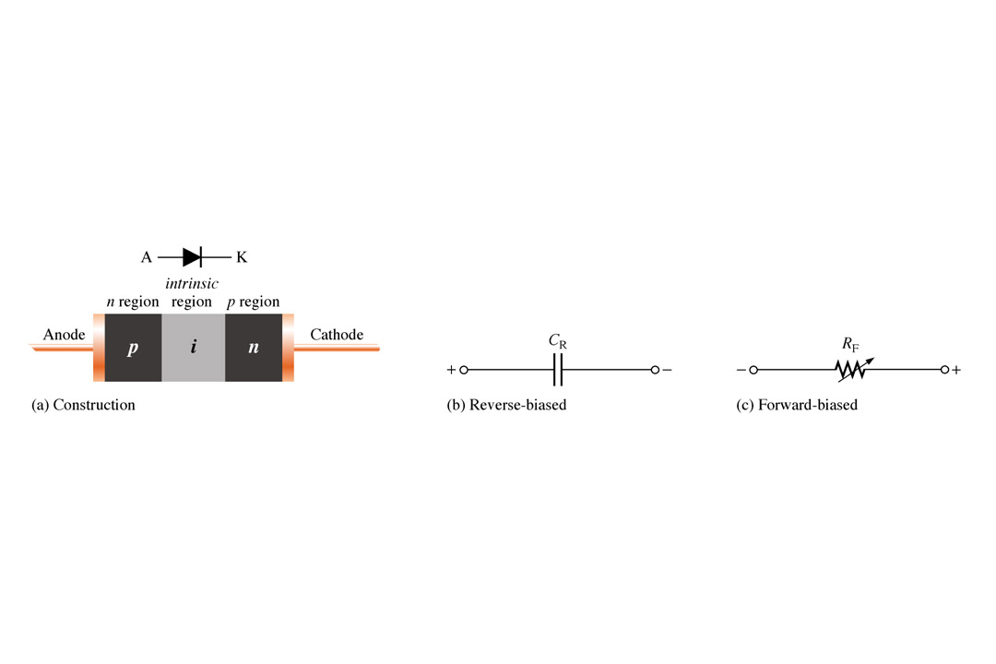
Special Diode Types
5.5.5 The PIN Diode
The pin diode is also used in mostly microwave frequency applications. Its variable forward series resistance characteristic is used for attenuation, modulation, and switching. In reverse bias it exhibits a nearly constant capacitance.
Fig.5-25: PIN diode

Slide 31
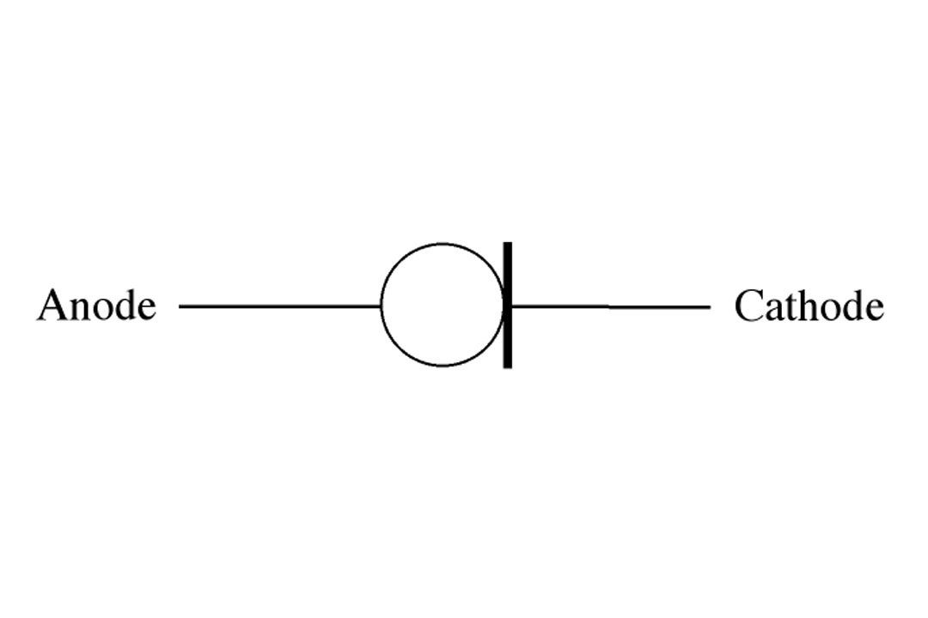
Special Diode Types
5.5.4 Current Regulator Diode
Current regulator diodes keeps a constant current value over a specified range of forward voltages ranging from about 1.5 V to 6 V.
Fig.5-24: Symbol for a current regulator diode.

Slide 32
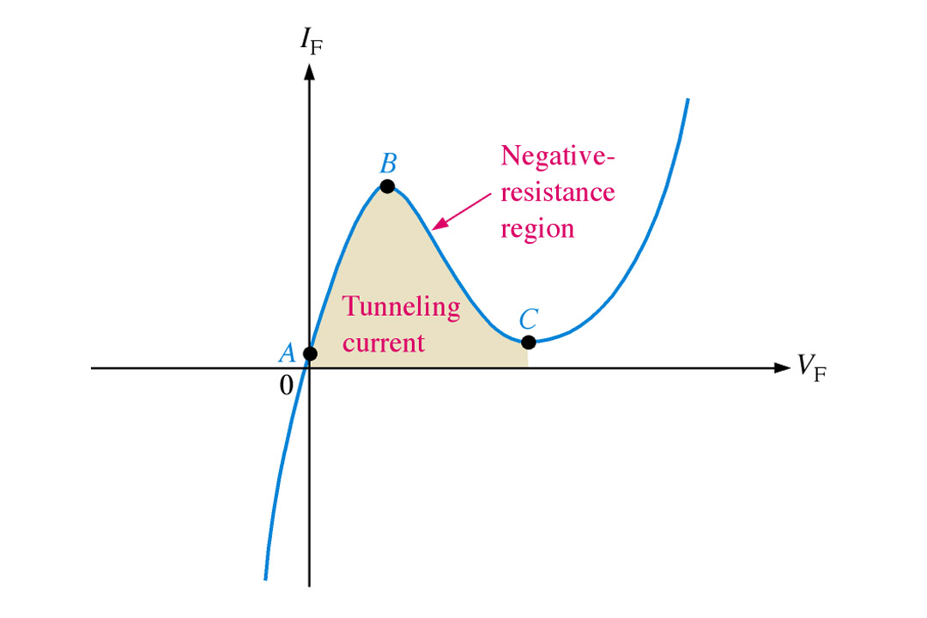
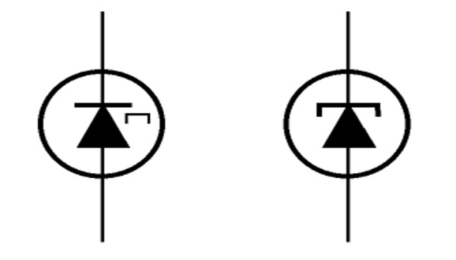
Special Diode Types
5.5.5 The Step-Recovery Diode
The step-recovery diode is also used for fast switching applications. This is achieved by reduced doping at the junction.
5.5.6 The Tunnel Diode
The tunnel diode has negative resistance. It will actually conduct well with low forward bias. With further increases in bias it reaches the negative resistance range where current will actually go down. This is achieved by heavily-doped p and n materials that creates a very thin depletion region.
Fig.5-25: Tunnel diode symbol and characteristic curve.

Slide 33
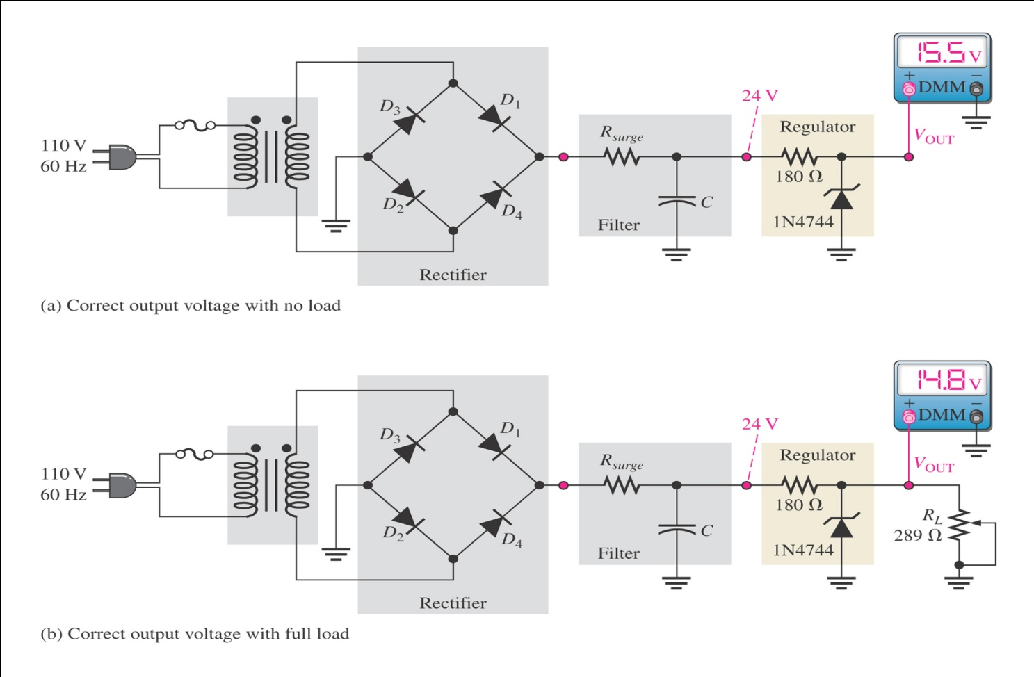
Special Diode Types
5.6 Troubleshooting
Although power supply outputs generally use IC regulators, zener diodes can be used as a voltage regulator when less precise regulation and low current is acceptable.
The meter readings of 15.5 V for no-load check and 14.8 V for full-load test indicate approximately the expected output voltage of 15 V.
A properly functioning zener will work to maintain the output voltage within certain limits despite changes in load.
Fig.5-25: Zener-regulated power supply test.

Slide 34
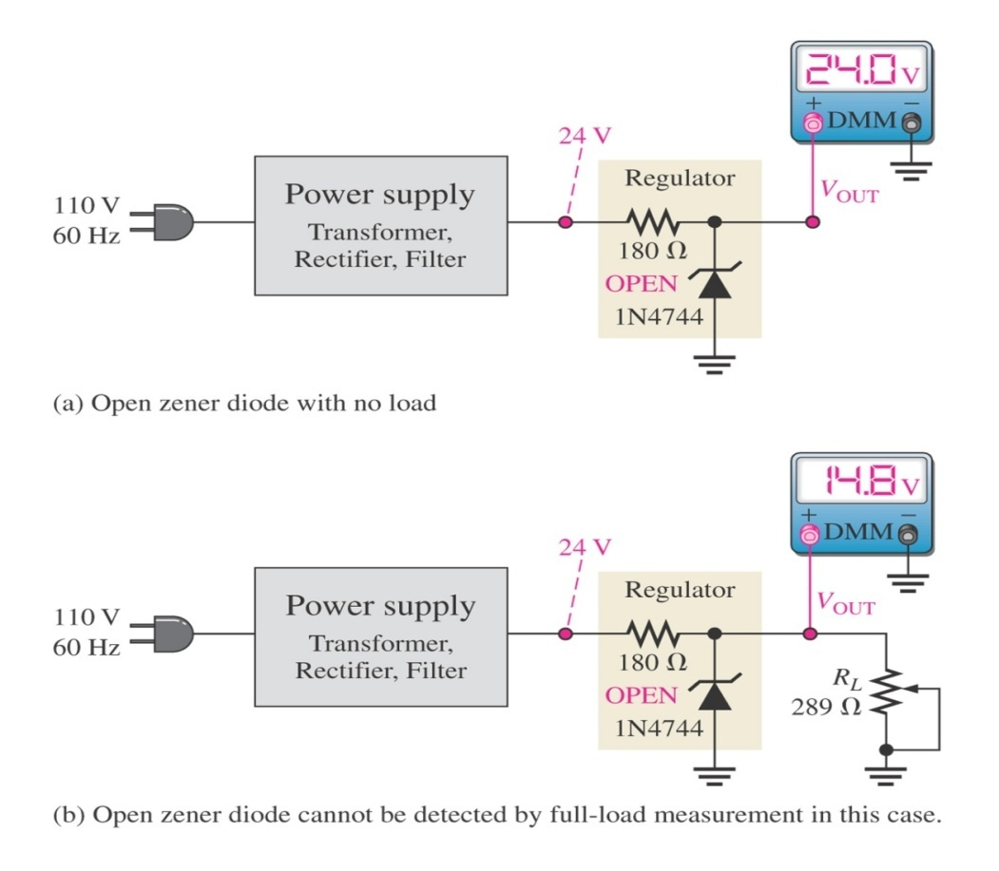
Special Diode Types
Case-1: Zener Diode Open
In no-load check, output voltage is 24 V as shown in Fig. 5-26(a). This indicates an open circuit between the output terminal and ground. Therefore, there is no voltage dropped between the filtered output of the power supply and the output terminal.
In full-load check, output voltage is 14.8 V due to the voltage-divider action of the 180 Ω series resistor and the 291 Ω load.
The result for full-load check is too close to the normal reading to be reliable fault indication and thus, the no-load check is used to verify the problem.
Figure 5-26: Indications of an open zener.

Slide 35
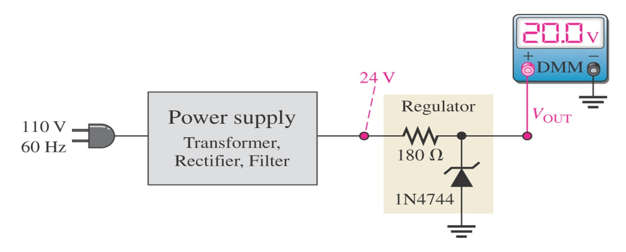
Special Diode Types
Case-2: Incorrect Zener Voltage
As indicated in Fig. 5-27, no-load check that result in an output voltage greater than the maximum zener voltage but less than the power supply output voltage indicates that the zener has failed. The 20 V output in this case is 4.5 V higher than the expected value of 15.5 V. That additional voltage indicates the zener is faulty or the wrong type has been installed.
Fig. 5-27: Indication of excessive zener impedance.

