Slide 1
9.3_Transistor Amp
PDS
SDN
NFV
Computer Vision
https://github.com/siagianp
https://www.youtube.com/@AmelOline/videos
https://github.com/amelcharolinesgn2/IoT_simulator-mqtt-NodeRed
https://github.com/amelcharolinesgn2/Cloud-Infrastructures
https://github.com/amelcharolinesgn2/ClouD-Infrastructure-SISKA-2025

Slide 2
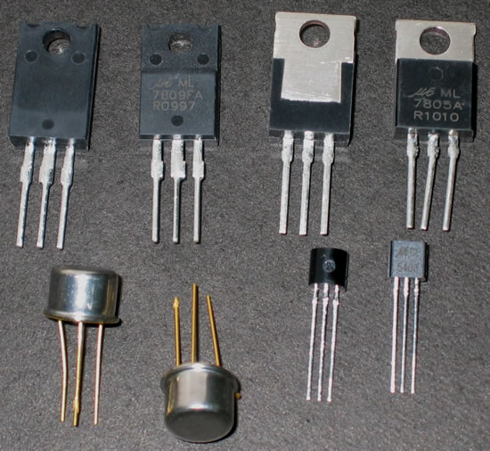
What is a transistor?

Slide 3
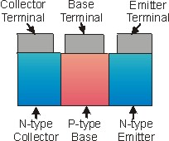
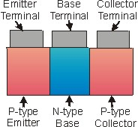
BJT Transistors:
NPN Transistor
Sandwiching a P-type layer between two n-type layers.
PNP Transistor
Sandwiching a N-type layer between two p-type layers.

Slide 4
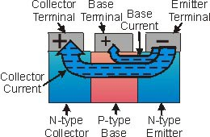

How a “NPN” Transistor works?
The base-emitter diode (forward) acts as a switch. when v1>0.7 it lets the electrons flow toward collector. so we can control our output current (Ic) with the input current (Ib) by using transistors.
C
B
E
backward
Forward

Slide 5
Transistors have three terminals:
Collector
Base
Emitter
Active: Always on
Ic=BIb
Saturation :Ic=Isaturation
On as a switch
Transistors work in 3 regions
Off :Ic=0
Off as a switch

Slide 6
Transistor as a Switch
Transistors can be used as switches.¹
Transistor
Switch
Transistors can either
conduct or not conduct current.²
ie, transistors can either be on or off.²

Slide 7
Transistor Switching Example¹⁵
X
12V
Variable
Voltage
Supply
When V_{BE} is less than 0.7V the transistor is off
and the lamp does not light.
When V_{BE} is greater than 0.7V the transistor is on
and the lamp lights.

Slide 8
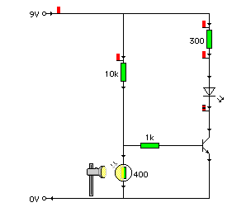
Transistor Circuit : Light-Controlled Circuit
This transistor circuit contains
a Light-Dependent Resistor.
Because of the LDR, this circuit is dependent on light.
The purpose of this circuit is to turn on the LED when the light reaches a certain intensity.
LED = Off.
Cover LDR.
R_{LDR} ↑.
V_{LDR} ↑.
Transistor switches on.
LED = On.
Input = Voltage Divider
Process = Transistor
Output = LED

Slide 9
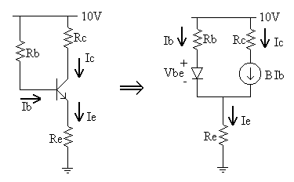
Transistor as an amplifier:
Transistors are often used as amplifiers to increase input signal in radios, televisions and some other applications .The circuit may be designed to increase the current or voltage level.
The power gain is the product of current gain and voltage gain (P=V*I).

Slide 10
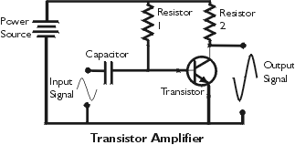
Amplifier example:
As you see, the transistor is biased to be always on. The input signal is amplified by this circuit. The frequency of output is the same as its input, but the polarity of the signal is inverted.
The measure of amplification is the gain of transistor.
Example:
Input Amplitude =0.2v
Output amplitude=10v
Gain=10/0.2=50

Slide 11
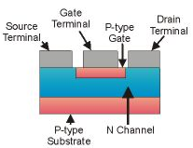
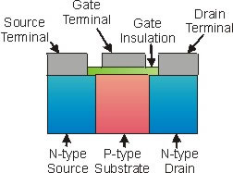
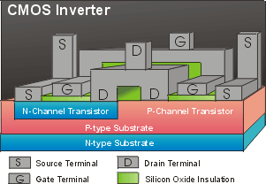




Field Effect Transistors
JFET
MOSFET
CMOS

Slide 12
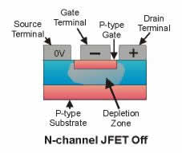
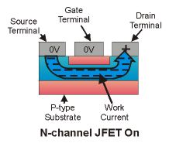
How a JFET transistor works?
When the gate is negative ,it repels the electron in the N-channel. So there is no way for electrons to flow from source to drain.
When the negative voltage is removed from Gate ,the electrons can flow freely from source to drain .so the transistor is on.

Slide 13
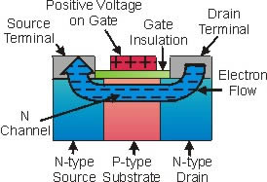
How a MOSFET Transistor works?
In MosFET, the Gate is insulated from p-channel or n-channel. This prevents gate current from flowing, reducing power usage.
When the Gate is positive voltage ,it allows electrons to flow from drain to source .In this case transistor is on.

Slide 14
PDS
SDN
NFV
Computer Vision
Thank You !!
https://github.com/siagianp
https://www.youtube.com/@AmelOline/videos
https://github.com/amelcharolinesgn2/IoT_simulator-mqtt-NodeRed
https://github.com/amelcharolinesgn2/Cloud-Infrastructures
https://github.com/amelcharolinesgn2/ClouD-Infrastructure-SISKA-2025

