Slide 1
9.4_Transistors
PDS
SDN
NFV
Computer Vision
https://github.com/siagianp
https://www.youtube.com/@AmelOline/videos
https://github.com/amelcharolinesgn2/IoT_simulator-mqtt-NodeRed
https://github.com/amelcharolinesgn2/Cloud-Infrastructures
https://github.com/amelcharolinesgn2/ClouD-Infrastructure-SISKA-2025

Slide 2
What is a transistor?

Slide 3
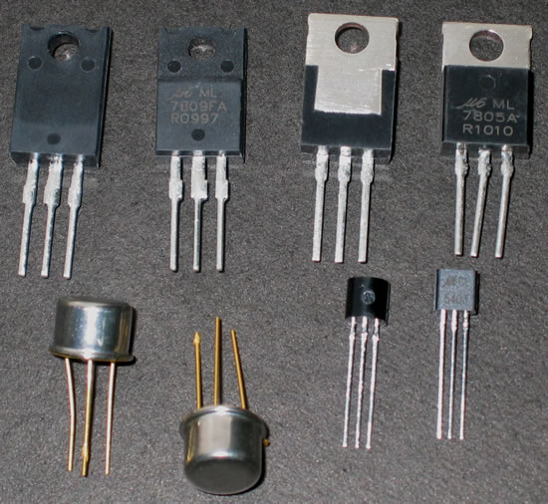
What is a transistor?
A transistor is a 3 terminal electronic device made of semiconductor material.
Transistors have many uses, including amplification, switching, voltage regulation, and the modulation of signals

Slide 4
Lecture Overview
What is a Transistor?
History
Types
Characteristics
Applications

Slide 5

What is a Transistor?
Semiconductors: ability to change from conductor to insulator
Can either allow current or prohibit current to flow
Useful as a switch, but also as an amplifier
Essential part of many technological advances

Slide 6
A Brief History
Guglielmo Marconi invents radio in 1895
Problem: For long distance travel, signal must be amplified
Lee De Forest improves on Fleming’s original vacuum tube to amplify signals
Made use of third electrode
Too bulky for most applications

Slide 7
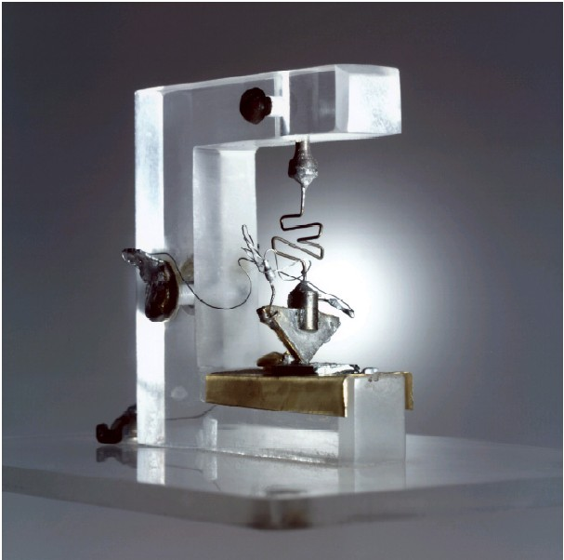

The Transistor is Born
Bell Labs (1947): Bardeen, Brattain, and Shockley
Originally made of germanium
Current transistors made of doped silicon

Slide 8
How Transistors Work
Doping: adding small amounts of other elements to create additional protons or electrons
P-Type: dopants lack a fourth valence electron (Boron, Aluminum)
N-Type: dopants have an additional (5th) valence electron (Phosphorus, Arsenic)
Importance: Current only flows from P to N

Slide 9
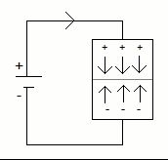
Diodes and Bias
Diode: simple P-N junction.
Forward Bias: allows current to flow from P to N.
Reverse Bias: no current allowed to flow from N to P.
Breakdown Voltage: sufficient N to P voltage of a Zener Diode will allow for current to flow in this direction.

Slide 10
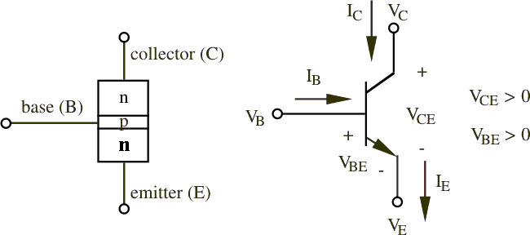
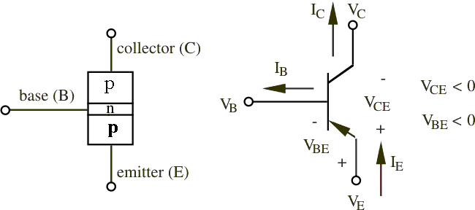
Bipolar Junction Transistor (BJT)
3 adjacent regions of doped Si (each connected to a lead):
Base. (thin layer,less doped).
Collector.
Emitter.
2 types of BJT:
npn.
pnp.
Most common: npn (focus on it).
npn bipolar junction transistor
Developed by Shockley (1949)
pnp bipolar junction transistor

Slide 11
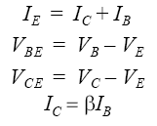

BJT NPN Transistor
1 thin layer of p-type, sandwiched between 2 layers of n-type.
N-type of emitter: more heavily doped than collector.
With V_{C}>V_{B}>V_{E}:
Base-Emitter junction forward biased, Base-Collector reverse biased.
Electrons diffuse from Emitter to Base (from n to p).
There’s a depletion layer on the Base-Collector junction →no flow of e⁻ allowed.
BUT the Base is thin and Emitter region is n⁺ (heavily doped) → electrons have enough momentum to cross the Base into the Collector.
The small base current I_{B} controls a large current I_{C}

Slide 12
BJT characteristics
Current Gain:
α is the fraction of electrons that diffuse across the narrow Base region
1- α is the fraction of electrons that recombine with holes in the Base region to create base current
The current Gain is expressed in terms of the β (beta) of the transistor (often called h_{fe} by manufacturers).
β (beta) is Temperature and Voltage dependent.
It can vary a lot among transistors (common values for signal BJT: 20 - 200).

Slide 13
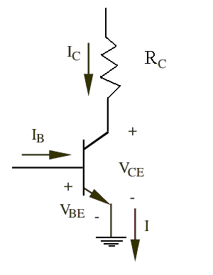
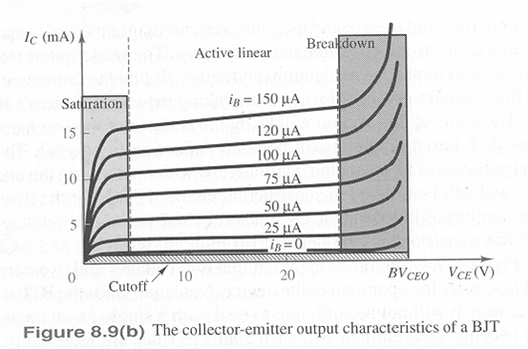
NPN Common Emitter circuit
Emitter is grounded.
Base-Emitter starts to conduct with V_{BE}=0.6V,I_{C} flows and it’s I_{C}=β∗I_{B}.
Increasing I_{B}, V_{BE} slowly increases to 0.7V but I_{C} rises exponentially.
As I_{C} rises ,voltage drop across R_{C} increases and V_{CE} drops toward ground. (transistor in saturation, no more linear relation between I_{C} and I_{B})

Slide 14
Common Emitter characteristics
Collector current controlled by the collector circuit. (Switch behavior)
In full saturation V_{CE}=0.2V.
Collector current proportional to Base current
The avalanche multiplication of current through collector junction occurs: to be avoided
No current flows

Slide 15
Operation region summary
Operation Region | I_{B} or V_{CE} Char. | BC and BE Junctions | Mode
Cutoff | I_{B} = Very small | Reverse & Reverse | Open Switch
Saturation | V_{CE} = Small | Forward & Forward | Closed Switch
Active Linear | V_{CE} = Moderate | Reverse & Forward | Linear Amplifier
Break-down | V_{CE} = Large | Beyond Limits | Overload

Slide 16
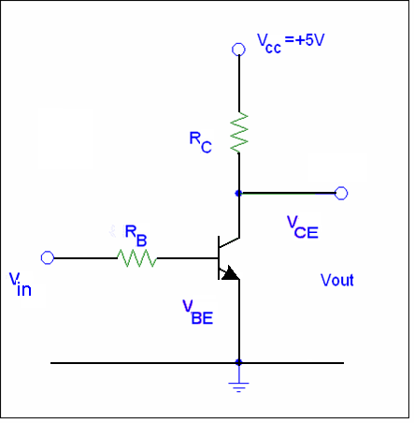
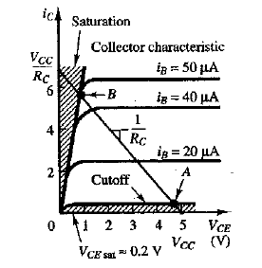
BJT as Switch
V_{in}(Low ) < 0.7 V
BE junction not forward biased
Cutoff region
No current flows
V_{out} = V_{CE} = V_{cc}
V_{out} = High
V_{in}(High)
BE junction forward biased (V_{BE}=0.7V)
Saturation region
V_{CE} small (~0.2 V for saturated BJT)
V_{out} = small
I_{B} = (V_{in}-V_{B})/R_{B}
V_{out} = Low

Slide 17
BJT as Switch 2
Basis of digital logic circuits
Input to transistor gate can be analog or digital
Building blocks for TTL – Transistor Transistor Logic
Guidelines for designing a transistor switch:
V_{C}>V_{B}>V_{E}
V_{BE}= 0.7 V
I_{C} independent from I_{B} (in saturation).
Min. I_{B} estimated from by (I_{Bmin}≈ I_{C}/β).
Input resistance→ such that I_{B} > 5-10 times I_{Bmin} because β varies among components, with temperature and voltage and R_{B} may change when current flows.
Calculate the max I_{C} and I_{B} not to overcome device specifications.

Slide 18
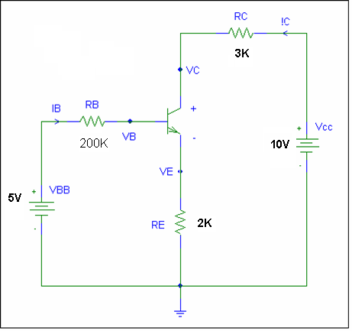
BJT as Amplifier
Common emitter mode
Linear Active Region
Significant current Gain
Example:
Let Gain, β = 100
Assume to be in active region -> V_{BE}=0.7V
Find if it’s in active region

Slide 19
BJT as Amplifier
V_{CB}>0 so the BJT is in active region

Slide 20
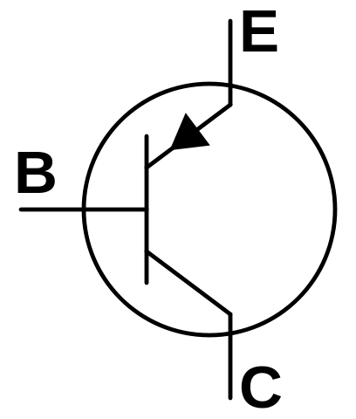
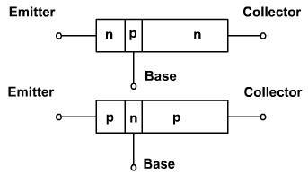
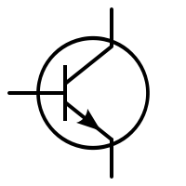
Bipolar Transistor
A transistor is basically a Si or Ge crystal containing three separate regions.

Slide 21
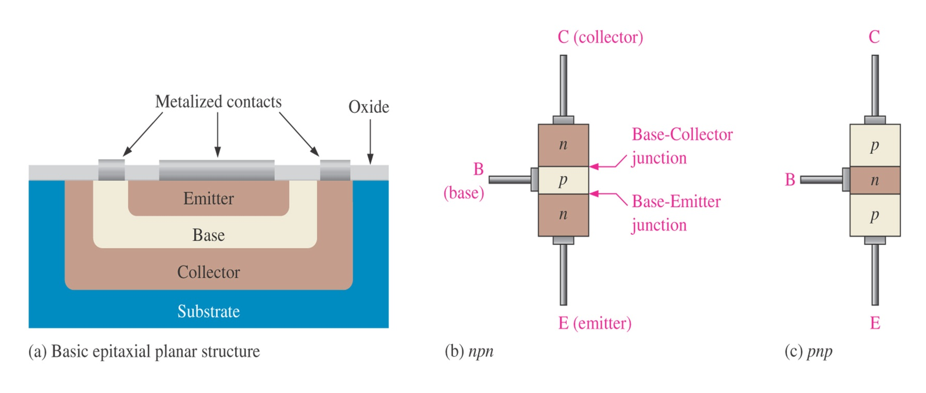
Architecture of BJTs
The bipolar junction transistor (BJT) is constructed with three doped semiconductor regions separated by two pn junctions
Regions are called emitter, base and collector

Slide 22
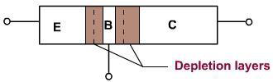
Bipolar Transistor
The depletion layers do not have the same width, because different regions have different doping levels.

Slide 23
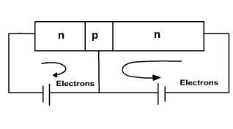
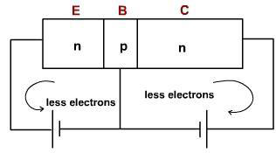
Biasing
If both the junctions are forward biased free electrons enter the emitter and collector of the transistor, joins at the base and come out of the base.
If both the junction are reverse biased then small currents flows through both junctions only due to thermally produced minority carriers and surface leakage.

Slide 24
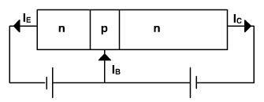
Biasing
When the emitter junction is forward biased and collector junction is reverse biased then one expect large emitter current and small collector current but collector current is almost as large as emitter current.

Slide 25
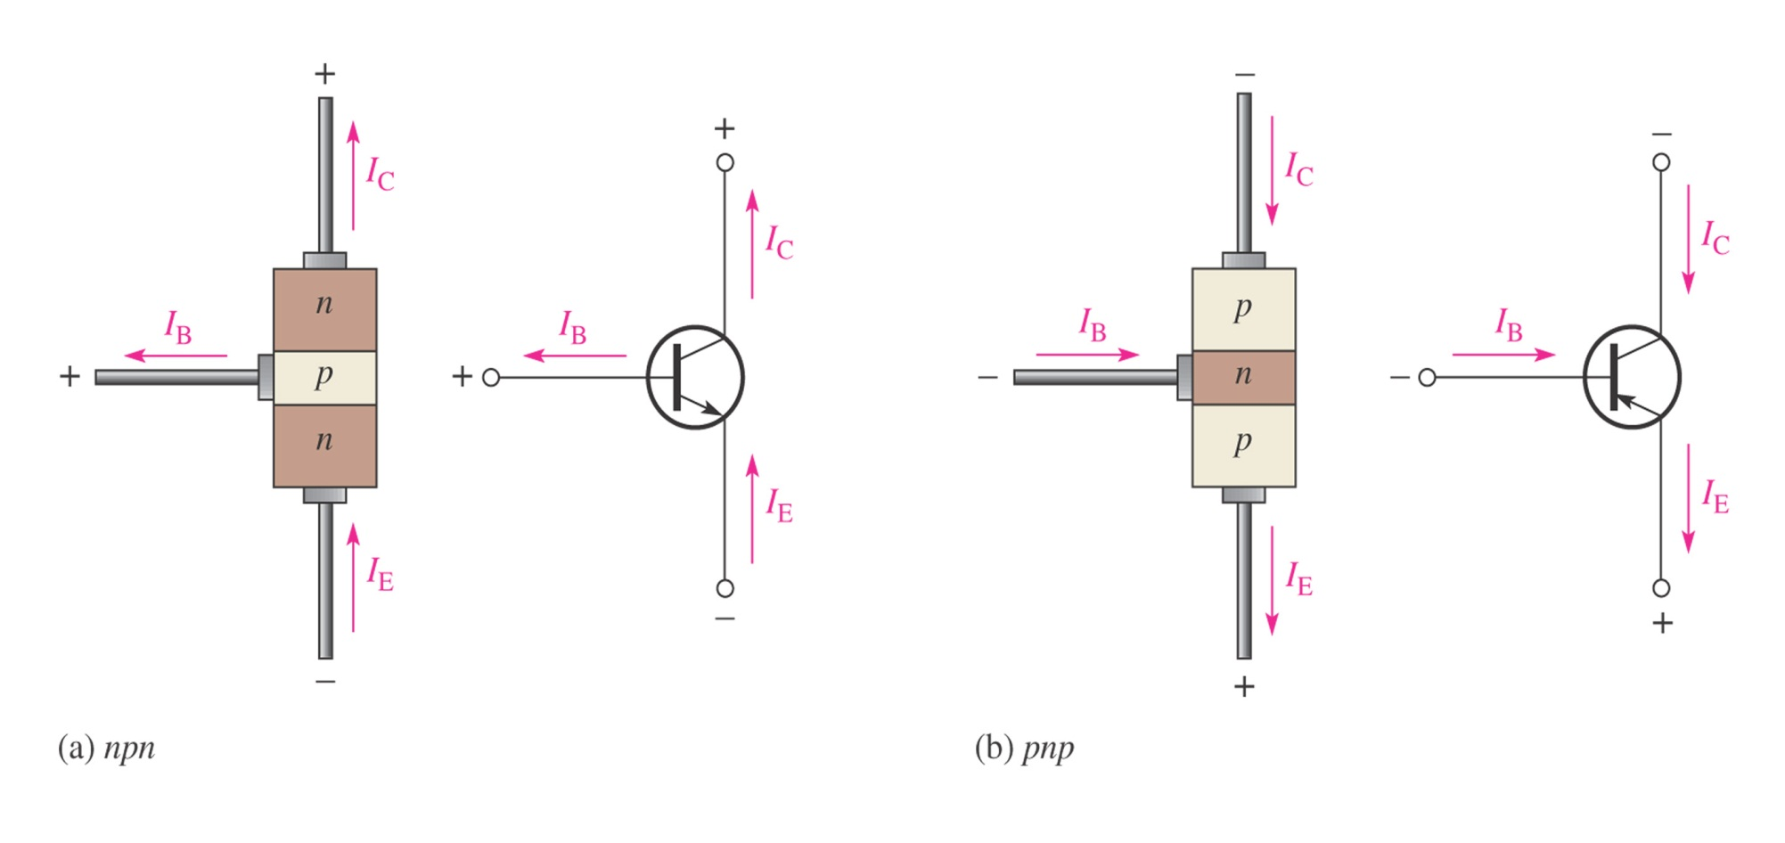
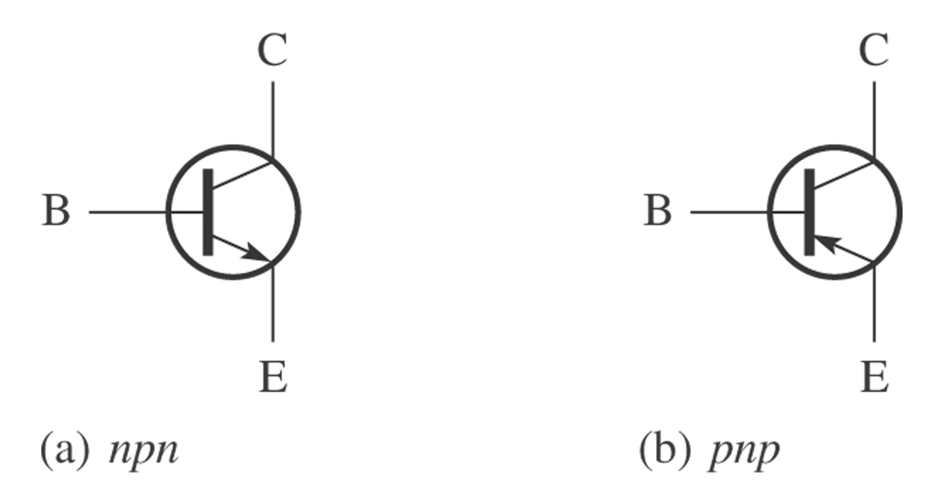

Transistor Current
The total current flowing into the transistor must be equal to the total current flowing out of it.
$$I_{E}=I_{C}+I_{B}$$

Slide 26
Transistor Applications
Switching
Amplification
Variable Resistor
Impedance Matching
Voltage Regulation

Slide 27
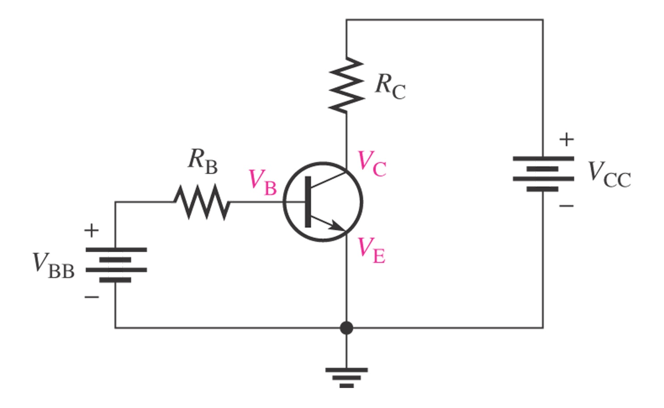
Basic circuits of BJT

Slide 28
Operation of BJTs
BJT will operates in one of following four region
Cutoff region (for digital circuit)
Saturation region (for digital circuit)
Linear (active) region (to be an amplifier)
Breakdown region (always be a disaster)

Slide 29
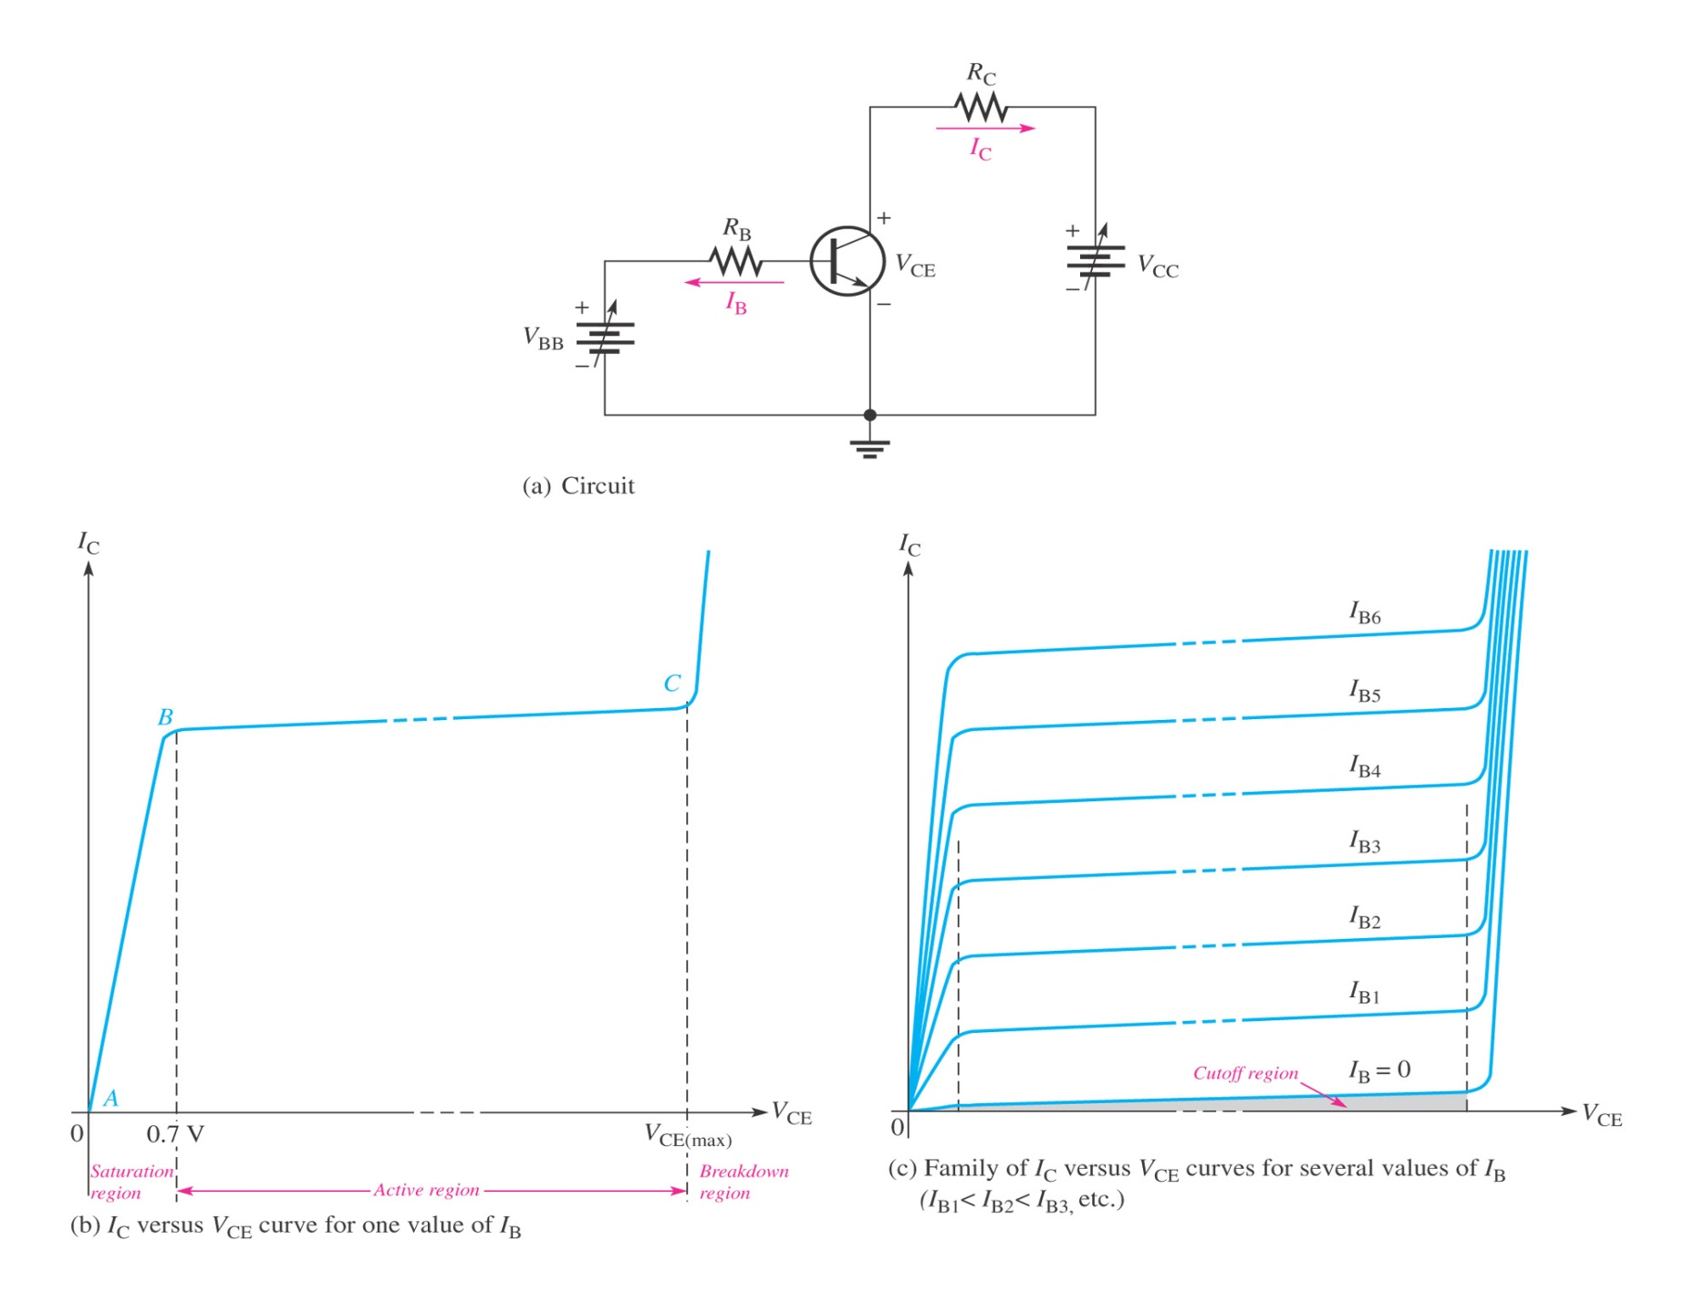
Operation of BJTs

Slide 30
DC Analysis of BJTs
Transistor Currents:
I_{E} = I_{C} + I_{B}
alpha (α_{DC})
I_{C} = α_{DC}I_{E}
beta (β_{DC})
I_{C} = β_{DC}I_{B}
β_{DC} typically has a value between 20 and 200

Slide 31
DC Analysis of BJTs
DC voltages for the biased transistor:
Collector voltage
V_{C} = V_{CC} - I_{C}R_{C}
Base voltage
V_{B} = V_{E} + V_{BE}
for silicon transistors, V_{BE} = 0.7 V
for germanium transistors, V_{BE} = 0.3 V

Slide 32
Q-point
The base current, I_{B}, is established by the base bias
The point at which the base current curve intersects the dc load line is the quiescent or Q-point for the circuit

Slide 33
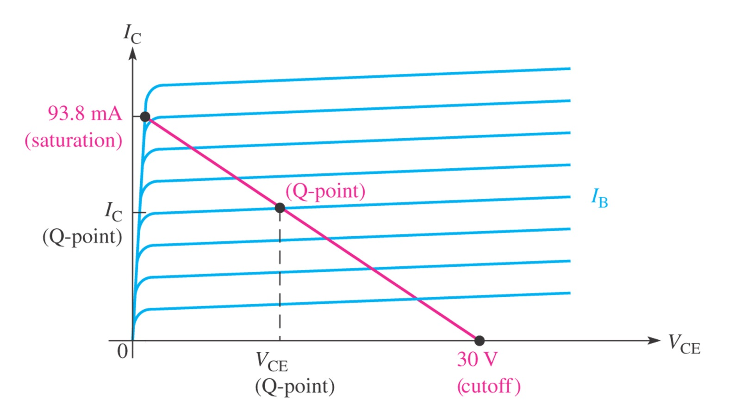
Q-point

Slide 34
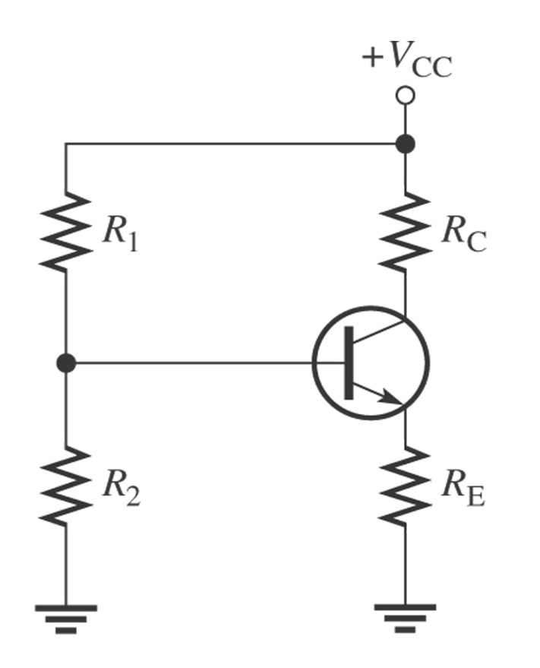
DC Analysis of BJTs
The voltage divider biasing is widely used
Input resistance is:
R_{IN} ≅ β_{DC}R_{E}
The base voltage is approximately:
V_{B} ≅ V_{CC}R₂/(R₁+R₂)

Slide 35
PDS
SDN
NFV
Computer Vision
Thank You !!
https://github.com/siagianp
https://www.youtube.com/@AmelOline/videos
https://github.com/amelcharolinesgn2/IoT_simulator-mqtt-NodeRed
https://github.com/amelcharolinesgn2/Cloud-Infrastructures
https://github.com/amelcharolinesgn2/ClouD-Infrastructure-SISKA-2025

