Slide 1
9.4_Transistors
PDS
SDN
NFV
Computer Vision
https://github.com/siagianp
https://www.youtube.com/@AmelOline/videos
https://github.com/amelcharolinesgn2/IoT_simulator-mqtt-NodeRed
https://github.com/amelcharolinesgn2/Cloud-Infrastructures
https://github.com/amelcharolinesgn2/ClouD-Infrastructure-SISKA-2025

Slide 2
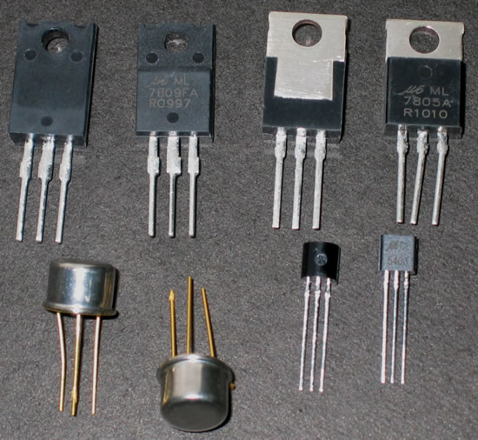
What is a FET?

Slide 3
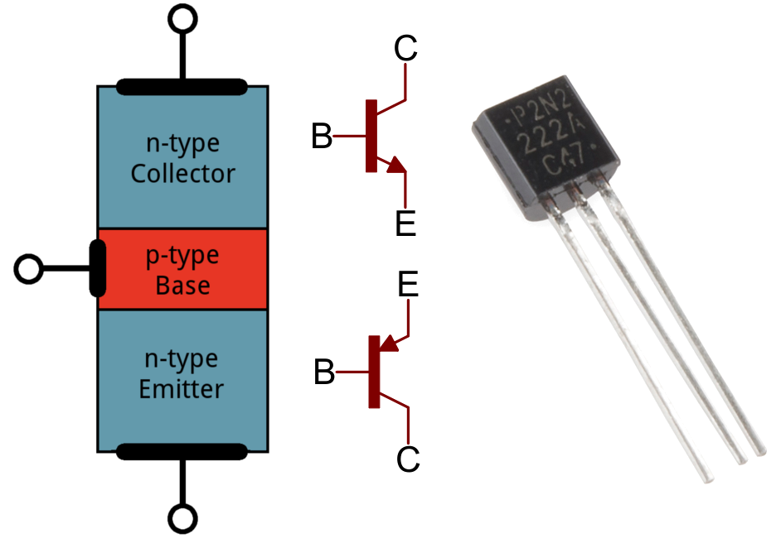
TRANSISTORS
A transistor is a semiconductor device used to amplify or switch electronic signals and electrical power. It is composed of semiconductor material usually with at least three terminals for connection to an external circuit.

Slide 4
The three different transistor configurations are:
Common Base (CB)
Common Emitter(CE)
Common Collector(CC)

Slide 5
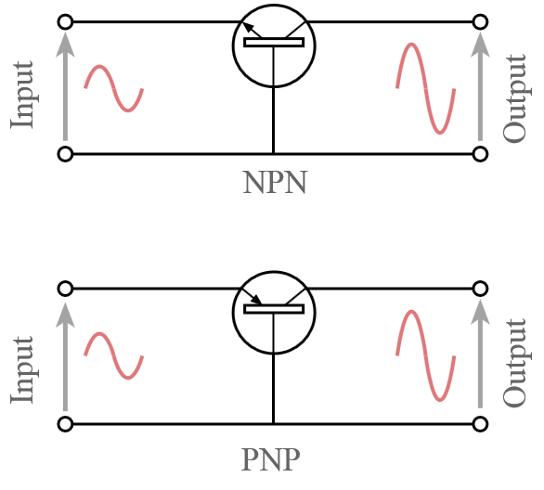
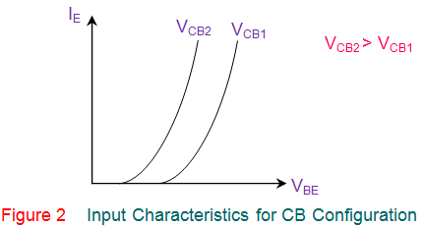
Common Base(CB):
This transistor configuration provides a low input impedance while offering a high output impedance

Slide 6
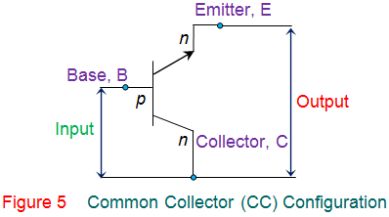
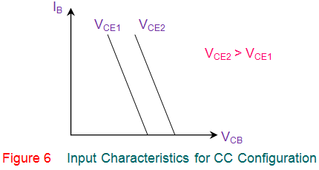
Common Collector(CC):
This transistor configuration has the collector terminal of the transistor common between the input and the output terminals . This offers high input impedance, low output impedance, voltage gain less than one and a large current gain

Slide 7

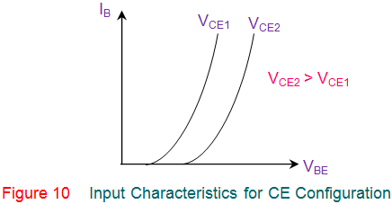
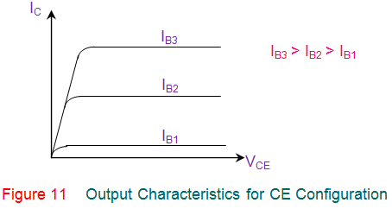
Common Emitter(CE):
In this configuration, the emitter terminal is common between the input and the output terminals . This configuration offers medium input impedance, medium output impedance, medium current gain and voltage gain.

Slide 8
FET(Field Effect Transistor):
FET is a transistor, where output current is controlled by electric field. FET sometimes, is called uni-polar transistor as it involves single carrier type operation. The basic types of FET transistor is completely different from BJT transistor basics.

Slide 9
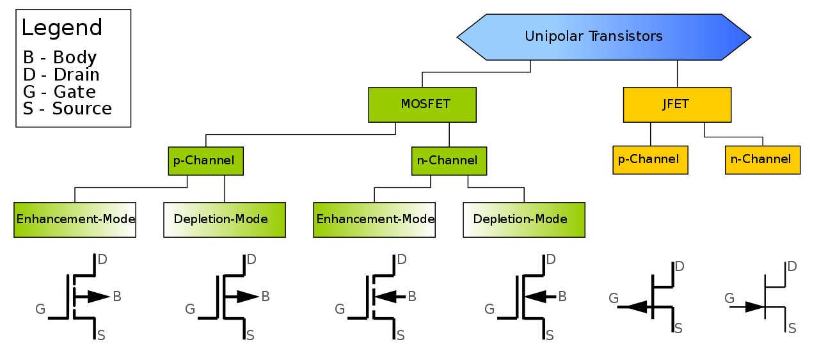
FET Conventional symbol types:

Slide 10
Three terminals of FET:
Source (S): which the carriers enter the channel. Conventionally, current entering the channel at S is designated by I_{S}.
Drain (D): which the carriers leave the channel. Conventionally, current entering the channel at D is designated by I_{D}. Drain-to-source voltage is V_{DS}.
Gate (G): The terminal that modulates the channel conductivity. By applying voltage to G, one can control I_{D}.

Slide 11
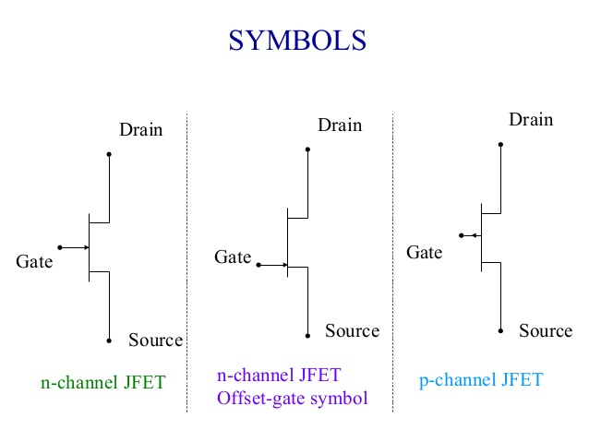

Slide 12
UJT (uni junction transistor ):
A unijunction transistor (UJT) is a three-lead electronic semiconductor device with only one junction that acts exclusively as an electrically controlled switch. The UJT is not used as a linear amplifier.

Slide 13
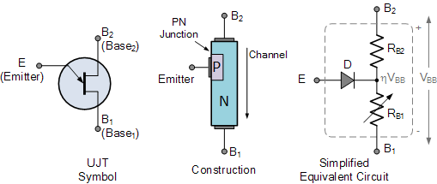
UJT Symbol and Construction

Slide 14

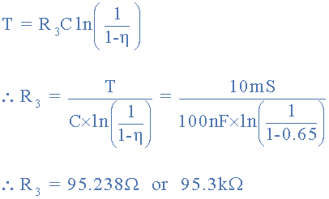
The value of the timing resistor, R₃ is calculated as:
The time peroid is:

Slide 15
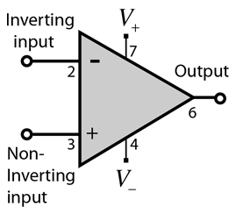
Op-AMP(Operational Amplifier)
An operational amplifier (often op-amp or opamp) is a DC-coupled high-gain electronic voltage amplifier with a differential input and, usually, a single-ended output.

Slide 16

Applications of op-AMP:
Op Amps and Op Amp Circuits. ... Op amps are used in a wide variety of applications in electronics. Some of the more common applications are: as a voltage follower, selective inversion circuit, a current-to-voltage converter, active rectifier, integrator, a whole wide variety of filters, and a voltage comparator
The Voltage Gain (A_{V}) of the operational amplifier can be found using the following formula

Slide 17
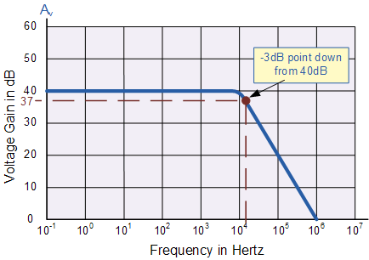
:
Operational Amplifiers Bandwidth:
The operational amplifiers bandwidth is the frequency range over which the voltage gain of the amplifier is above 70.7% or -3dB (where 0dB is the maximum) of its maximum output value as shown below.

Slide 18
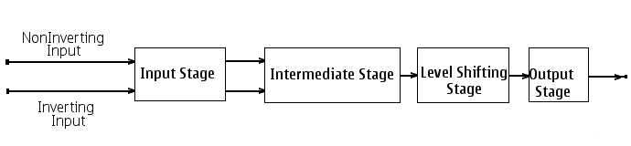
Block diagram of op-amp:

Slide 19
Block diagram consists of 4 stages:
Input stage
Mid stage
Level shifter
Output stage

Slide 20
Input stage:
It is having dual input and balanced output and used to provide voltage gain to an Op-Amp and it decides input resistance.
Mid stage:
It is having dual input and unbalanced output. It provides additional voltage gain to the input signal.
Level shifter:
In this emitter coupled logic circuit is used so that it provides the dc level to zero voltage level with respect to ground.
Output stage:
In this complimentary push pull circuit is used so that it provides low output resistance.

Slide 21
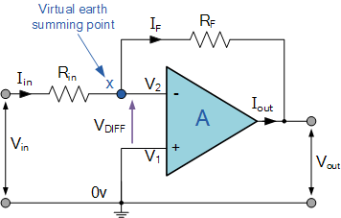
Inverting amplifier:
Inverting Operational Amplifier. ... Negative Feedback is the process of “feeding back” a fraction of the output signal back to the input, but to make the feedback negative, we must feed it back to the negative or “inverting input” terminal of the op-ampusing an external Feedback Resistor called Rƒ.

Slide 22
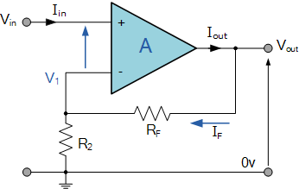
Non-inverting amplifier:
In this configuration, the input voltage signal, ( V_{IN} ) is applied directly to the non-inverting ( + ) input terminal which means that the output gain of theamplifier becomes “Positive” in value in contrast to the “Inverting Amplifier” circuit we saw in the last tutorial whose output gain is negative in value.

Slide 23
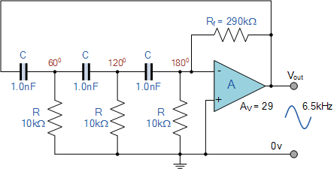
Op-amp Oscillator:
The Op-amp RC Oscillator. When used as RC oscillators, Operational Amplifier RC Oscillatorsare more common than their bipolar transistors counterparts.
The oscillator circuit consists of a negative-gain operational amplifier and a three section RC network that produces the 180º phase shift.

Slide 24
PDS
SDN
NFV
Computer Vision
Thank You !!
https://github.com/siagianp
https://www.youtube.com/@AmelOline/videos
https://github.com/amelcharolinesgn2/IoT_simulator-mqtt-NodeRed
https://github.com/amelcharolinesgn2/Cloud-Infrastructures
https://github.com/amelcharolinesgn2/ClouD-Infrastructure-SISKA-2025

