Slide 1

Data Communications
How do computers really communicate?
They need a physical connection.
Data is encoded and transmitted as energy.
Energy is decoded at the destination back into data.
Each form of energy has different properties and requirements for transmission.

Slide 2
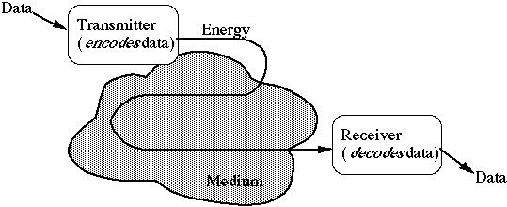
Transmission Media
Energy is carried through a medium
Copper: twisted pair
Glass: optical
Air : radio (many portions of the frequency spectrum can be used)

Slide 3
Choosing a Medium
Copper wire (traditional wired network) is mature technology, rugged and inexpensive; maximum transmission speed is limited.
Glass fiber (optical network):
Higher speed
More resistant to electro-magnetic interference
Spans longer distances
Requires only single fiber
More expensive; less rugged
Radio and microwave (wireless network) don't require physical connection and can be used for mobile connections.

Slide 4
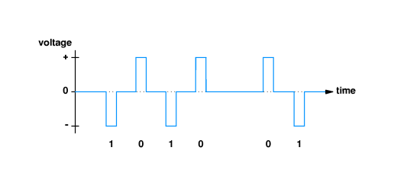
Data Communications
Simplest approach - use varying voltages to represent 1s and 0s
One common encoding use negative voltage for 1 and positive voltage for 0
In following figure, transmitter puts positive voltage on line for 0 and negative voltage on line for 1

Slide 5
Data Communications
Encoding scheme leaves several questions unanswered:
How long will voltage last for each bit?
How soon will next bit start?
How will the transmitter and receiver agree on timing?
Standards specify operation of communication systems
Devices from different vendors that adhere to the standard can interoperate
Example organizations:
International Telecommunications Union (ITU)
Electronic Industries Association (EIA)
Institute for Electrical and Electronics Engineers (IEEE)

Slide 6
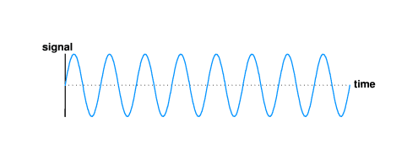
Data Communications
Digital signals can’t travel very far.
Continuous, oscillating signal will propagate farther than digital signal
Long distance communication uses such a signal, called a carrier
Waveform for carrier looks like:
Various methods used to ‘modulate’ data using a carrier

Slide 7
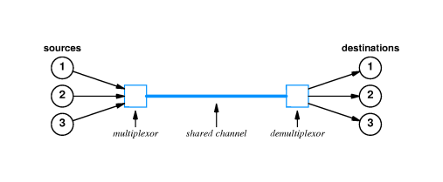
Multiplexing
Modulation allows a medium to be shared by separate signals by using carriers of different frequencies.
Frequency division multiplexing (FDM) achieves multiplexing by using different carrier frequencies.
Allows multiple sources to simultaneously share a single medium without interference
Receiver can "tune" to specific frequency and extract modulation for that one channel
Frequencies must be separated to avoid interference
Only useful in media that can carry multiple signals with different frequencies - high-bandwidth required

Slide 8
Multiplexing
Time division multiplexing uses a single carrier and sends data streams sequentially
Allow multiple sources to share a medium by ‘taking turns’
Transmitter/receiver pairs share single channel
Basis for most computer networks used shared media
Statistical multiplexing is similar to TDM except if a source does not have data to send, the multiplexor skips the source

Slide 9
Bandwidth
The communications channel along with the modulation technique determines the bandwidth:
Channel bandwidth: Measured in cycles per second or Hertz (hz), is the fastest continuously oscillating signal that can be sent over the channel.
Can also refer to bandwidth as the width of the spectrum available to the signal.
A transmitter’s maximum signal rate (i.e., baud rate) is limited by the channel bandwidth.
Some might equate bandwidth to data rates or throughput
Data rate: the maximum possible rate at which link layer frames can be sent
Throughput : the rate at which application data is sent

Slide 10
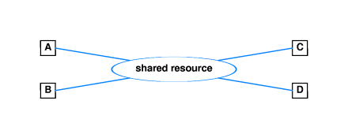
Data Communications
To fairly share resources….
Data is divided into small blocks called packets. Computers effectively take turn sending packets over a packet switched network.

Slide 11

Data Communications
A packet is referred to as a frame once it ‘hits’ the wire.
Host B
Host A
Time first bit
Of frame hits the wire
Time it takes the first bit
To propagate over the medium
Before arriving at Host B
Time last bit
Of frame hits the wire
Time
The time it takes the frame to get from Host A to Host B includes the transmission time as well as the propagation delay.

Slide 12
Data Communications
What if a bit gets damaged while it is in flight?
Error Detection: methods such as checksums can detect bit errors
Error Recovery: : methods such as window-based protocols can detect a dropped packet and initiate a retransmission

Slide 13
Ethernet
On a shared communication channel (e.g., an Ethernet network)
Enhances network resource utilization
Three main topologies: star, ring and bus
What is an Ethernet ?

Slide 14
Ethernet
Ethernet is a bus network in which multiple computers share a single transmission medium. While one computer transmits a frame, all others must wait.
Evolution of Ethernet
Original Ethernet was a true shared bus and involved a distributed coordination scheme called carrier sense multiple access with collision detection (CSMA/CD)
Switched Ethernet- no longer a shared bus….switches interconnect computers
Gigabit Ethernet is standard, high end is 100 Gbps

Slide 15
IEEE LAN (802.2/802.3) Frame Format
Dest
Address
(6)
CRC
(4)
Source
Address
(6)
Length
(2)
DSAP SSAP cntl code type
(1) (1) (1) (3) (2)
Data ( 38 -1492)
Preamble
(7)
MAC header
802.2 header
Data: IP, ARP, SNA

