Slide 1






PDS
Computer Vision
Starlink and IoT
@ P. Siagian
https://github.com/siagianp
https://www.youtube.com/@AmelOline/videos
https://github.com/amelcharolinesgn2/IoT_simulator-mqtt-NodeRed
github.com/amelcharolinesgn2/ANJAR

Slide 2
Starlink and IoT
Do you think Starlink would be usable for IoT devices?
Starlink is a satellite constellation being constructed by SpaceX to provide satellite Internet access.

Slide 3

The constellation will consist of thousands of mass-produced small satellites in low Earth orbit (LEO), working in combination with ground transceivers.

Slide 4
. SpaceX also plans to sell some of the satellites for military, scientific, or exploratory purposes. Product development began in 2015, with the first two prototype test-flight satellites launched in February 2018. A second set of test satellites and the first large deployment occurred on May 24, 2019 UTC when the first 60 operational satellites were launched. The SpaceX satellite development facility in Redmond, Washington, houses the Starlink research, development, manufacturing, and on-orbit control operations.

Slide 5
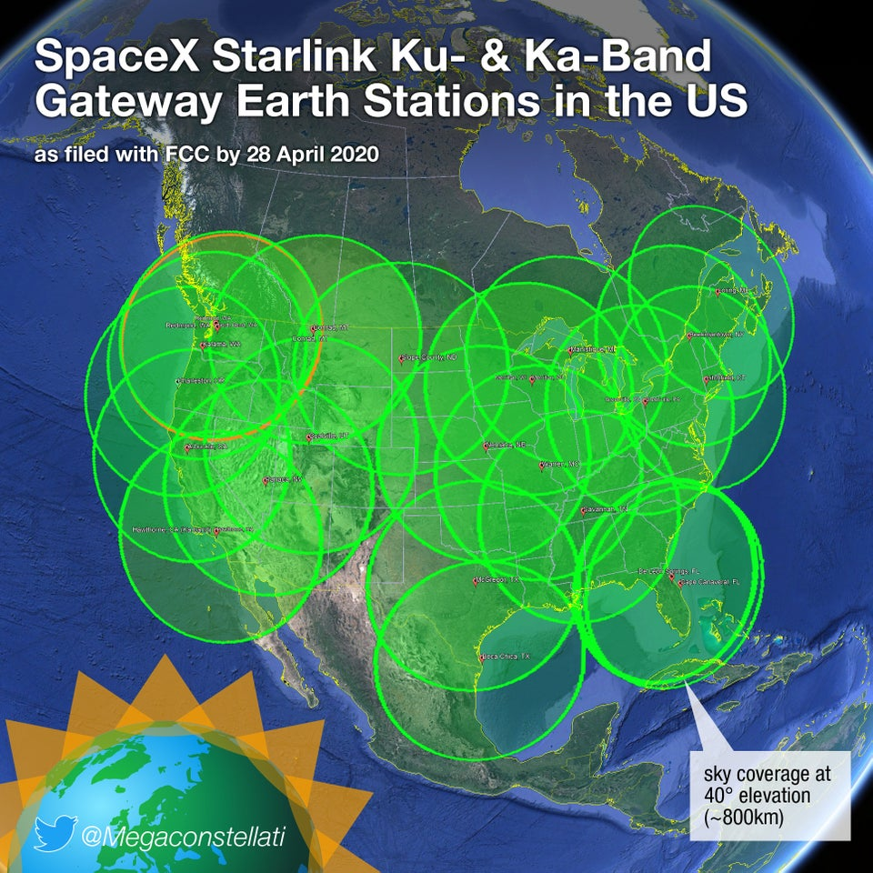
By design, Starlink requires directional antennas with a narrow beam width -- and physics demands that such an antenna must be about the size of a pizza. If this is acceptable for a particular IoT application (say, where the "thing" is a standard shipping container), then the next factor would be the cost of hardware, which is still uncertain.

Slide 6
The plan for the initial constellation is 72 planes of 22 satellites each. This was modified from 24 planes of 66 satellites each, with SpaceX apparently able to launch to multiple planes at once. All well and good, essentially no change.
ISPs have been known to shut down any sort of competition before it gets any momentum, so maybe Elon said they aren’t going after the current ISP so that they dont try to take them down.

Slide 7
IoT is a system of interrelated computing devices, machines, animals, and humans with the ability to transfer data and communicate via a network without hu
The issue with IoT is that networks rely on cellular, wifi, or Bluetooth service in order to communicate. Yet 90% of the surface of the Earth is not serviced by these communication mediums, such as over open ocean or farmland. man-to-human or human-to-computer interaction.

Slide 8

StarLink: Get Ready for lots of IoT (and lots of space junk)!

Slide 9

Apparently the astronomers are already upset with SpaceX, after a rather small string of 60 of their satellites polluted the night sky with ambient light disrupting their deep space telescopes for about an hour this month. The time-lapse video is pretty cool too (left).

Slide 10
Starlink Specifications
SERVICE DESCRIPTION
Starlink provides two-way satellite-based internet service (“Services”), receivable with a Starlink user terminal, Wi-Fi router, power supply and mount ("Starlink Kit” or “Kit”). The Starlink Kit and Services are novel, under development, and subject to change. Starlink performance goals will be amended by SpaceX from time to time based on experience and innovation.
PERFORMANCE
Starlink users typically experience download speeds between 25 and 220 Mbps, with a majority of users experiencing speeds over 100 Mbps. Upload speeds are typically between 5 and 20 Mbps. Latency ranges between 25 and 60 ms on land, and 100+ ms in certain remote locations (e.g. Oceans, Islands, Antarctica, Alaska, Northern Canada, etc.). These speeds make Starlink suitable for streaming, video calls, online gaming, and other typical household internet use.
Stated speeds below and the uninterrupted use of the Services is not guaranteed. Actual speeds may be lower than expected speeds during times of high usage. Performance varies based on location, time of day and the precedence Starlink gives your data in the network based on your Service Plan. Please see our Fair Use Policy for more information on how Starlink treats Standard, Priority, Mobile, and Mobile Priority data and how that impacts your Services under each Plan.

Slide 11
Expected speeds per service plan:
SERVICE PLAN | STANDARD (FIXED) | PRIORITY (FIXED) | MOBILE (MOBILITY) | MOBILE PRIORITY (MOBILITY)
AVAILABILITY | ≥99% | ≥99% | ≥99% | ≥99%
DOWNLOAD | 25-100 Mbps | 40-220 Mbps | 5-50 Mbps | 40-220 Mbps
UPLOAD | 5-10 Mbps | 8-25 Mbps | 2-10 Mbps | 8-25 Mbps
LATENCY* | 25-60 ms | 25-60 ms | <99 ms | <99 ms
Notes:
https://www.starlink.com/legal/documents/DOC-1400-28829-70

Slide 12
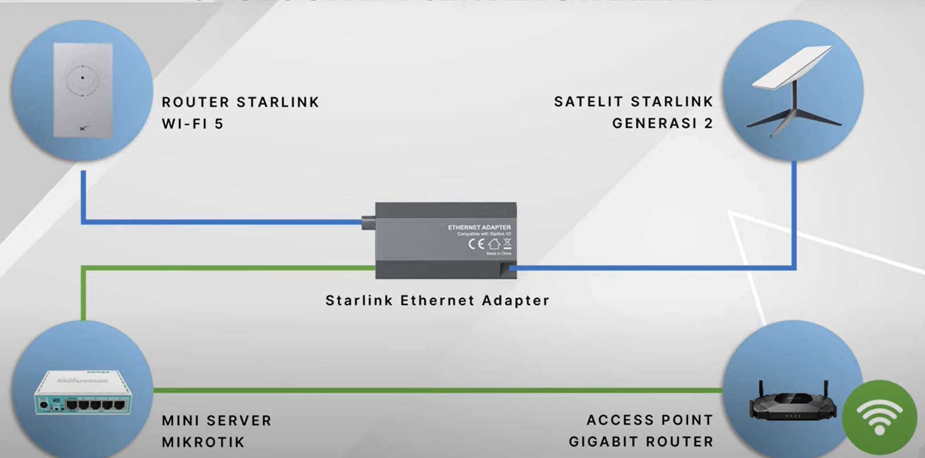
Notes:
https://www.youtube.com/watch?v=3OhD1NbYgAw

Slide 13
PDS
Computer Vision
Huawei Expected speeds per service plan and Specifications
@ P. Siagian
https://github.com/siagianp
https://www.youtube.com/@AmelOline/videos
https://github.com/amelcharolinesgn2/IoT_simulator-mqtt-NodeRed
github.com/amelcharolinesgn2/ANJAR
Notes:
https://support.huawei.com/enterprise/en/doc/EDOC1000079719/3763fae3/what-can-i-do-if-the-speed-test-performance-does-not-meet-requirements
https://support.huawei.com/enterprise/en/doc/EDOC1000079719/3763fae3/what-can-i-do-if-the-speed-test-performance-does-not-meet-requirements

Slide 14
Speed Test Performance
The expected rate exceeds the claimed rate of the device.
The signal quality of the device is poor.
The LTE/5G antennas are incorrectly installed or incorrect antennas are used.
The network cable and network adapter are not gigabit capable.
VPN or another proxy is used on the PC.
The speed test software is not properly configured.
The actual air interface rate is not calculated based on traffic statistics on the cellular interface.
Notes:
https://support.huawei.com/enterprise/en/doc/EDOC1000079719/3763fae3/what-can-i-do-if-the-speed-test-performance-does-not-meet-requirements

Slide 15
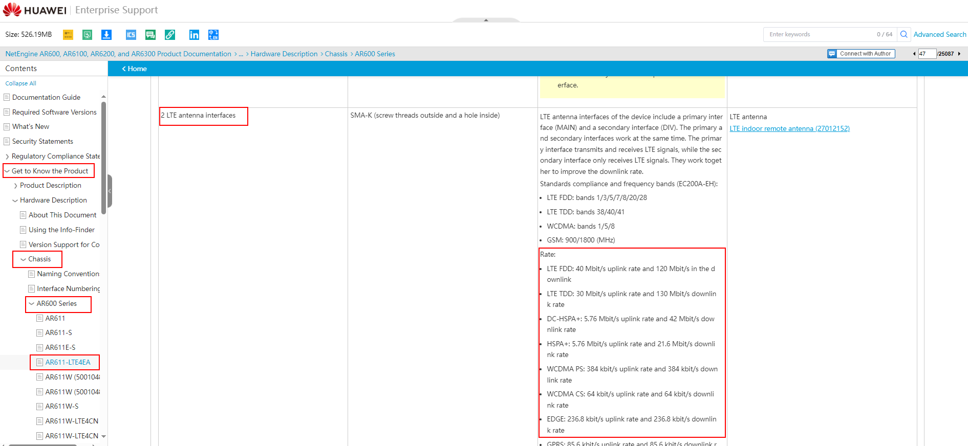
Procedure
Check the claimed rate of the current device in the product documentation. (For details, see Learn about the product, choose Get to Know the Product > Hardware Description > Chassis, and select the corresponding model, interface, and LTE/5G antenna interface.) The claimed rate is the ideal rate for sending traffic through a meter (the feeder of the meter is physically directly connected to the antenna interface of the device, without being affected by signal strength or interference). The actual rate is affected by the environment and may be different from the claimed rate.
2. Run the display cellular interface-number all command on the device to check the signal quality of the LTE/5G interface.

Slide 16


Slide 17
[Huawei] display Cellular 2/0/0 all
Modem State:
Hardware Information.
=====================
Model = RG801
Modem Type = 5G module
Modem Firmware Version = RG801HEAAAR03A03M8G
Hardware Version = HiB5000_MODEM Ver.A
Integrate circuit card identity (ICCID) = 98681020100202000060
International Mobile Subscriber Identity (IMSI) = 460070075590906
Mobile Station International ISDN Number (MSISDN) = None
International Mobile Equipment Identity (IMEI) = 867147050004796
Factory Serial Number (FSN) = 0123456789ABCDEF
Modem Status = Online
Profile Information.
====================
Profile 1
--------
PDP Type = IPv4, Header Compression = OFF
Data Compression = OFF
Packet Session Status = Active
* - Default profile
Network Information.
====================
Current Service Status = Service available
Service Domain = Combined
Current Service = PS
Packet Service = Attached
Packet Session Status = Active
Current Roaming Status = Roaming
Network Selection Mode = Automatic
Network Connection Mode = Automatic
Current Network Connection = LTE(LTE)
Mobile Country Code (MCC) = 369
Mobile Network Code (MNC) = 77
Mobile Operator Information = Unknown
Tracking Area Code (TAC) = 1002
Cell ID = 9881858
Radio Information.
==================
Current Bands : AUTO
Current Band = B3
Current RSSI >= -51 dBm
Current RSRP = -70 dBm (strong)
Current RSRQ = -4 dB
Current SINR = 24 dB
Bands supported :
WCDMA: WCDMA850 WCDMA900 WCDMA2100
FDD LTE: B1 B3 B5 B7 B8 B20 B28
TDD LTE: B34 B38 B39 B40 B41
FDD NR: N1 N3 N28
TDD NR: N41 N77 N78 N79
Modem Security Information.
===========================
SIM ID = 1
PIN Verification = Disabled
PIN Status = Ready
Number of Retries remaining = 3
SIM Status = OK

Slide 18
Pay attention to the following parameters:
Current Network Connection: indicates the type of the currently connected network, for example, LTE, 5GSA, or 5GNSA. Check whether it meets the customer's requirements.
Cell ID = 9881858: indicates the cell ID of a base station. During a comparison test, ensure that the cell IDs of the tested devices are the same.
Current Band: indicates the frequency band in use. During a comparison test, ensure that the frequency bands used by the tested devices are the same.
Current RSSI: indicates the received signal strength indication (RSSI). In the speed test environment, the RSSI must be greater than or equal to -65 dBm.
Current RSRP: indicates the reference signal received power (RSRP). In the speed test environment, the RSRP must be greater than or equal to -85 dBm.
Current SINR: indicates the signal to interference plus noise ratio (SINR). In the speed test environment, the SINR must be greater than or equal to 20 dB.
Check whether LTE/5G antennas are installed. Pay attention to the following points:
The AR617 has two Wi-Fi antennas, and two LTE antennas need to be installed.
5G antennas are different from LTE antennas and cannot be interchanged.
LTE antennas and Wi-Fi antennas are different and cannot be interchanged.
Improve signal quality.
Adjust the antenna direction towards an open area.
Adjust the device location or replace antennas with indoor/outdoor remote antennas, and keep the device and antennas away from signal interference sources (such as power supplies, metal, and other signal generators).
Ensure that the network cable and network adapter are gigabit capable when the device is connected to a PC. The Ethernet network speed on a Windows PC is for reference only. You are advised to perform a speed test in the wired network environment.

Slide 19
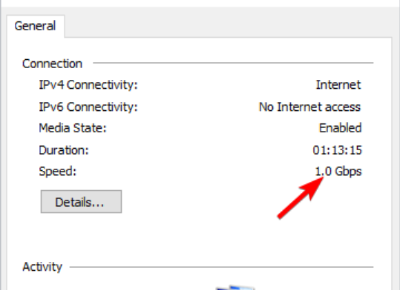

Slide 20
Thx you

