Slide 1
Introduction to Deep Learning
Date: 12 Nov, 2015
1

Slide 2
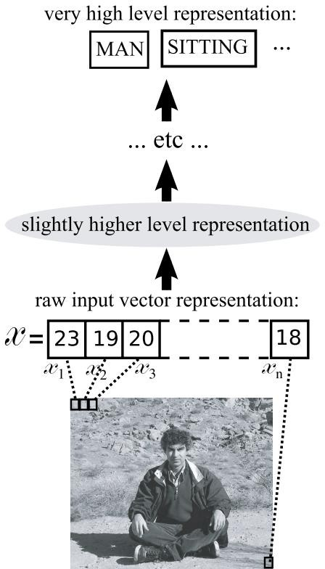
A Motivational Task: Percepts → Concepts
Create algorithms
that can understand scenes and describe them in natural language
that can infer semantic concepts to allow machines to interact with humans using these concepts
Requires creating a series of abstractions
Image (Pixel Intensities) → Objects in Image → Object
Interactions → Scene Description
Deep learning aims to automatically learn these abstractions with little supervision
Courtesy: Yoshua Bengio, Learning Deep Architectures for AI

Slide 3
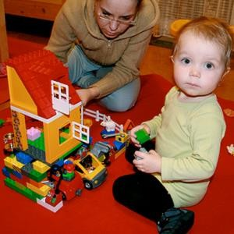
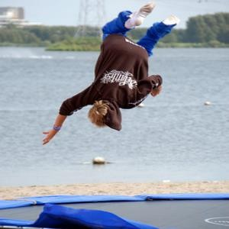


Deep Visual-Semantic Alignments for Generating Image Descriptions (Karpathy, Fei-Fei; CVPR 2015)
“two young girls are playing with lego toy.”
"boy is doing backflip
on wakeboard."
"construction worker in orange safety vest is working on road."
"man in black shirt is playing guitar."
http://cs.stanford.edu/people/karpathy/deepimagesent/

Slide 4
Challenge in Modelling Complex Behaviour
Too many concepts to learn
Too many object categories
Too many ways of interaction between objects categories
Behaviour is a highly varying function underlying factors
f: L → V
L: latent factors of variation
low dimensional latent factor space
V: visible behaviour
high dimensional observable space
f: highly non-linear function

Slide 5
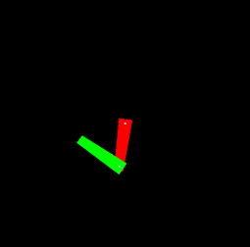
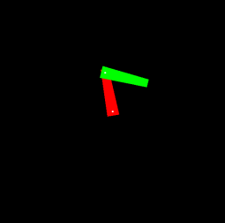
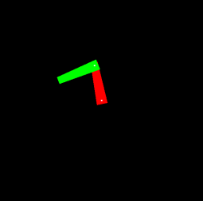
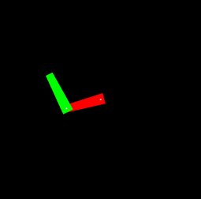
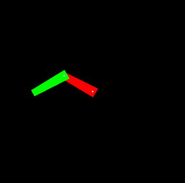
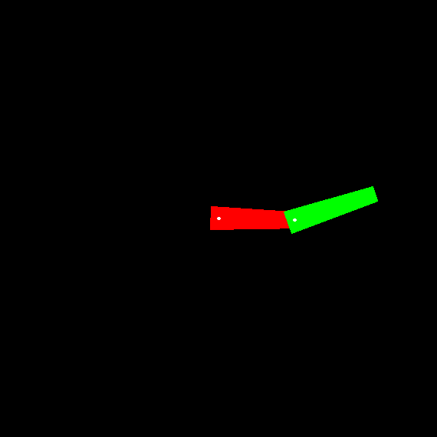
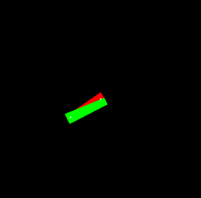

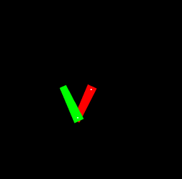
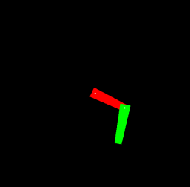
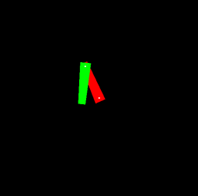
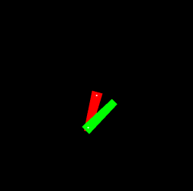
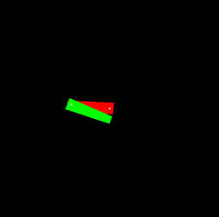
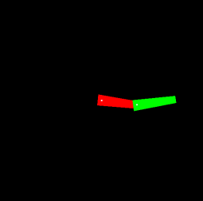
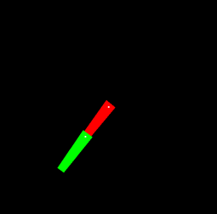
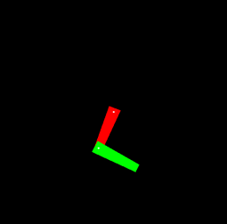
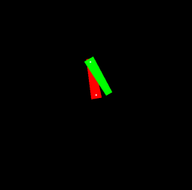
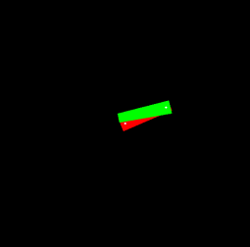
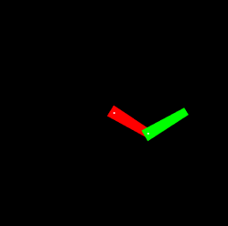
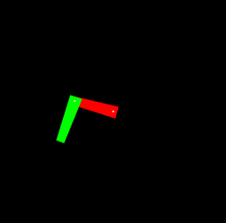
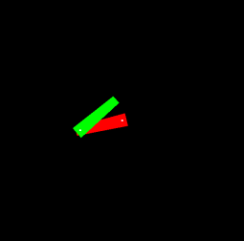
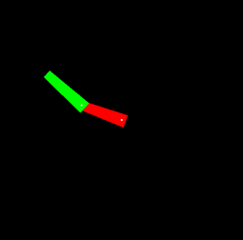
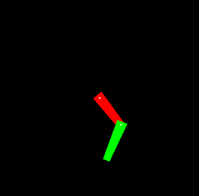
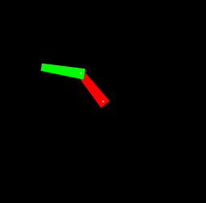
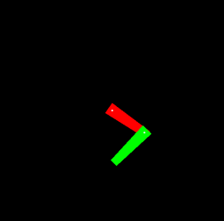
Example: Learning the Configuration Space of a Robotic Arm

Slide 6
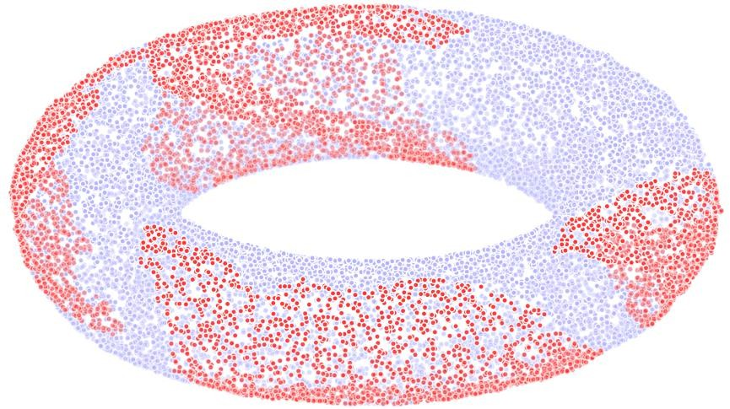
C-Space Discovery using Isomap

Slide 7
How do We Train Deep Architectures?
Inspiration from mammal brain
Multiple Layers of “neurons” (Rumelhart et al 1986)
Train each layer to compose the representations of the previous layer to learn a higher level abstraction
Ex: Pixels → Edges → Contours → Object parts → Object categories
Local Features → Global Features
Train the layers one-by-one (Hinton et al 2006)
Greedy strategy

Slide 8
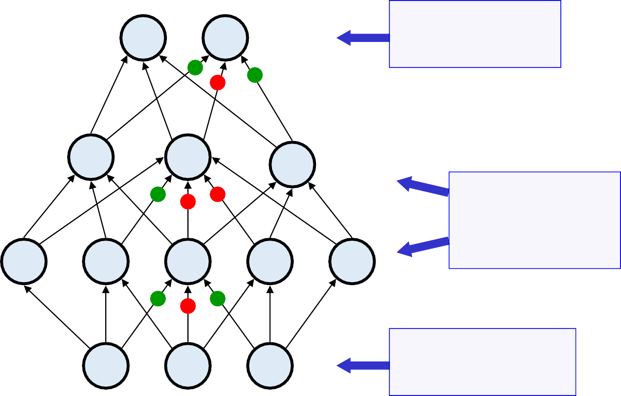
Multilayer Perceptron with Back-propagation
First deep learning model (Rumelhart, Hinton, Williams 1986)
Compare outputs with correct answer to get error signal
Back-propagate error signal to get derivatives for learning
outputs
hidden layers
input vector
Source: Hinton’s 2009 tutorial on Deep Belief Networks
8

Slide 9
Drawbacks of Back-propagation based Deep Neural Networks
They are discriminative models
Get all the information from the labels
And the labels don’t give so much of information
Need a substantial amount of labeled data
Gradient descent with random initialization leads to poor local minima

Slide 10
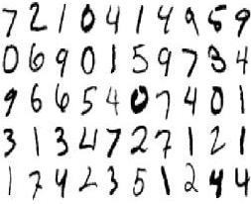
Hand-written digit recognition
Classification of MNIST hand-written digits
10 digit classes
Input image: 28x28 gray scale
784 dimensional input

Slide 11
A Deeper Look at the Problem
One hidden layer with 500 neurons
=> 784 * 500 + 500 * 10
≈ 0.4 million weights
Fitting a model that best explains the training data is an optimization problem in a 0.4 million dimensional space
It’s almost impossible for Gradient descent with random initialization to arrive at the global optimum

Slide 12



A Solution – Deep Belief Networks (Hinton et al. 2006)
Pre-trained N/W Weights
Slow Fine-tuning
(Using Back-propagation)
Fast unsupervised pre-training
Good
Solution
Random Initial position
Very slow Back-propagation
(Often gets stuck at poor local minima)
Very high-dimensional parameter space

Slide 13
A Solution – Deep Belief Networks (Hinton et al. 2006)
Before applying back-propagation, pre-train the network as a series of generative models
Use the weights of the pre-trained network as the initial point for the traditional back-propagation
This leads to quicker convergence to a good solution
Pre-training is fast; fine-tuning can be slow

Slide 14
Quick Check: MLP vs DBN on MNIST
MLP (1 Hidden Layer)
1 hour: 2.18%
14 hours: 1.65%
DBN
1 hour: 1.65%
14 hours: 1.10%
21 hours: 0.97%
Intel QuadCore 2.83GHz, 4GB RAM MLP: Python :: DBN: Matlab

Slide 15
Intermediate Representations in Brain
Disentanglement of factors of variation underlying the data
Localized Representation
Distributed Representations
Activation of each neuron is a function of
multiple features of the previous layer
Feature combinations of different neurons are not necessarily mutually exclusive
Distributed Representation
Sparse Representations
Only 1-4% neurons are active at a time

Slide 16
Local vs. Distributed in Input Space
Local Methods
Assume smoothness prior
g(x) = f(g(x₁), g(x₂), …, g(x_{k}))
{x₁, x₂, …, x_{k}} are neighbours of x
Require a metric space
A notion of distance or similarity in the input space
Fail when the target function is highly varying
Examples
Nearest Neighbour methods
Kernel methods with a Gaussian kernel
Distributed Methods
No assumption of smoothness ➔ No need for a notion of similarity
Ex: Neural networks

Slide 17
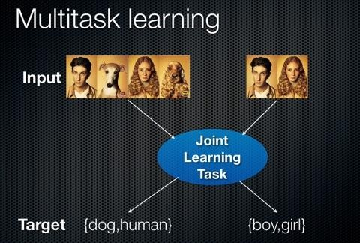
Multi-task Learning
Source: https://en.wikipedia.org/wiki/Multi-task_learning

Slide 18
Desiderata for Learning AI
Ability to learn complex, highly-varying functions
Ability to learn multiple levels of abstraction with little human input
Ability to learn from a very large set of examples
Training time linear in the number of examples
Ability to learn from mostly unlabeled data
Unsupervised and semi-supervised
Multi-task learning
Sharing of representations across tasks
Fast predictions

