Slide 1

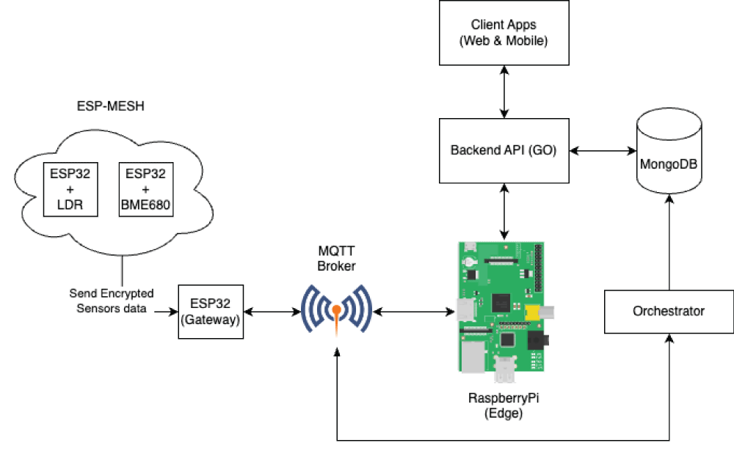
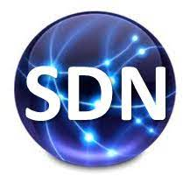
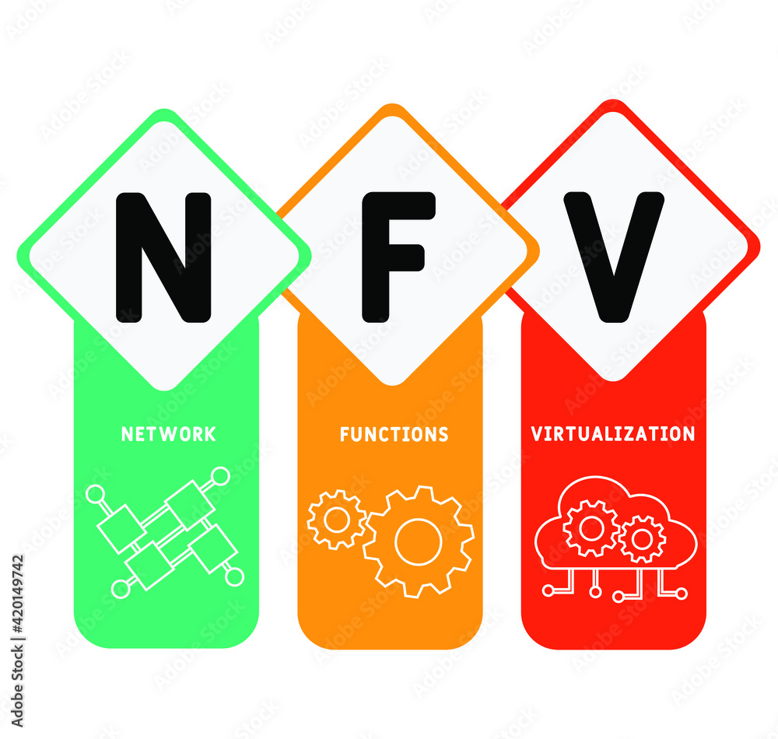

PDS
Computer Vision
Project 1:
Home Lock
https://github.com/siagianp
https://www.youtube.com/@AmelOline/videos
https://github.com/amelcharolinesgn2/IoT_simulator-mqtt-NodeRed
https://github.com/amelcharolinesgn2/Cloud-Infrastructures
https://github.com/amelcharolinesgn2/ClouD-Infrastructure-SISKA-2025
https://github.com/amelcharolinesgn2/Gyroscope-Sensor-Data-Accelerometer
Notes:
https://docs.openstack.org/liberty/install-guide-rdo/overview.html

Slide 2
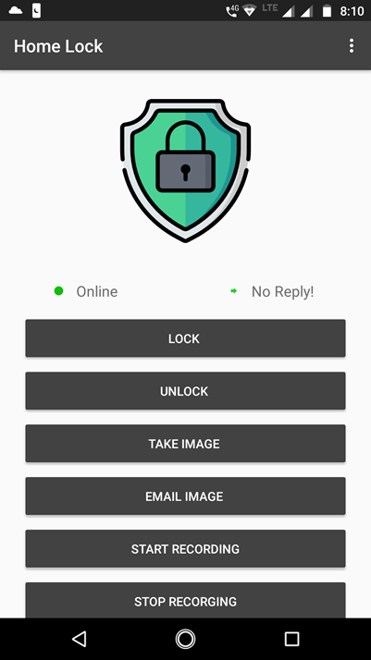
Project 1_Home Lock

Slide 3

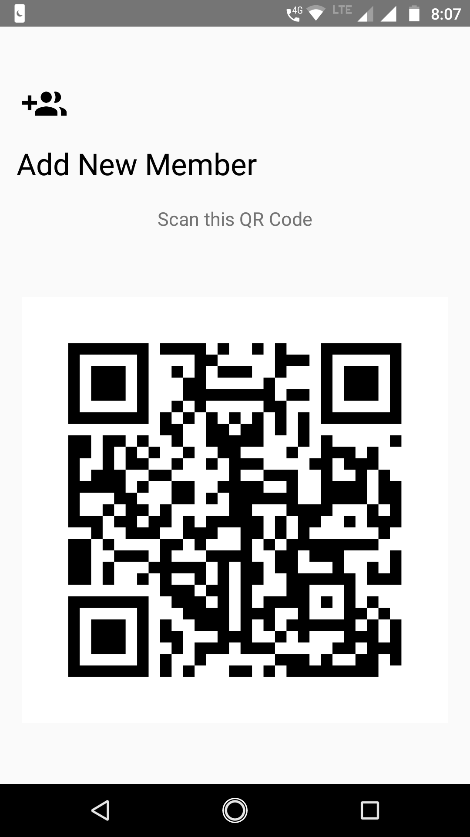
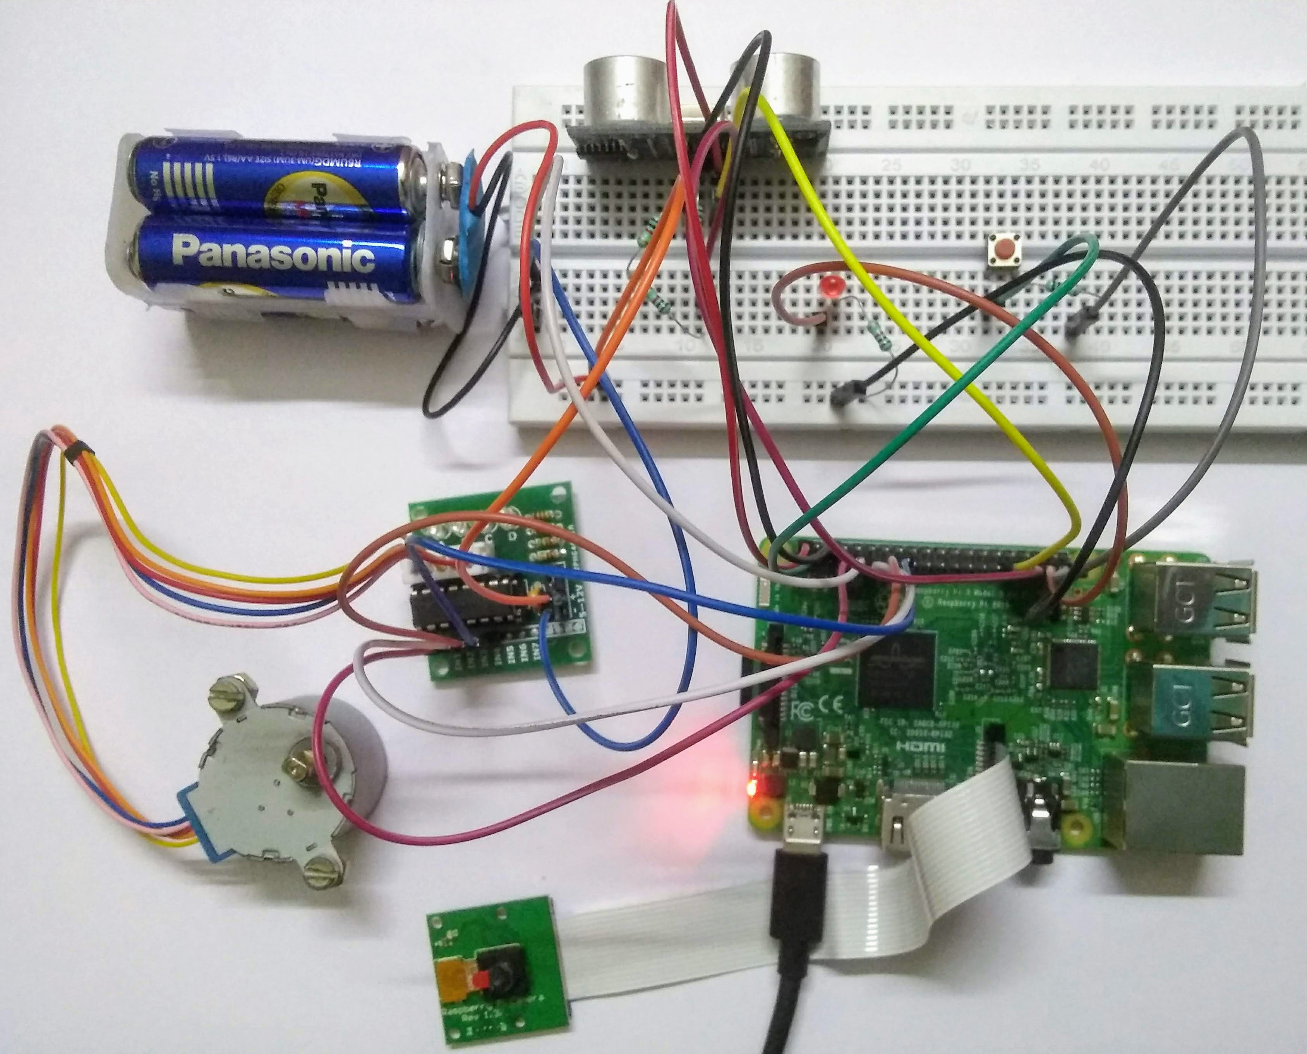
HomeLock
Pi Camera
HC-SRO4 Ultrasonic Sensor (Trig = 6, Echo = 13)
28BYJ-48 Stepper Motor and ULN2003 Driver (pin: 4, 17, 27, 22)
Push button (pin 26)
LED (pin 19)
.vscode Renamed solution
IOT_DeviceManager.API.Test updated dependencys
5 years ago
IOT_DeviceManager.API added subscription to mqtt will messages
IOT_DeviceManager.APP refactored code
IOT_DeviceManager.IOT Added device disconnected unexpectedly handler
IOT_DeviceManager.MQTTbroker Renamed solution
IOT_DeviceManager.Web/web Bump follow-redirects in /IOT_DeviceManager.Web/web
Notes:
https://github.com/suvam
https://github.com/suvambasak/HomeLockbasak/HomeLock
Raspberry Pi 3 Model B https://github.com/suvambasak/lock-server
https://github.com/suvambasak/lock-server

Slide 4
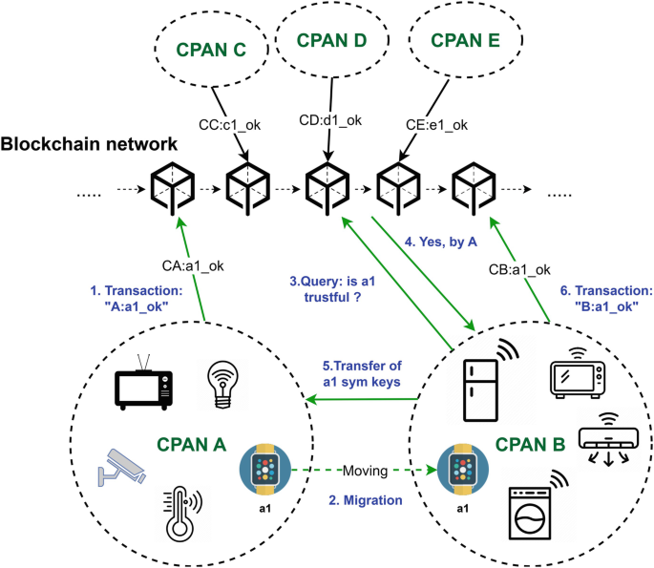
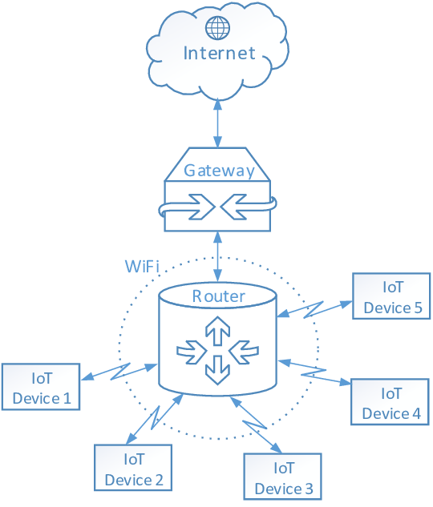
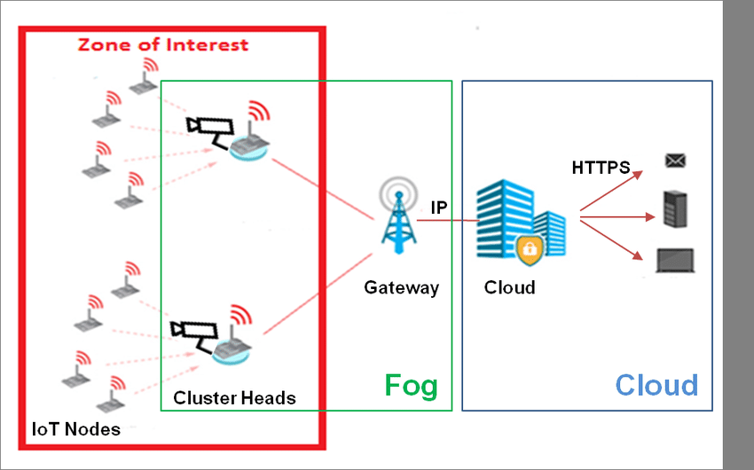

Slide 5
🏗️ Arsitektur Sistem
Proyek ini mengintegrasikan beberapa komponen utama:
Perangkat IoT: Perangkat fisik yang terhubung melalui protokol MQTT.
Broker MQTT: Menerima dan mendistribusikan pesan antara perangkat IoT dan sistem backend.
Backend API: Dibangun dengan ASP.NET Core 3.1 untuk menangani logika bisnis dan komunikasi dengan database.
Database MongoDB: Menyimpan data pengukuran dan pengaturan perangkat.
Antarmuka Web: Dibuat dengan Angular 9 untuk visualisasi data dan manajemen perangkat.
Aplikasi Android: Dikembangkan menggunakan Xamarin untuk kontrol perangkat melalui ponsel.
Containerisasi dengan Docker: Menyederhanakan proses deployment dan pengelolaan dependensi.

Slide 6
🔄 Alur Kerja Sistem
Pengumpulan Data: Perangkat IoT mengirimkan data melalui broker MQTT.
Penyimpanan Data: Backend API menerima data dan menyimpannya dalam MongoDB.
Visualisasi dan Manajemen: Pengguna dapat mengakses antarmuka web atau aplikasi Android untuk melihat data dan mengontrol perangkat.igminresearch.com

Slide 7
🖼️ Diagram TopologiBerikut adalah representasi visual dari arsitektur sistem:luaSalinEdit
+----------------+ +----------------+ +------------------+
| IoT Device | <-- | MQTT Broker | <-- | Backend API (ASP.NET) |
+----------------+ +----------------+ +------------------+
|
v
+-------------+
| MongoDB |
+-------------+
|
+----------------+----------------+
| |
+-------------+ +-------------+
| Web Interface| | Android App |
+-------------+ +-------------+
🛠️ Teknologi yang DigunakanProtokol: MQTT untuk komunikasi ringan antar perangkat.Backend: ASP.NET Core 3.1 untuk API.Frontend: Angular 9 untuk antarmuka web.Mobile: Xamarin untuk aplikasi Android.Database: MongoDB untuk penyimpanan data.Containerization: Docker untuk deployment.
Notes:
OK https://github.com/suvambasak/lock-server
https://github.com/Joren-Thijs/IOT_DeviceManager
https://medium.com/engineering-iot/building-a-real-time-sensor-monitoring-system-with-esp32-and-freertos-b4e4f214df8e
https://github.com/Joren-Thijs/IOT_DeviceManager
https://github.com/Joren-Thijs/IOT_DeviceManager

Slide 8
1. IoT Device
Konfigurasi MQTT client di Python:pythonSalinEdit
import paho.mqtt.client as mqtt
broker_address = "IP_MQTT_BROKER"
topic = "sensor/data"
def on_connect(client, userdata, flags, rc):
print("Connected with result code "+str(rc))
client = mqtt.Client()
client.on_connect = on_connect
client.connect(broker_address, 1883, 60)
# Contoh publish data
client.publish(topic, "sensor reading")
client.loop_forever()
Perangkat IoT yang mengirimkan data ke MQTT broker.
Installasi & Konfigurasi:Hardware:
Raspberry Pi / ESP32 / Arduino dengan koneksi internet.
Software:
Program client MQTT (contoh: menggunakan Python dengan paho-mqtt).
Koneksikan ke MQTT Broker menggunakan IP dan port broker.

Slide 9
2. MQTT Broker
Restart mosquitto jika konfigurasi berubah:
Bash salin edit
sudo systemctl restart mosquitto
Server pusat yang menerima dan meneruskan pesan dari perangkat IoT ke Backend.
Installasi & Konfigurasi (contoh menggunakan Mosquitto):
Ubuntu:
Bash salin edit
sudo apt update
sudo apt install mosquitto mosquitto-clients -y
sudo systemctl enable mosquitto
sudo systemctl start mosquitto
Konfigurasi dasar:
File konfigurasi di /etc/mosquitto/mosquitto.conf
Contoh mengaktifkan listener default:
Bash salin edit
listener 1883
allow_anonymous true

Slide 10
3. Backend API (ASP.NET Core)
Konfigurasi MQTT client pada backend:
Tambahkan koneksi MQTT client (pakai library MQTT di .NET seperti MQTTnet)
Contoh menghubungkan ke broker dan subscribe topic tertentu.
Konfigurasi koneksi MongoDB di appsettings.json:
API yang menerima data dari MQTT broker dan mengelola data dalam database MongoDB.
Installasi & Konfigurasi :
Prasyarat:.
NET Core SDK Download
MongoDB driver untuk .NET (MongoDB.Driver NuGet package)
Cara menjalankan:
Clone repo backend (contoh dari GitHub):
json salin edit
{
"ConnectionStrings": {
"MongoDb": "mongodb://localhost:27017/yourdbname"
}
}
Bash salin edit
git clone https://github.com/Joren-Thijs/IOT_DeviceManager.git
cd IOT_DeviceManager/Backend
dotnet restore
dotnet run
Jalankan MongoDB sebelum menjalankan backend.

Slide 11
4. MongoDB
Verifikasi MongoDB berjalan:
Bash salin edit
mongo --eval 'db.runCommand({ connectionStatus: 1 })'
Buat database dan collection sesuai kebutuhan backend
Database NoSQL untuk menyimpan data pengukuran dan konfigurasi.
Installasi & Konfigurasi:
Ubuntu:
Bash salin edit
wget -qO - https://www.mongodb.org/static/pgp/server-4.4.asc | sudo apt-key add -
echo "deb [ arch=amd64 ] https://repo.mongodb.org/apt/ubuntu focal/mongodb-org/4.4 multiverse" | sudo tee /etc/apt/sources.list.d/mongodb-org-4.4.list
sudo apt update
sudo apt install -y mongodb-org
sudo systemctl start mongod
sudo systemctl enable mongod

Slide 12
5. Web Interface (Angular)
Konfigurasi API endpoint di environment config (src/environments/environment.ts):
typescript salin edit
export const environment = {
production: false,
apiUrl: 'http://backend-api-address/api'
};
Frontend berbasis web untuk monitoring dan kontrol perangkat.
Installasi & Konfigurasi:
Prasyarat:
Node.js & npm Download
Angular CLI:
Bash salin edit
npm install -g @angular/cli
Cara menjalankan:
Clone repo frontend:
Bash salin edit
git clone https://github.com/Joren-Thijs/IOT_DeviceManager.git
cd IOT_DeviceManager/Frontend
npm install
ng serve --open

Slide 13
6. Android App (Xamarin)
Verifikasi MongoDB berjalan:
Bash salin edit
mongo --eval 'db.runCommand({ connectionStatus: 1 })'
Buat database dan collection sesuai kebutuhan backend
Aplikasi mobile untuk kontrol dan monitoring.
Installasi & Konfigurasi:
Install Visual Studio dengan workload Mobile development with .NET (Xamarin).
Buka project Xamarin Android dari repo IOT_DeviceManager.
Konfigurasi endpoint API backend pada file konfigurasi aplikasi.
Build dan deploy ke emulator atau device fisik.
less salin edit
[IoT Devices] --> MQTT Broker --> Backend API --> MongoDB
|
+------------+------------+
| |
[Web Interface] [Android App]

Slide 14
1. IoT Device (Python MQTT Client contoh sederhana)
Python salin edit
import paho.mqtt.client as mqtt
import time
import random
broker_address = "IP_MQTT_BROKER" # Ganti dengan IP MQTT broker-mu
topic = "sensor/data"
def on_connect(client, userdata, flags, rc):
print("Connected with result code "+str(rc))
client = mqtt.Client()
client.on_connect = on_connect
client.connect(broker_address, 1883, 60)
client.loop_start()
try:
while True:
# Simulasi sensor data acak
sensor_value = random.randint(20, 30)
client.publish(topic, f"temperature:{sensor_value}")
print(f"Published: temperature:{sensor_value}")
time.sleep(5)
except KeyboardInterrupt:
client.loop_stop()

Slide 15
2. MQTT Broker (Mosquitto di Ubuntu)
bash salin edit
sudo apt update
sudo apt install -y mosquitto mosquitto-clients
sudo systemctl enable mosquitto
sudo systemctl start mosquitto
# Testing broker
mosquitto_sub -h localhost -t sensor/data

Slide 16
3. Backend API (ASP.NET Core minimal example + MQTT subscribe)
csharp salin edit
using MQTTnet;
using MQTTnet.Client;
using MongoDB.Driver;
var builder = WebApplication.CreateBuilder(args);
// Setup MongoDB client
var mongoClient = new MongoClient("mongodb://localhost:27017");
var database = mongoClient.GetDatabase("iotdb");
var collection = database.GetCollection<BsonDocument>("sensordata");
var app = builder.Build();
// Setup MQTT client
var factory = new MqttFactory();
var mqttClient = factory.CreateMqttClient();
mqttClient.UseConnectedHandler(async e =>
{
Console.WriteLine("Connected to MQTT broker");
await mqttClient.SubscribeAsync(new MQTTnet.Client.Subscribing.MqttClientSubscribeOptionsBuilder()
.WithTopicFilter("sensor/data")
.Build());
});
mqttClient.UseApplicationMessageReceivedHandler(e =>
{
var payload = System.Text.Encoding.UTF8.GetString(e.ApplicationMessage.Payload);
Console.WriteLine($"Received message: {payload}");
// Simpan ke MongoDB
var doc = new BsonDocument { { "data", payload }, { "timestamp", DateTime.Now } };
collection.InsertOne(doc);
});
await mqttClient.ConnectAsync(new MqttClientOptionsBuilder()
.WithTcpServer("localhost", 1883)
.Build());
app.MapGet("/", () => "Backend API running");
app.Run();

Slide 17
Pastikan kamu sudah install NuGet package:
bash salin edit
dotnet add package MQTTnet
dotnet add package MongoDB.Driver
4. MongoDB
Sudah diberikan installasi sebelumnya, tinggal pastikan mongod berjalan.

Slide 18
5. Web Interface (Angular minimal)
environment.ts
typescript salin edit
export const environment = {
production: false,
apiUrl: 'http://localhost:5000'
};
contoh service sensor.service.tstypes
typescript salin edit
import { HttpClient } from '@angular/common/http';
import { Injectable } from '@angular/core';
@Injectable({ providedIn: 'root' })
export class SensorService {
constructor(private http: HttpClient) {}
getSensorData() {
return this.http.get(`${environment.apiUrl}/sensordata`);
}
}

Slide 19
6. Android App (Xamarin example snippet)
csharp salin edit
using System.Net.Http;
using System.Threading.Tasks;
public class ApiService {
HttpClient client = new HttpClient { BaseAddress = new Uri("http://backend-api-address/") };
public async Task<string> GetSensorDataAsync() {
var response = await client.GetAsync("sensordata");
if(response.IsSuccessStatusCode)
return await response.Content.ReadAsStringAsync();
return null;
}
}

Slide 20
Step-by-step
Setup lengkap buat:
IoT Device (contoh MQTT client)?
MQTT Broker (install Mosquitto)?
Backend API (ASP.NET Core dengan MQTT + MongoDB)?
MongoDB install & config?
Web Interface Angular?
Android App sederhana?

Slide 21
Alur arsitektur IoT DeviceManager dengan komponen-komponen utama berikut:
IoT Device —> connect ke
MQTT Broker (Mosquitto) —> connect ke
Backend API (ASP.NET Core) —> connect ke
MongoDB
Data dari Backend API akan disimpan di MongoDB
Backend API juga melayani
Web Interface
Android App

Slide 22
1. Install dan konfigurasi MQTT Broker (Mosquitto)
Untuk Linux (Ubuntu/Debian):
bash salin edit
sudo apt update
sudo apt install mosquitto mosquitto-clients
sudo systemctl enable mosquitto
sudo systemctl start mosquitto
Konfigurasi dasar Mosquitto (optional, contoh file /etc/mosquitto/mosquitto.conf):
conf salin edit
allow_anonymous true
listener 1883
Restart Mosquitto jika mengubah konfigurasi:
bash salin edit
sudo systemctl restart mosquitto

Slide 23
2. Backend API (ASP.NET Core) Setup dan konfigurasi
Persyaratan:.
NET SDK terinstal (download di sini)
MongoDB connection string dan Mosquitto broker URL (biasanya localhost:1883)
Contoh steps:
Buat project API
bash salin edit
dotnet new webapi -o BackendAPI
cd BackendAPI
Tambahkan package MQTT client dan MongoDB driver
bash salin edit
dotnet add package MQTTnet
dotnet add package MongoDB.Driver
Implementasi koneksi MQTT client di API
Implementasi koneksi MongoDB untuk simpan data
Implementasi endpoint untuk web dan mobile client

Slide 24
3. MongoDB install dan konfigurasi
Untuk Linux (Ubuntu/Debian):
bash salin edit
sudo apt update
sudo apt install -y mongodb
sudo systemctl enable mongodb
sudo systemctl start mongodb
Cek status:
bash salin edit
udo systemctl status mongodb
MongoDB biasanya berjalan di port 27017. Pastikan backend API bisa mengakses MongoDB.

Slide 25
4. Web Interface Setup (contoh Angular)
Pastikan sudah install Node.js dan Angular CLI
bash salin edit
npm install -g @angular/cli
Buat project Angular
bash salin edit
ng new web-interface
cd web-interface
ng serve --open
Konsumsi API dari backend ASP.NET Core

Slide 26
5. Android App Setup (opsional)
Gunakan Android Studio
Buat project baru
Implementasi MQTT client library (contoh: Paho MQTT)
Connect ke MQTT Broker dan Backend API

Slide 27
1. Backend API (ASP.NET Core) Minimal
File Program.cs (ASP.NET Core 6+ minimal API style):
csharp salin edit
using MQTTnet;
using MQTTnet.Client;
using MQTTnet.Client.Options;
using MongoDB.Bson;
using MongoDB.Driver;
var builder = WebApplication.CreateBuilder(args);
// Configurations (hardcoded for demo)
string mqttHost = "localhost";
int mqttPort = 1883;
string mongoConnString = "mongodb://localhost:27017";
string mongoDbName = "iotdb";
var app = builder.Build();
// MongoDB client
var mongoClient = new MongoClient(mongoConnString);
var database = mongoClient.GetDatabase(mongoDbName);
var devicesCollection = database.GetCollection<BsonDocument>("devices");
// MQTT Client connect (async fire and forget)
var factory = new MqttFactory();
var mqttClient = factory.CreateMqttClient();
var mqttOptions = new MqttClientOptionsBuilder()
.WithTcpServer(mqttHost, mqttPort)
.Build();
await mqttClient.ConnectAsync(mqttOptions);
// Simple API endpoint to get all devices from MongoDB
app.MapGet("/devices", async () =>
{
var devices = await devicesCollection.Find(new BsonDocument()).ToListAsync();
return Results.Ok(devices);
});
// MQTT subscribe example (assumes devices publish to "devices/+/data")
mqttClient.UseApplicationMessageReceivedHandler(async e =>
{
var topic = e.ApplicationMessage.Topic;
var payload = e.ApplicationMessage.Payload == null ? "" : System.Text.Encoding.UTF8.GetString(e.ApplicationMessage.Payload);
// Store MQTT message payload to MongoDB
var doc = new BsonDocument
{
{"topic", topic },
{"payload", payload },
{"receivedAt", DateTime.UtcNow }
};
await devicesCollection.InsertOneAsync(doc);
});
await mqttClient.SubscribeAsync("devices/+/data");
app.Run();

Slide 28
2. Angular Web Interface - Service to call Backend API
Create device.service.ts:
Typescript salin edit
import { Injectable } from '@angular/core';
import { HttpClient } from '@angular/common/http';
import { Observable } from 'rxjs';
@Injectable({
providedIn: 'root'
})
export class DeviceService {
private apiUrl = 'http://localhost:5000/devices'; // adjust port if needed
constructor(private http: HttpClient) { }
getDevices(): Observable<any[]> {
return this.http.get<any[]>(this.apiUrl);
}
}

Slide 29
2. Angular Web Interface - Service to call Backend API (cont’s)
Use it in a component:
Typescript salin edit
import { Component, OnInit } from '@angular/core';
import { DeviceService } from './device.service';
@Component({
selector: 'app-root',
template: `
<h2>Device Data</h2>
<ul>
<li *ngFor="let device of devices">
{{device.topic}} : {{device.payload}} ({{device.receivedAt}})
</li>
</ul>
`
})
export class AppComponent implements OnInit {
devices: any[] = [];
constructor(private deviceService: DeviceService) {}
ngOnInit() {
this.deviceService.getDevices().subscribe(data => this.devices = data);
}
}
Make sure to import HttpClientModule in app.module.ts and run Angular dev server.
Notes:
Make sure to import HttpClientModule in app.module.ts and run Angular dev server.

Slide 30
3. Android MQTT Client Example (Kotlin)
Add dependencies in build.gradle:
Gradle salin edit
implementation 'org.eclipse.paho:org.eclipse.paho.client.mqttv3:1.2.5'
implementation 'org.eclipse.paho:org.eclipse.paho.android.service:1.1.1'
Basic MQTT connection example:
kotlin salin edit
val mqttClient = MqttAndroidClient(context, "tcp://localhost:1883", MqttClient.generateClientId())
val options = MqttConnectOptions()
mqttClient.connect(options, null, object : IMqttActionListener {
override fun onSuccess(asyncActionToken: IMqttToken?) {
mqttClient.subscribe("devices/your-device-id/data", 0)
}
override fun onFailure(asyncActionToken: IMqttToken?, exception: Throwable?) {
// handle failure
}
})
mqttClient.setCallback(object : MqttCallback {
override fun messageArrived(topic: String?, message: MqttMessage?) {
val payload = message?.toString() ?: ""
// Process incoming MQTT messages
}
override fun connectionLost(cause: Throwable?) {}
override fun deliveryComplete(token: IMqttDeliveryToken?) {}
})

Slide 31
4. Testing MQTT with Mosquitto Client
In terminal, publish a test message:
bash salin edit
mosquitto_pub -h localhost -t "devices/device1/data" -m "Temperature=27"

Slide 32
sistem IoT sesuai arsitektur
MQTT Broker (Mosquitto)
Backend API (ASP.NET Core)
MongoDB
Angular Web Interface
Android MQTT Client (contoh singkat)
Step 0: Prasyarat
Docker & Docker Compose terinstall (untuk mudah setup MongoDB dan Mosquitto)
.NET 6+ SDK terinstall (untuk backend)
Node.js & Angular CLI terinstall (untuk frontend)
Android Studio (untuk testing Android MQTT app)

Slide 33
Step 1: Setup MQTT Broker dengan Mosquitto (Docker)
Cek endpoint http://localhost:5000/devices harus bisa mengakses data JSON dari MongoDB (walau kosong di awal).
Step 2: Setup MongoDB dengan Docker
bash salin edit
docker run -d --name mongodb -p 27017:27017 mongo
Buat file mosquitto.conf (opsional, untuk konfigurasi):
conf salin edit
listener 1883
allow_anonymous true
Step 3: Backend API ASP.NET Core
Buat project baru:
bash salin edit
dotnet new web -o BackendAPI
cd BackendAPI
Jalankan Mosquitto via docker:
bash salin edit
docker run -d --name mosquitto -p 1883:1883 -v $(pwd)/mosquitto.conf:/mosquitto/config/mosquitto.conf eclipse-mosquitto
Tambahkan package MongoDB & MQTTnet:
bash salin edit
dotnet add package MongoDB.Driver
dotnet add package MQTTnet
Test broker MQTT:
Ganti isi Program.cs dengan kode minimal backend seperti contoh sebelumnya (atau minta aku kirim ulang jika perlu).
bash salin edit
mosquitto_pub -h localhost -t test/topic -m "hello"
mosquitto_sub -h localhost -t test/topic
bash salin edit
dotnet run
Cek endpoint http://localhost:5000/devices harus bisa mengakses data JSON dari MongoDB (walau kosong di awal).
Notes:
Make sure to import HttpClientModule in app.module.ts and run Angular dev server.

Slide 34
Step 4: Angular Frontend
Edit app.component.ts dan app.component.html sesuai contoh.
Jalankan frontend:
Buat project baru:
bash salin edit
ng new frontend
cd frontend
bash salin edit
ng serve --open
Step 5: Android MQTT Client
Di Android Studio buat project baru.
Tambahkan dependency Paho MQTT ke build.gradle.
Implementasi MQTT client seperti contoh di atas.
Jalankan dan test device bisa connect ke broker Mosquitto di tcp://[IP_HOST]:1883
Install dependencies (biasanya sudah ada HttpClientModule).
Buat service device.service.ts seperti contoh di atas.
Edit app.module.ts untuk import HttpClientModule:
typescript salin edit
import { HttpClientModule } from '@angular/common/http';
@NgModule({
imports: [HttpClientModule, /* ... */],
// ...
})
export class AppModule { }
Step 6: Test End-to-End
Dari Android MQTT client, publish data ke topic: devices/device1/data
Backend akan subscribe topic tersebut dan simpan ke MongoDB
Angular frontend akan fetch data dari backend API dan tampilkan
Notes:
Make sure to import HttpClientModule in app.module.ts and run Angular dev server.

Slide 35
docker-compose.yml yang menggabungkan MongoDB dan Mosquitto MQTT Broker
docker-compose.yml
mosquitto.conf
conf salin edit
listener 1883
allow_anonymous true
yaml salin edit
version: "3.8"
services:
mongodb:
image: mongo:latest
container_name: mongodb
ports:
- "27017:27017"
volumes:
- mongodb_data:/data/db
mosquitto:
image: eclipse-mosquitto:latest
container_name: mosquitto
ports:
- "1883:1883"
- "9001:9001"
volumes:
- ./mosquitto.conf:/mosquitto/config/mosquitto.conf
volumes:
mongodb_data:
Cara pakai:
Simpan docker-compose.yml dan mosquitto.conf di folder yang sama.
Jalankan perintah:
bash salin edit
docker-compose up -d
3. Cek MongoDB di port 27017 dan Mosquitto di port 1883.

Slide 36
buat skeleton backend ASP.NET Core yang connect ke MongoDB dan subscribe MQTT.
Bisa juga buat Angular frontend.
Atau contoh Android MQTT client.
2. Tambahkan package MongoDB dan MQTT:
bash salin edit
dotnet add package MongoDB.Driver
dotnet add package MQTTnet
Langkah 2: Contoh kode koneksi MongoDB & MQTT subscriber
Di folder Services, buat file MqttService.cs:
backend ASP.NET Core :
Connect ke MongoDBSubscribe ke MQTT Broker (Mosquitto)
Expose API untuk frontend dan mobile
csharp salin edit
using MQTTnet;
using MQTTnet.Client;
using MQTTnet.Client.Options;
using System;
using System.Threading;
using System.Threading.Tasks;
using MongoDB.Driver;
public class MqttService
{
private readonly IMongoCollection<DeviceData> _collection;
private IMqttClient _mqttClient;
public MqttService(IMongoClient mongoClient)
{
var database = mongoClient.GetDatabase("iotdb");
_collection = database.GetCollection<DeviceData>("device_data");
}
public async Task StartAsync()
{
var factory = new MqttFactory();
_mqttClient = factory.CreateMqttClient();
var options = new MqttClientOptionsBuilder()
.WithTcpServer("localhost", 1883) // sesuaikan kalau beda host
.Build();
_mqttClient.UseConnectedHandler(async e =>
{
Console.WriteLine("Connected to MQTT broker.");
await _mqttClient.SubscribeAsync(new MqttTopicFilterBuilder()
.WithTopic("iot/devices/#")
.Build());
Console.WriteLine("Subscribed to topic.");
});
_mqttClient.UseApplicationMessageReceivedHandler(e =>
{
var payload = System.Text.Encoding.UTF8.GetString(e.ApplicationMessage.Payload);
Console.WriteLine($"Message received on topic {e.ApplicationMessage.Topic}: {payload}");
// Simpan ke MongoDB (simplified)
var deviceData = new DeviceData
{
Topic = e.ApplicationMessage.Topic,
Payload = payload,
Timestamp = DateTime.UtcNow
};
_collection.InsertOne(deviceData);
});
await _mqttClient.ConnectAsync(options, CancellationToken.None);
}
}
public class DeviceData
{
public string Topic { get; set; }
public string Payload { get; set; }
public DateTime Timestamp { get; set; }
}
Langkah 1: Setup project ASP.NET Core Web API
Buat project baru:
bash salin edit
dotnet new webapi -n IoTDeviceManager
cd IoTDeviceManager

Slide 37
Langkah 3: Daftarkan service di Program.cs (atau Startup.cs untuk versi lama)
cshap salin edit
using MongoDB.Driver;
var builder = WebApplication.CreateBuilder(args);
// MongoDB client singleton
builder.Services.AddSingleton<IMongoClient>(s =>
new MongoClient("mongodb://localhost:27017"));
// MQTT service
builder.Services.AddSingleton<MqttService>();
var app = builder.Build();
var mqttService = app.Services.GetRequiredService<MqttService>();
mqttService.StartAsync(); // jalankan subscriber MQTT
app.MapGet("/", () => "IoT Device Manager API");
app.Run();

Slide 38
2. Frontend React
Misal pakai create-react-app:
Backend API Endpoint untuk baca data device dari MongoDB
Frontend Web (React) untuk fetch dan tampilkan data
Android App contoh MQTT client subscribe data
jsx salin edit
import React, { useEffect, useState } from "react";
function App() {
const [deviceData, setDeviceData] = useState([]);
useEffect(() => {
fetch("http://localhost:5000/api/DeviceData")
.then((res) => res.json())
.then((data) => setDeviceData(data))
.catch(console.error);
}, []);
return (
<div>
<h1>Data Device</h1>
<ul>
{deviceData.map((d, i) => (
<li key={i}>
<strong>Topic:</strong> {d.topic} <br />
<strong>Payload:</strong> {d.payload} <br />
<strong>Time:</strong> {new Date(d.timestamp).toLocaleString()}
</li>
))}
</ul>
</div>
);
}
export default App;
Backend: API Endpoint baca data device
Tambahkan controller baru DeviceDataController.cs:
cshap salin edit
using Microsoft.AspNetCore.Mvc;
using MongoDB.Driver;
using System.Collections.Generic;
using System.Threading.Tasks;
[ApiController]
[Route("api/[controller]")]
public class DeviceDataController : ControllerBase
{
private readonly IMongoCollection<DeviceData> _collection;
public DeviceDataController(IMongoClient client)
{
var database = client.GetDatabase("iotdb");
_collection = database.GetCollection<DeviceData>("device_data");
}
[HttpGet]
public async Task<List<DeviceData>> Get()
{
return await _collection.Find(_ => true).ToListAsync();
}
}

Slide 39
3. Android MQTT Client (Kotlin)
Tambahkan dependensi MQTT:
gradle salin edit
implementation 'org.eclipse.paho:org.eclipse.paho.client.mqttv3:1.2.5'
implementation 'org.eclipse.paho:org.eclipse.paho.android.service:1.1.1'
Contoh kode subscribe MQTT di MainActivity.kt:
kotlin salin edit
import org.eclipse.paho.android.service.MqttAndroidClient
import org.eclipse.paho.client.mqttv3.*
class MainActivity : AppCompatActivity() {
private lateinit var mqttClient: MqttAndroidClient
override fun onCreate(savedInstanceState: Bundle?) {
super.onCreate(savedInstanceState)
setContentView(R.layout.activity_main)
val serverUri = "tcp://broker.hivemq.com:1883" // contoh broker publik
val clientId = "AndroidClient_" + System.currentTimeMillis()
mqttClient = MqttAndroidClient(this, serverUri, clientId)
val options = MqttConnectOptions()
mqttClient.connect(options, null, object : IMqttActionListener {
override fun onSuccess(asyncActionToken: IMqttToken?) {
mqttClient.subscribe("iot/devices/#", 0)
}
override fun onFailure(asyncActionToken: IMqttToken?, exception: Throwable?) {
Log.e("MQTT", "Connection failed: ${exception?.message}")
}
})
mqttClient.setCallback(object : MqttCallback {
override fun messageArrived(topic: String?, message: MqttMessage?) {
Log.d("MQTT", "Message arrived: $topic -> ${message.toString()}")
runOnUiThread {
// Update UI if needed
}
}
override fun connectionLost(cause: Throwable?) {}
override fun deliveryComplete(token: IMqttDeliveryToken?) {}
})
}
}
'

Slide 40
deploy backend API dan frontend React di local environment, supaya bisa coba running sistem IoT
4. Tambahkan konfigurasi di appsettings.json
A. Setup dan Deploy Backend API (ASP.NET Core + MongoDB)
1. Persiapan
Pastikan sudah install:
Visual Studio 2022 / VS Code
.NET SDK terbaru (minimal .NET 6 atau 7)
MongoDB sudah jalan di lokal (default: localhost:27017)
2. Buat project ASP.NET Core Web API baru
json salin edit
{
"MongoDB": {
"ConnectionString": "mongodb://localhost:27017",
"Database": "iotdb"
},
//... lainnya
}
bash salin edit
dotnet new webapi -n IoTDeviceManagerAPI
cd IoTDeviceManagerAPI
3. Tambahkan paket MongoDB driver
bash salin edit
dotnet add package MongoDB.Driver

Slide 41
5. Buat Model DeviceData.cs
6. Setup service MongoClient di Program.cs (atau Startup.cs di .NET 6 ke bawah)
csharp salin edit
using MongoDB.Bson;
using MongoDB.Bson.Serialization.Attributes;
using System;
public class DeviceData
{
[BsonId]
[BsonRepresentation(BsonType.ObjectId)]
public string Id { get; set; }
public string Topic { get; set; }
public string Payload { get; set; }
public DateTime Timestamp { get; set; }
}
csharp salin edit
var builder = WebApplication.CreateBuilder(args);
// MongoDB config
builder.Services.AddSingleton<IMongoClient>(sp =>
{
var settings = builder.Configuration.GetSection("MongoDB");
return new MongoClient(settings["ConnectionString"]);
});
builder.Services.AddControllers();
var app = builder.Build();
app.MapControllers();
app.Run();

Slide 42
7. Buat Controller DeviceDataController.cs
(sama seperti yang aku buat sebelumnya
8. Jalankan API)
C. Testing End-to-End
Pastikan MongoDB jalan dan sudah ada data di collection device_data (bisa pakai MongoDB Compass untuk insert manual data contoh)
Jalankan Backend API (dotnet run)
Jalankan Frontend React (npm start)
Buka browser ke http://localhost:3000 dan lihat data device tampil
Opsional: Tambahkan MQTT Broker lokal (Mosquitto)
Kalau mau coba full stack IoT dengan MQTT:
Install Mosquitto: https://mosquitto.org/download/
Jalankan mosquitto broker di localhost
Pakai MQTT client untuk publish topic (misal iot/devices/temp dsb)
Backend API bisa listen dan simpan data ke MongoDB
Frontend fetch data dari backend
bash salin edit
dotnet run
B. Setup Frontend React
1. Buat project React (pakai create-react-app)
bash salin edit
npx create-react-app iot-frontend
cd iot-frontend
2. Ganti src/App.js dengan kode fetch data dari backend (kode sudah aku kasih sebelumnya)
3. Jalankan frontend
bash salin edit
npm start
Frontend jalan di http://localhost:3000

Slide 43
deploy di server (VPS / cloud) atau buatkan tutorial bikin Android MQTT client
Tutorial lengkap setup MQTT broker Mosquitto di lokal + contoh publish/subscribe
Cara deploy backend API + frontend React ke VPS (DigitalOcean, AWS, dll)
Contoh program Android MQTT client untuk connect ke broker dan tampilkan data
Atau kamu mau langsung ke pembuatan fitur baru di project IoT DeviceManager?
https://github.com/siagianp
https://www.youtube.com/@AmelOline/videos
https://github.com/amelcharolinesgn2/IoT_simulator-mqtt-NodeRed
https://github.com/amelcharolinesgn2/Cloud-Infrastructures
https://github.com/amelcharolinesgn2/ClouD-Infrastructure-SISKA-2025
https://github.com/amelcharolinesgn2/Gyroscope-Sensor-Data-Accelerometer

