Slide 1
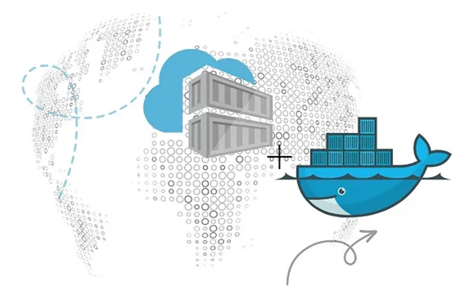

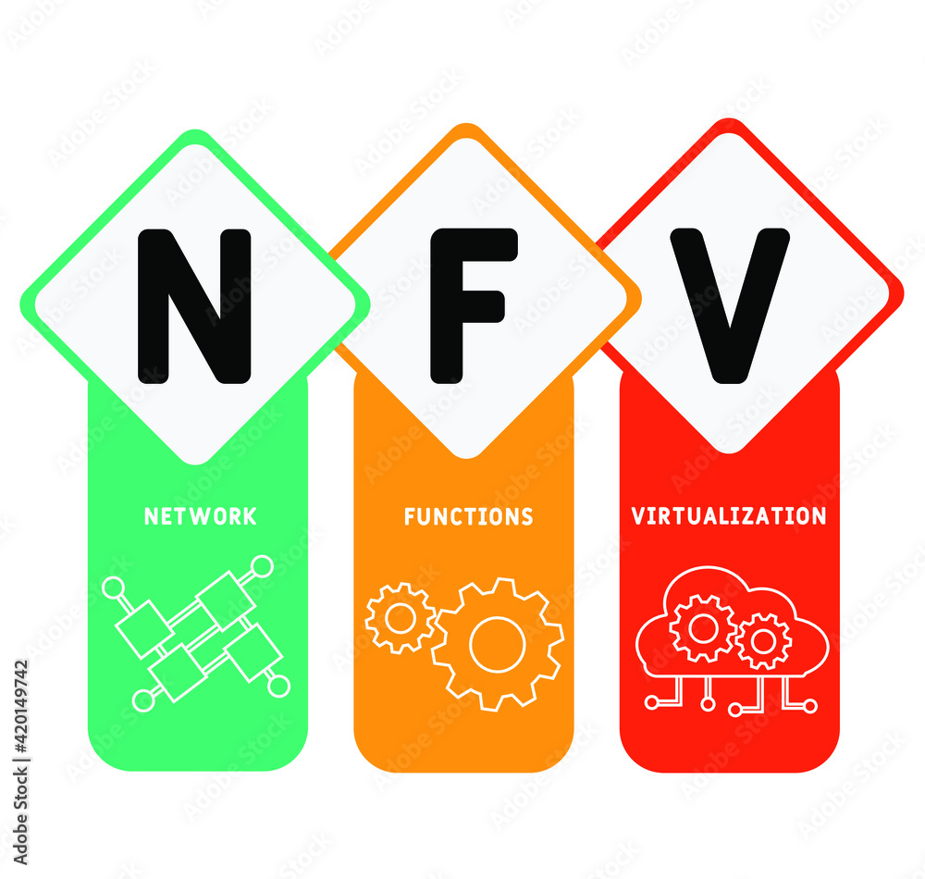
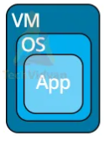
PDS
Computer Vision
CoAP-Constrained Application Protocol
Application Layers
.
https://github.com/siagianp
https://www.youtube.com/@AmelOline/videos
https://github.com/amelcharolinesgn2/IoT_simulator-mqtt-NodeRed
https://github.com/amelcharolinesgn2/Cloud-Infrastructures
https://github.com/amelcharolinesgn2/IoT_app-and-Modules
https://github.com/amelcharolinesgn2/ClouD-Infrastructure-SISKA-2025
Notes:
https://github.com/mikeroyal/Google-Cloud-Guide

Slide 2
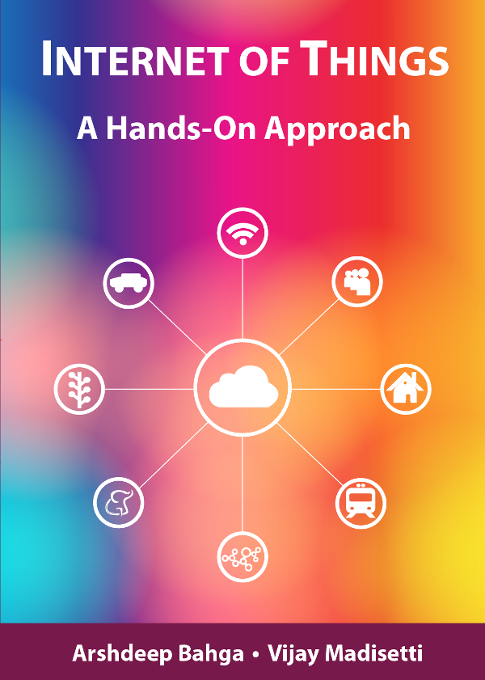
Review::
Chapter 1
Introduction to IoT
Book website: http://www.internet-of-things-book.com
Notes:
https://indobot.co.id/mqtt-penting-dalam-iot/

Slide 3
Table of Contents:
Intro
CoAP
Query processing

Slide 4
Introduction

Slide 5
Application layer in the Internet
Lower layers
The meaning of all lower layers is to provide a communication facility for applications
Are not really designed for end users
Application layer
Application layer protocols work on top of the transport layer protocols
Implement applications for end users
A large set of different applications (protocols) with totally different requirements and assumptions
According to ISO/OSI three layers, but in the Internet exists only one layer
OSI Reference Model
Application Layer
Presentation Layer
Session Layer
Transport Layer
Network Layer
Data Link Layer
Physical Layer
Notes:
https://indobot.co.id/mqtt-penting-dalam-iot/

Slide 6
Application layer in the Internet
File Transfer
Email
Network Management
Name Service File Transfer
WWW
Virtual Terminal
HTTP FTP Telnet SMTP DNS SNMP TFTP
TCP SCTP UDP DCCP
ARP RARP IP ICMP IGMP
Ethernet Token Ring Token Bus WLAN
Internet protocols
Layer 1/2

Slide 7
Application layer in the Internet
Protocols of the application layer are common communication services
Protocols of the application layer are defined for special purposes and specify ...
the types of the messages
the syntax of the message types
the semantics of the message types
rules for definition, when and how an application process sends a message resp. responses to it

Slide 8









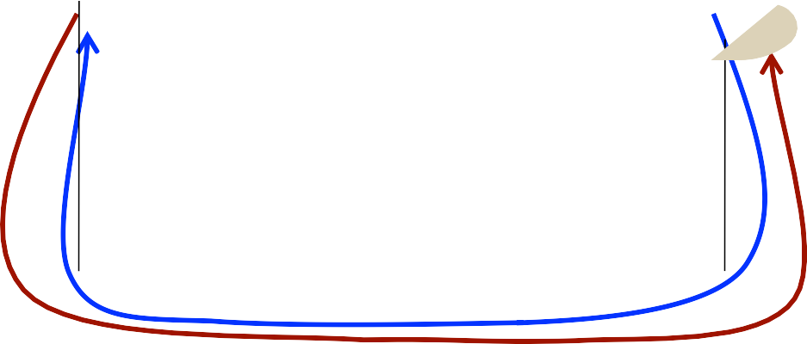


Application layer in the Internet
Usually client/server structure
Processes on the application layer use TCP(UDP)/IP- Sockets
Client
Server
Client Process
Server Process
Reply
Request

Slide 9

Protocol stack
Application Layer
Task Management Plane
Mobility Management Plane Power Management Plane
Transport Layer
Network Layer
Link Layer
Physical Layer

Slide 10
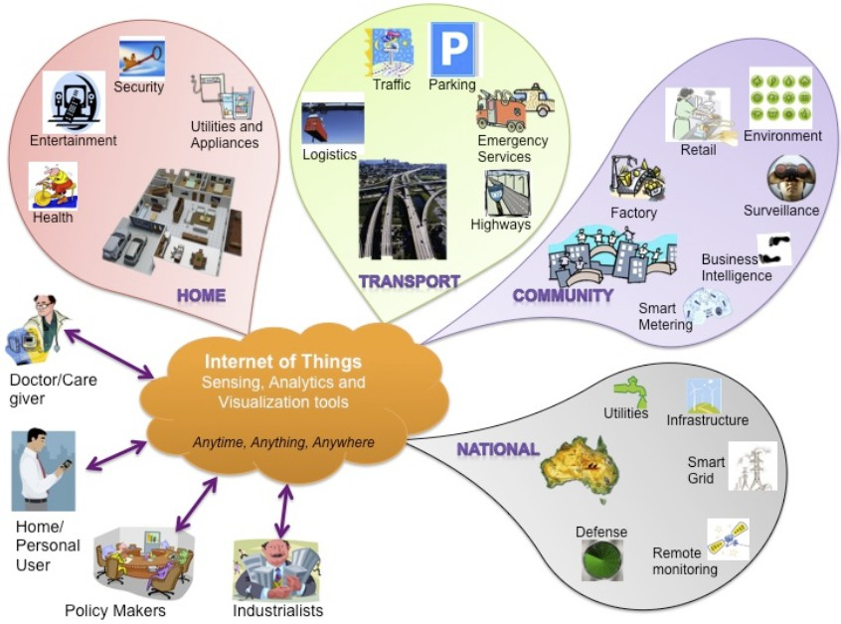
IoT Applications

Slide 11
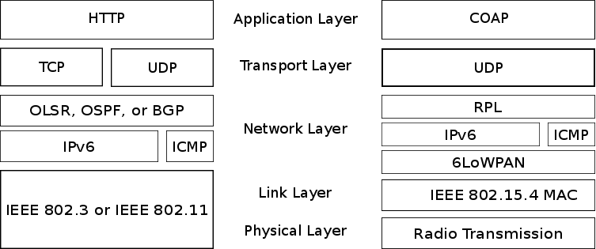
Protocol stack
Different protocol stack models for the future

Slide 12
Protocol stack
Different protocol stack models for the future
XML
HTTP
TCP
IP
Ethernet MAC
Ethernet PHY
EXI
CoAP
UDP
6LoWPAN
IEEE 802.* MAC
IEEE 802.* PHY
Payload
Application Transport Network Data Link Physical
W3C Efficient XML Interchange (EXI) format is a binary high performance XML representation for M2M communication.

Slide 13
Protocol stack
EXI
CoAP
UDP
Payload
Application Transport
RPL
IPv6 | ICMP
6LoWPAN
Network
IEEE 802.* MAC
Data Link
Physical
IEEE 802.* PHY

Slide 14
CoAP

Slide 15
Constrained Application Protocol (CoAP)
IETF working group
Constrained RESTful Environments (core)
Documents related to CoAP
Most specifications are currently work in progress!
draft-ietf-core-coap-13
“Constrained Application Protocol (CoAP)”, 2012-12-06
RFC 6690 (draft-ietf-core-link-format)
“Constrained RESTful Environments (CoRE) Link Format“, 2012-08
See for a list of all documents.
http://datatracker.ietf.org/wg/core/

Slide 16
What is REST?
REST was defined by Roy T. Fielding in his PhD thesis
Co-author of many web protocols
Key principles of REST (simplified)
Give every “thing” (resource) an ID
Link things together
Use standard methods
Resources with multiple representations
Communicate statelessly

Slide 17
Constrained Application Protocol (CoAP)
Description of Working Group
“CoRE is providing a framework for resource-oriented applications intended to run on constrained IP networks. A
constrained IP network has limited packet sizes, may exhibit a
high degree of packet loss, and may have a substantial number
of devices that may be powered off at any point in time but periodically "wake up" for brief periods of time.
These networks and the nodes within them are characterized by severe limits on throughput, available power, and particularly on
the complexity that can be supported with limited code size and
limited RAM per node. More generally, we speak of constrained
networks whenever at least some of the nodes and networks
involved exhibit these characteristics. Low-Power Wireless
Personal Area Networks (LoWPANs) are an example of this type
of network. Constrained networks can occur as part of home and building automation, energy management, and the Internet of Things.”
(http://datatracker.ietf.org/wg/core/charter/)

Slide 18
Constrained Application Protocol (CoAP)
Features
Constrained web protocol fulfilling M2M requirements.
UDP binding with optional reliability supporting unicast and multicast requests.
Asynchronous message exchanges.
Low header overhead and parsing complexity.
URI and Content-type support.
Simple proxy and caching capabilities.
A stateless HTTP mapping, allowing proxies to be built providing access to CoAP resources via HTTP in a uniform way or for HTTP simple interfaces to be realized alternatively over CoAP.
Security binding to Datagram Transport Layer Security (DTLS).

Slide 19
CoAP: Message types
Type
Description
CON Confirmable Message
Each confirmable message is acknowledged either by a message type of “Ack” or “Reset”.
NON Non-Confirmable Message
For messages that do not require an acknowledgement.
This is particularly true for messages that are repeated regularly for application requirements, such as repeated readings from a sensor where eventual success is sufficient.
Ack Acknowledgement Message
An Ack acknowledges that a specific CON message arrived. It does not indicate success or failure of any encapsulated request.
Reset Reset Message
A Reset message indicates that a specific message (CON or NON) was received, but some context is missing to properly process it.
This condition is usually caused when the receiving node has rebooted and has forgotten some
state that would be required to interpret the message. Provoking a Reset message (e.g., by sending an empty Confirmable message) is also useful as an inexpensive check of the liveness of an endpoint ("CoAP ping").

Slide 20
CoAP
Abstract layering of CoAP
Application Layer
Requests/Responses
CoAP
Messages
UDP

Slide 21
CoAP
Reliable message transmission
Client
|
Unreliable message transmission
Client
|
Server
|
|
Server
|
|
| CON [0x7d34]
| NON [0x01a0]
+----------------->|
+----------------->|
|
| ACK [0x7d34]
|
|
|
|
|
|
|
|
|
|
|
|
|
|
|<-----------------+
|
|
|
|
|
|

Slide 22
CoAP
Request/Response Model
Client | |  | Server | | Client | |  | Server |
| | CON [0xbc90] | | | | | CON [0xbc91] | |
| | GET /temperature | | | | | GET /temperature | |
| | (Token 0x71) | | | | | (Token 0x72) | |
+----------------->| |  |  | +----------------->|
| | | ACK [0xbc90] | | | | | | | ACK [0xbc91] | | |
| | 2.05 Content | | | | | 4.04 Not Found | |
| | (Token 0x71) | | | | | (Token 0x72) | |
| | "22.5 C" | | | | | "Not found" | |
|<-----------------+ |  |  | |<-----------------+
| | | |  | | | |
Figure 4: Two GET requests with piggy-backed responses
A Token is used to match responses to requests independently from the underlying messages

Slide 23
CoAP
Client | | |  | CON [0x7a10] | Server | |
| | GET /temperature |  |  | |
| | (Token 0x73) |  |  | |
+----------------->| | | | ACK [0x7a10] |
|<-----------------+ | | ... Time Passes ...
| | |  | CON [0x23bb] | | |
| |  | 2.05 Content | |
| |  | (Token 0x73) | |
| |  | "22.5 C" | |
|<-----------------+ | | | ACK [0x23bb] |
Figure 5: A GET request with a separate response
+----------------->|
| |

Slide 24
CoAP
Client | |  |  | Server |
| |  | NON [0x7a11] | |
| | GET /temperature |  |  | |
| | (Token 0x74) |  |  | |
+----------------->| | |
| | NON [0x23bc] |  | |
| | 2.05 Content |  | |
| | (Token 0x74) |  | |
| | "22.5 C" |  | |
|<-----------------+
| |
Figure 6: A NON request and response

Slide 25
Message format
0 1 2 3
0 1 2 3 4 5 6 7 8 9 0 1 2 3 4 5 6 7 8 9 0 1 2 3 4 5 6 7 8 9 0 1
+-+-+-+-+-+-+-+-+-+-+-+-+-+-+-+-+-+-+-+-+-+-+-+-+-+-+-+-+-+-+-+-+
|Ver| T | TKL | Code | Message ID |
+-+-+-+-+-+-+-+-+-+-+-+-+-+-+-+-+-+-+-+-+-+-+-+-+-+-+-+-+-+-+-+-+
| Token (if any, TKL bytes) ...
+-+-+-+-+-+-+-+-+-+-+-+-+-+-+-+-+-+-+-+-+-+-+-+-+-+-+-+-+-+-+-+-+
| Options (if any) ...
+-+-+-+-+-+-+-+-+-+-+-+-+-+-+-+-+-+-+-+-+-+-+-+-+-+-+-+-+-+-+-+-+
|1 1 1 1 1 1 1 1| Payload (if any) ...
+-+-+-+-+-+-+-+-+-+-+-+-+-+-+-+-+-+-+-+-+-+-+-+-+-+-+-+-+-+-+-+-+
Figure 7: Message Format

Slide 26
Message format: The header
0 1 2 3
0 1 2 3 4 5 6 7 8 9 0 1 2 3 4 5 6 7 8 9 0 1 2 3 4 5 6 7 8 9 0 1
+-+-+-+-+-+-+-+-+-+-+-+-+-+-+-+-+-+-+-+-+-+-+-+-+-+-+-+-+-+-+-+-+
|Ver| T | TKL
| Code | Message ID |
+-+-+-+-+-+-+-+-+-+-+-+-+-+-+-+-+-+-+-+-+-+-+-+-+-+-+-+-+-+-+-+-+
Version (Ver): Indicates the CoAP version number, currently 1.
Type (T): Indicates the type of message
0: Confirmable
1: Non-Confirmable
2: Acknowledgement
3: Reset
Token Length (TKL): Length of the variable-length Token field (0-8 bytes).
Code: Message code
0:
empty
1-31:
request
64-191: response
else: reserved
Message ID: 16-bit unsigned integer in network byte order.
Used for the detection of message duplication.
To match messages of type Ack/Reset to CON/NON messages

Slide 27
Message transmission
A message carries
A request
A response
Is empty
A CoAP endpoint is the source or destination of a CoAP message.
Endpoint is identified by (IP address, UDP port)

Slide 28
Message transmission
CoAP messages are exchanged asynchronously between CoAP endpoints.
They are used to transport CoAP requests and responses
As CoAP is bound to non-reliable transports such as UDP, CoAP messages may arrive
out of order
appear duplicated
go missing without notice
-> Mechanism for reliable transport required!

Slide 29
Message transmission
CoAP implements a lightweight reliability mechanism, without trying to re-create the full feature set of a transport protocol like TCP.
It has the following features:
Simple stop-and-wait retransmission reliability with exponential back-off for Confirmable messages.
Duplicate detection for both Confirmable and Non-Confirmable messages.

Slide 30
Message transmission: Reliability
The reliable transmission of a message is initiated by marking the message as Confirmable in the CoAP header.
A Confirmable message always carries either a request or response and MUST NOT be empty.
A recipient MUST acknowledge such a message with an Acknowledgement message or, if it lacks context to process the message properly, MUST reject it.
Rejecting a Confirmable message is effected by sending a matching Reset message and otherwise ignoring it.
The Acknowledgement message MUST echo the Message ID of the Confirmable message, and MUST carry a response or be empty.
The Reset message MUST echo the Message ID of the confirmable message, and MUST be empty.

Slide 31
Message transmission: Reliability
The sender retransmits the Confirmable message at exponentially increasing intervals, until it receives an acknowledgement (or Reset message), or runs out of attempts.
Retransmission is controlled by
a timeout
a retransmission counter
If the retransmission counter reaches MAX_RETRANSMIT on a timeout, or if the endpoint receives a Reset message, then the attempt to transmit the message is canceled and the application process informed of failure.

Slide 32
Congestion control
Basic congestion control for CoAP is provided by the exponential back-off mechanism
Clients (including proxies) MUST strictly limit the number of simultaneous outstanding interactions that they maintain to a given server

Slide 33
Transmission parameters
Message transmission is controlled by the following parameters:
Name | Default value
ACK_TIMEOUT | 2 seconds
ACK_RANDOM_FACTOR | 1.5
MAX_RETRANSMIT | 4
NSTART | 1
DEFAULT_LEISURE | 5 seconds
PROBING_RATE | 1 byte/second

Slide 34
Transmission parameters
Time Values derived from Transmission Parameters
MAX_TRANSMIT_SPAN is the maximum time from the first transmission of a confirmable message to its last retransmission.
ACK_TIMEOUT * (2**MAX_RETRANSMIT - 1) * ACK_RANDOM_FACTOR
For the default transmission parameters, the value is 2*15*1.5 = 45 seconds

Slide 35
Transmission parameters
MAX_TRANSMIT_WAIT is the maximum time from the first transmission of a confirmable message to the time when the sender gives up on receiving an acknowledgement or reset.
ACK_TIMEOUT * (2 ** (MAX_RETRANSMIT + 1) - 1) * ACK_RANDOM_FACTOR
For the default transmission parameters, the value is 2*31*1.5 = 93 seconds.

Slide 36
Transmission parameters
MAX_LATENCY is the maximum time a datagram is expected to take from the start of its transmission to the completion of its reception.
PROCESSING_DELAY is the time a node takes to turn around a confirmable message into an acknowledgement.
MAX_RTT is the maximum round-trip time, or:
2 * MAX_LATENCY + PROCESSING_DELAY

Slide 37
Transmission parameters
EXCHANGE_LIFETIME is the time from starting to send a confirmable message to the time when an acknowledgement is no longer expected, i.e. message layer information about the message exchange can be purged.
(ACK_TIMEOUT * (2 ** MAX_RETRANSMIT - 1) * ACK_RANDOM_FACTOR) + (2 * MAX_LATENCY) + PROCESSING_DELAY
248 seconds with the default transmission parameters

Slide 38
Transmission parameters
NON_LIFETIME is the time from sending a non- confirmable message to the time its message-ID can be safely reused.
MAX_TRANSMIT_SPAN + MAX_LATENCY
145 seconds with the default transmission parameters

Slide 39
Request/Response Semantics
CoAP operates under a similar request/response model as HTTP
A CoAP endpoint in the role of a "client" sends one or more CoAP requests to a "server", which services the requests by sending CoAP responses.
Unlike HTTP, requests and responses are not sent over a previously established connection, but exchanged asynchronously over CoAP messages.

Slide 40
Request/Response Semantics
Requests
A CoAP request consists of the method to be applied to the resource, the identifier of the resource, a payload and Internet media type (if any), and optional meta-data about the request.
CoAP supports the basic methods of GET, POST, PUT, DELETE, which are easily mapped to HTTP.
They have the same properties as in HTTP:
safe (only retrieval)
idempotent (you can invoke it multiple times with the same effects)
Responses
A response is identified by the Code field in the CoAP header being set to a Response Code.

Slide 41
Request/Response Semantics
The response codes are designed to be extensible
0 1 2 3 4 5 6 7
+-+-+-+-+-+-+-+-+
|class| detail |
+-+-+-+-+-+-+-+-+
Figure 9: Structure of a Response Code
There are 3 classes:
2 - Success: The request was successfully received, understood, and accepted.
4 - Client Error: The request contains bad syntax or cannot be fulfilled.
5 - Server Error: The server failed to fulfill an apparently valid request.

Slide 42
Request/Response Semantics
As a human readable notation for specifications and protocol diagnostics, the numeric value of a response code is indicated by giving the upper three bits in decimal, followed by a dot and then the lower five bits in a two-digit decimal.
E.g., "Not Found" is written as 4.04 -- indicating a value of hexadecimal 0x84 or decimal 132.

Slide 43
Options
CoAP defines a single set of options that are used in both requests and responses:
Content-Format
Etag
Location-Path
Location-Query
Max-Age
Proxy-Uri
Proxy-Scheme
Uri-Host
Uri-Path
Uri-Port
Uri-Query
Accept
If-Match
If-None-Match

Slide 44
Caching
CoAP endpoints MAY cache responses in order to reduce the response time and network bandwidth consumption on future, equivalent requests.
The goal of caching in CoAP is to reuse a prior response message to satisfy a current request.
Freshness Model
When a response is "fresh" in the cache, it can be used to satisfy subsequent requests without contacting the origin server, thereby improving efficiency.
The mechanism for determining freshness is for an origin server to provide an explicit expiration time in the future, using the Max- Age Option

Slide 45
Methods
GET
The GET method retrieves a representation for the information that currently corresponds to the resource identified by the request URI.
The GET method is safe and idempotent.
POST
The POST method requests that the representation enclosed in the request be processed.
POST is neither safe nor idempotent.
PUT
The PUT method requests that the resource identified by the request URI be updated or created with the enclosed representation.
PUT is not safe, but is idempotent.
DELETE
The DELETE method requests that the resource identified by the request URI be deleted.
DELETE is not safe, but is idempotent.

Slide 46
CoAP URIs
CoAP uses the "coap" and "coaps" URI schemes for identifying CoAP resources and providing a means of locating the resource.
CoAP URI scheme
"coap:" "//" host [":" port] path-abempty ["?" query]
CoAPs URI scheme
"coaps:" "//" host [":" port] path-abempty ["?" query]
Examples (all identical)
coap://example.com:5683/˜sensors/temp.xml
coap://EXAMPLE.com/%7Esensors/temp.xml
coap://EXAMPLE.com:/%7esensors/temp.xml

Slide 47
Discovery
Service Discovery
A server is discovered by a client by the client knowing or learning a URI that references a resource in the namespace of the server.
Alternatively, clients can use Multicast CoAP and the "All CoAP Nodes" multicast address to find CoAP servers.
Resource Discovery
A CoAP client can query a server for its list of hosted resources.
It is up to the server which resources are made discoverable (if any).

Slide 48
Query processing

Slide 49
Query processing
The classical way of developing applications
Write programs in low-level languages like C
Difficult, error prone, and expensive
Most users are computer/network experts
Consider the network (e.g. WSN) as a distributed database system
Alternative way application “development”
Applications can “created” in the form of a “query”
But: Traditional DB approaches are not applicable

Slide 50
Query processing
Properties of wireless multi-hop networks
Streaming data: Nodes produce data continuously
Real-time processing: Generated data represent real-time events
Communication errors: Wireless multi-hop communication affects reliability
Uncertainty: Generated data contains noise from environment
Limited (disk, memory) space: Generated data cannot be stored for long time
Processing vs. communication: Processing is cheap in comparison to communication -> Process more, communicate less!

Slide 51
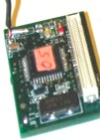




Query processing
Query
User Query
User
Dissemination
Storage

Slide 52



Query processing
User Query
Charts, graphs, etc.
User
Storage

Slide 53
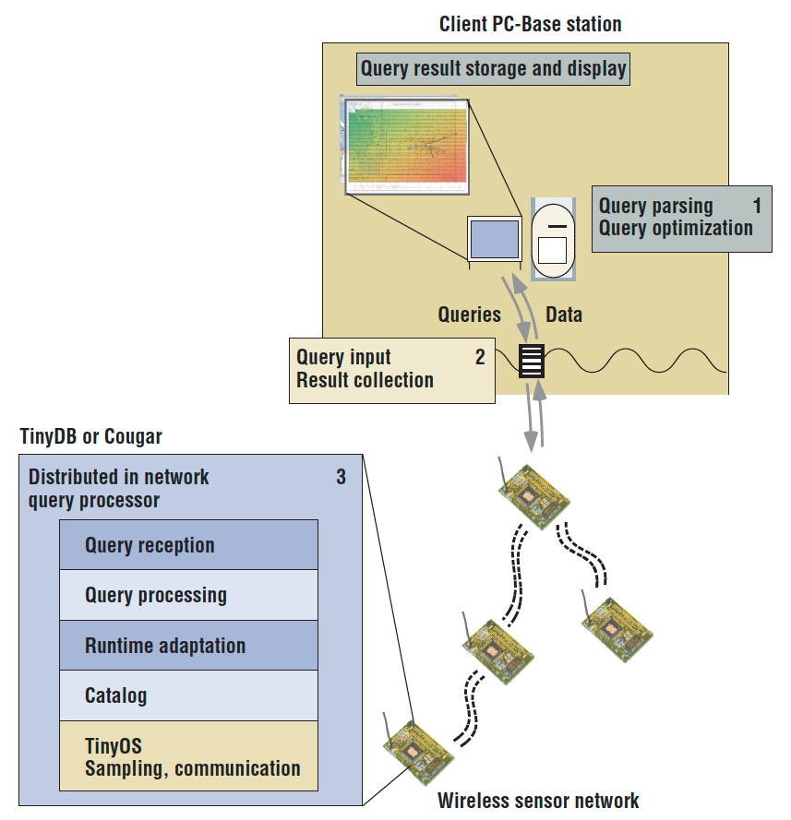

Query processing
Architecture
Server-side
parse query
deliver into the network
collects results as they stream out of the network
Sensor-side

Slide 54
Query processing
Query representation

Slide 55
Query representation
The representation of the query is a key factor
Representation for the user
Representation for processing algorithms
Representation is send to the (sensor) nodes
Representation -> interest -> task
Example:
User sends a query and gets response from sensor nodes
Which area has humidity higher than 50?
Type = humidity
Timestamp = 28/01/2013/19:38:27
Location = [60N,120W]
Humidity > 50

Slide 56
Query representation
Example: Animal Tracking Query
Type = four legged animal
Interval = 30 s
Duration = 1h
Rec = [-100,100,200,400]
(detect animal location)
(send back events every 30 s) (... for the next hour)
(from sensors within the rectangle)
Sensor detecting the animal generates the data
Type = four legged animal
Instance = elephant
Location = (125,220)
Intensity = 0.6
Confidence = 0.85
Timestamp = 19:41:40
(type of animal seen) (instance of this type) (node location)
(signal amplitude measure) (confidence in the match) (event generation time)

Slide 57
Query representation
Alternative query representation based on SQL
Select
[ task, time, location, [distinct [ [avg | min |max | count | sum ] [any , every ]
| all], amplitude, (amplitude)]]
From Where
[ power available [<|>] PA | location [in | not in] RECT | tmin < time < tmax |
task = t | amplitude [<|==|>] a ] by task
on [time limit = lt | packet limit
Group Based
= lp |
resolution = r | region = xy ]

Slide 58
Query processing
Sensor Query and Tasking Language (SQTL)

Slide 59
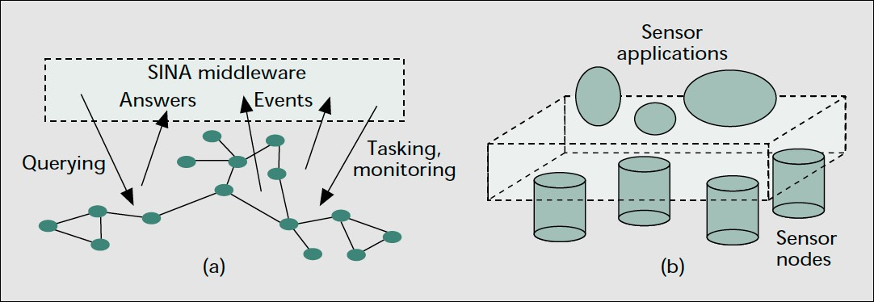
Sensor Query and Tasking Language (SQTL)
Sensor Information Networking Architecture and Applications (SINA)
Middleware for sensor networks
SQTL -> Query language
Sensor Execution Environment (SSE) -> Runs on each node

Slide 60
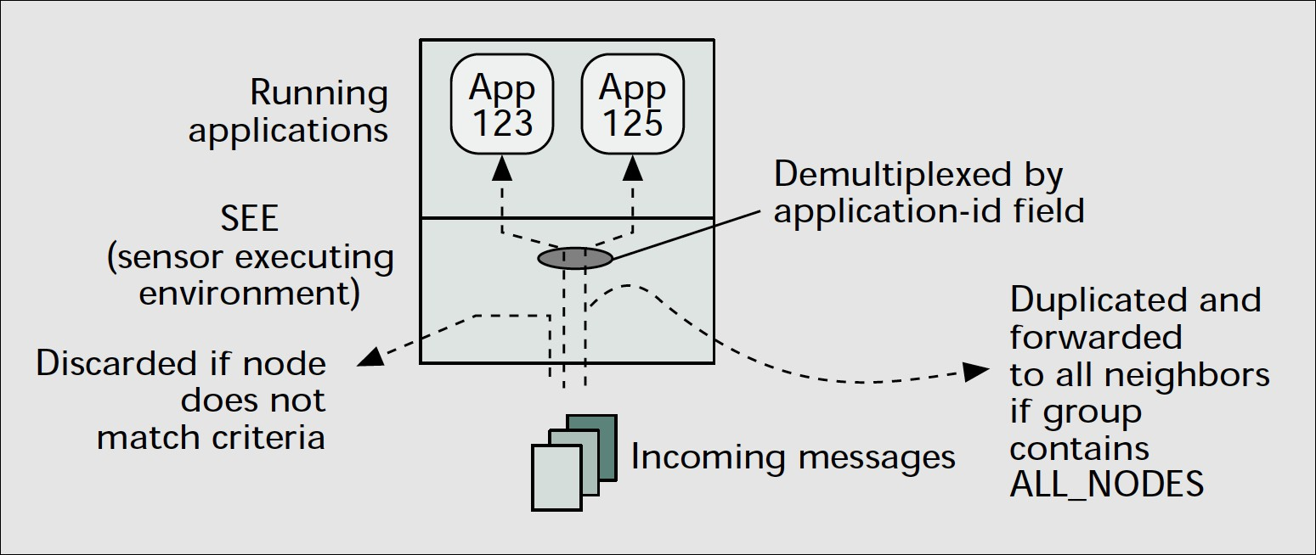
SQTL
Cooperation of SQTL and SSE
Dispatching of messages received by a sensor node

Slide 61
SQTL and SSE
Once an SQTL script is injected into the network, the script is pushed to other nodes in order to complete the assigned task.
A tell message is generated after a result is produced at each individual node and is delivered back
SEE is responsible for
Demultiplexing of incoming SQTL messages
Transmission of outgoing SQTL messages from all running applications
Outgoing messages are distributed to target node(s) specified in the receiver argument through the underlying communication mechanism.
Translation of an attribute-based name into a unique, numeric link- layer address

Slide 62
SQTL
SQTL is a procedural scripting language
It provides …
Sensor access: getTemperature(), turnOn(), turnOff()
Location awareness: isNeighbor(), getPosition(), isNorthOf()
Communication: tell(), execute(), send()

Slide 63
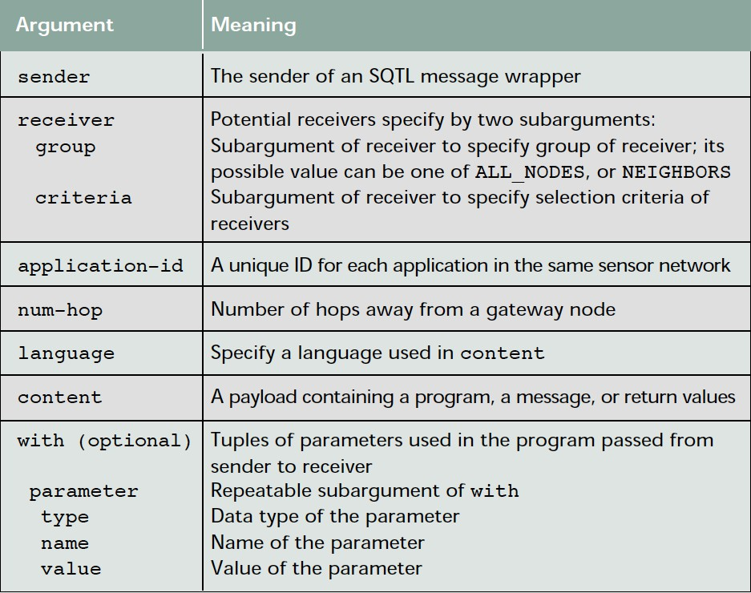
SQTL
Arguments used by actions in an SQTL wrapper

Slide 64
SQTL: Example
Example for temperature reading application
Sink is interested in the maximum temperature
(execute
:sender SINK
:receiver (:group NODE(1) :criteria TRUE)
:application-id 123
:language SQL
:content ( SELECT Max(getTemperature()) FROM ALL_Nodes
)
)

Slide 65
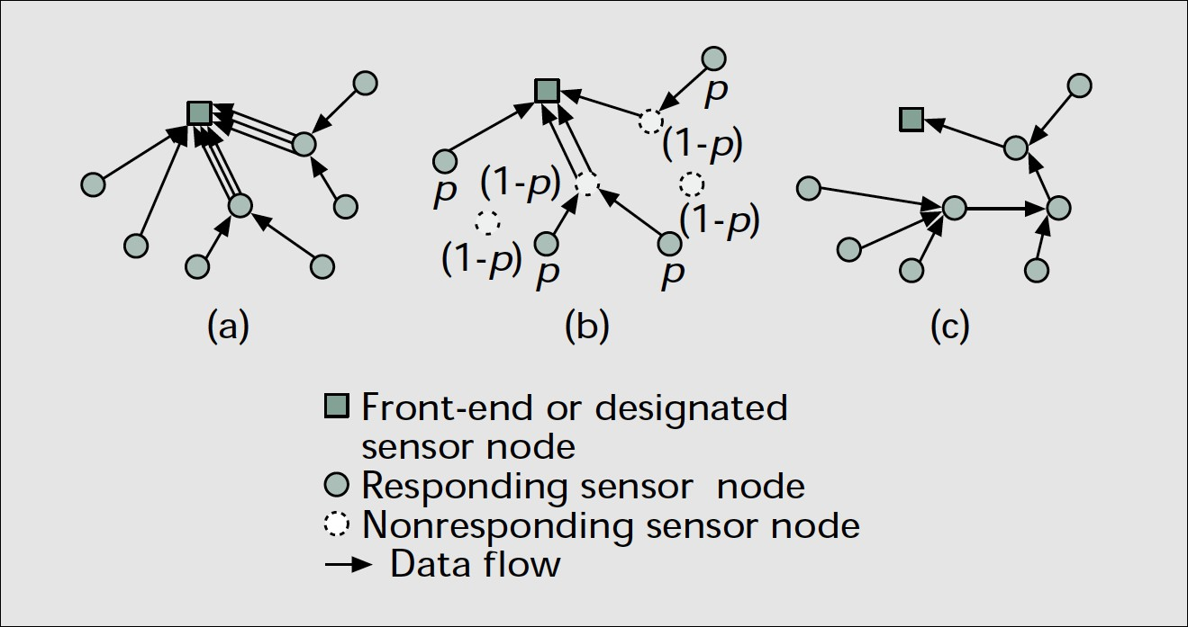
SQTL: Response implosion problem
The response implosion problem
Reduction of responses by probabilistic reply
Aggregation at intermediate nodes

Slide 66
SQTL
By using the upon command, a programmer can create an “event handling block” for 3 types of events:
Events generated when a message is received by a sensor node (RECEIVE)
Events triggered periodically (EVERY)
Events caused by the expiration of a timer (EXPIRE)

Slide 67
Main approaches in query processing
Pull-based (interest dissemination)
Sink-initiated query dissemination
Users send their interest to a sensor node, a subset of the nodes or the entire network.
This interest may be about a certain attribute of the sensor field or a triggering event.
Push-based (advertisement of available data)
Sensor-initiated information delivery
Sensor nodes advertise the available data to the users
The users query the data which they are interested in
Push-pull
Both sensors/sink are actively involved

Slide 68
Query classification
Query
Temporal
Spatial
content
content
Continuous
Snapshot
Historical
Data- centric
Geographi cal
Real-time
detection
Collected data span some long period of time
Collect data about now or some other point in time
Collect summary data about past
Attribute based query
Location based query

Slide 69







Example:
Data-centric query (attribute based query)
Query: Sensor nodes that read >70ºF temperature
71
75
68
67
Sink
66
71
71
68
71
69

Slide 70






Example:
Geographical query (location based query)
Query: Region A nodes should send their temperatures
71
Region A
75
Region C
66
68
67
Sink
71
71
68
71
69
Region B

Slide 71
Query processing
Data aggregation

Slide 72
Data Aggregation/Fusion
Impossible to continuously collect raw sensor data
Limited memory and bandwidth
Information overload
Individual sensor readings are of limited use
Interest in collective information rather than individual sensor data
Exploit in-network processing
Goal
Save energy and increase network lifetime by combining several sensor data

Slide 73
Data Aggregation/Fusion
Data Aggregation
Process of combining data or information to estimate or predict events
Idea
Take advantage of the routing hierarchy and high network density

Slide 74
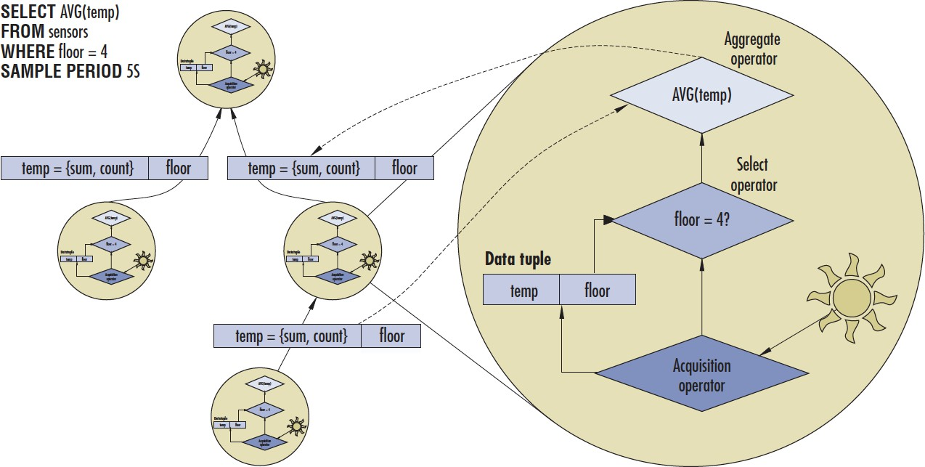
Data Aggregation/Fusion

Slide 75




Data Aggregation/Fusion
Aggregation
Query processor
Σ
User Query
Σ
Charts, graphs, etc.
User
Storage

Slide 76
Data aggregation
Source 1
Source 2
Source 2
Source 1
Source 2
Aggregate data before routing
Source 1 & 2
Sink

Slide 77






Data aggregation/fusion
The sink asks the sensor nodes to report certain conditions. Data coming from multiple sensor nodes are aggregated.
71
68
75
67
66
71
71
Sink
68
71
69
Query: Sensor nodes that read >70ºF temperature

Slide 78
Data aggregation components
Data Storage
Store sensor data in a memory efficient way, while preserving the accuracy of the information.
Aggregation Functions
Place aggregation points on the paths from sensors to sink.
Aggregation Paths
Which are the optimal aggregation points?
Which is the most suitable path from source to sink to favor data aggregation?

Slide 79


Data storage representations
Data can be represented with different degrees of accuracy.
Store individual data -> histograms and lists
Data samples
1 2
…
k
3 | 4 | 2 | 1 | 0 | 4 | 7 | 2
Store only mean and variance or other statistical representations
Data samples
M_{x} σ_{x}

Slide 80
Aggregate functions
Simple functions
Average, max, min, median
Suppression of duplicates
More sophisticated functions
Exploit spatial and temporal correlation
Signal processing (convolution, filtering, etc.)
What type of information should we expect from aggregation?
Streams
Robust estimates

Slide 81
Aggregate paths
Sink
Challenges
Find the optimal number of aggregation points
Selection of aggregation points
Dynamic change of aggregation points
Energy efficiency
Aggregation point Sensor node

Slide 82
Aggregate challenges
Properties of the environment
unreliable environment
-> Never complete/up-to-date information about the neighborhood
certain information unavailable
-> Information trickles in one message at a time
expensive to obtain
Open questions
how many nodes are present?
how many nodes are supposed to respond?
what is the error distribution?
what about malicious nodes?
-> Trying to build an infrastructure to remove all uncertainty from the application may not be feasible

Slide 83
Optimal data aggregation
Optimal data aggregation is NP-Hard
Sub-optimal algorithms
Opportunistic
Just aggregate when possible
Center at nearest source (CNS)
The nearest source acts as the aggregation point
Shortest path tree (SPT)
Sources send using shortest path, if able aggregate
Greedy Incremental Tree (GIT)
Recursively select the closest source to the tree
Clustered Diffusion with Dynamic Data Aggregation
Hybrid between diffusion and clustering with the ability to aggregate data at the cluster heads

Slide 84
Advantages and disadvantages of aggregation
Advantages
Reduce traffic load by aggregating data en route
Energy and memory efficiency
Scalable to large numbers of both sinks and sensors
Disadvantages
Requires careful design to tradeoff accuracy and storage and message size
Incurs information loss, making robust estimation more difficult
e.g. a single outlier reading can damage MAX/MIN aggregates

Slide 85
Query challenges
High density: Rich and massive data
Correlation: Spatially distributed and correlated data
Uncertainty: Noise, erroneous data, outliers
Semantics: Individual data ≠ useful information

Slide 86
Querying Sensor Networks
TinyDB
Information storage framework
Tree-based data collection
COUGAR
Individual sensor data
Distributed Gathering
SQL-like
TAG (Tiny Aggregation)
Focus on Aggregation using SQL-like query language
Integrated in TinyOS

Slide 87
Query processing
TinyDB

Slide 88
TinyDB
A distributed query processor for networks of Micas
-> Sensor network = Distributed database
Goal: Eliminate the need to write C code for most users
Features
Declarative queries
Temporal + spatial operations
Data stored locally
Multi-hop routing -> tree-based routing
In-network storage
Top-down SQL query
Results aggregated back to the sink

Slide 89
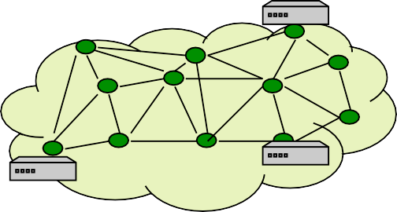

TinyDB
High level abstraction
Data centric programming
Interact with sensor network as a whole
Extensible framework
SELECT MAX(mag)
FROM sensors WHERE mag > thresh
SAMPLE PERIOD 64ms
App
Under the hood
Intelligent query processing
query optimization
power efficient execution
Fault mitigation
automatically introduce redundancy
avoid problem areas
Query, Trigger
Data
TinyDB
Sensor Network

Slide 90
Feature Overview
Declarative SQL-like query interface
Metadata catalog management
Multiple concurrent queries
Network monitoring (via queries)
In-network, distributed query processing
Extensible framework for attributes, commands, and aggregates
In-network, persistent storage

Slide 91
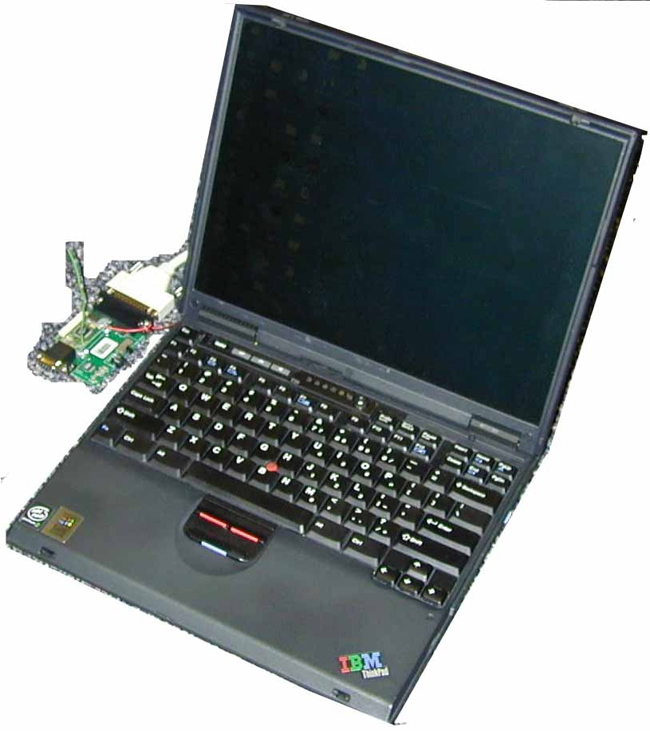

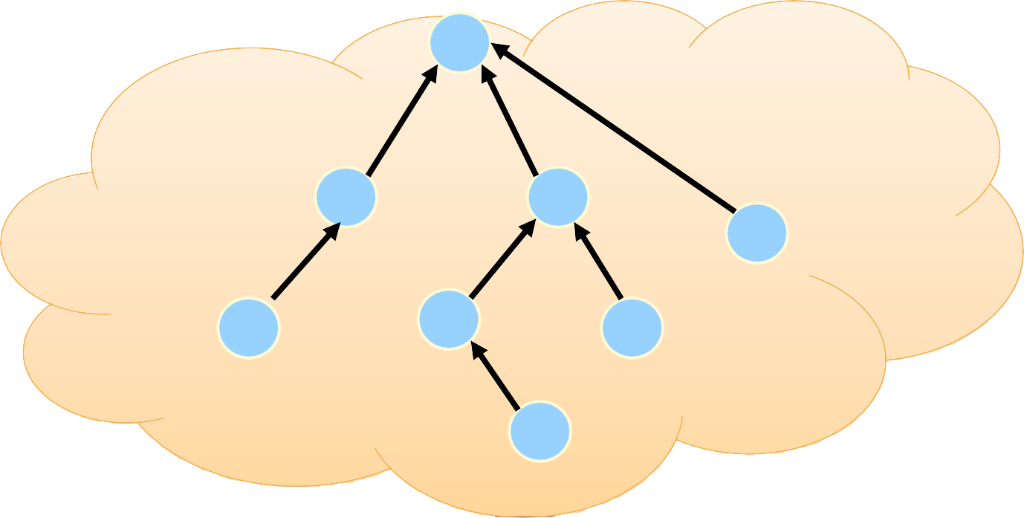
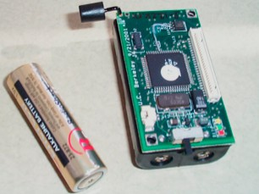
Architecture
TinyDB GUI
TinyDB Client API
JDBC
DBMS
PC side
Mote side
0
TinyDB query processor
8
1
2
4
Sensor network
5
6
7

Slide 92
Data Model
Entire sensor network as one single, infinitely-long logical table: sensors
Columns consist of all the attributes defined in the network
Typical attributes
Sensor readings
Meta-data: node id, location, etc.
Internal states: routing tree parent, timestamp, queue length, etc.
Nodes return NULL for unknown attributes
On server, all attributes are defined in catalog.xml
Discussion: other alternative data models?

Slide 93
Query Language (TinySQL)
SELECT <aggregates>, <attributes>
FROM {sensors | <buffer>} WHERE <predicates> GROUP BY <exprs>
SAMPLE PERIOD <const> | ONCE
INTO <buffer>
TRIGGER ACTION <command>

Slide 94
Comparison with SQL
Single table in FROM clause
Only conjunctive comparison predicates in WHERE and HAVING
No subqueries
No column alias in SELECT clause
Arithmetic expressions limited to column op constant
Only fundamental difference: SAMPLE PERIOD clause

Slide 95

TinySQL Examples
“Find the sensors in bright nests.”
1
SELECT nodeid, nestNo, light
FROM sensors WHERE light > 400 EPOCH DURATION 1s
Sensors
Epoch | Nodeid | nestNo | Light
0 | 1 | 17 | 455
0 | 2 | 25 | 389
1 | 1 | 17 | 422
1 | 2 | 25 | 405

Slide 96

TinySQL Examples
2
SELECT AVG(sound) FROM sensors
EPOCH DURATION 10s
“Count the number occupied nests in each loud region of the island.”
3
SELECT region, CNT(occupied), AVG(sound) FROM sensors
GROUP BY region
HAVING AVG(sound) > 200 EPOCH DURATION 10s
Regions w/ AVG(sound) > 200
Epoch | region | CNT(…) | AVG(…)
0 | North | 3 | 360
0 | South | 3 | 520
1 | North | 3 | 370
1 | South | 3 | 520

Slide 97
Event-based Queries
ON event SELECT …
Run query only when interesting events happens
Event examples
Button pushed
Message arrival
Bird enters nest
Analogous to triggers but events are user-defined

Slide 98
Query over Stored Data
Named buffers in Flash memory
Store query results in buffers
Query over named buffers
Analogous to materialized views
Example:
CREATE BUFFER name SIZE x (field1 type1, field2 type2, …)
SELECT a1, a2 FROM sensors SAMPLE PERIOD d INTO name
SELECT field1, field2, … FROM name SAMPLE PERIOD d

Slide 99
Query processing
COUGAR

Slide 100
COUGAR
Performs in-network computation
Decreases energy consumption
Attempts to merge similar queries
Propagates results to sink

Slide 101
COUGAR Architecture
Sink
Sensors send their information towards designated leaders
Partial aggregation is performed at sensors
Collected data aggregated optimally at the leaders
Leader Sensor node

Slide 102
COUGAR Components
Sensor Node
Towards the leader
Leader Node
Towards the sink
Select
Partial Aggregation
Aggregated Results
Aggregate Operator
Received Data (radio)
Collected Data (sensor)
Partially aggregated results
Received Data (radio)
Data from neighbor node
Data from neighbor nodes

Slide 103
COUGAR Leader Selection
Methods
Fixed
Randomly
Leader selection policy
Dynamically maintained in case of failure
Minimize communication distance

Slide 104
Query processing
Tiny Aggregation (TAG)

Slide 105
Tiny Aggregation (TAG)
Aggregation service for TinyOS sensor motes
SQL-like declarative language
Uses simple and declarative interfaces
Sensitive to resource constraints and link failures
Reduces costs depending on type of aggregates

Slide 106
TAG Approach
TAG approach consists of two phases
Query Distribution: Aggregate queries are pushed down the network to construct a spanning tree from the sink
Root broadcasts the query, each node hearing the query broadcasts.
Each node selects a parent. The routing structure is a spanning tree rooted at the query node.
Data Collection: Aggregate values are routed up the tree.
Internal node aggregates the partial data received from its sub- tree.

Slide 107
TAG: Query representation
TAG queries have the form:
SELECT {agg(expr), attrs}
FROM WHERE GROUP
sensors
{selPreds}
BY {attrs}
HAVING
{havingPreds}
EPOCH DURATION i

Slide 108
TAG: Classification of aggregates
Classification keys
Duplicate insensitive: aggregates are unaffected by duplicate readings from a single device while duplicate sensitive aggregates will change when a duplicate reading is reported.
Exemplary: aggregates return one or more representative values from the set of all values; summary aggregates compute some property over all values.
Monotonic: Given two partial states s1, s2, evaluator function e, and merging function f
Resulting state record s’ = f(s1, s2)
➙ e(s’) ≥ max(e(s1), e(s2)) ∧ e(s’) ≤ min(e(s1), e(s2))
Partial: amount of state that is required

Slide 109
TAG: Classification of aggregates
Classes of aggregates
 | MAX,MIN | COUNT, SUM | AVERAGE | MEDIAN | COUNT DISTINCT | HISTOGRAM
Duplicate sensitive | No | Yes | Yes | Yes | No | Yes
Exemplary (E), Summary (S) | E | S | S | E | S | S
Monotonic | Yes | Yes | No | No | Yes | No
Partial state | Distributive | Distributive | Algebraic | Holistic | Unique | Content- Sensitive

Slide 110
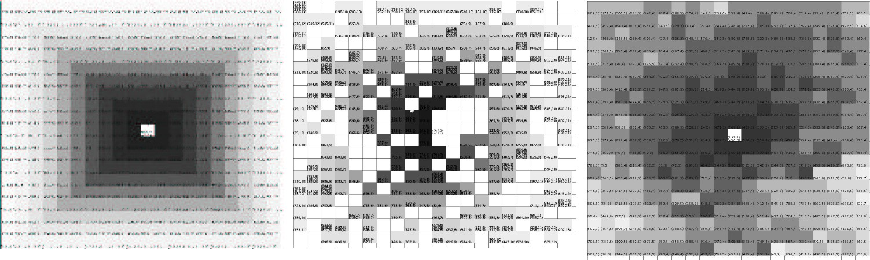
TAG: Results
Simple
Random
Realistic

Slide 111
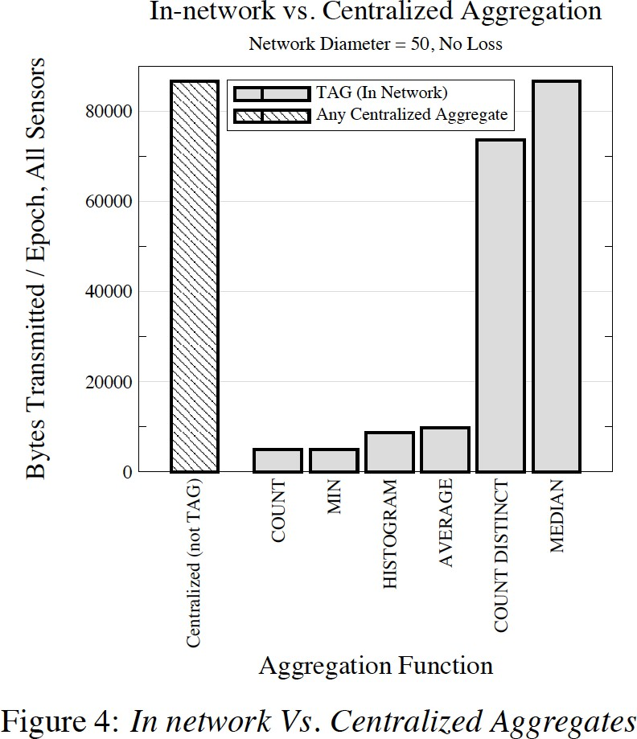
TAG: Results

Slide 112
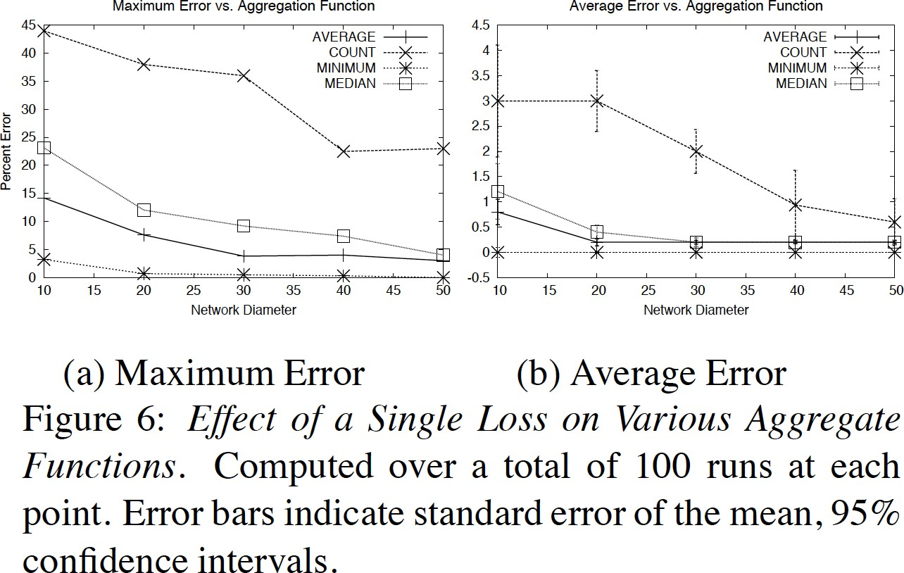
TAG: Results

Slide 113
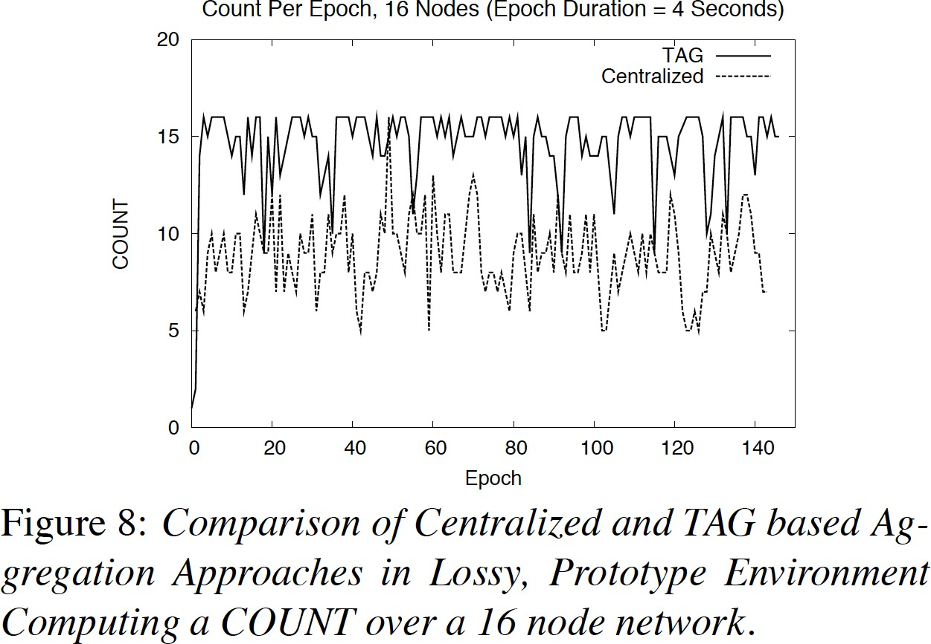
TAG: Results

Slide 114
Result Summary
Application protocols very specific
CoAP as flexible application protocol
Query processing systems for simple “programming”

Slide 115
Reference
[Madden04] S. Madden and J. Gehrke, “Query Processing in Sensor Networks”, IEEE Pervasive Computing, vol. 3, No. 1., March 2004.
[Madden02] S. Madden et al., “TAG: A Tiny Aggregation Service for Ad-Hoc Sensor Networks”, in Proc. of OSDI, 2002
[Yao] Yong Yao, Johannes Gehrke, “The Cougar Approach to In-Network Query Processing in Sensor Networks”, Sigmod Record, Volume 31, Number 3.
September 2002
[Gubbi] Jayavardhana Gubbi, Rajkumar Buyya, Slaven Marusic, Marimuthu Palaniswami, “Internet of Things (IoT): A Vision, Architectural Elements, and Future Directions”, Technical Report CLOUDS-TR-2012-2, Cloud Computing and Distributed Systems Laboratory, The University of Melbourne, June 29, 2012

Slide 116
Mauliate Godang

