Slide 1
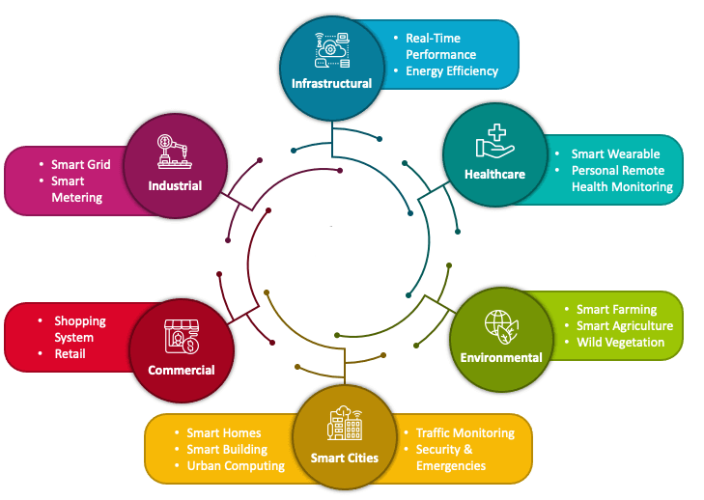

Internet of Things
PDS
https://github.com/siagianp
https://www.youtube.com/@AmelOline/videos
https://github.com/amelcharolinesgn2/IoT_simulator-mqtt-NodeRed
https://github.com/amelcharolinesgn2/Cloud-Infrastructures
https://github.com/amelcharolinesgn2/ClouD-Infrastructure-SISKA-2025
https://github.com/amelcharolinesgn2/IoT_app-and-Modules
Notes:
https://www.vturesource.com/vtu-syllabus/CS/2018/8/18CS81
AWS : IoT Device Simulator https://aws.amazon.com/solutions/implementations/iot-device-simulator/?did=sl_card&trk=sl_card
https://aws.amazon.com/s3/
https://www.vturesource.com/vtu-syllabus/CS/2018/8/18CS81
https://www.simplilearn.com/pgp-full-stack-web-development-certification-training-course?utm_campaign=Skillup-IOT-6mBO2vqLv38&utm_medium=Comments&utm_source=youtube

Slide 2
Internet of Things
Arsitektur IoT
Basic Technologies
IoT Simulation
Notes:
PDS

Slide 3
Arsitektur IoT
Network Layer
Content Layer
User interface devices (e.g. computer screens, PoS stations, tablets, smart glasses, smart surfaces)
Hardware: CPS, machines, sensors
Service Layer
Device Layer
Applications, software to analyze data and transform it into actionable information
Communications protocols, Wi-Fi, Bluetooth, LoRa, cellular
Notes:
PDS

Slide 4
Arsitektur IOT
Arsitektur IOT : NODE
Sensors
Protocol
Wireless Link + Protocol
Server
Nodes
Gateway
Services
Nodes
Controller, Memory, Power Management
Notes:
PDS

Slide 5
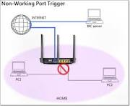
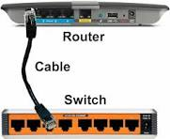
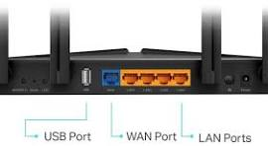
Arsitektur IOT : Gateway
BT Ethernet
Connect
Data Sensor
Data Pasien
Data GPS
………….
SMS
Ethernet
Next.. Devices
Ethernet Connect UK adalah layanan Ethernet Wide Area Network (WAN) lapisan 2 generasi berikutnya, adaptif, dan berkinerja tinggi
Notes:
PDS

Slide 6
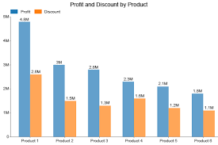
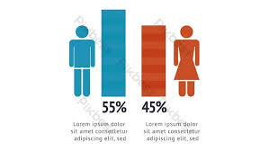
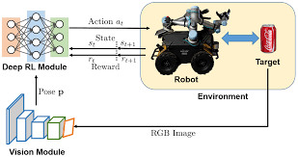
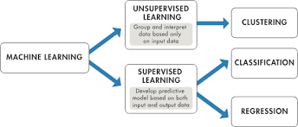
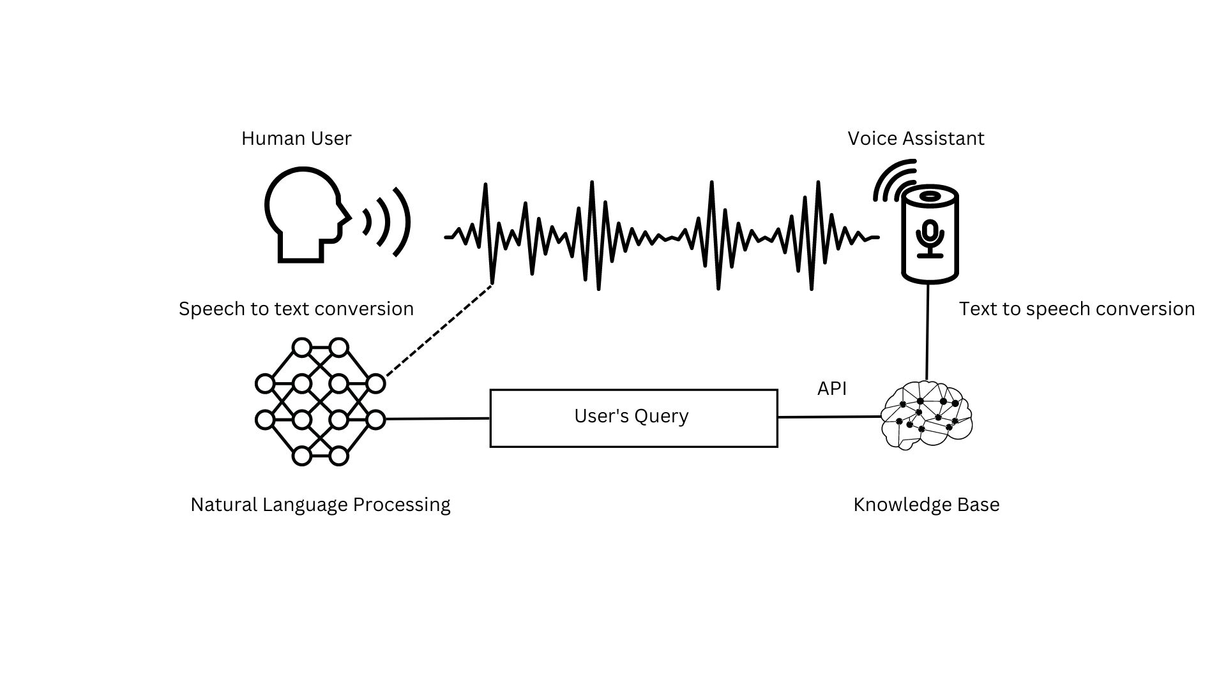

Arsitektur IOT : Services
Visualization Graph
Machine Learning
Alerting
Input
Storage,
Process
Output
Data Sensor
Data Pasien
Data GPS
………….
Dataset
Notes:
PDS

Slide 7
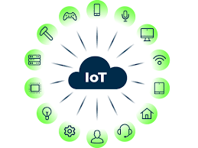
BASIC TECHNOLOGIES
Things
Data Analytics
Gateways/Cloud Gateways
Big Data Warehouse
Streaming Data Processor
Machine Learning
Data Lake
User Application

Slide 8
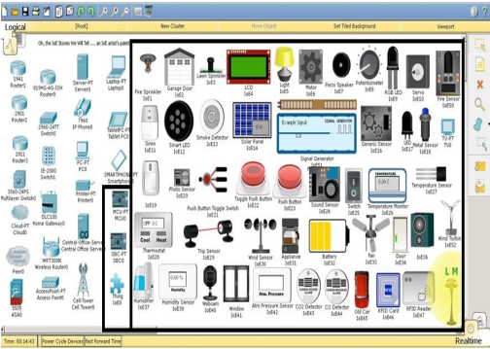
PACKET TRACER IOT SIMULATION
Notes:
PDS

Slide 9
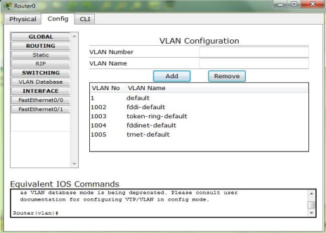
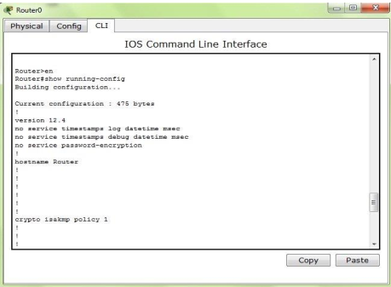
Packet Tracer DEVICE CONFIGURATION METHOD
Notes:
PDS

Slide 10
Packet Tracer Protocols
Layer | Protocols
Application | FTP,SMTP, POP3, HTTP, TFTP, Telnet, SSH, DNS, DHCP, NTP, SNMP,AAA, ISR VOIP, SCCP config and calls ISR command support, Call Manager Express
Transport | TCP and UDP, TCP Nagle Algorithm & IP Fragmentation, RTP
Network | BGP, IPv4, ICMP, ARP, IPv6, ICMPv6, IPSec, RIPv1/ v2/ng, Multi Area OSPF, EIGRP, Static Routing, Route Redistribution, Multilayer Switching, L3 QoS, NAT, CBAL, Zone-based policy firewall and Intrusion Protection System on the ISR, GRE VPN, IPSec VPN
Network Access/ Interface | Interface Ethernet (802.3), 802.11, HDLC, Frame Relay, PPP, PPPoE, STP, RSTP, VTP, DTP, CDP, 802.1q, PAgP, L2 QoS, SLARP, Simple WEP, WPA, EAP
Notes:
PDS

Slide 11
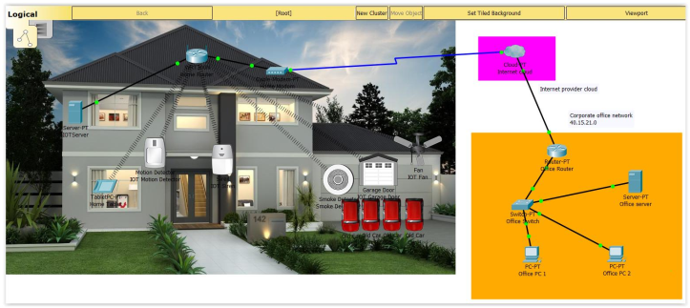
Ex: SMART HOME
Notes:
PDS

Slide 12
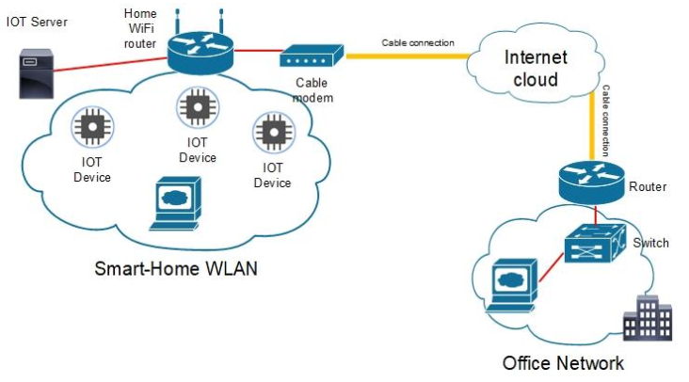
SMART HOME NETWORK TOPOLOGY

Slide 13

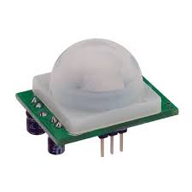
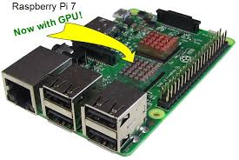

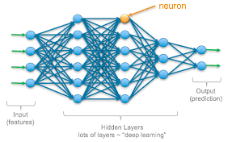

SMART HOME MICROCONTROLLER
Door
Motion Sensor
SBC-PT
Light
Input
Process
Output
Notes:
PDS

Slide 14
EXercise
Jelaskan Cara Kerja Arsitektur IoT ! Disertai dengan bagan/skema/gambar
Buatlah simluasi IoT Smart Home sederhana menggunakan packet tracer. Contoh ada di video.
Alat yang digunakan : 2 Home device (usahakan berbeda dengan device yang ada di video), 1 Home Gateway, 1 Smartphone
Tugas 1 dan 2 dikerjakan di word. Untuk tugas no 2, Capture tiap langkah yang dikerjakan disertai penjelasan
Terdapat 2 file yang dikumpulkan :
File word hasil pengerjaan nomor 1 dan 2
File hasil simulasi di packet tracer (simulasi.pkt)
5. Semua file di jadikan 1 berbentuk rar/zip dan dikumpulkan dengan format :
IoT_namakelas_nim_nama
File di kumpulkan di github/Gd paling lambat tanggal .... Jam ....
Notes:
PDS

Slide 15
Referensi
Journal: IoT
https://www.sciencedirect.com/journal/internet-of-things/vol/25/suppl/C
A smart IoT-based monitoring system in poultry farms using chicken behavioural analysis
In-cabin and outdoor environmental monitoring in vehicular scenarios with distributed computing
Managing a QoS-enabled Bluetooth Mesh network using a Digital Twin Network: An experimental evaluation
Sustainable collaboration: Federated learning for environmentally conscious forest fire classification in Green Internet of Things (IoT)
Notes:
https://internetofthingsagenda.techtarget.com/definition/Industrial-Internet-of-Things-IIoT
https://www.trendmicro.com/vinfo/us/security/definition/industrial-internet-of-things-iiot
https://www.i-scoop.eu/internet-of-things-iot/industrial-internet-things-iiot-saving-costs-innovation/
Yoo, Youngjin; Henfridsson, Ola; Lyytinen, Kalle (2010-12-01). "Research Commentary---The New Organizing Logic of Digital Innovation: An Agenda for Information Systems Research". Information Systems Research. 21 (4): 724–735. doi:10.1287/isre.1100.0322. ISSN 1526-5536.
https://www.iiot-center.org/

Slide 16
Thank You

