Slide 1

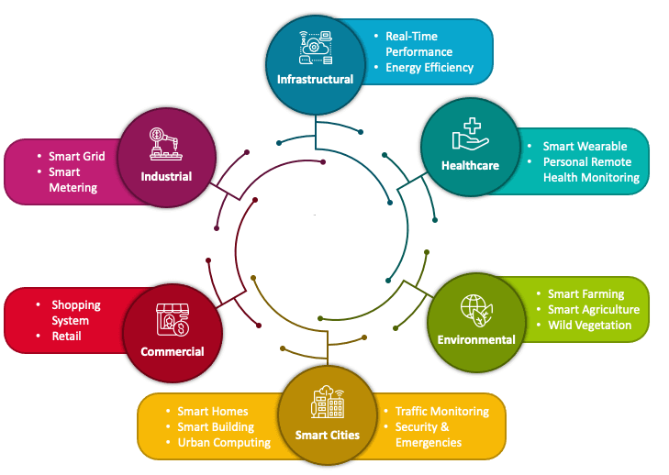
Tools, Apps
Pandapotan Siagian
https://github.com/siagianp
https://www.youtube.com/@AmelOline/videos
https://github.com/amelcharolinesgn2/IoT_simulator-mqtt-NodeRed
https://github.com/amelcharolinesgn2/Cloud-Infrastructures
https://github.com/amelcharolinesgn2/ClouD-Infrastructure-SISKA-2025
https://github.com/amelcharolinesgn2/IoT_app-and-Modules
Notes:
https://www.vturesource.com/vtu-syllabus/CS/2018/8/18CS81
AWS : IoT Device Simulator https://aws.amazon.com/solutions/implementations/iot-device-simulator/?did=sl_card&trk=sl_card
https://aws.amazon.com/s3/
https://www.vturesource.com/vtu-syllabus/CS/2018/8/18CS81
https://www.simplilearn.com/pgp-full-stack-web-development-certification-training-course?utm_campaign=Skillup-IOT-6mBO2vqLv38&utm_medium=Comments&utm_source=youtube

Slide 2
Training
Get Trained And Certified
Keywords
https://mindmajix.com/iot-architecture
Security and Privacy in Internet of Things
IoT network security
IoT cloud integration
IoT low power design
Big data and IoT
Notes:
Sylabus
https://www.coursehero.com/file/59100338/IoT-Network-Architecture-and-Designpptx/

Slide 3
Table Of Content
Application architecture fundamentals
History of Iot
Iot Definition
How IoT works?
What is an example of an Internet of Things device?
IoT benefits to organizations
Why Is Internet of Things (IoT) so important?
Iot Applications
Challenges of Internet of Things (IoT)
Advantages
Disadvantages
References

Slide 4
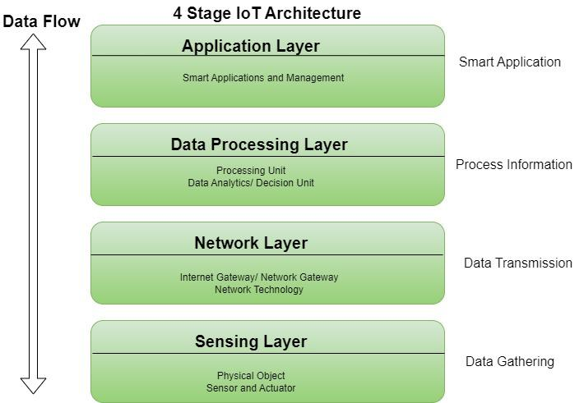

Slide 5
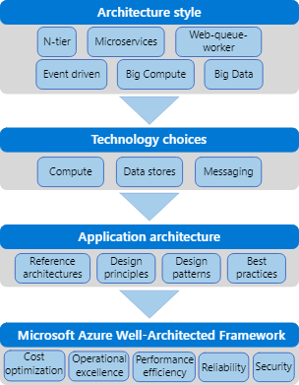
Application architecture fundamentals

Slide 6
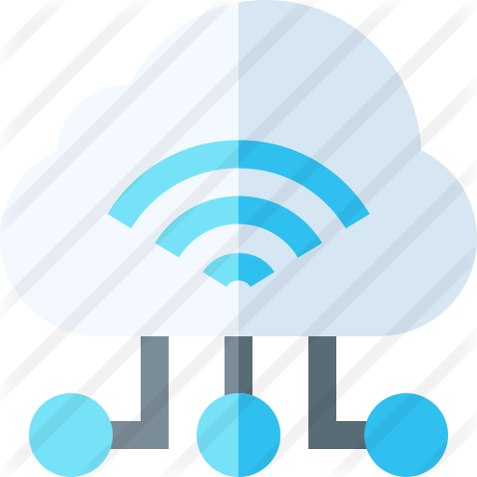
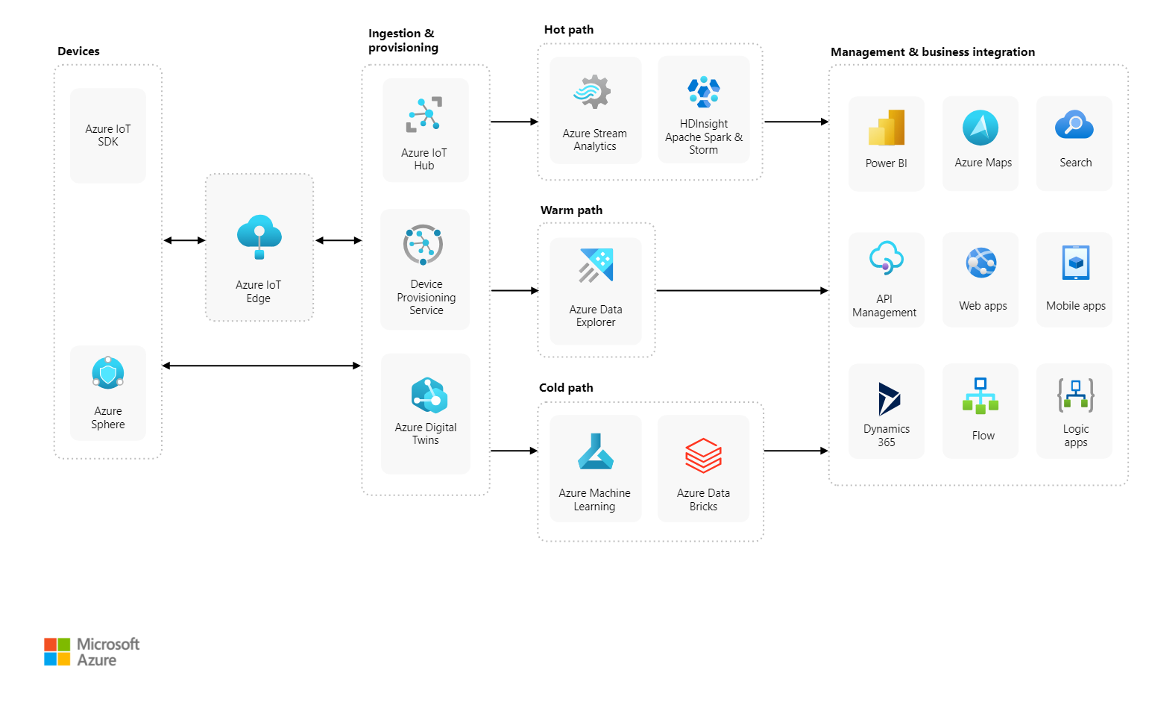
Azure IoT reference architecture
https://learn.microsoft.com/en-us/azure/architecture/reference-architectures/iot
Notes:
https://learn.microsoft.com/en-us/azure/architecture/reference-architectures/iot

Slide 7
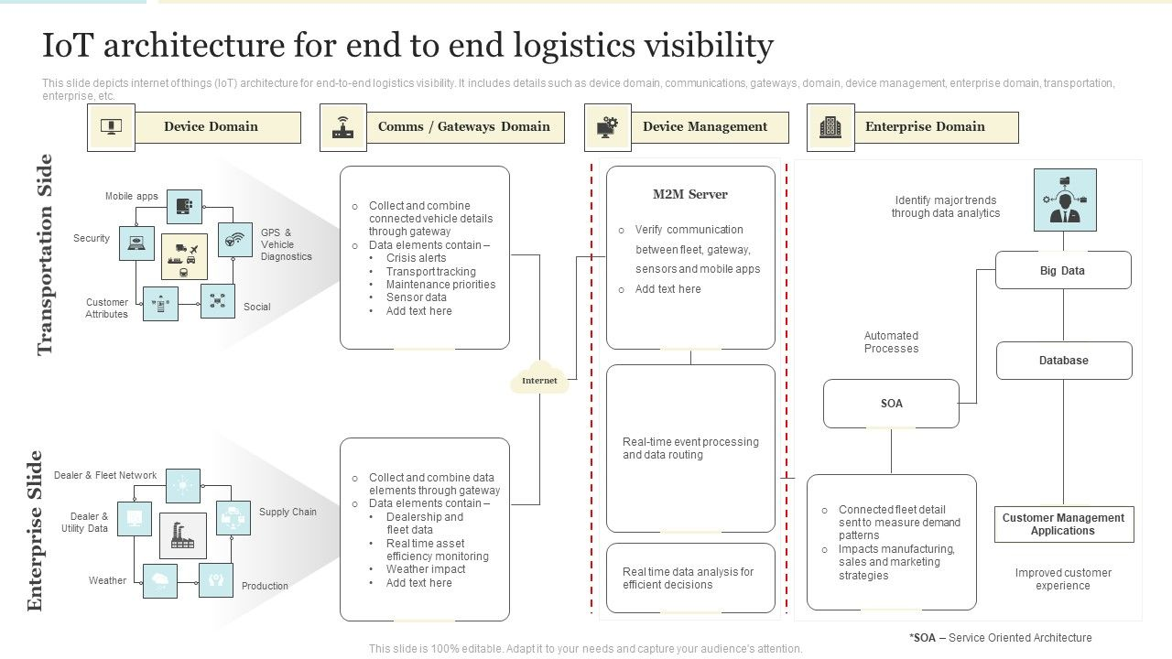
How IoT works?

Slide 8
Thank You

