Slide 1
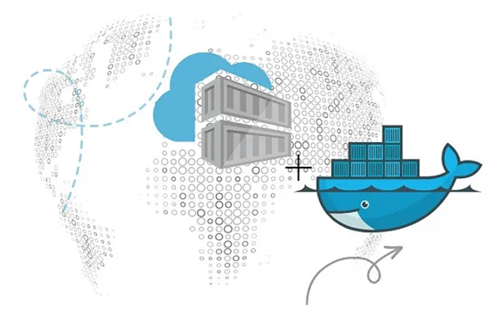
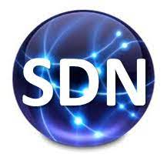
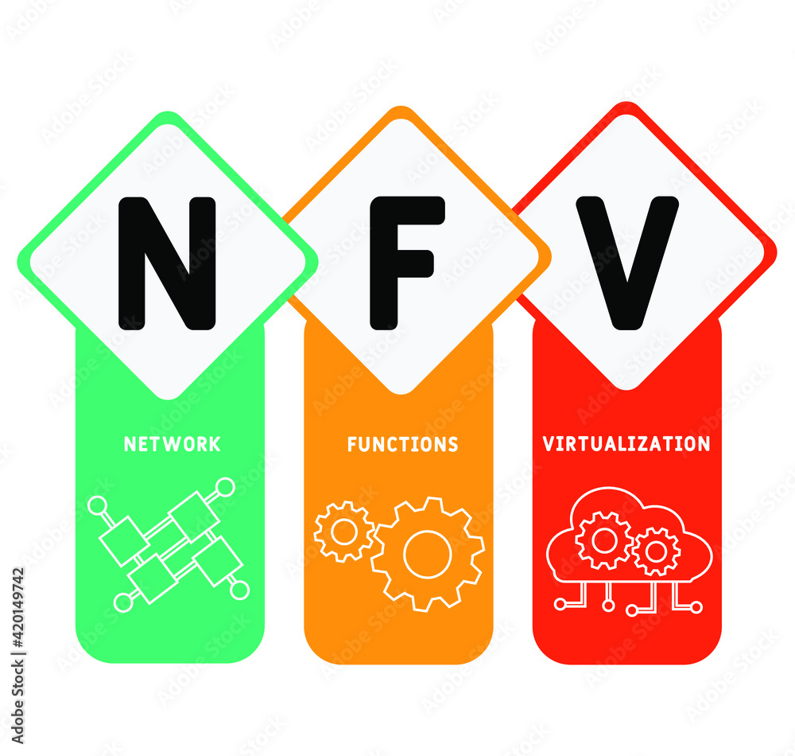
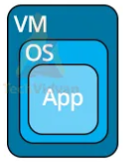
PDS
Computer Vision
Chapter 1:
IoT
INTERNET OF THINGS (IoT) Basic
https://github.com/siagianp
https://www.youtube.com/@AmelOline/videos
https://github.com/amelcharolinesgn2/IoT_simulator-mqtt-NodeRed
https://github.com/amelcharolinesgn2/Cloud-Infrastructures
https://github.com/amelcharolinesgn2/ClouD-Infrastructure-SISKA-2025
Notes:
Performance evaluation of CoAP and MQTT with security support for IoT environments
Author links open overlay panelVictor Seoane
https://www.sciencedirect.com/science/article/pii/S1389128621003364
https://www.mi.fu-berlin.de/inf/groups/ag-tech/teaching/2012-13_WS/L_19528_Embedded_Internet_and_the_Internet_of_Things/08.pdf
https://www.hivemq.com/blog/mqtt-vs-coap-for-iot/
https://thingsboard.io/docs/user-guide/integrations/coap/
Performance evaluation of CoAP and MQTT with security support for IoT environments
Author links open overlay panelVictor Seoane, Carlos Garcia-Rubio
https://www.sciencedirect.com/science/article/pii/S1389128621003364

Slide 2
Outline
Definition of IoT
Characteristics of IoT
Physical design of IoT
Logical design of IoT
IoT protocols
IoT levels and deployment templates
Book website: http://www.internet-of-things-book.com
Bahga & Madisetti, © 2015

Slide 3
Deﬁnition of IoT
A dynamic global network infrastructure with self-conﬁguring capabilities based on standard and interoperable communication protocols where physical and virtual "things" have identities, physical attributes and virtual personalities, use intelligent interfaces, are seamlessly integrated into the information network, and often communicate data associated with users and their environments.
Book website: http://www.internet-of-things-book.com
Bahga & Madisetti, © 2015

Slide 4
Characteristics of IoT
Dynamic and self-adapting
Self-configuring
Interoperable communication protocols
Unique identity
Integrated into the information network
Book website: http://www.internet-of-things-book.com
Bahga & Madisetti, © 2015

Slide 5
Physical Design of IoT
The "Things" in IoT usually refers to IoT devices which have unique identities and can perform remote sensing and actuating and have monitoring capabilities.
IoT devices can:
Exchange data with other connected devices and applications (directly or indirectly), or
Collect data from other devices and process the data locally, or
Send the data to centralized servers or cloud-based application back-ends for processing the data, or
Perform some tasks locally and other tasks within the IoT infrastructure, based on temporal and space constraints
Book website: http://www.internet-of-things-book.com
Bahga & Madisetti, © 2015

Slide 6
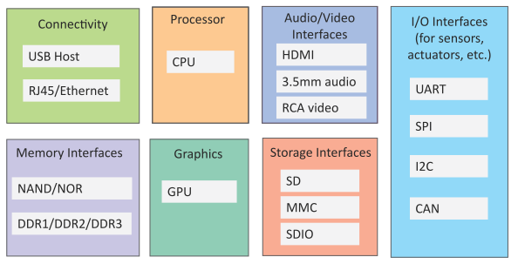
Generic Block Diagram of an IoT Device
An IoT device may consist of several interfaces for connections to other devices, both wired and wireless.
I/O interfaces for sensors
Interfaces for internet connectivity
Memory and storage interfaces
Audio/video interfaces
Book website: http://www.internet-of-things-book.com
Bahga & Madisetti, © 2015

Slide 7
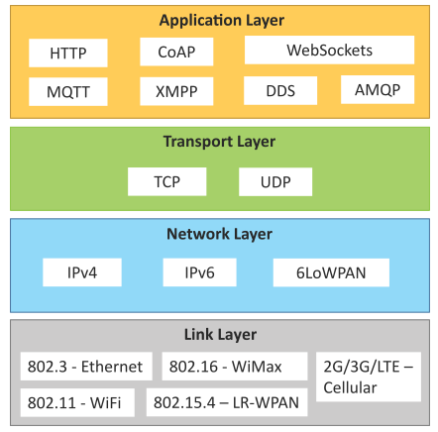
IoT Protocols
Link Layer
802.3 – Ethernet
802.11 – WiFi
802.16 – WiMax
802.15.4 – LR-WPAN
2G/3G/4G
Network/Internet Layer
IPv4
IPv6
6LoWPAN
Transport Layer
TCP
UDP
Application Layer
HTTP
CoAP
WebSocket
MQTT
XMPP
DDS
AMQP
Book website: http://www.internet-of-things-book.com
Bahga & Madisetti, © 2015

Slide 8
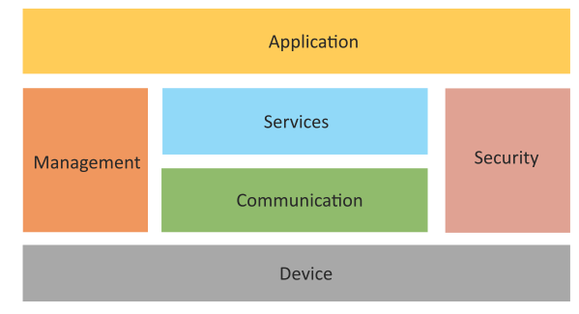
Logical Design of IoT
Logical design of an IoT system refers to an abstract representation of the entities and processes without going into the low-level specifics of the implementation.
An IoT system comprises a number of functional blocks that provide the system the capabilities for identification, sensing, actuation, communication and management.
Book website: http://www.internet-of-things-book.com
Bahga & Madisetti, © 2015

Slide 9
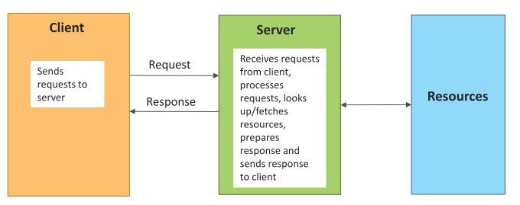
Request–Response Communication Model
Request–Response is a communication model in which the client sends requests to the server and the server responds to the requests.
When the server receives a request, it decides how to respond, fetches the data, retrieves resource representations, prepares the response and then sends the response to the client.
Book website: http://www.internet-of-things-book.com
Bahga & Madisetti, © 2015

Slide 10
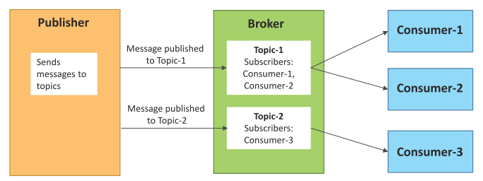
Publish–Subscribe Communication Model
Publish–Subscribe is a communication model that involves publishers, brokers and consumers.
Publishers are the source of data. Publishers send the data to the topics which are managed by the broker. Publishers are not aware of the consumers.
Consumers subscribe to the topics which are managed by the broker.
When the broker receives data for a topic from the publisher, it sends the data to all the subscribed consumers.
Book website: http://www.internet-of-things-book.com
Bahga & Madisetti, © 2015

Slide 11
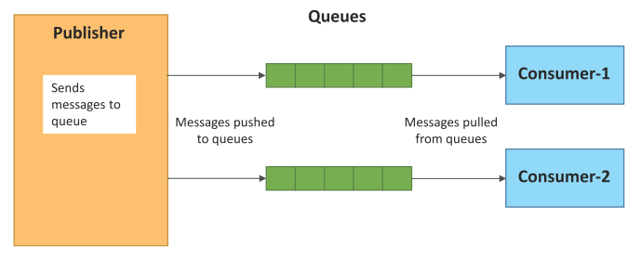
Push–Pull Communication Model
Push–Pull is a communication model in which the data producers push the data to queues and the consumers pull the data from the queues. Producers do not need to be aware of the consumers.
Queues help in decoupling the messaging between the producers and consumers.
Queues also act as a buffer which helps in situations when there is a mismatch between the rate at which the producers push data and the rate at which the consumers pull data.
Book website: http://www.internet-of-things-book.com
Bahga & Madisetti, © 2015

Slide 12
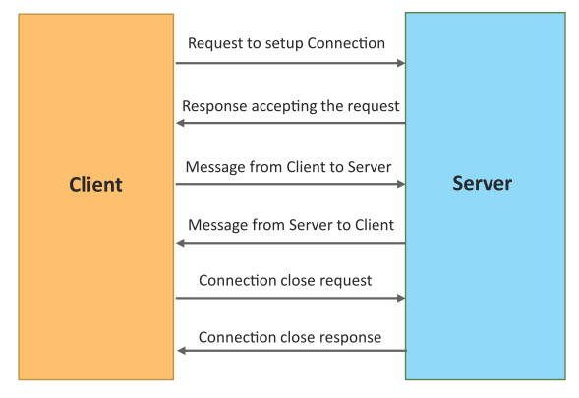
Exclusive Pair Communication Model
Exclusive Pair is a bidirectional, fully duplex communication model that uses a persistent connection between the client and the server.
Once the connection is set up it, remains open until the client sends a request to close the connection.
Client and server can send messages to each other after connection setup.
Book website: http://www.internet-of-things-book.com
Bahga & Madisetti, © 2015

Slide 13
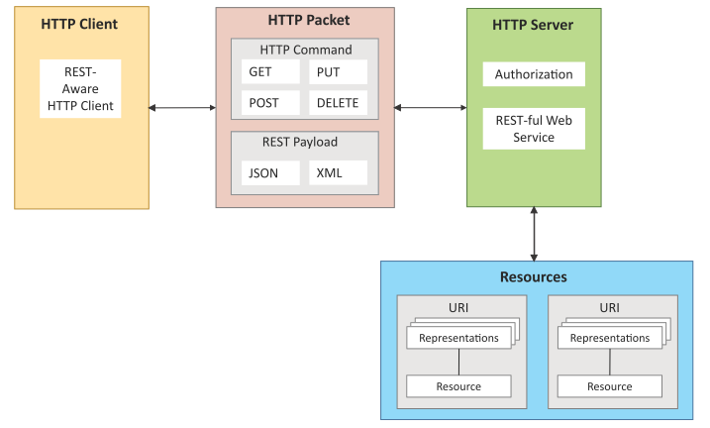
REST-based Communication APIs
Representational State Transfer (REST) is a set of architectural principles by which you can design web services and web APIs that focus on a system’s resources and how resource states are addressed and transferred.
REST APIs follow the request–response communication model.
REST architectural constraints apply to the components, connectors and data elements within a distributed hypermedia system.
Book website: http://www.internet-of-things-book.com
Bahga & Madisetti, © 2015

Slide 14
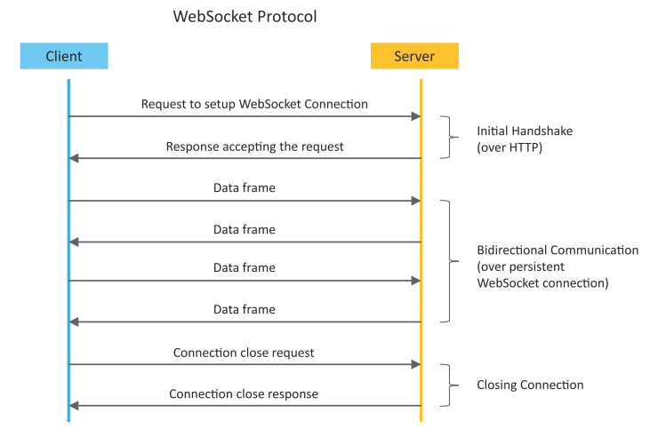
WebSocket-based Communication APIs
WebSocket APIs allow bi-directional, full duplex communication between clients and servers.
WebSocket APIs follow the exclusive pair communication model.
Book website: http://www.internet-of-things-book.com
Bahga & Madisetti, © 2015

Slide 15
IoT Levels and Deployment Templates
An IoT system comprises the following components:
Device: An IoT device allows identiﬁcation, remote sensing, actuating and remote monitoring capabilities.
Resource: Resources are software components on the IoT device for accessing, processing and storing sensor information, or for controlling actuators connected to the device. Resources also include the software components that enable network access for the device.
Controller Service: Controller service is a native service that runs on the device and interacts with the web services. Controller service sends data from the device to the web service and receives commands from the application (via web services) for controlling the device.
Book website: http://www.internet-of-things-book.com
Bahga & Madisetti, © 2015

Slide 16
IoT Levels and Deployment Templates
Database: Database can be either local or in the cloud and stores the data generated by the IoT device.
Web Service: Web services serve as a link between the IoT device, application, database and analysis components. Web service can be implemented using HTTP and REST principles (REST service) or using the WebSocket protocol (WebSocket service).
Analysis Component: This is responsible for analyzing the IoT data and generating results in a form that is easy for the user to understand.
Application: IoT applications provide an interface that the users can use to control and monitor various aspects of the IoT system. Applications also allow users to view the system status and the processed data.
Book website: http://www.internet-of-things-book.com
Bahga & Madisetti, © 2015

Slide 17
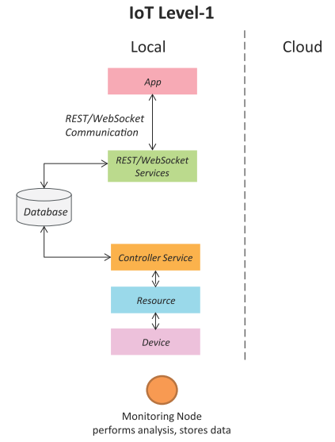
IoT Level-1
A level-1 IoT system has a single node/device that performs sensing and/or actuation, stores data, performs analysis and hosts the application.
Level-1 IoT systems are suitable for modelling low-cost and low-complexity solutions where the data involved is not big and the analysis requirements are not computationally intensive.
Book website: http://www.internet-of-things-book.com
Bahga & Madisetti, © 2015

Slide 18
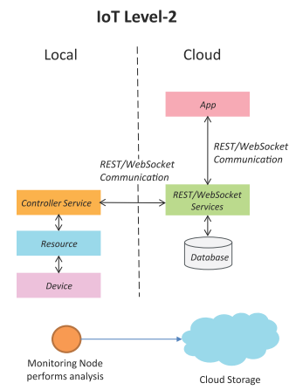
IoT Level-2
A level-2 IoT system has a single node that performs sensing and/or actuation and local analysis.
Data is stored in the cloud and the application is usually cloud-based.
Level-2 IoT systems are suitable for solutions where the data involved is big; however, the primary analysis requirement is not computationally intensive and can be done locally.
Book website: http://www.internet-of-things-book.com
Bahga & Madisetti, © 2015

Slide 19
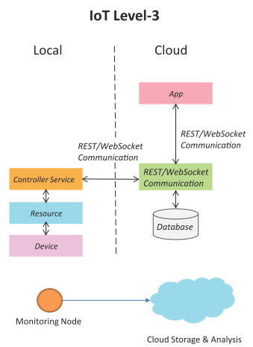
IoT Level-3
A level-3 IoT system has a single node. Data is stored and analyzed in the cloud and the application is cloud-based.
Level-3 IoT systems are suitable for solutions where the data involved is big and the analysis requirements are computationally intensive.
Book website: http://www.internet-of-things-book.com
Bahga & Madisetti, © 2015

Slide 20
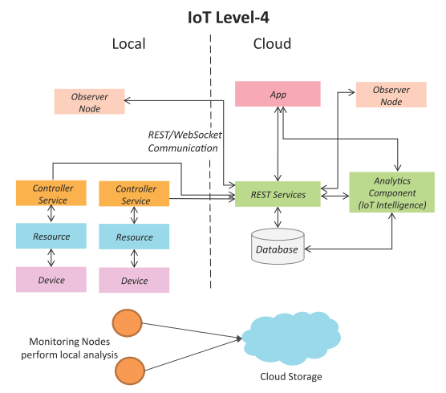
IoT Level-4
A level-4 IoT system has multiple nodes that perform local analysis. Data is stored in the cloud and the application is cloud-based.
Level-4 contains local and cloud-based observer nodes which can subscribe to and receive information collected in the cloud from IoT devices.
Level-4 IoT systems are suitable for solutions where multiple nodes are required, the data involved is big and the analysis requirements are computationally intensive.
Book website: http://www.internet-of-things-book.com
Bahga & Madisetti, © 2015

Slide 21
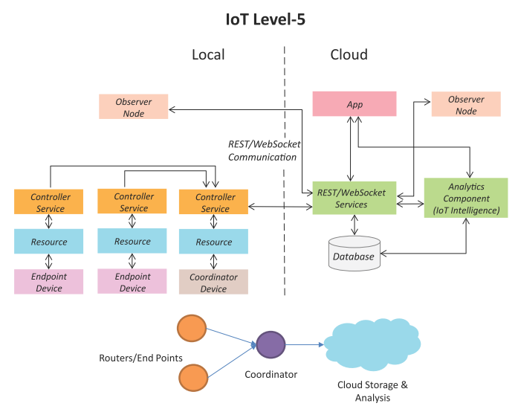
IoT Level-5
A level-5 IoT system has multiple end nodes and one coordinator node.
The end nodes perform sensing and/or actuation.
The coordinator node collects data from the end nodes and sends it to the cloud.
Data is stored and analyzed in the cloud and the application is cloud-based.
Level-5 IoT systems are suitable for solutions based on wireless sensor networks, in which the data involved is big and the analysis requirements are computationally intensive.
Book website: http://www.internet-of-things-book.com
Bahga & Madisetti, © 2015

Slide 22
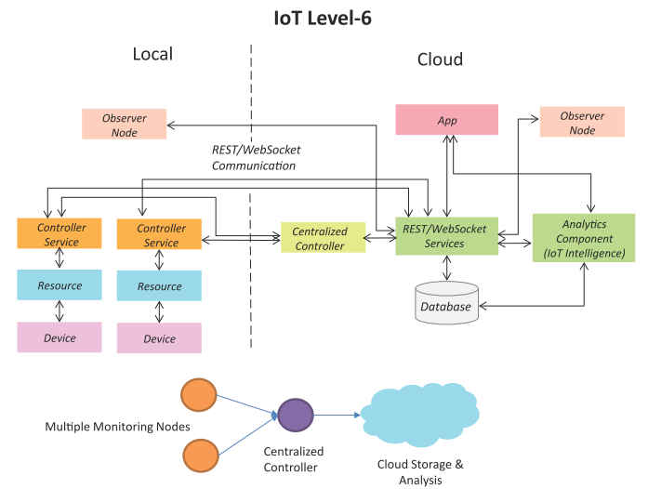
IoT Level-6
A level-6 IoT system has multiple independent end nodes that perform sensing and/or actuation and send data to the cloud.
Data is stored in the cloud and the application is cloud-based.
The analytics component analyzes the data and stores the results in the cloud database.
The results are visualized with the cloud-based application.
The centralized controller is aware of the status of all the end nodes and sends control commands to the nodes.
Book website: http://www.internet-of-things-book.com
Bahga & Madisetti, © 2015

Slide 23
Thank you!
PDS
Computer Vision
Thank you For being a great class!
https://github.com/siagianp
https://www.youtube.com/@AmelOline/videos
https://github.com/amelcharolinesgn2/IoT_simulator-mqtt-NodeRed
https://github.com/amelcharolinesgn2/Cloud-Infrastructures
https://github.com/amelcharolinesgn2/ClouD-Infrastructure-SISKA-2025
Notes:
https://medium.com/buildpiper/simplifying-containerization-with-docker-run-command-2f74e114f42a
https://github.com/IBA-Group-IT/IoT-data-simulator
https://www.bevywise.com/blog/docker-mqtt-broker-easy-service-manageability/

