Slide 1
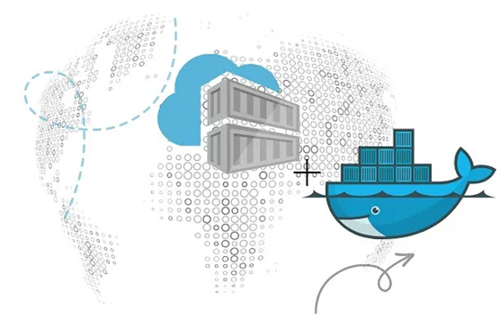


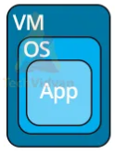
PDS
Computer Vision
Chapter 5_4-Q1:
MQTT for IoT
Message Queuing Telemetry Transport
(Internet of Things)
https://github.com/siagianp
https://www.youtube.com/@AmelOline/videos
https://github.com/amelcharolinesgn2/IoT_simulator-mqtt-NodeRed
https://github.com/amelcharolinesgn2/Cloud-Infrastructures
https://github.com/amelcharolinesgn2/ClouD-Infrastructure-SISKA-2025
Notes:
https://www.mi.fu-berlin.de/inf/groups/ag-tech/teaching/2012-13_WS/L_19528_Embedded_Internet_and_the_Internet_of_Things/08.pdf
https://www.hivemq.com/blog/mqtt-vs-coap-for-iot/

Slide 2





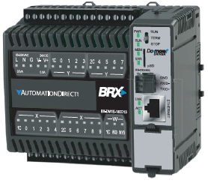



MQTT Fundamentals
Subscribe
Publish
Subscribe
Publish
MQTT Broker
Publish
Subscribe
Publish
Publish
Publish
Subscribe
Publish

Slide 3
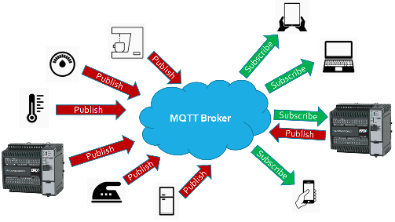
MQTT Terminology (1 of 2)
MQTT Broker
Receives published topics
Distributes topics to subscribers
Keeps Client connections alive
Sends Last Will & Testament (LWT) to subscribers if a Client “ungracefully disconnects”
MQTT Client
Can publish topic(s), keep-alive time, Retain bit, QoS, Last Will & Testament
Can subscribe to topic(s)
Topic
Name of the data
Payload
Actual data
Message
Topic + Payload
QoS (Quality of Service)
0 = At most once (BRX always, publish & subscribe): transmits message once (relies on TCP)
1 = At least once : transmits message until it is acknowledged by receiver (may receive more than one)
2 = Exactly once: transmits message, needs “received” message, asks if it can be “released,” needs “complete” message

Slide 4
MQTT Terminology (2 of 2)
Publish
To send a Topic w/Payload to MQTT Broker
Subscribe
To request a Topic w/Payload update from MQTT Broker
Retain
Asks MQTT Broker to save the Topic w/Payload even after sending it to all the subscribing Clients
Keep-alive Time
How often Broker “pings” client to see if he’s there
Last Will & Testament (LWT)
Topic w/Payload initially sent by an MQTT Client to the MQTT Broker for the Broker to send to other Clients if he is “ungracefully disconnected”

Slide 5
MQTT Data Exchange
MQTT Broker
Publishers are fundamentally separate from Subscribers
Publishers only care about getting data to Broker
Broker is fully responsible for getting data to Subscribers
Clients connect to an MQTT Broker (TCP/IP, MQTT)
Clients can publish data to topics, e.g.
host/office/greg/temp, 72.3
Clients subscribe to topics, e.g.
host/office/greg/temp
NOTE: MQTT supports wildcards for topics, but BRX doesn’t
Clients receive (from Broker) all data published to topics they subscribe to
Data can be anything (in BRX it can only be strings)
Publish
Subscribe
host/office/greg/temp

Slide 6
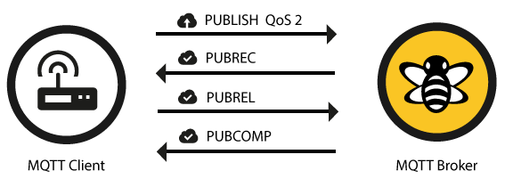
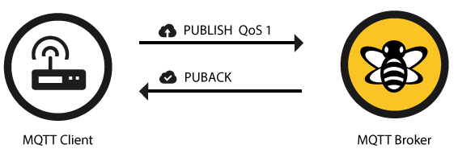
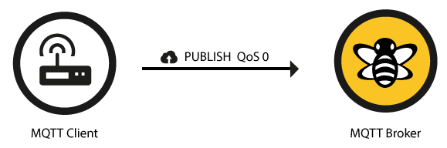
MQTT Quality of Service (QoS)
Financial Transactions
Basic Peer-to-peer
BRX Uses QoS = 0 for publish & subscribe
(Lowest Bandwidth)
0: At most once
1: At least once
2: Exactly once

Slide 7
MQTT Broker – EXAMPLE
LWT sent to Client #3
Broker sends Topic1 to #3
MQTT Client #1
Connect
MQTT Broker
Connect
MQTT Client #3
No Subscribers
Topic1 (data), R1
CLIENT LIST:
Subscribe
Topic1
Publish
(data)
(data)
Topic2 (data), R0
#1-KAT:1s
#4-KAT:30s
Topic3
(data)
Topic3 is retained
Client#4 needs Topic6
Client #1 is abruptly cut off!
#3-KAT:5s
#2-KAT:30s
If Client #1 had disconnected in a normal way: 1. Broker deletes LWT (Topic3)
2. Broker does not send Topic3 to anyone
LWT:
Topic3 (data), R1
TOPIC LIST:
SUBSCRIBE:
Topic2 not retained
Topic1 (data)
#3: T1, T3
Topic2 not retained
Broker sends Topic1 to #4
Topic2 data changes so Client publishes change
Topic2 (data)
#4: T1, T2, T6
Broker sends Topic6 to #4
Broker sends Topic2 to #4
Topic4 (data)
Topic1 exists & is retained
Topic3 not sent because it is LWT & #1 is still alive
Connect
Connect
Topic5 (data)
MQTT Client #4
MQTT Client #2
Topic3 is retained
Topic4 (data), R0
Topic6 (data)
Topic2 & Topic6 do not exist
Subscribe
Client#4 needs Topic2
(data)
Topic1
(data)
Topic5 (data), R0
Publish
LWT:
Topic2
(data)
Topic4, 5 & 6 not retained
Topic6
Topic6 (data), R0
#1: Topic3 (data)
(data)

Slide 8
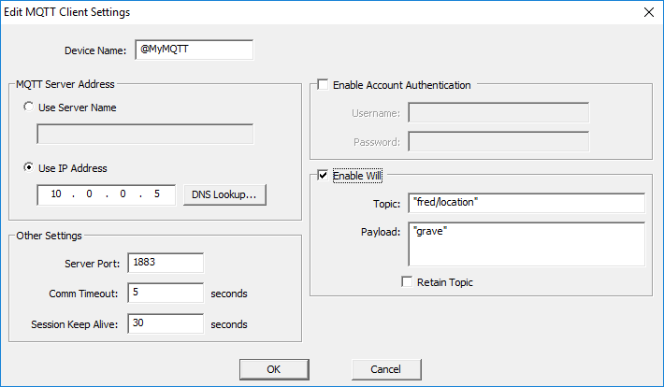
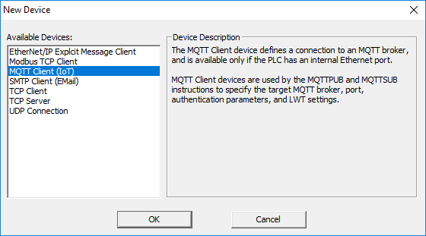
MQTT in BRX (Configuration)
Must create MQTT Client Device
Device Name
Referenced by the MQTTPUB & MQTTSUB instructions
MQTT Server Address
Use Server Name
URL of Broker; will be resolved when instructions are executed
Use IP Address
IP address of Broker
Other Settings
Server Port
1883 (MQTT default)
Comm Timeout
How long Device will wait for response from Broker before an error
Session Keep Alive
Client tells Broker this time upon connection
If Client doesn’t talk to Broker in this time period, Broker will ping him to make sure he’s still there.

Slide 9
MQTT in BRX (Configuration)
Enable Account Authentication
Some MQTT Brokers require authentication with Username & Password
Enable Will
If Client is “ungracefully disconnected” from Broker, Broker will send this Topic to any Client that has subscribed to it
Topic:
Text name of Topic of Last Will & Testament
Payload:
Text of the data of the Last Will & Testament
Retain Topic
If this is checked, and this Client is “ungracefully disconnected,” Broker will hold this value and send it to any other Client who subscribes to the Topic in the future

Slide 10
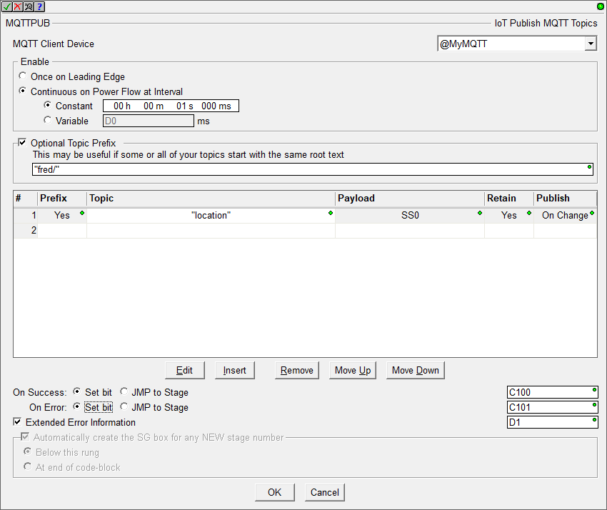
MQTTPUB “IoT Publish MQTT Topics”
MQTTPUB “IoT Publish MQTT Topics”
MQTT Client Device
MQTT Device name you just created
Enable
Once on Leading Edge
Makes TCP connection to Broker
Publishes listed Topics
Disconnects from Broker
Continuous on Power Flow at Interval
Constant or Variable
Every interval, instruction scans list & does what each Topic’s Publish rule states

Slide 11
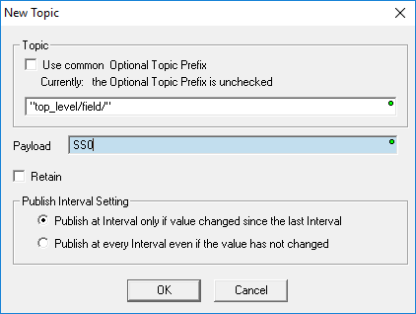
MQTTPUB “IoT Publish MQTT Topics”
Optional Topic Prefix
Prepended text for all Topics in list
Topic List
Up to 50 Topics to publish
When instruction is executed each Topic in list is published according to Publish Interval Setting rule
Topic
Use common Optional Topic Prefix – check to use the prepended text
Enter a name for a Topic that makes sense to you
Payload - Enter the string element or a literal string in quotes
Retain – tells the MQTT server you want this Topic to be retained
NOTE: to delete a retained Topic from the MQTT server, send another Retained Topic with an empty Payload (e.g. “”, or an empty string Element)
Publish Interval Setting
Publish at Interval only if value changed since the last Interval
Publish at every Interval even if the value has not changed

Slide 12
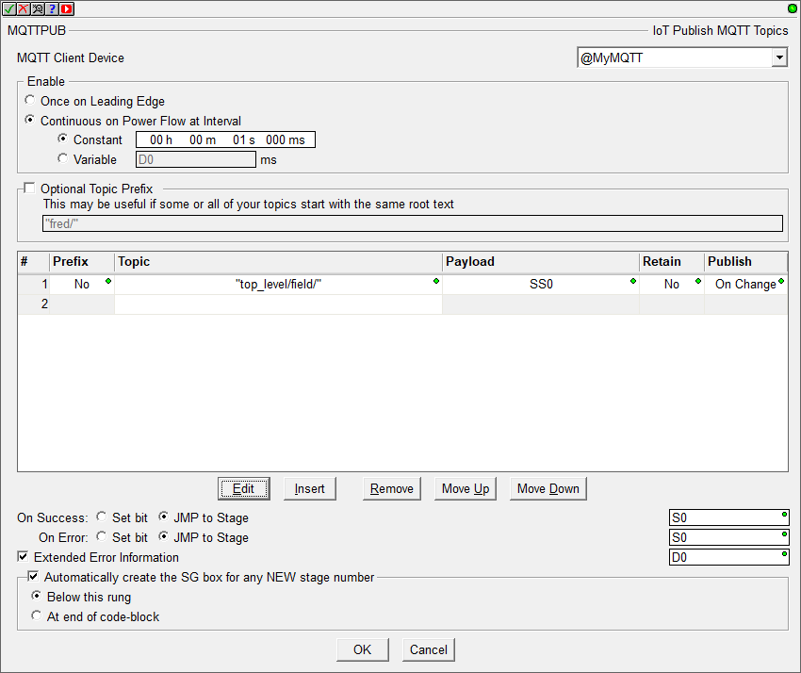
MQTTPUB “IoT Publish MQTT Topics”
On Success and On Error
Set a bit, or JMP to Stage
Extended Error Information
Must be a double-word
Upper word contains entry number of the first Topic that failed (e.g. D0:W1)
Lower word contains error code (e.g. D0:W0)
Ladder Stage editing helper
Automatically create the SG box for any NEW stage number – if either of the On Success or On Error selection is “JMP to Stage” this option can be checked
Below this rung
At end of code-block
VALUE | ERROR | DESCRIPTION
0 | <none> | <none>
57 | Unexpected MQTT Response | MQTT Broker response not properly formed
58 | MQTT Broker rejected | MQTT Broker refused Topic (Username? Password? Security violation?)
59 | Out of resources (MQTTSUB only) | > 10 MQTTSUBs or > 100 Topics using same MQTT Client device
60 | Invalid Topic | Topic is empty
61 | Duplicate Topic | Topic already subscribed to in different MQTTSUB

Slide 13
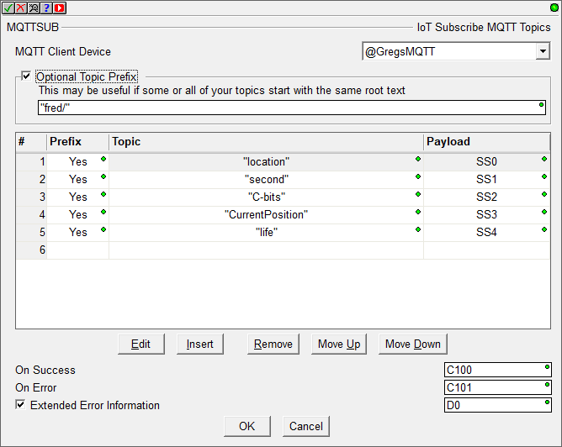
MQTTSUB “IoT Subscribe MQTT Topics”
MQTTSUB “IoT Subscribe MQTT Topics”
MQTT Client Device
MQTT Device name you just created
Enable to subscribe to Topics in the Topic list, and keep enabled for them to constantly update

Slide 14
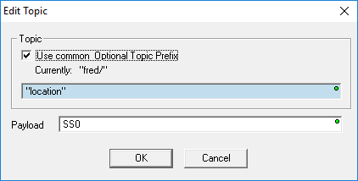
MQTTSUB “IoT Subscribe MQTT Topics”
Optional Topic Prefix
Prepended text for all Topics in list
Topic List
Up to 50 Topics to subscribe to
Topic
Use common Optional Topic Prefix – check to use the prepended text
Enter a name for a Topic you want to subscribe to
Payload - enter the string Element where the Topic’s data will be stored

Slide 15
MQTTSUB “IoT Subscribe MQTT Topics”
Instruction Operation
When 1st enabled:
On Success & On Error bits are turned OFF
NOTE: Instruction must remain enabled for all subscribed Topics to keep updating.
Attempts to subscribe to all Topics
If > 0 successfully subscribed then On Success bit comes ON
If all subscriptions failed then On Error bit comes ON
While kept enabled:
Continuously updates all Topics it receives from MQTT Broker
NOTE: It does NOT try to re-subscribe to Topics that may have failed initially
When disabled:
Attempts to unsubscribe from all Topics
If > 0 successfully unsubscribed then On Success bit comes ON
If all Topics failed to unsubscribe then On Error bit comes ON
If no other MQTTSUB or MQTTPUB instructions are using the MQTT Client Device, then it will cause the MQTT Client to disconnect from the MQTT Broker (TCP disconnect)
Extended Error Information is same as MQTTPUB

Slide 16
Lab
MQTT Simulator
Features • Getting Started • Configuration • Main contributors
DaemonGPU
Notes:
https://github.com/DamascenoRafael/mqtt-simulator
Features
Lightweight and easy-to-configure simulator for publishing data to an MQTT broker
Simple setup with a single JSON configuration file
Publish data on predefined fixed topics
Publish data on multiple topics that have a variable id or items at the end
Simulated random variation of data based on configurable parameters
Real-time event logging during simulation

Slide 17
Thank you!
PDS
Computer Vision
Thank you For being a great class!
https://github.com/siagianp
https://www.youtube.com/@AmelOline/videos
https://github.com/amelcharolinesgn2/IoT_simulator-mqtt-NodeRed
https://github.com/amelcharolinesgn2/Cloud-Infrastructures
https://github.com/amelcharolinesgn2/ClouD-Infrastructure-SISKA-2025
Notes:
https://medium.com/buildpiper/simplifying-containerization-with-docker-run-command-2f74e114f42a
https://github.com/IBA-Group-IT/IoT-data-simulator
https://www.bevywise.com/blog/docker-mqtt-broker-easy-service-manageability/

