Slide 1
VLSM and CIDR

Slide 2
Notes:
If you see any mistake on my PowerPoint slides or if you have any questions about the materials, please feel free to email me at chento@cod.edu.
Thanks!
Tony Chen
College of DuPage
Cisco Networking Academy

Slide 3
Objectives
Compare and contrast classful and classless IP addressing.
Review VLSM and explain the benefits of classless IP addressing.
Describe the role of the Classless Inter-Domain Routing (CIDR) standard in making efficient use of scarce IPv4 addresses
In addition to subnetting, it became possible to summarize a large collection of classful networks into an aggregate route, or supernet.

Slide 4
Introduction
Prior to 1981, IP addresses used only the first 8 bits to specify the network portion of the address
In 1981, RFC 791 modified the IPv4 32-bit address to allow for three different classes
    Class A addresses used 8 bits for the network portion of the address,
    Class B used 16 bits,
    Class C used 24 bits.
  This format became known as classful IP addressing.
IP address space was depleting rapidly
  the Internet Engineering Task Force (IETF) introduced Classless Inter-Domain Routing (CIDR)
      CIDR uses Variable Length Subnet Masking (VLSM) to help conserve address space.
        -VLSM is simply subnetting a subnet

Slide 5
Introduction
With the introduction of CIDR and VLSM, ISPs could now assign one part of a classful network to one customer and different part to another customer.
This discontiguous address assignment by ISPs was paralleled by the development of classless routing protocols.
  Classless routing protocols do include the subnet mask in routing updates and are not required to perform summarization.
  The classless routing protocols discussed in this course are RIPv2, EIGRP and OSPF.

Slide 6
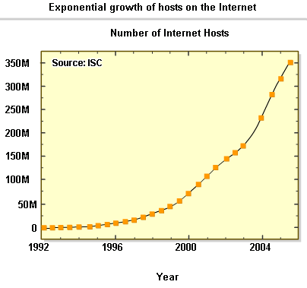
Classful and Classless IP Addressing
Classful IP addressing
  When the ARPANET was commissioned in 1969, no one anticipated that the Internet would explode.
  1989, ARPANET transformed into what we now call the Internet.
  As of January 2007, there are over 433 million hosts on internet
Initiatives to conserve IPv4 address space include:
-VLSM & CIDR notation (1993, RFC 1519)
-Network Address Translation (1994, RFC 1631)
-Private Addressing (1996, RFC 1918)

Slide 7
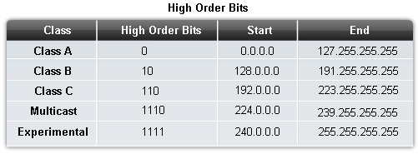
Classful and Classless IP Addressing
Classes of IP addresses are identified by the decimal number of the 1st octet
Class A address begin with a 0 bit
Range of class A addresses = 0.0.0.0 to 127.255.255.255
Class B address begin with a 1 bit and a 0 bit
Range of class B addresses = 128.0.0.0 to 191.255.255.255
Class C addresses begin with two 1 bits & a 0 bit
Range of class C addresses = 192.0.0.0 to 223.255.255.255.

Slide 8
Classful and Classless IP Addressing
Multicast addresses begin with three 1s and a 0 bit. Multicast addresses are used to identify a group of hosts that are part of a multicast group.
IP addresses that begin with four 1 bits were reserved for future use.

Slide 9
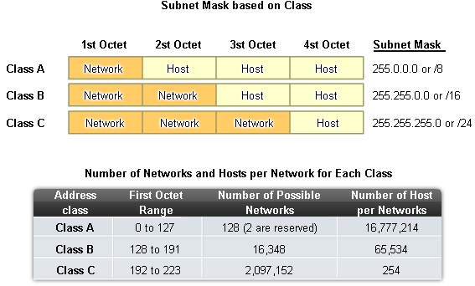
Classful and Classless IP Addressing
The IPv4 Classful Addressing Structure (RFC 790)
An IP address has 2 parts:
-The network portion
Found on the left side of an IP address
-The host portion
Found on the right side of an IP address

Slide 10
Classful and Classless IP Addressing
As shown in the figure, class A networks used the first octet for network assignment, which translated to a 255.0.0.0 classful subnet mask.
  Because only 7 bits were left in the first octet (remember, the first bit is always 0), this made 2 to the 7th power or 128 networks.
  With 24 bits in the host portion, each class A address had the potential for over 16 million individual host addresses.

Slide 11
Classful and Classless IP Addressing
With 24 bits in the host portion, each class A address had the potential for over 16 million individual host addresses.
What was one organization going to do with 16 million addresses?
Now you can understand the tremendous waste of address space that occurred in the beginning days of the Internet, when companies received class A addresses.
Some companies and governmental organizations still have class A addresses.
  General Electric owns 3.0.0.0/8,
  Apple Computer owns 17.0.0.0/8,
  U.S. Postal Service owns 56.0.0.0/8.

Slide 12
Classful and Classless IP Addressing
Class B: RFC 790 specified the first two octets as network.
  With the first two bits already established as 1 and 0, 14 bits remained in the first two octets for assigning networks, which resulted in 16,384 class B network addresses.
  Because each class B network address contained 16 bits in the host portion, it controlled 65,534 addresses. (Remember, 2 addresses were reserved for the network and broadcast addresses.)

Slide 13
Classful and Classless IP Addressing
class C: RFC 790 specified the first three octets as network.
  With the first three bits established as 1 and 1 and 0, 21 bits remained for assigning networks for over 2 million class C networks.
  But, each class C network only had 8 bits in the host portion, or 254 possible host addresses.

Slide 14
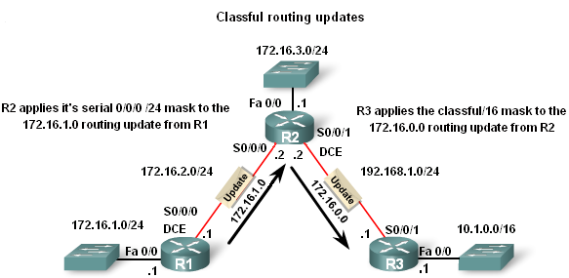
Classful and Classless IP Addressing
Classful Routing Updates
  Recall that classful routing protocols (i.e. RIPv1) do not send subnet masks in their routing updates
  This is because the router receiving the routing update could determine the subnet mask simply by examining the value of the first octet in the network address, or by applying its ingress interface mask for subnetted routes. The subnet mask was directly related to the network address.
/24
/16

Slide 15
Classful and Classless IP Addressing
In the example,
  R1 knows that subnet 172.16.1.0 belongs to the same major classful network as the outgoing interface. Therefore, it sends a RIP update to R2 containing subnet 172.16.1.0.
    When R2 receives the update, it applies the receiving interface subnet mask (/24) to the update and adds 172.16.1.0 to the routing table
  When sending updates to R3, R2 summarizes subnets 172.16.1.0/24, 172.16.2.0/24, and 172.16.3.0/24 into the major classful network 172.16.0.0.
    Because R3 does not have any subnets that belong to 172.16.0.0, it will apply the classful mask for a class B network, /16
/24
/16

Slide 16
Classful and Classless IP Addressing
Classless Inter-domain Routing (CIDR – RFC 1517)
    Advantage of CIDR :
      More efficient use of IPv4 address space
      Route summarization
        (→ reduce routing table size)
        (→ reduce routing update traffic)
    Requires subnet mask to be included in routing update because address class is meaningless
      The network portion of the address is determined by the network subnet mask, also known as the network prefix, or prefix length (/8, /19, etc.).
      The network address is no longer determined by the class of the address
      Blocks of IP addresses could be assigned to a network based on the requirements of the customer, ranging from a few hosts to hundreds or thousands of hosts.

Slide 17
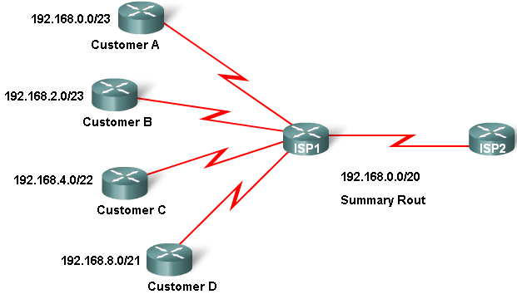
Classful and Classless IP Addressing
Classless IP Addressing
CIDR & Route Summarization
  Variable Length Subnet Masking (VLSM)
  Allows a subnet to be further sub-netted
    according to individual needs
  Prefix Aggregation a.k.a. Route Summarization
  CIDR allows for routes to be summarized as a single route

Slide 18
Classful and Classless IP Addressing
Route Summarization
  In the figure, notice that ISP1 has four customers, each with a variable amount of IP address space.
  However, all of the customer address space can be summarized into one advertisement to ISP2.
  The 192.168.0.0/20 summarized or aggregated route includes all the networks belonging to Customers A, B, C, and D.
    This type of route is known as a supernet route.
    A supernet summarizes multiple network addresses with a mask less than the classful mask.

Slide 19
Classful and Classless IP Addressing
Route Summarization
  Propagating VLSM and supernet routes requires a classless routing protocol, because the subnet mask can no longer be determined by the value of the first octet.
    Classless routing protocols include the subnet mask with the network address in the routing update.
    RIPv2, EIGRP, IS-IS, OSPF and BGP.
Interior:
  RIPv2
  EIGRP
  IS-IS
  OSPF
Exterior:
  BGP

Slide 20
Classful and Classless IP Addressing
Is there any difference between the terms CIDR and VLSM??

Slide 21
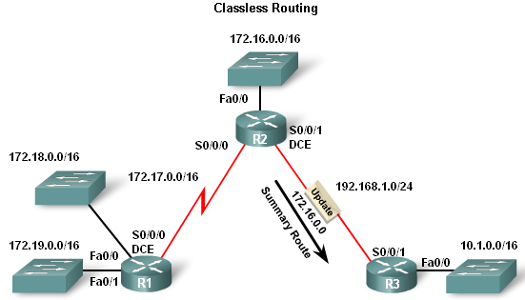
Classful and Classless IP Addressing
For example, the networks 172.16.0.0/16, 172.17.0.0/16, 172.18.0.0/16 and 172.19.0.0/16 can be summarized as 172.16.0.0/14.
  If R2 sends the 172.16.0.0 summary route without the /14 mask, R3 only knows to apply the default classful mask of /16.
  In a classful routing protocol scenario, R3 is unaware of the 172.17.0.0/16, 172.18.0.0/16 and 172.19.0.0/16 networks
  With a classless routing protocol, R2 will advertise the 172.16.0.0 network along with the /14 mask to R3. R3 will then be able to install the supernet route 172.16.0.0/14 in its routing table giving it reachability to the 172.16.0.0/16, 172.17.0.0/16, 172.18.0.0/16 and 172.19.0.0/16 networks.
172.16.0.0 /14

Slide 22
Classful and Classless IP Addressing
Classless Routing Protocol
Routing Protocol | Routing updates Include subnet Mask | Supports VLSM | Ability to send Supernet routes
Classful (RIPv1) | No | No | No
Classless | Yes | Yes | Yes

Slide 23
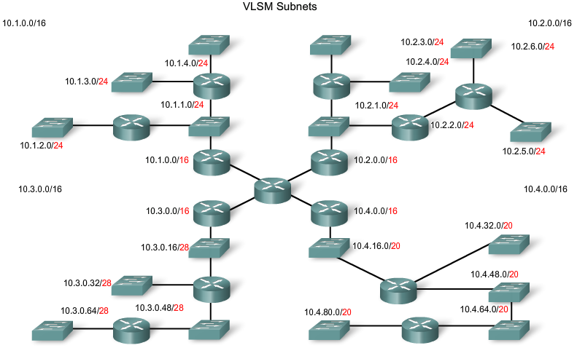
VLSM
Classful routing
  -only allows for one subnet mask for all networks
VLSM & classless routing
-This is the process of subnetting a subnet
-More than one subnet mask can be used
-More efficient use of IP addresses as compared to classful IP addressing

Slide 24
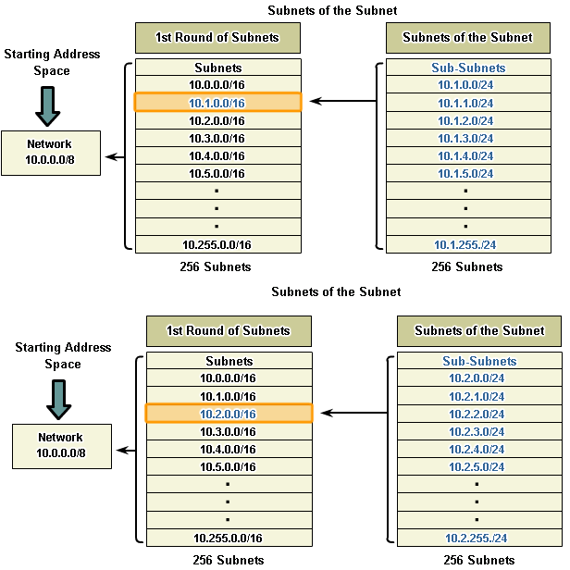
VLSM
VLSM – the process of sub-netting a subnet to fit your needs
-Example:
Subnet 10.1.0.0/16, 8 more bits are borrowed again, to create 256 subnets with a /24 mask.
  -Mask allows for 254 host addresses per subnet
  -Subnets range from: 10.1.0.0 / 24 to 10.1.255.0 / 24
* Same process for Subnet 10.2.0.0/16

Slide 25
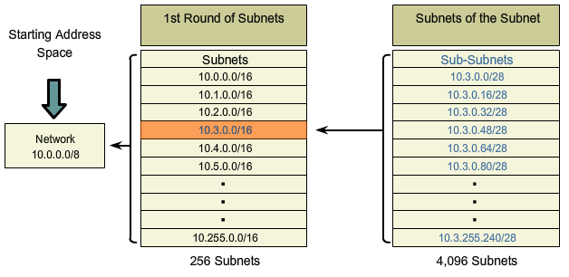
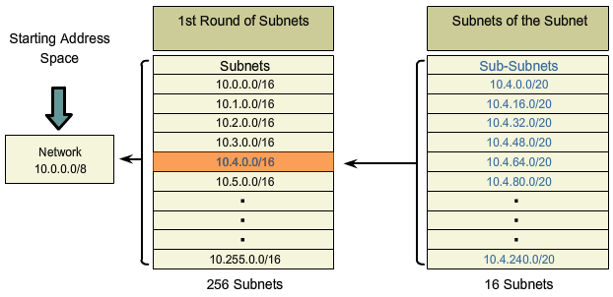
VLSM
Subnet 10.3.0.0/16, 12 more bits are borrowed again, to create 4,096 subnets with a /28 mask.
  Mask allows for 14 host addresses per subnet
  Subnets range from: 10.3.0.0 / 28 to 10.3.255.240 / 28
Subnet 10.4.0.0/16, 4 more bits are borrowed again, to create 16 subnets with a /20 mask.
  Mask allows for 2,046 host addresses per subnet
  Subnets range from: 10.4.0.0 / 20 to 10.4.240.0 / 20

Slide 26
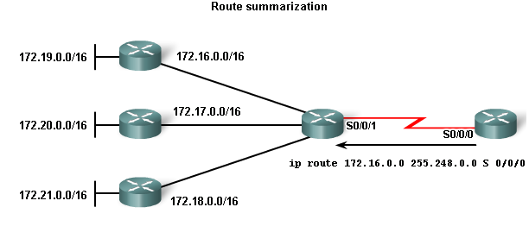
Classless Inter-Domain Routing (CIDR)
Route summarization done by CIDR
-Routes are summarized with masks that are less than that of the default classful mask (supernetting)
-Example:
172.16.0.0 / 13 is the summarized route for the 172.16.0.0 / 16 to 172.23.0.0 / 16 classful networks
Although 172.22.0.0/16 and 172.23.0.0/16 are not shown in the graphic, these are also included in the summary route.

Slide 27
Classless Inter-Domain Routing (CIDR)
Note: You may recall that a supernet is always a route summary, but a route summary is not always a supernet.
  It is possible that a router could have both a specific route entry and a summary route entry covering the same network.
  Let us assume that router X has a specific route for 172.22.0.0/16 using Serial 0/0/1 and a summary route of 172.16.0.0/13 using Serial0/0/0.
  Packets with the IP address of 172.22.n.n match both route entries.
  These packets destined for 172.22.0.0 would be sent out the Serial0/0/1 interface because there is a more specific match of 16 bits, than with the 13 bits of the 172.16.0.0/13 summary route.
ip route 172.22.0.0 255.255.0.0 s 0/0/1
Router X
s 0/0/1

Slide 28
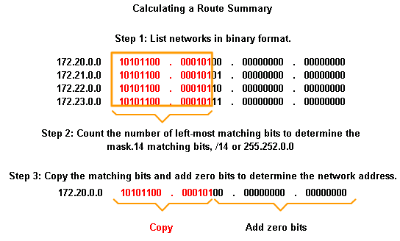
Classless Inter-Domain Routing (CIDR)
Steps to calculate a route summary
1. List networks in binary format
2. Count number of left most matching bits to determine summary route’s mask
3. Copy the matching bits and add zero bits to determine the summarized network address

Slide 29
Example: Calculating a summary route
Which address can be used to summarize networks
A:
  192.168.0.0/30
  192.168.0.4/30
  192.168.0.8/30
  192.168.0.16/29
B
  192.168.4.0/30
  192.168.5.0/30
  192.168.6.0/30
  192.168.7.0/29
11000000 10101000 00000000 00000000
11000000 10101000 00000000 00000100
11000000 10101000 00000000 00001000
11000000 10101000 00000000 00010000
11000000 10101000 00000100 00000000
11000000 10101000 00000101 00000000
11000000 10101000 00000110 00000000
11000000 10101000 00000111 00000000
Answer:

Slide 30
Example: Calculating a summary route
Reverse process of summary route:
  Can you figure what networks are included in 192.168.32.0 /20
11000000 10101000 00100000 00000000
11000000 10101000 00100000 00000000
11000000 10101000 00100001 00000000
11000000 10101000 00100010 00000000
…..
…..
11000000 10101000 00101101 00000000
11000000 10101000 00101110 00000000
11000000 10101000 00101111 00000000
Answer:

Slide 31
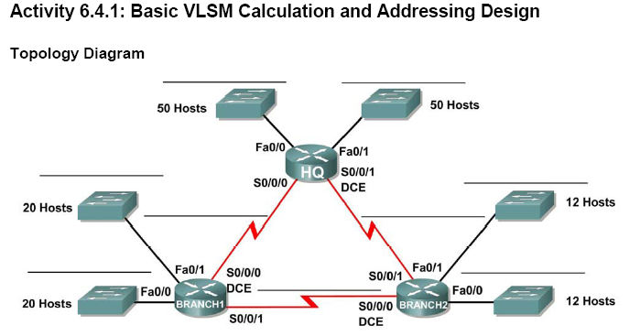
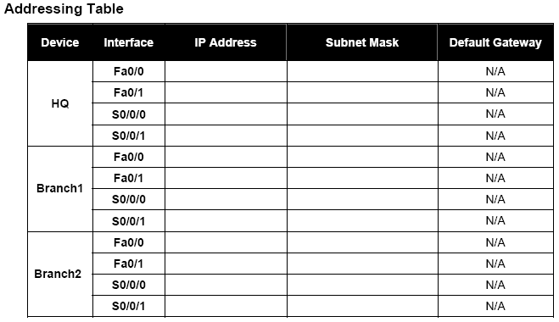
Designing VLSM Addressing 6.4.1
In this activity, you will use the network address 192.168.1.0/24 to subnet and provide the IP addressing for a given topology.

Slide 32
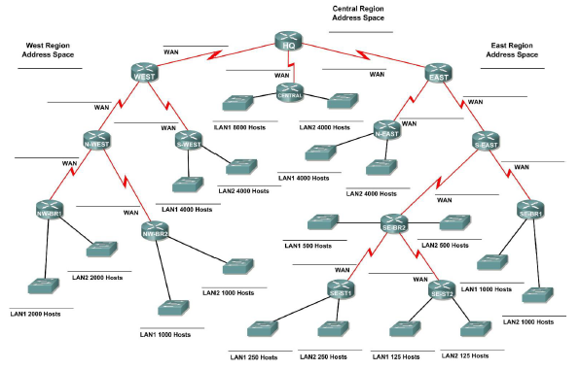
Designing VLSM Addressing 6.4.2
In this activity, you will use the network address 172.16.0.0/16 to subnet and provide the IP addressing for a given topology.

Slide 33
Designing VLSM Addressing 6.4.2
The network has the following addressing requirements:
East Network Section
  The N-EAST (Northeast) LAN1 will require 4000 host IP addresses.
  The N-EAST (Northeast) LAN2 will require 4000 host IP addresses.
  The SE-BR1 (Southeast Branch1) LAN1 will require 1000 host IP addresses.
  The SE-BR1 (Southeast Branch1) LAN2 will require 1000 host IP addresses.
  The SE-BR2 (Southeast Branch2) LAN1 will require 500 host IP addresses.
  The SE-BR2 (Southeast Branch2) LAN2 will require 500 host IP addresses.
  The SE-ST1 (Southeast Satellite1) LAN1 will require 250 host IP addresses.
  The SE-ST1 (Southeast Satellite1) LAN2 will require 250 host IP addresses.
  The SE-ST2 (Southeast Satellite2) LAN1 will require 125 host IP addresses.
  The SE-ST2 (Southeast Satellite2) LAN2 will require 125 host IP addresses.
West Network Section
  The S-WEST (Southwest) LAN1 will require 4000 host IP addresses.
  The S-WEST (Southwest) LAN2 will require 4000 host IP addresses.
  The NW-BR1 (Northwest Branch1) LAN1 will require 2000 host IP addresses.
  The NW-BR1 (Northwest Branch1) LAN2 will require 2000 host IP addresses.
  The NW-BR2 (Northwest Branch2) LAN1 will require 1000 host IP addresses.
  The NW-BR2 (Northwest Branch2) LAN2 will require 1000 host IP addresses.
Central Network Section
  The Central LAN1 will require 8000 host IP addresses.
  The Central LAN2 will require 4000 host IP addresses.
The WAN links between each of the routers will require an IP address for each end of the link.

Slide 34
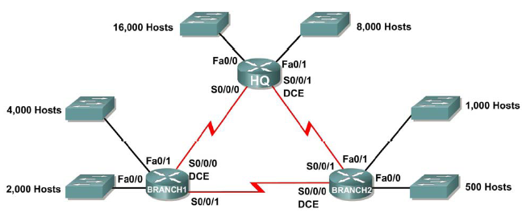
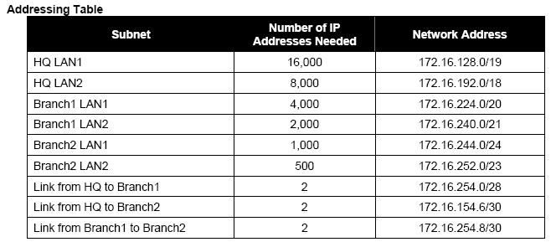
Troubleshooting VLSM Addressing 6.4.3
In this activity, the network address 172.16.128.0/17 was used to provide the IP addressing for a network. VLSM has been used to subnet the address space incorrectly.
You will need to troubleshoot the addressing that was assigned to each subnet to determine where errors are present and determine the correct addressing assignments where needed.

Slide 35
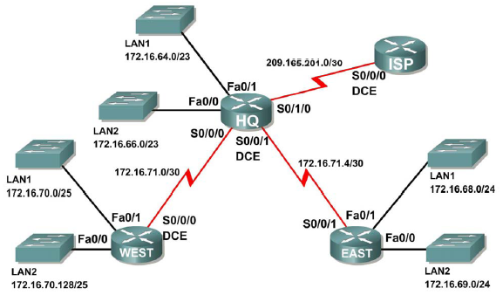
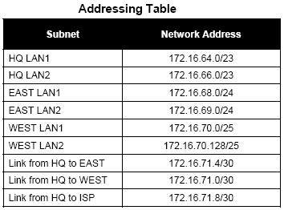
Basic Route Summarization 6.4.4
In this activity, you are given a network with subnetting and address assignments already completed.
Your task is to determine summarized routes that can be used to reduce the number of entries in routing tables

Slide 36
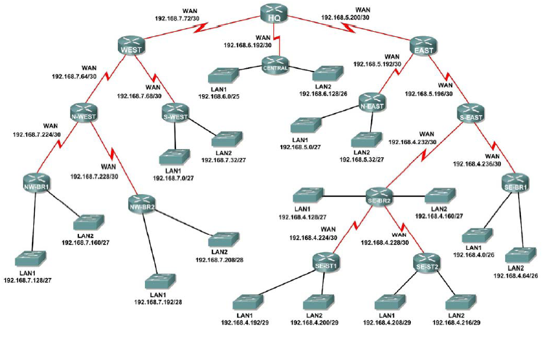
Challenge Route Summarization 6.4.5
In this activity, you are given a network with subnetting and address assignments already completed.
Your task is to determine summarized routes that can be used to reduce the number of entries in routing tables

Slide 37
Challenge Route Summarization 6.4.5
  Addressing Table
Subnet Network Address
S-WEST LAN1 192.168.7.0/27
S-WEST LAN2 192.168.7.32/27
Link from WEST to N-WEST 192.168.7.64/30
Link from WEST to S-WEST 192.168.7.68/30
Link from HQ to WEST 192.168.7.72/30
NW-BR1 LAN1 192.168.7.128/27
NW-BR1 LAN2 192.168.7.160/27
NW-BR2 LAN1 192.168.7.192/28
NW-BR2 LAN2 192.168.7.208/28
Link from N-WEST to NW-BR1 192.168.7.224/30
Link from N-WEST to NW-BR2 192.168.7.228/30
CENTRAL LAN1 192.168.6.0/25
CENTRAL LAN2 192.168.6.128/26
Link from HQ to CENTRAL 192.168.6.192/30
  Addressing Table
Subnet Network Address
N-EAST LAN1 192.168.5.0/27
N-EAST LAN2 192.168.5.32/27
Link from EAST to N-EAST 192.168.5.192/30
Link from EAST to S-EAST 192.168.5.196/30
Link from HQ to EAST 192.168.5.200/30
SE-BR1 LAN1 192.168.4.0/26
SE-BR1 LAN2 192.168.4.64/26
SE-BR2 LAN1 192.168.4.128/27
SE-BR2 LAN2 192.168.4.160/27
SE-ST1 LAN1 192.168.4.192/29
SE-ST1 LAN2 192.168.4.200/29
SE-ST2 LAN1 192.168.4.208/29
SE-ST2 LAN2 192.168.4.216/29
Link from SE-BR2 to SE-ST1 192.168.4.224/30
Link from SE-BR2 to SE-ST2 192.168.4.228/30
Link from S-EAST to SE-BR2 192.168.4.232/30
Link from S-EAST to SE-BR1 192.168.4.236/30

Slide 38
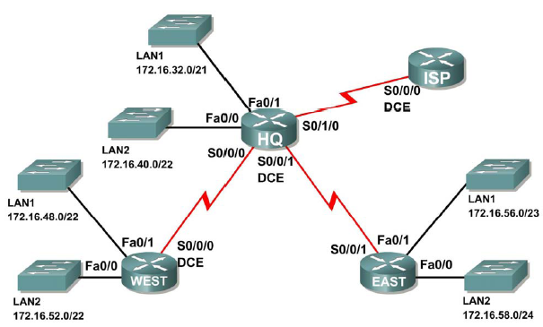
Troubleshooting Route Summarization 6.4.6
In this activity, the LAN IP addressing is already completed for the network. VLSM was used to subnet the address space. The summary routes are incorrect.
You will need to troubleshoot the summary routes that have been assigned to determine where errors are present and determine the correct summary routes.
Addressing Table
Router Summary Route Network Address
HQ WEST LANs 172.16.52.0/21
HQ EAST LANs 172.16.56.0/23
WEST HQ LANs 172.16.32.0/19
WEST EAST LANs 172.16.58.0/23
EAST HQ LANs 172.16.30.0/20
EAST WEST LANs 172.16.48.0/21
ISP HQ, WEST, and EAST LANs 172.16.32.0/18

Slide 39
Summary
Classful IP addressing
  IPv4 addresses have 2 parts:
        -Network portion found on left side of an IP address
        -Host portion found on right side of an IP address
  Class A, B, & C addresses were designed to provide IP addresses for different sized organizations
  The class of an IP address is determined by the decimal value found in the 1st octet
  IP addresses are running out so the use of Classless Inter Domain Routing (CIDR) and Variable Length Subnet Mask (VLSM) are used to try and conserve address space

Slide 40
Summary
Classful Routing Updates
  Subnet masks are not sent in routing updates
Classless IP addressing
  Benefit of classless IP addressing
        Can create additional network addresses using a subnet mask that fits your needs
  Uses Classless Interdomain Routing (CIDR)

Slide 41
Summary
CIDR
  Uses IP addresses more efficiently through use of VLSM
        -VLSM is the process of subnetting a subnet
  Allows for route summarization
        -Route summarization is representing multiple contiguous routes with a single route

Slide 42
Summary
Classless Routing Updates
  Subnet masks are included in updates

Slide 43
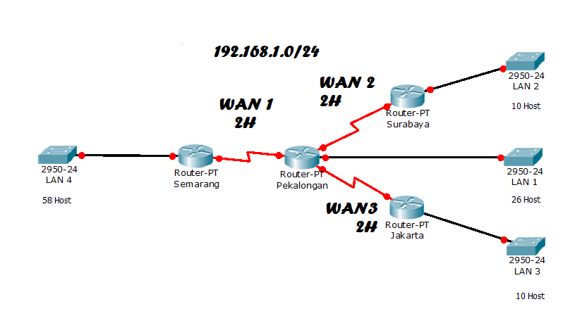
SUBNETTING DENGAN VLSM
Variable Length Subnet Mask
VLSM (Variable Length Subnet Mask) adalah sebuah cara pengelolaan pengalamatan IP yang lebih terstruktur dibandingkan sekedar menggunakan FLSM (Fixed Length Subnet Mask).
Perhitungan IP Address menggunakan metode VLSM adalah metode yang berbeda dengan memberikan suatu Network Address lebih dari satu subnet mask, berbeda jika menggunakan CIDR dimana suatu Network ID hanya memiliki satu subnet mask saja.
VLSM memiliki manfaat untuk mengurangi jumlah alamat yang terbuang.
Untuk lebih mudahnya sebagai contoh, kita akan menghitung alamat IP menggunakan VLSM dengan topologi sebagai berikut:
Pertama, kita cari host yang paling banyak digunakan. yaitu pada LAN4 dengan 58 Host, LAN1 (26 Host), LAN2 (10 Host), LAN3 (10 Host), dan masing2 WAN 2 Host. Disini diberikan IP 192.168.1.0/24, dan kita akan membaginya dengan VLSM.
CIDR = Classes Inter Domain Routing

Slide 44
1. Menghitung IP untuk LAN4 ( 58 Host )
NetMask Desimal | Netmask Biner | Format CIDR | Jumlah Host
255.255.255.0 | 11111111.11111111.11111111.00000000 | /24 | 254
255.255.255.128 | 11111111.11111111.11111111.10000000 | /25 | 126
255.255.255.192 | 11111111.11111111.11111111.11000000 | /26 | 62
255.255.255.224 | 11111111.11111111.11111111.11100000 | /27 | 30
255.255.255.240 | 11111111.11111111.11111111.11110000 | /28 | 14
255.255.255.248 | 11111111.11111111.11111111.11111000 | /29 | 6
255.255.255.252 | 11111111.11111111.11111111.11111100 | /30 | 2
NetMask Desimal | Netmask Biner | Format CIDR | Jumlah Host
255.255.255.0 | 11111111.11111111.11111111.00000000 | /24 | 254
255.255.255.128 | 11111111.11111111.11111111.10000000 | /25 | 126
255.255.255.192 | 11111111.11111111.11111111.11000000 | /26 | 62
255.255.255.224 | 11111111.11111111.11111111.11100000 | /27 | 30
255.255.255.240 | 11111111.11111111.11111111.11110000 | /28 | 14
255.255.255.248 | 11111111.11111111.11111111.11111000 | /29 | 6
255.255.255.252 | 11111111.11111111.11111111.11111100 | /30 | 2
Jika kita menggunakan /24 tentunya terlalu banyak Host yang tersisa (tdk digunakan),
Karena kita hanya butuh 58 Host. Kita tentukan subnet mask yang memiliki host lebih dari 58, dilihat dari tabel diatas yang terpenuhi adalah /26 (62 Host) dengan subnet 255.255.255.192.

Slide 45
2. Menghitung IP untuk LAN1 ( 26 Host )
berikut adalah peluang alamat IP yang digunakan dari /26 (Perhatikan 2-bit MSB pada oktet terakhir)
/26 = 11111111.11111111.11111111.11000000
Network | IP Range | Broadcast
.0 | 1-62 | .63
.64 | 65 - 126 | .127
.128 | 129 - 190 | .191
.192 | 193 - 254 | .255
Kita tentukan subnet mask yang memiliki 26 host lebih, dilihat dari tabel subnetting diatas yang terpenuhi adalah /27 (30 Host) dengan subnet 255.255.255.224.
Karena diLAN4 telah menggunakan IP 192.168.1.0/26 , maka kita akan menggunakan IP dibawahnya yang belum digunakan yaitu 192.168.1.64/26. seperti cara sebelumnya kita akan mengubah subnet mask nya menjadi 255.255.255.224.
Untuk 58 Host kita menggunakan IP Address 192.168.1.0/26
Network 192.168.1.0
IP Range 192.168.1.1-192.168.1.62
Broadcast 192.168.1.63
NetMask Desimal | Netmask Biner | Format CIDR | Jumlah Host
255.255.255.0 | 11111111.11111111.11111111.00000000 | /24 | 254
255.255.255.128 | 11111111.11111111.11111111.10000000 | /25 | 126
255.255.255.192 | 11111111.11111111.11111111.11000000 | /26 | 62
255.255.255.224 | 11111111.11111111.11111111.11100000 | /27 | 30
255.255.255.240 | 11111111.11111111.11111111.11110000 | /28 | 14
255.255.255.248 | 11111111.11111111.11111111.11111000 | /29 | 6
255.255.255.252 | 11111111.11111111.11111111.11111100 | /30 | 2

Slide 46
3. Menghitung IP untuk LAN3 ( 10 Host )
berikut kemungkinan IP yang digunakan (/27): 11111111.11111111.11111111.11100000
Network | IP Range | Broadcast
.64 | 65-94 | .95
.96 | 97-126 | .127
.128 | 129-158 | .159
.160 | 161-190 | .191
NetMask Desimal | Netmask Biner | Format CIDR | Jumlah Host
255.255.255.0 | 11111111.11111111.11111111.00000000 | /24 | 254
255.255.255.128 | 11111111.11111111.11111111.10000000 | /25 | 126
255.255.255.192 | 11111111.11111111.11111111.11000000 | /26 | 62
255.255.255.224 | 11111111.11111111.11111111.11100000 | /27 | 30
255.255.255.240 | 11111111.11111111.11111111.11110000 | /28 | 14
255.255.255.248 | 11111111.11111111.11111111.11111000 | /29 | 6
255.255.255.252 | 11111111.11111111.11111111.11111100 | /30 | 2
Untuk 26 Host kita menggunakan IP Address 192.168.1.0/27
Network 192.168.1.64
IP Range 192.168.1.65-192.168.1.94
Broadcast 192.168.1.95
Kita tentukan subnet mask yang memiliki 10 host lebih, dilihat dari tabel subnetting diatas yang terpenuhi adalah /28 (14 Host) dengan subnet 255.255.255.240.
Karena diLAN1 telah menggunakan IP 192.168.1.64/27 , maka kita akan menggunakan IP dibawahnya yang belum digunakan yaitu 192.168.1.96/27. seperti cara sebelumnya kita akan merubah subnet mask nya menjadi 255.255.255.240.

Slide 47
4. Menghitung WAN untuk LAN2 dan LAN3 ( 2 Host )
berikut kemungkinan IP yang digunakan (/28):
11111111.11111111.11111111.11110000
Kita tentukan subnet mask yang memiliki 2 host atau lebih, dilihat dari tabel subnetting diatas yang terpenuhi adalah /30 (2 Host) dengan subnet 255.255.255.252.
Karena diLAN sebelumnya telah menggunakan IP 192.168.1.96/28 dan 192.168.1.112/28, maka kita akan menggunakan IP dibawahnya yang belum digunakan yaitu 192.168.1.128/28. seperti cara sebelumnya kita akan merubah subnet mask nya menjadi 255.255.255.252.
Network | IP Range | Broadcast
.96 | .97-.110 | .111
.112 | .113-.126 | .127
.128 | .129-.142 | .143
.144 | .145-.158 | .159
Karena ada 2 LAN yang butuh 10 Host kita menggunakan IP address 192.168.1.96/28 dan 192.168.1.112/28
Network 192.168.1.96
IP Range 192.168.1.97-192.168.1.110
Broadcast 192.168.1.111
Network 192.168.1.112
IP Range 192.168.1.113-192.168.1.126
Broadcast 192.168.1.127
berikut kemungkinan IP yang digunakan (/30):
11111111.11111111.11111111.11111100
Network | IP Range | Broadcast
.128 | .129-.130 | .131
.132 | .133-.134 | .135
.136 | .137-.138 | .139
.140 | .141-.142 | .143
.144 | .145-.146 | .147
Karena ada 3 WAN yang butuh 2 Host kita menggunakan IP address 192.168.1.128/30, 192.168.1.132/30 dan 192.168.136/30
Network 192.168.1.128
IP Range 192.168.1.129-192.168.1.130
Broadcast 192.168.1.131
Network 192.168.1.132
IP Range 192.168.1.133-192.168.1.134
Broadcast 192.168.1.135
Network 192.168.1.136
IP Range 192.168.1.137-192.168.1.138
Broadcast 192.168.1.139

