Slide 1
Scope of POC
To demonstrate that multiple assemblies can be composed by host dynamically via lazy loading using Managed Extensibility Framework

Slide 2
What is Managed Extensibility?
Managed Extensibility Framework or MEF is a library for creating lightweight, extensible applications
MEF is focused on application extensibility that can easily be discovered, and supports discovery of extensions
MEF lets extension developers easily encapsulate code and avoid fragile hard dependencies
MEF uses Dependency Injection as a strategy for composing the different extensions

Slide 3
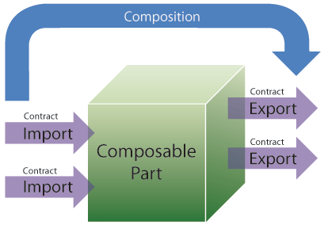
Core Concepts of MEF
Composable part (or, simply, part)—A part provides services to other parts and consumes services provided by other parts. Parts in MEF can come from anywhere, from within the application or externally; from an MEF perspective, it makes no difference.
Export—An export is a service that a part provides. When a part provides an export, it is said that the part exports it. For example, a part may export a logger, or in the case of Visual Studio, an editor extension. Parts can provide multiple exports, though most parts provide a single export.
Import—An import is a service that a part consumes. When a part consumes an import, the part imports it. Parts can import single services, such as the logger, or import multiple services, such as an editor extension.
Contracts—A contract is an identifier for an export or an import. An exporter specifies a string contract that it provides, and an importer specifies the contract that it needs. MEF derives contract names from the types that are being exported and imported, so in most cases you don’t have to think about it.
Composition—Parts are composed by MEF, which instantiates them and then matches up exporters to importers.

Slide 4
MEF - Programming Model
MEF is an integral part of the .NET Framework 4.0
Developers consume MEF through an attributed programming model
Programming model provides a means to declare components as MEF parts
MEF’s core API is completely agnostic to attributes.
Parts live in System.ComponentModel.Composition namespace.

Slide 5
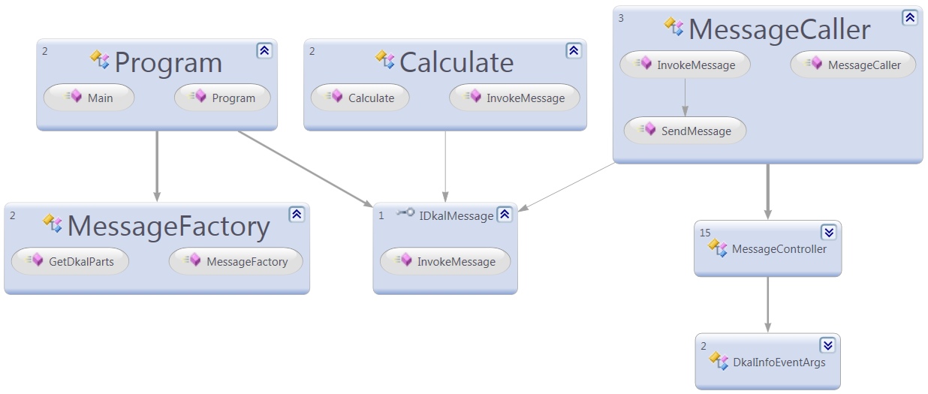
MEF Concept Applied

Slide 6
References & Source
Managed Extensibility Framework
http://mef.codeplex.com/
Framework Overview
http://msdn.microsoft.com/en-us/library/dd460648.aspx
Managed Extensibility Framework Tutorial
http://www.pnpguidance.net/Post/ManagedExtensibilityFrameworkTutorialMEF.aspx

