Slide 1
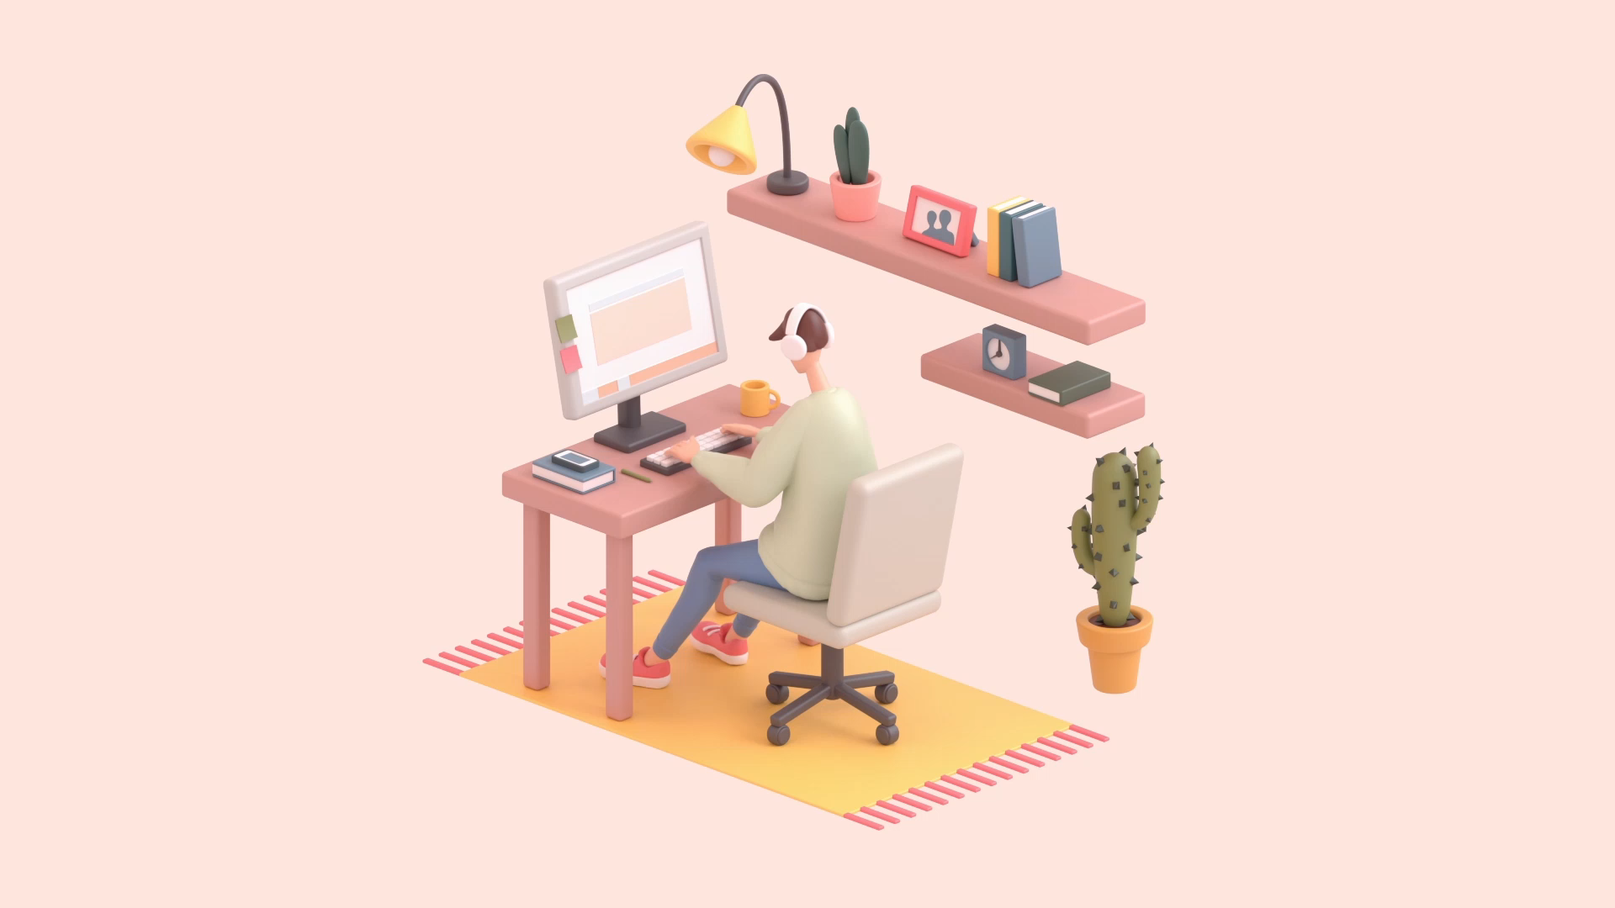
Amel Hamdi
Chekpoint :
Amel Hamdi

Slide 2
How does the web work ??
Web servers and web browsers communicate via HTTP
HTTP ensures that all parts of the web page are delivered
Web browser decides how these items are displayed

Slide 3


Slide 4
What do you need to be a web developer?
* Learn web development fundamentals
* Choose a development specialization
* Learn key programming languages for web development
* Work on projects to develop your Web Developer skills
* Build your portfolio

Slide 5
Why did you choose to learn web developpment???
* I Can Work From Anywhere
* There Are Always Freelance Opportunities
* It’s Creative and Fun

