Slide 1
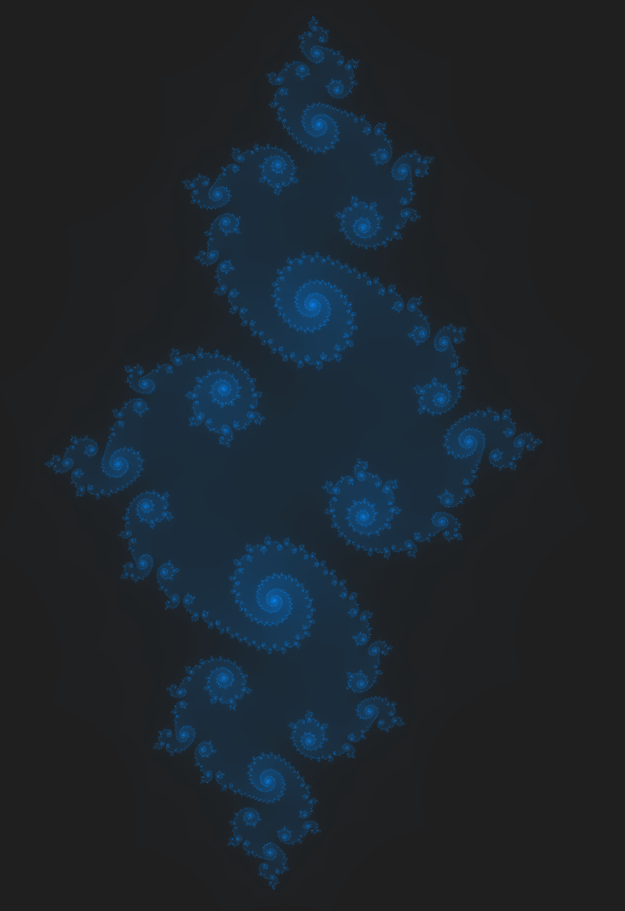
Shader Workshop
Fractals & generating art with code
By Amelia Hamer

Slide 2
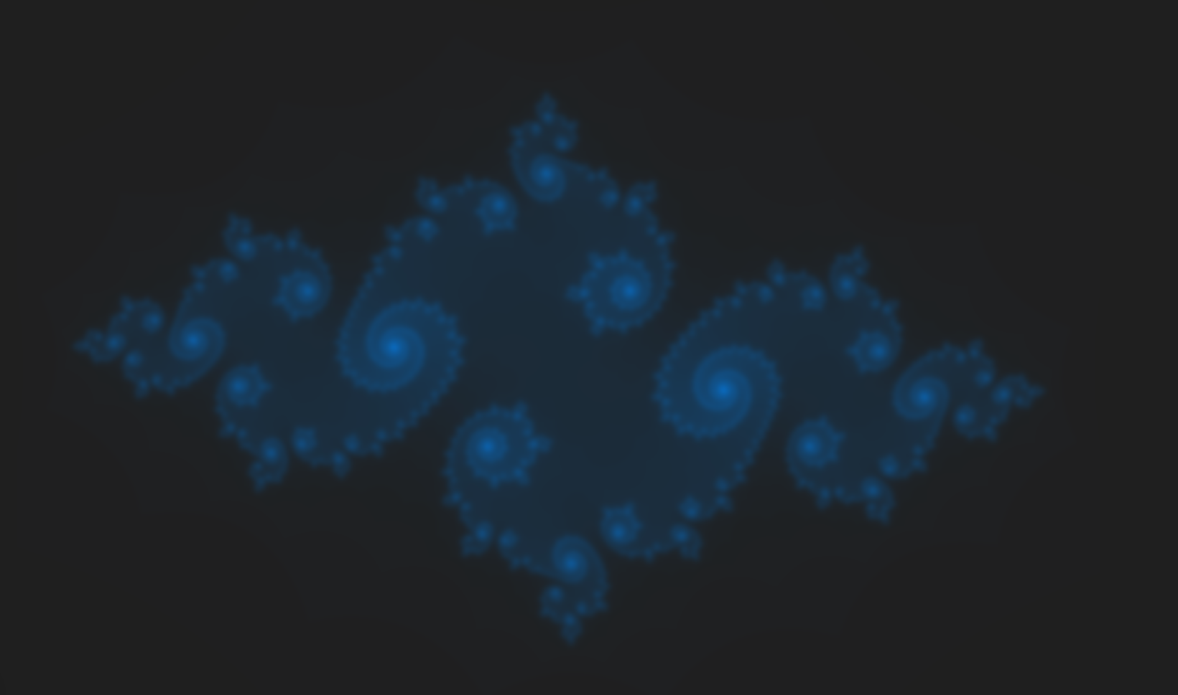
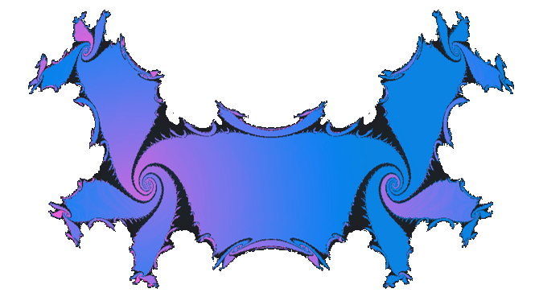
Workshop Outline
What GLSL is and why were using it
Intro to Shadertoy & ShaderLoom
Explanation of the example code
Workshop starts, please ask
questions then

Slide 3
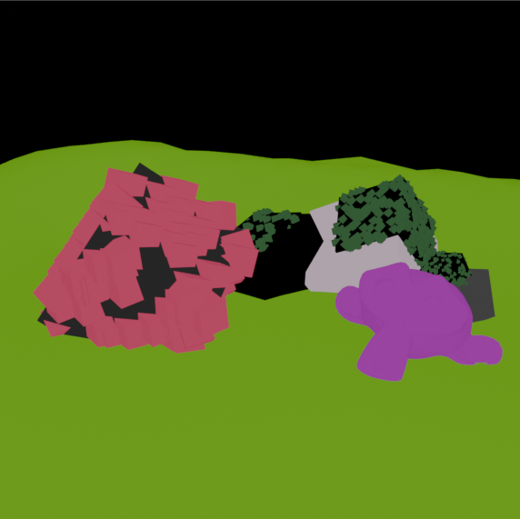
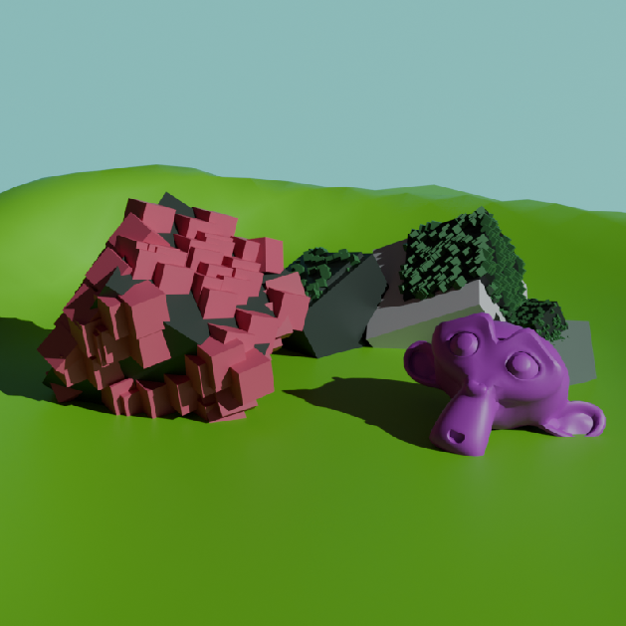

OpenGL & GLSL
OpenGL is a graphics library
Used for desktop/mobile/console apps & games
OpenGL uses GLSL as its shading language (Graphics Library Shading Language)
Shader program runs for every pixel in parallel
Without any shading
With shading & shadows

Slide 4
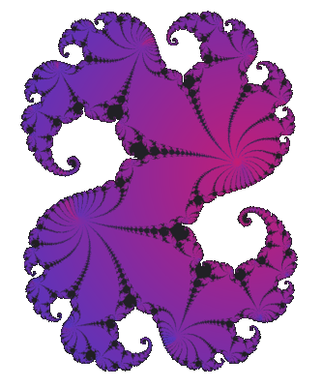
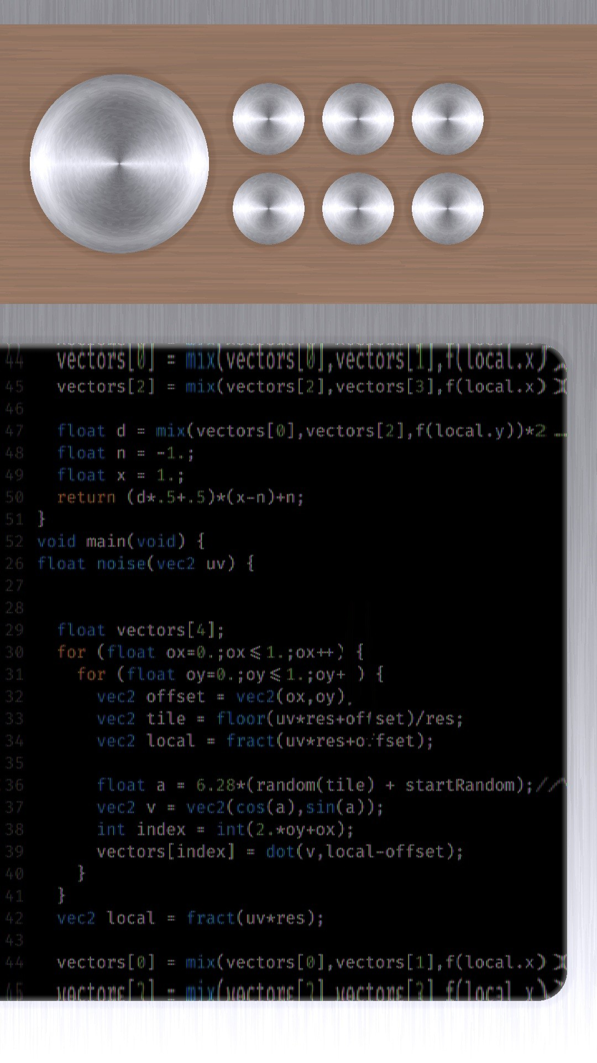
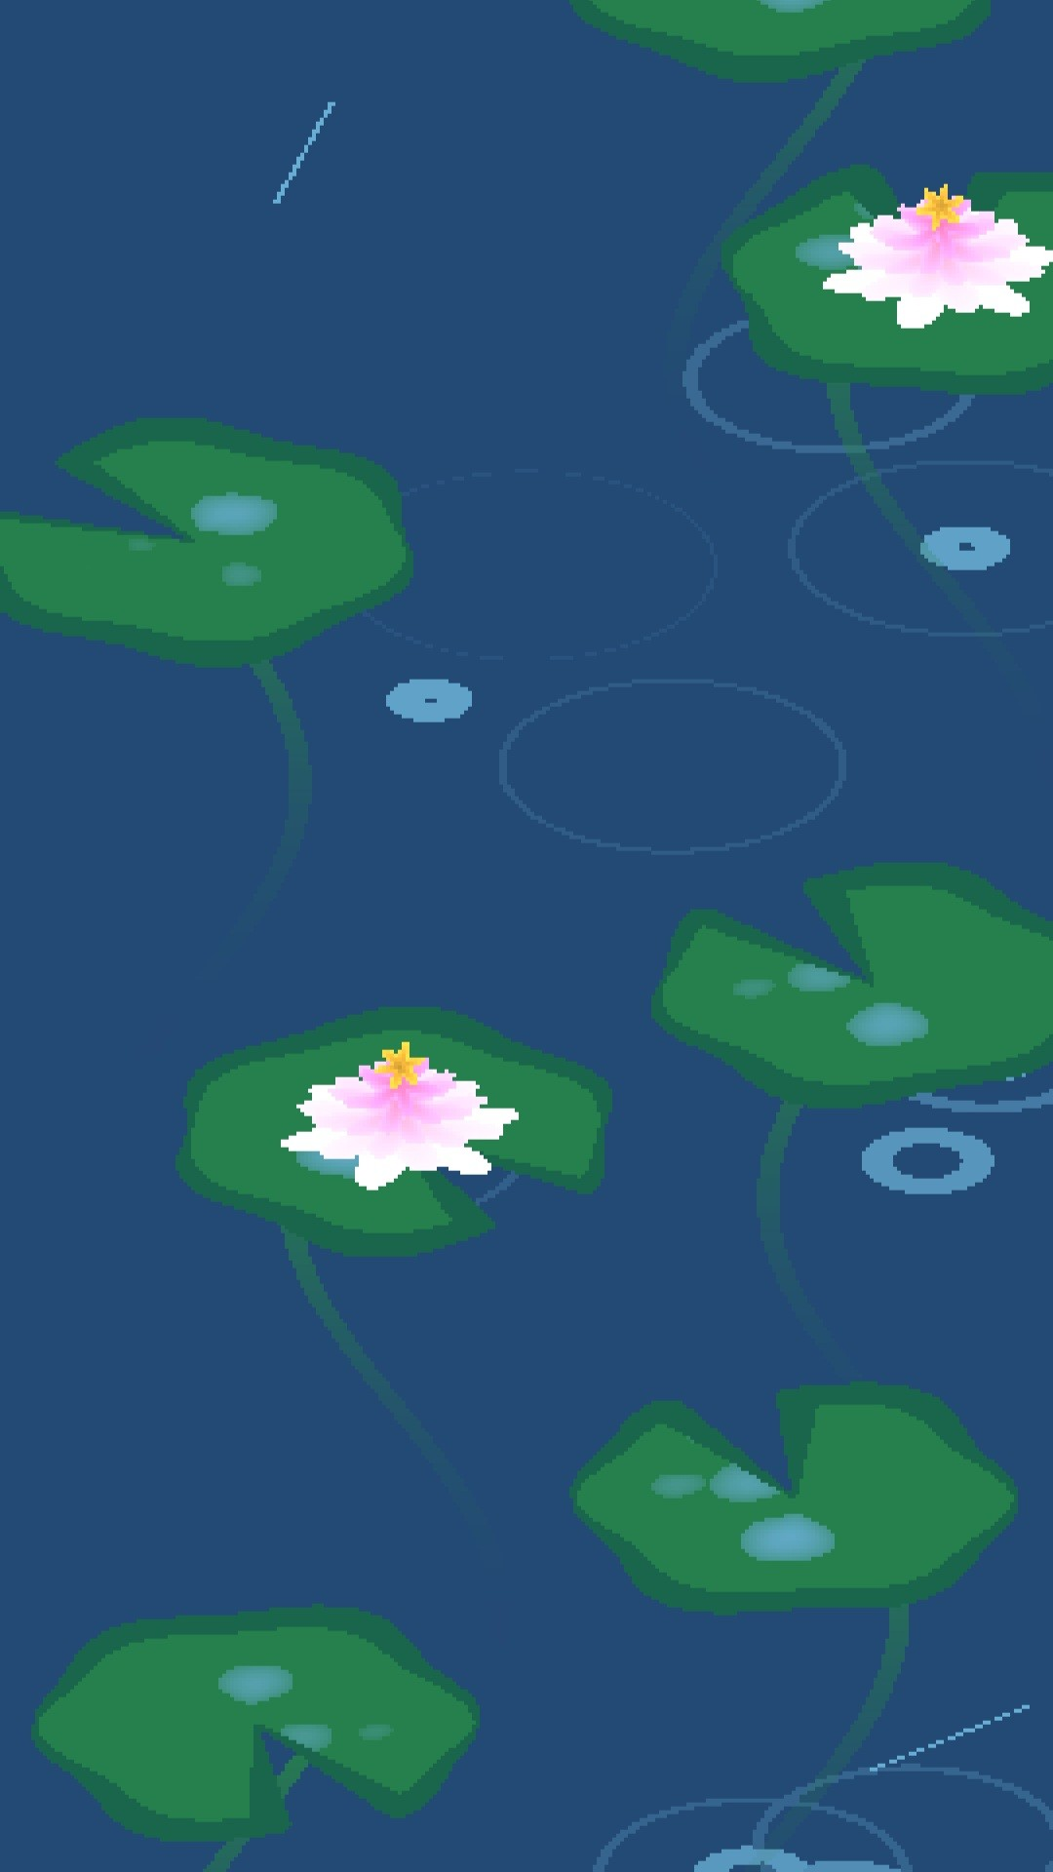
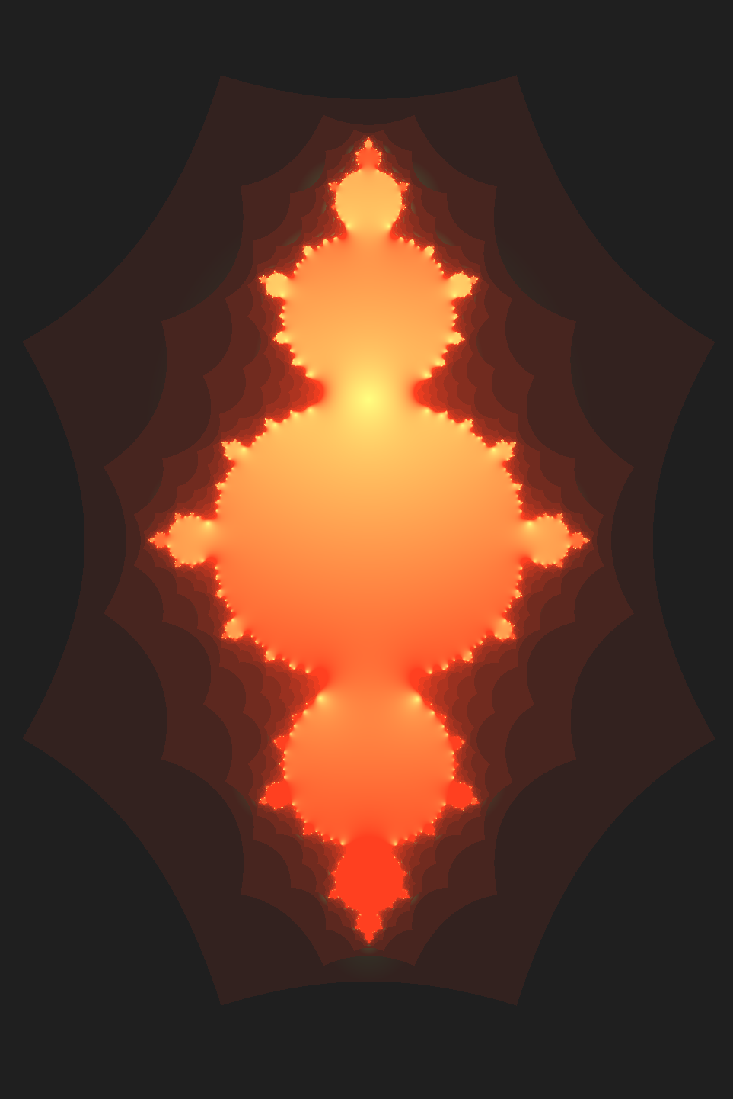
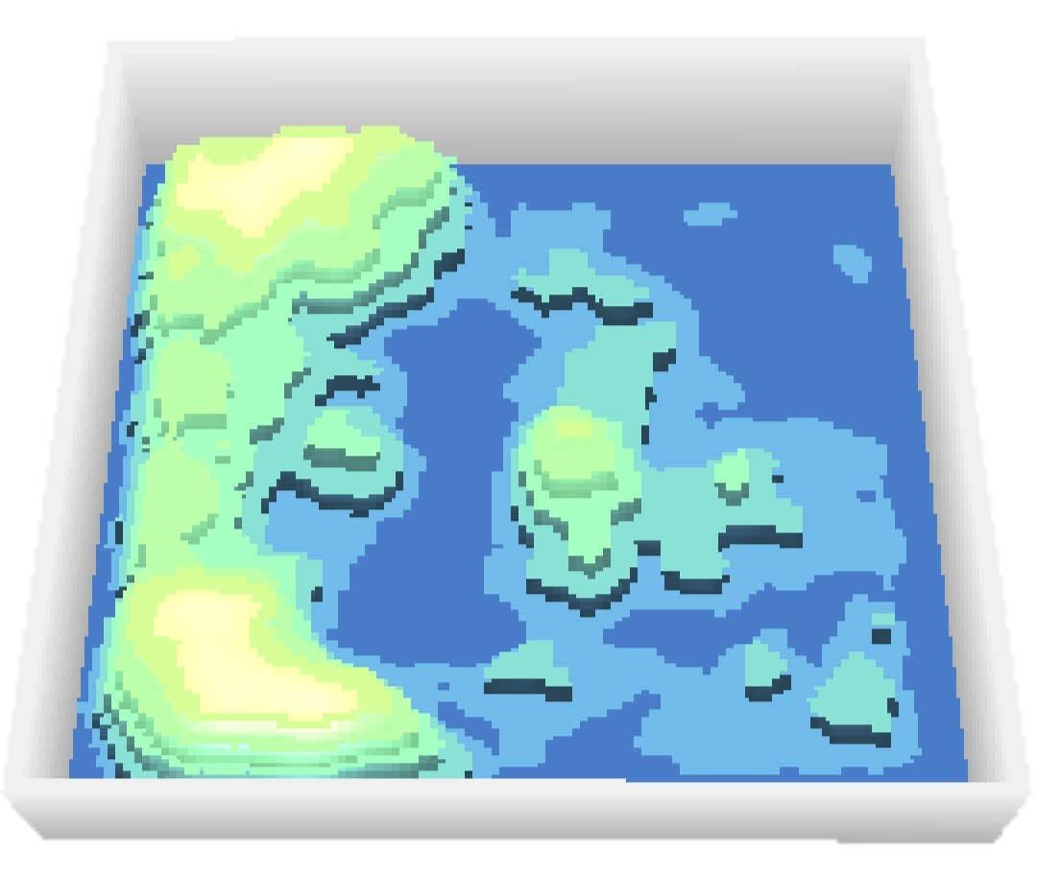
Why use GLSL for art?
Direct control over every pixel
built to make lighting and graphic look nice
Easy to use, not many strict rules
Visual feedback when coding
Tools exists to make it even easier

Slide 5
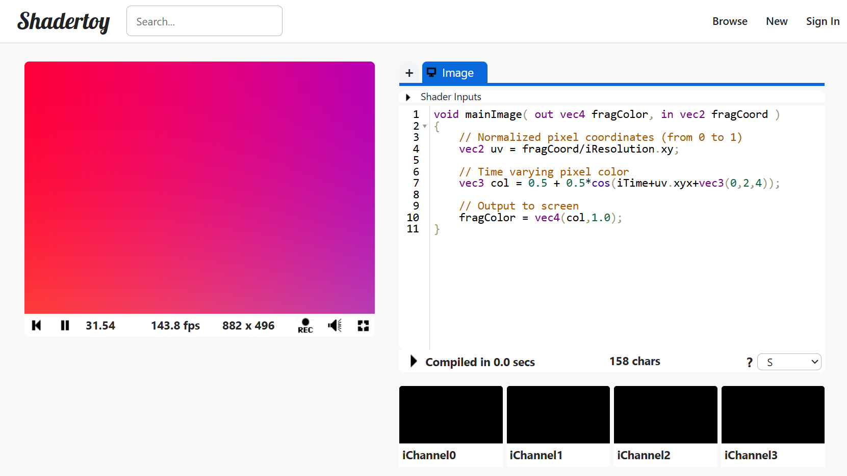
Shadertoy

Slide 6
Shadertoy
create a new project
see inputs or “uniforms”
pause, play and reset
run your shader

Slide 7
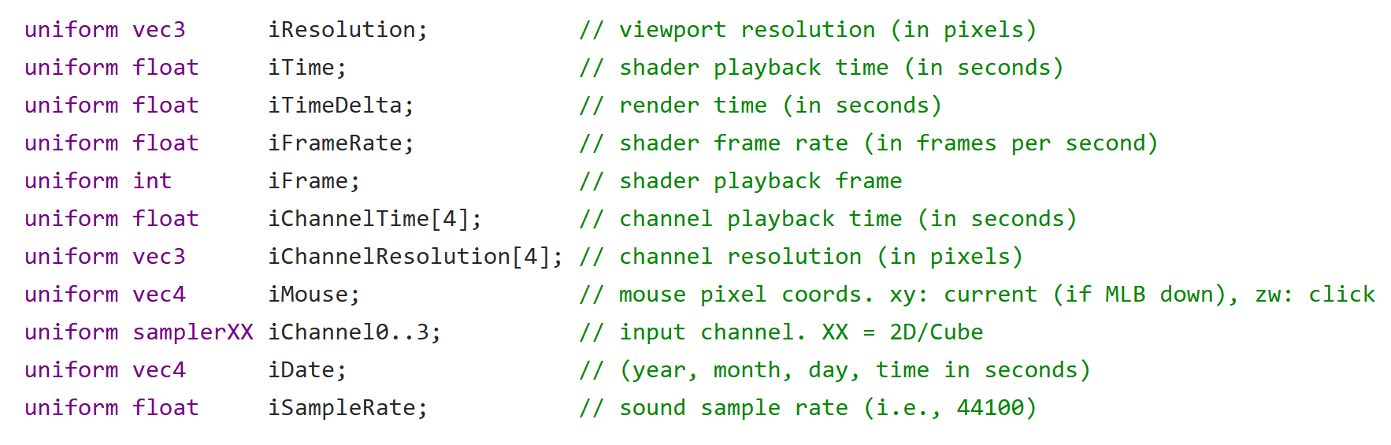
Default uniforms provided by Shadertoy

Slide 8
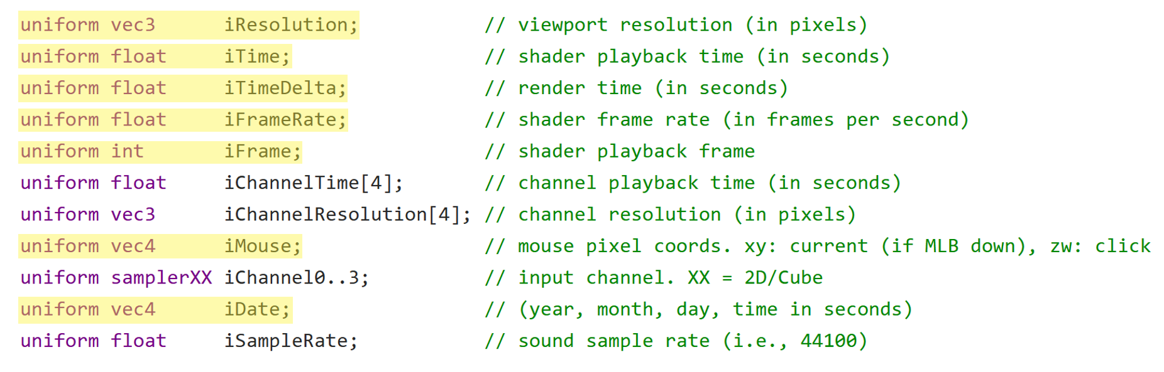
ShaderLoom compatible uniforms

Slide 9
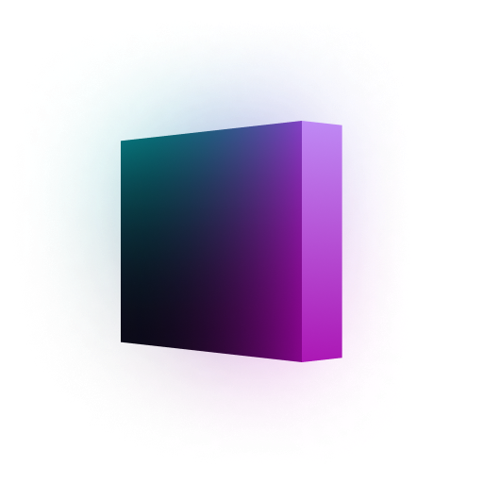
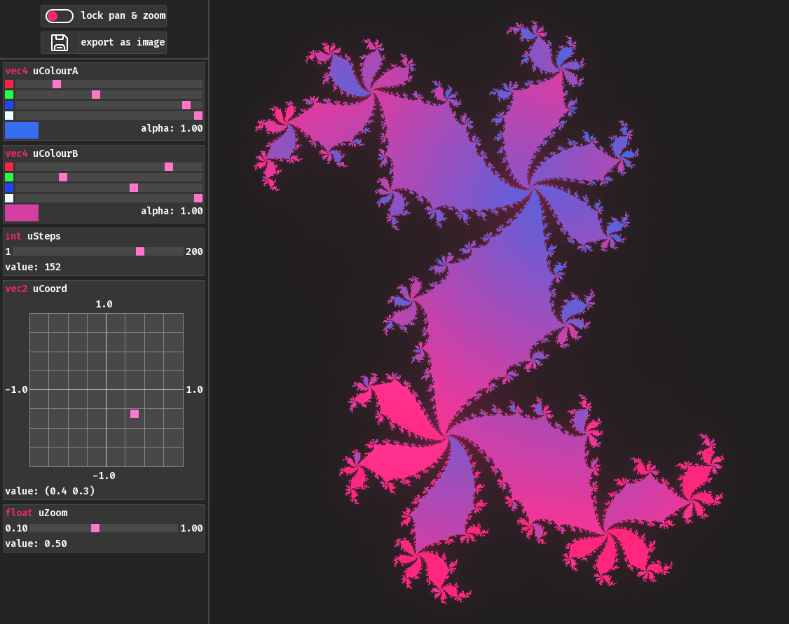

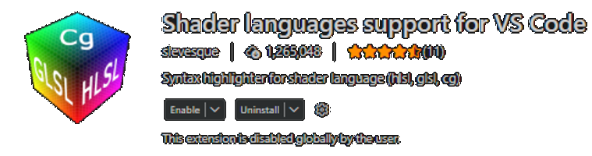
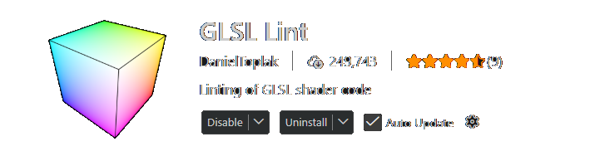
ShaderLoom
+
or

Slide 10
ShaderLoom
lock movement of shader
save as image (800x800)
or press ctrl+s
click & drag to pan view
scroll mouse wheel to zoom in/out
click to open
a colour picker
drag to change side panel size

Slide 11
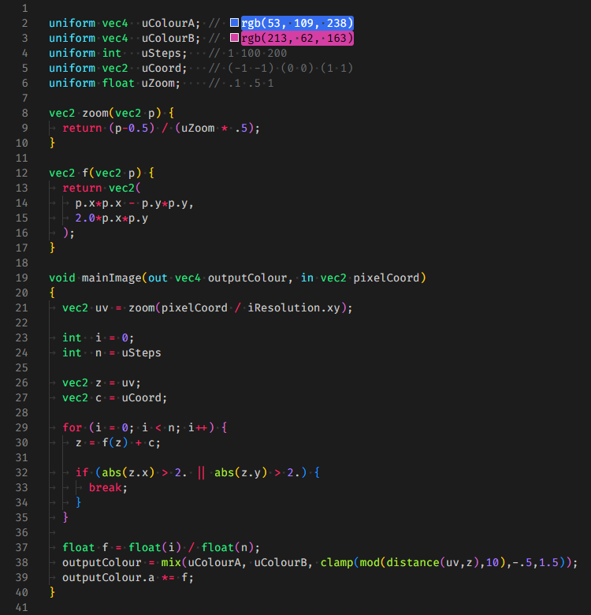
Widgets

Slide 12
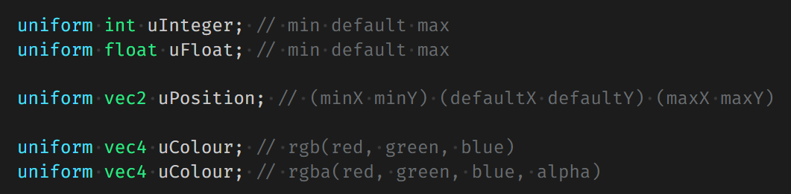
Uniforms in ShaderLoom
Needs to start with “u” to show up in the side panel
Needs to have a comment after the variable describing the widget
Int’s, float’s, vec2’s and vec4’s (as colours) are supported

Slide 13
The Workshop Begins
Feel free to ask questions
Experiment with the code given or make something new
Fractal template for ShaderToy
https://pastebin.com/PPBPG80q
(ShaderLoom already comes with a similar template)

Slide 15

The maths behind the fractals
𝑧&=𝑎+𝑏𝑖𝑐&=𝑥+𝑦𝑖𝑧&=𝑧2+𝑐𝑧&=𝑎+𝑏𝑖2+𝑥+𝑦𝑖𝑧&=𝑎2+2𝑎𝑏𝑖+𝑏2𝑖2+𝑥+𝑦𝑖𝑧&=𝑎2+2𝑎𝑏𝑖−𝑏2𝑖2+𝑥+𝑦𝑖𝑧&=𝑎2−𝑏2+𝑥+𝑖2𝑎𝑏+𝑦

