Slide 1
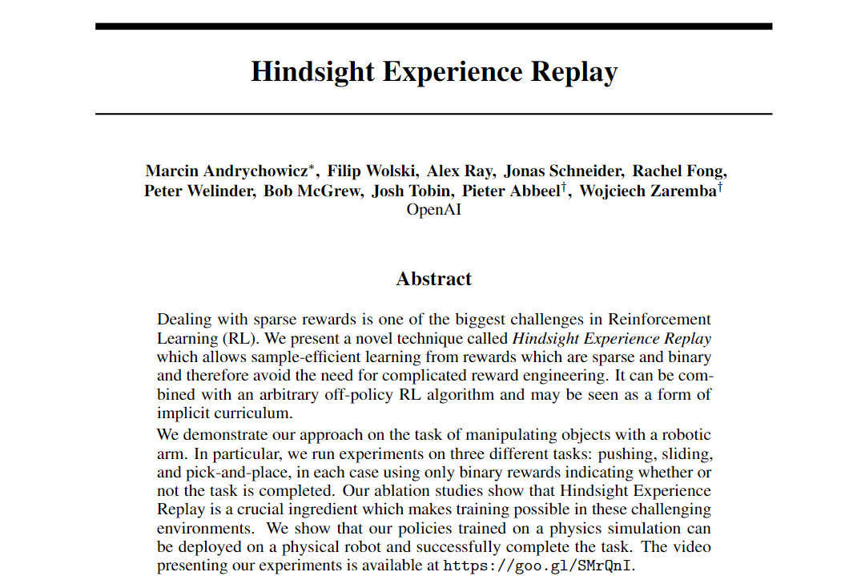

‘뒤늦게 깨달은 경험’ 리플레이
Hindsight
Experience
Replay
세종대학교
항공우주공학 석사과정
홍다선

Slide 2
Hindsight
Experience
Replay
‘뒤늦게 깨달은 경험’ 리플레이

Slide 3







Hindsight
Experience
Replay
Replay Buffer
$$action$$
Transition 1
State
Transition 2
Critic Net
Actor Loss
$$update$$
Actor Net
Transition 3
.
.
.
Transition 4
$$update$$
$$Value$$
$$Value$$
Apply Noise
Transition 5
Critic Loss
$$action$$
Environment
$$reward$$
$$R$$
State’

Slide 4
Hindsight
Experience
Replay
Binary
reward
+1
Target
-1
-1
-1
-1
-1

Slide 5
Hindsight
Experience
Replay
Shaped
reward
-0.5
+1
Target
+0.5
+0.9
+0.2
-0.3

Slide 6
Hindsight
Experience
Replay
-0.998
Colossal
environment
Target
-0.9935
-0.996
-0.995
-0.993
-0.9942
-0.9935

Slide 7
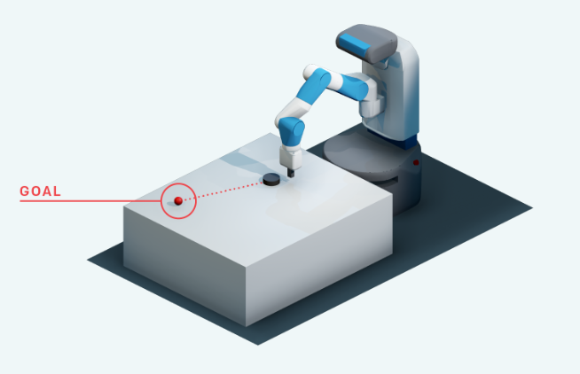
Hindsight
Experience
Replay
Sparse
Reward
environment
Pushing
Sliding
Pick&Place

Slide 8
Hindsight
Experience
Replay
Sparse
Reward
environment
Pushing
Sliding
Pick&Place

Slide 9
Hindsight
Experience
Replay
Sparse
Reward
environment
Pushing
Sliding
Pick&Place

Slide 10
Hindsight
Experience
Replay
Sparse
Reward
environment
Pushing
Sliding
Pick&Place

Slide 11
Hindsight
Experience
Replay
Sparse
Reward
environment
Pushing
Sliding
Pick&Place

Slide 12
Hindsight
Experience
Replay
Sparse
Reward
environment
Pushing
Sliding
Pick&Place

Slide 13
Hindsight
Experience
Replay
Sparse
Reward
environment
- 평생 돌려봐야 실패만 계속함
- 운 좋게 한번 성공해도 이후에는 헛걸음만침
- 언젠가는 성공한다고 쳐도 시간이 너무 오래 걸림
- 최적화가 제대로 되지 않은 상태로의 학습 종료 가능성 올라감
Pushing
Sliding
Pick&Place

Slide 14
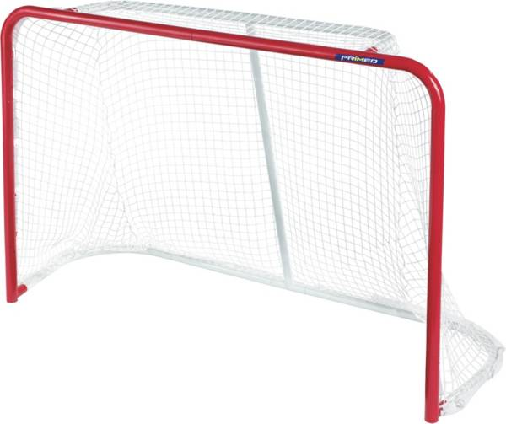

Hindsight
Experience
Replay

Slide 15
Hindsight
Experience
Replay

Slide 16
Hindsight
Experience
Replay

Slide 17
Hindsight
Experience
Replay

Slide 18
Hindsight
Experience
Replay

Slide 19
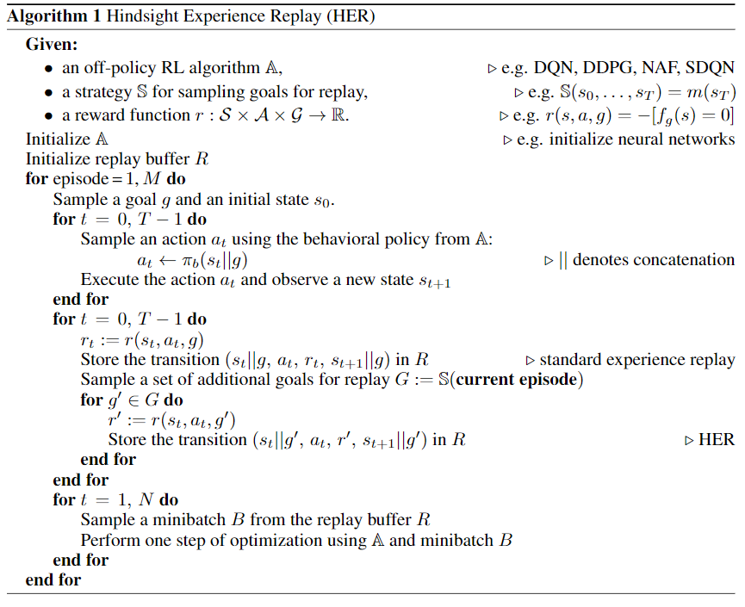
Hindsight
Experience
Replay

Slide 20
Hindsight
Experience
Replay
Initialize the learning process

Slide 21
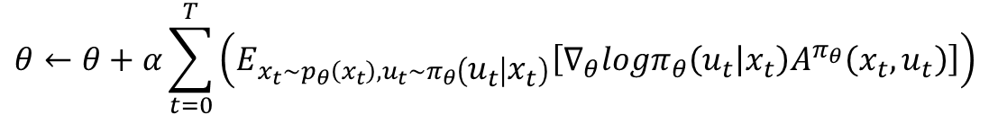
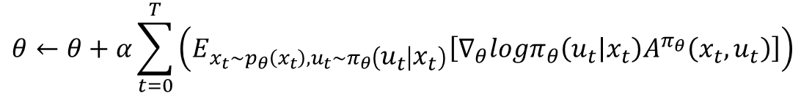
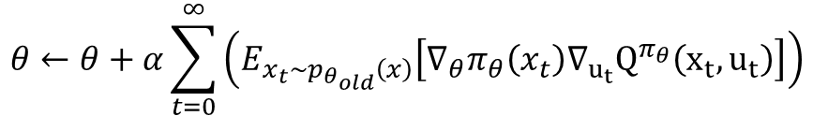
Hindsight
Experience
Replay
AAC
$$θ←θ+α\sum_{t=0}^{T}{\left(E_{x_{t}\sim p_{θ}\left(x_{t}\right), u_{t}\sim π_{θ}\left(u_{t} | x_{t}\right)}\left[∇_{θ}logπ_{θ}\left(u_{t} | x_{t}\right)A^{π_{θ}}\left(x_{t}, u_{t}\right)\right]\right) }$$
AAAC
$$θ←θ+α\sum_{t=0}^{T}{\left(E_{x_{t}\sim p_{θ}\left(x_{t}\right), u_{t}\sim π_{θ}\left(u_{t} | x_{t}\right)}\left[∇_{θ}logπ_{θ}\left(u_{t} | x_{t}\right)A^{π_{θ}}\left(x_{t}, u_{t}\right)\right]\right) }$$
PPO
$$θ←θ+α\sum_{t=0}^{∞}{E_{x_{t}\sim p_{θ_{old}}\left(x_{t}\right), u_{t}\sim π_{θ_{old}}(u_{t}|x_{t})}\left[\frac{π_{θ}\left(u_{t} | x_{t}\right)}{π_{θ_{old}}\left(u_{t} | x_{t}\right)}∇_{θ} logπ_{θ}\left(u_{t} | x_{t}\right)γ^{t}A^{{πθ}_{old}}(x_{t}, u_{t})\right]}$$
DDPG
$$θ←θ+α\sum_{t=0}^{∞}{\left(E_{x_{t}\sim p_{θ_{old}}\left(x\right)}\left[∇_{θ}π_{θ}\left(x_{t}\right)∇_{u_{t}}Q^{π_{θ}}\left(x_{t}, u_{t}\right)\right]\right)}$$

Slide 22
Hindsight
Experience
Replay
Run the episode

Slide 23
Hindsight
Experience
Replay
Store the transition

Slide 24
Hindsight
Experience
Replay
Sample a set of modified additional goal
Swap the transition

Slide 25

Hindsight
Experience
Replay
Binary
$$r\left(s, a, g\right)=−\left[\left|g−s_{object}\right|>ε\right]$$
Shaped
$$r\left(s, a, g\right)=−{\left|g−s_{object}^{}\right|}^{2}$$

Slide 26
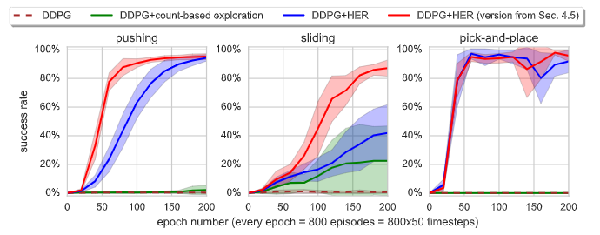
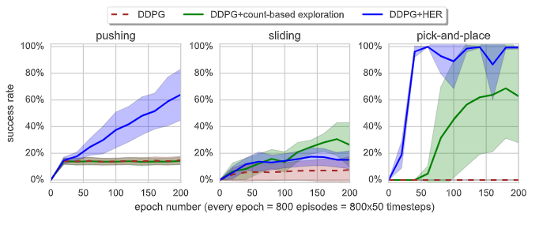
Hindsight
Experience
Replay

Slide 27
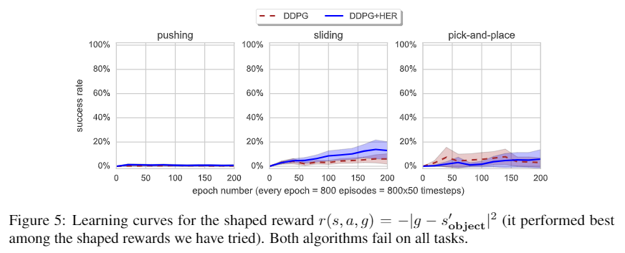
Hindsight
Experience
Replay

Slide 28
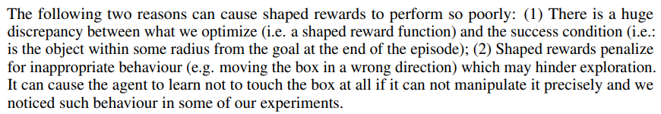
Hindsight
Experience
Replay

Slide 29
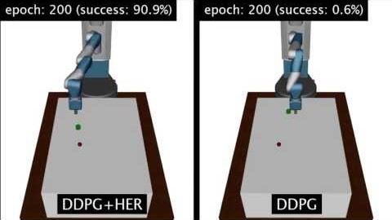
Hindsight
Experience
Replay
FIN

Slide 30
Hindsight
Experience
Replay
FIN

