Slide 1
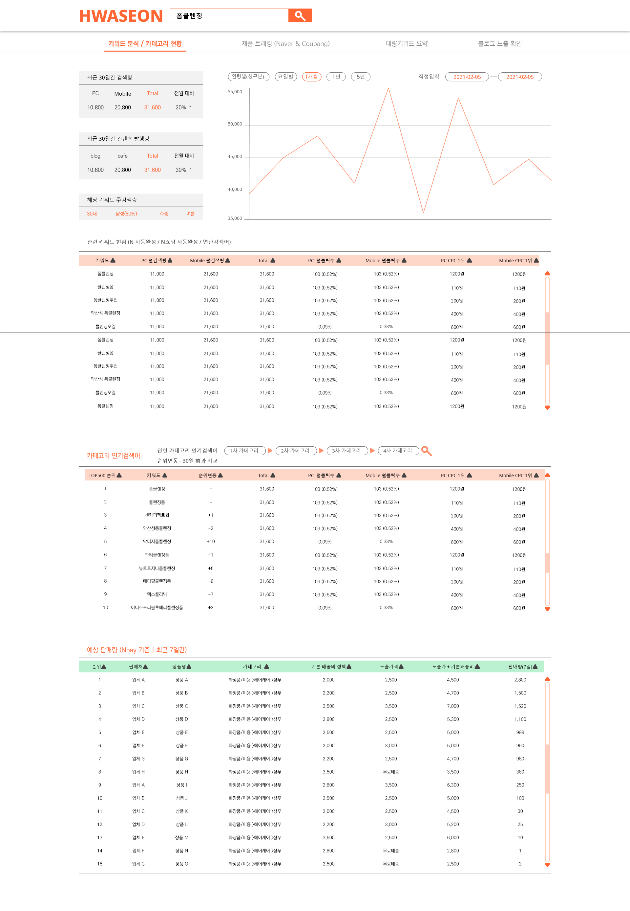
http://naver.github.io/searchad-apidoc/#/tags/RelKwdStat
절대값
최근30일
http://naver.github.io/searchad-apidoc/#/tags/RelKwdStat
https://developers.naver.com/docs/datalab/search/
상대값
보류
보류
https://developers.naver.com/docs/search/blog/
보류
평균비용
평균비용
http://naver.github.io/searchad-apidoc/#/tags/RelKwdStat
https://workingwithpython.com/naversearchadapi3/

Slide 2
https://developers.naver.com/docs/search/shopping/
카테고리 가져오기
https://developers.naver.com/docs/datalab/shopping/
카테고리 클릭시 데이터 가져오기

