Slide 1
Single tone synthesizer
(with distortion module)
Arshdeep Singh

Slide 2
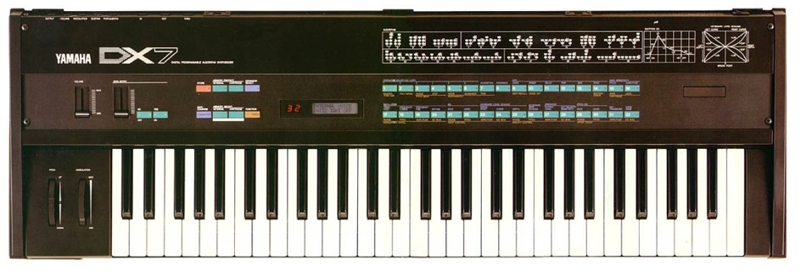
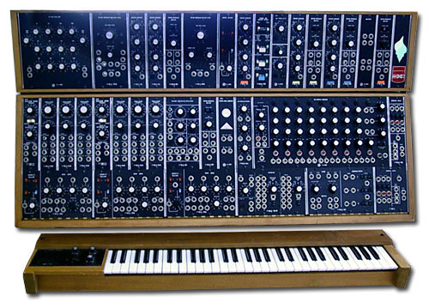
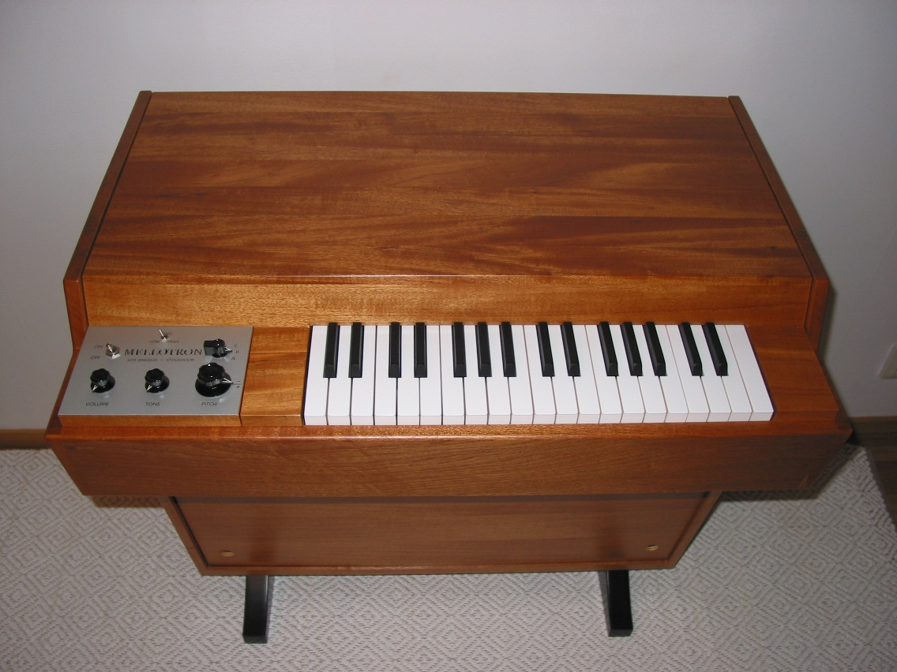
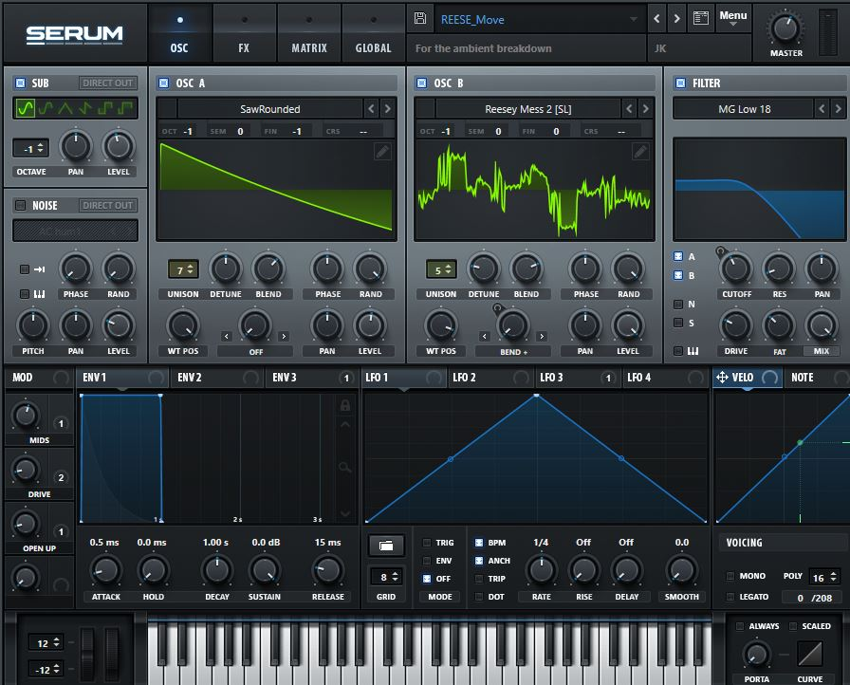
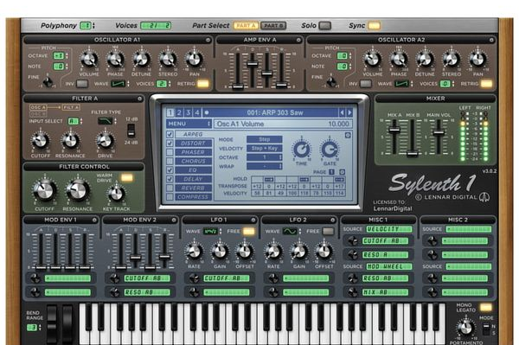
SO MANY DIFFERENT SYNTHS!!!

Slide 3
Basic Structure of a Synthesizer
VCO
VCF
VCA
VCO_A
MIXER
VCF
DAC
`
VCO_B

Slide 4
Structure of my Synth
VCO
2 to 1
DEMUX
Distortion
Module
Digital
Speaker
Switch

Slide 5
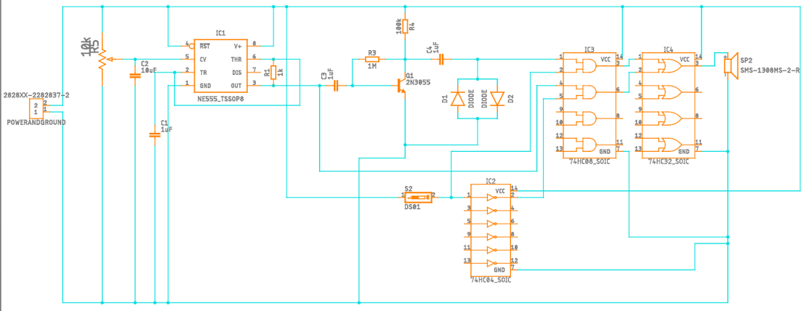
Schematic

Slide 6
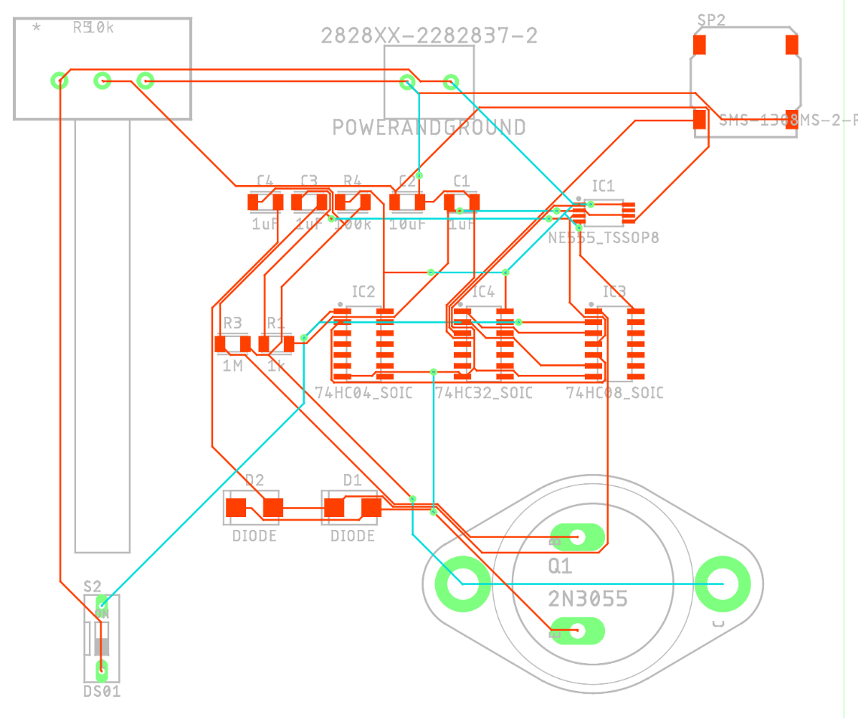
PCB

Slide 7
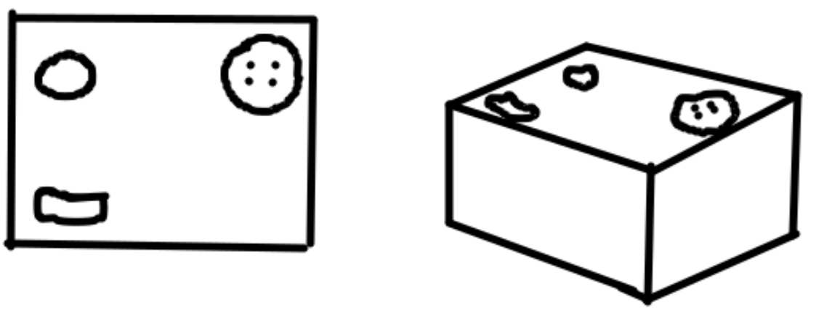
PCB

Slide 8
The goal of this project was to create a single frequency synthesizer that has an distortion module that can be toggled on or off.
While the modules (VCO and distortion circuit) work alone, the logic gates that tie them together, unfortunately, prevent the device from working.
If I were to recreate this device, I’d use a demux instead of a series of logic gates.

