Slide 1




Azure Blueprints Quick Start
Tim Warner
Author evangelist, pluralsight
@TechTrainerTim techtrainertim.com

Slide 2
Describe Azure Blueprints
Use cases
High-level workflow
Create, deploy, and track Blueprints
Extend Blueprints functionality
Learning Objectives

Slide 3

Session Materials
timw.info/azb

Slide 4
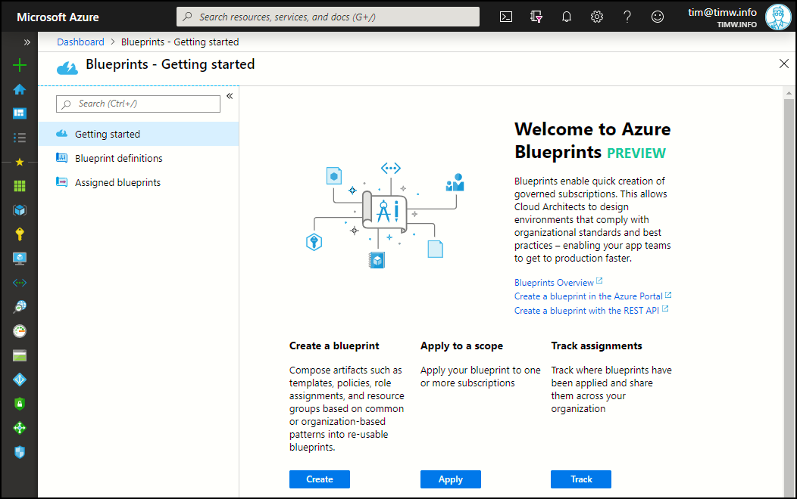
Azure Blueprints

Slide 5
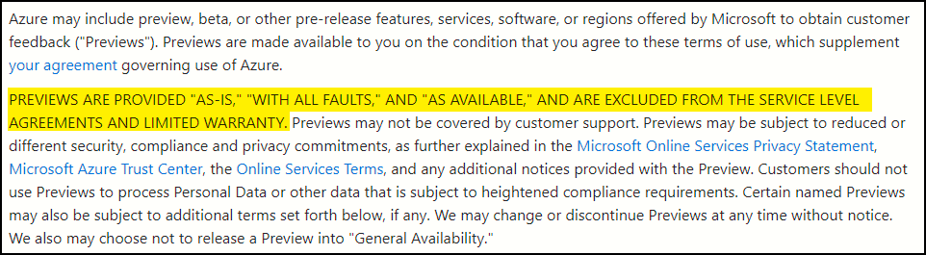
Microsoft Azure Preview Terms of Use

Slide 6
Problem Statements
"It's difficult to track deployments!"
"We have no consistency in our infrastructure!"
"We have misspelled tags!"
"We're deploying to unauthorized regions!"
"We are NOT on top of least-privilege access."
"We need source control and CI/CD!"

Slide 7




Azure Blueprints Value Proposition
Blueprint
Track deployments
Ensure consistency
Integrate with Azure DevOps
Resource group
ARM template
RBAC
Policy

Slide 8
Azure Blueprint Workflow
Draft
Publish
Assign
Track

Slide 9




How Blueprints Protect Deployments
Resource locks
Control updates to blueprint assignments
Unassign blueprints (remove protection)
Delete blueprint versions(s)

Slide 10


Slide 11
Resources: timw.info/azb
Twitter: @TechTrainerTim
Web: TechTrainerTim.com
Thank You!

